Slide 1
LBSC 690 Session #10
Programming, JavaScript
Jimmy Lin
The iSchool
University of Maryland
Wednesday, November 5, 2008
This work is licensed under a Creative Commons Attribution-Noncommercial-Share Alike 3.0 United States
See http://creativecommons.org/licenses/by-nc-sa/3.0/us/ for details

Slide 2
Take-Away Messages
Programming is a lot like cooking
Although after this session, you may never want to do it again…

Slide 3
You will learn about…
Different types of programming languages
Basic programming constructs
Controlling execution of instructions

Slide 4

Source: Wikipedia

Slide 5
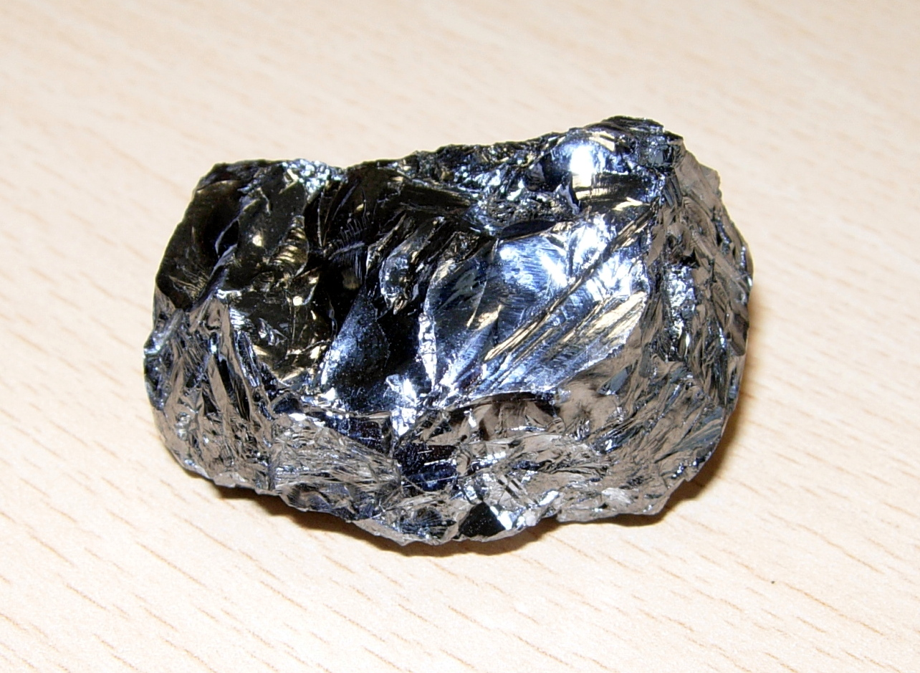
Source: Wikipedia

Slide 6
Software
Hardware
“It’s just sand!”

Slide 7
Types of Software
Application programs (e.g., PowerPoint)
  What you normally think of as a “software’’
Operating system (e.g., Windows XP)
  Software that manages your computing resources
Compilers and interpreters
  Software used to write other software
Embedded software (e.g., TiVO)
  Programs permanently embedded inside some physical device

Slide 8
Programming

Slide 9
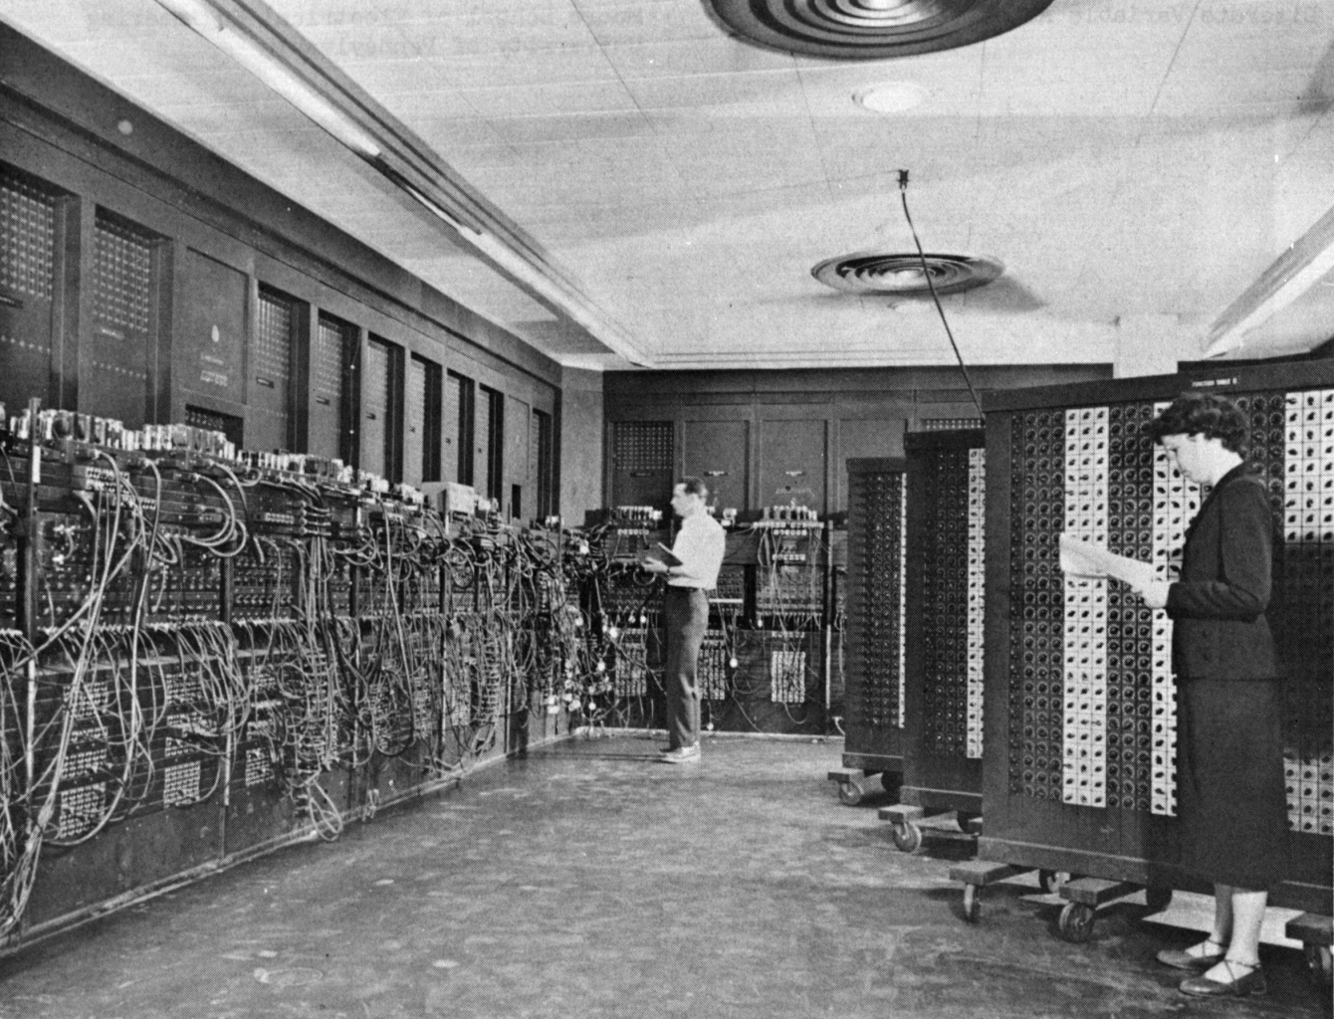
Source: Wikipedia

Slide 10
Programming Languages
Software “does something”
  Instructions for telling the machine “what to do” are expressed in a programming language
Special purpose: geared towards specific tasks
  Spreadsheets (e.g., Excel)
  Databases (e.g., SQL)
  Complex math (e.g., Matlab)
General purpose: able to accomplish anything
  Examples: Java, JavaScript, C, C++, Perl, Python ...

Slide 11
Types of Programming
Low-level languages
  Directly specifies actions of the machine
  Example: assembly language
High-level languages
  Specifies machine instructions at a more abstract level
  Compiler/interpreter translates instructions into machine actions
  Example: JavaScript

Slide 12
Programming
… it’s a lot like cooking

Slide 13
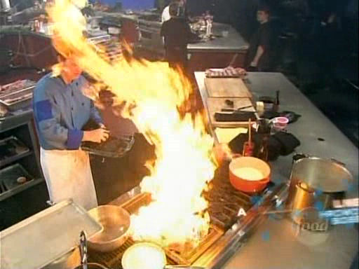
Source: Iron Chef America

Slide 14
Ingredients
Data types
Containers
Variables
Instructions
Instructions

Slide 15
Constructs for controlling
execution of instructions
Sequence
Condition
Repetition

Slide 16
Data Types and Variables
Data types = things that you can operate on
  Boolean: true, false
  Number: 5, 9, 3.1415926
  String: “Hello World”
Variables hold values of a particular data type
  Represented as symbols (e.g., x)
In JavaScript, var declares a variable
  var b = true; create a boolean b and set it to true
  var n = 1; create a number n and set it to 1
  var s = “hello”; create a string s and set it to “hello”

Slide 17
Instructions
Things that you can do:
  -x reverse the sign of x (negation)
  6+5 Add 6 and 5 (numeric)
  “Hello” + “World” Concatenate two strings
  2.1 * 3 Multiply two values
Storing results:
  x = 5 set the value of x to be 5
  x += y x = x + y
  x *= 5 x = x * 5
  x++ increase value of x by 1
In JavaScript, all instructions end with a semicolon (;)

Slide 18
Controlling Execution
Sequence
Condition
Repetition

Slide 19
Sequence
Do
Something
Something Else
Third
Thing
var a = 2;
var b = 3;
var c = a * b;

Slide 20
Condition
Condition
true
false
if (gender == “male”) {
greeting = “Hello, Sir”;
} else {
greeting = “Hello, Madam”;
}
Do
Something
Something Else
Continue

Slide 21
Repetition
n = 1;
while (n <= 10) {
document.writeln(n);
n++;
}
for (n = 1; n <= 10; n++) {
document.writeln(n);
}
Condition
Continue
false
true
Do
Something

Slide 22
Test Conditions
x == y true if x and y are equal
x != y true if x and y are not equal
x > y true if x is greater than y
x <= y true if x is smaller than or equal to y
x && y true if both x and y are true
x || y true if either x or y is true
!x true if x is false

Slide 23
Arrays
A set of elements grouped together
  For example, the number of days in each month
Each element is assigned an index
  A number is used to refer to that element
  For example, x[4] is the fifth element (count from zero!)
  Arrays and repetitions work naturally together

Slide 24
Functions
Reusable code for doing a single task
A function takes in one or more parameters and returns one value
function convertToCelsius(f) {
var celsius = 5/9 * (f-32);
return celsius;
}
function weirdAddition(a, b) {
var result = a + b - 0.5;
return result;
}

Slide 25
Calling Functions
When you “call” a function, you invoke the set of instructions it represents
c = convertToCelsius(60);
function convertToCelsius(f) {
var celsius = 5/9 * (f-32);
return celsius;
}

Slide 26
More Examples
var f = 60;
c = convertToCelsius(f);
r = weirdAddition(2, 4);
var a = 2;
var b = 3;
r = weirdAddition(a, b);

Slide 27
Algorithms
Derived from the name of the Persian mathematician Al-Khwarizmi
A sequence of well-defined instructions designed to accomplish a certain task

Slide 28
Programming for the Web
Common Gateway Interface (CGI) [Server-side]
  User inputs information into a form
  Form values passed to the sever via CGI
  Program on the server generates a Web page as a response
JavaScript [Client-side]
  Human-readable “source code” sent to the browser
  Web browser runs the program

Slide 29
Where is the JavaScript?
JavaScript is usually kept in the <head> section of an HTML document
…
<head>
<script language="JavaScript" type="text/javascript">
<!--
function calculate() {
var num = eval(document.input.number.value);
…
document.output.number.value = total;
}
//-->
</script>
</head>
…

Slide 30
Handling Events
When does code actually get executed?
Events:
  User actions trigger “events”
  Embedded in all modern GUIs
Event handlers are used to respond to events
  Examples of event handlers in JavaScript
    onMouseover: the mouse moved over an object
    onMouseout: the mouse moved off an object
    onClick: the user clicked on an object

Slide 31
Input and Output
How do you get information to/from the user?
  Forms provide a method for accepting input and displaying output
In HTML
<form name="input" action="">
Please enter a number:
<input size="10" value=" " name="number"/>
</form>
<form name="output" action="">
The sum of all numbers up to the number above is
<input size="10" value=" " name="number" readonly="true"/>
</form>
Reads in a value
eval function turns it into a number
JavaScript code
var num = eval(document.input.number.value);
document.output.number.value = 10;
Changes the value in the textbox

Slide 32
JavaScript Resources
Google “javascript”
  Tutorials: to learn to write programs
  Code: to do things you want to do (“borrow”)
Books

Slide 33
Programming Tips
Details are everything!
  Careful where you place that comma, semi-colon, etc.
Write a little bit of code at a time
  Add a small new functionality, make sure it works, then move on
  Don’t try to write a large program all at once
Debug by outputting the state of the program
  Print out the value of variables using document.write
  Is the value what you expected?

Slide 34
You have learned about…
Different types of programming languages
Basic programming constructs
Controlling execution of instructions

