Slide 1
LBSC 690 Session #11
Multimedia
Jimmy Lin
The iSchool
University of Maryland
Wednesday, November 12, 2008
This work is licensed under a Creative Commons Attribution-Noncommercial-Share Alike 3.0 United States
See http://creativecommons.org/licenses/by-nc-sa/3.0/us/ for details

Slide 2
Take-Away Messages
Human senses are gullible
  Images, video, and audio are all about “trickery”
Compression: storing a lot of information in a little space
  So that it fits on your hard drive
  So that you can send it quickly across the network

Slide 3
How do you make a picture?

Slide 4
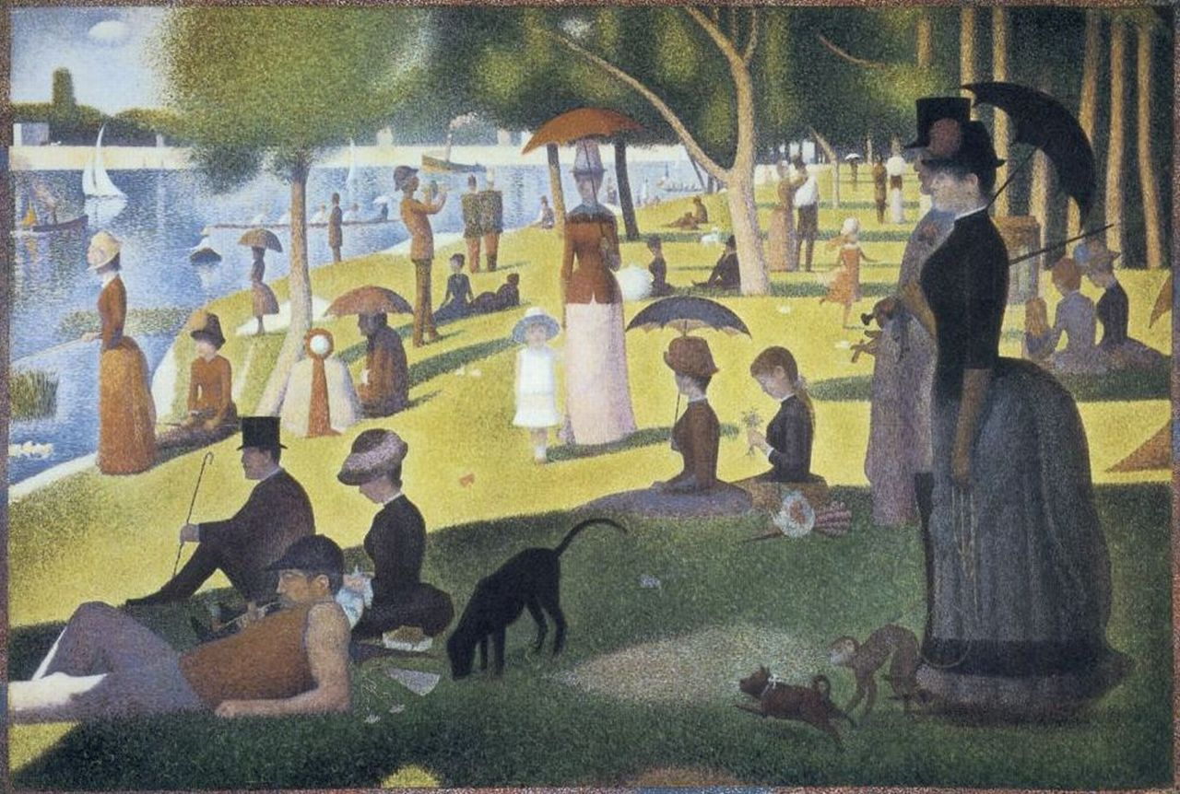
Georges Seurat - A Sunday Afternoon on the Island of La Grande Jatte

Slide 5
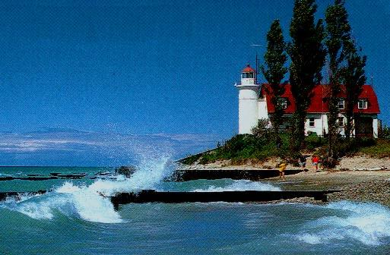

Slide 6
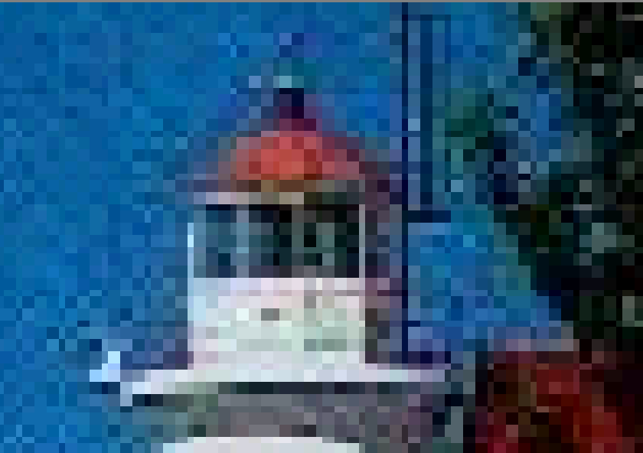

Slide 7
What’s a pixel?
What’s “resolution”?

Slide 8
How do you get color?

Slide 9
8 bits
8 bits
8 bits

Slide 10
#99FF66
#9999FF

Slide 11
How do LCDs work?

Slide 12


Slide 13
How do digital cameras work?

Slide 14
2,048 x 1,536 = 3,145,728 ≈ 3 MP
2,560 x 1,920 = 4,915,200 ≈ 5 MP
3,264 x 2,448 = 7,990,272 ≈ 8 MP
3,648 x 2,736 = 9,980,928 ≈ 10 MP

Slide 15
Is a picture really worth 1000 words?
(consider an image with 1024 x 768 resolution)

Slide 16
Compression
Goal: represent the same information using fewer bits
Two basic types of data compression:
  Lossless: can reconstruct exactly
  Lossy: can’t reconstruct, but looks the same
Two basic strategies:
  Reduce redundancy
  Throw away stuff that doesn’t matter

Slide 17
Run-Length Encoding
Opportunity:
  Large regions of a single color are common
Approach:
  Record # of consecutive pixels for each color
An example with text:
Sheep go baaaaaaaaaa and cows go moooooooooo
→ Sheep go ba<10> and cows go mo<10>
Notes:
Run Length Encoding (RLE)
Pixels are organized into lines
Most pixels are the same as the one before
That can be coded in 1 bit (1/24 the space)
Smaller files take less time to transmit

Slide 18
Using Dictionaries
Opportunity:
  Data often has shared substructure, e.g., patterns
Approach:
  Create a dictionary of commonly seen patterns
  Replace patterns with shorthand code
An example with text:
The rain in Spain falls mainly in the plain
→ The r* ^ Sp* falls m*ly ^ the pl* (*=ain,^=in)

Slide 19
Palette Selection
Opportunity:
  No picture uses all 16 million colors
Approach:
  Select a palette of 256 colors
  Indicate which palette entry to use for each pixel
  Look up each color in the palette
What happens if there are more than 256 colors?
This is GIF!

Slide 20
Discrete Cosine Transform
Opportunity:
  Images can be approximated by a series of patterns
  Complex patterns require more information than simple patterns
Approach:
  Break an image into little blocks (8 x 8)
  Represent each block in terms of “basis images”
Notes:
Jpeg vs gif
http://hotwired.lycos.com/webmonkey/geektalk/97/30/index3a.html?tw=design
JPEG is designed to exploit known limitations of the human eye, notably the fact that small color changes are perceived less accurately than small changes in brightness. Thus, JPEG is intended for compressing images that will be looked at by humans. If you plan to machine-analyze your images, the small errors introduced by JPEG may be a problem for you, even if they are invisible to the eye.
JPEG is that it stores full color information: 24 bits/pixel (16 million colors). GIF, the other image format widely used on the net, can only store 8 bits/pixel (256 or fewer colors).
What is color quantization? Many people don't have full-color (24 bit per pixel) display hardware. Inexpensive display hardware stores 8 bits per pixel, so it can display at most 256 distinct colors at a time. To display a full-color image, the computer must choose an appropriate set of representative colors and map the image into these colors. This process is called "color quantization". (This is something of a misnomer; "color selection" or "color reduction" would be a better term. But we're stuck with the standard usage.)
Making a good color quantization method is a black art, and no single algorithm is best for all images.
http://www.faqs.org/faqs/jpeg-faq/part1/

Slide 21
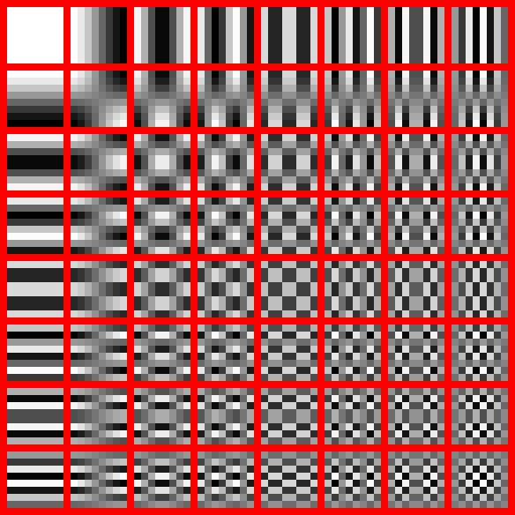
This is JPEG!

Slide 22
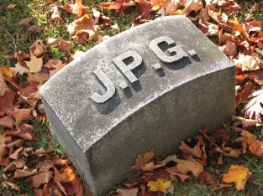



Full quality (Q = 100): 83,261 bytes
Medium quality (Q = 25): 9,553 bytes
Average quality (Q = 50): 15,138 bytes
Low quality (Q = 10): 4,787 btes

Slide 23
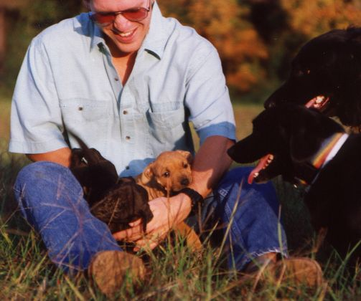
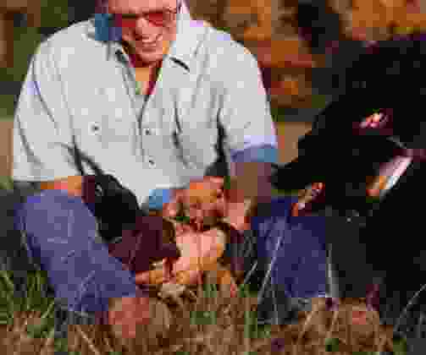
Notes:
Good examples about jpeg and gif
http://www.wpdfd.com/wpdgraph.htm

Slide 24
When should you use jpegs?
When should you use gifs?

Slide 25
Demo!

Slide 26
Raster vs. Vector Graphics
Raster images = bitmaps
  Actually describe the contents of the image
Vector images = composed of mathematical curves
  Describe how to draw the image

Slide 27
What happens when you scale vector images?
What happens when you scale raster images?

Slide 28


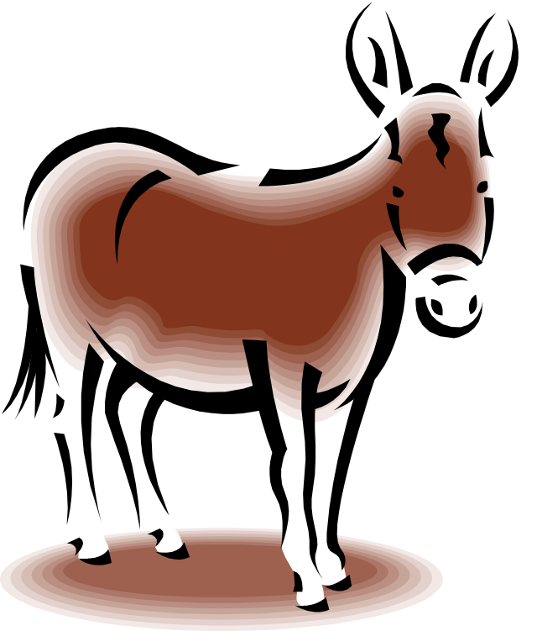


Slide 29
How do you make video?

Slide 30
Basic Video Coding
Display a sequence of images…
  Fast enough to trick your eyes
  (At least 30 frames per second)
NTSC Video
  60 “interlaced” half-frames/sec, 720x486
HDTV
  30 “progressive” full-frames/sec, 1280x720

Slide 31
Video Example
Typical low-quality video:
  640 x 480 pixel image
  3 bytes per pixel (red, green, blue)
  30 frames per second
Storage requirements:
  26.4 MB/second!
  A CD-ROM would hold 25 seconds
  30 minutes would require 46.3 GB
Some form of compression required!

Slide 32
Video Compression
Opportunity:
  One frame looks very much like the next
Approach:
  Record only the pixels that change

Slide 33
Frame Reconstruction
I₁
I₁+P₁
I₁+P₁+P₂
I₂
• • •
• • •
updates
  I frames provide complete image
  P frames provide series of updates to most recent I frame
P₁
P₂

Slide 34
What is sound?
How does hearing work?
How does a speaker work?
How does a microphone work?

Slide 35
Basic Audio Coding
Sample at twice the highest frequency
  8 bits or 16 bits per sample
Speech (0-4 kHz) requires 8 KB/s
  Standard telephone channel (8-bit samples)
Music (0-22 kHz) requires 172 KB/s
  Standard for CD-quality audio (16 bit samples)
Sampler

Slide 36
How do MP3s work?
Opportunity:
  The human ear cannot hear all frequencies at once, all the time
Approach:
  Don’t represent things that the human ear cannot hear

Slide 37
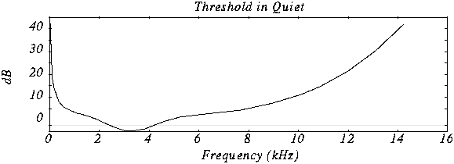
Human Hearing Response
Experiment: Put a person in a quiet room. Raise level of 1kHz tone until just barely audible. Vary the frequency and plot the results.

Slide 38
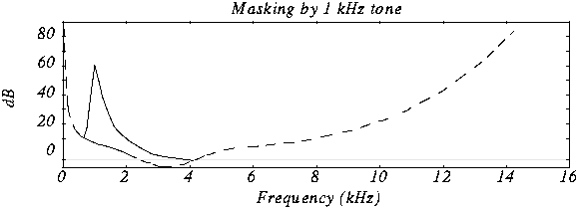
Frequency Masking
Experiment: Play 1kHz tone (masking tone) at fixed level (60 db). Play test tone at a different level and raise level until just distinguishable. Vary the frequency of the test tone and plot the threshold when it becomes audible.

Slide 39
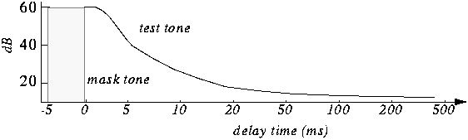
Temporal Masking
If we hear a loud sound, then it stops, it takes a while until we can hear a soft tone at about the same frequency.

Slide 40
MP3s: Psychoacoustic compression
Eliminate sounds below threshold of hearing
Eliminate sounds that are frequency masked
Eliminate sounds that are temporally masked
Eliminate stereo information for low frequencies

Slide 41
How do you deliver continuous data over packet-switched networks?

Slide 42

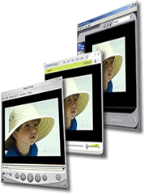
Streaming Audio and Video
Simultaneously:
  Receive downloaded content in buffer
  Play current content of buffer
Analogy: filling and draining a basin concurrently
Media Sever
Internet
Buffer
Notes:
Understanding streaming media
Streaming media is a technology for delivering audio, video, or multimedia files across a network without waiting for the entire file to download. When you click an Internet link to open a streaming media file, the file is partially downloaded and stored in a buffer; this is called buffering. The file then begins to play. As more information in the file is streamed to Windows Media Player, it continues to buffer information before playing it. Windows Media Player does this so that if traffic on the Internet interrupts the flow of information, there will be no breaks or interference with the file as it plays. You will notice a break in play when the data in the buffer runs out.
Windows Media Player alerts you when information is buffering. All streaming Windows Media files buffer before they begin playing. Unlike a downloaded file, data is not saved to the hard disk drive when streaming files are done playing.
Windows Media Player also supports intelligent streaming; it monitors network conditions and automatically makes adjustments to ensure the best reception and playback.
When you play streamed media or CD tracks, you can view statistics and information about the quality of the connection and the performance of the playback. The information in the Statistics dialog box can help you determine whether you are receiving a quality data transmission.
To view statistics about content
On the View menu, click Statistics.
If you want more specific information, click the Advanced tab.
To view details about a file
On the File menu, click Properties. –or-
In Media Library, right-click the file in the right pane, and then click Properties.

Slide 43
to buffer or not to buffer…
Internet radio
YouTube
Skype
Instant Messenger

Slide 44

Example: Internet Telephony

Slide 45
IP Phones: Network Issues
Network loss: packets lost due to network congestion
Delay loss: packets arrives too late for playout at receiver
Loss tolerance: depending on voice encoding packet loss rates between 1% and 10% can be tolerated

Slide 46
IP Phones: Playout Delay
Receiver attempts to playout each chunk exactly q ms after chunk was generated
  Chunk has time stamp t: play out chunk at t+q
  Chunk arrives after t+q: data arrives too late for playout, data “lost”
Tradeoff for q:
  Large q: less packet loss
  Small q: better interactive experience

Slide 47
Take-Away Messages
Human senses are gullible
  Images, video, and audio are all about “trickery”
Compression: storing a lot of information in a little space
  So that it fits on your hard drive
  So that you can send it quickly across the network

