Slide 1
LBSC 690 Session #12
Building and Deploying Technology
Jimmy Lin
The iSchool
University of Maryland
Wednesday, November 19, 2008
This work is licensed under a Creative Commons Attribution-Noncommercial-Share Alike 3.0 United States
See http://creativecommons.org/licenses/by-nc-sa/3.0/us/ for details

Slide 2
Today’s Topics
The system life cycle
The open source model
Cloud computing
Notes:
2

Slide 3
Take-Away Messages
Not “what are the right answers”, but “what are the right questions”
There is no right answer
  It all depends on the exact circumstances
  It’s all about tradeoffs

Slide 4
The System Life Cycle
Analysis and Design
  How do we know what to build?
Implementation
  How do we actually build it?
Maintenance
  How do we keep it running?
Notes:
3

Slide 5
User-Centered Design
As opposed to what?
Understanding user needs
  Who are the present and future users?
  How can you understand their needs?
Understanding the use context
  How does the particular need relate to broader user activities?
  How does software fit into the picture?
Notes:
8

Slide 6
Some Library Activities
Acquisition
Cataloging
Reference
Circulation, interlibrary loan, reserves
Recall, fines, …
Budget, facilities schedules, payroll, ...
Notes:
6

Slide 7
Important Questions
Where does information originate?
  Beware of “chicken and egg” problems
What components already exist?
  Sometimes it’s easier to start with a clean slate
Which components should be automated?
  Some things are easier to do without computers
Notes:
7

Slide 8
Important Questions
Which components should be integrated?
  Pick your poison: centralization vs. decentralization
  Implications for privacy, security, etc.
How will technology impact human processes?
  Technology is not neutral
How can we take advantage of the community?
  Web 2.0, Library 2.0, etc.
Notes:
7

Slide 9
Requirements
Availability
  Mean Time Between Failures (MTBF)
  Mean Time To Repair (MTTR)
Capacity
  Number of users (typical and maximum)
  Response time
Flexibility
  Upgrade path
  Interoperability with other applications
It’s all about tradeoffs…
Notes:
9

Slide 10
Decisions, Decisions…
Off-the-shelf applications vs. custom-developed
“Best-of-breed” vs. integrated system
Notes:
4

Slide 11
More Decisions: Architectures
Desktop applications
  What we normally think of as software
Batch processing (e.g., recall notices)
  Save it up and do it all at once
Client-Server (e.g., Web)
  Some functions done centrally, others locally
Peer-to-Peer (e.g., Kazaa)
  All data and computation is distributed
Notes:
10

Slide 12
The Waterfall Model
Key insight: upfront investment in design
  An hour of design can save a week of debugging!
Five stages:
  Requirements: figure out what the software is supposed to do
  Design: figure out how the software will accomplish the tasks
  Implementation: actually build the software
  Verification: makes sure that it works
  Maintenance: makes sure that it keeps working

Slide 13
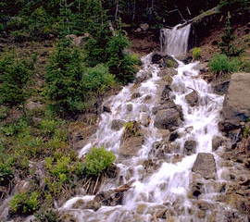
The Waterfall Model
Requirements
Design
Implementation
Verification
Maintenance

Slide 14
The Spiral Model
Build what you think you need
  Perhaps using the waterfall model
Get a few users to help you debug it
  First an “alpha” release, then a “beta” release
Release it as a product (version 1.0)
  Make small changes as needed (1.1, 1.2, ….)
Save big changes for a major new release
  Often based on a total redesign (2.0, 3.0, …)
Notes:
Barry Boehm 1988

Slide 15
The Spiral Model
2.3
1.2
0.5
1.1
2.2
1.0
2.1
2.0
3.0

Slide 16
Unpleasant Realities
The waterfall model doesn’t work well
  Requirements usually incomplete or incorrect
The spiral model is expensive
  Redesign leads to recoding and retesting

Slide 17
A Hybrid Model
Goal: explore requirements
  Without building the complete product
Start with part of the functionality
  That will (hopefully) yield significant insight
Build a prototype
  Focus on core functionality
Use the prototype to refine the requirements
Repeat the process, expanding functionality

Slide 18
A Hybrid Model
Update
Requirements
Write
Specification
Initial
Requirements
Choose
Functionality
Create
Software
Build
Prototype
Write
Test Plan

Slide 19
Management Issues
Operating costs
  Staff time
  Physical resources (space, cooling, power)
  Periodic maintenance
  Equipment replacement
Retrospective conversion
  Moving from “legacy systems”
  Even converting electronic information is expensive!
Incremental improvements
  No piece of software is perfect
Notes:
13

Slide 20
Management Issues
Management information
  Usage logs, audit trails, etc.
  Often easy to collect, difficult to analyze
Training
  Staff
  Users
Privacy, security, access control
Backup and disaster recovery
  Periodicity, storage location
Remember Murphy’s Law!
Notes:
13

Slide 21
TCO
TCO = “Total cost of ownership”
Hardware and software isn’t the only cost!
Other (hidden) costs:
  Planning, installation, integration
  Disruption and migration
  Ongoing support and maintenance
  Training (of staff and end users)
Notes:
13

Slide 22
What is open source?
Proprietary vs. open source software
Open source used to be a crackpot idea:
  Bill Gates on Linux (3/24/1999): “I don’t really think in the commercial market, we’ll see it in any significant way.”
  MS 10-Q quarterly filing (1/31/2004): “The popularization of the open source movement continues to pose a significant challenge to the company’s business model”
Open source…
  For tree hugging hippies?
  Make love, not war?

Slide 23
Basic Definitions
What is a program?
What is source code?
What is object/executable code (binaries)?
An organized list of instructions that, when executed, causes the computer to behave in a predetermined manner. Like a recipe.
Program instructions in their original, human-readable form.
Program instructions in a form that can be directly executed by a computer. A compiler takes source code and generates executable code.

Slide 24
Proprietary Software
Distribution in machine-readable binaries only
Payment for a license
  Grants certain usage rights
  Restrictions on copying, further distribution, modification
Analogy: buying a car…
  With the hood welded shut
  That only you can drive
  That you can’t change the rims on

Slide 25
Open Source Principles
Free distribution and redistribution
  “Free as in speech, not as in beer”
Source code availability
Provisions for derived works
“The license may not restrict any party from selling or giving away the software as a component of an aggregate software distribution containing programs from several different sources. The license may not require royalty or other fee for such sale.”
“The program must include source code, and must allow distribution in source code as well as compiled form”.
“The license must allow modifications and derived works, and must allow them to be distributed under the same terms as the license of the original software.”

Slide 26
Open Source vs. Proprietary
Who gets the idea to develop the software?
Who actually develops the software?
How much does it cost?
Who can make changes?

Slide 27
Examples of Open Source Software
 | Proprietary | Open Source
Operating system | Windows XP | Linux
Office suite | Microsoft Office | OpenOffice
Image editor | Photoshop | GIMP
Web browser | Internet Explorer | Mozilla
Web server | IIS | Apache
Database | Oracle | MySQL

Slide 28
Open Source: Pros
Peer-reviewed code
Dynamic community
Iterative releases, rapid bug fixes
Released by engineers, not marketing people
High quality
No vendor lock-in
Simplified licensed management

Slide 29
Pros in Detail
Peer-reviewed code
  Everyone gets to inspect the code
  More eyes, fewer bugs
Dynamic community
  Community consists of coders, testers, debuggers, users, etc.
  Any person can have multiple roles
  Both volunteers and paid by companies
  Volunteers are highly-motivated to work on something that interests them

Slide 30
Pros in Detail
Iterative releases, rapid bug fixes
  Anyone can fix bugs
  Bugs rapidly fixed when found
  Distribution of “patches”
Released by engineers, not marketing people
  Stable versions ready only when they really are ready
  Not dictated by marketing deadlines
High quality

Slide 31
Pros in Detail
No vendor lock-in
  Lock in: dependence on a specific program from a specific vendor
  Putting content in MS Word ties you to Microsoft forever
  Open formats: can use a variety of systems
Simplified licensed management
  Can install any number of copies
  No risk of illegal copies or license audits
  No anti-piracy measures (e.g. CD keys, product activation)
  No need to pay for perpetual upgrades
  Doesn't eliminate software management, of course

Slide 32
Cons of Open Source
Dead-end software
Fragmentation
Developed by engineers, often for engineers
Community development model
Inability to point fingers

Slide 33
Cons in Detail
Dead-end software
  Development depends on community dynamics: What happens when the community loses interest?
  How is this different from the vendor dropping support for a product? At least the source code is available
Fragmentation
  Code might “fork” into multiple versions: incompatibilities develop
  In practice, rarely happens

Slide 34
Cons in Detail
Developed by engineers, often for engineers
  My favorite “pet feature”
  Engineers are not your typical users!
Community development model
  Cannot simply dictate the development process
  Must build consensus and support within the community
Inability to point fingers
  Who do you call up and yell at when things go wrong?
  Buy a support contract from a vendor!

Slide 35
Open Source Business Models
Support Sellers
Loss Leader
Widget Frosting
Accessorizing
Give away the software, but sell distribution, branding, and after-sale service.
Give away the software as a loss-leader and market positioner for closed software.
If you’re in the hardware business, giving away software doesn’t hurt you and has it’s advantages. What are they?
Sell accessories: books, compatible hardware, complete systems with open-source software pre-installed. (open-source T-shirts, coffee mugs, Linux penguin dolls, etc.)

Slide 36
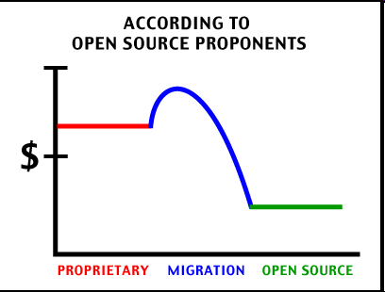
It comes down to cost…

Slide 37
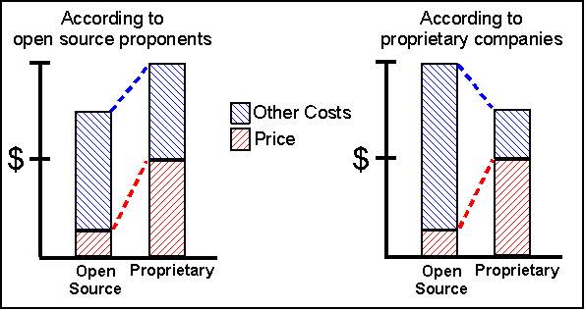
The TCO Debate

Slide 38
Is open source right for you?
Do you have access to the necessary expertise?
Do you have buy-in from the stakeholders?
Are you willing to retool your processes?
Are you willing to retrain staff and users?
Are you prepared for a period of disruption?
Have you thought through these issues?

Slide 39

Source: http://www.free-pictures-photos.com/

Slide 40
What is Cloud Computing?
Web-scale problems
Large data centers
Different models of computing
Highly-interactive Web applications

Slide 41
1. Web-Scale Problems
Characteristics:
  Definitely data-intensive
  May also be processing intensive
Examples:
  Crawling, indexing, searching, mining the Web
  “Post-genomics” life sciences research
  Other scientific data (physics, astronomers, etc.)
  Sensor networks
  Web 2.0 applications
  …

Slide 42
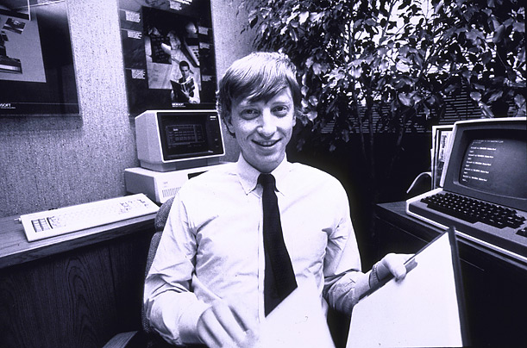
How much data?
Wayback Machine has 2 PB + 20 TB/month (2006)
Google processes 20 PB a day (2008)
“all words ever spoken by human beings” ~ 5 EB
NOAA has ~1 PB climate data (2007)
CERN’s LHC will generate 15 PB a year (2008)
640K ought to be enough for anybody.

Slide 43
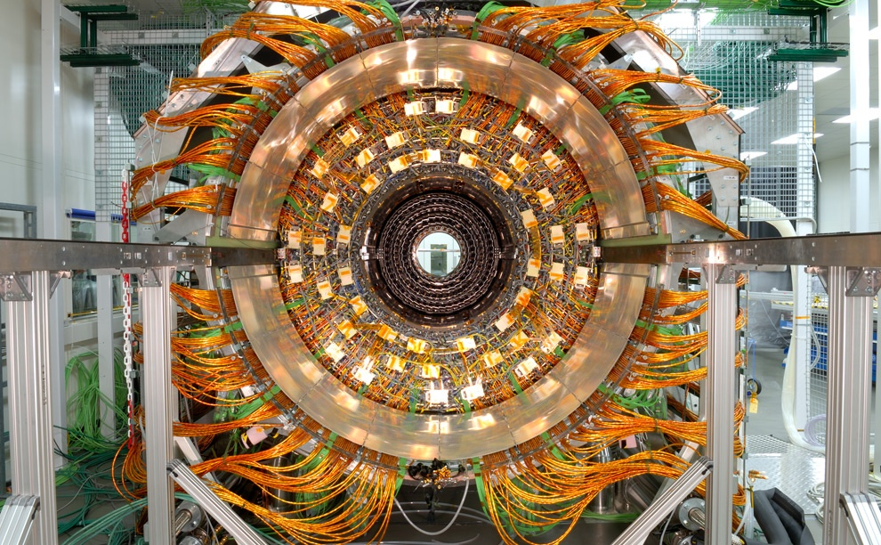
Maximilien Brice, © CERN

Slide 44
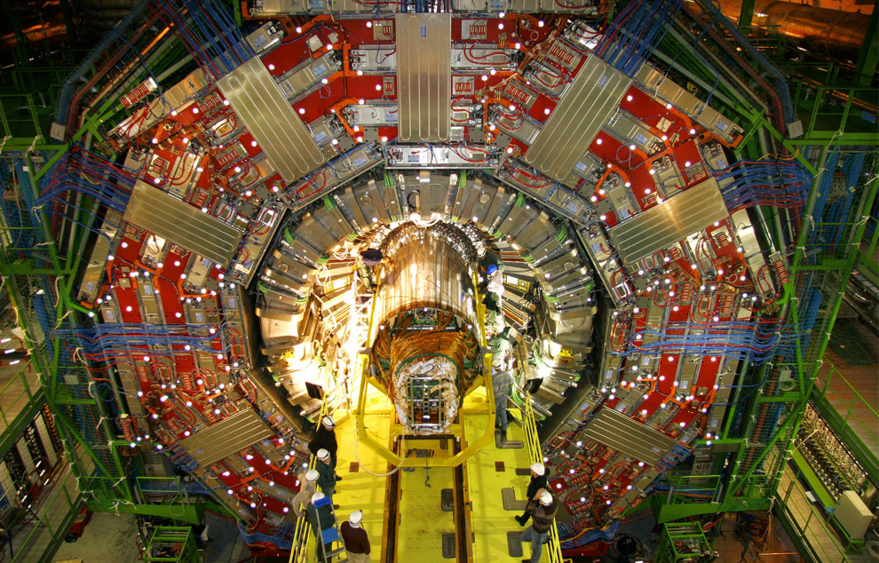
Maximilien Brice, © CERN

Slide 45
2. Large Data Centers
Web-scale problems? Throw more machines at it!
Clear trend: centralization of computing resources in large data centers
  Necessary ingredients: fiber, juice, and space
  What do Oregon, Iceland, and abandoned mines have in common?
Important Issues:
  Redundancy
  Efficiency
  Utilization
  Management

Slide 46
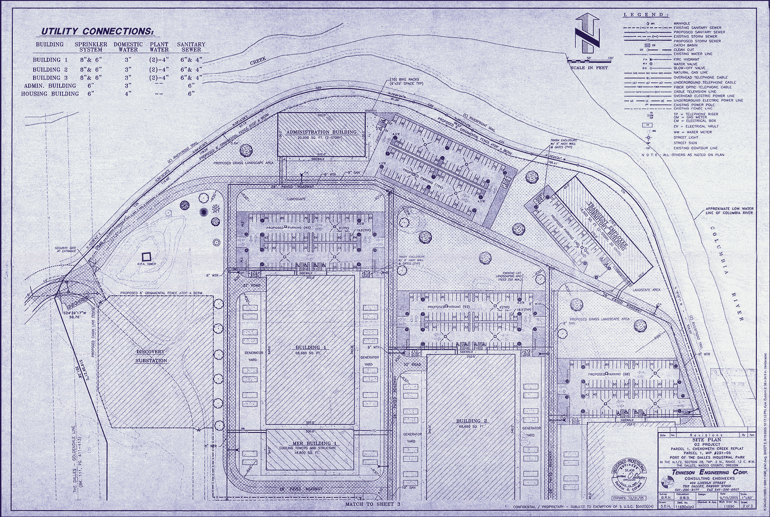
Source: Harper’s (Feb, 2008)

Slide 47
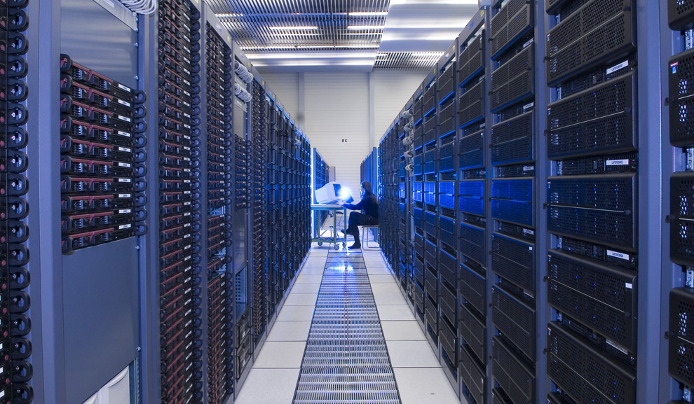
Maximilien Brice, © CERN

Slide 48
Key Technology: Virtualization
App
App
App
App
App
App
OS
OS
OS
Operating System
Hypervisor
Hardware
Hardware
Traditional Stack
Virtualized Stack

Slide 49
3. Different Computing Models
Utility computing
  Why buy machines when you can rent cycles?
  Examples: Amazon’s EC2, GoGrid, AppNexus
Platform as a Service (PaaS)
  Give me nice API and take care of the implementation
  Example: Google App Engine
Software as a Service (SaaS)
  Just run it for me!
  Example: Gmail
“Why do it yourself if you can pay someone to do it for you?”

Slide 50
4. Web Applications
What is the nature of software applications?
  From the desktop to the browser
  Rise of Web-based applications
  Examples: Google Maps, Facebook
How do we deliver highly-interactive Web-based applications?
  Ajax (Asynchronous JavaScript and XML)

Slide 51
The Grand Plan
Building and Deploying Systems
Databases
Search
Programming
Multimedia
Metadata and XML
Interacting with Computers
Computers, Networks, the Web

