Slide 1
LBSC 690 Session #2
FTP, "Hello World!" HTML
Jimmy Lin
The iSchool
University of Maryland
Wednesday, September 10, 2008
This work is licensed under a Creative Commons Attribution-Noncommercial-Share Alike 3.0 United States
See http://creativecommons.org/licenses/by-nc-sa/3.0/us/ for details

Slide 2
Goals
Gain a better understanding of networking
Build you very own homepage!

Slide 3
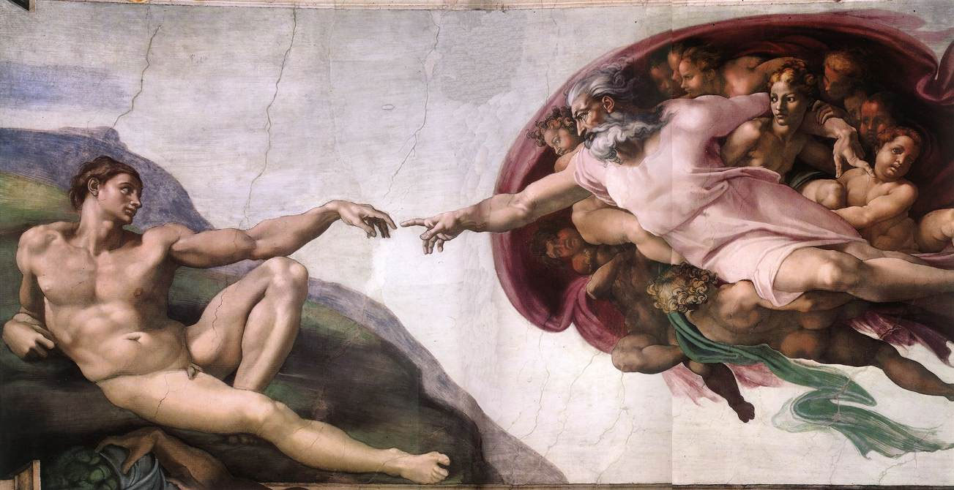

Slide 4
Operating System

Slide 5
Paths
How do you specify the location of files on your hard drive?
The folder metaphor
  Hierarchically nested directories
  Absolute vs. relative paths
  File extensions?
/afs/wam.umd.edu/home/wam/j/i/jimmylin/home
C:\Documents and Settings\Jimmy Lin\My Documents
../pub
..\Desktop

Slide 6

Server
(Web? File?)
Source: http://www.studyzone.org/

Slide 7

Clients
Source: http://www.netofinancial.com/

Slide 8
Port / Protocol

Slide 9
FTP

Slide 10
HTML

Slide 11
Today’s Tutorial
Your first HTML page
Uploading your page to the Web server via FTP
But first….

Slide 12
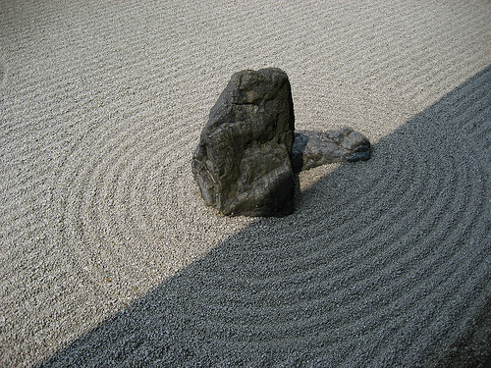
Source: http://davidzinger.wordpress.com/2007/05/page/2/

Slide 13
“Hello World” HTML
This is the header
<html>
<head>
<title>Hello World!</title>
</head>
<body>
<p>Hello world! This is my first webpage!</p>
</body>
</html>
This is the actual content of the HTML document

Slide 14
Uploading Your Page
Connect to “terpconnect.umd.edu”
Change directory to “/pub/USERID”
Upload files
Your very own home page at:
http://www.wam.umd.edu/~USERID/

Slide 15
Why Code HTML by Hand?
The only way to learn is by doing
WSIWYG editors…
  Often generate unreadable code
  Ties you down to that particular editor
  Cannot help you connect to backend databases
Hand coding HTML allows you to have finer-grained control
HTML is merely demonstrative of other important concepts:
  Structured documents
  Metadata

Slide 16
Tips
Edit files on your own machine, upload when you’re happy
Save early, save often, just save!
Reload browser
File naming
  Don’t use spaces!
  Punctuation matters!

Slide 17
Details…

Slide 18
Internet ≠ Web
Internet = collection of global networks
Web = particular way of accessing information on the Internet
  Uses the HTTP protocol
Other ways of using the Internet
  Usenet
  FTP
  email (SMTP, POP, IMAP, etc.)
  Internet Relay Chat

Slide 19
Intranets
Intranet
Gateways
What are firewalls?
Why can’t you do certain things behind firewalls?
Intranet

Slide 20
VPNs
Problem: How do you securely connect separate networks?
Public Internet
Intranet
“leased line”
VPN = Virtual Private Network
a secure private network over the public Internet
Intranet

Slide 21
Foundations
Basic protocols for the Internet:
  TCP/IP (Transmission Control Protocol/Internet Protocol):
  basis for communication
  DNS (Domain Name Service):
  basis for naming computers on the network
Protocol for the Web:
  HTTP (HyperText Transfer Protocol):
  protocol for transferring Web pages

Slide 22
IP Address
Every computer on the Internet is identified by a address
IP address = 32 bit number, divided into four “octets”
  Example: go in your browser and type “http://66.249.93.99/”
Are there enough IP addresses to go around?
What is the difference between static and dynamic IP?

Slide 23
Packet Routing (TCP/IP)
128.0.1.5
63.6.9.12
4.8.15.2
52.55.64.2
18.1.1.4
192.28.2.5
(Much simplified) Routing table for 4.8.15.2
Destination | Next Hop
52.55.*.* | 63.6.9.12
18.1.*.* | 192.28.2.5/63.6.9.12
4.*.*.* | 225.2.55.1
…

Slide 24
Domain Name Service (DNS)
“Domain names” improve usability
  Easier to remember than numeric IP addresses
  DNS coverts between names and numbers
  Written like a postal address: specific-to-general
Each name server knows one level of names
  “Top level” name server knows .edu, .com, .mil, …
  .edu name server knows umd, mit, stanford, …
  .umd.edu name server knows ischool, wam, …

Slide 25
Demo
Play with various utilities at
  http://network-tools.com/
  http://visualroute.visualware.com/

Slide 26
HyperText Transfer Protocol
Send request
Server response
GET /path/file.html HTTP/1.0
From: someuser@somedomain.com
User-Agent: HTTPTool/1.0
HTTP/1.0 200 OK
Date: Fri, 31 Dec 1999 23:59:59 GMT
Content-Type: text/html
Content-Length: 1354
<html><body> <h1>Happy New Millennium!</h1> … </body> </html>

Slide 27
Tell me what happens…
From the moment you click on “check messages” to the moment you start reading your email
From the moment you click “send” to the moment the other party receives the email
From the moment you type a URL and hit “enter” to the moment you see the Web page

