Slide 1
LBSC 690 Session #5
Metadata and XML
Jimmy Lin
The iSchool
University of Maryland
Wednesday, October 1, 2008
This work is licensed under a Creative Commons Attribution-Noncommercial-Share Alike 3.0 United States
See http://creativecommons.org/licenses/by-nc-sa/3.0/us/ for details

Slide 2


Slide 3
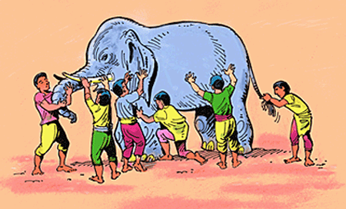

Slide 4
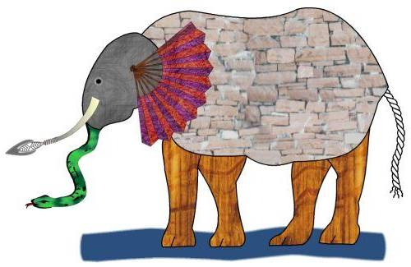

Slide 5
Take-Away Messages
Metadata makes data useful
XML is a way to encode data and metadata
XML allows computers to exchange information in new and interesting ways

Slide 6
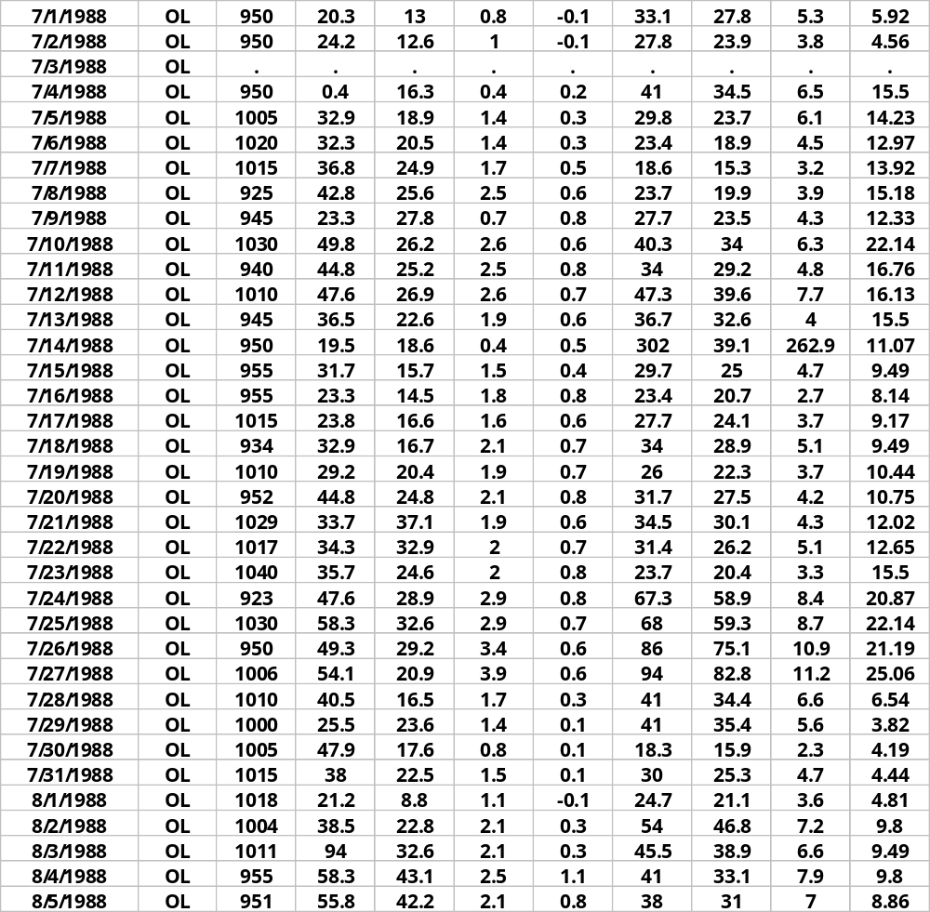
Who?
What?
When?
Where?
Why?
How?

Slide 7
Metadata
(literally “data about data”)
“a set of data that describes and gives information about other data” ― Oxford English Dictionary

Slide 8
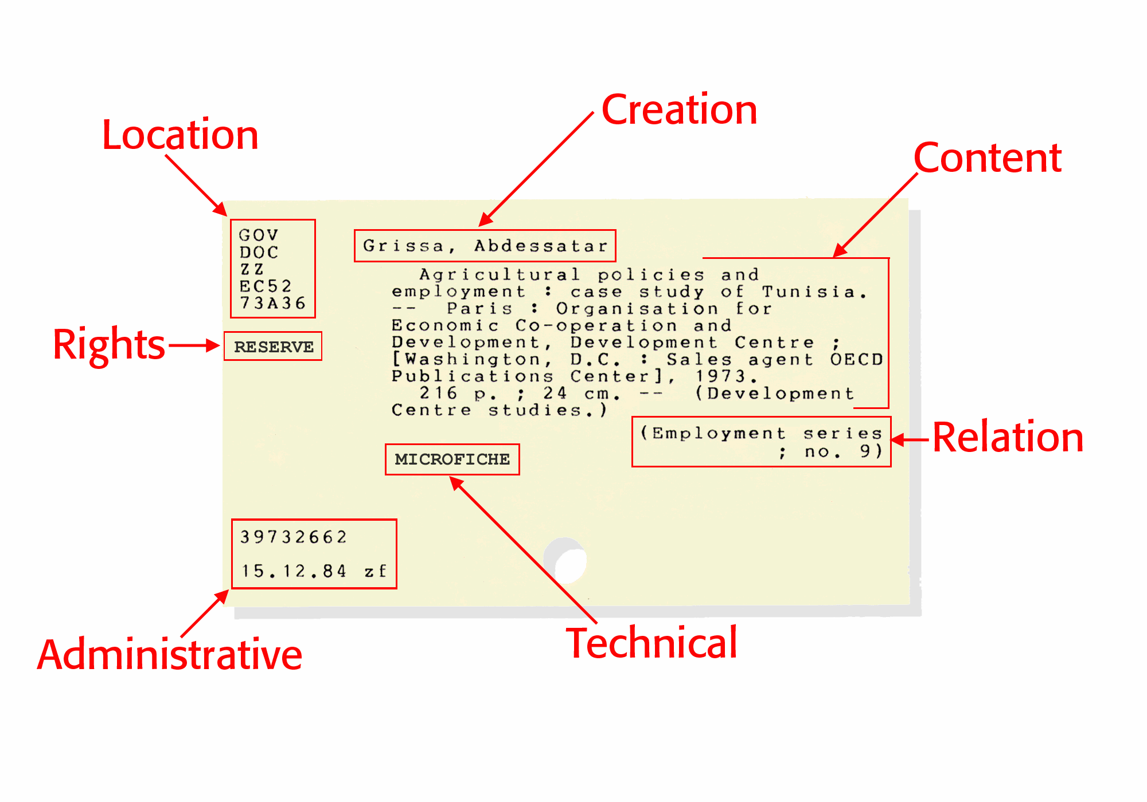

Slide 9
What is the Dublin Core?
A metadata standard for describing digital resources
An initiative to create a “library card catalog” for the Web
Dublin Core fields:
Title Creator Subject
Description Publisher Contributor
Date Type Format
Identifier Source Language
Relation Coverage Rights

Slide 10

Source: http://www.anoige.ie/

Slide 11
Encoding Metadata
Language for encoding metadata should be:
  Universal - so all can understand
  Flexible - to incorporate different types
  Extensible - flexible to custom types
  Simple - to encourage adoption
  Modular - so that schemes can be mixed, extended
From: Ian Graham, An Introduction to RDF. http://www.utoronto.ca/ian/talks/

Slide 12
How do we encode metadata?
To support interoperability?

Slide 13
January 31, 2001
31 janvier 2001
2001-01-31
01-31-2000
31012000

Slide 14
What is XML?
XML = eXtensible Markup Language
XML is a standard for exchanging structured data
  Provides standardization at the syntactic level
  Does not provide “meaning” for the tags
XML is a standard recommended by the W3C

Slide 15
Goals of XML
Easy to use
Easy to extend and adapt
Easy to write programs that use XML
Support a wide variety of applications
Should be human legible
Formal and concise

Slide 16
The Basic Rules
XML is case sensitive
All start tags must have end tags
Elements must be properly nested
XML declaration is the first statement
  <?xml version="1.0"?>
Every document must contain a root element
Attribute values must have quotation marks
  <item id=“33905”>
Certain characters are reserved for parsing
  &lt; = ‘<’

Slide 17
<rdf:RDF
xmlns:rdf="http://www.w3.org/1999/02/22-rdf-syntax-ns#"
xmlns:dc="http://purl.org/dc/elements/1.1/">
<rdf:Description rdf:about="http://media.example.com/audio/guide.ra">
<dc:creator>Rose Bush</dc:creator>
<dc:title>A Guide to Growing Roses</dc:title>
<dc:description>Describes process for planting and nurturing different kinds of
rose bushes.</dc:description>
<dc:date>2001-01-20</dc:date>
</rdf:Description>
</rdf:RDF>
Source: http://dublincore.org/documents/usageguide/

Slide 18
What does XML actually do?
(NOTHING)

Slide 19
Syntax vs. Semantics
(We’ll come back to this later…)

Slide 20
How is XML like HTML?
How is HTML like XML?

Slide 21
XML: Historic Perspective
HTML and the birth of the Web
HTML is not enough
Development of XML
The next few slides are adapted from presentations by Ian Graham: http://www.utoronto.ca/ian/talks/

Slide 22
In the beginning…
The foundations of the Web:
HTML
FTP
News
Email
HTTP
URLs
Web
Server
Databases and
Other “backends”
URLs
(location
e.g.,http://www.foo.org/)
Internet
communication
protocols
HTML
(data/display)
HTTP
(transfer)

Slide 23
Three Core Technologies
HTTP - HyperText Transfer Protocol
  A protocol for transferring data between machines on the Internet
URL - Uniform Resource Locator
  A scheme for referencing the specific location of a resource
HTML - HyperText Markup Language
  A markup language for encoding information to be read by humans
HTTP and URLs have pretty-well stood the test of time.
But by 1996, HTML was already showing signs of age ....

Slide 24
HTML
Started with very few tags …
Language evolved as more tags were added:
  Forms
  Tables
  Fonts
  Frames
  …

Slide 25
Problems with HTML
I want personalized tags
  HTML can’t be extended
I want to incorporate other types of data
  Mathematics, database entries, literary text, poems, purchase orders …
  HTML can’t accommodate other types of data
I want to process pages automatically with software
  HTML is too messy and inconsistent

Slide 26
Back to Basics
HTML was defined using SGML
  Standard Generalized Markup Language
  A meta-language for defining languages
Complex, sophisticated, powerful
  … too difficult to use
Idea: create a simpler version of SGML
  The birth of XML!

Slide 27
XML Languages
XML can be used to define other languages
Many XML languages, optimized for different roles
  XHTML: HTML by XML rules
  MathML: for mathematics
  SMIL: for synchronized multimedia
  RSS: for news feeds
  …

Slide 28
XHTML: Cleaning up HTML
<?xml version="1.0" encoding="iso-8859-1"?>
<html xmlns="http://www.w3.org/TR/xhtml1" >
<head>
<title> Title of text XHTML Document </title>
</head>
<body>
<div class="myDiv">
<h1> Heading of Page </h1>
<p> here is a paragraph of text. I will include inside this paragraph
a bunch of wonky text so that it looks fancy. </p>
<p>Here is another paragraph with <em>inline emphasized</em>
text, and <b> absolutely no</b> sense of humor. </p>
<p>And another paragraph, this one with an <img src="image.gif"
alt="waste of time" /> image, and a <br /> line break. </p>
</div>
</body></html>

Slide 29
MathML
An XML language for defining mathematic formulas
x² + 4x + 4 =0
<mrow>
<mrow>
<msup><mi>x</mi><mn>2</mn></msup>
<mo>+</mo>
<mrow>
<mn>4</mn>
<mo>&InvisibleTimes;</mo>
<mi>x</mi>
</mrow>
<mo>+</mo><mn>4</mn>
</mrow>
<mo>=</mo><mn>0</mn>
</mrow>
See http://www.mozilla.org/projects/mathml/demo/tester.html

Slide 30
SMIL
Synchronized Multimedia Integration Language
Integration of multimedia with text, audio, video
Support in RealPlayer
See demo linked from syllabus

Slide 31
RSS
RSS = Really Simple Syndication or Rich Site Summary
An XML format for distributing news headlines on the Web
See example at http://www.nytimes.com/services/xml/rss/

Slide 32
And Others…
CML – chemical Markup Lang
CellML – biological models
BSML – bioinformatic sequences
MAGE-ML – Microarray Gene Expression
XSTAR – for archaeological research
MARCXML – MARC in XML
AML – astronomy markup language
SportsML – for sharing sports data
List goes on and on and on…

Slide 33
The XML Family Tree
SMIL
SpeechML
XUL
XHTML
MathML
RDF
HTML
TEI
. . .
. . .
XML
SGML

Slide 34
Mixing XML Dialects
XML is designed to support the integration of multiple standards
Allows users to mix elements from different standards
  Snapping together XML dialects like Lego pieces
  Based on the notion of “namespaces”

Slide 35
Example
<?xml version="1.0"?>
<rdf:RDF
xmlns:rdf="http://www.w3.org/1999/02/22-rdf-syntax-ns#"
xmlns:rss="http://purl.org/rss/1.0/"
xmlns:dc="http://purl.org/dc/elements/1.1/">
<rss:channel rdf:about="http://www.xml.com/xml/news.rss">
<rss:title>XML.com</rss:title>
<rss:link>http://xml.com/pub</rss:link>
<dc:description>
XML.com features a rich mix of
information and services for the XML community.
</dc:description>
<dc:subject>XML, RDF, metadata, information
syndication services</dc:subject>
<dc:identifier>http://www.xml.com</dc:identifier>
<dc:publisher>O'Reilly & Associates, Inc.</dc:publisher>
<dc:rights>Copyright 2000, O'Reilly &
Associates, Inc.</dc:rights>
</rss:channel>
</rdf:RDF>
Source: http://www.xml.com/pub/a/2000/10/25/dublincore

Slide 36
Another Example
<?xml version="1.0" encoding="iso-8859-1"?>
<html xmlns="http://www.w3.org/TR/xhtml1" >
<head>
<title> Title of XHTML Document </title>
</head><body>
<div class="myDiv">
<h1> Heading of Page </h1>
<math xmlns="http://www.w3.org/1998/Math/MathML">
… MathML markup …
</math>
<p> more html stuff goes here </p>
<smil xmlns=“http://www.w3.org/TR/smil1”>
… SMIL markup …
</smil>
</div>
</body></html>
See demo linked from syllabus

Slide 37
Take-Away Messages
Metadata makes data useful
XML is a way to encode data and metadata
XML allows computers to exchange information in new and interesting ways

Slide 38
Interoperability
What does it mean and what’s the role of XML?
XML as a universal format for data interchange
  Software exchange data as XML-format messages
Advantages?
  Eliminates proprietary data formats
  Promotes interoperability
  Encourages cooperation
  Leverages lots of existing XML processing software
The next few slides are adapted from presentations by Ian Graham: http://www.utoronto.ca/ian/talks/

Slide 39
XML Messaging
Place order
Supplier
Factory
Supplier
Supplier
Response

Slide 40
XML Messaging
Send/request data
Database
Database
Database
Database
Request/send data

Slide 41
What’s in it for me?

Slide 42
Evolution of Software:
Desktop Applications
Web Forms
Rich Web Applications

Slide 43
Web 2.0
Mashups

Slide 44
Syntax vs. Semantics
How does meaning “come about”?

Slide 45
Take-Away Messages
Metadata makes data useful
XML is a way to encode data and metadata
XML allows computers to exchange information in new and interesting ways

