Slide 1
LBSC 690 Session #7
Structured Information: Databases
Jimmy Lin
The iSchool
University of Maryland
Wednesday, October 15, 2008
This work is licensed under a Creative Commons Attribution-Noncommercial-Share Alike 3.0 United States
See http://creativecommons.org/licenses/by-nc-sa/3.0/us/ for details

Slide 2
Take-Away Messages
Databases are suitable for storing structured information
Databases are important tools to organize, manipulate, and access structured information
Databases are integral components of modern Web applications

Slide 3
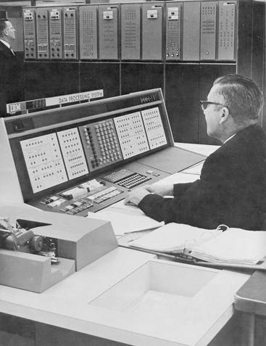
Databases Yesterday…
Database today?

Slide 4
What’s structured information?
It’s what you put in a database
What’s a database?
It’s what you store structured information in

Slide 5
So what’s a database?
  An integrated collection of data organized according to some model…

Slide 6
So what’s a relational database?
  An integrated collection of data organized according to a relational model

Slide 7
Database Management System (DBMS)
  Software system designed to store, manage, and facilitate access to databases

Slide 8

Databases (try to) model reality…
Entities: things in the world
  Example: airlines, tickets, passengers
Relationships: how different things are related
  Example: the tickets each passenger bought
“Business Logic”: rules about the world
  Example: fare rules

Slide 9
So what’s the Web?

Slide 10

Relational Databases
Source: Microsoft Office Clip Art

Slide 11
Components of a Relational Database
Field: an “atomic” unit of data
Record: a collection of related fields
Table: a collection of related records
  Each record is a row in the table
  Each field is a column in the table
Database: a collection of tables

Slide 12
A Simple Example
Field Name
Table
Name | DOB | SSN
John Doe | 04/15/1970 | 153-78-9082
Jane Smith | 08/31/1985 | 768-91-2376
Mary Adams | 11/05/1972 | 891-13-3057
Record
Field
Primary Key

Slide 13
Why “Relational”?
View of the world in terms of entities and relations between them:
  Tables represent “relations”
  Each row in the table is sometimes called a “tuple”
  Each tuple is “about” an entity
  Fields can be interpreted as “attributes” or “properties” of the entity
Data is manipulated by “relational algebra”:
  Defines things you can do with tuples
  Expressed in SQL

Slide 14
The Registrar Example
What do we need to know?
  Something about the students
  (e.g., first name, last name, email, department)
  Something about the courses
  (e.g., course ID, description, enrolled students, grades)
  Which students are in which courses
How do we capture these things?

Slide 15
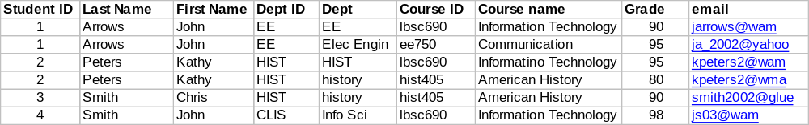
A First Try
Put everything in a big table…
Why is this a bad idea?

Slide 16
Goals of “Normalization”
Save space
  Save each fact only once
More rapid updates
  Every fact only needs to be updated once
More rapid search
  Finding something once is good enough
Avoid inconsistency
  Changing data once changes it everywhere

Slide 17
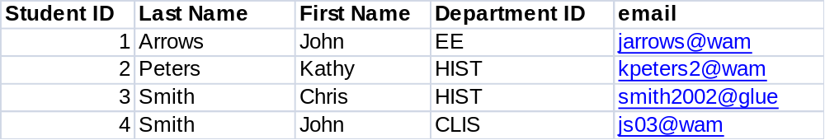
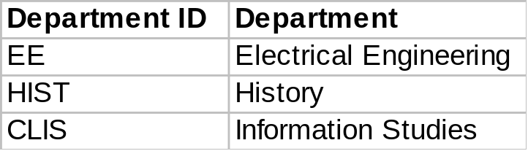
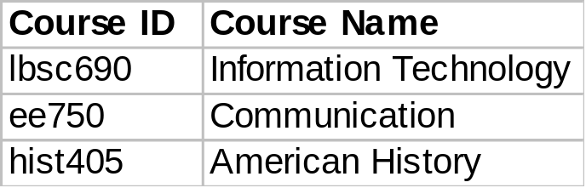
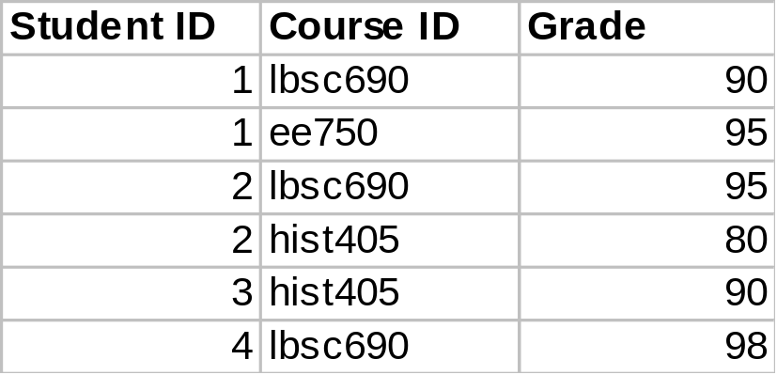
Another Try...
Student Table
Department Table
Course Table
Enrollment Table

Slide 18

Keys
“Primary Key” uniquely identifies a record
  e.g., student ID in the student table
“Foreign Key” is primary key in the other table
  It need not be unique in this table

Slide 19
Approaches to Normalization
For simple problems (like the homework):
  Start with the entities you’re trying to model
  Group together fields that “belong together”
  Add keys where necessary to connect entities in different tables
For more complicated problems:
  Entity-relationship modeling (LBSC 670)

Slide 20
The Data Model
Student Table
Department Table
Course Table
Enrollment Table

Slide 21
Registrar ER Diagram
Student
Student ID
First name
Last name
Department
E-mail
…
Enrollment
Student
Course
Grade
…
has
has
associated with
Course
Course ID
Course Name
…
Department
Department ID
Department Name
…

Slide 22
Types of Relationships
Many-to-Many
One-to-Many
One-to-One

Slide 23
Database Integrity
Registrar database must be internally consistent
  All enrolled students must have an entry in the student table
  All courses must have a name
  …
What happens:
  When a student withdraws from the university?
  When a course is taken off the books?

Slide 24
Integrity Constraints
Conditions that must be true of the database at any time
  Specified when the database is designed
  Checked when the database is modified
RDBMS ensures that integrity constraints are always kept
  So that database contents remain faithful to the real world
  Helps avoid data entry errors
Where do integrity constraints come from?

Slide 25
Relational Algebra
  (Don’t Panic!)

Slide 26
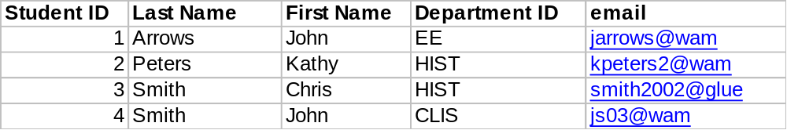
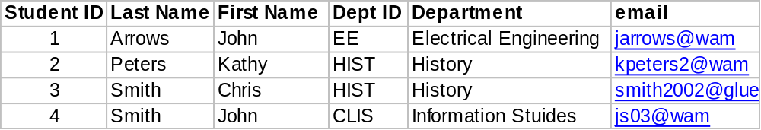
Join
Student Table
Department Table
“Joined” Table

Slide 27
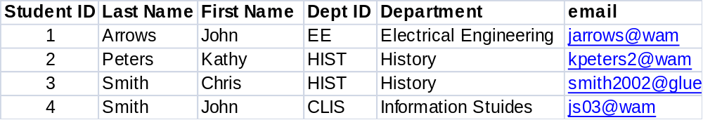
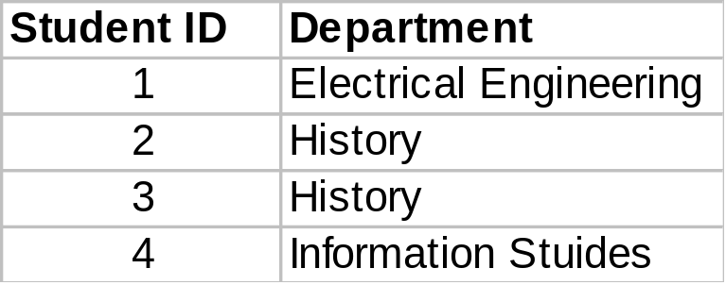
Project
SELECT Student ID, Department

Slide 28
Restrict
WHERE Department ID = “HIST”

Slide 29
Relational Operations
Joining tables: JOIN
Choosing columns: SELECT
  Based on their labels (field names)
Choosing rows: WHERE
  Based on their contents
These can be specified together
department ID = “HIST”
SELECT Student ID, Dept WHERE Dept = “History”

Slide 30
So how’s a database more than a spreadsheet?

Slide 31
Databases in Web Applications
Browser
Browser
Client
network
network
Server
Web Server
Web Server
“Middleware”
Database
Database

Slide 32
Database in the “Real World”
Typical database applications:
  Banking (e.g., saving/checking accounts)
  Trading (e.g., stocks)
  Traveling (e.g., airline reservations)
  Networking (e.g., Facebook)
  …
Characteristics:
  Lots of data
  Lots of concurrent operations
  Must be fast
  “Mission critical” (well… sometimes)

Slide 33
Operational Requirements
Must hold a lot of data
Must be reliable
Must be fast
Must support concurrent operations

Slide 34
Must hold a lot of data
Solution: Use lots of machines
(Each machine holds a small slice)
So which machine has your copy?

Slide 35
Must be reliable
Solution: Use lots of machines
(Store multiple copies)
But which copy is the right one?
How do you keep the copies in sync?

Slide 36
Must be fast
Solution: Use lots of machines
(Share the load)
How do you spread the load?

Slide 37
Must support concurrent operations
Solution: this is hard!
(But fortunately doesn’t matter for many applications)

Slide 38
Database Transactions
Transaction = sequence of database actions grouped together
  e.g., transfer $500 from checking to savings
ACID properties:
  Atomicity: all-or-nothing
  Consistency: each transaction must take the DB between consistent states
  Isolation: concurrent transactions must appear to run in isolation
  Durability: results of transactions must survive even if systems crash

Slide 39

Making Transactions
Idea: keep a log (history) of all actions carried out while executing transactions
  Before a change is made to the database, the corresponding log entry is forced to a safe location
Recovering from a crash:
  Effects of partially executed transactions are undone
  Effects of committed transactions are redone
  Trickier than it sounds!
the log

Slide 40
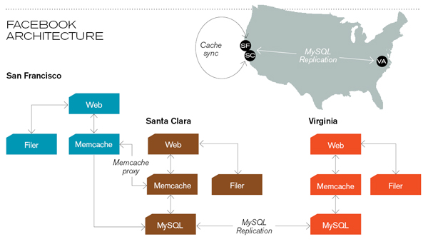
Caching servers: 15 million requests per second, 95% handled by memcache (15 TB of RAM)
Database layer: 800 eight-core Linux servers running MySQL (40 TB user data)
Source: Technology Review (July/August, 2008)

Slide 41
RideFinder Exercise
Design a database to match drivers with passengers (e.g., for road trips):
  Drivers post available seats; they want to know about interested passengers
  Passengers call up looking for rides: they want to know about available rides (they don’t get to post “rides wanted” ads)
  These things happen in no particular order

Slide 42
Exercise Goals
Design the tables you will need
  First decide what information you need to keep track of
  Then design tables to capture this information
Design queries (using join, project, and restrict)
  What happens when a passenger comes looking for a ride?
  What happens when a driver comes to find out who his passengers are?
Role play!

