Slide 1

CMSC 723: Computational Linguistics I ― Session #12
Large Scale Language Modeling with Stupid Backoff
Nitin Madnani
Department of Computer Science
University of Maryland
Wednesday, November 18, 2009

Slide 2
Language Modeling Recap
Interpolation: Consult all models at the same time to compute an interpolated probability estimate.
Backoff: Consult the highest order model first and backoff to lower order model only if there are no higher order counts.
Interpolated Kneser Ney (state-of-the-art)
  Use absolute discounting to save some probability mass for lower order models.
  Use a novel form of lower order models (count unique single word contexts instead of occurrences)
  Combine models into a true probability model using interpolation

Slide 3
Questions for today
Can we efficiently train an IKN LM with terabytes of data?
Does it really matter?

Slide 4
Using MapReduce to Train IKN
Step 0: Count words [MR]
Step 0.5: Assign IDs to words [vocabulary generation]
(more frequent => smaller IDs)
Step 1: Compute n-gram counts [MR]
Step 2: Compute lower order context counts [MR]
Step 3: Compute unsmoothed probabilities and interpolation weights [MR]
Step 4: Compute interpolated probabilities [MR]
[MR] = MapReduce Instantiation

Slide 5
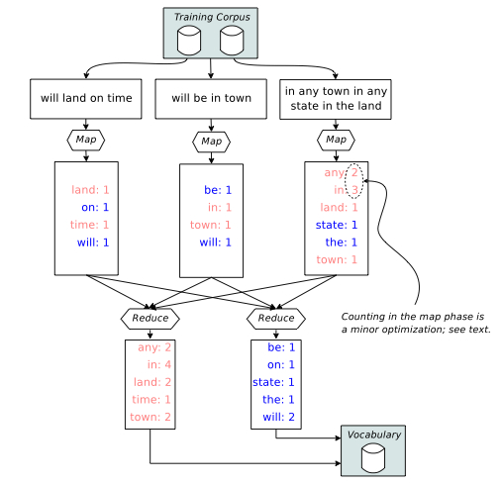
Steps 0 & 0.5
Step 0
Step 0.5

Slide 6
Steps 1-4
 | Step 1 | Step 2 | Step 3 | Step 4
Input Key | DocID | n-grams “a b c” | “a b c” | “a b”
Input Value | Document | C_{total}(“a b c”) | C_{KN}(“a b c”) | _Step 3 Output_
Intermediate Key | n-grams “a b c” | “a b c” | “a b” (history) | “c b a”
Intermediate Value | C_{doc}(“a b c”) | C’_{KN}(“a b c”) | (“c”, C_{KN}(“a b c”)) | (P’(“a b c”), λ(“a b”))
Partitioning | “a b c” | “a b c” | “a b” | “c b”
Output Value | C_{total}(“a b c”) | C_{KN}(“a b c”) | (“c”, P’(“a b c”), λ(“a b”)) | (P_{KN}(“a b c”), λ(“a b”))
Mapper Input
Mapper Output
Reducer Input
Reducer
Output
Count
n-grams
Count
contexts
Compute unsmoothed
probs AND interp. weights
Compute
Interp. probs
All output keys are always the same as the intermediate keys
I only show trigrams here but the steps operate on bigrams and unigrams as well

Slide 7
Steps 1-4
 | Step 1 | Step 2 | Step 3 | Step 4
Input Key | DocID | n-grams “a b c” | “a b c” | “a b”
Input Value | Document | C_{total}(“a b c”) | C_{KN}(“a b c”) | _Step 3 Output_
Intermediate Key | n-grams “a b c” | “a b c” | “a b” (history) | “c b a”
Intermediate Value | C_{doc}(“a b c”) | C’_{KN}(“a b c”) | (“c”, C_{KN}(“a b c”)) | (P’(“a b c”), λ(“a b”))
Partitioning | “a b c” | “a b c” | “a b” | “c b”
Output Value | C_{total}(“a b c”) | C_{KN}(“a b c”) | (“c”, P’(“a b c”), λ(“a b”)) | (P_{KN}(“a b c”), λ(“a b”))
Mapper Input
Details are not important!
5 MR instantiations to train IKN (expensive)!
IKN LMs are big!
(interpolation weights are context dependent)
Can we do something that has better
behavior at scale in terms of time and space?
Mapper Output
Reducer Input
Reducer
Output
Count
n-grams
Count
contexts
Compute unsmoothed
probs AND interp. weights
Compute
Interp. probs
All output keys are always the same as the intermediate keys
I only show trigrams here but the steps operate on bigrams and unigrams as well

Slide 8
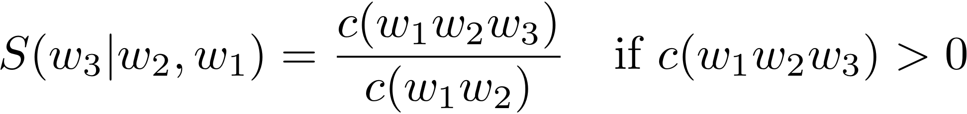
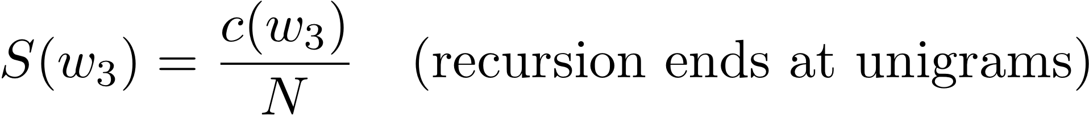
Let’s try something stupid!
Simplify backoff as much as possible!
Forget about trying to make the LM be a true probability distribution!
Don’t do any discounting of higher order models!
Have a single backoff weight independent of context!
[α(.) = α]
“Stupid Backoff (SB)”

Slide 9
Using MapReduce to Train SB
Step 0: Count words [MR]
Step 0.5: Assign IDs to words [vocabulary generation]
(more frequent => smaller IDs)
Step 1: Compute n-gram counts [MR]
Step 2: Generate final LM “scores” [MR]
[MR] = MapReduce Instantiation

Slide 10
Steps 0 & 0.5
Step 0
Step 0.5

Slide 11
Steps 1 & 2
 | Step 1 | Step 2
Input Key | DocID | n-grams “a b c”
Input Value | Document | C_{total}(“a b c”)
Intermediate Key | n-grams “a b c” | “a b c”
Intermediate Value | C_{doc}(“a b c”) | S(“a b c”)
Partitioning | first two words “a b” | last two words “b c”
Output Value | C_{total}(“a b c”) | S(“a b c”) [write to disk]
Mapper Input
Mapper Output
Reducer Input
Reducer
Output
Count
n-grams
Compute
LM scores
The clever partitioning in Step 2 is the key to efficient use at runtime!

Slide 12
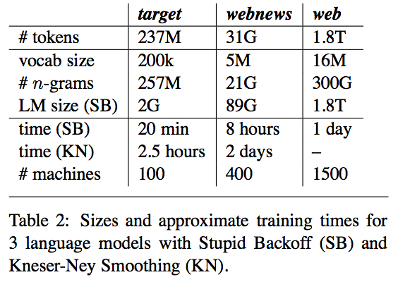
Which one wins?

Slide 13
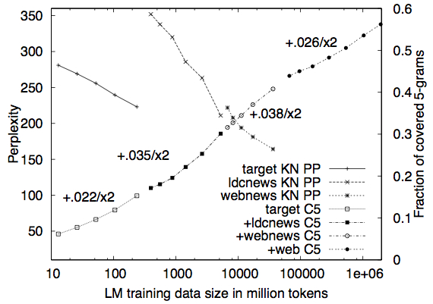
Which one wins?
Can’t compute perplexity for SB. Why?
Why do we care about 5-gram coverage for a test set?

Slide 14
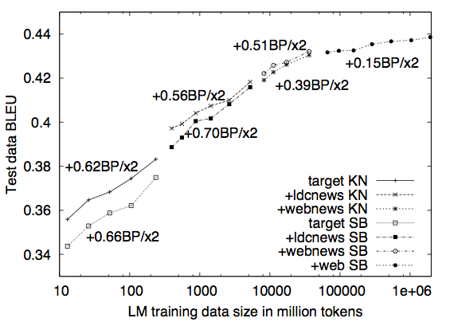
Which one wins?
SB overtakes IKN
BLEU is a measure of MT performance.
Not as stupid as you thought, huh?

Slide 15
Take away
The MapReduce paradigm and infrastructure make it simple to scale algorithms to web scale data
At Terabyte scale, efficiency becomes really important!
When you have a lot of data, a more scalable technique (in terms of speed and memory consumption) can do better than the state-of-the-art even if it’s stupider!
“The difference between genius and stupidity is that genius has its limits.”
- Oscar Wilde
“The dumb shall inherit the cluster”
- Nitin Madnani

