Slide 1

LBSC 796/INFM 718R: Week 1
Introduction to Information Retrieval
Jimmy Lin
College of Information Studies
University of Maryland
Monday, January 30, 2006

Slide 2
Information Retrieval Systems
Information
  What is “information”?
Retrieval
  What do we mean by “retrieval”?
  What are different types information needs?
Systems
  How do computer systems fit into the human information seeking process?
Notes:
What exactly is this course about? We’re going to spend most of this class on three words.

Slide 3
What is Information?
What do you think?
There is no “correct” definition
Cookie Monster’s definition:
  “news or facts about something”
Different approaches:
  Philosophy
  Psychology
  Linguistics
  Electrical engineering
  Physics
  Computer science
  Information science

Slide 4
Dictionary says…
Oxford English Dictionary
  information: informing, telling; thing told, knowledge, items of knowledge, news
  knowledge: knowing familiarity gained by experience; person’s range of information; a theoretical or practical understanding of; the sum of what is known
Random House Dictionary
  information: knowledge communicated or received concerning a particular fact or circumstance; news

Slide 5
Intuitive Notions
Information must
  Be something, although the exact nature (substance, energy, or abstract concept) is not clear;
  Be “new”: repetition of previously received messages is not informative
  Be “true”: false or counterfactual information is “mis-information”
  Be “about” something
Robert M. Losee. (1997) A Discipline Independent Definition of Information. Journal of the American Society for Information Science, 48(3), 254-269.

Slide 6
Three Views of Information
Information as process
Information as communication
Information as message transmission and reception

Slide 7
One View
Information = characteristics of the output of a process
  Tells us something about the process and the input
Information-generating process do not occur in isolation
Input
Output
Input
Process
Output
Input
Output
Input
Process₁
Process₂
…
Output
Ibid.

Slide 8
Where’s the human?
If a tree falls in the forest, and no one is around to hear it, is information transmitted?
In the “information as process”: Yes, but that’s not very interesting to us
We’re concerned about information for human consumption
  Transmission of information from one person to another
  Recording of information
  Reconstruction of stored information
Notes:
You’ll note that this “information as process” view doesn’t necessarily involve a human.

Slide 9
Another View
Information science is characterized by “the deliberate (purposeful) structure of the message by the sender in order to affect the image structure of the recipient”
  This implies that the sender has knowledge of the recipient's structure
Text = “a collection of signs purposefully structured by a sender with the intention of changing image-structure of a recipient”
Information = “the structure of any text which is capable of changing the image-structure of a recipient”
Nicholas J. Belkin and Stephen E. Robertson. (1976) Information Science and the Phenomenon of Information. Journal of the American Society for Information Science, 27(4), 197-204.
Notes:
Here’s another view of information

Slide 10
Transfer of Information
Communication = transmission of information
Thoughts
Thoughts
Telepathy?
Words
Words
Writing
Sounds
Sounds
Speech
Encoding
Decoding
Notes:
Under this view, information is closely linked to communication.
How does the “information as communication” view relate to the “information as process” view?

Slide 11
Information Theory
Better called “communication theory”
Developed by Claude Shannon in 1940’s
  Concerned with the transmission of electrical signals over wires
  How do we send information quickly and reliably?
Underlies modern electronic communication:
  Voice and data traffic…
  Over copper, fiber optic, wireless, etc.
Famous result: Channel Capacity Theorem
Formal measure of information in terms of entropy
  Information = “reduction in surprise”
Notes:
Here’s yet another view of information, this time from the point of view of electrical engineers.

Slide 12
The Noisy Channel Model
Communication = producing the same message at the destination that was sent at the source
  The message must be encoded for transmission across a medium (called channel)
  But the channel is noisy and can distort the message
Semantics (meaning) is irrelevant
Source
Destination
message
Transmitter
channel
Receiver
message
noise

Slide 13
A Synthesis
Information retrieval as communication over time and space, across a noisy channel
Source
Destination
message
Transmitter
channel
Receiver
message
noise
Sender
Recipient
message
Encoding
storage
Decoding
message
indexing/writing
retrieval/reading
noise
Notes:
So we have three separate views? How do they fit together?

Slide 14
Information Hierarchy
More refined and abstract
Wisdom
Knowledge
Information
Data
Notes:
“Information” actually exists as part of a hierarchy, of how refined it is

Slide 15
Information Hierarchy
Data
  The raw material of information
Information
  Data organized and presented in a particular manner
Knowledge
  “Justified true belief”
  Information that can be acted upon
Wisdom
  Distilled and integrated knowledge
  Demonstrative of high-level “understanding”

Slide 16
A (Facetious) Example
Data
  98.6º F, 99.5º F, 100.3º F, 101º F, …
Information
  Hourly body temperature: 98.6º F, 99.5º F, 100.3º F, 101º F, …
Knowledge
  If you have a temperature above 100º F, you most likely have a fever
Wisdom
  If you don’t feel well, go see a doctor

Slide 17
“Retrieval?”
“Fetch something” that’s been stored
Recover a stored state of knowledge
Search through stored messages to find some messages relevant to the task at hand
Sender
Recipient
message
Encoding
storage
Decoding
message
indexing/writing
Retrieval/reading
noise
Notes:
5
We’re communicating over time and space.
The message recreates the mental state of the sender.

Slide 18
What is IR?
Information retrieval is a problem-oriented discipline, concerned with the problem of the effective and efficient transfer of desired information between human generator and human user
Anomalous States of Knowledge as a Basis for Information Retrieval. (1980) Nicholas J. Belkin. Canadian Journal of Information Science, 5, 133-143.
Notes:
There are some disciplines that aren’t problem-oriented. For example, statistics

Slide 19
Modern History
The “information overload” problem is much older than you may think
Origins in period immediately after World War II
  Tremendous scientific progress during the war
  Rapid growth in amount of scientific publications available
The “Memex Machine”
  Conceived by Vannevar Bush, President Roosevelt's science advisor
  Outlined in 1945 Atlantic Monthly article titled “As We May Think”
  Foreshadows the development of hypertext (the Web) and information retrieval system

Slide 20
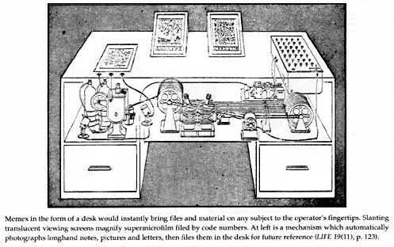
The Memex Machine

Slide 21
Types of Information Needs
Retrospective
  “Searching the past”
  Different queries posed against a static collection
  Time invariant
Prospective
  “Searching the future”
  Static query posed against a dynamic collection
  Time dependent
Notes:
When we’re talking about information retrieval, we’re talking mainly about searching.

Slide 22
Retrospective Searches (I)
Ad hoc retrieval: find documents “about this”
Known item search
Directed exploration
Identify positive accomplishments of the Hubble telescope since it was launched in 1991.
Compile a list of mammals that are considered to be endangered, identify their habitat and, if possible, specify what threatens them.
Find Jimmy Lin’s homepage.
What’s the ISBN number of “Modern Information Retrieval”?
Who makes the best chocolates?
What video conferencing systems exist for digital reference desk services?

Slide 23
Retrospective Searches (II)
Question answering
Who discovered Oxygen?
When did Hawaii become a state?
Where is Ayer’s Rock located?
What team won the World Series in 1992?
“Factoid”
What countries export oil?
Name U.S. cities that have a “Shubert” theater.
“List”
“Definition”
Who is Aaron Copland?
What is a quasar?

Slide 24
Prospective “Searches”
Filtering
  Make a binary decision about each incoming document
Routing
  Sort incoming documents into different bins?
Spam or not spam?
Categorize news headlines: World? Nation? Metro? Sports?
Notes:
5

Slide 25
What types of information?
Text (Documents and portions thereof)
XML and structured documents
Images
Audio (sound effects, songs, etc.)
Video
Source code
Applications/Web services
Notes:
Why would you want to search for each type of information?
Types of information needs and types of information form a matrix: this course is mostly focused on one section thereof.

Slide 26
Content-Based Search
This is a relative new concept!
What else would you search on?
What’s more effective?
Why is this hard in many applications?
Notes:
What else would you search on? metadata, manually-assigned indexing terms, link structure

Slide 27
Interesting Examples
Google image search
Google video search
Finding naked people (seriously!)
Query by humming
http://images.google.com/
http://video.google.com/
http://http.cs.berkeley.edu/~daf/people.html
http://www.cs.cornell.edu/Info/Faculty/bsmith/query-by-humming.html

Slide 28
What about databases?
What are examples of databases?
  Banks storing account information
  Retailers storing inventories
  Universities storing student grades
What exactly is a (relational) database?
  Think of them as a collection of tables
  They model some aspect of “the world”

Slide 29
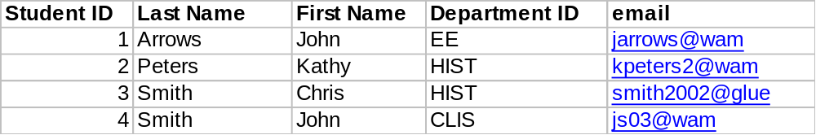
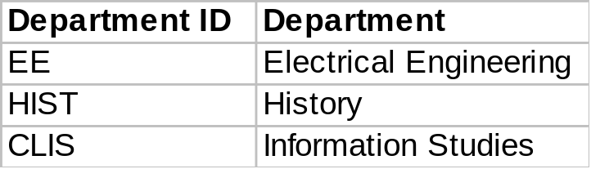
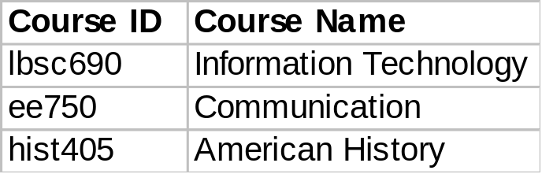
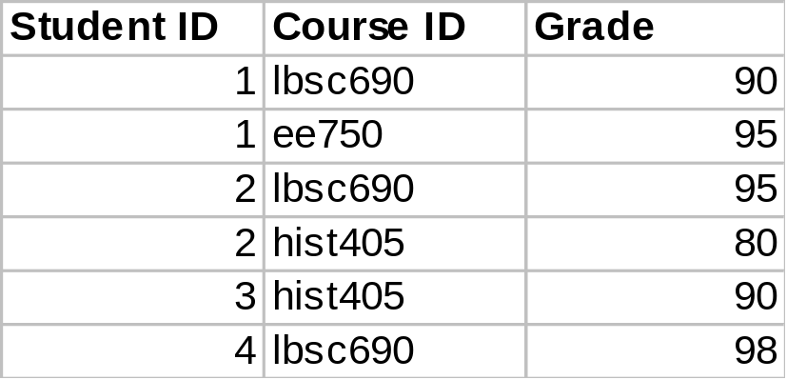
A (Simple) Database Example
Student Table
Department Table
Course Table
Enrollment Table

Slide 30
Database Queries
What would you want to know from a database?
  What classes is John Arrow enrolled in?
  Who has the highest grade in LBSC 690?
  Who’s in the history department?
  Of all the non-CLIS students taking LBSC 690 with a last name shorter than six characters and were born on a Monday, who has the longest email address?

Slide 31
Databases vs. IR
Databases
IR
What we’re retrieving
Structured data. Clear semantics based on a formal model.
Mostly unstructured. Free text with some metadata.
Queries we’re posing
Formally (mathematically) defined queries. Unambiguous.
Vague, imprecise information needs (often expressed in natural language).
Results we get
Exact. Always correct in a formal sense.
Sometimes relevant, often not.
Interaction with system
One-shot queries.
Interaction is important.
Other issues
Concurrency, recovery, atomicity are all critical.
Issues downplayed.

Slide 32
The Big Picture
The four components of the information retrieval environment:
  User
  Process
  System
  Collection
What computer geeks care about!
What we care about!

Slide 33
The Information Retrieval Cycle
Source
Selection
Resource
Query
Formulation
Query
Search
Ranked List
Selection
Documents
query reformulation,
vocabulary learning,
relevance feedback
Examination
Documents
source reselection
Delivery

Slide 34
Supporting the Search Process
Source
Selection
Resource
Query
Formulation
Query
Search
Ranked List
Indexing
Selection
Index
Documents
Examination
Acquisition
Collection
Documents
Delivery

Slide 35
Simplification?
Source
Selection
Resource
Is this itself a vast simplification?
Query
Formulation
Query
Search
Ranked List
Selection
Documents
query reformulation,
vocabulary learning,
relevance feedback
Examination
Documents
source reselection
Delivery

Slide 36
Taylor’s Model
The visceral need (Q₁) ⎯ the actual, but unexpressed, need for information
The conscious need (Q₂) ⎯ the conscious within-brain description of the need
The formalized need (Q₃) ⎯ the formal statement of the question
The compromised need (Q₄) ⎯ the question as presented to the information system
Robert S. Taylor. (1962) The Process of Asking Questions. American Documentation, 13(4), 391--396.

Slide 37
Taylor’s Model and IR Systems
Visceral need (Q₁)
Conscious need (Q₂)
Question
Negotiation
Formalized need (Q₃)
naïve users
Compromised need (Q₄)
IR System
Results

Slide 38
Tackling the IR Challenge
Divide and conquer!
Strategy: use encapsulation to limit complexity
Approach:
  Define interfaces (input and output) for each component
  Define the functions performed by each component
  Study each component in isolation
  Repeat the process within components as needed
  Make sure that this decomposition makes sense
Result: a hierarchical decomposition
Notes:
19
Okay, I’ve presented a very complex field… how do we actually go about studying it?
Example of a decomposition that doesn’t make sense: separating engine from transmission

Slide 39
Where do we make the cut?
Study the IR black box in isolation
  Simple behavior: in goes query, out comes documents
  Optimize the quality of documents that come out
Study everything else around the black box
  Put the human back in the loop!
Query
Search
Ranked List

Slide 40
A Tour of This Course
Major themes:
  Learn about the IR black box
  Put the user back in the loop
  Extensions beyond standard document retrieval
Along the way:
  Homework assignments
  Midterm and final
  Project

Slide 41
The IR Black Box
Documents
Query
Hits

Slide 42
Inside The IR Black Box
Documents
Query
Representation
Function
Representation
Function
Query Representation
Document Representation
Index
Comparison
Function
Hits

Slide 43


The Central Problem in IR
Information Seeker
Authors
Concepts
Concepts
Query Terms
Document Terms
Do these represent the same concepts?
Notes:
Why is IR hard? Because language is hard!

Slide 44
What makes IR “experimental”?
Week 2: Evaluation
  How do design experiments that answer our questions?
  How do we assess the quality of the documents that come out of the IR black box?
  Can we do this automatically?

Slide 45
Building the IR Black Box
Week 3 and 4: Different models of information retrieval
  Boolean model
  Vector space model
  Languages models
Week 5: Representing the meaning of documents
  How do we capture the meaning of documents?
  Is meaning just the sum of all terms?
Week 6: Indexing
  How do we actually store all those words?
  How do we access indexed terms quickly?

Slide 46
Beyond the IR Black Box
Studying the IR black box in isolation: Is this realistic?
What are the assumptions of this methodology?
Notes:
Analogy: drive-by information seeking

Slide 47
The User in the Loop
Week 8: Relevance Feedback
  How do humans (and machines) modify queries based on retrieved results?
Week 9: User Interaction
  Information retrieval meets computer-human interaction
  How do we present search results to users in an effective manner?
  What tools can systems provide to aid the user in information seeking?

Slide 48
Extensions
Week 10: Filtering and Categorization
  Traditional information retrieval: static collection, dynamic queries
  What about static queries against dynamic collections?
Week 11: Multimedia Retrieval
  Thus far, we’ve been focused on text…
  What about images, sounds, video, etc.?
Week 12: Question Answering
  We want answers, not just documents!

Slide 49
Technical Assumptions
You should be:
  Familiar with the general operation of a computer
  Comfortable with learning new applications and computing environments
What about programming?
  Not necessary…
  But you may get more out of the course if you know some programming

