Slide 1

LBSC 796/INFM 718R: Week 11
Cross-Language and Multimedia Information Retrieval
Jimmy Lin
College of Information Studies
University of Maryland
Monday, April 17, 2006

Slide 2
Topics covered so far…
Evaluation of IR systems
Inner workings of IR black boxes
Interacting with retrieval systems
Interfaces in support of retrieval

Slide 3
Questions for Today
What if the collection contains documents in a foreign language?
What if the collection isn’t even comprised of textual documents?

Slide 4
Cross-Language IR
Or “finding documents in languages you can’t read”
Why would you want to do it?
How would you do it?

Slide 5
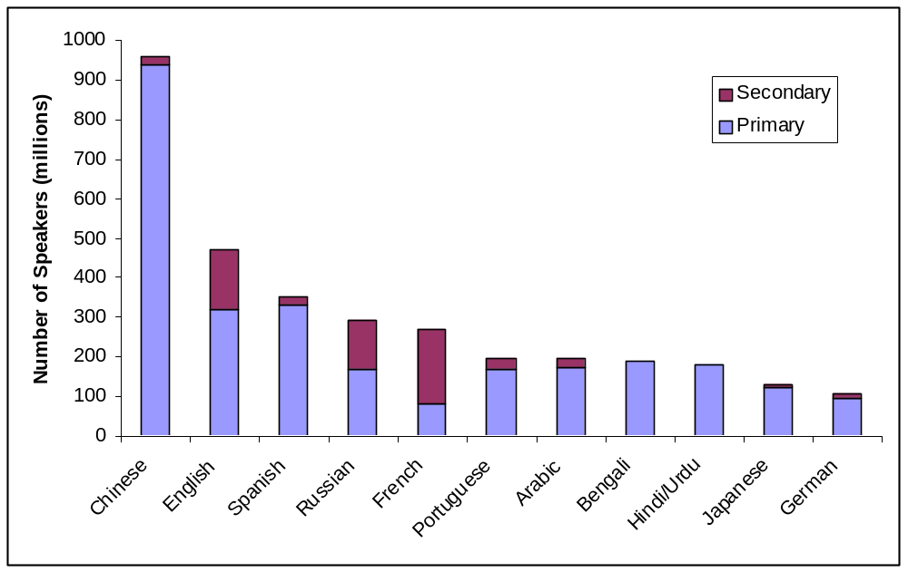
Most Widely-Spoken Languages
Source: Ethnologue (SIL), 1999

Slide 6
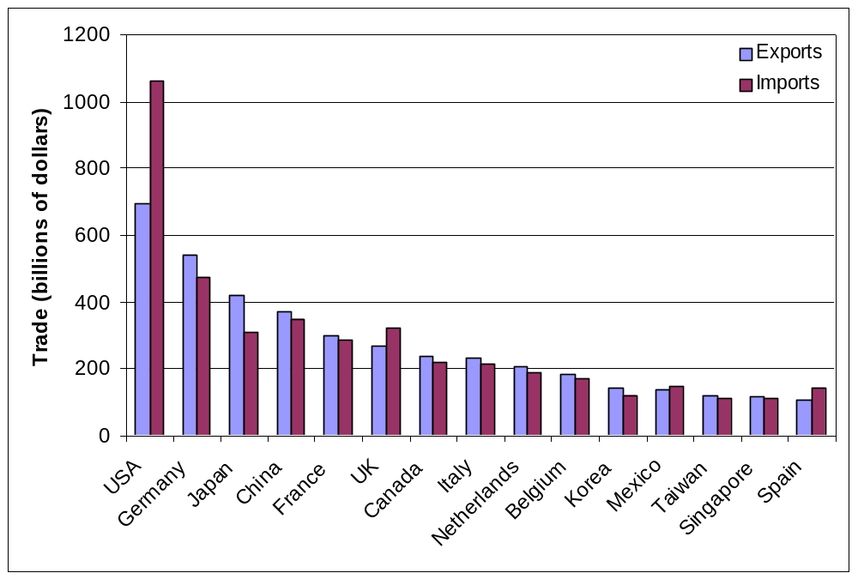
Global Trade
Source: World Trade Organization 2000 Annual Report

Slide 7
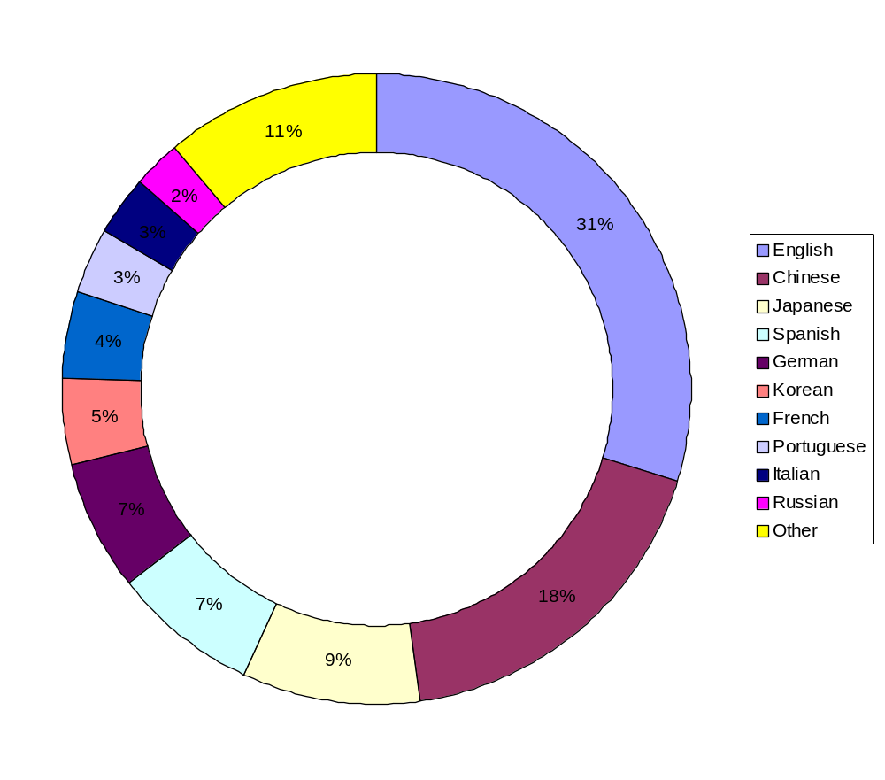
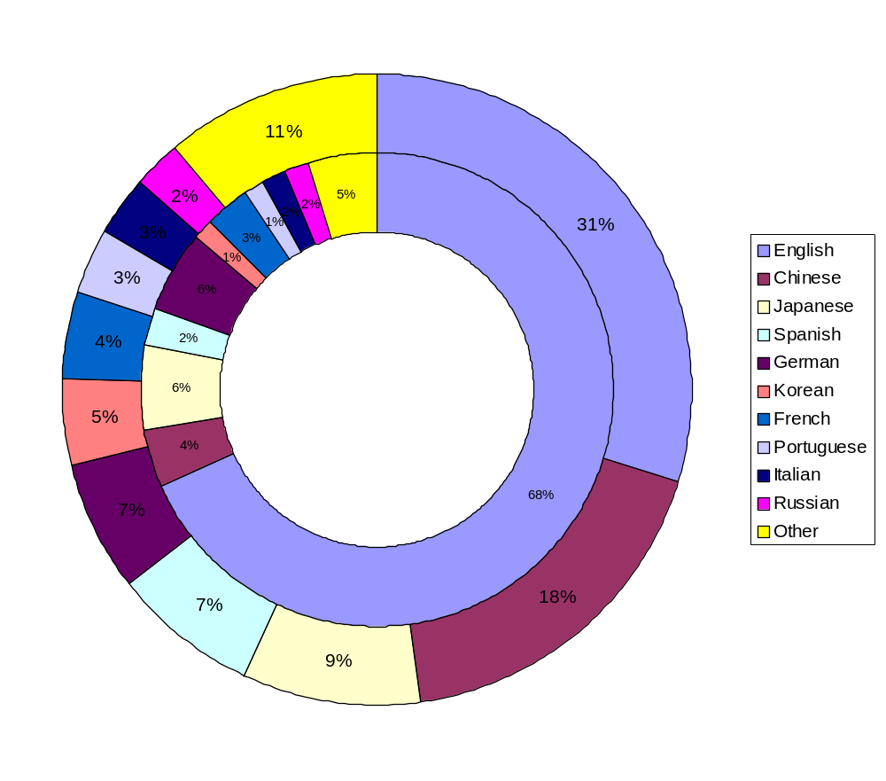
Global Internet Users
Web Pages
Native speakers, Global Reach projection for 2004 (as of Sept, 2003)
Notes:
Until the year 2000, more than half of all users of the Internet spoke English as their native language. Although the total number of English speakers on the Internet continues to increase, the number of Internet users that speak a first language other than English is rising far more rapidly. The consulting firm Global Reach estimates that more that two-thirds of all Internet users presently speak a first language other than English.

Slide 8
A Community: CLEF
CLEF = “Cross-Language Evaluation Forum”
8 tracks at CLEF 2005
  Multilingual information retrieval
  Cross-language information retrieval
  Interactive cross-language information retrieval
  Multiple language question answering
  Cross-language retrieval on image collections
  Cross-language spoken document retrieval
  Multilingual Web retrieval
  Cross-language geographic retrieval

Slide 9
The Information Retrieval Cycle
If you can’t understand the documents…
Source
Selection
How do you formulate a query?
Resource
How do you know something is worth looking at?
Query
Formulation
Query
How can you understand the retrieved documents?
Search
Ranked List
Selection
Documents
System discovery
Vocabulary discovery
Concept discovery
Document discovery
Examination
Documents
source reselection
Delivery

Slide 10
CLIR
CLIR = “Cross Language Information Retrieval”
Typical setup
  User speaks only English
  Wants access to documents in a foreign language (e.g., Chinese or Arabic)
Requirements
  User needs to understand retrieved documents!
  Interface must support browsing of documents in foreign languages
How do we do it?

Slide 11
Two Approaches
Query translation
  Translate English query into Chinese query
  Search Chinese document collection
  Translate retrieved results back into English
Document translation
  Translate entire document collection into English
  Search collection in English
Translate both?

Slide 12

Query Translation
Chinese Document
Collection
Chinese
documents
Retrieval
Engine
Results
Translation System
Chinese
queries
select
examine
English
queries

Slide 13
Document Translation
Chinese Document
Collection
Translation
System
Results
select
examine
Retrieval
Engine
English
queries
English Document
Collection

Slide 14
Tradeoffs
Query Translation
  Often easier
  Disambiguation of query terms may be difficult with short queries
  Translation of documents must be performed at query time
Document Translation
  Documents can be translate and stored offline
  Automatic translation can be slow
Which is better?
  Often depends on the availability of language-specific resources (e.g., morphological analyzers)
  Both approaches present challenges for interaction

Slide 15
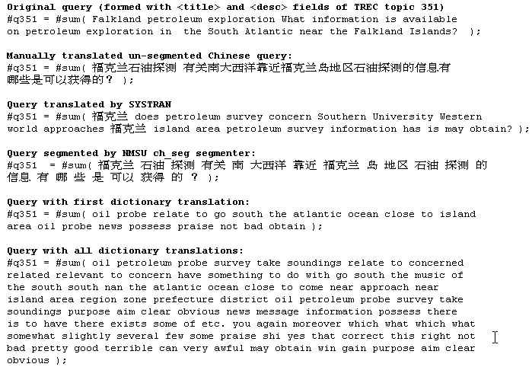
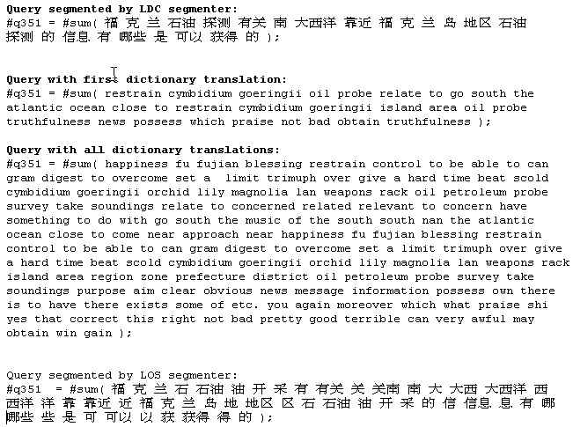
CLIR Issues
oil
petroleum
probe
survey
take samples
No
translation!
Which
translation?
cymbidium
goeringii
probe
survey
take samples
oil
petroleum
Wrong
segmentation
restrain

Slide 16
Learning to Translate
Lexicons
  Phrase books, bilingual dictionaries, …
Large text collections
  Translations (“parallel”)
  Similar topics (“comparable”)
People

Slide 17
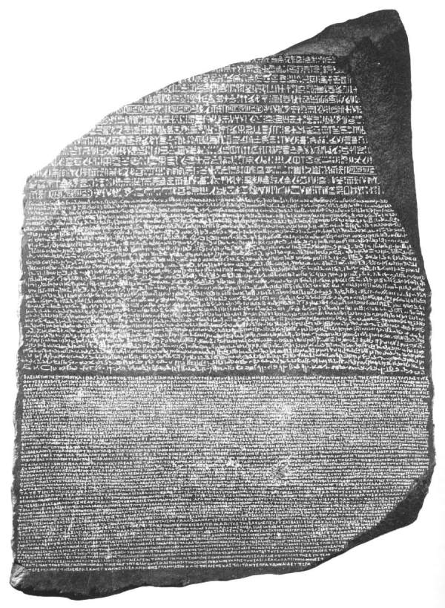
Hieroglyphic
Demotic
Greek

Slide 18
Modern Rosetta Stones
Newswire:
  DE-News (German-English)
  Hong-Kong News, Xinhua News (Chinese-English)
Government:
  Canadian-Hansards (French-English)
  Europarl (Danish, Dutch, English, Finnish, French, German, Greek, Italian, Portugese, Spanish, Swedish)
  UN Treaties (Russian, English, Arabic, …)
The Bible (many, many languages)

Slide 19
Parallel Corpus
Example from DE-News (8/1/1996)
English:
Diverging opinions about planned tax reform
German:
Unterschiedliche Meinungen zur geplanten Steuerreform
English:
The discussion around the envisaged major tax reform continues .
German:
Die Diskussion um die vorgesehene grosse Steuerreform dauert an .
English:
The FDP economics expert , Graf Lambsdorff , today came out in favor of advancing the enactment of significant parts of the overhaul , currently planned for 1999 .
German:
Der FDP - Wirtschaftsexperte Graf Lambsdorff sprach sich heute dafuer aus , wesentliche Teile der fuer 1999 geplanten Reform vorzuziehen .

Slide 20
Word-Level Alignment
English
Diverging opinions about planned tax reform
Unterschiedliche Meinungen zur geplanten Steuerreform
German
English
Madam President , I had asked the administration …
Señora Presidenta, había pedido a la administración del Parlamento …
Spanish

Slide 21
Learning Translations
From alignments, automatically induce a translation lexicon
survey
探测
(p = 0.4)
试探
(p = 0.3)
测量
(p = 0.25)
样品
(p = 0.05)
Multiple Translations
Translation Probabilities

Slide 22

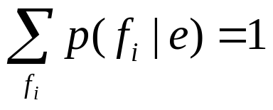
A Translation Model
From word-aligned bilingual text, we induce a translation model
Example:
where,
p(探测|survey) = 0.4
p(试探|survey) = 0.3
p(测量|survey) = 0.25
p(样品|survey) = 0.05

Slide 23
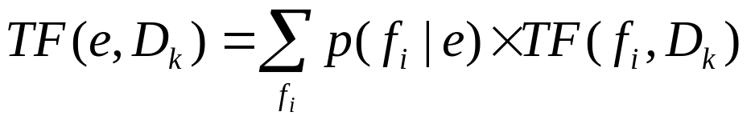
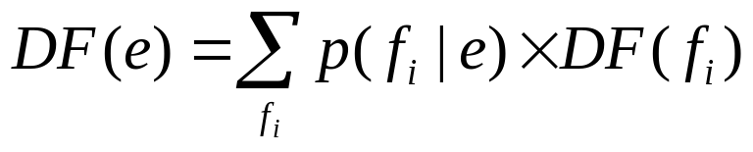
Using Multiple Translations
Weighted Structured Query Translation
  Takes advantage of multiple translations and translation probabilities
TF and DF of query term e are computed using TF and DF of its translations:

Slide 24
Experiment Setup
Does weighted structured query translation work?
Test collection (from CLEF 2000-2003)
  ~ 44,000 documents in French
  153 topics in English (and French, for comparison)
IR system: Okapi weights
Translation resources
  Europarl parallel corpus: ~ 100M on each side
  GIZA++ Statistical MT toolkit

Slide 25
Does it work?
Runs:
  Monolingual baseline
  One-best translation baseline
  Weighted structured query translation
Results:
  Weighted structured query translation always beats one-best translation
  Weighted structured query translation performance approaches monolingual performance

Slide 26
Morphology and Segmentation
For the query translation approach
  The retrieval engine needs to perform monolingual IR in a foreign language
  Morphology and segmentation pose problems
Good segmenters and morphological analyzers are expensive to develop
N-gram indexing provides a good solution
  Use character n-grams based on length of average word
  Performs about as well as with a good segmenter

Slide 27
Blind Relevance Feedback
Augment the query representation with related terms
Multiple opportunities for expansion
  Before doc translation: Enrich the vocabulary
  After doc translation: Mitigate translation errors
  Before query translation: Improve the query
  After query translation: Mitigate translation errors
Notes:
41

Slide 28
Query Expansion/Translation
source language query
Source
Language
IR
Query
Translation
Target
Language
IR
results
expanded
source language
query
expanded
target language
terms
source language
collection
target language
collection
Pre-translation expansion
Post-translation expansion

Slide 29
McNamee and Mayfield
Research questions:
  What are the effects of pre- and post- translation query expansion in CLIR?
  How is performance affected by quality of resources?
  Is CLIR simply measuring translation performance?
Setup:
  CLEF 2001 test collection
  Dutch, French, German, Italian, Spanish queries
  English documents
  Varied the size translation lexicons (randomly threw out entries)
Paul McNamee and James Mayfield. (2002) Comparing Cross-Language Query Expansion Techniques by Degrading Translation Resources. Proceedings of SIGIR 2002.

Slide 30
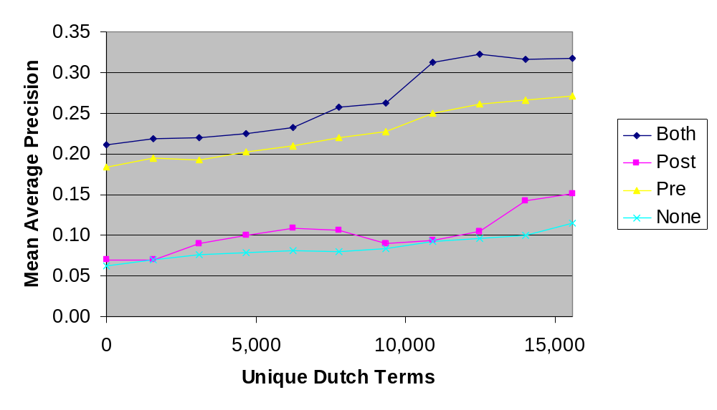
Query Expansion Effect

Slide 31
Lessons
Both pre- and post- translation expansions help
Pre-translation expansion is a bigger win… why?
Translation resources are important!

Slide 32
Interaction
CLIR poses some unique challenges for interaction
  How do you help users select translated query terms?
  How do you help users select document terms for query refinement?
  How do you compensate for poor translation quality?

Slide 33
Document Selection
Can users recognize relevant documents in a cross-language retrieval setting?
What’s the impact of translation quality?
Ranked List
Selection
Documents
Examination

Slide 34
Selection Experiment
Experimental setup (UMD, iCLEF 2001):
  English topics, French documents
  Each user works with the same hit list
  Can users make relevance judgments?
  What’s the effect of translation quality?
Comparison of two translation methods:
  Term-for-term gloss translation (Gloss)
    Easily built for a wide range of language pairs
    Widely available bilingual word lists
  Machine translation (MT)
    Syntactic/semantic constraints improve accuracy & fluency
    Used Systran, a commercially available MT system
    Developing new language pairs is expensive (years)

Slide 35
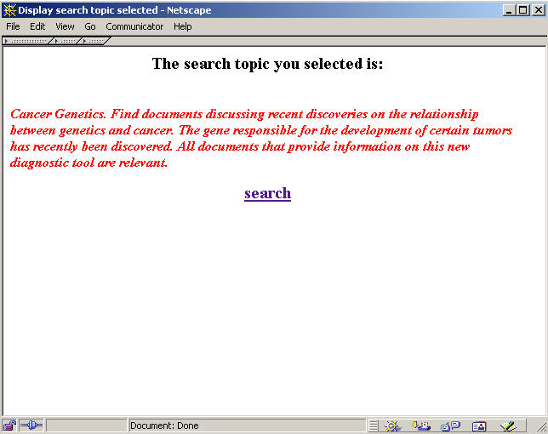

Slide 36
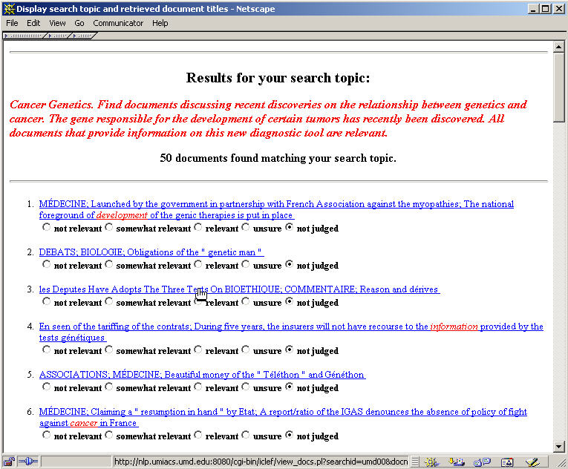

Slide 37
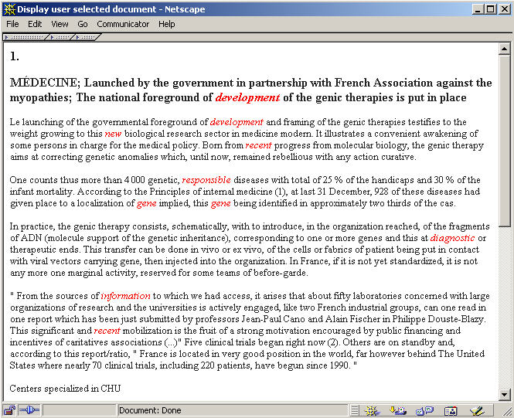

Slide 38
Results
Quantitative measures:
  Users with the MT system achieved higher F-score
Observed behavior (from observational notes):
  Documents were usually examined in rank order
  Title alone was seldom used to judge documents as “relevant”
Subjective reactions (from questionnaires):
  Everyone liked MT
  Only one participant liked anything about gloss translation
  MT was preferred overall

Slide 39
Making MIRACLEs
Putting everything together in an interactive, cross-language retrieval system…

Slide 40
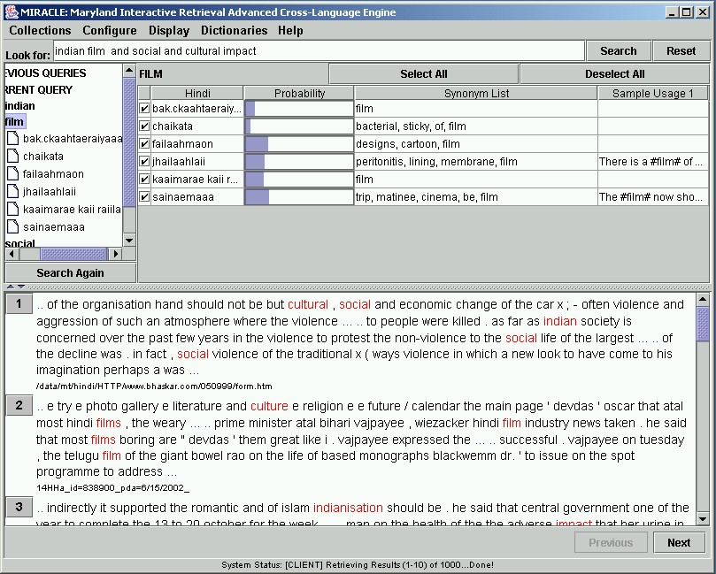

Slide 41
Key Points
Good translation is the key to cross-language information retrieval
  Where does one obtain them? (e.g., bilingual dictionaries, aligned text, etc.)
  How does one use them? (e.g., query translation, document translation, etc.)
CLIR performance approaches monolingual IR performance
CLIR presents addition challenges for interaction support

Slide 42
Multimedia Retrieval
We’re primarily going to focus on image and video search

Slide 43
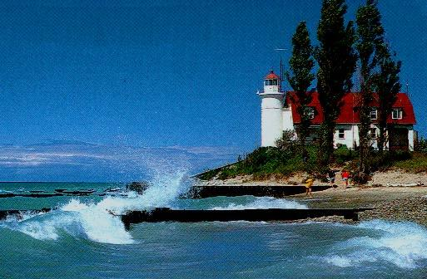
A Picture…

Slide 44
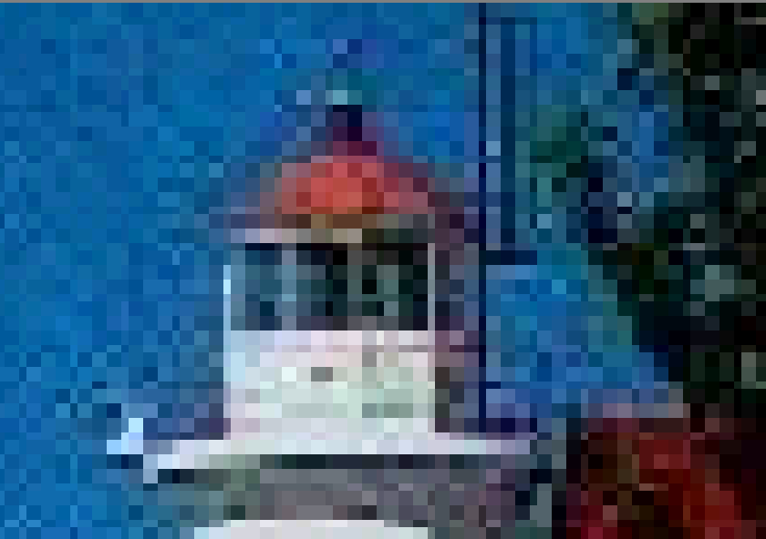
… is comprised of pixels

Slide 45
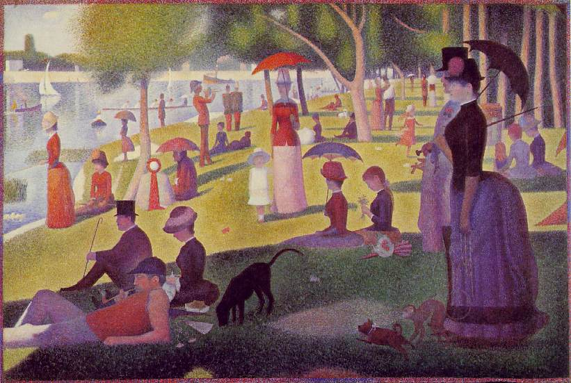
This is nothing new!
Seurat, Georges, A Sunday Afternoon on the Island of La Grande Jatte

Slide 46
Images and Video
A digital image = a collection of pixels
  Each pixel has a “color”
Different types of pixels
  Binary (1 bit): black/white
  Grayscale (8 bits)
  Color (3 colors, 8 bits each): red, green, blue
A video is simply lots of images in rapid sequence
  Each image is called a frame
  Smooth motion requires about 24 frames/sec
Compression is the key!

Slide 47
The Structure of Video
Video
Scenes
Shots
Frames

Slide 48
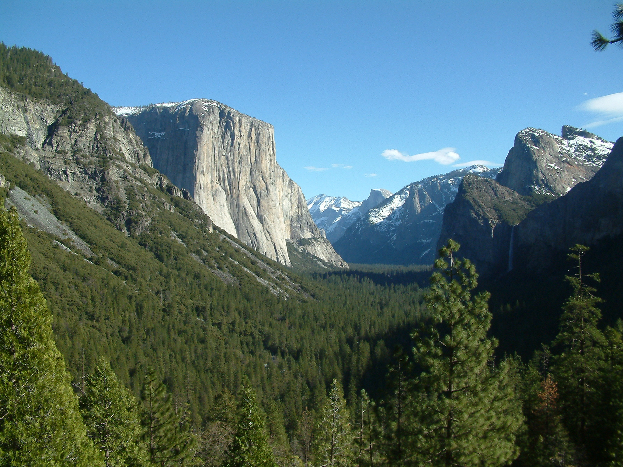
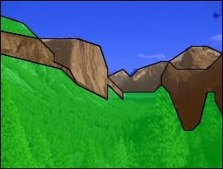
The Semantic Gap
This is what we have to work with
Raw Media
Image-level descriptors
SKY
MOUNTAINS
Content descriptors
This is what we want
TREES
Photo of Yosemite valley showing El Capitan and Glacier Point with the Half Dome in the distance
Semantic content

Slide 49
The IR Black Box
Documents
Multimedia
Objects
Query
Representation
Function
Representation
Function
Query Representation
Document Representation
Index
Comparison
Function
Hits

Slide 50
Recipe for Multimedia Retrieval
Extract features
  Low-level features: blobs, textures, color histograms
  Textual annotations: captions, ASR, video OCR, human labels
Match features
  From “bag of words” to “bag of features”

Slide 51
Demos
Google Image Search
Hermitage Museum
IBM’s MARVEL System
http://images.google.com/
http://www.hermitagemuseum.org/fcgi-bin/db2www/qbicSearch.mac/qbic?selLang=English
http://mp7.watson.ibm.com/

Slide 52
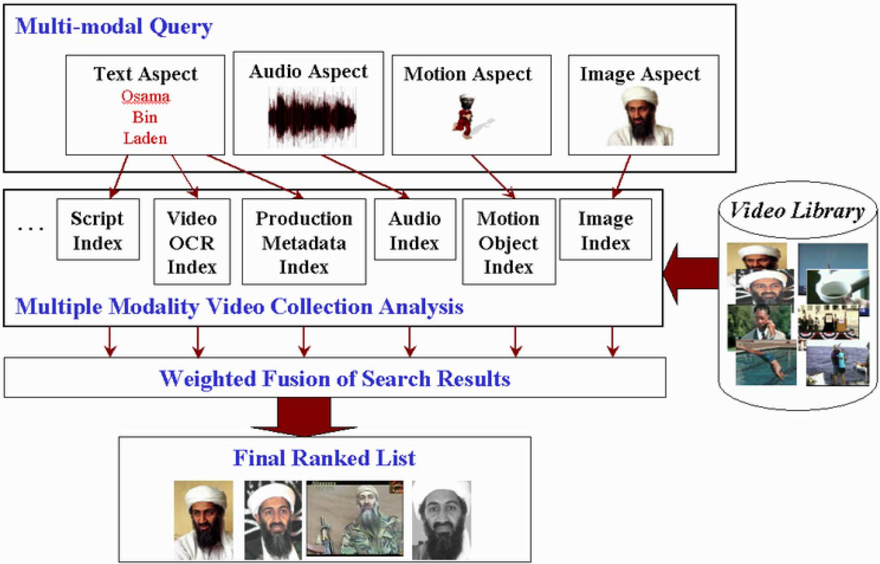
Combination of Evidence

Slide 53
TREC For Video Retrieval?
TREC Video Track (TRECVID)
  Started in 2001
  Goal is to investigate content-based retrieval from digital video
  Focus on the shot as the unit of information retrieval
  (why?)
Test Data Collection in 2004:
  74 hours of CNN Headline News, ABC World News Tonight, C-SPAN
http://www-nlpir.nist.gov/projects/trecvid/

Slide 54
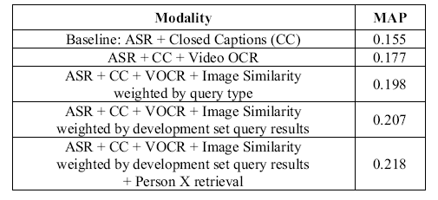
Searching Performance
A. Hauptmann and M. Christel. (2004) Successful Approaches in the TREC Video Retrieval Evaluations. Proceedings of ACM Multimedia 2004.

Slide 55
Interaction in Video Retrieval
Discussion point: What unique challenges does video retrieval present for interactive systems?

Slide 56
Take-Away Message
Multimedia IR systems build on the same basic set of tools as textual IR systems
  If you have a hammer, everything becomes a nail
The feature set is different… but the ideas are the same
Text is important!

