Slide 1

LBSC 796/INFM 718R: Week 12
Question Answering
Jimmy Lin
College of Information Studies
University of Maryland
Monday, April 24, 2006

Slide 2
The Information Retrieval Cycle
Source
Selection
Resource
Query
Formulation
Query
Search
Ranked List
Selection
Documents
System discovery
Vocabulary discovery
Concept discovery
Document discovery
Examination
Documents
source reselection
Delivery

Slide 3
Question Answering
Think of
Question
Question
Answer
Retrieval
Answer
Delivery

Slide 4
Information Seeking Behavior
Potentially difficult or time-consuming steps of the information seeking process:
  Query formulation
  Query refinement
  Document examination and selection
What if a system can directly satisfy information needs phrased in natural language?
  Question asking is intuitive for humans
  Compromised query = formalized query
This is a goal of question answering…

Slide 5
When is QA a good idea?
Question asking is effective when…
  The user knows exactly what he or she wants
  The desired information is short, fact-based, and (generally) context-free
Question asking is less effective when…
  The information need is vague or broad
  The information request is exploratory in nature
Who discovered Oxygen?
When did Hawaii become a state?
Where is Ayer’s Rock located?
What team won the World Series in 1992?

Slide 6
Contrasting Information Needs
Ad hoc retrieval: find me documents “like this”
Question answering
Identify positive accomplishments of the Hubble telescope since it was launched in 1991.
Compile a list of mammals that are considered to be endangered, identify their habitat and, if possible, specify what threatens them.
Who discovered Oxygen?
When did Hawaii become a state?
Where is Ayer’s Rock located?
What team won the World Series in 1992?
“Factoid”
What countries export oil?
Name U.S. cities that have a “Shubert” theater.
“List”
“Definition”
Who is Aaron Copland?
What is a quasar?

Slide 7
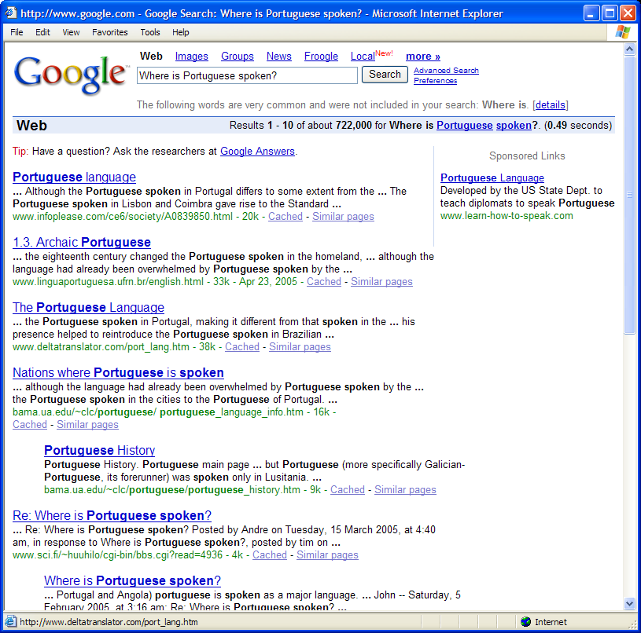
From this…
Where is Portuguese spoken?

Slide 8
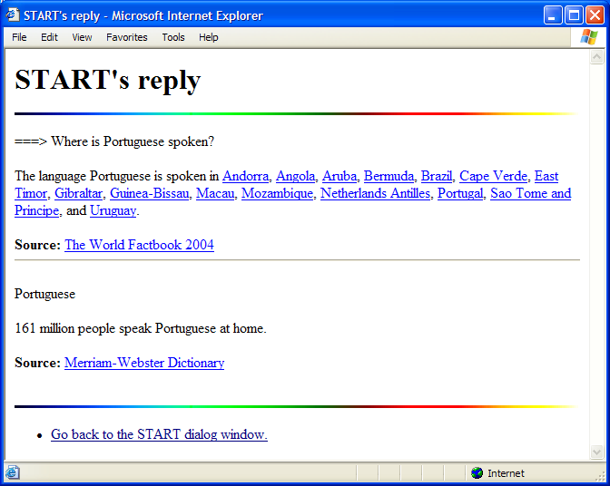
To this…
Where is Portuguese spoken?
http://start.csail.mit.edu/

Slide 9
Why is this better than Google?
Keywords cannot capture semantic constraints between query terms:
Document retrieval systems cannot fuse together information from multiple documents
“home run records”
Who holds the record for most home runs hit in a season?
Where is the home page for Run Records?
“Boston sublet”
I am looking for a room to sublet in Boston.
I have a room to sublet in Boston.
“Russia invade”
What countries have invaded Russia in the past?
What countries has Russia invaded in the past?

Slide 10
Who would benefit?
Sample target users of a QA system
Question answering fills an important niche in the broader information seeking environment
Journalists checking facts:
When did Mount Vesuvius last erupt?
Who was the president of Vichy France?
Analysts seeking specific information:
What is the maximum diving depth of a Kilo sub?
What’s the range of China’s newest ballistic missile?
School children doing homework:
What is the capital of Zimbabwe?
Where was John Wilkes Booth captured?

Slide 11
Roots of Question Answering
Information Retrieval (IR)
Information Extraction (IE)

Slide 12
Information Retrieval (IR)
Can substitute “document” for “information”
IR systems
  Use statistical methods
  Rely on frequency of words in query, document, collection
  Retrieve complete documents
  Return ranked lists of “hits” based on relevance
Limitations
  Answers questions indirectly
  Does not attempt to understand the “meaning” of user’s query or documents in the collection

Slide 13
Information Extraction (IE)
IE systems
  Identify documents of a specific type
  Extract information according to pre-defined templates
  Place the information into frame-like database records
Templates = pre-defined questions
Extracted information = answers
Limitations
  Templates are domain dependent and not easily portable
  One size does not fit all!
Weather disaster:
Type
Date
Location
Damage
Deaths
...

Slide 14
Basic Strategy for Factoid QA
Determine the semantic type of the expected answer
Retrieve documents that have keywords from the question
Look for named-entities of the proper type near keywords
“Who won the Nobel Peace Prize in 1991?” is looking for a PERSON
Retrieve documents that have the keywords “won”, “Nobel Peace Prize”, and “1991”
Look for a PERSON near the keywords “won”, “Nobel Peace Prize”, and “1991”

Slide 15
An Example
Who won the Nobel Peace Prize in 1991?
But many foreign investors remain sceptical, and western governments are withholding aid because of the Slorc's dismal human rights record and the continued detention of Ms Aung San Suu Kyi, the opposition leader who won the Nobel Peace Prize in 1991.
The military junta took power in 1988 as pro-democracy demonstrations were sweeping the country. It held elections in 1990, but has ignored their result. It has kept the 1991 Nobel peace prize winner, Aung San Suu Kyi - leader of the opposition party which won a landslide victory in the poll - under house arrest since July 1989.
The regime, which is also engaged in a battle with insurgents near its eastern border with Thailand, ignored a 1990 election victory by an opposition party and is detaining its leader, Ms Aung San Suu Kyi, who was awarded the 1991 Nobel Peace Prize. According to the British Red Cross, 5,000 or more refugees, mainly the elderly and women and children, are crossing into Bangladesh each day.

Slide 16
Generic QA Architecture
NL question
Question Analyzer
Text Retrieval
IR Query
Document Retriever
Answer Type
Documents
Passage Retriever
Passages
Answer Extractor
Named Entity Recognition
Answers

Slide 17
Question analysis
Question word cues
  Who → person, organization, location (e.g., city)
  When → date
  Where → location
  What/Why/How → ??
Head noun cues
  What city, which country, what year...
  Which astronaut, what blues band, ...
Scalar adjective cues
  How long, how fast, how far, how old, ...
Cues from verbs
  For example, win implies person or organization

Slide 18
Using WordNet
What is the service ceiling of an U-2?
length
NUMBER
wingspan
diameter
radius
altitude
ceiling

Slide 19
Extracting Named Entities
Person: Mr. Hubert J. Smith, Adm. McInnes, Grace Chan
Title: Chairman, Vice President of Technology, Secretary of State
Country: USSR, France, Haiti, Haitian Republic
City: New York, Rome, Paris, Birmingham, Seneca Falls
Province: Kansas, Yorkshire, Uttar Pradesh
Business: GTE Corporation, FreeMarkets Inc., Acme
University: Bryn Mawr College, University of Iowa
Organization: Red Cross, Boys and Girls Club

Slide 20
More Named Entities
Currency: 400 yen, $100, DM 450,000
Linear: 10 feet, 100 miles, 15 centimeters
Area: a square foot, 15 acres
Volume: 6 cubic feet, 100 gallons
Weight: 10 pounds, half a ton, 100 kilos
Duration: 10 day, five minutes, 3 years, a millennium
Frequency: daily, biannually, 5 times, 3 times a day
Speed: 6 miles per hour, 15 feet per second, 5 kph
Age: 3 weeks old, 10-year-old, 50 years of age

Slide 21
How do we extract NEs?
Heuristics and patterns
Fixed-lists (gazetteers)
Machine learning approaches

Slide 22
Indexing Named Entities
Why would we want to index named entities?
Index named entities as special tokens
And treat special tokens like query terms
Works pretty well for question answering
In reality, at the time of Edison’s 1879 patent, the light bulb
PERSON
DATE
had been in existence for some five decades ….
Who patented the light bulb?
patent light bulb PERSON
When was the light bulb patented?
patent light bulb DATE
John Prager, Eric Brown, and Anni Coden. (2000) Question-Answering by Predictive Annotation. Proceedings of SIGIR 2000.

Slide 23
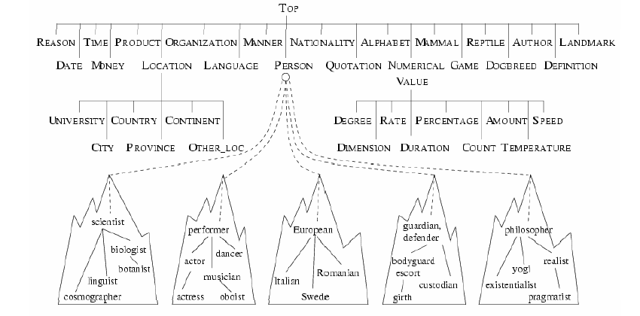
Answer Type Hierarchy

Slide 24
When things go awry…
Where do lobsters like to live?
  on a Canadian airline
Where do hyenas live?
  in Saudi Arabia
  in the back of pick-up trucks
Where are zebras most likely found?
  near dumps
  in the dictionary
Why can't ostriches fly?
  Because of American economic sanctions
What’s the population of Maryland?
  three

Slide 25
Question Answering… 2001
TREC QA Track: TREC-8 (1999), TREC-9 (2000)
  Formal evaluation of QA sponsored by NIST
  Answer unseen questions using a newspaper corpus
Question answering systems consisted of
  A named-entity detector…
  tacked on to a traditional document retrieval system
General architecture:
  Identify question type: person, location, date, etc.
  Get candidate documents from off-the-shelf IR engines
  Find named-entities of the correct type

Slide 26
Elaborate Ontologies
Falcon: SMU’s 2000 system in TREC:
  27 named entity categories
  15 top level nodes in answer type hierarchy
  Complex many-to-many mapping between entity types and answer type hierarchy
Webclopedia: ISI’s 2000 system TREC:
  Manually analyzed 17,384 questions
  QA typology with 94 total nodes, 47 leaf nodes
As conceived, question answering was an incredibly labor-intensive endeavor…
Is there a way to shortcut the knowledge engineering effort?

Slide 27
Just Another Corpus?
Is the Web just another corpus?
Can we simply apply traditional IR+NE-based question answering techniques on the Web?
Questions
Questions
?
Closed corpus
(e.g., news articles)
The Web
Answers
Answers

Slide 28
Not Just Another Corpus…
The Web is qualitatively different from a closed corpus
Many IR+NE-based question answering techniques are still effective
But we need a different set of techniques to capitalize on the Web as a document collection

Slide 29
Using the Web for QA
How big is the Web?
  Tens of terabytes? No agreed upon methodology on how to measure it
  Google indexes over 8 billion Web pages
How do we access the Web?
  Leverage existing search engines
Size gives rise to data redundancy
  Knowledge stated multiple times…
  in multiple documents
  in multiple formulations

Slide 30
Other Considerations
Poor quality of many individual pages
  Documents contain misspellings, incorrect grammar, wrong information, etc.
  Some Web pages aren’t even “documents” (tables, lists of items, etc.): not amenable to named-entity extraction or parsing
Heterogeneity
  Range in genre: encyclopedia articles vs. weblogs
  Range in objectivity: CNN articles vs. cult websites
  Range in document complexity: research journal papers vs. elementary school book reports

Slide 31
Leveraging Data Redundancy
Take advantage of different reformulations
  The expressiveness of natural language allows us to say the same thing in multiple ways
  This poses a problem for question answering
  With data redundancy, it is likely that answers will be stated in the same way the question was asked
Cope with poor document quality
  When many documents are analyzed, wrong answers become “noise”
Question asked in one way
How do we bridge these two?
Answer stated in another way
“Colorado was admitted to the Union on August 1, 1876.”
“When did Colorado become a state?”
“Colorado became a state on August 1, 1876”

Slide 32
Shortcutting NLP Challenges
Data Redundancy = Surrogate for sophisticated NLP
Obvious reformulations of questions can be easily found
Who killed Abraham Lincoln?
John Wilkes Booth killed Abraham Lincoln.
John Wilkes Booth altered history with a bullet. He will forever be known as the man who ended Abraham Lincoln’s life.
When did Wilt Chamberlain score 100 points?
Wilt Chamberlain scored 100 points on March 2, 1962 against the New York Knicks.
On December 8, 1961, Wilt Chamberlain scored 78 points in a triple overtime game. It was a new NBA record, but Warriors coach Frank McGuire didn’t expect it to last long, saying, “He’ll get 100 points someday.” McGuire’s prediction came true just a few months later in a game against the New York Knicks on March 2.

Slide 33
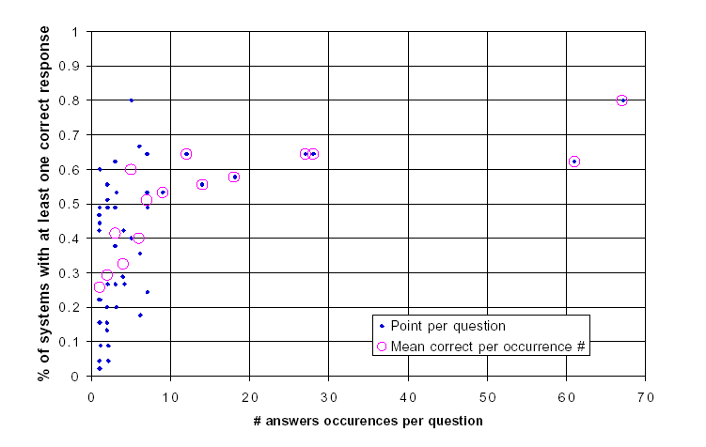
Effects of Data Redundancy
[Breck et al. 2001; Light et al. 2001]
Are questions with more answer occurrences “easier”? Examined the effect of answer occurrences on question answering performance (on TREC-8 results)
~27% of systems produced a correct answer for questions with 1 answer occurrence.
~50% of systems produced a correct answer for questions with 7 answer occurrences.

Slide 34
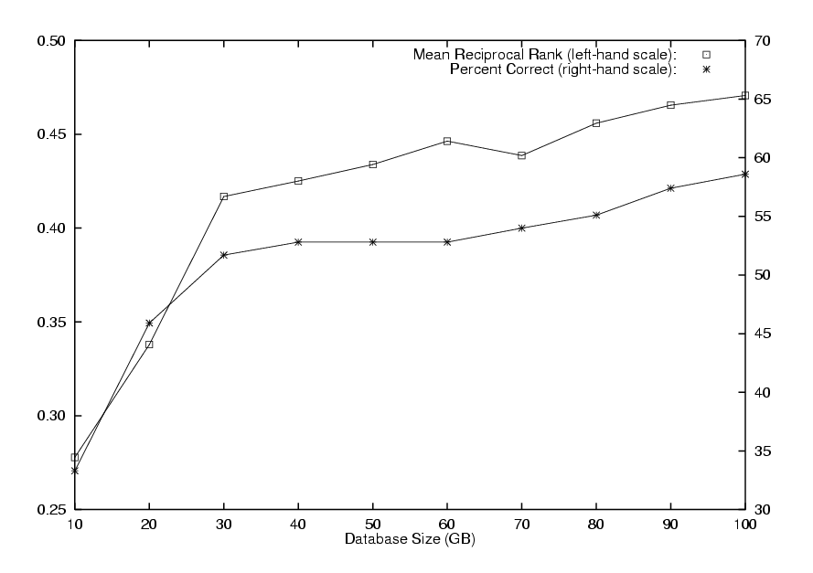
Effects of Data Redundancy
[Clarke et al. 2001a]
How does corpus size affect performance?
Selected 87 “people” questions from TREC-9; Tested effect of corpus size on passage retrieval algorithm (using 100GB TREC Web Corpus)
Conclusion: having more data improves performance

Slide 35
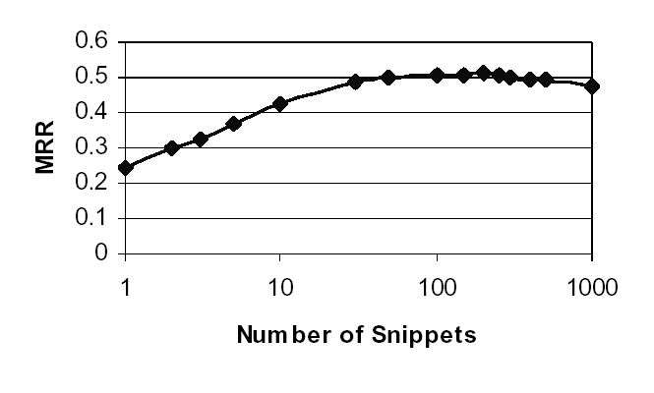
Effects of Data Redundancy
[Dumais et al. 2002]
How many search engine results should be used?
Plotted performance of a question answering system against the number of search engine snippets used
Performance drops as too many irrelevant results get returned
# Snippets | MRR
1 | 0.243
5 | 0.370
10 | 0.423
50 | 0.501
200 | 0.514
MRR as a function of number of snippets returned from the search engine. (TREC-9, q201-700)

Slide 36
Capitalizing on Search Engines
Data redundancy would be useless unless we could easily access all that data…
Leverage existing information retrieval infrastructure
  The engineering task of indexing and retrieving terabyte-sized document collections has been solved
Existing search engines are “good enough”
  Build systems on top of commercial search engines, e.g., Google, FAST, AltaVista, Teoma, etc.
[Brin and Page 1998]
Question
Analysis
Web
Search Engine
Results
Processing
Question
Answer

Slide 37
Redundancy-Based QA
Reformulate questions into surface patterns likely to contain the answer
Harvest “snippets” from Google
Generate n-grams from snippets
Compute candidate scores
“Compact” duplicate candidates
Apply appropriate type filters

Slide 38
Question Reformulation
Anticipate common ways of answering questions
Translate questions into surface patterns
  Apply simple pattern matching rules
Default to “bag of words” query if no reformulation can be found
When did the Mesozoic period end?
→ The Mesozoic period ended ?x
wh-word did … verb → … verb+ed

Slide 39
N-Gram Mining
Apply reformulated patterns to harvest snippets
Question: Who is Bill Gates married to?
Default:
?x can be up to 5 tokens
Bill Gates is married to ?x
... It is now the largest software company in the world. Today, Bill Gates is married
to co-worker Melinda French. They live together in a house in the Redmond ...
... I also found out that Bill Gates is married to Melinda French Gates and they have
a daughter named Jennifer Katharine Gates and a son named Rory John Gates. I ...
... of Microsoft, and they both developed Microsoft. * Presently Bill Gates is married
to Melinda French Gates. They have two children: a daughter, Jennifer, and a ...
Generate N-Grams from Google summary snippets (bypassing original Web pages)
co-worker, co-worker Melinda, co-worker Melinda French, Melinda,
Melinda French, Melinda French they, French, French they, French they live…

Slide 40
Refining Answer Candidates
Score candidates by frequency of occurrence and idf-values
Eliminate candidates that are substrings of longer candidates
Filter candidates by known question type
  What state … → answer must be a state
  What language … → answer must be a state
  How {fast, tall, far, …} → answer must be a number

Slide 41
What IS the answer?
Who is Bill Gates married to?
  Melinda French
  Microsoft
  Mary Maxwell

Slide 42
Evaluation Metrics
Mean Reciprocal Rank (MRR)
  Reciprocal rank = inverse of rank at which first correct answer was found: {1, 0.5, 0.33, 0.25, 0.2, 0}
  MRR = average over all questions
  Judgments: correct, unsupported, incorrect
Percentage wrong
  Fraction of questions judged incorrect
Correct: answer string answers the question in a “responsive” fashion and is supported by the document
Unsupported: answer string is correct but the document does not support the answer
Incorrect: answer string does not answer the question

Slide 43
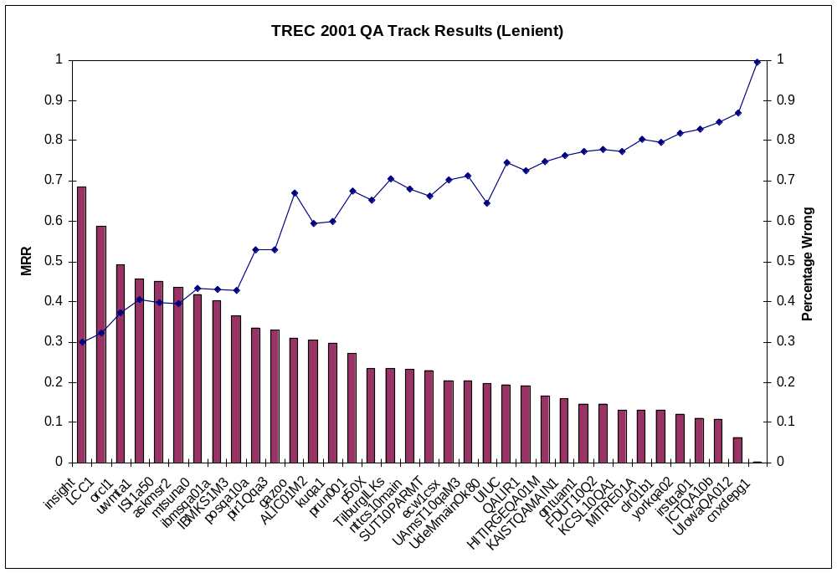
How well did it work?

Slide 44
Pattern Learning
[Ravichandran and Hovy 2002]
Automatically learn surface patterns for answering questions from the World Wide Web
BIRTHYEAR questions: When was <NAME> born?
<NAME> was born on <BIRTHYEAR>
<NAME> (<BIRTHYEAR>-
born in <BIRTHYEAR>, <NAME>
…
Start with a “seed”, e.g. (Mozart, 1756)
Download Web documents using a search engine
Retain sentences that contain both question and answer terms
Extract the longest matching substring that spans <QUESTION> and <ANSWER>
Calculate precision of patterns
  Precision for each pattern = # of patterns with correct answer / # of total patterns

Slide 45
Pattern Learning
Observations
  Surface patterns perform better on the Web than on the TREC corpus
  Surface patterns could benefit from notion of constituency, e.g., match not words but NPs, VPs, etc.
Example: DISCOVERER questions (Who discovered X?)
1.0 | when <ANSWER> discovered <NAME>
1.0 | <ANSWER>’s discovery of <NAME>
1.0 | <ANSWER>, the discoverer of <NAME>
1.0 | <ANSWER> discovers <NAME>
1.0 | <ANSWER> discover <NAME>
1.0 | <ANSWER> discovered <NAME>, the
1.0 | discovery of <NAME> by <ANSWER>
0.95 | <NAME> was discovered by <ANSWER>
0.91 | of <ANSWER>’s <NAME>
0.9 | <NAME> was discovered by <ANSWER> in

Slide 46
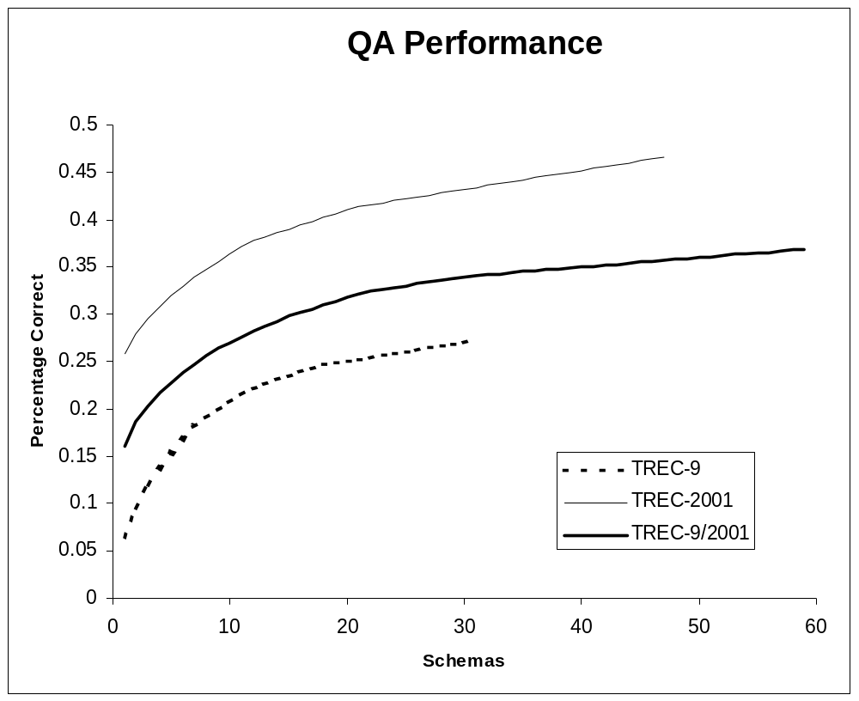
Zipf’s Law in TREC
Cumulative distribution of question types in the TREC test collections
Knowledge Coverage
Question Types
Ten question types alone account for ~20% of questions from TREC-9 and ~35% of questions from TREC-2001

Slide 47
The Big Picture
Start with structured or semistructured resources on the Web
Organize them to provide convenient methods for access
Connected these resources to a natural language front end

Slide 48
Sample Resources
Internet Movie Database
  Content: cast, crew, and other movie-related information
  Size: hundreds of thousands of movies; tens of thousands of actors/actresses
CIA World Factbook
  Content: geographic, political, demographic, and economic information
  Size: approximately two hundred countries/territories in the world
Biography.com
  Content: short biographies of famous people
  Size: tens of thousands of entries

Slide 49
“Zipf’s Law of QA”
Observation: a few “question types” account for a large portion of all question instances
  Similar questions can be parameterized and grouped into question classes, e.g.,
Mozart
Einstein
Gandhi
…
When was born?
state bird
state capital
state flower
…
Alabama
Alaska
Arizona
…
What is the of ?
the Eiffel Tower
the Statue of Liberty
Taj Mahal
…
Where is located?

Slide 50
Applying Zipf’s Law of QA
Observation: frequently occurring questions translate naturally into database queries
How can we organize Web data so that such “database queries” can be easily executed?
What is the population of x? x ∈ {country}
get population of x from World Factbook
When was x born? x ∈ {famous-person}
get birthdate of x from Biography.com

Slide 51
Slurp or Wrap?
Two general ways for accessing structured and semistructured Web resources
Wrap
  Also called “screen scraping”
  Provide programmatic access to Web resources (in essence, an API)
  Retrieve results dynamically by
    Imitating a CGI script
    Fetching a live HTML page
Slurp
  “Vacuum” out information from Web sources
  Restructure information in a local database

Slide 52
Tradeoffs: Wrapping
Advantages:
  Information is always up-to-date (even when the content of the original source changes)
  Dynamic information (e.g., stock quotes and weather reports) is easy to access
Disadvantages:
  Queries are limited in expressiveness
  Reliability issues: what if source goes down?
  Wrapper maintenance: what if source changes layout/format?
Queries limited by the CGI facilities offered by the website
Aggregate operations (e.g., max) are often impractical

Slide 53
Tradeoffs: Slurping
Advantages:
  Queries can be arbitrarily expressive
  Information is always available (high reliability)
Disadvantages:
  Stale data problem: what if the original source changes or is updated?
  Dynamic data problem: what if the information changes frequently? (e.g., stock quotes and weather reports)
  Resource limitations: what if there is simply too much data to store locally?
Allows retrieval of records based on different keys
Aggregate operations (e.g., max) are easy

Slide 54
Putting it together
Connecting natural language questions to structured and semistructured data
Natural Language System
structured
query
Semistructured Database
(slurp or wrap)
What is the population of x? x ∈ {country}
get population of x from CIA Factbook
When was x born? x ∈ {famous-person}
get birthdate of x from Biography.com

Slide 55
START and Omnibase
The first question answering system for the World Wide Web ⎯ online since 1993
biography.com
World Factbook
Merriam-Webster
POTUS
IMDb
NASA
etc.
START
structured
query
Omnibase
User Questions
World Wide Web
http://start.csail.mit.edu/

Slide 56
Omnibase: Overview
A “virtual” database that integrates structured and semistructured data sources
An abstraction layer over heterogeneous sources
Omnibase
Uniform Query Language
wrapper
wrapper
wrapper
wrapper
Web
Data Source
Web
Data Source
Web
Data Source
Local Database

Slide 57
Omnibase: OPV Model
The Object-Property-Value (OPV) data model
  Relational data model adopted for natural language
  Simple, yet pervasive
The “get” command:
Sources contain objects
Objects have properties
Properties have values
Many natural language questions can be analyzed as requests for the value of a property of an object
(get source object property) → value

Slide 58
Omnibase: OPV Examples
“What is the population of Taiwan?”
  Source: CIA World Factbook
  Object: Taiwan
  Property: Population
  Value: 22 million
“When was Andrew Johnson president?”
  Source: Internet Public Library
  Object: Andrew Johnson
  Property: Presidential term
  Value: April 15, 1865 to March 3, 1869

Slide 59
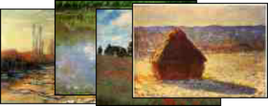
Omnibase: OPV Coverage
10 Web sources mapped into the Object-Property-Value data model cover 27% of the TREC-9 and 47% of the TREC-2001 QA Track questions
Question | Object | Property | Value
Who wrote the music for the Titanic? | Titanic | composer | John Williams
Who invented dynamite? | dynamite | inventor | Alfred Nobel
What languages are spoken in Guernsey? | Guernsey | languages | English, French
Show me paintings by Monet. | Monet | works

Slide 60
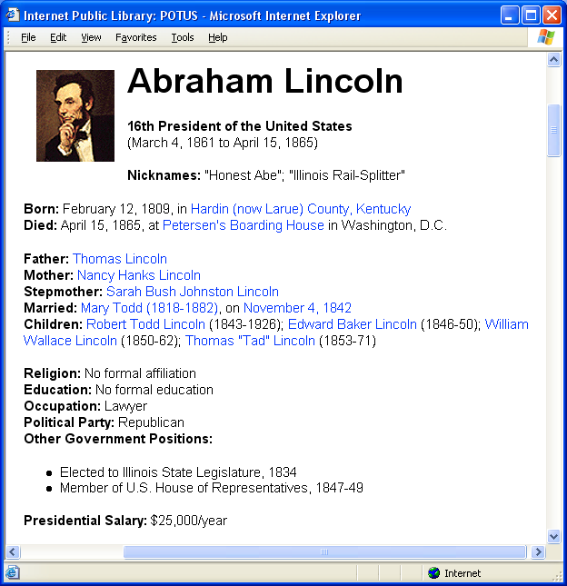
Omnibase: Wrappers
Omnibase Query
(get IPL “Abraham Lincoln” spouse)
Mary Todd (1818-1882), on November 4, 1842

Slide 61
Omnibase: Wrapper Operation
Generate URL
  Map symbols onto URL
Fetch Web page
Extract relevant information
  Search for textual landmarks that delimit desired information (usually with regular expressions)
Sometimes URLs can be computed directly from symbol
Sometimes the mapping must be stored locally
“Abraham Lincoln”
“Abe Lincoln”
“Lincoln”
http://www.ipl.org/div/potus/alincoln.html
<strong>Married: </strong>(.*)<br>
Relevant information

Slide 62
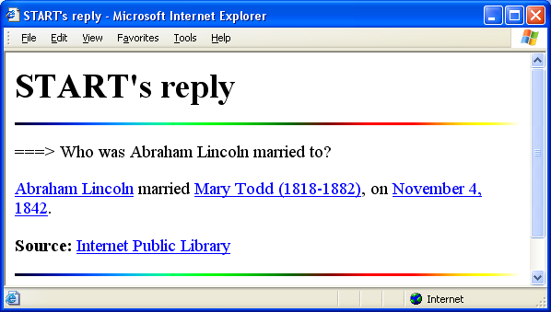
Connecting the Pieces

Slide 63
Advanced Question Answering
Move form “factoid” questions to more realistic question answering environments
My current direction of research: clinical question answering

Slide 64
Beyond Counting Words…
Information retrieval is based on counting words
Different ways of “bookkeeping”:
  Vector space
  Probabilistic
  Language modeling
Words alone aren’t enough to capture meaning
Retrieval of information:
  Should be performed at the conceptual level
  Should leverage knowledge about the information seeking process

Slide 65
What type of knowledge?
Knowledge about user tasks
  User intentions
  Why does the user need the information?
Knowledge about the problem structure
  The method for approaching a problem
  What information is needed?
Knowledge about the domain
  Background knowledge needed to understand the question and answers
  Relationships such as hypernymy and synonymy
Jimmy Lin and Dina Demner-Fushman. The Role of Knowledge in Conceptual Retrieval: A Study in the Domain of Clinical Medicine. Proceedings of SIGIR 2006.

Slide 66
Knowledge: User Tasks
Clinical tasks
  Therapy: Selecting effective treatments, taking into account other factors such as risk and cost
  Diagnosis: Selecting and interpreting diagnostic tests, while considering their precision, safety, cost, etc
  Prognosis: Estimating the patient’s likely course over time and anticipating likely complications
  Etiology: Identifying the causes for diseases
Considerations for strength of evidence
  Strength of Recommendations Taxonomy (SORT): three evidence grades
Knowledge about user tasks
Knowledge about problem structure
Knowledge about the domain

Slide 67
Knowledge: Problem Structure
EBM identifies four components of a question:
  Problem/Population
  Intervention
  Comparison
  Outcome
= PICO frame
What is the primary problem or disease? What are the characteristics of the patient (age, gender, etc.)?
What is the main intervention (e.g., a medication, a diagnostic test, or therapeutic procedure)?
What is the main intervention compared to (e.g., another drug, a placebo)?
What is the effect of the intervention? Were the patient's symptoms relieved or eliminated?
Knowledge about user tasks
Knowledge about problem structure
Knowledge about the domain

Slide 68
Knowledge: Problem Structure
Population/Problem: children/acute febrile illness
Intervention: acetaminophen
Comparison: ibuprofen
Outcome: reducing fever
“In children with an acute febrile illness, what is the efficacy of single-medication therapy with acetaminophen or ibuprofen in reducing fever?”
Knowledge about user tasks
Knowledge about problem structure
Knowledge about the domain

Slide 69
Knowledge: Domain
The Unified Medical Language System (UMLS)
  2004 version: > 1 million biomedical concepts, > 5 million concept names
  Semantic groups provide higher-level generalizations
Software for leveraging this resource:
  MetaMap for identifying concepts
  SemRep for identifying relations
Knowledge about user tasks
Knowledge about problem structure
Knowledge about the domain

Slide 70
Matching PICO frames
Question:
In children with an acute febrile illness, what is the efficacy of single-medication therapy with acetaminophen or ibuprofen in reducing fever?
Task therapy
P children/acute febrile illness
I acetaminophen
C ibuprofen
O reducing fever
Answer:
Ibuprofen provided greater temperature decrement and longer duration of antipyresis than acetaminophen when the two drugs were administered in approximately equal doses.
P children/acute febrile illness
I acetaminophen
C ibuprofen
O reducing fever
MEDLINE

Slide 71
Knowledge Extraction Example
Antipyretic efficacy of ibuprofen vs acetaminophen.
OBJECTIVE--To compare the antipyretic efficacy of ibuprofen, placebo, and acetaminophen. DESIGN--Double-dummy, double-blind, randomized, placebo-controlled trial. SETTING--Emergency department and inpatient units of a large, metropolitan, university-based, children's hospital in Michigan. PARTICIPANTS--37 otherwise healthy children aged 2 to 12 years with acute, intercurrent, febrile illness. INTERVENTIONS--Each child was randomly assigned to receive a single dose of acetaminophen (10 mg/kg), ibuprofen (7.5 or 10 mg/kg), or placebo. MEASUREMENTS/MAIN RESULTS--Oral temperature was measured before dosing, 30 minutes after dosing, and hourly thereafter for 8 hours after the dose. Patients were monitored for adverse effects during the study and 24 hours after administration of the assigned drug. All three active treatments produced significant antipyresis compared with placebo. Ibuprofen provided greater temperature decrement and longer duration of antipyresis than acetaminophen when the two drugs were administered in approximately equal doses. No adverse effects were observed in any treatment group. CONCLUSION--Ibuprofen is a potent antipyretic agent and is a safe alternative for the selected febrile child who may benefit from antipyretic medication but who either cannot take or does not achieve satisfactory antipyresis with acetaminophen.
Am J Dis Child. 1992 May; 146(5):622-5
Antipyretic efficacy of ibuprofen vs acetaminophen.
OBJECTIVE--To compare the antipyretic efficacy of ibuprofen, placebo, and acetaminophen. DESIGN--Double-dummy, double-blind, randomized, placebo-controlled trial. SETTING--Emergency department and inpatient units of a large, metropolitan, university-based, children's hospital in Michigan. PARTICIPANTS--37 otherwise healthy children aged 2 to 12 years with acute, intercurrent, febrile illness. INTERVENTIONS--Each child was randomly assigned to receive a single dose of acetaminophen (10 mg/kg), ibuprofen (7.5 or 10 mg/kg), or placebo. MEASUREMENTS/MAIN RESULTS--Oral temperature was measured before dosing, 30 minutes after dosing, and hourly thereafter for 8 hours after the dose. Patients were monitored for adverse effects during the study and 24 hours after administration of the assigned drug. All three active treatments produced significant antipyresis compared with placebo. Ibuprofen provided greater temperature decrement and longer duration of antipyresis than acetaminophen when the two drugs were administered in approximately equal doses. No adverse effects were observed in any treatment group. CONCLUSION--Ibuprofen is a potent antipyretic agent and is a safe alternative for the selected febrile child who may benefit from antipyretic medication but who either cannot take or does not achieve satisfactory antipyresis with acetaminophen.
Am J Dis Child. 1992 May; 146(5):622-5
Population Problem Interventions Outcome

Slide 72
Knowledge Extractors
Antipyretic efficacy of ibuprofen vs acetaminophen.
OBJECTIVE--To compare the antipyretic efficacy of ibuprofen, placebo, and acetaminophen. DESIGN--Double-dummy, double-blind, randomized, placebo-controlled trial. SETTING--Emergency department and inpatient units of a large, metropolitan, university-based, children's hospital in Michigan. PARTICIPANTS--37 otherwise healthy children aged 2 to 12 years with acute, intercurrent, febrile illness. INTERVENTIONS--Each child was randomly assigned to receive a single dose of acetaminophen (10 mg/kg), ibuprofen (7.5 or 10 mg/kg), or placebo. MEASUREMENTS/MAIN RESULTS--Oral temperature was measured before dosing, 30 minutes after dosing, and hourly thereafter for 8 hours after the dose. Patients were monitored for adverse effects during the study and 24 hours after administration of the assigned drug. All three active treatments produced significant antipyresis compared with placebo. Ibuprofen provided greater temperature decrement and longer duration of antipyresis than acetaminophen when the two drugs were administered in approximately equal doses. No adverse effects were observed in any treatment group. CONCLUSION--Ibuprofen is a potent antipyretic agent and is a safe alternative for the selected febrile child who may benefit from antipyretic medication but who either cannot take or does not achieve satisfactory antipyresis with acetaminophen.
Am J Dis Child. 1992 May; 146(5):622-5
Problem
Population
Intervention
Outcome
?
?
?
?
90% 5% 5%
80% 13% 7%
80% 0% 20%
95% 0% 5%
Dina Demner-Fushman and Jimmy Lin. Knowledge Extraction for Clinical Question Answering: Preliminary Results. Proceedings of the AAAI-05 Workshop on Question Answering in Restricted Domains, 2005.

Slide 73
Overall Architecture
Clinical Question
Knowledge
Extractor
(for questions)
search query
clinical task and
PICO elements
PubMed
UMLS
Evidence-Based
Medicine
Semantic
Matcher
Answer
Generator
MetaMap/SemRep
Knowledge
Extractor
(for abstracts)
MEDLINE
abstracts
PICO elements
Answer

Slide 74
Citation Reranking Experiment
Question: What is the best treatment for analgesic rebound headaches?
(((“analgesics”[TIAB] NOTMedline[SB]) OR “analgesics”[MeSH Terms] OR “analgesics”[Pharmacological Action] OR analgesic[TextWord]) AND ((“headache”[TIAB] NOT Medline[SB]) OR “headache”[MeSH Terms] OR headaches[TextWord]) AND (“adverse effects”[Subheading] OR side effects[Text Word])) AND hasabstract[text] AND English[Lang] AND “humans”[MeSH Terms]
Clinical task,
PICO frame
Knowledge
Extractor
Semantic
Matcher
MEDLINE
How much is this list better?

Slide 75
Experimental Results
We created a test collection comprised of 50 realistic clinical questions
Performance on held-out blind test set:
 | Therapy | Diagnosis | Prognosis | Etiology | All
Precision at 10 (P@10)
PubMed | .350 | .150 | .200 | .320 | .281
EBM | .792 (+126%) | .567 (+278%) | .433 (+117%) | .640 (+100%) | .669 (+97%)
Mean Average Precision (MAP)
PubMed | .421 | .279 | .235 | .364 | .356
EBM | .775 (+84%) | .657 (+135%) | .715 (+204%) | .681 (+87%) | .723 (+103%)
Jimmy Lin and Dina Demner-Fushman. The Role of Knowledge in Conceptual Retrieval: A Study in the Domain of Clinical Medicine. Proceedings of SIGIR 2006.

Slide 76
Multiple Approaches to QA
Employ answer type ontologies (IR+IE)
Leverage Web redundancy
Leverage semi-structured data sources
Semantically model restricted domains for “conceptual retrieval”

