Slide 1

LBSC 796/INFM 718R: Week 2
Evaluation
Jimmy Lin
College of Information Studies
University of Maryland
Monday, February 6, 2006

Slide 2
IR is an experimental science!
Formulate a research question: the hypothesis
Design an experiment to answer the question
Perform the experiment
  Compare with a baseline “control”
Does the experiment answer the question?
  Are the results significant? Or is it just luck?
Report the results!
Rinse, repeat…
Notes:
IR isn’t very different from other fields we think of as “experimental”, e.g., a chemist in the lab mixing bubbling test tubes

Slide 3
Questions About the Black Box
Example “questions”:
  Does morphological analysis improve retrieval performance?
  Does expanding the query with synonyms improve retrieval performance?
Corresponding experiments:
  Build a “stemmed” index and compare against “unstemmed” baseline
  Expand queries with synonyms and compare against baseline unexpanded queries

Slide 4
Questions That Involve Users
Example “questions”:
  Does keyword highlighting help users evaluate document relevance?
  Is letting users weight search terms a good idea?
Corresponding experiments:
  Build two different interfaces, one with keyword highlighting, one without; run a user study
  Build two different interfaces, one with term weighting functionality, and one without; run a user study

Slide 5
The Importance of Evaluation
The ability to measure differences underlies experimental science
  How well do our systems work?
  Is A better than B?
  Is it really?
  Under what conditions?
Evaluation drives what to research
  Identify techniques that work and don’t work
  Formative vs. summative evaluations

Slide 6
Desiderata for Evaluations
Insightful
Affordable
Repeatable
Explainable

Slide 7
Summary
Qualitative user studies suggest what to build
Decomposition breaks larger tasks into smaller components
Automated evaluation helps to refine components
Quantitative user studies show how well everything works together

Slide 8
Outline
Evaluating the IR black box
  How do we conduct experiments with reusable test collections?
  What exactly do we measure?
  Where do these test collections come from?
Studying the user and the system
  What sorts of (different) things do we measure when a human is in the loop?
Coming up with the right questions
  How do we know what to evaluate and study?

Slide 9
Types of Evaluation Strategies
System-centered studies
  Given documents, queries, and relevance judgments
  Try several variations of the system
  Measure which system returns the “best” hit list
User-centered studies
  Given several users, and at least two retrieval systems
  Have each user try the same task on both systems
  Measure which system works the “best”

Slide 10
Evaluation Criteria
Effectiveness
  How “good” are the documents that are returned?
  System only, human + system
Efficiency
  Retrieval time, indexing time, index size
Usability
  Learnability, frustration
  Novice vs. expert users

Slide 11
Good Effectiveness Measures
Should capture some aspect of what the user wants
  That is, the measure should be meaningful
Should have predictive value for other situations
  What happens with different queries on a different document collection?
Should be easily replicated by other researchers
Should be easily comparable
  Optimally, expressed as a single number

Slide 12
The Notion of Relevance
IR systems essentially facilitate communication between a user and document collections
Relevance is a measure of the effectiveness of communication
  Logic and philosophy present other approaches
Relevance is a relation… but between what?
Notes:
The goal of an IR system is to fetch good documents.
When we talk about how good a document is, we’re really talking about the notion of relevance.

Slide 13
What is relevance?
Relevance is the
measure
degree
dimension
estimate
appraisal
relation
of a
correspondence
utility
connection
satisfaction
fit
bearing
matching
existing between a
document
article
textual form
reference
information provided
fact
and a
query
request
information used
point of view
information need statement
as determined by
person
judge
user
requester
Information specialist
Does this help?
Tefko Saracevic. (1975) Relevance: A Review of and a Framework for Thinking on the Notion in Information Science. Journal of the American Society for Information Science, 26(6), 321-343;

Slide 14
Mizzaro’s Model of Relevance
Four dimensions of relevance
Dimension 1: Information Resources
  Information
  Document
  Surrogate
Dimension 2: Representation of User Problem
  Real information needs (RIN) = visceral need
  Perceived information needs (PIN) = conscious need
  Request = formalized need
  Query = compromised need
Stefano Mizzaro. (1999) How Many Relevances in Information Retrieval? Interacting With Computers, 10(3), 305-322.

Slide 15
Time and Relevance
Dimension 3: Time
RIN₀
PIN₀
…
PIN_{m}
r₀
r₁
r_{n}
q₀
q₁
q₂
q₃
q_{r}

Slide 16
Components and Relevance
Dimension 4: Components
  Topic
  Task
  Context

Slide 17
What are we after?
Ultimately, relevance of the information
  With respect to the real information need
  At the conclusion of the information seeking process
  Taking into consideration topic, task, and context
In system-based evaluations, what do we settle for?
Rel( Information, RIN, t(f), {Topic, Task, Context} )
Rel( surrogate, request, t(0), Topic )
Rel( document, request, t(0), Topic )

Slide 18
Evaluating the Black Box
Query
Search
Ranked List

Slide 19
Evolution of the Evaluation
Evaluation by inspection of examples
Evaluation by demonstration
Evaluation by improvised demonstration
Evaluation on data using a figure of merit
Evaluation on test data
Evaluation on common test data
Evaluation on common, unseen test data
Notes:
A bit of evaluation history

Slide 20
Automatic Evaluation Model
Query
Documents
IR Black Box
Ranked List
Evaluation
Module
Relevance Judgments
Measure of Effectiveness
These are the four things we need!

Slide 21
Test Collections
Reusable test collections consist of:
  Collection of documents
    Should be “representative”
    Things to consider: size, sources, genre, topics, …
  Sample of information needs
    Should be “randomized” and “representative”
    Usually formalized topic statements
  Known relevance judgments
    Assessed by humans, for each topic-document pair (topic, not query!)
    Binary judgments make evaluation easier
Measure of effectiveness
  Usually a numeric score for quantifying “performance”
  Used to compare different systems
Notes:
For now, let’s assume we have the test collection already.

Slide 22
Which is the Best Rank Order?
A.
B.
C.
D.
E.
F.
= relevant document

Slide 23
Set-Based Measures
Precision = A ÷ (A+B)
Recall = A ÷ (A+C)
Miss = C ÷ (A+C)
False alarm (fallout) = B ÷ (B+D)
 | Relevant | Not relevant
Retrieved | A | B
Not retrieved | C | D
Collection size = A+B+C+D
Relevant = A+C
Retrieved = A+B
When is precision important?
When is recall important?

Slide 24
Another View
Space of all documents
Relevant
Relevant +
Retrieved
Retrieved
Not Relevant + Not Retrieved

Slide 25
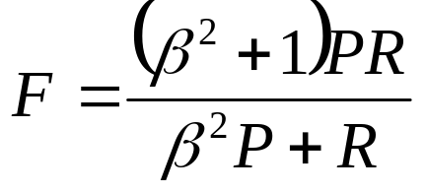
F-Measure
Harmonic mean of recall and precision
Beta controls relative importance of precision and recall
  Beta = 1, precision and recall equally important
  Beta = 5, recall five times more important than precision
What if no relevant documents exist?

Slide 26
Single-Valued Measures
Precision at a fixed number of documents
  Precision at 10 docs is often useful for Web search
R-precision
  Precision at r documents, where r is the total number of relevant documents
Expected search length
  Average rank of the first relevant document
How do we take into account the relationship between precision and recall?
Notes:
Here are some other single-valued measures.

Slide 27
Measuring Precision and Recall
Assume there are a total of 14 relevant documents
Hits 1-10
Precision
1/1
1/2
1/3
1/4
2/5
3/6
3/7
4/8
4/9
4/10
Recall
1/14
1/14
1/14
1/14
2/14
3/14
3/14
4/14
4/14
4/14
Hits 11-20
Precision
5/11
5/12
5/13
5/14
5/15
6/16
6/17
6/18
6/19
4/20
Recall
5/14
5/14
5/14
5/14
5/14
6/14
6/14
6/14
6/14
6/14
= relevant document

Slide 28
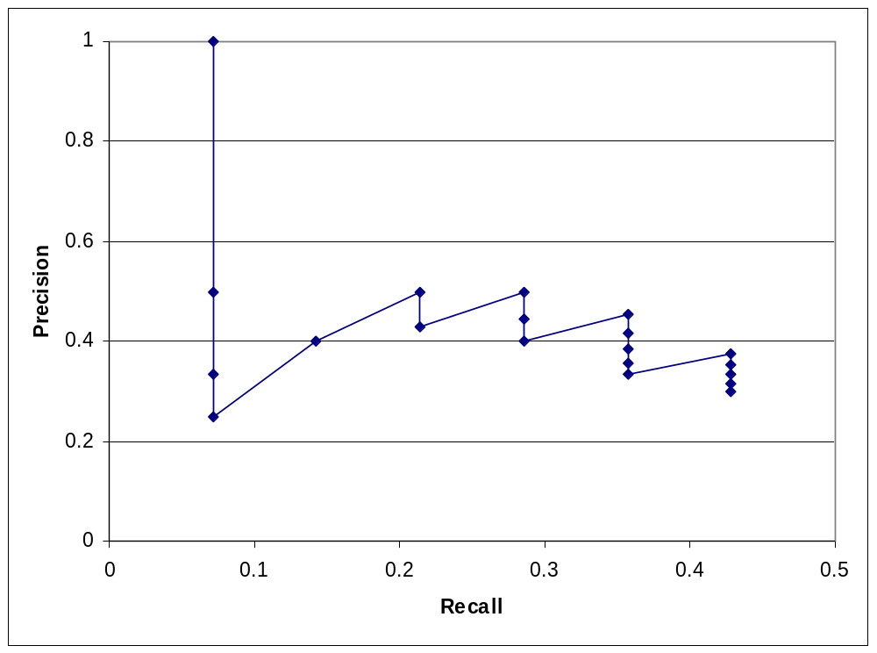
Graphing Precision and Recall
Plot each (recall, precision) point on a graph
Visually represent the precision/recall tradeoff

Slide 29
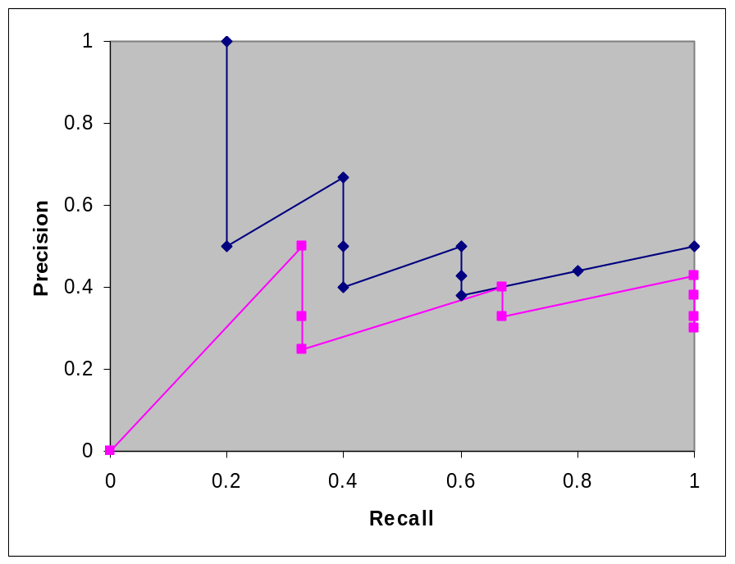
Need for Interpolation
Two issues:
  How do you compare performance across queries?
  Is the sawtooth shape intuitive of what’s going on?
Solution: Interpolation!

Slide 30
Interpolation
Why?
  We have no observed data between the data points
  Strange sawtooth shape doesn’t make sense
It is an empirical fact that on average as recall increases, precision decreases
Interpolate at 11 standard recall levels
  100%, 90%, 80%, … 30%, 20%, 10%, 0% (!)
How?
where S is the set of all observed (P,R) points

Slide 31
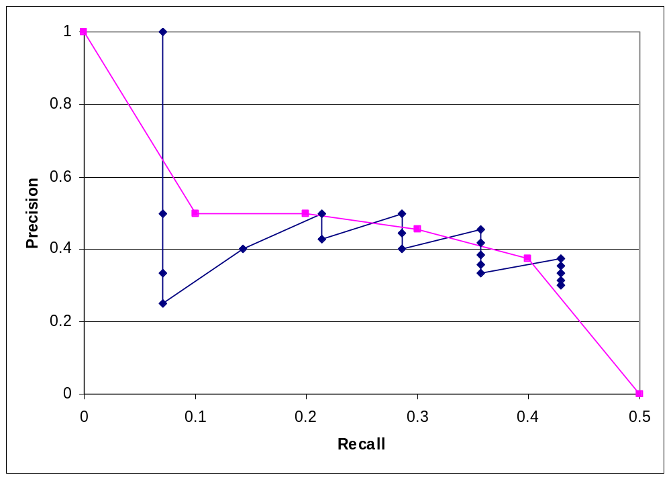
Result of Interpolation
We can also average precision across the 11 standard recall levels

Slide 32
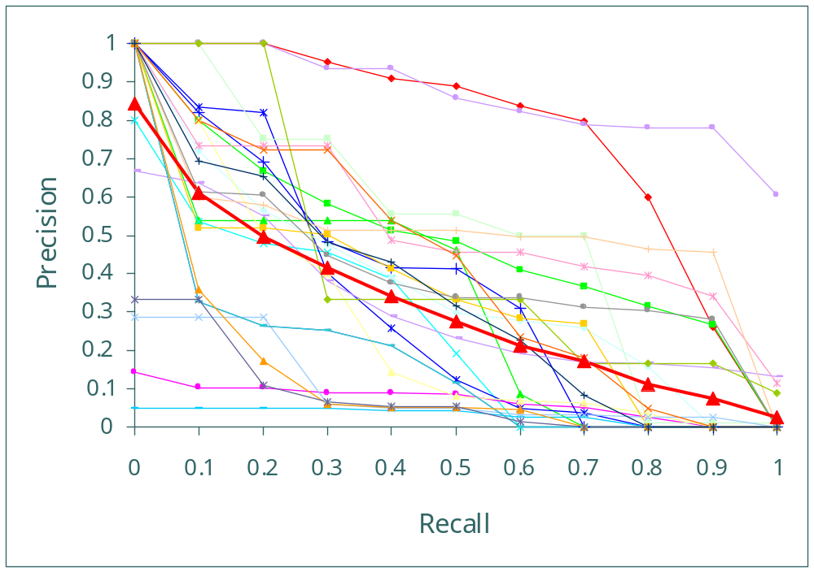
How do we compare curves?
Adapted from a presentation by Ellen Voorhees at the University of Maryland, March 29, 1999

Slide 33
The MOAM
Mean average precision (MAP)
  Average of precision at each retrieved relevant document
  Relevant documents not retrieved contribute zero to score
Hits 1-10
Precision
1/1
1/2
1/3
1/4
2/5
3/6
3/7
4/8
4/9
4/10
Hits 11-20
Precision
5/11
5/12
5/13
5/14
5/15
6/16
6/17
6/18
6/19
4/20
Assume total of 14 relevant documents: 8 relevant documents not retrieved contribute eight zeros
MAP = .2307
= relevant document

Slide 34
Building Test Collections
Where do test collections come from?
  Someone goes out and builds them (expensive)
  As the byproduct of large scale evaluations
TREC = Text REtrieval Conferences
  Sponsored by NIST
  Series of annual evaluations, started in 1992
  Organized into “tracks”
  Larger tracks may draw a few dozen participants
See proceedings online at http://trec.nist.gov/
Notes:
Thus far, we’ve assumed the existence of these wonderful packages called test collections…
Where do they come from?

Slide 35
Ad Hoc Topics
In TREC, a statement of information need is called a topic
Title: Health and Computer Terminals
Description: Is it hazardous to the health of individuals to work with computer terminals on a daily basis?
Narrative: Relevant documents would contain any information that expands on any physical disorder/problems that may be associated with the daily working with computer terminals. Such things as carpel tunnel, cataracts, and fatigue have been said to be associated, but how widespread are these or other problems and what is being done to alleviate any health problems.

Slide 36
Obtaining Judgments
Exhaustive assessment is usually impractical
  TREC has 50 queries
  Collection has >1 million documents
Random sampling won’t work
  If relevant docs are rare, none may be found!
IR systems can help focus the sample
  Each system finds some relevant documents
  Different systems find different relevant documents
  Together, enough systems will find most of them
  Leverages cooperative evaluations

Slide 37
Pooling Methodology
Systems submit top 1000 documents per topic
Top 100 documents from each are judged
  Single pool, duplicates removed, arbitrary order
  Judged by the person who developed the topic
Treat unevaluated documents as not relevant
Compute MAP down to 1000 documents
To make pooling work:
  Systems must do reasonable well
  Systems must not all “do the same thing”
Gather topics and relevance judgments to create a reusable test collection

Slide 38
Does pooling work?
But judgments can’t possibly be exhaustive!
But this is only one person’s opinion about relevance
But what about hits 101 to 1000?
But we can’t possibly use judgments to evaluate a system that didn’t participate in the evaluation!
It doesn’t matter: relative rankings remain the same!
Chris Buckley and Ellen M. Voorhees. (2004) Retrieval Evaluation with Incomplete Information. SIGIR 2004.
It doesn’t matter: relative rankings remain the same!
Ellen Voorhees. (1998) Variations in Relevance Judgments and the Measurement of Retrieval Effectiveness. SIGIR 1998.
It doesn’t matter: relative rankings remain the same!
Actually, we can!
Justin Zobel. (1998) How Reliable Are the Results of Large-Scale Information Retrieval Experiments? SIGIR 1998.

Slide 39
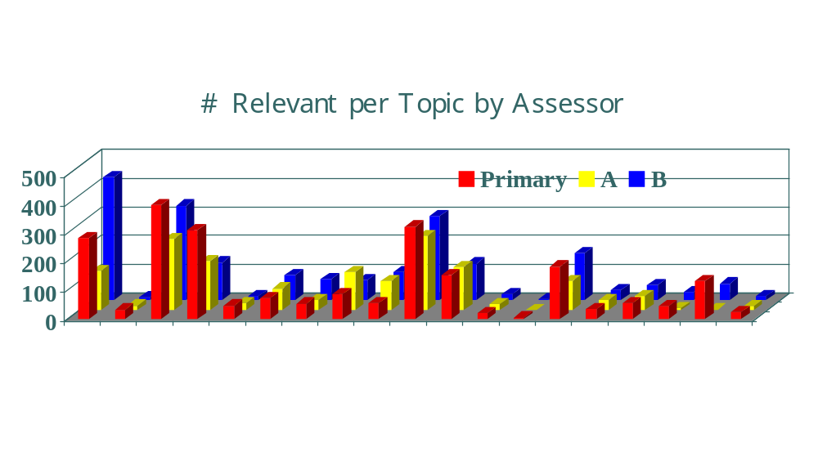
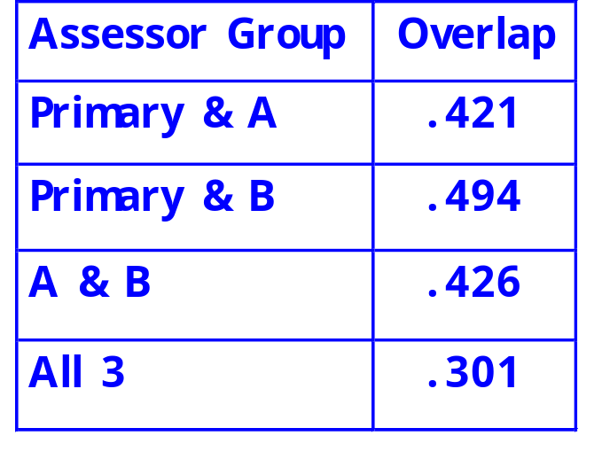
Agreement on Relevance
Adapted from a presentation by Ellen Voorhees at the University of Maryland, March 29, 1999

Slide 40
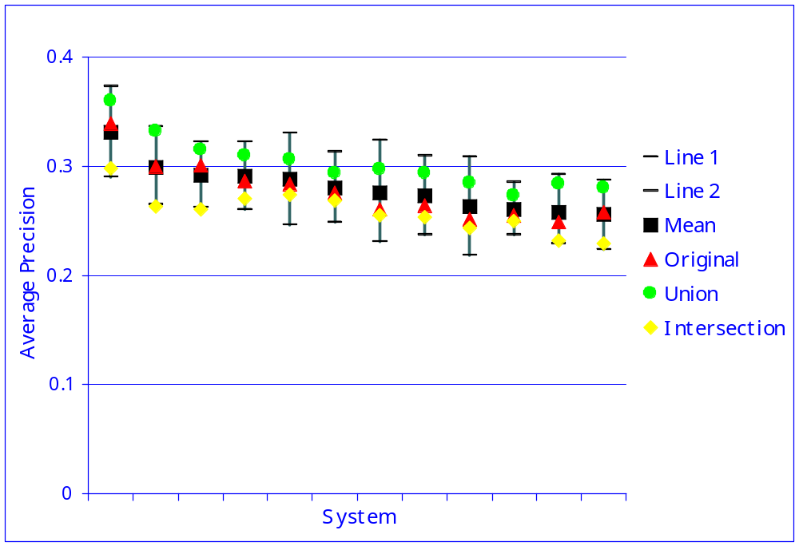
Effect of Different Judgments
Adapted from a presentation by Ellen Voorhees at the University of Maryland, March 29, 1999

Slide 41
Lessons From TREC
Absolute scores are not trustworthy
  Who’s doing the relevance judgment?
  How complete are the judgments?
Relative rankings are stable
  Comparative conclusions are most valuable
Cooperative evaluations produce reliable test collections
Evaluation technology is predictive

Slide 42
Alternative Methods
Search-guided relevance assessment
  Iterate between topic research/search/assessment
Known-item judgments have the lowest cost
  Tailor queries to retrieve a single known document
  Useful as a first cut to see if a new technique is viable

Slide 43
Why significance tests?
System A and B identical on all but one query:
  Is it just a lucky query for System A?
  Need A to beat B frequently to believe it is really better
  Need as many queries as possible
System A beats system B on every query:
  But only does so by 0.00001%
  Does that mean much?
Significance tests consider those issues
  What’s a p-value?
Empirical research suggests 25 is minimum needed
TREC tracks generally aim for at least 50 queries
Notes:
The urn metaphor
Are you drawing balls from the same urn?

Slide 44
Averages Can Deceive
Experiment 1
Experiment 2
Query
System A
System B
Query
System A
System B
1
2
3
4
5
6
7
0.20
0.21
0.22
0.19
0.17
0.20
0.21
0.40
0.41
0.42
0.39
0.37
0.40
0.41
1
2
3
4
5
6
7
0.02
0.39
0.16
0.58
0.04
0.09
0.12
0.76
0.07
0.37
0.21
0.02
0.91
0.46
Average
0.20
0.40
Average
0.20
0.40

Slide 45
How Much is Enough?
Measuring improvement
  Achieve a meaningful improvement
  Achieve reliable improvement on “typical” queries
Know when to stop!
  Inter-assessor agreement places a limit on human performance
Guideline: 0.05 is noticeable, 0.1 makes a difference (in MAP)
Wilcoxon signed rank test for paired samples

Slide 46
The Evaluation Commandments
Thou shalt define insightful evaluation metrics
Thou shalt define replicable evaluation metrics
Thou shalt report all relevant system parameters
Thou shalt establish upper bounds on performance
Thou shalt establish lower bounds on performance

Slide 47
The Evaluation Commandments
Thou shalt test differences for statistical significance
Thou shalt say whether differences are meaningful
Thou shalt not mingle training data with test data
Thou shalt not mingle training data with test data
Thou shalt not mingle training data with test data

Slide 48
Recap: Automatic Evaluation
Test collections abstract the evaluation problem
  Places focus on the IR black box
Automatic evaluation is one shot
  Ignores the richness of human interaction
Evaluation measures focus on one notion of performance
  But users care about other things
Goal is to compare systems
  Values may vary, but relative differences are stable
Mean values obscure important phenomena
  Augment with failure analysis and significance tests

Slide 49
Putting the User in the Loop
Resource
Query
Formulation
Query
Search
Ranked List
Selection
Documents
System discovery
Vocabulary discovery
Concept discovery
Document discovery
Examination
Documents

Slide 50
User Studies
Goal is to account for interaction
  By studying the interface component
  By studying the complete system
Two different types of evaluation
  Formative: provides a basis for system development
  Summative: designed to assess performance

Slide 51
Quantitative User Studies
Select independent variable(s)
  e.g., what info to display in selection interface
Select dependent variable(s)
  e.g., time to find a known relevant document
Run subjects in different orders
  Average out learning and fatigue effects
Compute statistical significance

Slide 52
Additional Effects to Consider
Learning
  Vary topic presentation order
Fatigue
  Vary system presentation order
Expertise
  Ask about prior knowledge of each topic

Slide 53
Blair and Maron (1985)
A classic study of retrieval effectiveness
  Earlier studies were on unrealistically small collections
Studied an archive of documents for a law suit
  40,000 documents, ~350,000 pages of text
  40 different queries
  Used IBM’s STAIRS full-text system
Approach:
  Lawyers stipulated that they must be able to retrieve at least 75% of all relevant documents
  Search facilitated by paralegals
  Precision and recall evaluated only after the lawyers were satisfied with the results
David C. Blair and M. E. Maron. (1984) An Evaluation of Retrieval Effectiveness for a Full-Text Document-Retrieval System. Communications of the ACM, 28(3), 289--299.

Slide 54
Blair and Maron’s Results
Average precision: 79%
Average recall: 20% (!!)
Why recall was low?
  Users can’t anticipate terms used in relevant documents
  Differing technical terminology
  Slang, misspellings
Other findings:
  Searches by both lawyers had similar performance
  Lawyer’s recall was not much different from paralegal’s
“accident” might be referred to as “event”, “incident”, “situation”, “problem,” …

Slide 55
Batch vs. User Evaluations
Do batch (black box) and user evaluations give the same results? If not, why?
Two different tasks:
  Instance recall (6 topics)
  Question answering (8 topics)
What countries import Cuban sugar?
What tropical storms, hurricanes, and typhoons have caused property damage or loss of life?
Which painting did Edvard Munch complete first, “Vampire” or “Puberty”?
Is Denmark larger or smaller in population than Norway?
Andrew Turpin and William Hersh. (2001) Why Batch and User Evaluations Do No Give the Same Results. Proceedings of SIGIR 2001.

Slide 56
The Study
Compared of two systems:
  a baseline system
  an improved system that was provably better in batch evaluations
Results:
 | Instance Recall |  | Question Answering
 | Batch MAP | User recall | Batch MAP | User accuracy
Baseline | 0.2753 | 0.3230 | 0.2696 | 66%
Improved | 0.3239 | 0.3728 | 0.3544 | 60%
Change | +18% | +15% | +32% | -6%
p-value (paired t-test) | 0.24 | 0.27 | 0.06 | 0.41

Slide 57
Analysis
A “better” IR black box doesn’t necessary lead to “better” end-to-end performance!
Why?
Are we measuring the right things?

Slide 58
Qualitative User Studies
How do we discover the right research questions to ask?
Observe user behavior
  Instrumented software, eye trackers, etc.
  Face and keyboard cameras
  Think-aloud protocols
  Interviews and focus groups
Organize the data
Look for patterns and themes
Develop a “grounded theory”

Slide 59
Questionnaires
Demographic data
  Age, education, computer experience, etc.
  Basis for interpreting results
Subjective self-assessment
  Which system did they think was more effective?
  Often at variance with objective results!
Preference
  Which system did they prefer? Why?

Slide 60
Summary
Qualitative user studies suggest what to build
Decomposition breaks larger tasks into smaller components
Automated evaluation helps to refine components
Quantitative user studies show how well everything works together

Slide 61
One Minute Paper
What was the muddiest point in today’s class?

