Slide 1

LBSC 796/INFM 718R: Week 3
Boolean and Vector Space Models
Jimmy Lin
College of Information Studies
University of Maryland
Monday, February 13, 2006

Slide 2
Muddy Points
Statistics, significance tests
Precision-recall curve, interpolation
MAP
Math, math, and more math!
Reading the book

Slide 3
The Information Retrieval Cycle
Source
Selection
Resource
Query
Formulation
Query
Search
Ranked List
Selection
Documents
System discovery
Vocabulary discovery
Concept discovery
Document discovery
Examination
Documents
source reselection
Delivery

Slide 4
What is a model?
A model is a construct designed help us understand a complex system
  A particular way of “looking at things”
Models inevitably make simplifying assumptions
  What are the limitations of the model?
Different types of models:
  Conceptual models
  Physical analog models
  Mathematical models
  …

Slide 5


The Central Problem in IR
Information Seeker
Authors
Concepts
Concepts
Query Terms
Document Terms
Do these represent the same concepts?
Notes:
Why is IR hard? Because language is hard!

Slide 6
The IR Black Box
Documents
Query
Representation
Function
Representation
Function
Query Representation
Document Representation
Index
Comparison
Function
Hits

Slide 7
Today’s Topics
Boolean model
  Based on the notion of sets
  Documents are retrieved only if they satisfy Boolean conditions specified in the query
  Does not impose a ranking on retrieved documents
  Exact match
Vector space model
  Based on geometry, the notion of vectors in high dimensional space
  Documents are ranked based on their similarity to the query (ranked retrieval)
  Best/partial match

Slide 8
Next Time…
Language models
  Based on the notion of probabilities and processes for generating text
  Documents are ranked based on the probability that they generated the query
  Best/partial match

Slide 9
Representing Text
Documents
Query
Representation
Function
Representation
Function
Query Representation
Document Representation
Index
Comparison
Function
Hits

Slide 10
How do we represent text?
How do we represent the complexities of language?
  Keeping in mind that computers don’t “understand” documents or queries
Simple, yet effective approach: “bag of words”
  Treat all the words in a document as index terms for that document
  Assign a “weight” to each term based on its “importance”
  Disregard order, structure, meaning, etc. of the words
What’s a “word”? We’ll return to this in a few lectures…

Slide 11
Sample Document
McDonald's slims down spuds
Fast-food chain to reduce certain types of fat in its french fries with new cooking oil.
NEW YORK (CNN/Money) - McDonald's Corp. is cutting the amount of "bad" fat in its french fries nearly in half, the fast-food chain said Tuesday as it moves to make all its fried menu items healthier.
But does that mean the popular shoestring fries won't taste the same? The company says no. "It's a win-win for our customers because they are getting the same great french-fry taste along with an even healthier nutrition profile," said Mike Roberts, president of McDonald's USA.
But others are not so sure. McDonald's will not specifically discuss the kind of oil it plans to use, but at least one nutrition expert says playing with the formula could mean a different taste.
Shares of Oak Brook, Ill.-based McDonald's (MCD: down $0.54 to $23.22, Research, Estimates) were lower Tuesday afternoon. It was unclear Tuesday whether competitors Burger King and Wendy's International (WEN: down $0.80 to $34.91, Research, Estimates) would follow suit. Neither company could immediately be reached for comment.
…
16 × said
14 × McDonalds
12 × fat
11 × fries
8 × new
6 × company french nutrition
5 × food oil percent reduce taste Tuesday
…
“Bag of Words”

Slide 12
What’s the point?
Retrieving relevant information is hard!
  Evolving, ambiguous user needs, context, etc.
  Complexities of language
To operationalize information retrieval, we must vastly simplify the picture
Bag-of-words approach:
  Information retrieval is all (and only) about matching words in documents with words in queries
  Obviously, not true…
  But it works pretty well!

Slide 13
Why does “bag of words” work?
Words alone tell us a lot about content
It is relatively easy to come up with words that describe an information need
Random: beating takes points falling another Dow 355
Alphabetical: 355 another beating Dow falling points
“Interesting”: Dow points beating falling 355 another
Actual: Dow takes another beating, falling 355 points

Slide 14
Vector Representation
“Bags of words” can be represented as vectors
  Why? Computational efficiency, ease of manipulation
  Geometric metaphor: “arrows”
A vector is a set of values recorded in any consistent order
“The quick brown fox jumped over the lazy dog’s back”
→ [ 1 1 1 1 1 1 1 1 2 ]
1st position corresponds to “back”
2nd position corresponds to “brown”
3rd position corresponds to “dog”
4th position corresponds to “fox”
5th position corresponds to “jump”
6th position corresponds to “lazy”
7th position corresponds to “over”
8th position corresponds to “quick”
9th position corresponds to “the”
Notes:
8

Slide 15
Representing Documents
Document 1
Term
Document 1
Document 2
The quick brown
fox jumped over
the lazy dog’s
back.
aid
0
1
all
0
1
Stopword
List
back
1
0
brown
1
0
come
0
1
for
dog
1
0
is
fox
1
0
of
Document 2
good
0
1
the
jump
1
0
to
lazy
1
0
Now is the time
for all good men
to come to the
aid of their party.
men
0
1
now
0
1
over
1
0
party
0
1
quick
1
0
their
0
1
time
0
1
Notes:
9

Slide 16
Boolean Retrieval
Weights assigned to terms are either “0” or “1”
  “0” represents “absence”: term isn’t in the document
  “1” represents “presence”: term is in the document
Build queries by combining terms with Boolean operators
  AND, OR, NOT
The system returns all documents that satisfy the query
Why do we say that Boolean retrieval is “set-based”?
Notes:
10

Slide 17
AND/OR/NOT
All documents
A
B
C

Slide 18
Logic Tables
B
0
1
A
B
0
1
0
0
1
1
0
1
1
1
NOT B
A OR B
B
0
1
B
0
1
A
A
0
0
0
0
0
0
1
0
1
1
1
0
A AND B
A NOT B
(= A AND NOT B)
Notes:
11
Start 1:45

Slide 19
Boolean View of a Collection
Term
Doc 2
Doc 3
Doc 1
Doc 4
Doc 5
Doc 6
Doc 7
Doc 8
aid
0
0
0
1
0
0
0
1
Each column represents the view of a particular document: What terms are contained in this document?
all
0
1
0
1
0
1
0
0
back
1
0
1
0
0
0
1
0
brown
1
0
1
0
1
0
1
0
come
0
1
0
1
0
1
0
1
dog
0
0
1
0
1
0
0
0
Each row represents the view of a particular term: What documents contain this term?
fox
0
0
1
0
1
0
1
0
good
0
1
0
1
0
1
0
1
jump
0
0
1
0
0
0
0
0
lazy
1
0
1
0
1
0
1
0
To execute a query, pick out rows corresponding to query terms and then apply logic table of corresponding Boolean operator
men
0
1
0
1
0
0
0
1
now
0
1
0
0
0
1
0
1
over
1
0
1
0
1
0
1
1
party
0
0
0
0
0
1
0
1
quick
1
0
1
0
0
0
0
0
their
1
0
0
0
1
0
1
0
time
0
1
0
1
0
1
0
0
Notes:
12

Slide 20
Sample Queries
Term
Doc 2
Doc 3
Doc 1
Doc 4
Doc 5
Doc 6
Doc 7
Doc 8
dog
0
0
1
0
1
0
0
0
fox
0
0
1
0
1
0
1
0
dog ∧ fox
0
0
1
0
1
0
0
0
dog AND fox → Doc 3, Doc 5
dog ∨ fox
0
0
1
0
1
0
1
0
dog OR fox → Doc 3, Doc 5, Doc 7
dog ¬ fox
0
0
0
0
0
0
0
0
dog NOT fox → empty
fox ¬ dog
0
0
0
0
0
0
1
0
fox NOT dog → Doc 7
Term
Doc 2
Doc 3
Doc 1
Doc 4
Doc 5
Doc 6
Doc 7
Doc 8
good
0
1
0
1
0
1
0
1
party
0
0
0
0
0
1
0
1
g ∧ p
0
0
0
0
0
1
0
1
good AND party → Doc 6, Doc 8
over
1
0
1
0
1
0
1
1
g ∧ p ¬ o
0
0
0
0
0
1
0
0
good AND party NOT over → Doc 6

Slide 21
Proximity Operators
More “precise” versions of AND
  “NEAR n” allows at most n-1 intervening terms
  “WITH” requires terms to be adjacent and in order
  Other extensions: within n sentences, within n paragraphs, etc.
Relatively easy to implement, but less efficient
  Store position information for each word in the document vectors
  Perform normal Boolean computations, but treat WITH and NEAR as extra constraints
Notes:
16
Start 2:30 after the break

Slide 22
Proximity Operator Example
Term
Doc 1
Doc 2
aid
0
1 (13)
all
0
1 (6)
back
1 (10)
0
time AND come → Doc 2
brown
1 (3)
0
come
0
1 (9)
time (NEAR 2) come → empty
dog
1 (9)
0
fox
1 (4)
0
quick (NEAR 2) fox → Doc 1
good
0
1 (7)
jump
1 (5)
0
quick WITH fox → empty
lazy
1 (8)
0
men
0
1 (8)
now
0
1 (1)
over
1 (6)
0
party
0
1 (16)
quick
1 (2)
0
their
0
1 (15)
time
0
1 (4)
Notes:
17
Start 2:35

Slide 23
Other Extensions
Ability to search on fields
  Leverage document structure: title, headings, etc.
Wildcards
  lov* = love, loving, loves, loved, etc.
Special treatment of dates, names, companies, etc.

Slide 24
WESTLAW® Query Examples
What is the statute of limitations in cases involving the federal tort claims act?
  LIMIT! /3 STATUTE ACTION /S FEDERAL /2 TORT /3 CLAIM
What factors are important in determining what constitutes a vessel for purposes of determining liability of a vessel owner for injuries to a seaman under the “Jones Act” (46 USC 688)?
  (741 +3 824) FACTOR ELEMENT STATUS FACT /P VESSEL SHIP BOAT /P (46 +3 688) “JONES ACT” /P INJUR! /S SEAMAN CREWMAN WORKER
Are there any cases which discuss negligent maintenance or failure to maintain aids to navigation such as lights, buoys, or channel markers?
  NOT NEGLECT! FAIL! NEGLIG! /5 MAINT! REPAIR! /P NAVIGAT! /5 AID EQUIP! LIGHT BUOY “CHANNEL MARKER”
What cases have discussed the concept of excusable delay in the application of statutes of limitations or the doctrine of laches involving actions in admiralty or under the “Jones Act” or the “Death on the High Seas Act”?
  EXCUS! /3 DELAY /P (LIMIT! /3 STATUTE ACTION) LACHES /P “JONES ACT” “DEATH ON THE HIGH SEAS ACT” (46 +3 761)

Slide 25
Why Boolean Retrieval Works
Boolean operators approximate natural language
  Find documents about a good party that is not over
AND can discover relationships between concepts
  good party
OR can discover alternate terminology
  excellent party, wild party, etc.
NOT can discover alternate meanings
  Democratic party
Notes:
13

Slide 26
The Perfect Query Paradox
Every information need has a perfect set of documents
  If not, there would be no sense doing retrieval
Every document set has a perfect query
  AND every word in a document to get a query for it
  Repeat for each document in the set
  OR every document query to get the set query
But can users realistically be expected to formulate this perfect query?
  Boolean query formulation is hard!
Notes:
14

Slide 27
Why Boolean Retrieval Fails
Natural language is way more complex
AND “discovers” nonexistent relationships
  Terms in different sentences, paragraphs, …
Guessing terminology for OR is hard
  good, nice, excellent, outstanding, awesome, …
Guessing terms to exclude is even harder!
  Democratic party, party to a lawsuit, …
Notes:
15

Slide 28
Strengths and Weaknesses
Strengths
  Precise, if you know the right strategies
  Precise, if you have an idea of what you’re looking for
  Efficient for the computer
Weaknesses
  Users must learn Boolean logic
  Boolean logic insufficient to capture the richness of language
  No control over size of result set: either too many documents or none
  When do you stop reading? All documents in the result set are considered “equally good”
  What about partial matches? Documents that “don’t quite match” the query may be useful also

Slide 29
Ranked Retrieval
Order documents by how likely they are to be relevant to the information need
  Present hits one screen at a time
  At any point, users can continue browsing through ranked list or reformulate query
Attempts to retrieve relevant documents directly, not merely provide tools for doing so

Slide 30
Why Ranked Retrieval?
Arranging documents by relevance is
  Closer to how humans think: some documents are “better” than others
  Closer to user behavior: users can decide when to stop reading
Best (partial) match: documents need not have all query terms
  Although documents with more query terms should be “better”
Easier said than done!

Slide 31
A First Try
Form several result sets from one long query
  Query for the first set is the AND of all the terms
  Then all but the first term, all but the second term, …
  Then all but the first two terms, …
  And so on until each single term query is tried
Remove duplicates from subsequent sets
Display the sets in the order they were made
Is there a more principled way to do this?

Slide 32
Similarity-Based Queries
Let’s replace relevance with “similarity”
  Rank documents by their similarity with the query
Treat the query as if it were a document
  Create a query bag-of-words
Find its similarity to each document
Rank order the documents by similarity
Surprisingly, this works pretty well!

Slide 33
Vector Space Model
t₃
d₂
d₃
d₁
θ
φ
t₁
d₅
t₂
d₄
Postulate: Documents that are “close together” in vector space “talk about” the same things
Therefore, retrieve documents based on how close the document is to the query (i.e., similarity ~ “closeness”)

Slide 34
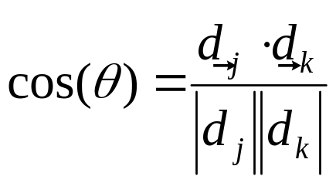
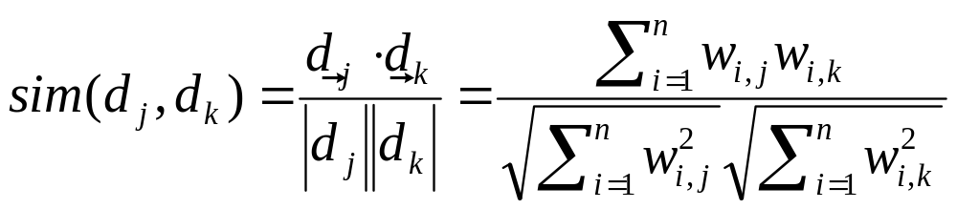
Similarity Metric
How about |d₁ – d₂|?
  This is the Euclidean distance between the vectors
Instead of distance, use “angle” between the vectors:
Why is this not a good idea?

Slide 35
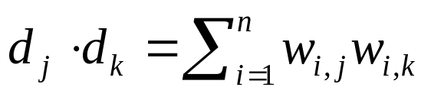
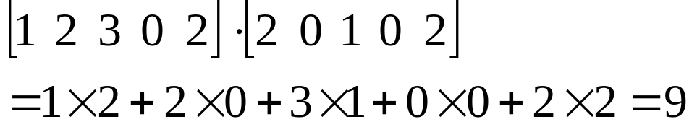
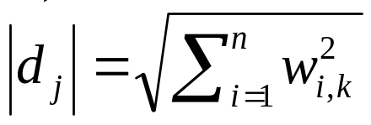
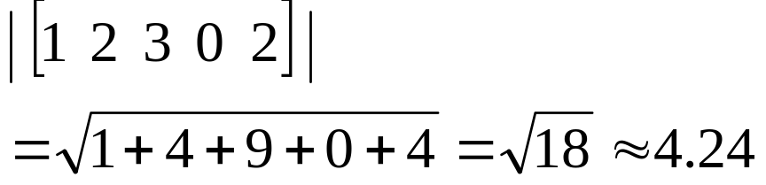
Components of Similarity
The “inner product” (aka dot product) is the key to the similarity function
The denominator handles document length normalization
Example:
Example:

Slide 36
Reexamining Similarity
Query Vector
Inner Product
Length
Normalization
Document Vector

Slide 37
How do we weight doc terms?
Here’s the intuition:
  Terms that appear often in a document should get high weights
  Terms that appear in many documents should get low weights
How do we capture this mathematically?
  Term frequency
  Inverse document frequency
The more often a document contains the term “dog”, the more likely that the document is “about” dogs.
Words like “the”, “a”, “of” appear in (nearly) all documents.

Slide 38
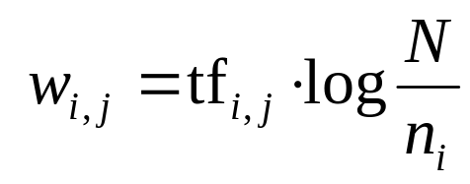
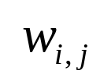
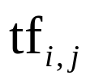


TF.IDF Term Weighting
Simple, yet effective!
weight assigned to term i in document j
number of occurrence of term i in document j
number of documents in entire collection
number of documents with term i

Slide 39
TF.IDF Example
tf
W_{i,j}
1
2
3
4
idf
1
2
3
4
complicated
5
2
0.301
1.51
0.60
contaminated
4
1
3
0.125
0.50
0.13
0.38
fallout
5
4
3
0.125
0.63
0.50
0.38
information
6
3
3
2
0.000
interesting
1
0.602
0.60
nuclear
3
7
0.301
0.90
2.11
retrieval
6
1
4
0.125
0.75
0.13
0.50
siberia
2
0.602
1.20

Slide 40
Normalizing Document Vectors
Recall our similarity function:
Normalize document vectors in advance
  Use the “cosine normalization” method: divide each term weight through by length of vector

Slide 41
Normalization Example
tf
W_{i,j}
W'_{i,j}
1
2
3
4
idf
1
2
3
4
1
2
3
4
complicated
5
2
0.301
1.51
0.60
0.57
0.69
contaminated
4
1
3
0.125
0.50
0.13
0.38
0.29
0.13
0.14
fallout
5
4
3
0.125
0.63
0.50
0.38
0.37
0.19
0.44
information
6
3
3
2
0.000
interesting
1
0.602
0.60
0.62
nuclear
3
7
0.301
0.90
2.11
0.53
0.79
retrieval
6
1
4
0.125
0.75
0.13
0.50
0.77
0.05
0.57
siberia
2
0.602
1.20
0.71
Length
1.70
0.97
2.67
0.87

Slide 42
Retrieval Example
Query: contaminated retrieval
W'_{i,j}
W'_{i,j}
query
1
2
3
4
complicated
0.57
0.69
contaminated
1
0.29
0.13
0.14
fallout
0.37
0.19
0.44
Ranked list:
Doc 2
Doc 4
Doc 1
Doc 3
information
interesting
0.62
nuclear
0.53
0.79
retrieval
1
0.77
0.05
0.57
siberia
0.71
similarity score
0.29
0.9
0.19
0.57
Do we need to normalize the query vector?

Slide 43
Weighted Retrieval
Weight query terms by assigning different term weights to query vector
Query: contaminated(3) retrieval
W'_{i,j}
W'_{i,j}
query
1
2
3
4
complicated
0.57
0.69
contaminated
3
0.29
0.13
0.14
fallout
0.37
0.19
0.44
Ranked list:
Doc 2
Doc 1
Doc 4
Doc 3
information
interesting
0.62
nuclear
0.53
0.79
retrieval
1
0.77
0.05
0.57
siberia
0.71
similarity score
0.87
1.16
0.47
0.57

Slide 44
What’s the point?
Information seeking behavior is incredibly complex
In order to build actual systems, we must make many simplifications
  Absolutely unrealistic assumptions!
  But the resulting systems are nevertheless useful
Know what these limitations are!

Slide 45
Summary
Boolean retrieval is powerful in the hands of a trained searcher
Ranked retrieval is preferred in other circumstances
Key ideas in the vector space model
  Goal: find documents most similar to the query
  Geometric interpretation: measure similarity in terms of angles between vectors in high dimensional space
  Documents weights are some combinations of TF, DF, and Length
  Length normalization is critical
  Similarity is calculated via the inner product

Slide 46
One Minute Paper
What was the muddiest point in today’s class?

