Slide 1

LBSC 796/INFM 718R: Week 4
Language Models
Jimmy Lin
College of Information Studies
University of Maryland
Monday, February 20, 2006

Slide 2
Last Time…
Boolean model
  Based on the notion of sets
  Documents are retrieved only if they satisfy Boolean conditions specified in the query
  Does not impose a ranking on retrieved documents
  Exact match
Vector space model
  Based on geometry, the notion of vectors in high dimensional space
  Documents are ranked based on their similarity to the query (ranked retrieval)
  Best/partial match

Slide 3
Today
Language models
  Based on the notion of probabilities and processes for generating text
  Documents are ranked based on the probability that they generated the query
  Best/partial match
First we start with probabilities…

Slide 4
Probability
What is probability?
  Statistical: relative frequency as n → ∞
  Subjective: degree of belief
Thinking probabilistically
  Imagine a finite amount of “stuff” (= probability mass)
  The total amount of “stuff” is one
  The event space is “all the things that could happen”
  Distribute that “mass” over the possible events
  Sum of all probabilities have to add up to one

Slide 5
Key Concepts
Defining probability with frequency
Statistical independence
Conditional probability
Bayes’ Theorem

Slide 6
Statistical Independence
A and B are independent if and only if:
  P(A and B) = P(A) × P(B)
Simplest example: series of coin flips
Independence formalizes “unrelated”
  P(“being brown eyed”) = 6/10
  P(“being a doctor”) = 1/1000
  P(“being a brown eyed doctor”)
  = P(“being brown eyed”) × P(“being a doctor”)
  = 6/10,000
Notes:
Think of it this way. Out of 100,000 people, you expect a thousandth to be doctors -- that’s 100 people.
Out of those 100 people, you expect 85 to have brown eyes. So you expect 85 of the original 100,000 to be brown-eyed doctors.

Slide 7
Dependent Events
Suppose:
  P(“having a B.S. degree”) = 4/10
  P(“being a doctor”) = 1/1000
Would you expect:
  P(“having a B.S. degree and being a doctor”)
  = P(“having a B.S. degree”) × P(“being a doctor”)
  = 4/10,000
Another example:
  P(“being a doctor”) = 1/1000
  P(“having studied anatomy”) = 12/1000
  P(“having studied anatomy” | “being a doctor”) = ??
Notes:
You know 10/1000 are doctors, and more than your average number of them (2 out of 10) are likely to have a B.S. degree. If you assume they’re independent, the probability you get is very much an underestimate of the true probability.

Slide 8
Conditional Probability
P(A | B) ≡ P(A and B) / P(B)
Event Space
A
A and B
B
P(A) = prob. of A relative to entire event space
P(A|B) = prob. of A considering that we know B is true

Slide 9
Doctors and Anatomy
P(A | B) ≡ P(A and B) / P(B)
What is P(“having studied anatomy” | “being a doctor”)?
A = having studied anatomy
B = being a doctor
P(“being a doctor”) = 1/1000
P(“having studied anatomy”) = 12/1000
P(“being a doctor who studied anatomy”) = 1/1000
P(“having studied anatomy” | “being a doctor”) = 1

Slide 10
More on Conditional Probability
What if P(A|B) = P(A)?
Is P(A|B) = P(B|A)?
A and B must be statistically independent!
A = having studied anatomy
B = being a doctor
P(“being a doctor”) = 1/1000
P(“having studied anatomy”) = 12/1000
P(“being a doctor who studied anatomy”) = 1/1000
P(“having studied anatomy” | “being a doctor”) = 1
If you’re a doctor, you must have studied anatomy…
P(“being a doctor” | “having studied anatomy”) = 1/12
If you’ve studied anatomy, you’re more likely to be a doctor, but you could also be a biologist, for example

Slide 11
Probabilistic Inference
Suppose there’s a horrible, but very rare disease
But there’s a very accurate test for it
Unfortunately, you tested positive…
The probability that you contracted it is 0.01%
The test is 99% accurate
Should you panic?

Slide 12
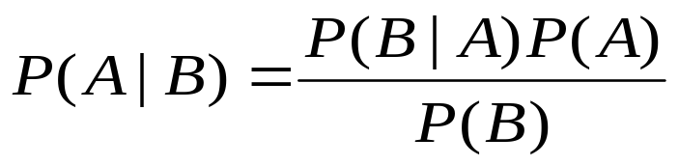
Bayes’ Theorem
You want to find
But you only know
  How rare the disease is
  How accurate the test is
Use Bayes’ Theorem (hence Bayesian Inference)
P(“have disease” | “test positive”)
Prior probability
Posterior probability

Slide 13
Applying Bayes’ Theorem
P(“have disease”) = 0.0001 (0.01%)
P(“test positive” | “have disease”) = 0.99 (99%)
P(“test positive”) = 0.010098
Two case:
You have the disease, and you tested positive
You don’t have the disease, but you tested positive (error)
Case 1: (0.0001)(0.99) = 0.000099
Case 2: (0.9999)(0.01) = 0.009999
Case 1+2 = 0.010098
P(“have disease” | “test positive”)
= (0.99)(0.0001) / 0.010098
= 0.009804 = 0.9804%
Don’t worry!

Slide 14
Another View
In a population of one million people
100 are infected
999,900 are not
99
test positive
1
test negative
9999
test positive
989901
test negative
10098 will test positive…
Of those, only 99 really have the disease!

Slide 15
Competing Hypotheses
Consider
  A set of hypotheses: H₁, H₂, H₃
  Some observable evidence: O
If you observed O, what likely caused it?
Example:
  You know that three things can cause the grass to be wet: rain, sprinkler, flood
  You observed that that grass is wet
  What caused it?
P₁ = P(H₁|O)
P₂ = P(H₂|O)
P₃ = P(H₃|O)
Which explanation is most likely?

Slide 16
An Example
Let
  O = “Joe earns more than $80,000/year”
  H1 = “Joe is a NBA referee”
  H2 = “Joe is a college professor”
  H3 = “Joe works in food services”
Suppose we know that Joe earns more than $80,000 a year…
What should be our guess about Joe’s profession?

Slide 17
What’s his job?
Suppose we do a survey and we find out
  P(O|H₁) = 0.6 P(H₁) = 0.0001 referee
  P(O|H₂) = 0.07 P(H₂) = 0.001 professor
  P(O|H₃) = 0.001 P(H₃) = 0.02 food services
We can calculate
  P(H₁|O) = 0.00006 / P(“earning > $80K/year”)
  P(H₂|O) = 0.00007 / P(“earning > $80K/year”)
  P(H₃|O) = 0.00002 / P(“earning > $80K/year”)
What do we guess?
Notes:
Notice that in this example, the prior probabilities reflect the likelihood of someone having a particular kind of job, ignoring any information about income. E.g. we’re supposing food services workers are estimated at 20% of the population. Thus the best guess about profession prior to info about income would be food services worker.

Slide 18
Recap: Key Concepts
Defining probability with frequency
Statistical independence
Conditional probability
Bayes’ Theorem

Slide 19
What is a Language Model?
Probability distribution over strings of text
  How likely is a string in a given “language”?
Probabilities depend on what language we’re modeling
p₁ = P(“a quick brown dog”)
p₂ = P(“dog quick a brown”)
p₃ = P(“быстрая brown dog”)
p₄ = P(“быстрая собака”)
In a language model for English: p₁ > p₂ > p₃ > p₄
In a language model for Russian: p₁ < p₂ < p₃ < p₄

Slide 20
How do we model a language?
Brute force counts?
  Think of all the things that have ever been said or will ever be said, of any length
  Count how often each one occurs
Is understanding the path to enlightenment?
  Figure out how meaning and thoughts are expressed
  Build a model based on this
Throw up our hands and admit defeat?

Slide 21
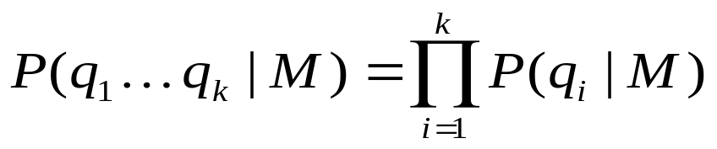
Unigram Language Model
Assume each word is generated independently
  Obviously, this is not true…
  But it seems to work well in practice!
The probability of a string, given a model:
The probability of a sequence of words decomposes into a product of the probabilities of individual words

Slide 22
A Physical Metaphor
Colored balls are randomly drawn from an urn (with replacement)
M
words
P ( ) =
P ( )
×
P ( )
×
P ( )
×
P ( )
= (4/9) × (2/9) × (4/9) × (3/9)

Slide 23
An Example
Model M
P(w) w
0.2 the
0.1 a
0.01 man
0.01 woman
0.03 said
0.02 likes
…
the
man
likes
the
woman
0.2
0.01
0.02
0.2
0.01
multiply
P(s | M) = 0.00000008
P(“the man likes the woman”|M)
= P(the|M) × P(man|M) × P(likes|M) × P(the|M) × P(man|M)
= 0.00000008

Slide 24
Comparing Language Models
Model M₁
Model M₂
P(w) w
0.2 the
0.0001 yon
0.01 class
0.0005 maiden
0.0003 sayst
0.0001 pleaseth
…
P(w) w
0.2 the
0.1 yon
0.001 class
0.01 maiden
0.03 sayst
0.02 pleaseth
…
the
class
pleaseth
yon
maiden
0.2
0.01
0.0001
0.0001
0.0005
P(s|M₂) > P(s|M₁)
0.2
0.001
0.02
0.1
0.01
What exactly does this mean?

Slide 25

Noisy-Channel Model of IR
Information need
d₁
d₂
Query
…
User has a information need, “thinks” of a relevant document…
and writes down some queries
d_{n}
document collection
Task of information retrieval: given the query, figure out which document it came from?

Slide 26
How is this a noisy-channel?
No one seriously claims that this is actually what’s going on…
  But this view is mathematically convenient!
Source
Destination
message
Transmitter
channel
Receiver
message
noise
Source
Destination
Information
need
Encoder
channel
Decoder
query
terms
Query formulation process

Slide 27
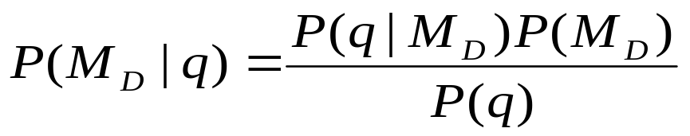
Retrieval w/ Language Models
Build a model for every document
Rank document d based on P(M_{D} | q)
Expand using Bayes’ Theorem
Same as ranking by P(q | M_{D})
P(q) is same for all documents; doesn’t change ranks
P(M_{D}) [the prior] is assumed to be the same for all d

Slide 28

What does it mean?
Ranking by P(M_{D} | q)…
is the same as ranking by P(q | M_{D})
Hey, what’s the probability this query came from you?
Hey, what’s the probability that you generated this query?
model₁
model₁
Hey, what’s the probability this query came from you?
Hey, what’s the probability that you generated this query?
model₂
model₂
…
…
Hey, what’s the probability this query came from you?
Hey, what’s the probability that you generated this query?
model_{n}
model_{n}

Slide 29

Ranking Models?
Ranking by P(q | M_{D})
… is the same as ranking documents
Hey, what’s the probability that you generated this query?
model₁
… is a model of document₁
Hey, what’s the probability that you generated this query?
model₂
… is a model of document₂
…
Hey, what’s the probability that you generated this query?
model_{n}
… is a model of document_{n}

Slide 30

Building Document Models
How do we build a language model for a document?
What’s in the urn?
Physical metaphor:
M
What colored balls and how many of each?

Slide 31
A First Try
Simply count the frequencies in the document = maximum likelihood estimate
M
Sequence S
P ( ) = 1/2
P ( ) = 1/4
P ( ) = 1/4
P(w|M_{S}) = #(w,S) / |S|
#(w,S) = number of times w occurs in S
|S| = length of S

Slide 32
Zero-Frequency Problem
Suppose some event is not in our observation S
  Model will assign zero probability to that event
M
Sequence S
P ( ) = 1/2
P ( ) = 1/4
P ( ) = 1/4
P ( ) =
P ( )
×
P ( )
×
P ( )
×
P ( )
!!
= (1/2) × (1/4) × 0 × (1/4) = 0

Slide 33
Why is this a bad idea?
Modeling a document
  Just because a word didn’t appear doesn’t mean it’ll never appear…
  But safe to assume that unseen words are rare
Think of the document model as a topic
  There are many documents that can be written about a single topic
  We’re trying to figure out what the model is based on just one document
Practical effect: assigning zero probability to unseen words forces exact match
  But partial matches are useful also!
Analogy: fishes in the sea

Slide 34

Smoothing
The solution: “smooth” the word probabilities
P(w)
Maximum Likelihood Estimate
Smoothed probability distribution
w

Slide 35
How do you smooth?
Assign some small probability to unseen events
  But remember to take away “probability mass” from other events
Simplest example: for words you didn’t see, pretend you saw it once
Other more sophisticated methods:
  Absolute discounting
  Linear interpolation, Jelinek-Mercer
  Dirichlet, Witten-Bell
  Good-Turing
  …
Lots of performance to be gotten out of smoothing!

Slide 36
Recap: LM for IR
Build language models for every document
  Models can be viewed as “topics”
  Models are “generative”
  Smoothing is very important
Retrieval:
  Estimate the probability of generating the query according to each model
  Rank the documents according to these probabilities

Slide 37
Advantages of LMs
Novel way of looking at the problem of text retrieval
Conceptually simple and explanatory
  Unfortunately, not realistic
Formal mathematical model
  Satisfies math envy
Natural use of collection statistics, not heuristics

Slide 38
Comparison With Vector Space
Similar in some ways
  Term weights are based on frequency
  Terms treated as if they were independent (unigram language model)
  Probabilities have the effect of length normalization
Different in others
  Based on probability rather than similarity
  Intuitions are probabilistic (processes for generating text) rather than geometric
  Details of use of document length and term, document, and collection frequencies differ

Slide 39
What’s the point?
Language models formalize assumptions
  Binary relevance
  Document independence
  Term independence
  Uniform priors
All of which aren’t true!
  Relevance isn’t binary
  Documents are often not independent
  Terms are clearly not independent
  Some documents are inherently higher in quality
But it works!

Slide 40
One Minute Paper
What was the muddiest point in today’s class?

