Slide 1

LBSC 796/INFM 718R: Week 5
Indexing
Jimmy Lin
College of Information Studies
University of Maryland
Monday, February 27, 2006

Slide 2
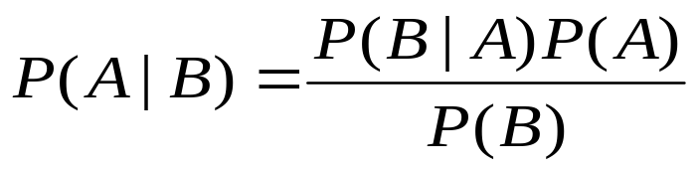
Muddy Points
Probability of a single word vs. probability of a sequence
Uniform priors
Smoothing
Difference between vector space and language models

Slide 3
Why smoothing?
I think language modeling is very very cool
Model M
P(w) w
0.125 cool
0.125 I
0.125 is
0.125 language
0.125 modeling
0.125 think
0. 250 very
What are the probabilities?
P(“language modeling think”)
P(“cool language modeling”)
P(“cool cool modeling”)
P(“language modeling retrieval”)

Slide 4
Some Questions for Today
How long will it take to do a search?
How do I measure speed?
How big a computer will I need?
  How much RAM?
  How much disk space?
What if more documents arrive?
How do I index the Web?
Notes:
12

Slide 5
Assumptions
Optimize for retrieval
  Searching should be fast: users are impatient
Indexing speed isn’t critical
  Document collection is relatively stable
When do these assumptions start to break down?

Slide 6
Algorithms
What is an algorithm?
Think “recipe” for problem solving
Today’s focus: algorithms for information retrieval
  What data structures are involved?
  How much space do they take up?
  How fast are they?
a precise rule (or set of rules) specifying how to solve some problem

Slide 7
Indexing
Query
Search
Ranked List
Indexing
Index
Acquisition
Collection

Slide 8
The Starting Point
Doc 2
Doc 3
Doc 1
Doc 4
Doc 5
Doc 6
Doc 7
Term
Doc 8
aid
0
0
0
1
0
0
0
1
all
0
1
0
1
0
1
0
0
back
1
0
1
0
0
0
1
0
brown
1
0
1
0
1
0
1
0
come
0
1
0
1
0
1
0
1
dog
0
0
1
0
1
0
0
0
fox
0
0
1
0
1
0
1
0
good
0
1
0
1
0
1
0
1
jump
0
0
1
0
0
0
0
0
lazy
1
0
1
0
1
0
1
0
men
0
1
0
1
0
0
0
1
now
0
1
0
0
0
1
0
1
over
1
0
1
0
1
0
1
1
party
0
0
0
0
0
1
0
1
quick
1
0
1
0
0
0
0
0
their
1
0
0
0
1
0
1
0
time
0
1
0
1
0
1
0
0
The term-document matrix has “bag of words” information about the collection
Notes:
15

Slide 9
Small yet Fast
Can we make this data structure smaller, keeping in mind the need for fast retrieval?
Observations:
  The nature of the search problem requires us to quickly find which documents contain a term
  The term-document matrix is very sparse
  Some terms are more useful than others

Slide 10
Why is size important?
RAM
  Typical size: 1 GB
  Typical access speed: 50 ns
Hard drive:
  Typical size: 80 GB (my laptop)
  Typical access speed: 10 ms
Hard drive is 200,000x slower than RAM!
Why is this an important issue?

Slide 11
Postings
Doc 2
Doc 3
Doc 1
Doc 4
Doc 5
Doc 6
Doc 7
Term
Doc 8
Postings
aid
0
0
0
1
0
0
0
1
4, 8
all
0
1
0
1
0
1
0
0
2, 4, 6
back
1
0
1
0
0
0
1
0
1, 3, 7
brown
1
0
1
0
1
0
1
0
1, 3, 5, 7
come
0
1
0
1
0
1
0
1
2, 4, 6, 8
dog
0
0
1
0
1
0
0
0
3, 5
fox
0
0
1
0
1
0
1
0
3, 5, 7
good
0
1
0
1
0
1
0
1
2, 4, 6, 8
jump
0
0
1
0
0
0
0
0
3
lazy
1
0
1
0
1
0
1
0
1, 3, 5, 7
men
0
1
0
1
0
0
0
1
2, 4, 8
now
0
1
0
0
0
1
0
1
2, 6, 8
over
1
0
1
0
1
0
1
1
1, 3, 5, 7, 8
party
0
0
0
0
0
1
0
1
6, 8
quick
1
0
1
0
0
0
0
0
1, 3
their
1
0
0
0
1
0
1
0
1, 5, 7
time
0
1
0
1
0
1
0
0
2, 4, 6
Notes:
15

Slide 12
An Inverted Index
Term
Postings
aid
4, 8
all
2, 4, 6
back
1, 3, 7
brown
1, 3, 5, 7
come
2, 4, 6, 8
dog
3, 5
fox
3, 5, 7
good
2, 4, 6, 8
jump
3
lazy
1, 3, 5, 7
men
2, 4, 8
now
2, 6, 8
over
1, 3, 5, 7, 8
party
6, 8
quick
1, 3
their
1, 5, 7
time
2, 4, 6
Notes:
15

Slide 13
What goes in the postings?
Boolean retrieval
  Just the document number
Ranked Retrieval
  Document number and term weight (tf.idf, ...)
Proximity operators
  Word offsets for each occurrence of the term
Notes:
17

Slide 14
The Retrieval Process
During retrieval:
  Find the relevant postings based on query terms
  Manipulate the postings based on the query
  Return appropriate documents
Example with Boolean queries

Slide 15
Further Compressing the Index
Postings can still be quite large
  Especially if you have a large collection
Idea: encode differences instead of document numbers
Many other ways to compress the postings
What about dropping unimportant terms from the index?
  How much space does stopword removal save?
e.g., 1 million documents → 20-bit document numbers
37, 42, 43, 48, 97, 98, 243 →
37, 5, 1, 5, 49, 1, 145

Slide 16
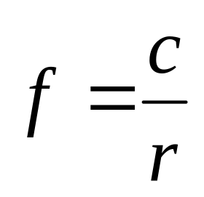
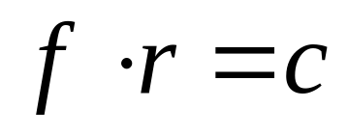
Zipf’s Law
George Kingsley Zipf (1902-1950) observed that for many frequency distributions, the nth most frequent event is related to its frequency in the following manner:
or
f = frequency
r = rank
c = constant

Slide 17
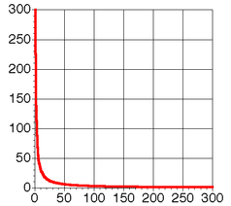
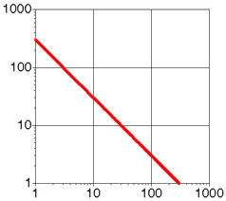
Zipfian Distribution

Slide 18
Zipfian Distribution
Key points:
  A few elements occur very frequently
  A medium number of elements have medium frequency
  Many elements occur very infrequently
What’s the big deal?
  English words obey Zipf’s Law

Slide 19
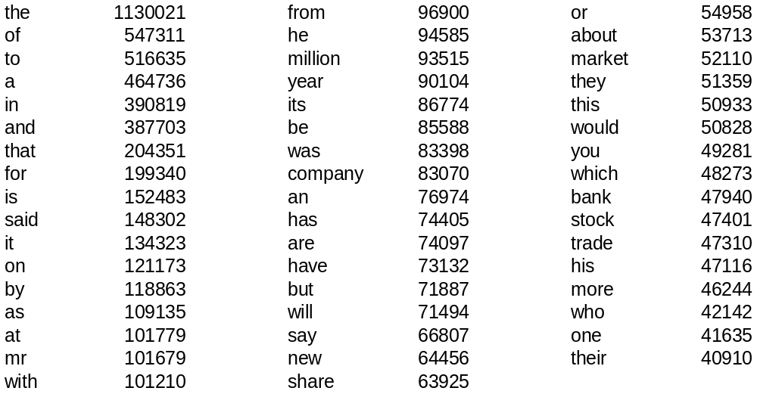
Word Frequency in English
Frequency of 50 most common words in English
(sample of 19 million words)

Slide 20
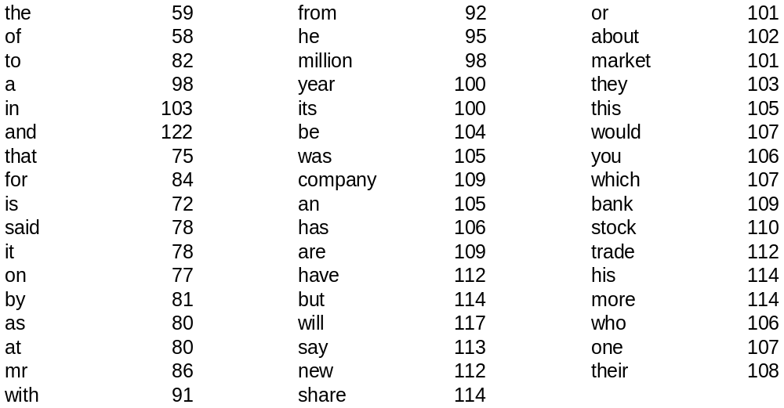
Does it fit Zipf’s Law?
The following shows rf*1000/n
r is the rank of word w in the sample
f is the frequency of word w in the sample
n is the total number of word occurrences in the sample

Slide 21
IR and Zipf's Law
What’s the relevance of Zipf’s Law to information retrieval?

Slide 22
Other Zipfian Distributions
Library book checkout patterns
Website popularity
Incoming Web page requests
Outgoing Web page requests
Document size on Web

Slide 23
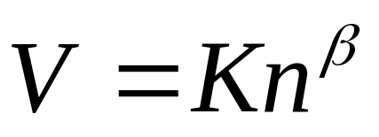

How big is the inverted index?
Postings take up most of the space
Heap’s Law tells us about vocabulary size
  When adding new documents, the system is likely to have seen terms already
  But the postings keep growing
V is vocabulary size
n is corpus size (number of documents)
K and β are constants
Notes:
22

Slide 24
How big are the postings?
Very compact for Boolean retrieval
  About 10% of the size of the documents
Not much larger for ranked retrieval
  Perhaps 20% of collection size
Enormous for proximity operators
  Sometimes larger than the document collection
Notes:
18

Slide 25
So far…
We have discussed:
  The data structure used for indexing and retrieval
  Methods for compressing the inverted index
We have not discussed:
  How the inverted index is actually built
  How a system looks up the query terms
  How fast all these operations are

Slide 26
Decoupling the Inverted Index
The term Index
Postings
aid
4, 8
all
2, 4, 6
back
1, 3, 7
brown
1, 3, 5, 7
come
2, 4, 6, 8
dog
3, 5
fox
3, 5, 7
good
2, 4, 6, 8
jump
3
lazy
1, 3, 5, 7
men
2, 4, 8
now
2, 6, 8
over
1, 3, 5, 7, 8
party
6, 8
quick
1, 3
their
1, 5, 7
time
2, 4, 6
Notes:
15

Slide 27
Terms in the Collection
Let’s focus on the term index
The postings are relatively simple
  During indexing: once you find the correct postings, add information from current document
  During retrieval: once you find the correct postings, manipulate based on query operator
Questions
  How do you find the correct posting quickly?
  What happens when you come across a new term?

Slide 28
How do you measure speed?
We want to know if one algorithm is faster than another
What do we measure?
  Number of clock cycles?
  Number of instructions?
  Clock time?
What’s wrong with these measures?

Slide 29
Big-O Notation
A mathematical method for quantifying the running time of an algorithm
  Abstracts away from actual implementation
  Abstracts away from specific machine architecture
Useful for theoretical considerations of speed
Best illustrate with examples…

Slide 30
Linear Dictionary Lookup
Suppose we want to find the word “complex”
How long does this take, in the worst case?
Running time is proportional to number of entries in the dictionary
This algorithm is O(n)
= linear time algorithm
relaxation
astronomical
zebra
belligerent
subterfuge
daffodil
cadence
wingman
loiter
peace
arcade
respondent
complex
tax
kingdom
jambalaya
Found it!

Slide 31
With a Sorted Dictionary
Let’s try again, except this time with a sorted dictionary: find “complex”
How long does this take, in the worst case?
arcade
astronomical
belligerent
cadence
complex
daffodil
jambalaya
kingdom
loiter
peace
relaxation
respondent
subterfuge
tax
wingman
zebra
Found it!

Slide 32
Binary Search: Analysis
Algorithm:
  Look in the middle entry of a region, call this x
  If the entry you’re looking for comes before x, then look in first half, otherwise look in second half
  Repeat until you find what you’re looking for
Analysis:
  Each time we look up an entry, we cut down the number to consider by a half
  How many times can you divide a number by 2?
This algorithm is O(lg n)

Slide 33
Which is faster?
Two algorithms:
  O(n): Sequentially search through every entry
  O(lg n): Binary search
Big-O notation
  Tells us the asymptotic worst case running time of an algorithm
  Allows us to compare the speed of different algorithms

Slide 34
What was glossed over?
How much effort did it take to sort the dictionary in the first place?
General strategy: reduce search time by doing work ahead of time

Slide 35
Selection Sort
One of the simplest sorting algorithms:
  Find smallest number, move it to the first position
  Find 2nd smallest number, move it to the 2nd position
  Find 3rd smallest number, move it to the 3rd position
  …
This algorithm is O(n²)
= quadratic (polynomial) algorithm
Faster sorting algorithm: Quick sort = O(n log n)

Slide 36
Satisfiability
Given a boolean expression, is there an assignment of TRUE and FALSE that makes the entire expression true?
3-SAT: expression grouped into clauses of three variables
The simplest algorithm is to try all possible combinations
This algorithm is O(2^{n})
= exponential algorithm
E = (x₁ or ~x₂ or ~x₃) and (x₁ or x₂ or x₄)
Solution: x₁ = TRUE, x₂ = TRUE, x₃ = TRUE, x₄ = TRUE

Slide 37
Do the details matter?
Arrange the following from fastest to slowest:
  O(n log n)
  O(n²)
  O(log n)
  O(n)
  O(2^{n})
What about?
  10n, 100n, 1000n
  n², 2n², 2n² + 100
3
4
1
2
5

Slide 38
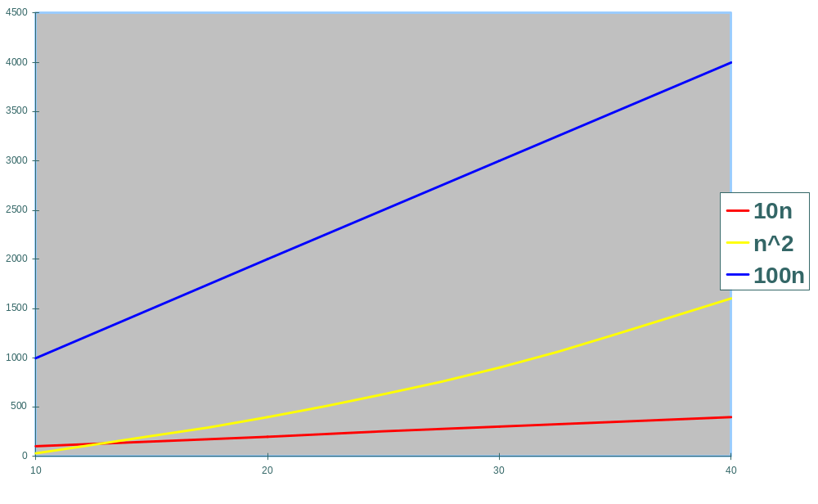
“Asymptotic” Complexity

Slide 39
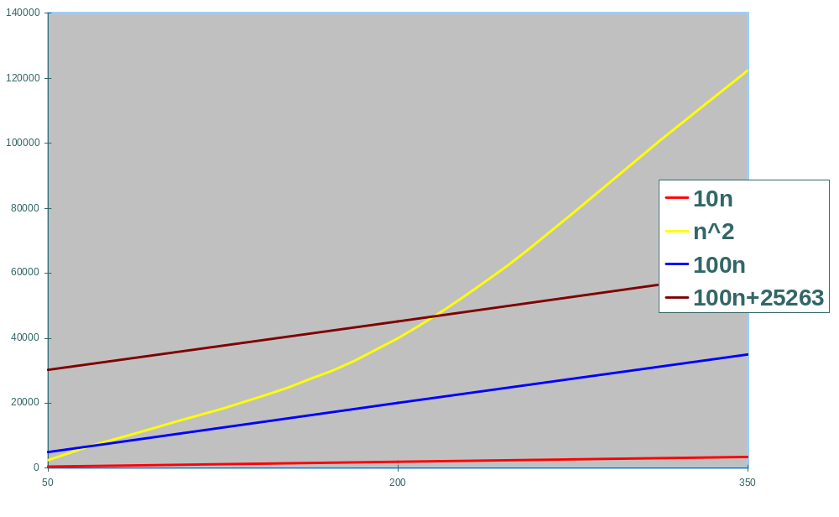
“Asymptotic” Complexity

Slide 40
Irrelevant Details
Big-O notation is concerned with
  Asymptotic complexity
  Worst-case running time
Therefore
  10n, 100n, 1000n → O(n)
  n², 2n², 2n² + 100 → O(n²)
  lg n, log₈ n, log n, ln n → O(log n)

Slide 41
How big?
Constant, i.e., O(1)
  n doesn’t matter
Sublinear, e.g., O(log n)
  n = 65536 → log n = 16
Linear, i.e. O(n)
  n = 65536 → n = 65536
Polynomial, e.g., O(n²)
  n = 65536 → n² = 4,294,967,296
Exponential, e.g., O(2^{n})
  n = 65536 → beyond astronomical

Slide 42
Linear Term Index
Keep terms in a list, use binary search to look up
Advantages
  Quick searching
  Economic use of storage
Disadvantages
  Long seek times
Are there alternatives for storing the term index?

Slide 43
Binary Tree
A tree structure where
  Each node has at most two children
  The left child comes before the parent
  The right child comes after the parent
Input: elk, hog, bee, fox, cat, gnu, ant, dog
elk
bee
hog
ant
cat
fox
dog
gnu

Slide 44
Binary Tree Operations
Searching (lookup x):
  Start at the root, compare current node to x
  Follow left child if x comes before current node
  Follow right child if x comes after current node
  Repeat until x is found
Indexing (adding term x) :
  Search for position where you would expect to see x
  Insert x there

Slide 45
Binary Trees
Advantages
  Can be searched quickly
  Easy to add an extra term
  Economical use of storage (although less so than linear term list)
Disadvantages
  Trees tend to become unbalanced

Slide 46
Unbalanced Trees
The shape of a binary trees depends on insertion order of terms
What’s the worst case scenario?
The need for balanced trees

Slide 47
B-Trees
A balanced, multiway search tree
50 65
10 19 35
55 59
70 90 98
1 5 8 9
36 47
66 68
91 95 97
12 14 18
72 73
21 24 28

Slide 48
Indexing and Searching
Indexing
  Access the term index
  Find the correct postings and add document accordingly
  Relatively slow process (hours, even days)
Searching
  Lookup the query terms in term index
  Read the postings
  Manipulate the postings based on query
  Very fast (seconds)
Notes:
24

Slide 49
Indexing the Web
We’ve assumed that the document collection is readily available
How do we index the Web?

Slide 50
Web Crawlers
How do Web search engines know what to index?
Main idea:
  Start with known sites
  Record information for these sites
  Follow the links from each site
  Record information found at new sites
  Repeat

Slide 51
Web Crawling Algorithm
Put a set of known sites on a queue
Repeat the until the queue is empty:
  Take the first page off of the queue
  Check to see if this page has been processed
  If this page has not yet been processed:
    Add this page to the index
    Add each link on the current page to the queue
    Record that this page has been processed

Slide 52
Web Crawling Issues
Size
Freshness
Different languages
The static collection assumption
Adversaries
Dynamic content
“Dark matter”
Technical problems
  Missing/broken links
  Invalid HTML

Slide 53
Summary
Information retrieval systems are only useful if they’re responsive
  Users are impatient
  Interaction is critical to the information seeking process
Building fast systems that operate on large collections is hard!
  Tradeoffs in different data structures
  Tradeoffs in searching/indexing cost

Slide 54
One Minute Paper
What was the muddiest point in today’s class?

