Slide 1

LBSC 796/INFM 718R: Week 6
Representing the Meaning of Documents
Jimmy Lin
College of Information Studies
University of Maryland
Monday, March 6, 2006

Slide 2
Muddy Points
Binary trees vs. binary search
Document presentation
Algorithm running times
  Logarithmic, linear, polynomial, exponential

Slide 3


The Central Problem in IR
Information Seeker
Authors
Concepts
Concepts
Query Terms
Document Terms
Do these represent the same concepts?
Notes:
Why is IR hard? Because language is hard!

Slide 4
Today’s Class
Documents
Query
Representation
Function
Representation
Function
Query Representation
Document Representation
Index
Comparison
Function
Hits

Slide 5
Outline
How do we represent the meaning of text?
What are the problems?
What are the possible solutions?
How well do they work?
Notes:
2

Slide 6
Why is IR hard?
IR is hard because natural language is so rich (among other reasons)
What are the issues?
  Encoding
  Tokenization
  Morphological Variation
  Synonymy
  Polysemy
  Paraphrase
  Ambiguity
  Anaphora

Slide 7
Possible Solutions
Vary the unit of indexing
  Strings and segments
  Tokens and words
  Phrases and entities
  Senses and concepts
Manipulate queries and results
  Term expansion
  Post-processing of results
Notes:
2

Slide 8
Representing Electronic Texts
A character set specifies the unit of composition
  Characters are the smallest units of text
  Abstract entities, separate from how they are stored
A font specifies the printed representation
  What each character will look like on the page
  Different characters might be depicted identically
An encoding is the electronic representation
  What each character will look like in a file
  One character may have several representations
An input method is a keyboard representation
Notes:
6

Slide 9
The Character ‘A’
ASCII = American Standard Code for Information Interchange
7 bits used per character
  Number of representable characters = 128
  Some character codes used for non-visible characters
The visible characters:
0 1 0 0 0 0 0 1 = 65 DEC = ‘A’
0 1 0 0 0 0 1 0 = 66 DEC = ‘B’
…
!"#$%&'()*+,-./0123456789:;<=>?@
ABCDEFGHIJKLMNOPQRSTUVWXYZ[\]^_‘
abcdefghijklmnopqrstuvwxyz{|}~

Slide 10
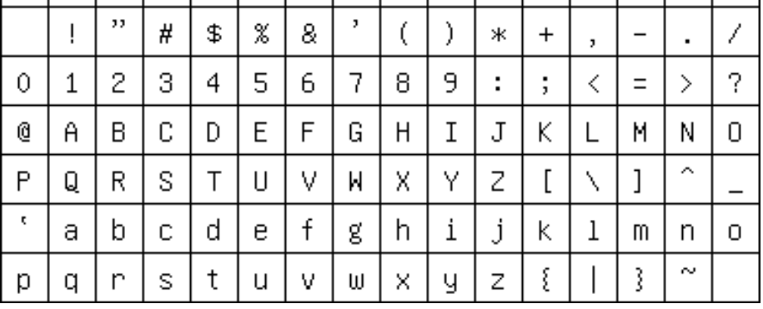
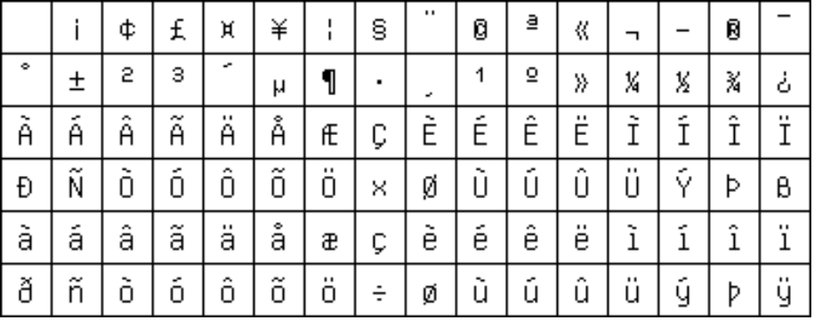
The Latin-1 Character Set
ISO 8859-1: 8-bit characters for Western Europe
  French, Spanish, Catalan, Galician, Basque, Portuguese, Italian, Albanian, Afrikaans, Dutch, German, Danish, Swedish, Norwegian, Finnish, Faroese, Icelandic, Irish, Scottish, and English
Printable Characters, 7-bit ASCII
Additional Defined Characters, ISO 8859-1
Notes:
8

Slide 11
What about these languages?
天主教教宗若望保祿二世因感冒再度住進醫院。這是他今年第二度因同樣的病因住院。
وقال مارك ريجيف - الناطق باسم
الخارجية الإسرائيلية - إن شارون قبل
الدعوة وسيقوم للمرة الأولى بزيارة
تونس، التي كانت لفترة طويلة المقر
الرسمي لمنظمة التحرير الفلسطينية بعد خروجها من لبنان عام 1982.
Выступая в Мещанском суде Москвы экс-глава ЮКОСа заявил не совершал ничего противозаконного, в чем обвиняет его генпрокуратура России.
भारत सरकार ने आर्थिक सर्वेक्षण में वित्तीय वर्ष 2005-06 में सात फ़ीसदी विकास दर हासिल करने का आकलन किया है और कर सुधार पर ज़ोर दिया है
日米連合で台頭中国に対処…アーミテージ前副長官提言
조재영 기자= 서울시는 25일 이명박 시장이 `행정중심복합도시'' 건설안에 대해 `군대라도 동원해 막고싶은 심정''이라고 말했다는 일부 언론의 보도를 부인했다.

Slide 12
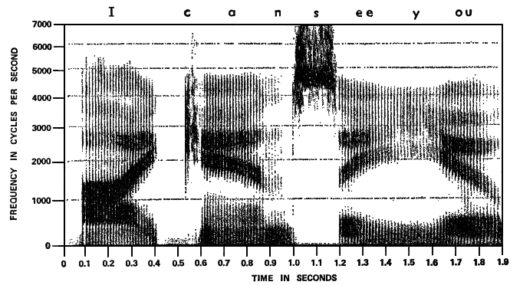
Tokenization
What’s a word?
  First try: words are separated by spaces
  What about clitics?
What about languages without spaces?
Same problem with speech!
The cat on the mat.
the, cat, on, the, mat
I’m not saying that I don’t want John’s input on this.
天主教教宗若望保祿二世因感冒再度住進醫院。
天主教 教宗 若望保祿二世 因 感冒 再度 住進 醫院。
Where are the spaces?

Slide 13
Word-Level Issues
Morphological variation
  = different forms of the same concept
  Inflectional morphology: same part of speech
  Derivational morphology: different parts of speech
Synonymy
  = different words, same meaning
Polysemy
  = same word, different meanings
break, broke, broken; sing, sang, sung; etc.
destroy, destruction; invent, invention, reinvention; etc.
{dog, canine, doggy, puppy, etc.} → concept of dog
Bank: financial institution or side of a river?
Crane: bird or construction equipment?
Is: depends on what the meaning of “is” is!

Slide 14
Paraphrase
Language provides different ways of saying the same thing
Who killed Abraham Lincoln?
John Wilkes Booth killed Abraham Lincoln.
John Wilkes Booth altered history with a bullet. He will forever be known as the man who ended Abraham Lincoln’s life.
When did Wilt Chamberlain score 100 points?
Wilt Chamberlain scored 100 points on March 2, 1962 against the New York Knicks.
On December 8, 1961, Wilt Chamberlain scored 78 points in a triple overtime game. It was a new NBA record, but Warriors coach Frank McGuire didn’t expect it to last long, saying, “He’ll get 100 points someday.” McGuire’s prediction came true just a few months later in a game against the New York Knicks on March 2.

Slide 15
Ambiguity
What exactly do you mean?
Why don’t we have problems (most of the time)?
I saw the man on the hill with the telescope?
Who has the telescope?
Time flies like an arrow.
Say what?
Visiting relatives can be annoying.
Who’s visiting?

Slide 16
Ambiguity in Action
Different documents with the same keywords may have different meanings…
What do frogs eat?
What is the largest volcano in the Solar System?
keywords: frogs, eat
keywords: largest, volcano, solar, system
✓
✓
Adult frogs eat mainly insects and other small animals, including earthworms, minnows, and spiders.
Alligators eat many kinds of small animals that live in or near the water, including fish, snakes, frogs, turtles, small mammals, and birds.
Some bats catch fish with their claws, and a few species eat lizards, rodents, small birds, tree frogs, and other bats.
Mars boasts many extreme geographic features; for example, Olympus Mons, is the largest volcano in the solar system.
The Galileo probe's mission to Jupiter, the largest planet in the Solar system, included amazing photographs of the volcanoes on Io, one of its four most famous moons.
Even the largest volcanoes found on Earth are puny in comparison to others found around our own cosmic backyard, the Solar System.
✗
✗
✗
✗

Slide 17
Anaphora
Language provides different ways of referring to the same entity
Who killed Abraham Lincoln?
John Wilkes Booth killed Abraham Lincoln.
John Wilkes Booth altered history with a bullet. He will forever be known as the man who ended Abraham Lincoln’s life.
When did Wilt Chamberlain score 100 points?
Wilt Chamberlain scored 100 points on March 2, 1962 against the New York Knicks.
On December 8, 1961, Wilt Chamberlain scored 78 points in a triple overtime game. It was a new NBA record, but Warriors coach Frank McGuire didn’t expect it to last long, saying, “He’ll get 100 points someday.” McGuire’s prediction came true just a few months later in a game against the New York Knicks on March 2.

Slide 18
More Anaphora
Terminology
  Anaphor = an expression that refers to another
  Anaphora = the phenomenon
Other different types of referring expressions:
Anaphora resolution can be hard!
Fujitsu and NEC said they were still investigating, and that knowledge of more such bids could emerge... Other major Japanese computer companies contacted yesterday said they have never made such bids.
The hotel recently went through a $200 million restoration… original artworks include an impressive collection of Greek statues in the lobby.
The city council denied the demonstrators a permit because…
they feared violence.
they advocated violence.

Slide 19
What can we do?
Here are the some of the problems:
  Encoding, tokenization
  Morphological variation, synonymy, polysemy
  Paraphrase, ambiguity
  Anaphora
General approaches:
  Vary the unit of indexing
  Manipulate queries and results

Slide 20
The Encoding Problem
天主教教宗若望保祿二世因感冒再度住進醫院。這是他今年第二度因同樣的病因住院。
وقال مارك ريجيف - الناطق باسم
الخارجية الإسرائيلية - إن شارون قبل
الدعوة وسيقوم للمرة الأولى بزيارة
تونس، التي كانت لفترة طويلة المقر
الرسمي لمنظمة التحرير الفلسطينية بعد خروجها من لبنان عام 1982.
Выступая в Мещанском суде Москвы экс-глава ЮКОСа заявил не совершал ничего противозаконного, в чем обвиняет его генпрокуратура России.
भारत सरकार ने आर्थिक सर्वेक्षण में वित्तीय वर्ष 2005-06 में सात फ़ीसदी विकास दर हासिल करने का आकलन किया है और कर सुधार पर ज़ोर दिया है
日米連合で台頭中国に対処…アーミテージ前副長官提言
조재영 기자= 서울시는 25일 이명박 시장이 `행정중심복합도시'' 건설안에 대해 `군대라도 동원해 막고싶은 심정''이라고 말했다는 일부 언론의 보도를 부인했다.

Slide 21
East Asian Character Sets
More than 128 characters are needed!
  Two-byte encoding schemes are used
Several countries have unique character sets
  GB in People’s Republic of China
  BIG5 in Taiwan
  JIS in Japan
  KS in Korea
  TCVN in Vietnam
Many characters appear in several languages
Notes:
10

Slide 22
Unicode
Goal is to unify the world’s character sets
  ISO Standard 10646
Limitations:
  Produces much larger files than Latin-1
  Fonts are hard to obtain for many characters
  Some characters have multiple representations, e.g., accents can be part of a character or separate
  Some characters look identical when printed, but they come from unrelated languages
  The sort order may not be appropriate
Notes:
11

Slide 23
What do we index?
In information retrieval, we are after the concepts represented in the documents
… but we can only index strings
So what’s the best unit of indexing?

Slide 24
The Tokenization Problem
In many languages, words are not separated by spaces…
Tokenization = separating a string into “words”
Simple greedy approach:
  Start with a list of every possible term (e.g., from a dictionary)
  Look for the longest word in the unsegmented string
  Take longest matching term as the next word and repeat
Notes:
15

Slide 25
Probabilistic Segmentation
For an input word: c₁ c₂ c₃ … c_{n}
Try all possible partitions:
Choose the highest probability partition
  E.g., compute P(c₁ c₂ c₃) using a language model
Challenges: search, probability estimation
c₁ c₂ c₃ c₄ … c_{n}
c₁ c₂ c₃ c₄ … c_{n}
c₁ c₂ c₃ c₄ … c_{n}
…

Slide 26
Indexing N-Grams
Consider a Chinese document: c₁ c₂ c₃ … c_{n}
Don’t segment (you could be wrong!)
Instead, treat every character bigram as a term
Break up queries the same way
Works at least as well as trying to segment correctly!
c₁ c₂ c₃ c₄ c₅ … c_{n}
c₁ c₂ c₂ c₃ c₃ c₄ c₄ c₅ … c_{n-1} c_{n}

Slide 27
Morphological Variation
Handling morphology: related concepts have different forms
  Inflectional morphology: same part of speech
  Derivational morphology: different parts of speech
Different morphological processes:
  Prefixing
  Suffixing
  Infixing
  Reduplication
dogs = dog + PLURAL
broke = break + PAST
destruction = destroy + ion
researcher = research + er

Slide 28
Stemming
Dealing with morphological variation: index stems instead of words
  Stem: a word equivalence class that preserves the central concept
How much to stem?
  organization → organize → organ?
  resubmission → resubmit/submission → submit?
  reconstructionism?

Slide 29
Stemmers
Porter stemmer is a commonly used stemmer
  Strips off common affixes
  Not perfect!
Many other stemming algorithms available
Errors of comission:
doe/doing
execute/executive
ignore/ignorant
Incorrectly lumps unrelated terms together
Errors of omission:
create/creation
europe/european
cylinder/cylindrical
Fails to lump related terms together

Slide 30
Does Stemming Work?
Generally, yes! (in English)
  Helps more for longer queries
  Lots of work done in this area
Donna Harman (1991) How Effective is Suffixing? Journal of the American Society for Information Science, 42(1):7-15.
Robert Krovetz. (1993) Viewing Morphology as an Inference Process. Proceedings of SIGIR 1993.
David A. Hull. (1996) Stemming Algorithms: A Case Study for Detailed Evaluation. Journal of the American Society for Information Science, 47(1):70-84.
And others…

Slide 31
Stemming in Other Languages
Arabic makes frequent use of infixes
What’s the most effective stemming strategy in Arabic? Open research question…
maktab (office),
kitaab (book),
kutub (books),
kataba (he wrote),
naktubu (we write),
etc.
the root ktb

Slide 32
Words = wrong indexing unit!
Synonymy
  = different words, same meaning
Polysemy
  = same word, different meanings
It’d be nice if we could index concepts!
  Word sense: a coherent cluster in semantic space
  Indexing word senses achieves the effect of conceptual indexing
{dog, canine, doggy, puppy, etc.} → concept of dog
Bank: financial institution or side of a river?
Crane: bird or construction equipment?

Slide 33
Indexing Word Senses
How does indexing word senses solve the synonym/polysemy problem?
Okay, so where do we get the word senses?
  WordNet: a lexical database for English
  Automatically find “clusters” of words that describe the same concepts
  Other methods also have been tried…
{dog, canine, doggy, puppy, etc.} → concept 112986
I deposited my check in the bank. bank → concept 76529
I saw the sailboat from the bank. bank → concept 53107
http://wordnet.princeton.edu/

Slide 34
Word Sense Disambiguation
Given a word in context, automatically determine the sense (concept)
  This is the Word Sense Disambiguation (WSD) problem
Context is the key:
  For each ambiguous word, note the surrounding words
  “Learn” a classifier from a collection of examples
  Use the classifier to determine the senses of words in the documents
bank {river, sailboat, water, etc.} → side of a river
bank {check, money, account, etc.} → financial institution
Notes:
24

Slide 35
Does it work?
Nope!
Examples of limited success….
Ellen M. Voorhees. (1993) Using WordNet to Disambiguate Word Senses for Text Retrieval. Proceedings of SIGIR 1993.
Mark Sanderson. (1994) Word-Sense Disambiguation and Information Retrieval. Proceedings of SIGIR 1994
And others…
Hinrich Schütze and Jan O. Pedersen. (1995) Information Retrieval Based on Word Senses. Proceedings of the 4th Annual Symposium on Document Analysis and Information Retrieval.
Rada Mihalcea and Dan Moldovan. (2000) Semantic Indexing Using WordNet Senses. Proceedings of ACL 2000 Workshop on Recent Advances in NLP and IR.

Slide 36
Why Disambiguation Hurts
Bag-of-words techniques already disambiguate
  Context for each term is established in the query
WSD is hard!
  Many words are highly polysemous, e.g., interest
  Granularity of senses is often domain/application specific
WSD tries to improve precision
  But incorrect sense assignments would hurt recall
  Slight gains in precision do not offset large drops in recall
Notes:
26

Slide 37
An Alternate Approach
Indexing word senses “freezes” concepts at index time
What if we expanded query terms at query time instead?
Two approaches
  Manual thesaurus, e.g., WordNet, UMLS, etc.
  Automatically-derived thesaurus, e.g., co-occurrence statistics
dog AND cat →
( dog OR canine ) AND ( cat OR feline )

Slide 38
Does it work?
Yes… if done “carefully”
User should be involved in the process
  Otherwise, poor choice of terms can hurt performance

Slide 39
Handling Anaphora
Anaphora resolution: finding what the anaphor refers to (called the antecedent)
Most common example: pronominal anaphora resolution
  Simplest method works pretty well: find previous noun phrase matching in gender and number
John Wilkes Booth altered history with a bullet. He will forever be known as the man who ended Abraham Lincoln’s life.
He = John Wilkes Booth

Slide 40
Expanding Anaphors
When indexing, replace anaphors with their antecedents
Does it work?
  Somewhat
  … but can be computationally expensive
  … helps more if you want to retrieve sub-document segments

Slide 41
Beyond Word-Level Indexing
Words are the wrong unit to index…
Many multi-word combinations identify entities
  Persons: George W. Bush, Dr. Jones
  Organizations: Red Cross, United Way
  Corporations: Hewlett Packard, Kraft Foods
  Locations: Easter Island, New York City
Entities often have finer-grained structures
Professor Stephen W. Hawking
title
first name
middle initial
last name
Cambridge, Massachusetts
city
state

Slide 42
Indexing Named Entities
Why would we want to index named entities?
Index named entities as special tokens
And treat special tokens like query terms
Works pretty well for question answering
In reality, at the time of Edison’s 1879 patent, the light bulb
PERSON
DATE
had been in existence for some five decades ….
Who patented the light bulb?
patent light bulb PERSON
When was the light bulb patented?
patent light bulb DATE
John Prager, Eric Brown, and Anni Coden. (2000) Question-Answering by Predictive Annotation. Proceedings of SIGIR 2000.

Slide 43
But First…
We have to recognize named entities
Before that, we have to first define a hierarchy
  Influenced by text genres of interest… mostly news
Decent algorithms based on pattern matching
Best algorithms based on supervised learning
  Annotate a corpus identifying entities and types
  “Train” a probabilistic model
  Apply the model to new text

Slide 44
Indexing Phrases
Two types of phrases
  Those that make sense, e.g., “school bus”, “hot dog”
  Those that don’t, e.g., bigrams in Chinese
Treat multi-word tokens as index terms
Three sources of evidence:
  Dictionary lookup
  Linguistic analysis
  Statistical analysis (e.g., co-occurrence)
Notes:
18

Slide 45
Known Phrases
Compile a term list that includes phrases
  Technical terminology can be very helpful
Index any phrase that occurs in the list
Most effective in a limited domain
  Otherwise hard to capture most useful phrases
Notes:
19

Slide 46
Syntactic Phrases
Parsing = automatically assign structure to a sentence
“Walk” the tree and extract phrases
  Index all noun phrases
  Index subjects and verbs
  Index verbs and objects
  etc.
Sentence
Prepositional Phrase
Noun Phrase
Noun phrase
Det
Adj
Adj
Noun
Verb
Prep
Det
Adj
Adj
Noun
The quick brown fox jumped over the lazy black dog
Notes:
20

Slide 47
Syntactic Variations
What does linguistic analysis buy?
  Coordinations
  Substitutions
  Permutations
lung and breast cancer →
lung cancer, breast cancer
inflammatory sinonasal disease →
inflammatory disease, sinonasal disease
addition of calcium → calcium addition

Slide 48
Statistical Analysis
Automatically discover phrases based on co-occurrence probabilities
If terms are not independent, they may form a phrase
Use this method to automatically learn a phrase dictionary
P(“kick the bucket”) = P(“kick”) × P(“the”) × P(“bucket”) ?
Notes:
21

Slide 49
Does Phrasal Indexing Work?
Yes…
But the gains are so small they’re not worth the cost
Primary drawback: too slow!

Slide 50
What about ambiguity?
Different documents with the same keywords may have different meanings…
What do frogs eat?
What is the largest volcano in the Solar System?
keywords: frogs, eat
keywords: largest, volcano, solar, system
✓
✓
Adult frogs eat mainly insects and other small animals, including earthworms, minnows, and spiders.
Alligators eat many kinds of small animals that live in or near the water, including fish, snakes, frogs, turtles, small mammals, and birds.
Some bats catch fish with their claws, and a few species eat lizards, rodents, small birds, tree frogs, and other bats.
Mars boasts many extreme geographic features; for example, Olympus Mons, is the largest volcano in the solar system.
The Galileo probe's mission to Jupiter, the largest planet in the Solar system, included amazing photographs of the volcanoes on Io, one of its four most famous moons.
Even the largest volcanoes found on Earth are puny in comparison to others found around our own cosmic backyard, the Solar System.
✗
✗
✗
✗

Slide 51
Indexing Relations
Instead of terms, index syntactic relations between entities in the text
Adult frogs eat mainly insects and other small animals, including earthworms, minnows, and spiders.
< frogs subject-of eat >
< insects object-of eat >
< animals object-of eat >
< adult modifies frogs >
< small modifies animals >
Alligators eat many kinds of small animals that live in or near the water, including fish, snakes, frogs, turtles, small mammals, and birds.
< alligators subject-of eat >
< kinds object-of animals >
< small modifies animals >
From the relations, it is clear who’s eating whom!

Slide 52
Are syntactic relations enough?
Consider this example:
Syntax sometimes isn’t enough… we need semantics (or meaning)!
Semantics, for example, allows us to relate the following two fragments:
John broke the window.
The window broke.
< John subject-of break >
< window subject-of break>
“John” and “window” are both subjects…
But John is the person doing the breaking (or “agent”),
and the window is the thing being broken (or “theme”)
The barbarians destroyed the city…
The destruction of the city by the barbarians…
event: destroy
agent: barbarians
theme: city

Slide 53
Semantic Roles
Semantic roles are invariant with respect to syntactic expression
The idea:
  Identify semantic roles
  Index “frame structures” with filled slots
  Retrieve answers based on semantic-level matching
Mary loaded the truck with hay.
Hay was loaded onto the truck by Mary.
event: load
agent: Mary
material: hay
destination: truck

Slide 54
Does it work?
No, not really…
Why not?
  Syntactic and semantic analysis is difficult: errors offset whatever gain is gotten
  As with WSD, these techniques are precision-enhancers… recall usually takes a dive
  It’s slow!

Slide 55
Alternative Approach
Sophisticated linguistic analysis is slow!
  Unnecessary processing can be avoided by query time analysis
Two-stage retrieval
  Use standard document retrieval techniques to fetch a candidate set of documents
  Use passage retrieval techniques to choose a few promising passages (e.g., paragraphs)
  Apply sophisticated linguistic techniques to pinpoint the answer
Passage retrieval
  Find “good” passages within documents
  Key Idea: locate areas where lots of query terms appear close together

Slide 56
Key Ideas
IR is hard because language is rich and complex (among other reasons)
Two general approaches to the problem
  Attempt to find the best unit of indexing
  Try to fix things at query time
It is hard to predict a priori what techniques work
  Questions must be answered experimentally
Words are really the wrong thing to index
  But there isn’t really a better alternative…

Slide 57
One Minute Paper
What was the muddiest point in today’s class?

