Slide 1

LBSC 796/INFM 718R: Week 8
Relevance Feedback
Jimmy Lin
College of Information Studies
University of Maryland
Monday, March 27, 2006

Slide 2
The IR Black Box
Query
Search
Ranked List

Slide 3
Anomalous State of Knowledge
Basic paradox:
  Information needs arise because the user doesn’t know something: “an anomaly in his state of knowledge with respect to the problem faced”
  Search systems are designed to satisfy these needs, but the user needs to know what he is looking for
  However, if the user knows what he’s looking for, there may not be a need to search in the first place
Implication: computing “similarity” between queries and documents is fundamentally wrong
How do we resolve this paradox?
Nicholas J. Belkin. (1980) Anomalous States of Knowledge as a Basis for Information Retrieval. Canadian Journal of Information Science, 5, 133-143.

Slide 4
The Information Retrieval Cycle
Source
Selection
Resource
Query
Formulation
Query
Search
Ranked List
Selection
Documents
System discovery
Vocabulary discovery
Concept discovery
Document discovery
Examination
Documents
source reselection
Delivery

Slide 5
Upcoming Topics
Source
Selection
Resource
Next Week
Query
Formulation
Query
Search
Ranked List
Today
Selection
Documents
System discovery
Vocabulary discovery
Concept discovery
Document discovery
Examination
Documents
source reselection
Delivery

Slide 6
Different Types of Interactions
System discovery – learning capabilities of the system
  Playing with different types of query operators
  “Reverse engineering” a search system
Vocabulary discovery – learning collection-specific terms that relate to your information need
  The literature on aerodynamics refers to aircrafts, but you query on planes
  How do you know what terms the collection uses?

Slide 7
Different Types of Interactions
Concept discovery – learning the concepts that relate to your information need
  What’s the name of the disease that Reagan had?
  How is this different from vocabulary discovery?
Document discovery – learning about the types of documents that fulfill your information need
  Were you looking for a news article, a column, or an editorial?

Slide 8
Relevance Feedback
Take advantage of user relevance judgments in the retrieval process:
  User issues a (short, simple) query and gets back an initial hit list
  User marks hits as relevant or non-relevant
  The system computes a better representation of the information need based on this feedback
  Single or multiple iterations (although little is typically gained after one iteration)
Idea: you may not know what you’re looking for, but you’ll know when you see it

Slide 9
Outline
Explicit feedback: users explicitly mark relevant and irrelevant documents
Implicit feedback: system attempts to infer user intentions based on observable behavior
Blind feedback: feedback in absence of any evidence, explicit or otherwise

Slide 10
Why relevance feedback?
You may not know what you’re looking for, but you’ll know when you see it
Query formulation may be difficult; simplify the problem through iteration
Facilitate vocabulary and concept discovery
Boost recall: “find me more documents like this…”

Slide 11
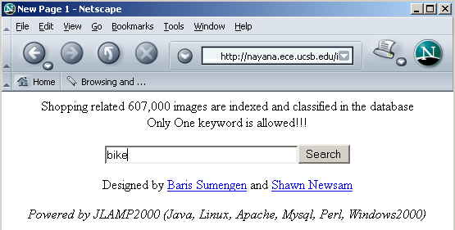
Relevance Feedback Example
Image Search Engine
http://nayana.ece.ucsb.edu/imsearch/imsearch.html

Slide 12
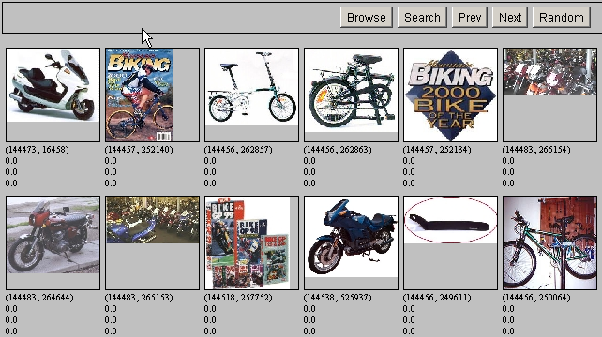
Initial Results

Slide 13
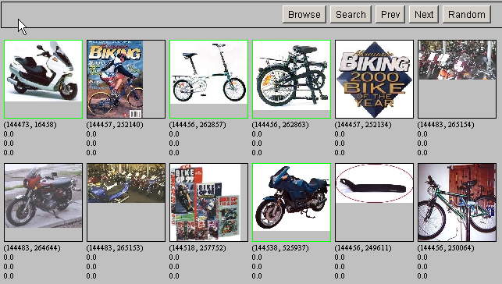
Relevance Feedback

Slide 14
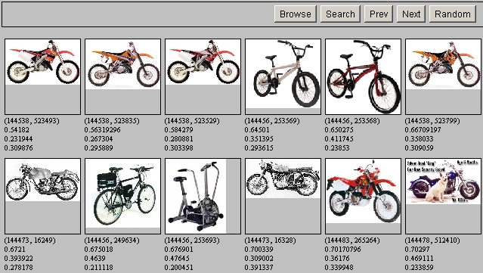
Revised Results

Slide 15
Updating Queries
Let’s assume that there is an optimal query
  The goal of relevance feedback is to bring the user query closer to the optimal query
How does relevance feedback actually work?
  Use relevance information to update query
  Use query to retrieve new set of documents
What exactly do we “feed back”?
  Boost weights of terms from relevant documents
  Add terms from relevant documents to the query
  Note that this is hidden from the user

Slide 16
Picture of Relevance Feedback
Initial query
x
x
x
x
o
x
x
x
x
Δ
x
x
x
o
x
o
x
Δ
x
o
x
o
o
x
x
x
x
Revised query
x non-relevant documents
o relevant documents

Slide 17
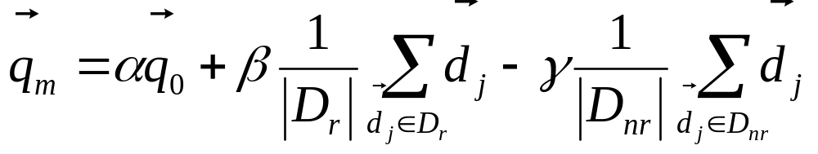
Rocchio Algorithm
Used in practice:
New query
  Moves toward relevant documents
  Away from irrelevant documents
q_{m} = modified query vector;
q₀ = original query vector;
α,β,γ: weights (hand-chosen or set empirically);
D_{r} = set of known relevant doc vectors;
D_{nr} = set of known irrelevant doc vectors

Slide 18
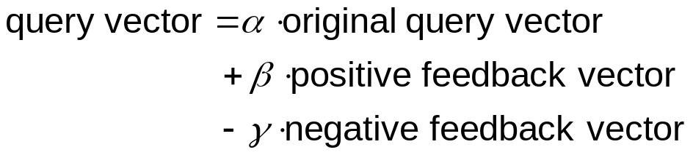



Rocchio in Pictures
Typically, γ < β
Original query
0
4
0
8
0
0
0
4
0
8
0
0
Positive Feedback
2
4
8
0
0
2
1
2
4
0
0
1
(+)
Negative feedback
8
0
4
4
0
16
2
0
1
1
0
4
(-)
New query
-1
6
3
7
0
-3
Notes:
16

Slide 19
Relevance Feedback: Assumptions
A1: User has sufficient knowledge for a reasonable initial query
A2: Relevance prototypes are “well-behaved”

Slide 20
Violation of A1
User does not have sufficient initial knowledge
Not enough relevant documents are retrieved in the initial query
Examples:
  Misspellings (Brittany Speers)
  Cross-language information retrieval
  Vocabulary mismatch (e.g., cosmonaut/astronaut)

Slide 21
Relevance Prototypes
Relevance feedback assumes that relevance prototypes are “well-behaved”
  All relevant documents are clustered together
  Different clusters of relevant documents, but they have significant vocabulary overlap
In other words,
  Term distribution in relevant documents will be similar
  Term distribution in non-relevant documents will be different from those in relevant documents

Slide 22
Violation of A2
There are several clusters of relevant documents
Examples:
  Burma/Myanmar
  Contradictory government policies
  Opinions

Slide 23
Evaluation
Compute standard measures with q₀
Compute standard measures with q_{m}
  Use all documents in the collection
    Spectacular improvements, but… it’s cheating!
    The user already selected relevant documents
  Use documents in residual collection (set of documents minus those assessed relevant)
    More realistic evaluation
    Relative performance can be validly compared
Empirically, one iteration of relevance feedback produces significant improvements
  More iterations don’t help

Slide 24
Relevance Feedback: Cost
Speed and efficiency issues
  System needs to spend time analyzing documents
  Longer queries are usually slower
Users often reluctant to provide explicit feedback
It’s often harder to understand why a particular document was retrieved

Slide 25
Koenemann and Belkin’s Work
Well-known study on relevance feedback in information retrieval
Questions asked:
  Does relevance feedback improve results?
  Is user control over relevance feedback helpful?
  How do different levels of user control effect results?
Jürgen Koenemann and Nicholas J. Belkin. (1996) A Case For Interaction: A Study of Interactive Information Retrieval Behavior and Effectiveness. Proceedings of SIGCHI 1996 Conference on Human Factors in Computing Systems (CHI 1996).

Slide 26
What’s the best interface?
Opaque (black box)
  User doesn’t get to see the relevance feedback process
Transparent
  User shown relevance feedback terms, but isn’t allowed to modify query
Penetrable
  User shown relevance feedback terms and is allowed to modify the query
Which do you think worked best?

Slide 27
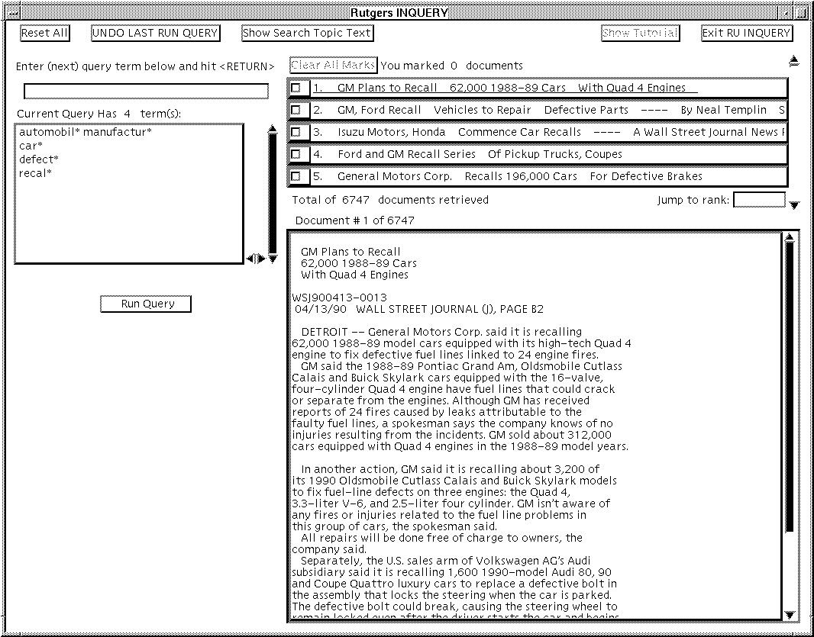
Query Interface

Slide 28
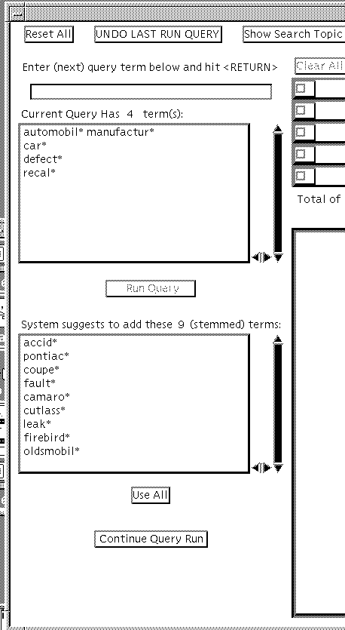
Penetrable Interface
Users get to select which terms they want to add

Slide 29
Study Details
Subjects started with a tutorial
  64 novice searchers (43 female, 21 male)
Goal is to keep modifying the query until they’ve developed one that gets high precision
INQUERY system used
TREC collection (Wall Street Journal subset)
Two search topics:
  Automobile Recalls
  Tobacco Advertising and the Young
Relevance judgments from TREC and experimenter

Slide 30
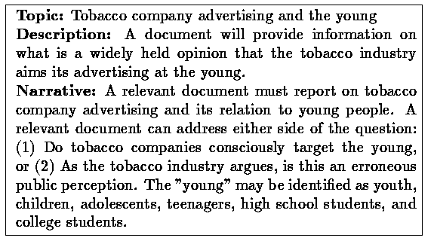
Sample Topic

Slide 31
Procedure
Baseline (Trial 1)
  Subjects get tutorial on relevance feedback
Experimental condition (Trial 2)
  Shown one of four modes: no relevance feedback, opaque, transparent, penetrable
Evaluation metric used: precision at 30 documents

Slide 32
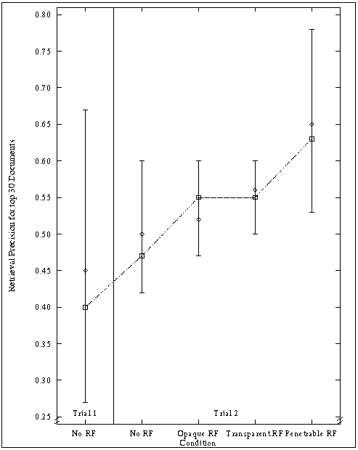
Precision Results

Slide 33
Relevance feedback works!
Subjects using the relevance feedback interfaces performed 17-34% better
Subjects in the penetrable condition performed 15% better than those in opaque and transparent conditions

Slide 34
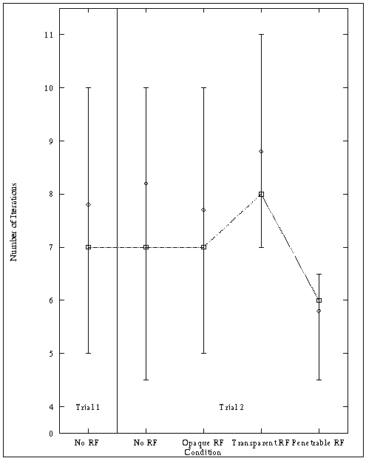
Number of Iterations

Slide 35
Behavior Results
Search times approximately equal
Precision increased in first few iterations
Penetrable interface required fewer iterations to arrive at final query
Queries with relevance feedback are much longer
  But fewer terms with the penetrable interface ⎯ users were more selective about which terms to add

Slide 36
Implicit Feedback
Users are often reluctant to provide relevance judgments
  Some searches are precision-oriented
  They’re lazy!
Can we gather feedback without requiring the user to do anything?
Idea: gather feedback from observed user behavior

Slide 37
Observable Behavior
Minimum Scope
Segment
Object
Class
Examine
View
Select
Listen
Retain
Print
Bookmark
Save
Purchase
Subscribe
Behavior Category
Delete
Reference
Copy / paste
Forward
Quote
Reply
Link
Cite
Annotate
Mark up
Rate
Organize
Publish

Slide 38
Discussion Point
How might user behaviors provide clues for relevance feedback?

Slide 39
So far…
Explicit feedback: take advantage of user-supplied relevance judgments
Implicit feedback: observe user behavior and draw inferences
Can we perform feedback without having a user in the loop?

Slide 40
Blind Relevance Feedback
Also called “pseudo relevance feedback”
Motivation: it’s difficult to elicit relevance judgments from users
  Can we automate this process?
Idea: take top n documents, and simply assume that they are relevant
Perform relevance feedback as before
If the initial hit list is reasonable, system should pick up good query terms
Does it work?

Slide 41
BRF Experiment
Retrieval engine: Indri
Test collection: TREC, topics 301-450
Procedure:
  Used topic description as query to generate initial hit list
  Selected top 20 terms from top 20 hits using tf.idf
  Added these terms to the original query

Slide 42
BRF Example
Number: 303
Title: Hubble Telescope Achievements
Description:
Identify positive accomplishments of the Hubble telescope since it was launched in 1991.
Narrative:
Documents are relevant that show the Hubble telescope has produced new data, better quality data than previously available, data that has increased human knowledge of the universe, or data that has led to disproving previously existing theories or hypotheses. Documents limited to the shortcomings of the telescope would be irrelevant. Details of repairs or modifications to the telescope without reference to positive achievements would not be relevant.
telescope 1041.33984032195
hubble 573.896477205696
space 354.090789112131
nasa 346.475671454331
ultraviolet 242.588034029191
shuttle 230.448255669841
mirror 184.794966339329
telescopes 155.290920607708
earth 148.865466409231
discovery 146.718067628756
orbit 142.597040178043
flaw 141.832019493907
scientists 132.384677410089
launch 116.322861618261
stars 116.205713485691
universe 114.705686405825
mirrors 113.677943638299
light 113.59717006967
optical 106.198288687586
species 103.555123536418
Terms added

Slide 43
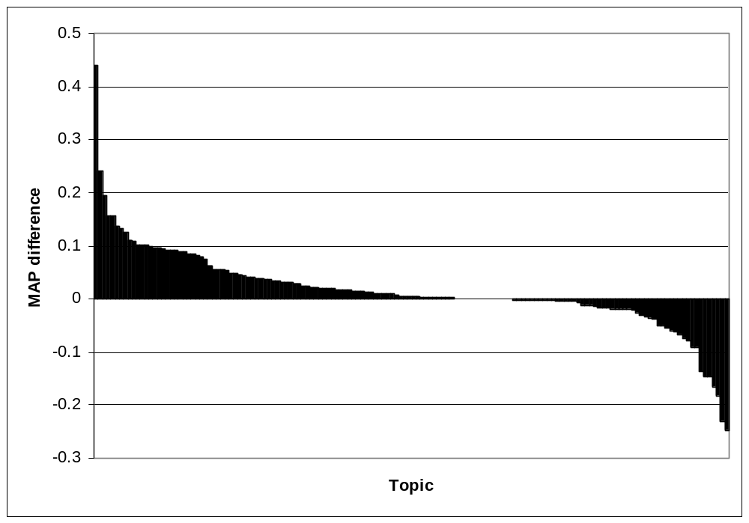
Results
 | MAP | R-Precision
No feedback | 0.1591 | 0.2022
With feedback | 0.1806 (+13.5%) | 0.2222 (+9.9%)
Blind relevance feedback doesn’t always help!

Slide 44
The Complete Landscape
Explicit, implicit, blind feedback: it’s all about manipulating terms
Dimensions of query expansion
  “Local” vs. “global”
  User involvement vs. no user involvement

Slide 45
Local vs. Global
“Local” methods
  Only considers documents that have be retrieved by an initial query
  Query specific
  Computations must be performed on the fly
“Global” methods
  Takes entire document collection into account
  Does not depend on the query
  Thesauri can be computed off-line (for faster access)

Slide 46
User Involvement
Query expansion can be done automatically
  New terms added without user intervention
Or it can place a user in the loop
  System presents suggested terms
  Must consider interface issues

Slide 47
Query Expansion Techniques
Where do techniques we’ve discussed fit?
Local
Global
Manual
Automatic

Slide 48
Global Methods
Controlled vocabulary
  For example, MeSH terms
Manual thesaurus
  For example, WordNet
Automatically derived thesaurus
  For example, based on co-occurrence statistics

Slide 49
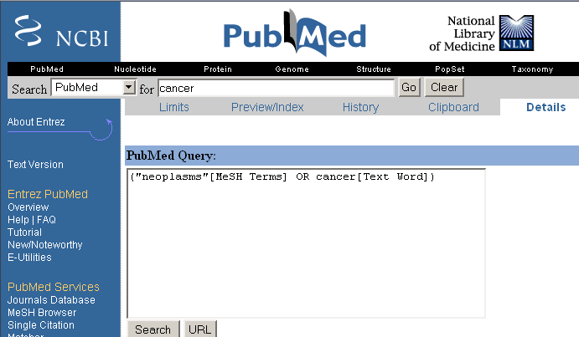
Using Controlled Vocabulary

Slide 50
Thesauri
A thesaurus may contain information about lexical semantic relations:
  Synonyms: similar words
  e.g., violin → fiddle
  Hypernyms: more general words
  e.g., violin → instrument
  Hyponyms: more specific words
  e.g., violin → Stradivari
  Meronyms: parts
  e.g., violin → strings

Slide 51
Using Manual Thesauri
For each query term t, added synonyms and related words from thesaurus
  feline → feline cat
Generally improves recall
Often hurts precision
  “interest rate” → “interest rate fascinate evaluate”
Manual thesauri are expensive to produce and maintain

Slide 52
Automatic Thesauri Generation
Attempt to generate a thesaurus automatically by analyzing the document collection
Two possible approaches
  Co-occurrence statistics (co-occurring words are more likely to be similar)
  Shallow analysis of grammatical relations
    Entities that are grown, cooked, eaten, and digested are more likely to be food items.

Slide 53
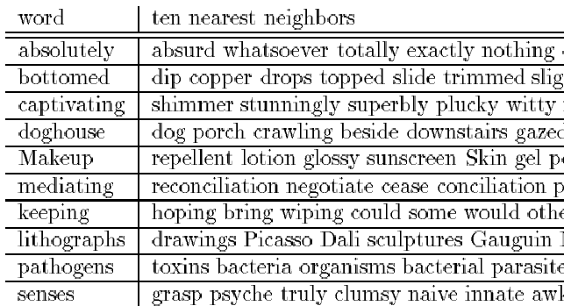
Automatic Thesauri: Example

Slide 54
Automatic Thesauri: Discussion
Quality of associations is usually a problem
Term ambiguity may introduce irrelevant statistically correlated terms.
  “Apple computer” → “Apple red fruit computer”
Problems:
  False positives: Words deemed similar that are not
  False negatives: Words deemed dissimilar that are similar
Since terms are highly correlated anyway, expansion may not retrieve many additional documents

Slide 55
Key Points
Moving beyond the black box… interaction is key!
Different types of interactions:
  System discovery
  Vocabulary discovery
  Concept discovery
  Document discovery
Different types of feedback:
  Explicit (user does the work)
  Implicit (system watches the user and guess)
  Blind (don’t even involve the user)
Query expansion as a general mechanism

Slide 56
One Minute Paper
What was the muddiest point in today’s class?

