Slide 1

LBSC 796/INFM 718R: Week 10
Clustering, Classifying, and Filtering
Jimmy Lin
College of Information Studies
University of Maryland
Monday, April 10, 2006

Slide 2
The Information Retrieval Cycle
Source
Selection
Resource
Query
Formulation
Query
Search
Ranked List
Selection
Documents
System discovery
Vocabulary discovery
Concept discovery
Document discovery
Examination
Documents
source reselection
Delivery

Slide 3
Organizing Search Results
Single document
Last week
Enhanced presentation
(syntax)
Concepts and relationships
(semantics)
Today
Collection of documents

Slide 4
Today’s Focus: Clustering
Can we do better than a ranked list?
How do we automatically group documents into clusters?
What are the issues to consider?

Slide 5
Related Topics
Using the tools in your toolbox to tackle related problems:
  Classification: automatically assign labels to documents
  Filtering: automatically decide if a document matches my information needs

Slide 6
Text Clustering
Automatically partition documents into clusters based on content
  Documents within each cluster should be similar
  Documents in different clusters should be different
Discover categories in an unsupervised manner
  No sample category labels provided by humans

Slide 7
Visualizing Clusters
Centroids

Slide 8
The Cluster Hypothesis
“Closely associated documents tend to be
relevant to the same requests.”
van Rijsbergen 1979
“… I would claim that document clustering
can lead to more effective retrieval than linear
search [which] ignores the relationships that
exist between documents.”
van Rijsbergen 1979

Slide 9
Outline of Clustering
How do you actually do it?
Why would you want to do it?
How can you build interfaces that support clustering?

Slide 10
Two Strategies
Aglommerative (bottom-up) methods
  Start with each document in its own cluster
  Iteratively combine smaller clusters to form larger clusters
Divisive (partitional, top-down) methods
  Directly separate documents into clusters

Slide 11
HAC
HAC = Hierarchical Agglomerative Clustering
Start with each document in its own cluster
Until there is only one cluster:
  Among the current clusters, determine the two clusters c_{i} and c_{j}, that are most similar
  Replace c_{i} and c_{j} with a single cluster c_{i} ∪ c_{j}
The history of merging forms the hierarchy

Slide 12
HAC
A B C D E F G H

Slide 13
What’s going on geometrically?

Slide 14
Cluster Similarity
Assume a similarity function that determines the similarity of two instances: sim(x,y)
  What’s appropriate for documents?
What’s the similarity between two clusters?
  Single Link: similarity of two most similar members
  Complete Link: similarity of two least similar members
  Group Average: average similarity between members

Slide 15
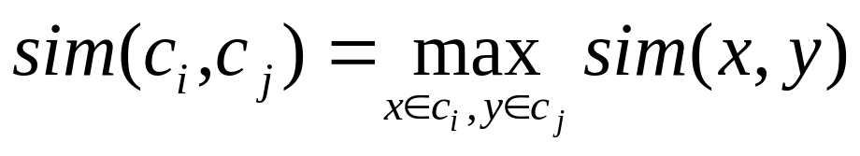
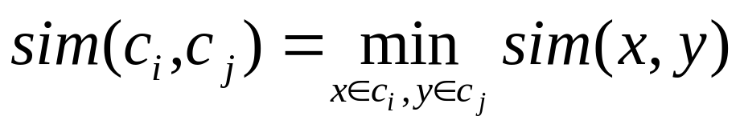
Different Similarity Functions
Single link:
  Uses maximum similarity of pairs:
  Can result in “straggly” (long and thin) clusters due to chaining effect
Complete link:
  Use minimum similarity of pairs:
  Makes more “tight,” spherical clusters

Slide 16
Non-Hierarchical Clustering
Typically, must provide the number of desired clusters, k
Randomly choose k instances as seeds, one per cluster
Form initial clusters based on these seeds
Iterate, repeatedly reallocating instances to different clusters to improve the overall clustering
Stop when clustering converges or after a fixed number of iterations

Slide 17
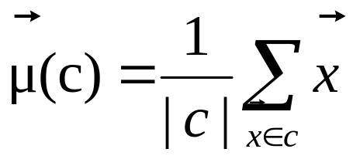
K-Means
Clusters are determined by centroids (center of gravity) of documents in a cluster:
Reassignment of documents to clusters is based on distance to the current cluster centroids

Slide 18
K-Means Algorithm
Let d be the distance measure between documents
Select k random instances {s₁, s₂,… s_{k}} as seeds.
Until clustering converges or other stopping criterion:
  Assign each instance x_{i} to the cluster c_{j} such that
  d(x_{i}, s_{j}) is minimal
  Update the seeds to the centroid of each cluster
  For each cluster c_{j}, s_{j} = μ(c_{j})

Slide 19
K-Means Clustering Example
Pick seeds
Reassign clusters
Compute centroids
Reasssign clusters
x
x
x
Compute centroids
x
x
x
Reassign clusters
Converged!

Slide 20
K-Means: Discussion
How do you select k?
Results can vary based on random seed selection
  Some seeds can result in poor convergence rate, or convergence to sub-optimal clusters

Slide 21
Why cluster for IR?
Cluster the collection
  Retrieve clusters instead of documents
Cluster the results
“Closely associated documents tend to be relevant to the same requests.”
“… I would claim that document clustering can lead to more effective retrieval than linear search [which] ignores the relationships that exist between documents.”

Slide 22
From Clusters to Centroids
Centroids

Slide 23
Clustering the Collection
Basic idea:
  Cluster the document collection
  Find the centroid of each cluster
  Search only on the centroids, but retrieve clusters
If the cluster hypothesis is true, then this should perform better
Why would you want to do this?
Why doesn’t it work?

Slide 24
Clustering the Results
Scatter/Gather
Swish
(Hearst and Pedersen, 1996)
(Chen and Dumais, 2000)

Slide 25
Scatter/Gather
How it works
  The system clusters documents into general “themes”
  The system displays the contents of the clusters by showing topical terms and typical titles
  User chooses a subset of the clusters
  The system automatically re-clusters documents within selected cluster
  The new clusters have different, more refined, “themes”
Originally used to give collection overview
Evidence suggests more appropriate for displaying retrieval results in context
Marti A. Hearst and Jan O. Pedersen. (1996) Reexaming the Cluster Hypothesis: Scatter/Gather on Retrieval Results. Proceedings of SIGIR 1996.

Slide 26
Scatter/Gather Example
Query = “star” on encyclopedic text
sports 14 docs
film, tv 47 docs
music 7 docs
symbols 8 docs
film, tv 68 docs
astrophysics 97 docs
astronomy 67 docs
flora/fauna 10 docs
stellar phenomena 12 docs
galaxies, stars 49 docs
constellations 29 docs
miscellaneous 7 docs
Clustering and re-clustering is entirely automated

Slide 27
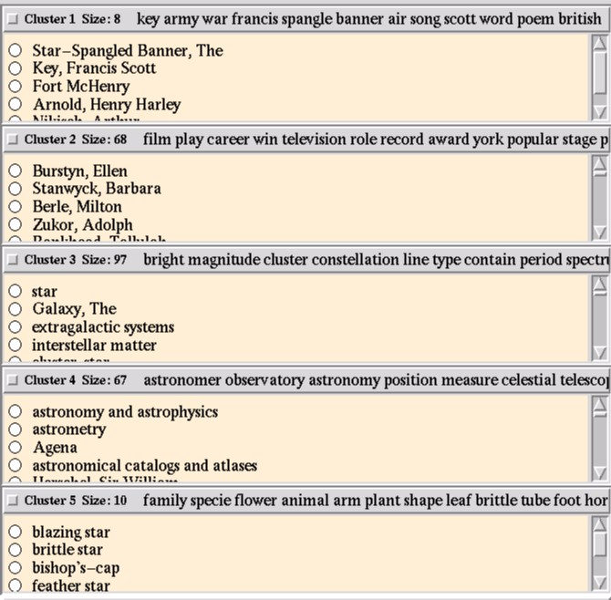

Slide 28
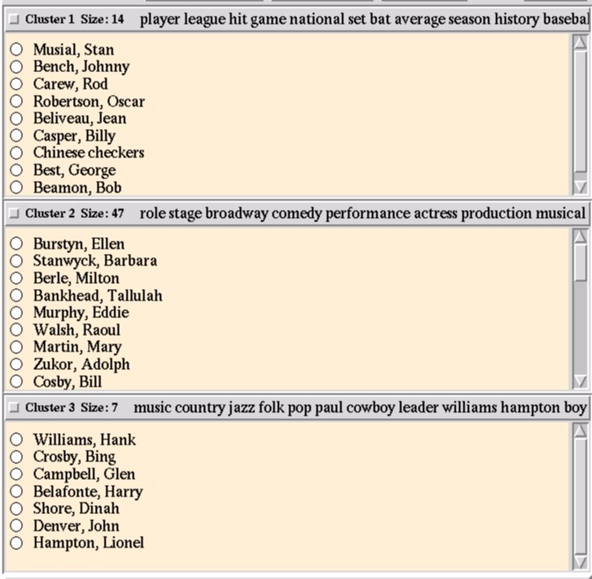

Slide 29
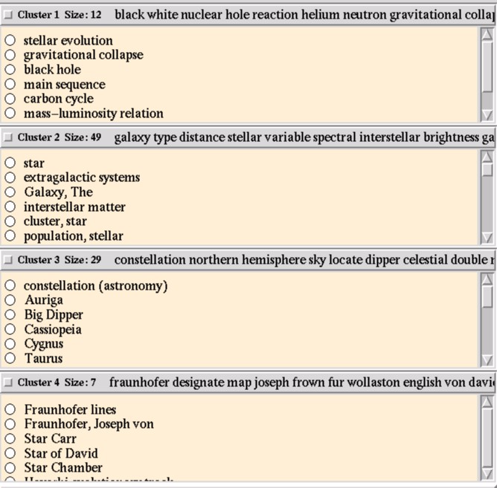

Slide 30
Clustering Result Sets
Advantages:
  Topically coherent sets of documents are presented to the user together
  User gets a sense for the range of themes in the result set
  Supports exploration and browsing of retrieved hits
Disadvantage:
  Clusters might not “make sense”
  May be difficult to understand the theme of a cluster based on summary terms
  Additional computational processing required
Things to ponder:
  What is the relationship between clusters and classification systems?
  Why does this work?

Slide 31
Two Queries: Two Clusterings
AUTO, CAR, ELECTRIC
AUTO, CAR, SAFETY
8 control drive accident …
25 battery california technology …
48 import j. rate honda toyota …
16 export international unit japan …
3 service employee automatic …
6 control inventory integrate …
10 investigation washington …
12 study fuel death bag air …
61 sale domestic truck import …
11 japan export defect unite …
…
…
The main differences are the clusters that are central to the query

Slide 32
The SWISH System
Basic idea:
  Use an existing hierarchical category structure to organize results of Web searches
  Automatically classify Web pages into the relevant category
  Present search results grouped according to categories
Research questions:
  How does a category interface compare with a list interface?
  What features of a category interface would users find useful?
Hao Chen and Susan Dumais. (2000) Bringing Order to the Web: Automatically Categorizing Search Results. Proceedings of CHI 2000.

Slide 33
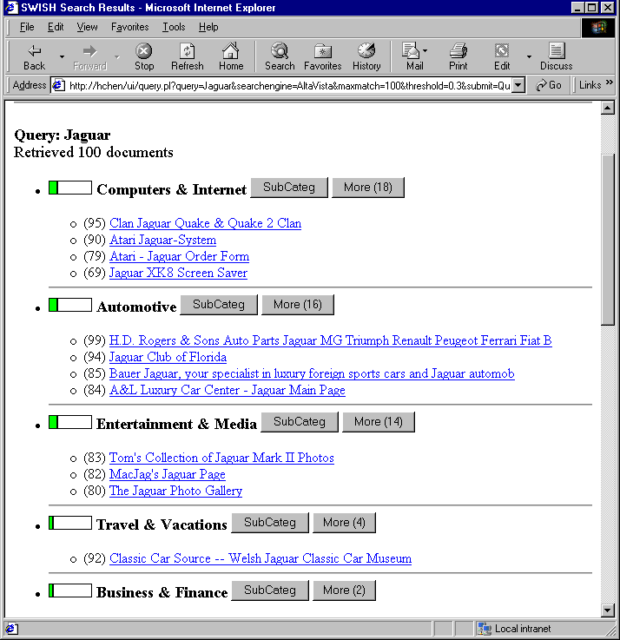
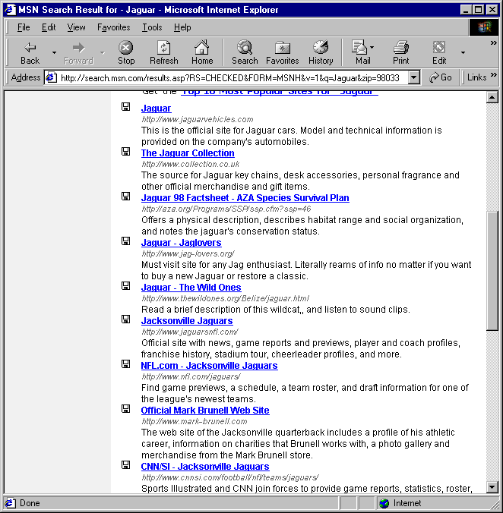
Organizing Search Results
Query: jaguar
Category Interface
List Interface
Notes:
When you search for info on web, you get a long undifferentiated list of results.
Our system, SWISH, automatically organizes search results into a category structure, so users can easily see different aspects of the results. In this example, the query Jaguar has pages related to “automobiles”, “computers”, and “animals” – that are nicely separated in the Category view but intermixed in the List view.
During the rest of the talk, I’m going to tell you how we do this.

Slide 34
Category Structure
Category hierarchy taken from LookSmart Web Directory (Spring, 1999)
  13 top-level categories
  150 second-level categories
Top-level Categories:
  Automotive
  Business & Finance
  Computers & Internet
  Entertainment & Media
  Health & Fitness
  Hobbies & Interests
  Home & Family
  People & Chat
  Reference & Education
  Shopping & Services
  Society & Politics
  Sports & Recreation
  Travel & Vacations

Slide 35
Interface Characteristics
Problems
  Large amount of information to display
  Limited screen real estate
Solutions
  Information overlay (“mouseovers”)
  Expandable information display

Slide 36
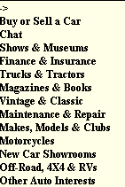
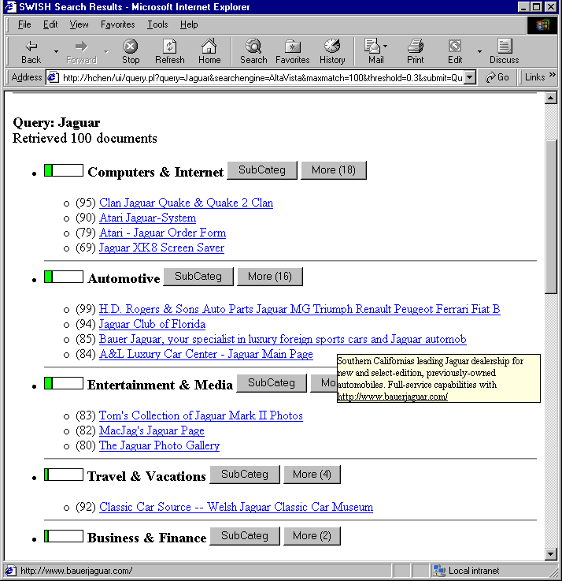
Information Overlay
Use “mouseovers” to show
  Summaries of web pages
  Category hierarchy

Slide 37
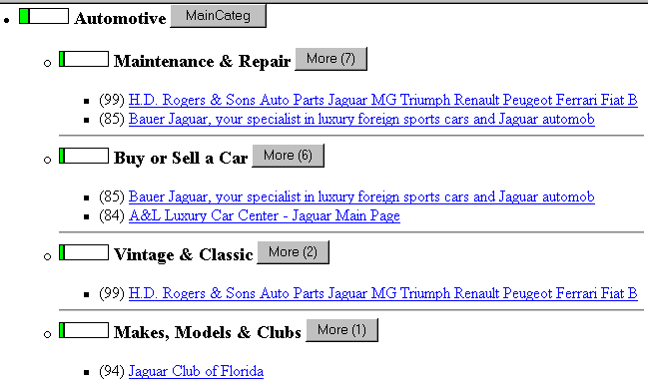
Expansion of Category Structure

Slide 38
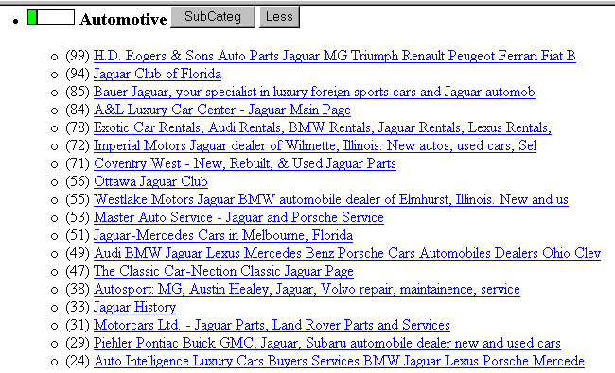
Expansion of Web Page List
Notes:
To save screen space, only a small portions of web pages are displayed within each category initially. The user may expand the category to see all pages.

Slide 39
Interface Conditions
Category Interface
List Interface
Notes:
When you search for info on web, you get a long undifferentiated list of results.
Our system, SWISH, automatically organizes search results into a category structure, so users can easily see different aspects of the results. In this example, the query Jaguar has pages related to “automobiles”, “computers”, and “animals” – that are nicely separated in the Category view but intermixed in the List view.
During the rest of the talk, I’m going to tell you how we do this.

Slide 40
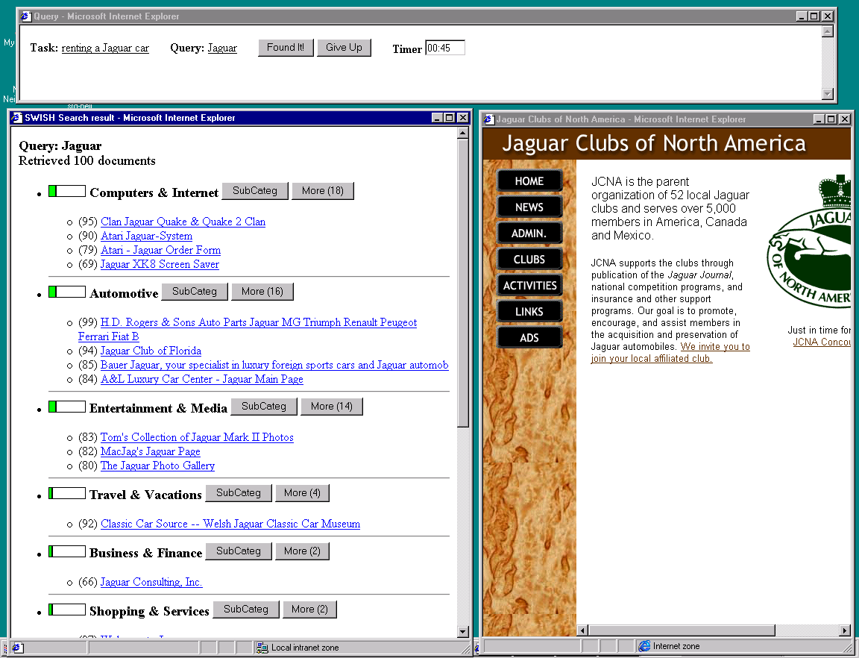
User Study Interface

Slide 41
User Study
Participants: 18 “intermediate” Web users
Tasks
  30 search tasks, e.g., “Find home page for Seattle Art Museum”
  Search terms are fixed for each task (cached Web pages)
Experimental Design
  Category/List – within subjects (15 search tasks with each interface)
  Order (Category/List first) – counterbalanced between subjects
Both Subjective and Objective Measures

Slide 42
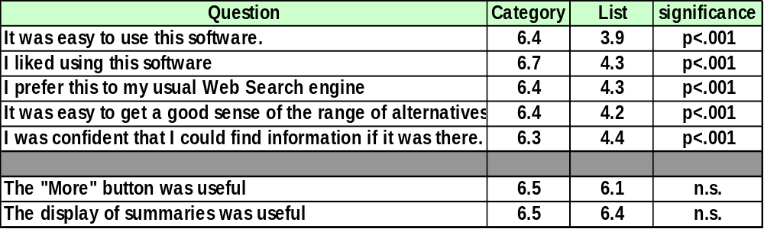
Subjective Results
7-point rating scale (1=disagree; 7=agree)
Notes:
In the first part of the questions, participants were asked to rate each interface. Category interface was rated higher than the list interface and the difference is statistically significant.
In the second part of the questions, participants were also asked to rate the same interface features in both interfaces, such as tooltips and expansion/collaping of structures. The result shows no statiscally significant difference. This suggests that the participants do not have overall bias against the list interface.

Slide 43
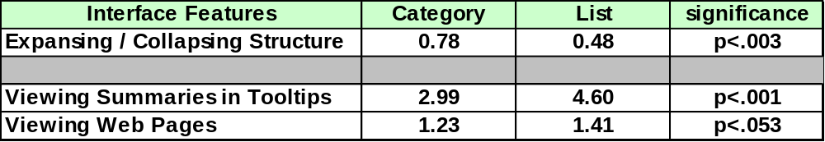
Use of Interface Features
Average number of uses of feature per task:
Notes:
Need to focus on what the main points are
category: more operations to manipulate structure … not surprising
category: look at fewer summaries and actual pages … we think this is because category context helps disambiguate the titles. Therefore, the participants are overall faster in finding information in the category interface.
<careful not to say “time”>

Slide 44
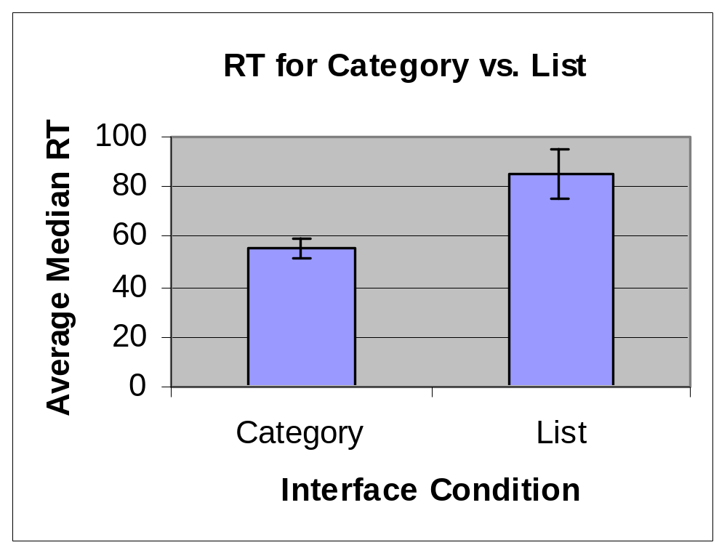
Search Time
Category: 56 sec.
List: 85 sec. (p < .002)
50% faster with category interface!

Slide 45
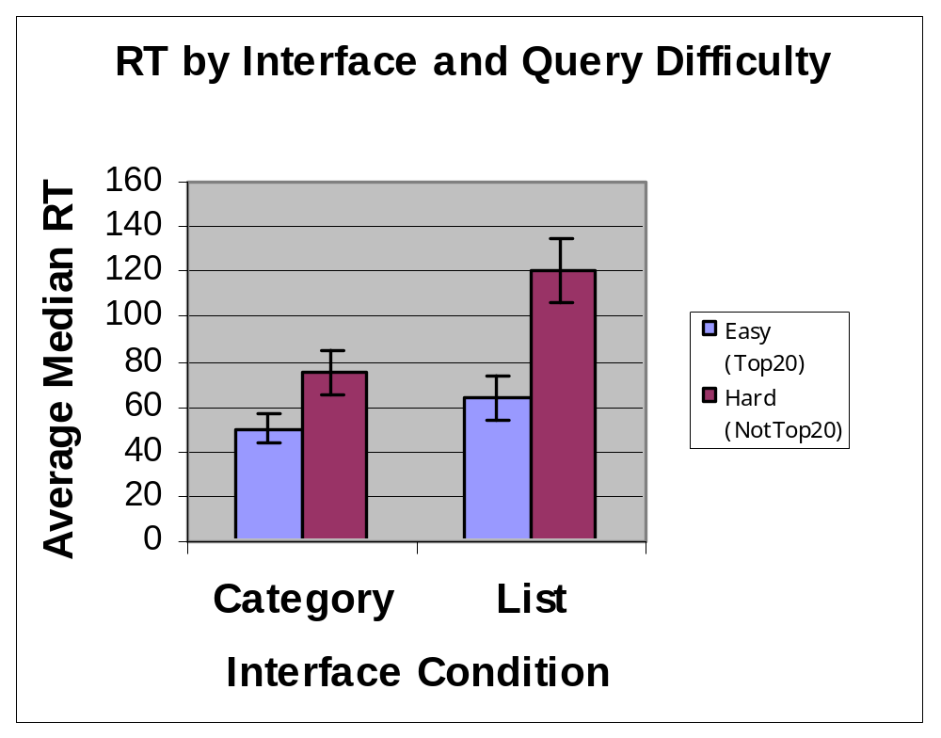
Search Time by Query Difficulty
Category interface is helpful for both easy and difficult queries!
Notes:
Further analyses by query difficulty – easy here mean the answer was in the Top20
Not surprisingly, faster for easy queries
Interestingly, the advantage of the category interface is seen both easy and hard queries

Slide 46
Visualization of Clusters
Feature Maps
Other 2D and 3D displays

Slide 47
Kohonen’s Feature Maps
AKA Self-Organizing Maps
Expresses complex, non-linear relationships between high dimensional data on a 2D display
  Geometric relationships on display preserve some relationships in original data set

Slide 48
Map Attributes
Different areas correspond to different concepts in collection
Size of area corresponds to its relative importance in set
Neighboring regions share commonalities

Slide 49
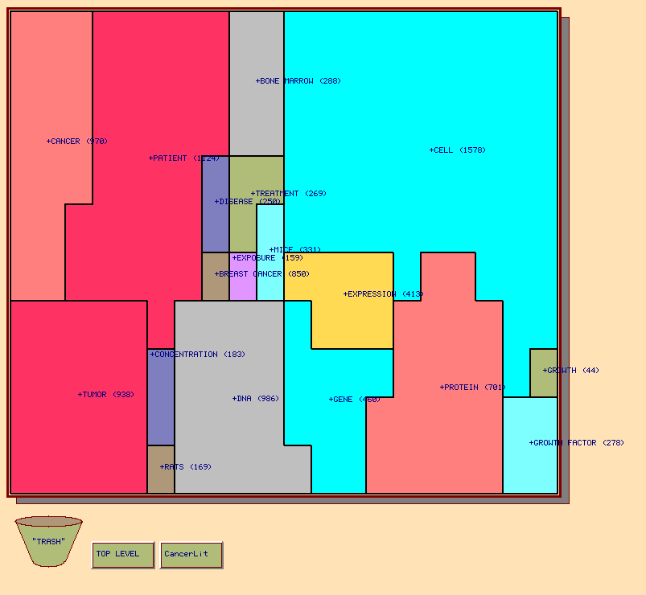

Slide 50
Study of Kohonen Feature Maps
Comparison: Kohonen Map and Yahoo
Task:
  “Window shop” for interesting home page
  Repeat with other interface
Results:
  Starting with map could repeat in Yahoo (8/11)
  Starting with Yahoo unable to repeat in map (2/14)
Hsinchun Chen, Andrea L. Houston, Robin R. Sewell, and Bruce R. Schatz. (1998) Journal of the American Society for Information Science, 49(7):582-603.

Slide 51
Feature Map Study (1)
Participants liked:
  Correspondence of region size to # documents
  Overview (but also wanted zoom)
  Ease of jumping from one topic to another
  Multiple routes to topics
  Use of category and subcategory labels

Slide 52
Feature Map Study (2)
Participants wanted:
  Hierarchical organization
  Other ordering of concepts (alphabetical)
  Integration of browsing and search
  Correspondence of color to meaning
  More meaningful labels
  Labels at same level of abstraction
  Fit more labels in the given space
  Combined keyword and category search
  Multiple category assignment (sports+entertainment)

Slide 53
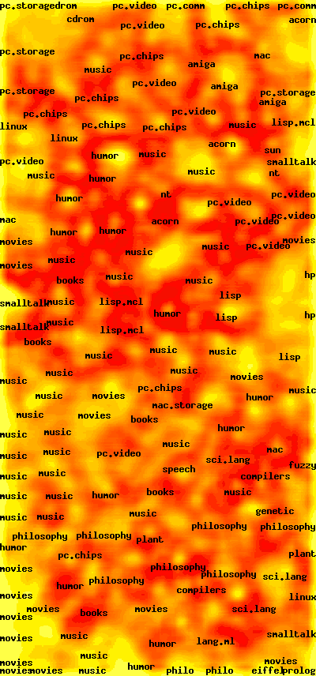
WEBSOM
Self-organizing map of Net newsgroups and postings

Slide 54
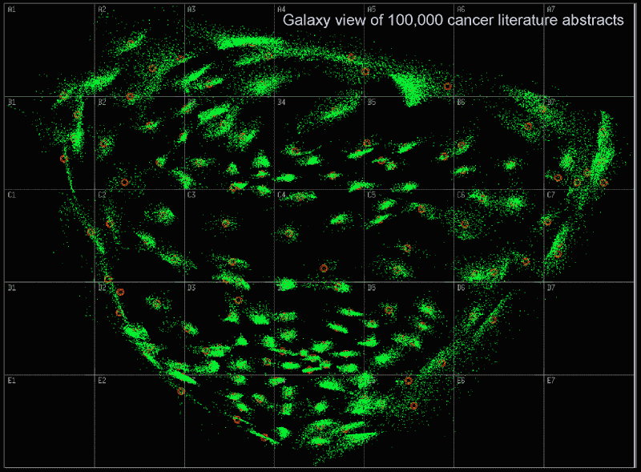
Galaxies

Slide 55
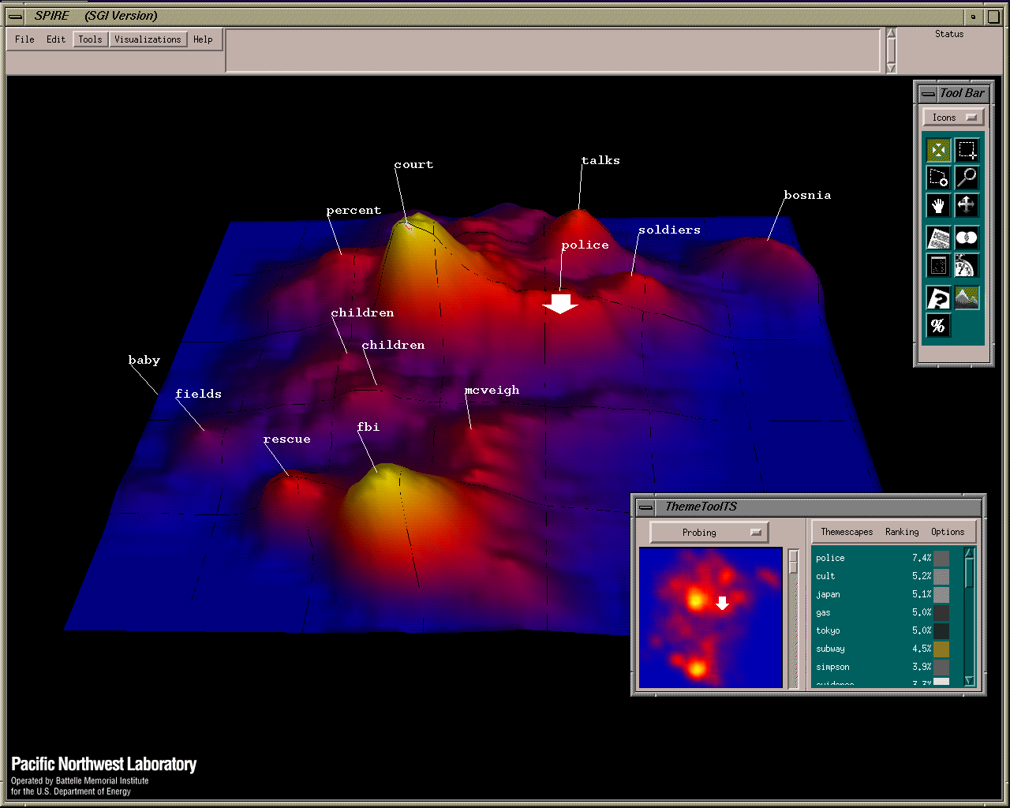
Themescape

Slide 56
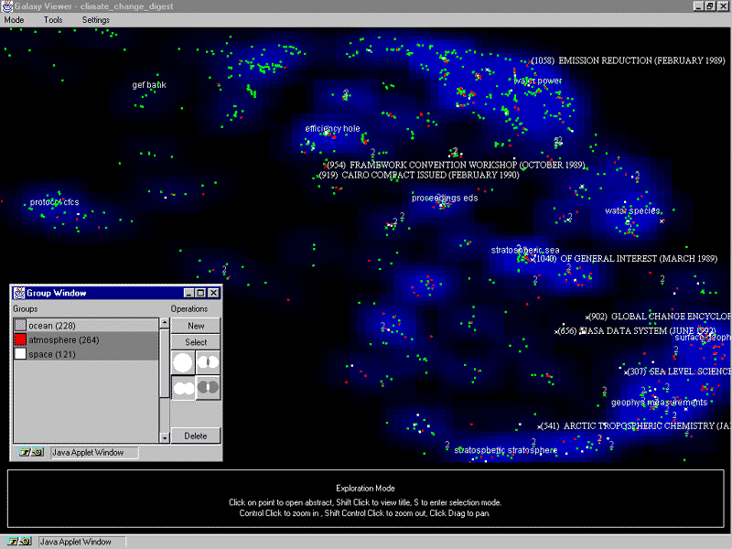
WebTheme

Slide 57
TreeMaps
Demos
  http://www.smartmoney.com/marketmap/
  http://www.cs.umd.edu/hcil/treemap/

Slide 58
Deployment
Web Search engine that employ clustering:
  http://www.vivisimo.com
  http://www.kartoo.com/

Slide 59
Summary: Clustering
Advantages:
  Provides users with an overview of main themes in search results
  Helps combat polysemy
  Can improve retrieval effectiveness
Disadvantages:
  Documents can be clustered in many ways
  Not always easy to understand the theme of a cluster
  What is the correct level of granularity?
  More information to present; requires careful design of user interfaces

Slide 60
Text Classification
Problem: automatically sort items into bins
Examples:
  Spam vs. non-spam
  Interesting vs. non-interesting
Machine learning approach
  Obtain a training set with ground truth labels
  Use a machine learning algorithm to “train” a classifier
    kNN, Bayesian classifier, SVMs, decision trees, etc.
  Apply classifier to new documents
    System assigns labels according to patterns learned in the training set
Notes:
27
Start 3:20

Slide 61
Machine Learning
Training
Testing
Training examples
Unlabeled
Document
label₁
label₂
label₃
label₄
Representation Function
label₁?
Text Classifier
label₂?
Supervised Machine
Learning Algorithm
label₃?
label₄?

Slide 62
kNN
A simple text classification algorithm: k Nearest Neighbors
Select k document that are similar to the test document
  Have them vote on what the correct label should be
  How can similarity be defined?

Slide 63
Information Access Problems
Different
Each Time
Retrieval
Information Need
Stable
Filtering
Stable
Different
Each Time
Collection
Notes:
5

Slide 64
Information Filtering
An abstract problem in which:
  The information need is stable: characterized by a “profile”
  A stream of documents is arriving: each must either be presented to the user or not
Introduced by Luhn in 1958
  As “Selective Dissemination of Information”
Named “filtering” by Denning in 1975
Notes:
6

Slide 65
A Simple Filtering Strategy
Use any information retrieval system
  Boolean, vector space, probabilistic, …
Have the user specify a “standing query”
  This will be the profile
Limit the standing query by date
  For each use, show new documents since the last use
Notes:
7

Slide 66
Social Filtering
Exploit ratings from other users as features
  Like personal recommendations, peer review, …
Reaches beyond topicality to:
  Accuracy, coherence, depth, novelty, style, …
Applies equally well to other modalities
  Movies, recorded music, …
Sometimes called “collaborative” filtering
Notes:
27

Slide 67
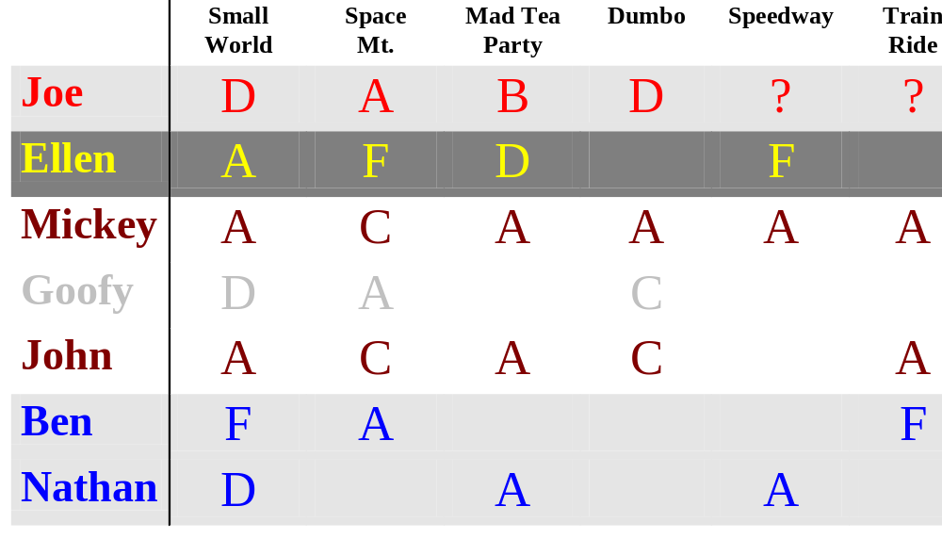
Using Positive Information
Source: Jon Herlocker, SIGIR 1999

Slide 68

Using Negative Information
Source: Jon Herlocker, SIGIR 1999

Slide 69
Some Things We (Sort of) Know
Treating each genre separately can be useful
  Separate predictions for separate tastes
Negative information can be useful
  “I hate everything my parents like”
People like to know who provided ratings
Popularity provides a useful fallback
People don’t like to provide ratings
Notes:
29

Slide 70
The Cold Start Problem
Social filtering will not work in isolation
  Without ratings, we get no recommendations
  Without recommendations, we read nothing
  Without reading, we get no ratings
An initial recommendation strategy is needed
  Stereotypes
  Content-based search

Slide 71
Cold Start: Potential Solutions
Provide motivation:
  Self-interest
  Altruism
  Economic benefit
Implicit feedback

Slide 72
Sample Observations
User selects an article
  Interpretation: Summary was interesting
User quickly prints the article
  Interpretation: They want to read it
User selects a second article
  Interpretation: another interesting summary
User scrolls around in the article
  Interpretation: Parts with high dwell time and/or repeated revisits are interesting
User stops scrolling for an extended period
  Interpretation: User was interrupted

Slide 73
Critical Issues
Protecting privacy
  What absolute assurances can we provide?
  How can we make remaining risks understood?
Scalable rating servers
  Is a fully distributed architecture practical?
Non-cooperative users
  How can the effect of spamming be limited?

Slide 74
Recap
Clustering
  Automatically group documents into clusters
Classification
  Automatically assign labels to documents
Filtering
  Automatically decide if a document matches my information needs
Many approaches to the same elephant

