Slide 1

Big Data Infrastructure
CS 489/698 Big Data Infrastructure (Winter 2017)
Week 7: Analyzing Relational Data (2/3)
February 9, 2017
Jimmy Lin
David R. Cheriton School of Computer Science
University of Waterloo
These slides are available at http://lintool.github.io/bigdata-2017w/
This work is licensed under a Creative Commons Attribution-Noncommercial-Share Alike 3.0 United States See http://creativecommons.org/licenses/by-nc-sa/3.0/us/ for details

Slide 2
external APIs
users
users
Frontend
Frontend
Frontend
Backend
Backend
Backend
OLTP database
OLTP database
OLTP database
ETL (Extract, Transform, and Load)
Data Warehouse
BI tools
analysts

Slide 3

Jeff Hammerbacher, Information Platforms and the Rise of the Data Scientist. In, Beautiful Data, O’Reilly, 2009.
“On the first day of logging the Facebook clickstream, more than 400 gigabytes of data was collected. The load, index, and aggregation processes for this data set really taxed the Oracle data warehouse. Even after significant tuning, we were unable to aggregate a day of clickstream data in less than 24 hours.”

Slide 4

users
Frontend
Backend
“OLTP”
Wait, so why not use a database to begin with?
ETL (Extract, Transform, and Load)
Cost + Scalability
SQL-on-Hadoop
Hadoop
map
map
map
…
map
map
…
map
map
map
…
map
reduce
reduce
reduce
map
map
…
map
…
reduce
reduce
…
reduce
reduce
reduce
…
reduce
reduce
reduce
…
reduce
data scientists

Slide 5
Databases are great…
If your data has structure (and you know what the structure is)
If your data is reasonably clean
If you know what queries you’re going to run ahead of time
Databases are not so great…
If your data has little structure (or you don’t know the structure)
If your data is messy and noisy
If you don’t know what you’re looking for

Slide 6
external APIs
users
users
Frontend
Frontend
Frontend
Backend
Backend
Backend
OLTP database
OLTP database
OLTP database
ETL (Extract, Transform, and Load)
“Data Lake”
Data Warehouse
Other tools
SQL on Hadoop
“Traditional”
BI tools
data scientists

Slide 7
What’s the selling point of SQL-on-Hadoop?
Trade (a little?) performance for flexibility
“Data Lake”
Data Warehouse
Other tools
SQL on Hadoop
“Traditional”
BI tools
data scientists

Slide 8

SQL-on-Hadoop
SQL query interface
Execution Layer
HDFS
Other Data Sources
Today: How all of this works…

Slide 9
Hive: Example
Relational join on two tables:
Table of word counts from Shakespeare collection
Table of word counts from the bible
SELECT s.word, s.freq, k.freq FROM shakespeare s
JOIN bible k ON (s.word = k.word) WHERE s.freq >= 1 AND k.freq >= 1 ORDER BY s.freq DESC LIMIT 10;
the 25848 62394
I 23031 8854
and 19671 38985
to 18038 13526
of 16700 34654
a 14170 8057
you 12702 2720
my 11297 4135
in 10797 12445
is 8882 6884
Source: Material drawn from Cloudera training VM

Slide 10
Hive: Behind the Scenes
SELECT s.word, s.freq, k.freq FROM shakespeare s
JOIN bible k ON (s.word = k.word) WHERE s.freq >= 1 AND k.freq >= 1 ORDER BY s.freq DESC LIMIT 10;
(Abstract Syntax Tree)
(TOK_QUERY (TOK_FROM (TOK_JOIN (TOK_TABREF shakespeare s) (TOK_TABREF bible k) (= (. (TOK_TABLE_OR_COL s) word) (. (TOK_TABLE_OR_COL k) word)))) (TOK_INSERT (TOK_DESTINATION (TOK_DIR TOK_TMP_FILE)) (TOK_SELECT (TOK_SELEXPR (. (TOK_TABLE_OR_COL s) word)) (TOK_SELEXPR (. (TOK_TABLE_OR_COL s) freq)) (TOK_SELEXPR (. (TOK_TABLE_OR_COL k) freq))) (TOK_WHERE (AND (>= (. (TOK_TABLE_OR_COL s) freq) 1) (>= (. (TOK_TABLE_OR_COL k) freq) 1))) (TOK_ORDERBY (TOK_TABSORTCOLNAMEDESC (. (TOK_TABLE_OR_COL s) freq))) (TOK_LIMIT 10)))
(one or more of MapReduce jobs)

Slide 11
Hive: Behind the Scenes
STAGE DEPENDENCIES:
Stage-1 is a root stage
Stage-2 depends on stages: Stage-1
Stage-0 is a root stage
STAGE PLANS:
Stage: Stage-1
Map Reduce
Alias -> Map Operator Tree:
s
TableScan
alias: s
Filter Operator
predicate:
expr: (freq >= 1)
type: boolean
Reduce Output Operator
key expressions:
expr: word
type: string
sort order: +
Map-reduce partition columns:
expr: word
type: string
tag: 0
value expressions:
expr: freq
type: int
expr: word
type: string
k
TableScan
alias: k
Filter Operator
predicate:
expr: (freq >= 1)
type: boolean
Reduce Output Operator
key expressions:
expr: word
type: string
sort order: +
Map-reduce partition columns:
expr: word
type: string
tag: 1
value expressions:
expr: freq
type: int
Stage: Stage-2
Map Reduce
Alias -> Map Operator Tree:
hdfs://localhost:8022/tmp/hive-training/364214370/10002
Reduce Output Operator
key expressions:
expr: _col1
type: int
sort order: -
tag: -1
value expressions:
expr: _col0
type: string
expr: _col1
type: int
expr: _col2
type: int
Reduce Operator Tree:
Extract
Limit
File Output Operator
compressed: false
GlobalTableId: 0
table:
input format: org.apache.hadoop.mapred.TextInputFormat
output format: org.apache.hadoop.hive.ql.io.HiveIgnoreKeyTextOutputFormat
Stage: Stage-0
Fetch Operator
limit: 10
Reduce Operator Tree:
Join Operator
condition map:
Inner Join 0 to 1
condition expressions:
0 {VALUE._col0} {VALUE._col1}
1 {VALUE._col0}
outputColumnNames: _col0, _col1, _col2
Filter Operator
predicate:
expr: ((_col0 >= 1) and (_col2 >= 1))
type: boolean
Select Operator
expressions:
expr: _col1
type: string
expr: _col0
type: int
expr: _col2
type: int
outputColumnNames: _col0, _col1, _col2
File Output Operator
compressed: false
GlobalTableId: 0
table:
input format: org.apache.hadoop.mapred.SequenceFileInputFormat
output format: org.apache.hadoop.hive.ql.io.HiveSequenceFileOutputFormat

Slide 12
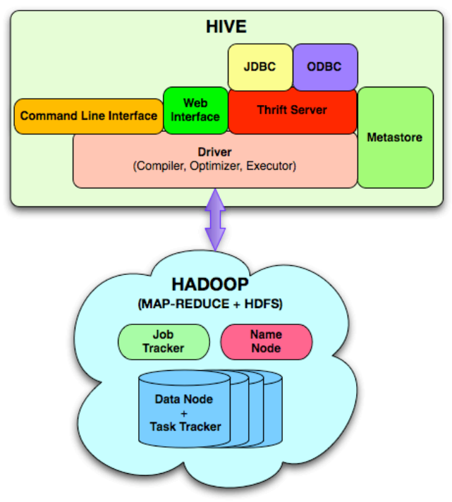
Hive Architecture

Slide 13
Hive Implementation
Metastore holds metadata
Tables schemas (field names, field types, etc.) and encoding
Permission information (roles and users)
Hive data stored in HDFS
Tables in directories
Partitions of tables in sub-directories
Actual data in files (plain text or binary encoded)
Feature or bug?
(this is the essence of SQL-on-Hadoop)

Slide 14
external APIs
users
users
Frontend
Frontend
Frontend
Backend
Backend
Backend
OLTP database
OLTP database
OLTP database
ETL (Extract, Transform, and Load)
“Data Lake”
Data Warehouse
Other tools
SQL on Hadoop
“Traditional”
BI tools
data scientists

Slide 15
A Simple OLAP Schema
Dim_Customer
Dim_Date
Dim_Product
Fact_Sales
Dim_Store

Slide 16
TPC-H Data Warehouse

Slide 17
OLAP Cubes
time
Common operations
slice and dice
roll up/drill down
pivot
product
store

Slide 18

MapReduce algorithms for processing relational data
Source: www.flickr.com/photos/stikatphotography/1590190676/

Slide 19
Relational Algebra
Primitives
Projection (π)
Selection (σ)
Cartesian product (×)
Set union (∪)
Set difference (−)
Rename (ρ)
Other Operations
Join (⋈)
Group by… aggregation
…

Slide 20
Selection
R₁
R₂
R₁
R₃
R₃
R₄
R₅

Slide 21
Selection in MapReduce
Easy!
In mapper: process each tuple, only emit tuples that meet criteria
Can be pipelined with projection
No reducers necessary (unless to do something else)
Performance mostly limited by HDFS throughput
Speed of encoding/decoding tuples becomes important
Take advantage of compression when available
Semistructured data? No problem!

Slide 22
Projection
R₁
R₁
R₂
R₂
R₃
R₃
R₄
R₄
R₅
R₅

Slide 23
Projection in MapReduce
Easy!
In mapper: process each tuple, re-emit with only projected attributes
Can be pipelined with selection
No reducers necessary (unless to do something else)
Implementation detail: bookkeeping required
Need to keep track of attribute mappings after projection e.g., name was r[4], becomes r[1] after projection
Performance mostly limited by HDFS throughput
Speed of encoding/decoding tuples becomes important
Take advantage of compression when available
Semistructured data? No problem!

Slide 24
Group by… Aggregation
Aggregation functions:
AVG, MAX, MIN, SUM, COUNT, …
MapReduce implementation:
Map over dataset, emit tuples, keyed by group by attribute
Framework automatically groups values by group by attribute
Compute aggregation function in reducer
Optimize with combiners, in-mapper combining
You already know how to do this!

Slide 25
Remember this?
Combiner Design
(week 2)
Combiners and reducers share same method signature
Sometimes, reducers can serve as combiners
Often, not…
Remember: combiner are optional optimizations
Should not affect algorithm correctness
May be run 0, 1, or multiple times
Example: find average of integers associated with the same key
SELECT key, AVG(value) FROM r GROUP BY key;

Slide 26
Computing the Mean: Version 1
class Mapper {
def map(key: Text, value: Int, context: Context) = {
context.write(key, value)
}
}
class Reducer {
def reduce(key: Text, values: Iterable[Int], context: Context) {
for (value <- values) {
sum += value
cnt += 1
}
context.write(key, sum/cnt)
}
}
Why can’t we use reducer as combiner?

Slide 27
Computing the Mean: Version 2
class Mapper {
def map(key: Text, value: Int, context: Context) =
context.write(key, value)
}
class Combiner {
def reduce(key: Text, values: Iterable[Int], context: Context) = {
for (value <- values) {
sum += value
cnt += 1
}
context.write(key, (sum, cnt))
}
}
class Reducer {
def reduce(key: Text, values: Iterable[Pair], context: Context) = {
for (value <- values) {
sum += value.left
cnt += value.right
}
context.write(key, sum/cnt)
}
}
Why doesn’t this work?

Slide 28
Computing the Mean: Version 3
class Mapper {
def map(key: Text, value: Int, context: Context) =
context.write(key, (value, 1))
}
class Combiner {
def reduce(key: Text, values: Iterable[Pair], context: Context) = {
for (value <- values) {
sum += value.left
cnt += value.right
}
context.write(key, (sum, cnt))
}
}
class Reducer {
def reduce(key: Text, values: Iterable[Pair], context: Context) = {
for (value <- values) {
sum += value.left
cnt += value.right
}
context.write(key, sum/cnt)
}
}
Fixed?

Slide 29
Computing the Mean: Version 4
class Mapper {
val sums = new HashMap()
val counts = new HashMap()
def map(key: Text, value: Int, context: Context) = {
sums(key) += value
counts(key) += 1
}
def cleanup(context: Context) = {
for (key <- counts) {
context.write(key, (sums(key), counts(key)))
}
}
}
Are combiners still needed?

Slide 30

Relational Joins
Source: Microsoft Office Clip Art

Slide 31
Relational Joins
R₁
S₁
R₂
S₂
R₃
S₃
R₄
S₄
R₁
S₂
R₂
S₄
R₃
S₁
R₄
S₃
(More precisely, an inner join)

Slide 32
Types of Relationships
Many-to-Many
One-to-Many
One-to-One

Slide 33
Join Algorithms in MapReduce
Reduce-side join
aka repartition join
aka shuffle join
Map-side join
aka sort-merge join
Hash join
aka broadcast join
aka replicated join

Slide 34
Reduce-side Join
aka repartition join, shuffle join
Basic idea: group by join key
<Huh?
Map over both datasets
Emit tuple as value with join key as the intermediate key
Execution framework brings together tuples sharing the same key
Perform join in reducer
Two variants
1-to-1 joins
1-to-many and many-to-many joins

Slide 35
Reduce-side Join: 1-to-1
Map
keys
values
R₁
R₁
R₄
R₄
S₂
S₂
S₃
S₃
Remember to “tag” the tuple as being from R or S…
Reduce
keys
values
R₁
S₂
S₃
R₄
Note: no guarantee if R is going to come first or S
More precisely, an inner join: What about outer joins?

Slide 36
Reduce-side Join: 1-to-many
Map
keys
values
R₁
R₁
S₂
S₂
S₃
S₃
S₉
S₉
Reduce
keys
values
R₁
S₂
S₃
…
What’s the problem?

Slide 37
Secondary Sorting
MapReduce sorts input to reducers by key
Values may be arbitrarily ordered
What if we want to sort value also?
E.g., k → (v₁, r), (v₃, r), (v₄, r), (v₈, r)…

Slide 38
Secondary Sorting: Solutions
Solution 1
Buffer values in memory, then sort
Why is this a bad idea?
Solution 2
“Value-to-key conversion” : form composite intermediate key, (k, v₁)
Let the execution framework do the sorting
Preserve state across multiple key-value pairs to handle processing
Anything else we need to do?

Slide 39
Value-to-Key Conversion
Before
k → (v₈, r₄), (v₁, r₁), (v₄, r₃), (v₃, r₂)…
Values arrive in arbitrary order…
After
(k, v₁) → r₁
Values arrive in sorted order…
(k, v₃) → r₂
Process by preserving state across multiple keys
(k, v₄) → r₃
Remember to partition correctly!
(k, v₈) → r₄
…

Slide 40
Reduce-side Join: V-to-K Conversion
In reducer…
keys
values
R₁
New key encountered: hold in memory
S₂
Cross with records from other dataset
S₃
S₉
R₄
New key encountered: hold in memory
S₃
Cross with records from other dataset
S₇

Slide 41
Reduce-side Join: many-to-many
In reducer…
keys
values
R₁
R₅
Hold in memory
R₈
S₂
Cross with records from other dataset
S₃
S₉
What’s the problem?

Slide 42
Map-side Join
aka sort-merge join
Assume two datasets are sorted by the join key:
R₁
S₂
R₂
S₄
R₄
S₃
R₃
S₁
merge to join

Slide 43
Map-side Join
aka sort-merge join
Assume two datasets are sorted by the join key:
R₁
S₂
R₁
S₂
R₂
S₄
R₂
S₄
R₄
S₃
R₄
S₃
R₃
S₁
R₃
S₁
merge to join
merge to join
How can we parallelize this?
Co-partitioning

Slide 44
Map-side Join
aka sort-merge join
Works if…
Two datasets are co-partitioned
Sorted by join key
MapReduce implementation:
Map over one dataset, read from other corresponding partition
No reducers necessary (unless to do something else)
Co-partitioned, sorted datasets: realistic to expect?

Slide 45
Hash Join
aka broadcast join, replicated join
Basic idea:
Load one dataset into memory in a hashmap, keyed by join key
Read other dataset, probe for join key
Works if…
<When?
R << S and R fits into memory
MapReduce implementation:
Distribute R to all nodes (e.g., DistributedCache)
Map over S, each mapper loads R in memory and builds the hashmap
For every tuple in S, probe join key in R
No reducers necessary (unless to do something else)

Slide 46
Hash Join Variants
Co-partitioned variant:
R and S co-partitioned (but not sorted)?
Only need to build hashmap on the corresponding partition
Striped variant:
R too big to fit into memory?
Divide R into R₁, R₂, R₃, … s.t. each R_{n} fits into memory
Perform hash join: ∀n, R_{n} ⋈ S
Take the union of all join results
Use a global key-value store:
Load R into memcached (or Redis)
Probe global key-value store for join key

Slide 47
Which join to use?
Hash join > map-side join > reduce-side join
Limitations of each?
In-memory join: memory
Map-side join: sort order and partitioning
Reduce-side join: general purpose

Slide 48
SQL-on-Hadoop
SQL query interface
Execution Layer
HDFS
Other Data Sources

Slide 49
Putting Everything Together
SELECT big1.fx, big2.fy, small.fz
FROM big1
JOIN big2 ON big1.id1 = big2.id1
JOIN small ON big1.id2 = small.id2
WHERE big1.fx = 2015 AND big2.f1 < 40 AND big2.f2 > 2;
Build logical plan
Optimize logical plan
Select physical plan
Note: generic SQL-on-Hadoop implementation; not exactly what Hive does, but pretty close.

Slide 50
Putting Everything Together
SELECT big1.fx, big2.fy, small.fz
FROM big1
JOIN big2 ON big1.id1 = big2.id1
JOIN small ON big1.id2 = small.id2
WHERE big1.fx = 2015 AND big2.f1 < 40 AND big2.f2 > 2;
project
select
join
Build logical plan
join
Optimize logical plan
Select physical plan
big1
big2
small

Slide 51
Putting Everything Together
SELECT big1.fx, big2.fy, small.fz
FROM big1
JOIN big2 ON big1.id1 = big2.id1
JOIN small ON big1.id2 = small.id2
WHERE big1.fx = 2015 AND big2.f1 < 40 AND big2.f2 > 2;
project
join
join
select
select
Build logical plan
project
project
Optimize logical plan
Select physical plan
big1
big2
small

Slide 52
Putting Everything Together
SELECT big1.fx, big2.fy, small.fz
FROM big1
JOIN big2 ON big1.id1 = big2.id1
JOIN small ON big1.id2 = small.id2
WHERE big1.fx = 2015 AND big2.f1 < 40 AND big2.f2 > 2;
project
Shuffle join?
Sort-merge join?
Hash join?
join
Shuffle join?
Sort-merge join?
Hash join?
join
select
select
Build logical plan
project
project
Optimize logical plan
Select physical plan
big1
big2
small

Slide 53
Putting Everything Together
SELECT big1.fx, big2.fy, small.fz
FROM big1
JOIN big2 ON big1.id1 = big2.id1
JOIN small ON big1.id2 = small.id2
WHERE big1.fx = 2015 AND big2.f1 < 40 AND big2.f2 > 2;
sink
hashJ
shuffleJ
Build logical plan
scan
scan
Optimize logical plan
Select physical plan
big1
big2
small

Slide 54
Putting Everything Together
SELECT big1.fx, big2.fy, small.fz
FROM big1
JOIN big2 ON big1.id1 = big2.id1
JOIN small ON big1.id2 = small.id2
WHERE big1.fx = 2015 AND big2.f1 < 40 AND big2.f2 > 2;
sink
Map
hashJ
Reduce
shuffleJ
Map
Build logical plan
scan
scan
Optimize logical plan
Select physical plan
big1
big2
small

Slide 55
Putting Everything Together
SELECT big1.fx, big2.fy, small.fz
FROM big1
JOIN big2 ON big1.id1 = big2.id1
JOIN small ON big1.id2 = small.id2
WHERE big1.fx = 2015 AND big2.f1 < 40 AND big2.f2 > 2;
sink
hashJ
Reduce
shuffleJ
Map
Build logical plan
scan
scan
Optimize logical plan
Select physical plan
big1
big2
small

Slide 56
Hive: Behind the Scenes
Now you understand what’s going on here!
SELECT s.word, s.freq, k.freq FROM shakespeare s
JOIN bible k ON (s.word = k.word) WHERE s.freq >= 1 AND k.freq >= 1 ORDER BY s.freq DESC LIMIT 10;
(Abstract Syntax Tree)
(TOK_QUERY (TOK_FROM (TOK_JOIN (TOK_TABREF shakespeare s) (TOK_TABREF bible k) (= (. (TOK_TABLE_OR_COL s) word) (. (TOK_TABLE_OR_COL k) word)))) (TOK_INSERT (TOK_DESTINATION (TOK_DIR TOK_TMP_FILE)) (TOK_SELECT (TOK_SELEXPR (. (TOK_TABLE_OR_COL s) word)) (TOK_SELEXPR (. (TOK_TABLE_OR_COL s) freq)) (TOK_SELEXPR (. (TOK_TABLE_OR_COL k) freq))) (TOK_WHERE (AND (>= (. (TOK_TABLE_OR_COL s) freq) 1) (>= (. (TOK_TABLE_OR_COL k) freq) 1))) (TOK_ORDERBY (TOK_TABSORTCOLNAMEDESC (. (TOK_TABLE_OR_COL s) freq))) (TOK_LIMIT 10)))
(one or more of MapReduce jobs)

Slide 57
Hive: Behind the Scenes
Now you understand what’s going on here!
STAGE DEPENDENCIES:
Stage-1 is a root stage
Stage-2 depends on stages: Stage-1
Stage-0 is a root stage
STAGE PLANS:
Stage: Stage-1
Map Reduce
Alias -> Map Operator Tree:
s
TableScan
alias: s
Filter Operator
predicate:
expr: (freq >= 1)
type: boolean
Reduce Output Operator
key expressions:
expr: word
type: string
sort order: +
Map-reduce partition columns:
expr: word
type: string
tag: 0
value expressions:
expr: freq
type: int
expr: word
type: string
k
TableScan
alias: k
Filter Operator
predicate:
expr: (freq >= 1)
type: boolean
Reduce Output Operator
key expressions:
expr: word
type: string
sort order: +
Map-reduce partition columns:
expr: word
type: string
tag: 1
value expressions:
expr: freq
type: int
Stage: Stage-2
Map Reduce
Alias -> Map Operator Tree:
hdfs://localhost:8022/tmp/hive-training/364214370/10002
Reduce Output Operator
key expressions:
expr: _col1
type: int
sort order: -
tag: -1
value expressions:
expr: _col0
type: string
expr: _col1
type: int
expr: _col2
type: int
Reduce Operator Tree:
Extract
Limit
File Output Operator
compressed: false
GlobalTableId: 0
table:
input format: org.apache.hadoop.mapred.TextInputFormat
output format: org.apache.hadoop.hive.ql.io.HiveIgnoreKeyTextOutputFormat
Stage: Stage-0
Fetch Operator
limit: 10
Reduce Operator Tree:
Join Operator
condition map:
Inner Join 0 to 1
condition expressions:
0 {VALUE._col0} {VALUE._col1}
1 {VALUE._col0}
outputColumnNames: _col0, _col1, _col2
Filter Operator
predicate:
expr: ((_col0 >= 1) and (_col2 >= 1))
type: boolean
Select Operator
expressions:
expr: _col1
type: string
expr: _col0
type: int
expr: _col2
type: int
outputColumnNames: _col0, _col1, _col2
File Output Operator
compressed: false
GlobalTableId: 0
table:
input format: org.apache.hadoop.mapred.SequenceFileInputFormat
output format: org.apache.hadoop.hive.ql.io.HiveSequenceFileOutputFormat

Slide 58
SQL-on-Hadoop
SQL query interface
Execution Layer
HDFS
Other Data Sources

Slide 59
What about Spark SQL?
Based on the DataFrame API:
A distributed collection of data organized into named columns
Two ways of specifying SQL queries:
Directly:
val sqlContext = ... // An existing SQLContext
val df = sqlContext.sql("SELECT * FROM table")
// df is a dataframe, can be further manipulated...
Via DataFrame API:
// employees is a dataframe:
employees
.join(dept, employees ("deptId") === dept ("id"))
.where(employees("gender") === "female")
.groupBy(dept("id"), dept ("name"))
.agg(count("name"))

Slide 60
Spark SQL: Query Planning
At the end of the day… it’s transformations on RDDs

Slide 61
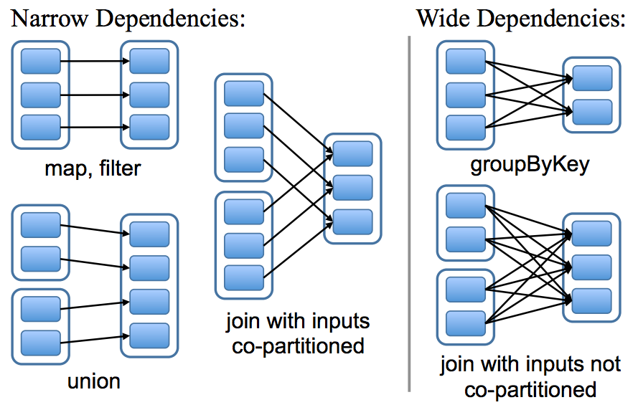
Spark SQL: Physical Execution
= Map-side join
= Reduce-side join
Hash join with broadcast variables

Slide 62
Hadoop Data Warehouse Design
Observation:
Joins are relatively expensive
OLAP queries frequently involve joins
Solution: denormalize
What’s normalization again?
Why normalize to begin with?
Fundamentally a time-space tradeoff
How much to denormalize?
What about consistency?

Slide 63
Denormalization Opportunities?
“Denormalizing the snowflake”

Slide 64
What’s the assignment?
SQL-on-Hadoop
SQL query interface
Execution Layer
HDFS
Other Data Sources

Slide 65
What’s the assignment?
SQL-on-Hadoop
SQL query interface
You
Spark
HDFS

Slide 66
What’s the assignment?

Slide 67
What’s the assignment?
select
l_returnflag,
l_linestatus,
sum(l_quantity) as sum_qty,
sum(l_extendedprice) as sum_base_price,
sum(l_extendedprice*(1-l_discount)) as sum_disc_price,
sum(l_extendedprice*(1-l_discount)*(1+l_tax)) as sum_charge,
avg(l_quantity) as avg_qty,
avg(l_extendedprice) as avg_price,
avg(l_discount) as avg_disc,
count(*) as count_order
from lineitem
where
l_shipdate = 'YYYY-MM-DD'
group by l_returnflag, l_linestatus;
input parameter
SQL query
Raw Spark program
Your task…

Slide 68

Questions?
Source: Wikipedia (Japanese rock garden)

