Slide 1
Near-Duplicate Detection
on Wikipedia Articles
Using LSH
CMSC818G – Final Project
Samet Ayhan
Joshua Bradley
Sarah Weissman
2 May 2013
Notes:
<number>

Slide 2
Agenda
Introduction
Data Definition
Algorithm
Preliminary Experimental Results
Conclusion and Future Work
Questions and Answers

Slide 3
Introduction
Internet-enabled collaboration has resulted in abundant number of near-duplicate web documents
Range of occurrences is even more evident within Wikipedia articles
Over 4.2 million articles in the English Wikipedia alone
~100,000 active contributors
Contributors can edit articles without prior approval.
No current mechanism for truth validation in place.*
*Wiki admins currently aware of ~30 duplicate articles

Slide 4

Introduction
Interested in finding near-duplicate occurrences at sentence level among Wikipedia articles
Questions to consider:
What is the most appropriate LSH technique to apply?
LSH does not map naturally to the edit distance measure
Do near duplicate sentences correspond to factual errors?

Slide 5
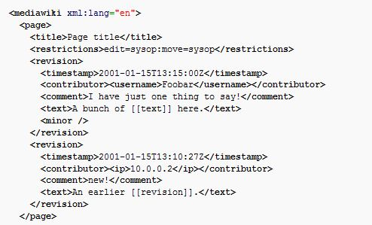
Data Definition
Wikipedia dump
bz2 compressed file
current revisions only, no talk or user pages
9GB compressed, 42GB uncompressed
Tests performed on 1 of 27 partitions of Wikipedia dump

Slide 6
Data Definition
Data set
Piece of full dump (957.7 MB):
enwiki-latest-pages-articles10.xml-p000925001p001325000
Page type counts:
ARTICLE = 178045
STUB = 19946
DISAMBIGUATION = 5454
NON_ARTICLE = 31963

Slide 7

Minhash
Locality Sensitive Hashing
Hash Family F,
Given a sentence S where s denotes shingle
Output N signatures.

Slide 8
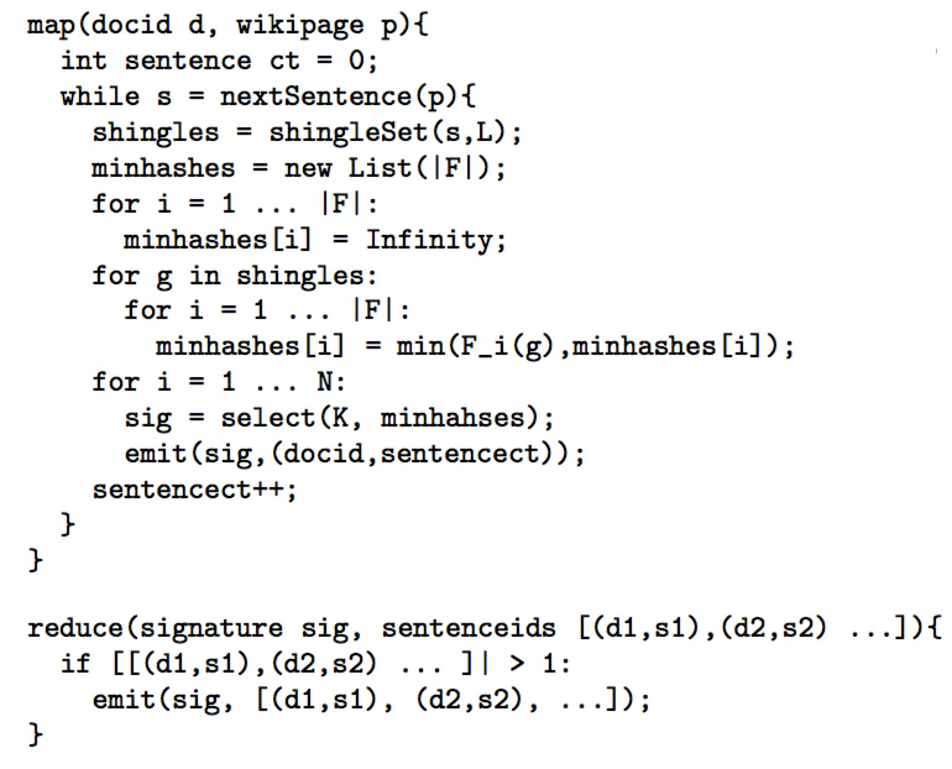
Algorithm

Slide 9
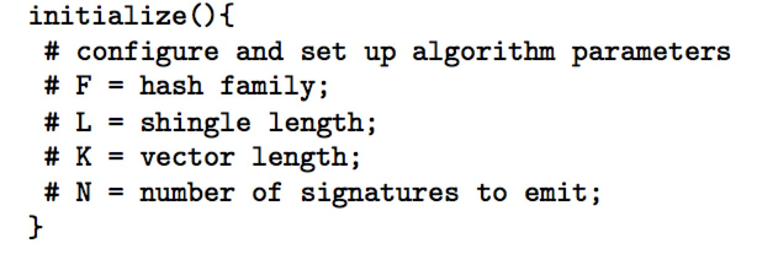
Algorithm
Quite a few parameters:
Min/max sentence length
Hash size

Slide 10
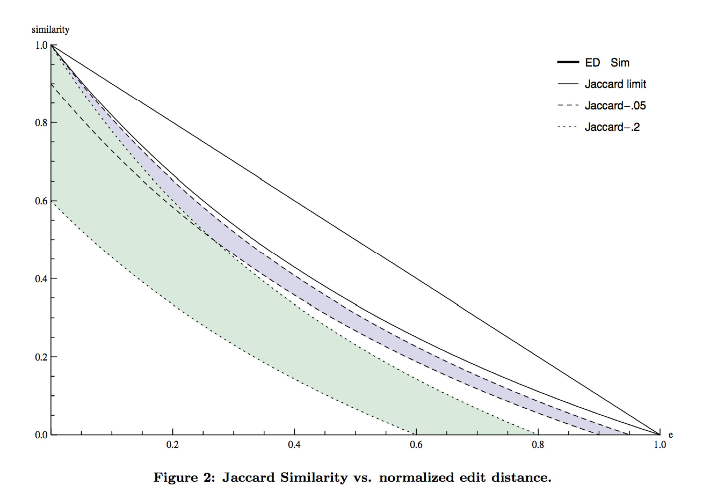
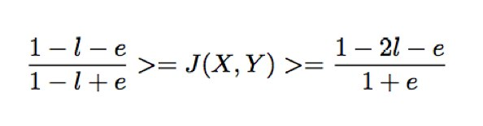
Error Estimation

Slide 11
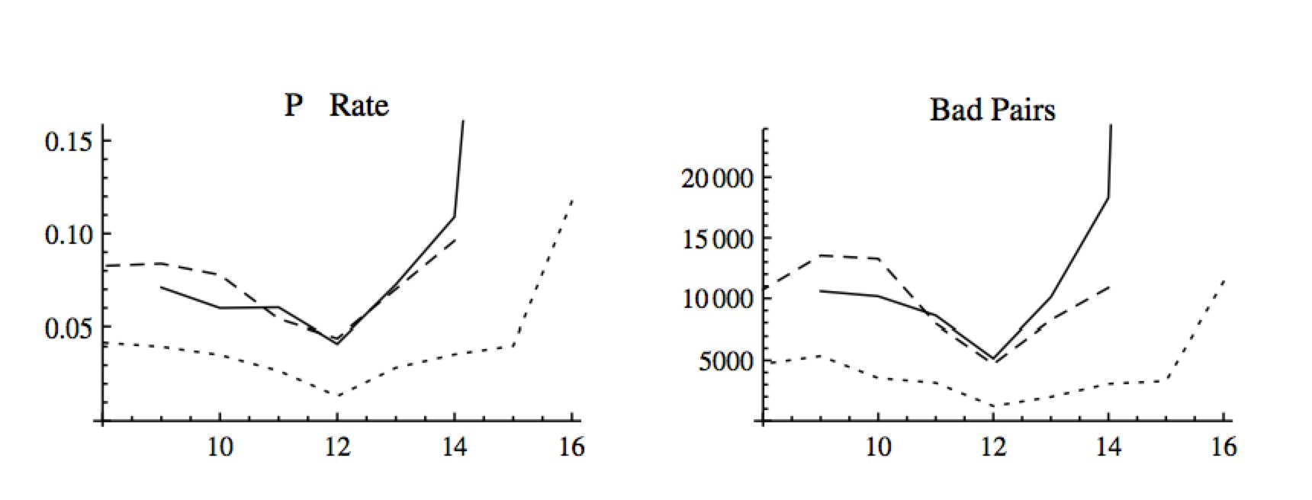
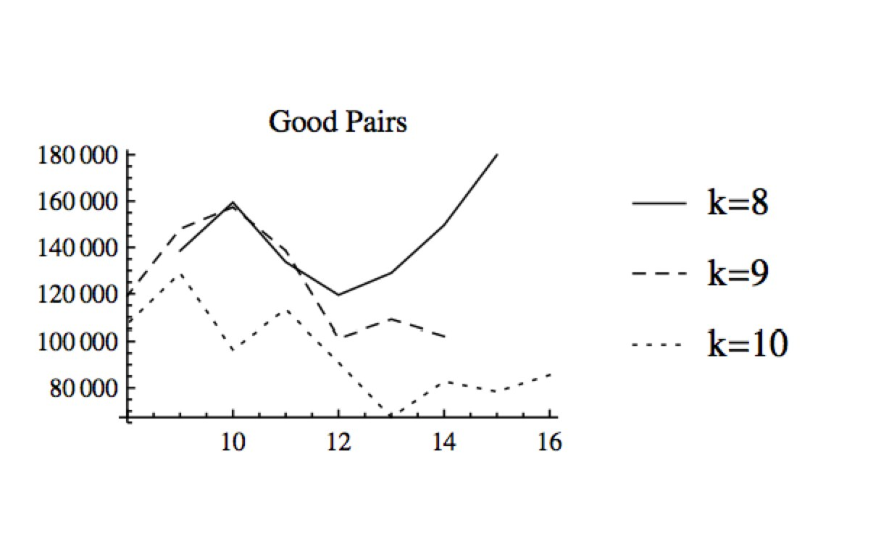
Error Estimation
F

Slide 12
Advanced Arrival Procedures with Active Abatement Potentials 9/23/10 <number>
Error Estimation
L is too big → Lots of false negatives
L is too small → Lots of false positives
(L is too big → Hash collisions?)
What to do?
Choose L just right!
Err on the side of false positives and use edit distance as a second pass to filter results.
Fix your hash function.

Slide 13
Preliminary Results

Slide 14
Advanced Arrival Procedures with Active Abatement Potentials 9/23/10 <number>
Example Sentences – exact duplicate
Article 1095706 – “Jesus”
After the discovery of the empty tomb, the gospels indicate that Jesus made a series of appearances to the disciples.
Article 1168010 – “Life of Jesus in the New Testament”
After the discovery of the empty tomb, the gospels indicate that Jesus made a series of appearances to the disciples.

Slide 15
Preliminary Results – near duplicates
Factual drift
On June 3 1621 it was granted a charter for a trade monopoly in the West Indies (meaning the Caribbean) by the Republic of the Seven United Netherlands and given jurisdiction over the African slave trade Brazil the Caribbean and North America.
On 2 June 1621 it was granted a charter for a trade monopoly in the West Indies (meaning the Caribbean) by the Republic of the Seven United Netherlands and given jurisdiction over the African slave trade Brazil the Caribbean and North America.
Nutrients There are seven major classes of nutrients: carbohydrates, fats, dietary fiber, minerals, proteins, vitamins, and water.These nutrient classes can be categorized as either macronutrients (needed in relatively large amounts) or micronutrients (needed in smaller quantities)
Nutrients There are six major classes of nutrients: carbohydrates, fats, minerals, protein, vitamins, and water.These nutrient classes can be categorized as either macronutrients (needed in relatively large amounts) or micronutrients (needed in smaller quantities).

Slide 16
Preliminary Results
Templatification
Eight Miles High (album) Eight Miles High is an album by Dutch hard rock band Golden Earring released in 1969.
The Hole (album) The Hole is an album by Dutch hard rock band Golden Earring released in 1986.
In the 2001 Census the village had a population of 380.
In the 2001 Census the village had a population of 78.
In the 2001 Census the village had a population of 435.
References
Neotropical Ichthyology 11 (1): 73-80.
Neotropical Ichthyology 10 (2): 245-253.
Copy Editing
Kerosene and natural gas soon replaced whale oil in North America for illuminating purposes.
Kerosene and natural gas soon replaced whale oil in North America.
The department tracks the traffic volumes along all state highways as a part of its maintenance responsibilities using a metric called average annual daily traffic (AADT).
The department tracks the traffic volumes along all state highway highways as a part of its maintenance responsibilities using a metric called average annual daily traffic (AADT).
Identical Sentences

Slide 17
Conclusion and Future Work
Presented our work on near-duplicate detection of Wikipedia articles at sentence level using MinHash, a LSH technique
In the future,
Is comparing multiple consecutive sentences more effective than comparing single sentences?
Investigate revision histories of these articles
Correlate them with their timestamps, and better relate similarities based on temporal dimensions

Slide 18
Questions and Answers
Thank You!

