Slide 1
CMSC818G – Final Project
Near-Duplicate Detection
on Wikipedia Articles
Using LSH
Samet Ayhan
Joshua Bradley
Sarah Weissman
2 May 2013

Slide 2
Agenda
Introduction
Data Definition
Algorithm
Preliminary Experimental Results
Conclusion and Future Work
Questions and Answers

Slide 3
Introduction
Internet enabled collaboration and cooperation on a large scale, resulting in abundant number of near-duplicate web documents
Range of occurrences is even more evident within Wikipedia articles
Over 4.2 million articles in the English Wikipedia alone
Almost all articles can be edited by anyone with access to the site (editing largely open)
About 100,000 active contributors
A contributor can edit the text by copying from another article without needing approval

Slide 4
Introduction
Interested in finding near-duplicate occurrences at various granularity levels among Wikipedia articles
Questions to consider:
What is the most appropriate LSH technique to apply?
No LSH family for edit distance is known to exist
What is the appropriate granularity for analysis?
Is comparing multiple consecutive sentences more effective than comparing single sentences?
What is the best shingle size?
Do near duplicate sentences correspond to factual errors?

Slide 5
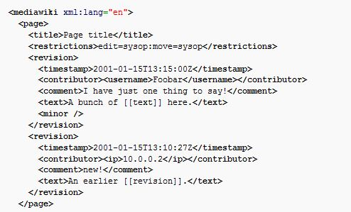
Data Definition
Wikipedia dumps
bz2 compressed file
current revisions only, no talk or user pages
9GB compressed, 42GB uncompressed
Wikipedia content

Slide 6
Minhash
Locality Sensitive Hashing
Pr[minhash(h,A) = minhash(h,B)] = J(A,B)
J(A,B) = intersection(A,B)/union(A,B)
Hash Family h_i,
sig(X) = [mh(h_1,X),mh(h_2,X),…,mh(h_k,X)]
For each X you output n signatures.

Slide 7
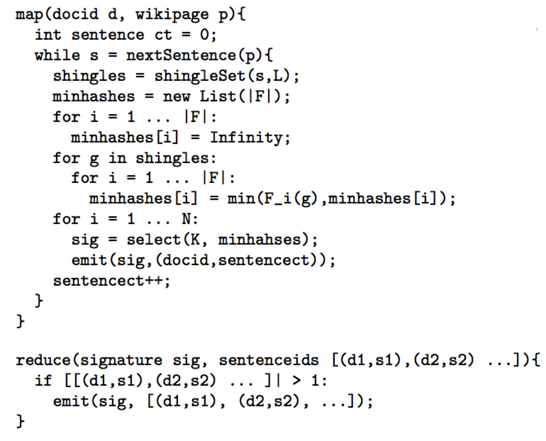
Algorithm

Slide 8
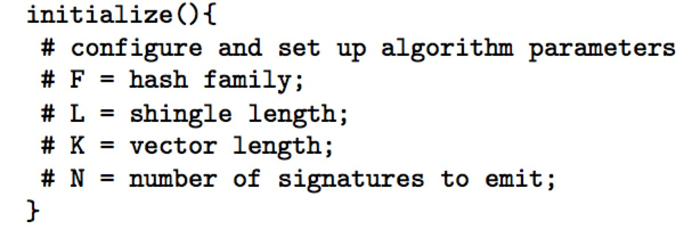
Algorithm
Quite a few parameters:
Min/max sentence length
Hash size

Slide 9
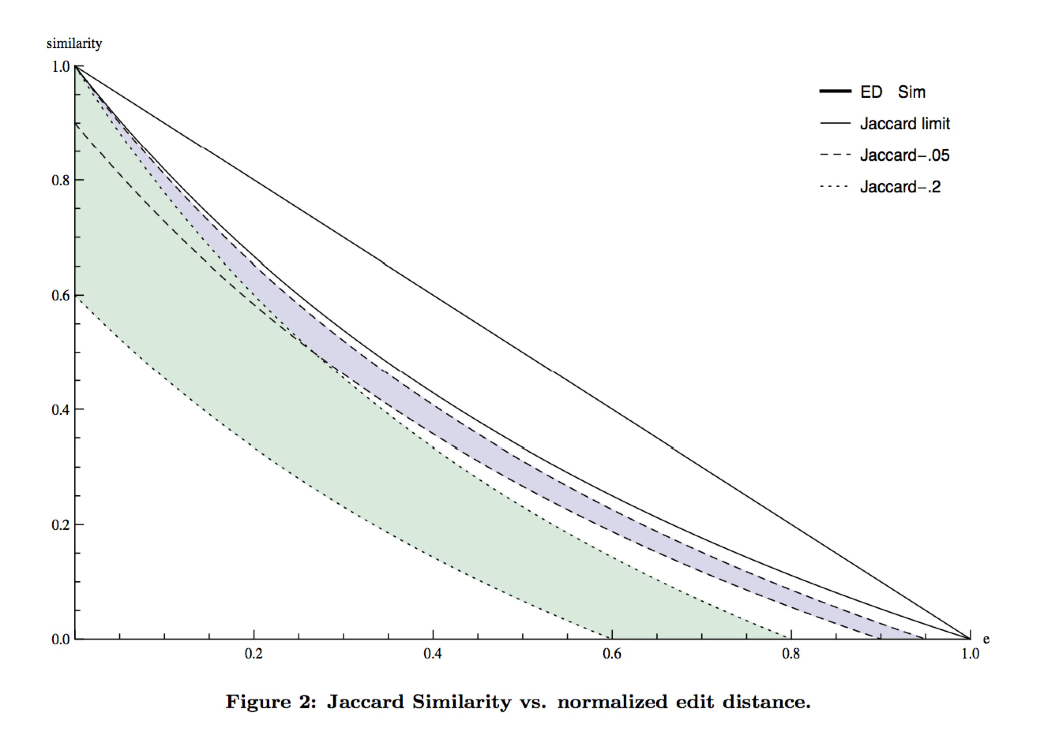
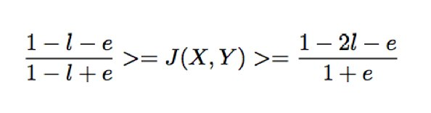
Error Estimation

Slide 10
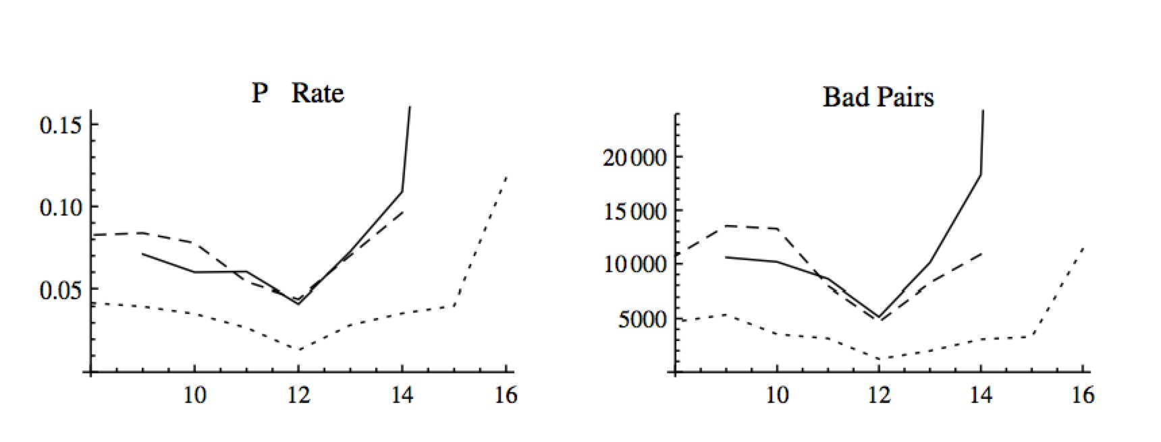
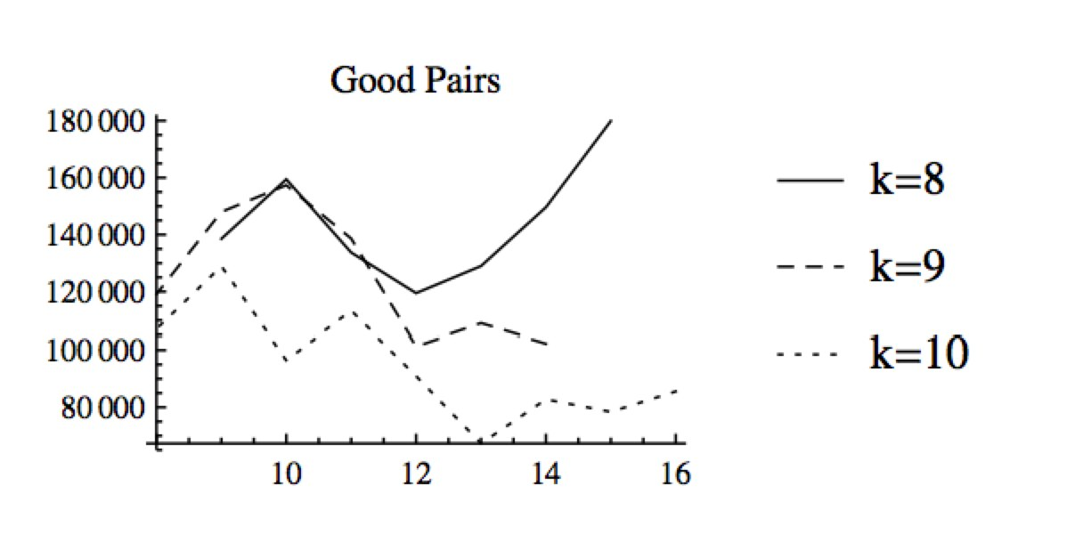
Error Estimation
F

Slide 11
Error Estimation
L is too big → Lots of false negatives
L is too small → Lots of false positivies
(L is too big → Hash collisions?)
What to do?
Choose L just right!
Err on the side of false positives and use edit distance as a second pass to filter results.
Fix your hash function.

Slide 12
Preliminary Experimental Results
Factual drift
On June 3 1621 it was granted a charter for a trade monopoly in the West Indies (meaning the Caribbean) by the Republic of the Seven United Netherlands and given jurisdiction over the African slave trade Brazil the Caribbean and North America.
On 2 June 1621 it was granted a charter for a trade monopoly in the West Indies (meaning the Caribbean) by the Republic of the Seven United Netherlands and given jurisdiction over the African slave trade Brazil the Caribbean and North America.
Nutrients There are seven major classes of nutrients: carbohydrates, fats, dietary fiber, minerals, proteins, vitamins, and water.These nutrient classes can be categorized as either macronutrients (needed in relatively large amounts) or micronutrients (needed in smaller quantities)
Nutrients There are six major classes of nutrients: carbohydrates, fats, minerals, protein, vitamins, and water.These nutrient classes can be categorized as either macronutrients (needed in relatively large amounts) or micronutrients (needed in smaller quantities).

Slide 13
Preliminary Experimental Results
Templatification
Eight Miles High (album) Eight Miles High is an album by Dutch hard rock band Golden Earring released in 1969.
The Hole (album) The Hole is an album by Dutch hard rock band Golden Earring released in 1986.
In the 2001 Census the village had a population of 380.
In the 2001 Census the village had a population of 78.
In the 2001 Census the village had a population of 435.
References
Neotropical Ichthyology 11 (1): 73-80.
Neotropical Ichthyology 10 (2): 245-253.
Copy Editing
Kerosene and natural gas soon replaced whale oil in North America for illuminating purposes.
Kerosene and natural gas soon replaced whale oil in North America.
The department tracks the traffic volumes along all state highways as a part of its maintenance responsibilities using a metric called average annual daily traffic (AADT).
The department tracks the traffic volumes along all state highway highways as a part of its maintenance responsibilities using a metric called average annual daily traffic (AADT).
Identical Sentences

Slide 14
Preliminary Experimental Results
Data set
Piece of full dump (957.7m):
enwiki-latest-pages-articles10.xml-p000925001p001325000
Page type counts:
ARTICLE 178045
DISAMBIGUATION 5454
NON_ARTICLE 31963

Slide 15
Preliminary Experimental Results
Goes here…

Slide 16
Conclusion and Future Work
Presented our work on near-duplicate detection of Wikipedia articles at various granularity levels using LSH technique
In the future,
Investigate revision histories of these articles
Correlate them with their timestamps, and better relate similarities based on temporal dimensions

Slide 17
Questions and Answers
Thank You!

