Slide 1
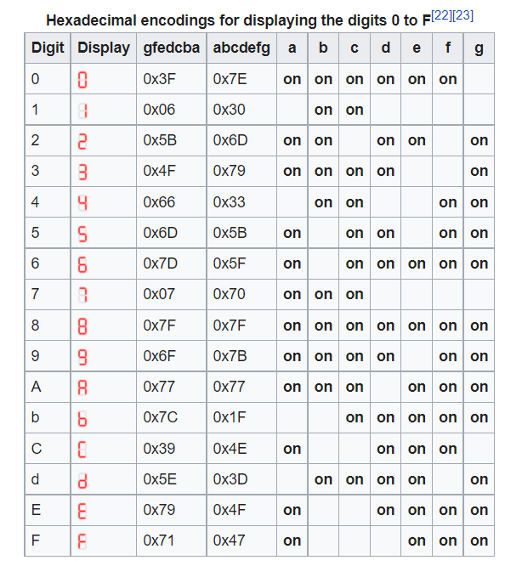
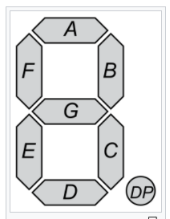
作業2 - Push Buttons and 7-Segment Control
資工三乙/林采昕/408262143 2021/10/26
(1) 問題
Q1：請說明7-Segment 如何顯示數字？
腳位順序:A ~ G 、 DP
on為1，代表開燈，空白，為0代表關燈
再轉成16進制表示
例如: 1 = 0110000 = 0x3F
顯示的燈號為: B、C

Slide 2
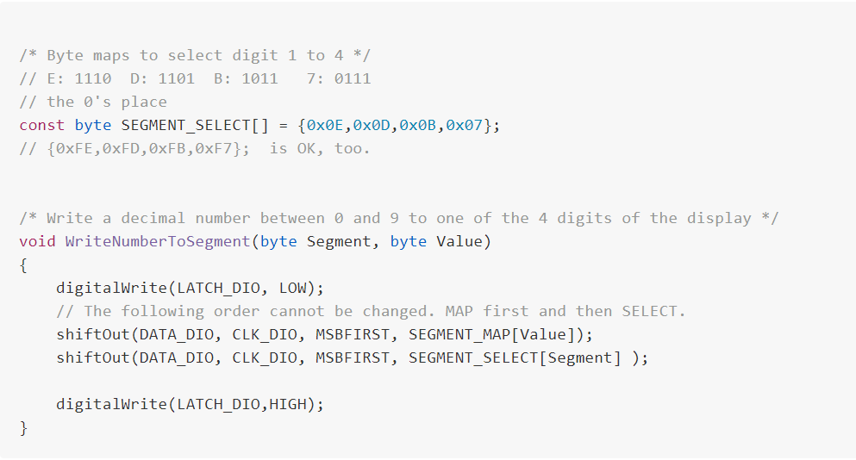
作業2 - Push Buttons and 7-Segment Control
資工三乙/林采昕/408262143 2021/10/26
Q2：請說明如何控制數字顯示在不同的7-Segment？
MSBFIRST:從左到右讀取二進制數
若Segment為，0則SEGMENT_SELECT = 0x0E = 1110
0為亮燈，所以數字會輸出在最左邊的腳位

Slide 3
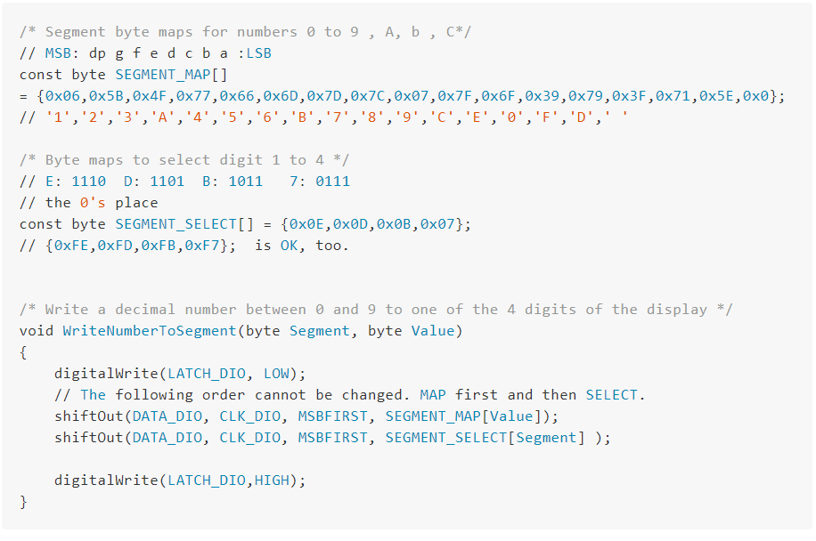
作業2 - Push Buttons and 7-Segment Control
資工三乙/林采昕/408262143 2021/10/26
Q3：請詳加說明數字5如何顯示在7-Segment上？
WriteNumberToSegment( i , 4);
控制輸出字元，陣列從0開始存，所以5在第4格
先選輸出字元，再選輸出位置

Slide 4
作業2 - Push Buttons and 7-Segment Control
資工三乙/林采昕/408262143 2021/10/26
Q4：請以文字詳加說明MC74HC595A IC之功能 (含腳位說明) 及操作方式？
分成橫向顯示(QA~QD)、縱向顯示(QA~QH)，兩者以SDO連接，且以低、高電位控制

Slide 5
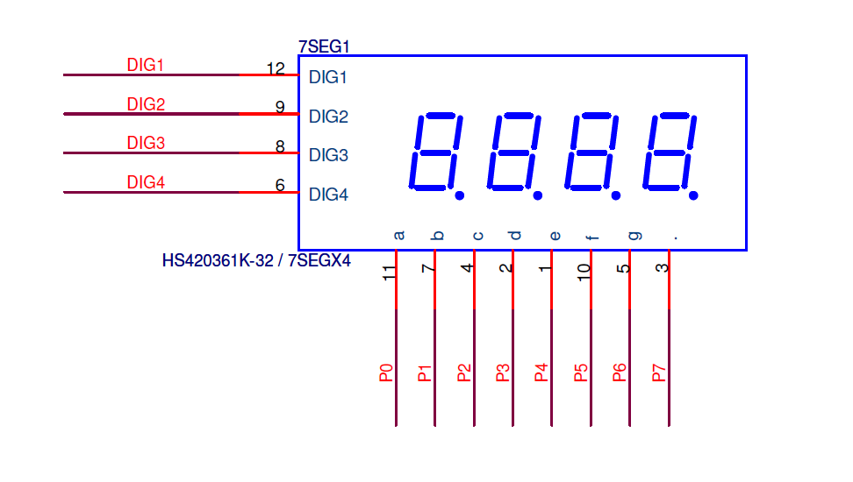
作業2 - Push Buttons and 7-Segment Control
資工三乙/林采昕/408262143 2021/10/26
Q5：ACET Shield Board上4個7-Segment，請以文字說明該板將數字顯示在不同的7-Segment上的硬體控制線路？必須說明控制程式如何運作？
DATA_DIO : 輸出訊號的PIN(QA~QD)
CLK_DIO : 連接的PIN(DIG1 ~ DIG4)
MSBFIRST : 訊號輸入順序(從左到右讀取二進制數)
SEGMENT_SELECT[Segment] : 輸入訊號的值

Slide 6
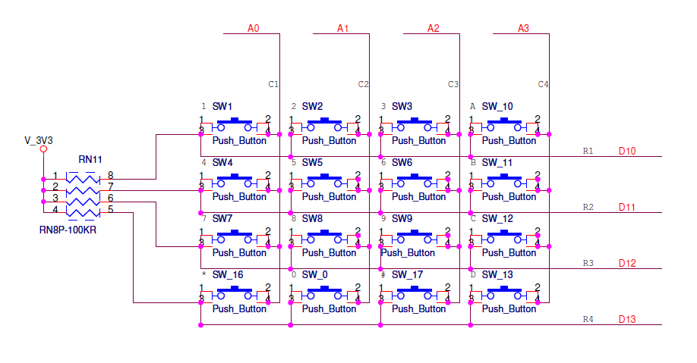
作業2 - Push Buttons and 7-Segment Control
資工三乙/林采昕/408262143 2021/10/26
Q6：請說明Push Button之運作方式與程式控制說明?
A0 ~ A3 : 控制縱向
R1 ~ R4 : 控制橫向
LOW : 開啟
HIGH : 關閉

Slide 7
作業2 - Push Buttons and 7-Segment Control
資工三乙/林采昕/408262143 2021/10/26
(2) 程式碼
/* Define shift register pins used for seven segment display */
#define LATCH_DIO D15
#define CLK_DIO D14
#define DATA_DIO 2 // D2 is OK, too
#define BUTTON1 BT1
#define BUTTON2 BT2
#define BUTTON3 BT3
#define BUTTON4 BT4
#define BUTTON_A0 A0
#define BUTTON_A1 A1
#define BUTTON_A2 A2
#define BUTTON_A3 A3
/* Segment byte maps for numbers 0 to 9 , A, b , C*/ // MSB: dp g f e d c b a :LSB
const byte SEGMENT_MAP[] = {0x06,0x5B,0x4F,0x77,0x66,0x6D,0x7D,0x7C,0x07,0x7F,0x6F,0x39,0x79,0x3F,0x71,0x5E, 0x0};
// '1','2','3','A','4','5','6','B','7','8','9','C','E','0','F','D',' '
const byte DP = 0x40; // Digit Point
byte Row=0, Col=0;
int t = 0;
/* Byte maps to select digit 1 to 4 */ // E: 1110 D: 1101 B: 1011 7: 0111 // the 0's place
const byte SEGMENT_SELECT[] = {0x0E,0x0D,0x0B,0x07}; // {0xFE,0xFD,0xFB,0xF7}; is OK, too.
void setup ()
{
/* Set DIO pins to outputs */
pinMode(LATCH_DIO, OUTPUT);
pinMode(CLK_DIO, OUTPUT);
pinMode(DATA_DIO, OUTPUT);
// put your setup code here, to run once:
pinMode(10, INPUT); //R1: S1,S2,S3,S4 (1,2,3,A)
pinMode(11, INPUT_PULLUP); //R2: S5,S6,S7,S8 (4,5,6,B)
pinMode(12, INPUT_PULLUP); //R3: S9, S10, S11,S12 (7,8,9,C)
pinMode(13, INPUT_PULLUP); //R4: (*,0,#,D)
pinMode(A0, OUTPUT); //A1, C1: S1,S5,S9 (1,4,7,*)
pinMode(A1, OUTPUT); //A2, C2: S2,S6,S10 (2,5,8,0)
pinMode(A2, OUTPUT); //A3, C3: S3,S7,S11 (3,6,9,#)
pinMode(A3, OUTPUT); //A4, C4, S4,S8,S12 (*,0, #,D)
//Pin left to right :R1 R2 R3 R4 C1 C2 C3 C4
digitalWrite(A0,HIGH);
digitalWrite(A1,HIGH);
digitalWrite(A2,HIGH);
digitalWrite(A3,HIGH);
}

Slide 8
作業2 - Push Buttons and 7-Segment Control
資工三乙/林采昕/408262143 2021/10/26
int arr[100];
//關掉最後一格
void turn_off()
{
WriteNumberToSegment( 0 , 16);
}
// 印出陣列後四格
void print_all()
{
turn_off();
for(int d = 0; d <= 50; d++){
for(int i = 0; i <= 3; i++){
WriteNumberToSegment( 3-i , arr[t-1-i]);
delay(5);
}
}
}
/* Main program */
//將所有陣列設為空
void clear(int t)
{
for(int i = 0; i < t; i++){
arr[i] = 16;
}
t = 0;
}
//跑馬燈向左
void to_left()
{
//跑馬燈右進
for(int i = 0; i <= 3; i++){
for(int d = 0; d <= 50; d++){
for(int j = 1; j <= i+1; j++){
WriteNumberToSegment( 2-i+j , arr[t-5+j]);
delay(5);
}
}
}
//跑馬燈左出
for(int i = 3; i >= 0; i--){
for(int d = 0; d <= 50; d++){
for(int j = i+1; j >= 1; j--){
WriteNumberToSegment( 1+i-j , arr[t-j]);
delay(5);
}
}
}
print_all();
}
//跑馬燈向右
void to_right()
{
//跑馬燈左進
for(int i = 0; i <= 3; i++){
for(int d = 0; d <= 50; d++){
for(int j = 1; j <= i+1; j++){
WriteNumberToSegment( i-j+1 , arr[t-j]);
delay(5);
}
}
}
//跑馬燈右出
for(int i = 0; i <= 3; i++){
for(int d = 0; d <= 50; d++){
for(int j = i+1; j <= 4; j++){
WriteNumberToSegment( 4+i-j , arr[t-j]);
delay(5);
}
}
}
print_all();
}

Slide 9
作業2 - Push Buttons and 7-Segment Control
資工三乙/林采昕/408262143 2021/10/26
void loop()
{
// put your main code here, to run repeatedly:
static int keypressedcount=0;
byte keyindex=0;
//if key is pressed in the first round scan,
//then call keyscan() again to check if the key pressed in first round is actually pressed
// if(t > 10) clear(t-4);
if(keyscan()==true)
{
keyindex=(Row-1)*4+Col; // 算出第幾顆按鈕
keyindex--;
arr[t] = keyindex; //存入陣列
delay(5);
if (keyscan()==true) //確認有按按鈕
{
WriteNumberToSegment(3 , keyindex); //在最右邊輸出按的值
delay(500);
}
t++; //紀錄按了幾個數
}
else if(!digitalRead(BUTTON1) ) //向右跑
{
to_right();
}
else if(!digitalRead(BUTTON2) ) //向左跑
{
to_left();
}
else if(!digitalRead(BUTTON3)) //初始化
{
clear(t);
}
}
/* Write a decimal number between 0 and 9 to one of the 4 digits of the display */
void WriteNumberToSegment(byte Segment, byte Value)
{
digitalWrite(LATCH_DIO, LOW);
// The following order cannot be changed. MAP first and then SELECT.
shiftOut(DATA_DIO, CLK_DIO, MSBFIRST, SEGMENT_MAP[Value]);
shiftOut(DATA_DIO, CLK_DIO, MSBFIRST, SEGMENT_SELECT[Segment] );
digitalWrite(LATCH_DIO,HIGH);
}

Slide 10
作業2 - Push Buttons and 7-Segment Control
資工三乙/林采昕/408262143 2021/10/26
bool keyscan( )
{
Row=0;Col=0;
bool keypressed = false;
//scan col1
digitalWrite(A0, LOW);
digitalWrite(A1, HIGH);
digitalWrite(A2, HIGH);
digitalWrite(A3, HIGH);
delayMicroseconds(100);
//Read keys in row.1
if(digitalRead(10)==LOW)
{
digitalWrite(A0, HIGH);
Col=1;Row=1;
keypressed = true;
return(keypressed);
}
//Read keys in row.2
if(digitalRead(11)==LOW)
{
digitalWrite(A0, HIGH);
Col=1;Row=2;
keypressed = true;
return(keypressed);
}
//Read keys in row.3
if(digitalRead(12)==LOW)
{
digitalWrite(A0, HIGH);
Col=1;Row=3;
keypressed = true;
return(keypressed);
}
//Read keys in row.4
if(digitalRead(13)==LOW)
{
digitalWrite(A0, HIGH);
Col=1;Row=4;
keypressed = true;
return(keypressed);
}
//scan col 2
digitalWrite(A0, HIGH);
digitalWrite(A1, LOW);
digitalWrite(A2, HIGH);
digitalWrite(A3, HIGH);
delayMicroseconds(100);
//Read keys in row.1
if(digitalRead(10)==LOW)
{
digitalWrite(A1, HIGH);
Col=2;Row=1;
keypressed = true;
return(keypressed);
}
//Read keys in row.2
if(digitalRead(11)==LOW)
{
digitalWrite(A1, HIGH);
Col=2;Row=2;
keypressed = true;
return(keypressed);
}
//Read keys in row.3
if(digitalRead(12)==LOW)
{
digitalWrite(A1, HIGH);
Col=2;Row=3;
keypressed = true;
return(keypressed);
}
//Read keys in row.4
if(digitalRead(13)==LOW)
{
digitalWrite(A1, HIGH);
Col=2;Row=4;
keypressed = true;
return(keypressed);
}
//scan col 3
digitalWrite(A0, HIGH);
digitalWrite(A1, HIGH);
digitalWrite(A2, LOW);
digitalWrite(A3, HIGH);
delayMicroseconds(100);
//Read keys in row.1
if(digitalRead(10)==LOW)
{
digitalWrite(A2, HIGH);
Col=3;Row=1;
keypressed = true;
return(keypressed);
}
//Read keys in row.2
if(digitalRead(11)==LOW)
{
digitalWrite(A2, HIGH);
Col=3;Row=2;
keypressed = true;
return(keypressed);
}
//Read keys in row.3
if(digitalRead(12)==LOW)
{
digitalWrite(A2, HIGH);
Col=3;Row=3;
keypressed = true;
return(keypressed);
}
//Read keys in row.4
if(digitalRead(13)==LOW)
{
digitalWrite(A2, HIGH);
Col=3;Row=4;
keypressed = true;
return(keypressed);
}
//scan col 4
digitalWrite(A0, HIGH);
digitalWrite(A1, HIGH);
digitalWrite(A2, HIGH);
digitalWrite(A3, LOW);
delayMicroseconds(100);
//Read keys in row.1
if(digitalRead(10)==LOW)
{
digitalWrite(A3, HIGH);
Col=4;Row=1;
keypressed = true;
return(keypressed);
}
//Read keys in row.2
if(digitalRead(11)==LOW)
{
digitalWrite(A3, HIGH);
Col=4;Row=2;
keypressed = true;
return(keypressed);
}
//Read keys in row.3
if(digitalRead(12)==LOW)
{
digitalWrite(A3, HIGH);
Col=4;Row=3;
keypressed = true;
return(keypressed);
}
//Read keys in row.4
if(digitalRead(13)==LOW)
{
digitalWrite(A3, HIGH);
Col=4;Row=4;
keypressed = true;
return(keypressed);
}
return(false);
}

