Slide 1
CHAPTER 4
Linked Lists

Slide 2
Introduction
Array
Successive items locate a fixed distance
Disadvantage
Data movements
Insertion and Deletion
Waste space
Storing n ordered lists of varying size
Possible solution
Linked List

Slide 3
LINKED LISTS
A linked list is a collection of data element
Each element contains the location of the next element. That is, each element contains two parts:
data and link (pointer)
The name of the list is the same as the name of this pointer variable.

Slide 4
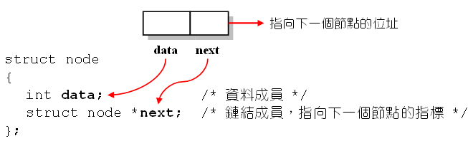
以struct來表示鏈結串列
以結構表示鏈結串列：
每一個節點有兩個成員
第一個成員用來存放資料 (data)
第二個成員用來存儲指向下一個節點的指標 (link or next)

Slide 5
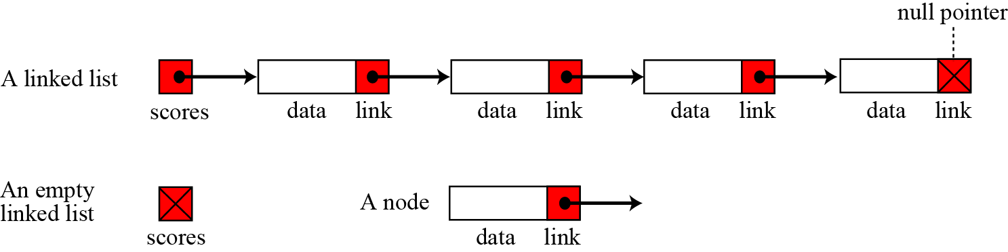
A linked list called “scores” that contains four elements.
We define an empty linked list to be only a null pointer.

Slide 6
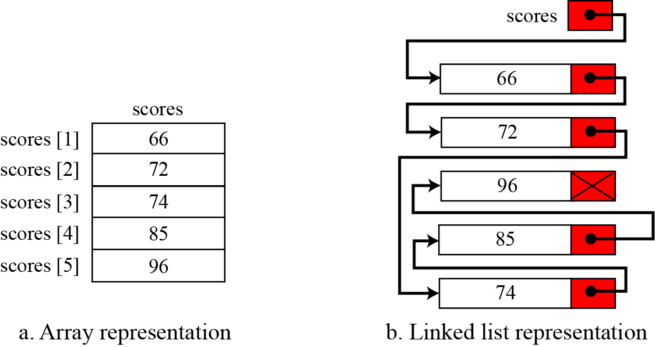
Arrays v.s. linked lists

Slide 7
Applications of linked lists
A linked list is a very efficient data structure for sorted list that will go through many insertions and deletions.
A linked list is a dynamic data structure in which the list can start with no nodes and then grow as new nodes are needed.
A node can be easily deleted without moving other nodes, as would be the case with an array.
For example, a linked list could be used to hold the records of students in a school.
Each quarter or semester, new students enroll in the school and some students leave or graduate.

Slide 8
4.2 SINGLY LINKED LISTS
bat •
cat •
sat •
vat NULL

Slide 9
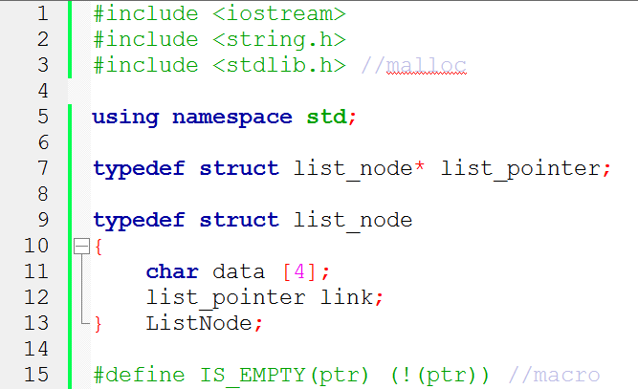
Create a linked list of words

Slide 10
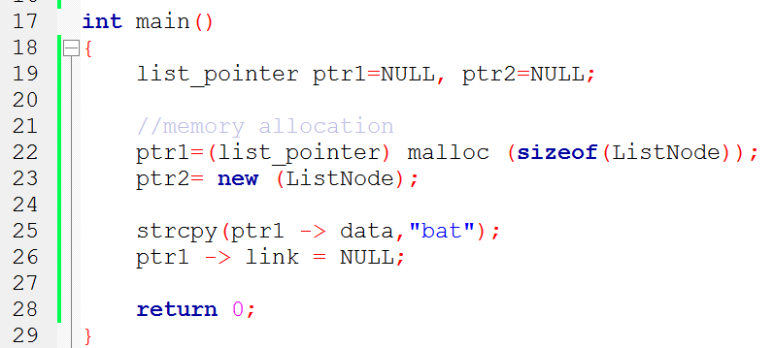
e -> name
(*e).name
The same
address of
first node
ptr ->data
ptr ->link
•
b a t \0 NULL
ptr

Slide 11
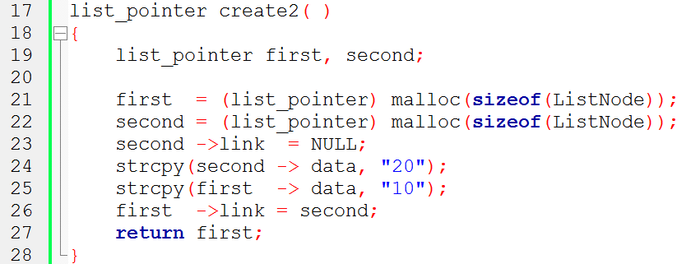
Example: create a two-node list
first
second
10 •
20

Slide 12
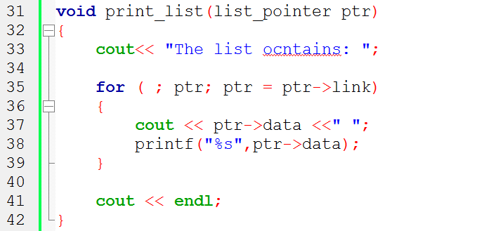
Print out a list (traverse a list)
No!!!
ptr
10 •
50 •
20

Slide 13
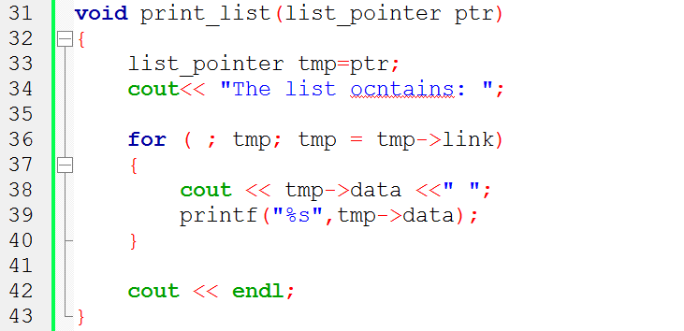
Print out a list (traverse a list)
ptr
10 •
50 •
20

Slide 14
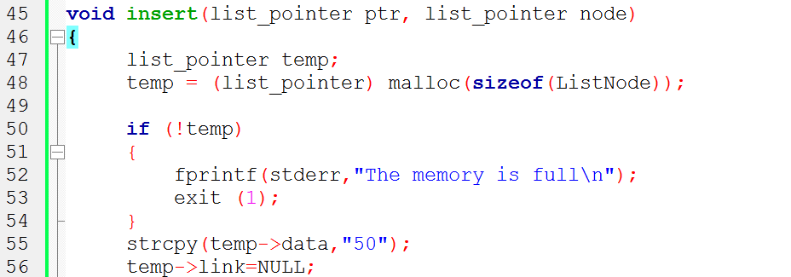
Node Insertion of Singly Linked List
ptr
10 •
20
node
50 •
temp

Slide 15
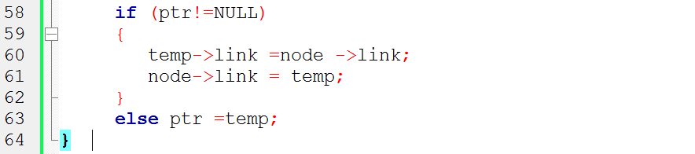
Case 1
①
②
Case 2
①
ptr
Case 1
ptr
Case 2
10 •
20 NULL
①
node
②
①
50 •
50 •
temp
temp

Slide 16
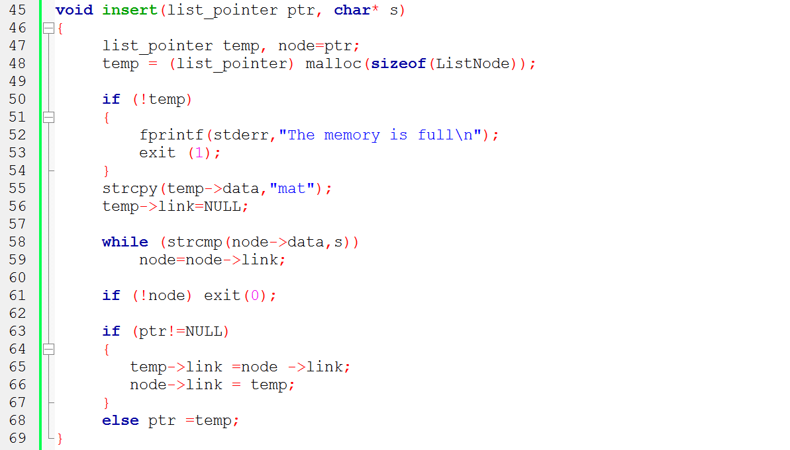
ptr
bat •
cat •
sat •
vat NULL
ptr
node
bat •
cat •
sat •
vat NULL
mat •

Slide 17
Node Insertion of Singly Linked List
We will allow insertion, otherwise we abort the insertion algorithm, because we do not allow data with duplicate values.
Four cases can arise:
❑ Inserting into an empty list.
❑ Insertion at the beginning of the list.
❑ Insertion at the end of the list.
❑ Insertion in the middle of the list.

Slide 18
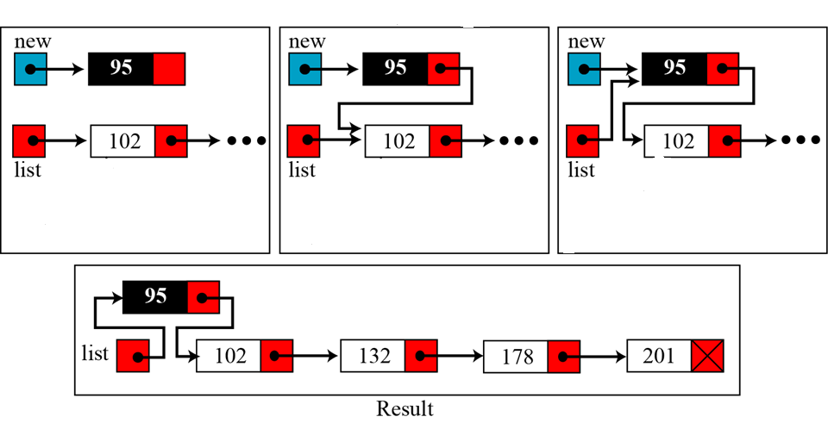
Insertion at the beginning of the list
new→link=list;
list=new;

Slide 19
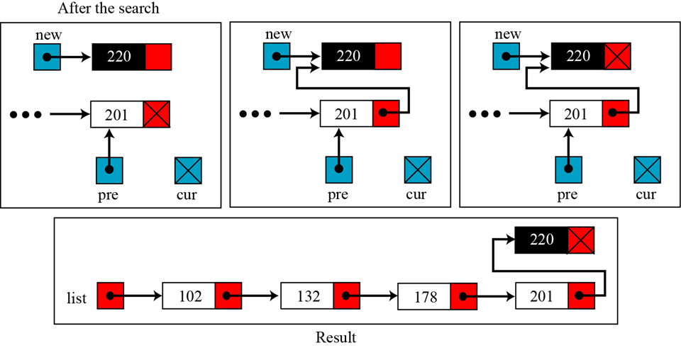
Insertion at the end of the list
pre→link=new;
new→link=cur;

Slide 20
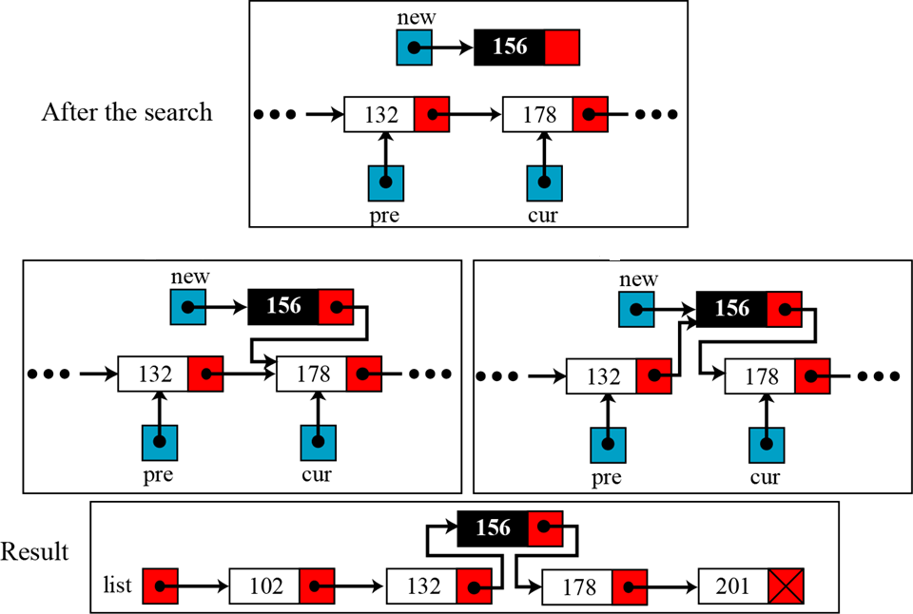
Insertion in the middle of the list
pre→link=new;
new→link=cur;

Slide 21
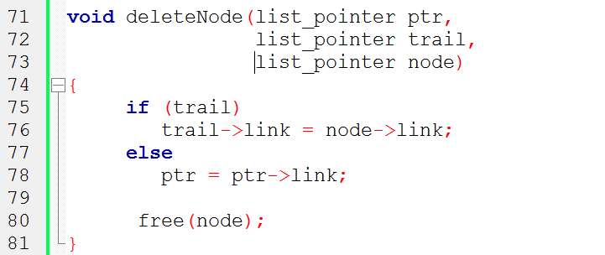
Node Deletion
of Singly Linked List
Case 1
①
Case 2
①
trail node
Case 1
Case 2
ptr
ptr
trail
node
10 •
50 •
20
10 •
①
①

Slide 22
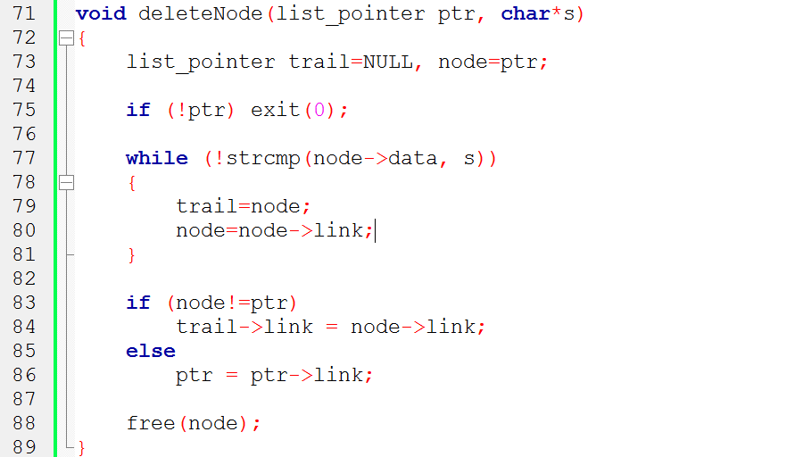
ptr
bat •
cat •
sat •
vat NULL
trail
node
bat •
cat •
mat •
sat •
vat NULL
dangling
reference

Slide 23
Deleting a node
Before deleting a node in a linked list, we apply the search algorithm.
If the flag returned from the search algorithm is true (the node is found), we can delete the node from the linked list.
However, deletion is simpler than insertion: we have only two cases:
Deleting the first node.
Deleting any other node.

Slide 24
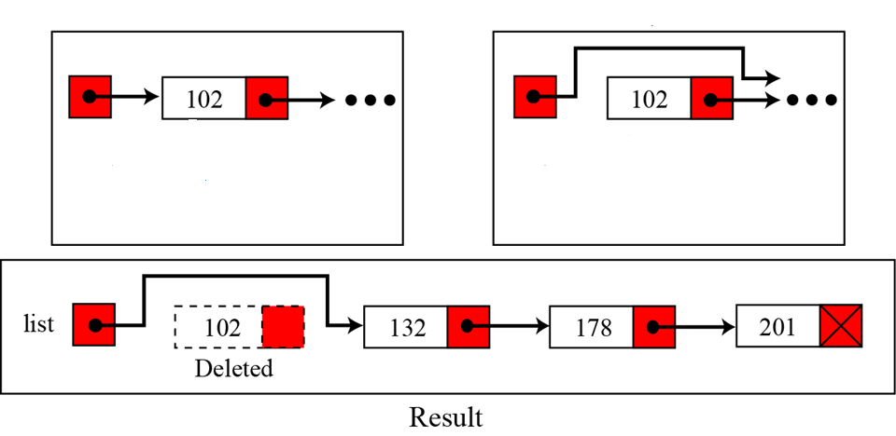
Deleting the first node.
temp=list;
list=list→link; free(temp);
list
list
temp
temp

Slide 25
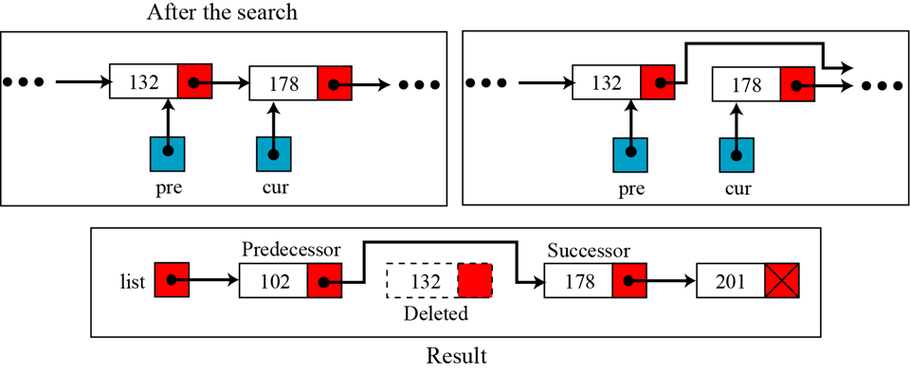
Deleting any other node
pre→link=cur→link; free(cur);

Slide 26
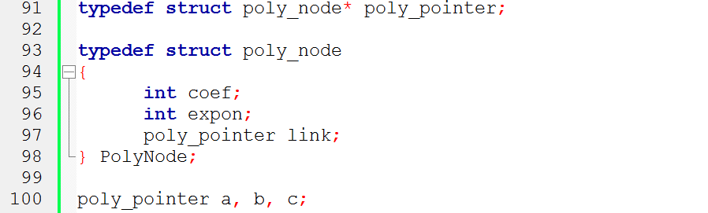
Represent Polynomials
coef expon link

Slide 27
Adding Two Polynomials
a
3 14
2 8
1 0
b
8 14
-3 10
10 6

Slide 28
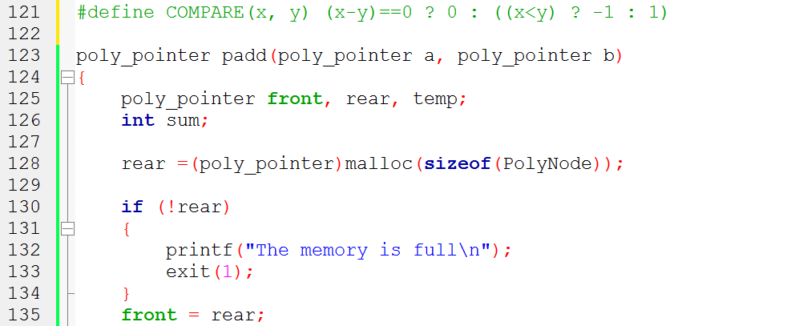
Padd
front
rear
a
3 14
2 8
1 0
b
8 14
-3 10
10 6

Slide 29
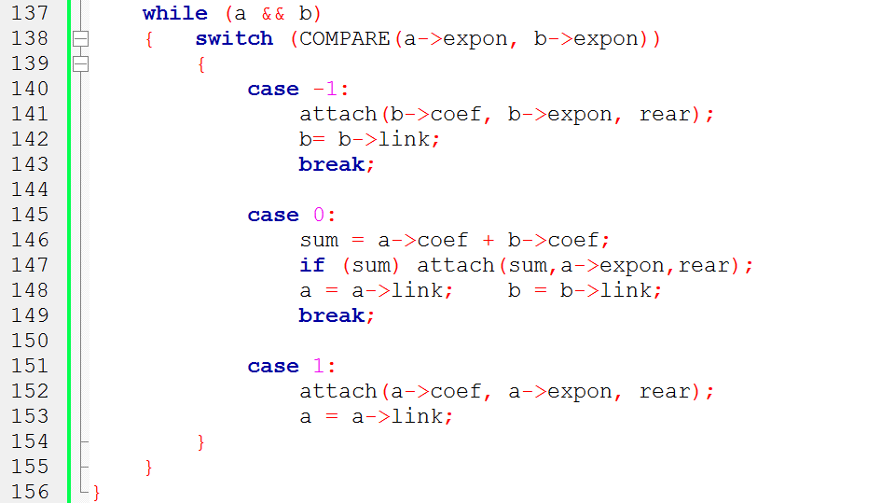
a->exp < b->exp
a->exp == b->exp
a->exp > b->exp
front
rear
a
3 14
2 8
1 0
b
8 14
-3 10
10 6

Slide 30
front
rear
sum=11
a
3 14
2 8
1 0
b
8 14
-3 10
10 6

Slide 31
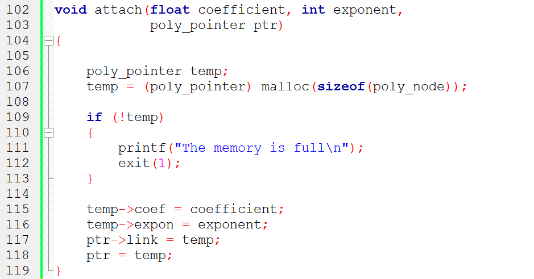
attach (11,14, rear)
ptr 就是傳進來的 rear
temp
front
11 14
a
3 14
2 8
1 0
b
8 14
-3 10
10 6
31

Slide 32
front
rear
11 14
a
3 14
2 8
1 0
b
8 14
-3 10
10 6

Slide 33
rear
front
11 14
a
3 14
2 8
1 0
b
8 14
-3 10
10 6

Slide 34
attach (-3,10,rear)
rear=ptr
temp
front
11 14
-3 10
a
3 14
2 8
1 0
b
8 14
-3 10
10 6
34

Slide 35
rear
front
11 14
-3 10
a
3 14
2 8
1 0
b
8 14
-3 10
10 6

Slide 36
rear
front
11 14
-3 10
a
3 14
2 8
1 0
b
8 14
-3 10
10 6

Slide 37
attach (2,8,rear)
rear=ptr
temp
2 8
front
11 14
-3 10
a
3 14
2 8
1 0
b
8 14
-3 10
10 6
37

Slide 38
rear
front
11 14
-3 10
2 8
a
3 14
2 8
1 0
b
8 14
-3 10
10 6

Slide 39
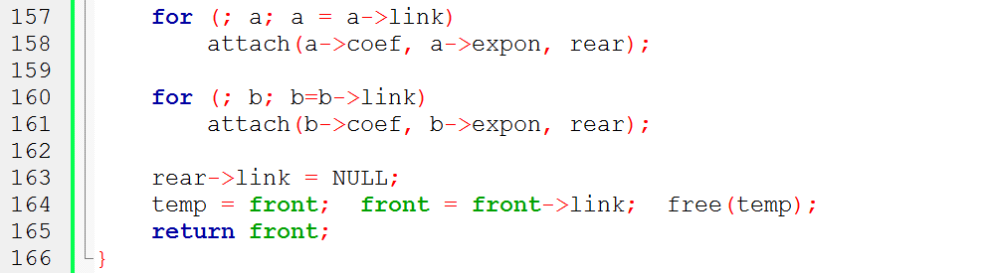
rear
10 6
temp
front
11 14
-3 10
2 8
a
3 14
2 8
1 0
b
8 14
-3 10
10 6

Slide 40
Analysis
(1) coefficient additions
0 ≤ additions ≤ min(m, n)
where m (n) denotes the number of terms in A (B).
(2) exponent comparisons
extreme case : e_{m-1} > f_{m-1} > e_{m-2} > f_{m-2} > … > e₀ > f₀
m+n-1 comparisons
(3) creation of new nodes
extreme case
m + n new nodes
Summary O(m+n)

Slide 41
A Suite for Polynomials
e(x) = a(x) * b(x) + d(x)
poly_pointer a, b, d, e;
...
a = read_poly();
b = read_poly();
d = read_poly();
temp = pmult(a, b);
e = padd(temp, d);
print_poly(e);
read_poly()
print_poly()
padd()
psub()
pmult()
temp is used to hold a partial result.
By returning the nodes of temp, we
may use it to hold other polynomials

Slide 42
Erase Polynomials
void earse(poly_pointer ptr)
{
poly_pointer temp;
while (ptr)
{ temp = ptr;
ptr = ptr->link;
free(temp);
}
}
ptr
3 14
2 8
1 0
temp

Slide 43
Uva Practices
Uva 11988 - Broken Keyboard

Slide 44
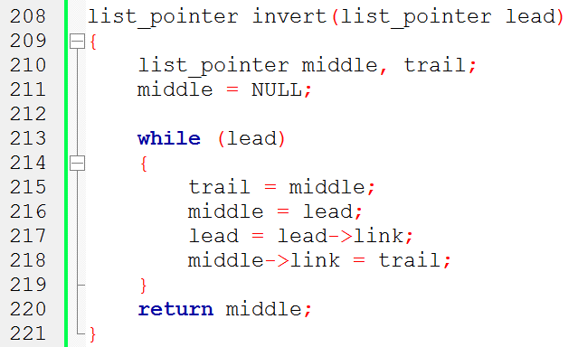
Invert Singly Linked List
middle
trail
lead
bat •
cat •
sat •
vat

Slide 45
Invert Singly Linked List
trail
middle
lead
bat •
cat •
sat •
vat

Slide 46
Invert Singly Linked List
trail
middle
lead
bat •
cat •
sat •
vat

Slide 47
Invert Singly Linked List
trail
middle
lead
bat •
cat •
sat •
vat

Slide 48
Invert Singly Linked List
trail
middle
lead
bat •
cat •
sat •
vat

Slide 49
Invert Singly Linked List (recursive version)

Slide 50
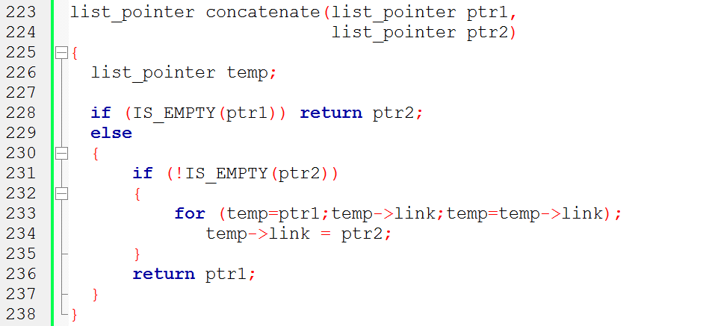
Concatenate Two Lists
ptr2
…
temp
ptr1
bat •
cat •
sat •
vat
O(m) where m is # of elements in the first list

Slide 51
Circularly Linked Lists
ptr
3 14
2 8
1 0

Slide 52
4.5.2 Operations for
Circularly Linked List
What happens when we insert a node to the front of a circular
linked list?
ptr
X₁ •
X₂ •
X₃ •
?
X₄ •

Slide 53
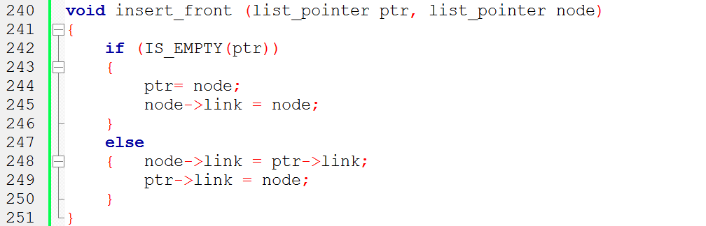
Insert Front in Circular Linked List
①
②
ptr
X₁ •
X₂ •
X₃ •
②
①
X₄ •
node

Slide 54
Insert Front in Circular Linked List
Same Code
①
②
X₁ •
X₂ •
X₃ •
ptr
②
①
node
X₄ •

Slide 55
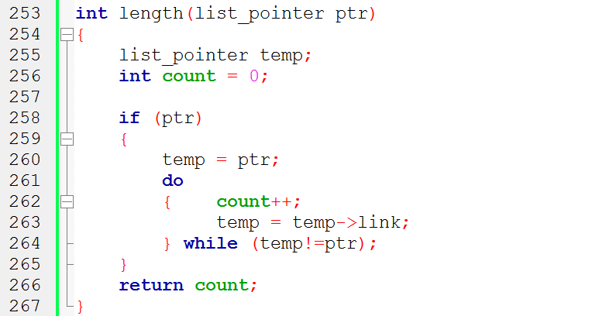
Length of Circular Linked List
temp
ptr
X₁ •
X₂ •
X₃ •

Slide 56
Length of Circular Linked List
Same Code???
ptr
temp
X₁ •
X₂ •
X₃ •

Slide 57
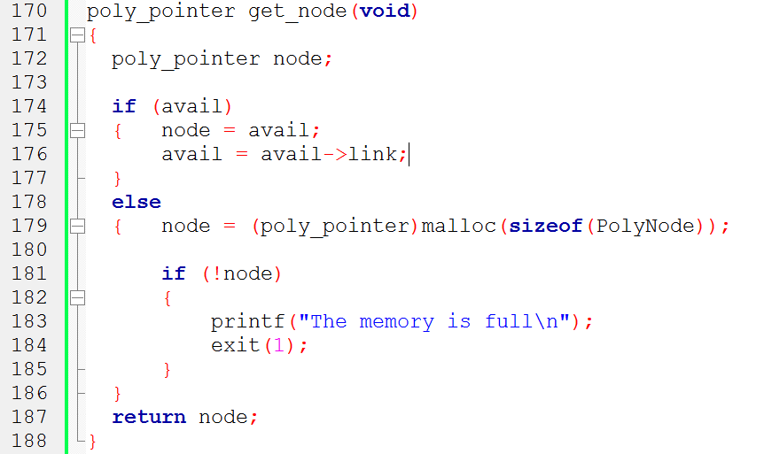
Maintain an Available List
node
avail
...

Slide 58
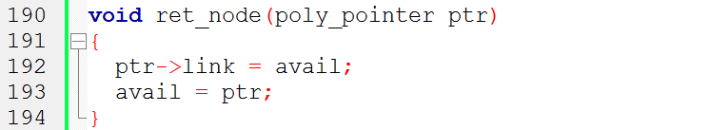
Maintain an Available List
ptr
avail
...

Slide 59
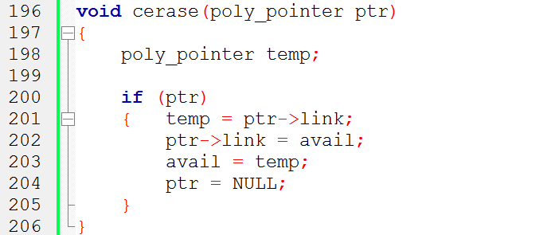
Maintain an Available List
①
②
③
④
③
ptr
④
temp
①
②
avail
...
Independent of # of nodes in a list O(1) constant time

Slide 60
Maintain an Available List
ptr
avail
...

Slide 61
4.4.4 Representing Polynomials
As Circularly Linked Lists
Represent polynomial as circular list.
(1) zero
Use Head Node
a
-1
Zero polynomial
(2) others
a
-1
3 14
2 8
1 0

Slide 62
CPadd
poly_pointer cpadd(poly_pointer a, poly_pointer b)
{
poly_pointer starta, d, lastd;
int sum, done = FALSE;
starta = a;
a = a->link;
b = b->link;
d = get_node();
d->expon = -1; lastd = d;
d, lastd
starta
-1
a
-1
3 14
2 8
1 0
b
-1
8 14
-3 10
10 6

Slide 63
do {
switch (COMPARE(a->expon, b->expon))
{ case -1: attach(b->coef, b->expon, &lastd);
b = b->link;
break;
case 0 : if (starta == a) done = TRUE;
else
{ sum = a->coef + b->coef;
if (sum) attach(sum,a->expon,lastd);
a = a->link; b = b->link;
}
break;
case 1 : attach(a->coef,a->expon,&lastd);
a = a->link;
}
} while (!done);

Slide 64
attach (11,14,lastd)
void attach(float coefficient, int exponent,
poly_pointer ptr)
{
poly_pointer temp;
temp = (poly_pointer) malloc(sizeof(poly_node));
if (IS_FULL(temp))
{ fprintf(stderr, “The memory is full\n”);
exit(1);
}
temp->coef = coefficient;
temp->expon = exponent;
ptr->link = temp;
ptr = temp;
}
d
lastd
temp
starta
-1
11 14
a
-1
3 14
2 8
1 0
b
-1
8 14
-3 10
10 6

Slide 65
CPadd
lastd->link = d;
return d;
}
d
lastd
-1
11 14
…
11 14

Slide 66
Equivalence Relations
A relation over a set, S, is said to be an equivalence relation over S iff it is symmertric, reflexive, and transitive over S.
reflexive, x≡x
symmetric, if x ≡ y, then y ≡ x
transitive, if x ≡ y and y ≡ z, then x ≡ z

Slide 67
Examples
Given Relations:
0 ≡ 4, 3 ≡ 1, 6 ≡ 10, 8 ≡ 9, 7 ≡ 4, 6 ≡ 8, 3 ≡ 5, 2 ≡ 11, 11 ≡ 0
Three equivalent classes
{0,2,4,7,11}; {1,3,5}; {6,8,9,10}

Slide 68
A Rough Program to Find Equivalence Classes
void equivalenec()
{
initialize;
while (there are more pairs) {
read the next pair <i,j>;
process this pair;
}
initialize the output;
do {
output a new equivalence class;
}while (not done);
}
Phase 1
Phase 2
What kinds of data structures are adopted?

Slide 69

#include <stdio.h>
#include <malloc.h>
#define MAX_SIZE 24
#define IS_FULL(ptr) (!(ptr))
#define FALSE 0
#define TRUE 1
void equivalence(){
initialize seq to NULL and out to TRUE
while (there are more pairs) {
read the next pair, <i,j>;
put j on the seq[i] list;
put i on the seq[j] list;
}
for (i=0; i<n; i++)
if (out[i]) {
out[i]= FALSE;
output this equivalence class;
}
}
Phase 1: read in and store the equivalence pairs <i, j>
Phase 2: Compute indirect equivalence using transitivity

Slide 70
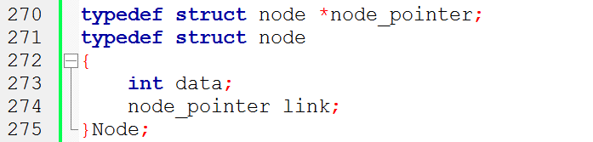
Lists After Pairs are input

Slide 71
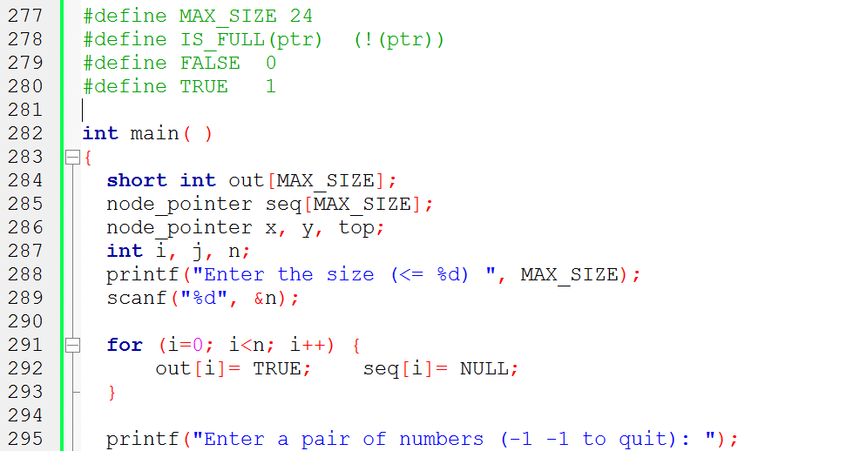
Final Version for Finding Equivalence Classes

Slide 72
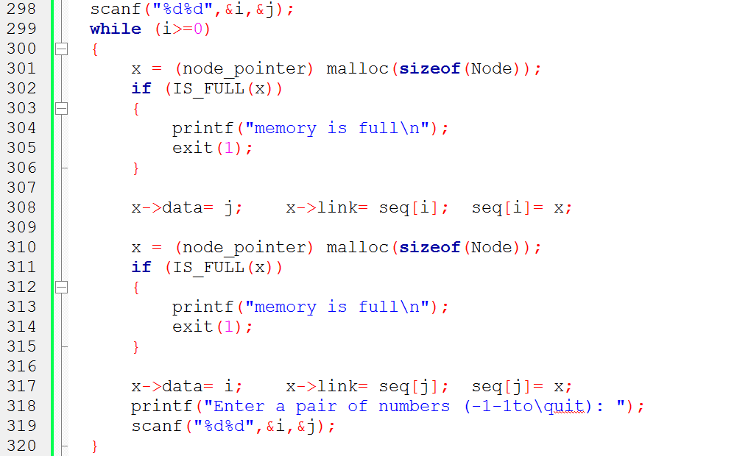
Phase 1: read in and store the equivalence pairs <i, j>
0 ≡ 4, 3 ≡ 1, 6 ≡ 10, 8 ≡ 9, 7 ≡ 4, 6 ≡ 8, 3 ≡ 5, 2 ≡ 11, 11 ≡ 0
[0]
11
4
NULL
[1]
3
NULL
[2]
11
NULL
[3]
5
1
NULL
Insert x to the top of lists seq[i]
[4]
7
0
NULL
[5]
3
NULL
[6]
8
10
NULL
[7]
4
NULL
[8]
6
Insert x to the top of lists seq[j]
9
NULL
[9]
8
NULL
[10]
6
NULL
[11]
0
2
NULL

Slide 73
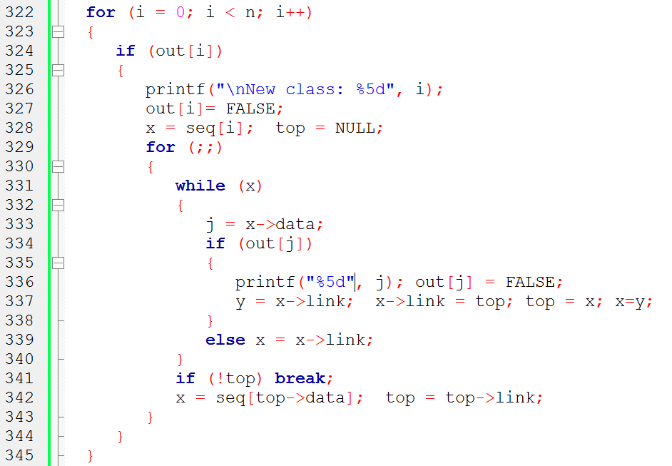
Phase 2: Compute indirect equivalence using transitivity
x
y
[0]
[1]
[2]
[3]
[4]
[5]
[6]
[7]
[8]
[9]
i=
1
0
j=
11
4
7
0
4
0
2
11
out:
[10]
[11]
top
[0]
11
4
NULL
[1]
3
NULL
[2]
11
NULL
[3]
5
1
NULL
[4]
7
0
NULL
[5]
3
NULL
[6]
8
10
NULL
[7]
4
NULL
[8]
6
9
NULL
[9]
8
NULL
[10]
6
NULL
[11]
0
2
NULL
New class: 0
11
4
7
2

Slide 74
Set Representation
S1={0, 6, 7, 8}, S2={1, 4, 9}, S3={2, 3, 5}
Two operations considered here
Disjoint set union :
ex: S₁ ∪ S₂={0,6,7,8,1,4,9}
Find(i) : Find the set containing the element i. ex: Find(3) ∈ S₃, Find(8) ∈ S₁
0
4
2
6
7
8
1
9
3
5
S_{i} ∩ S_{j} = φ

Slide 75
Set Representation
Union and Find Operations
Make one of trees a subtree of the other
4
0
0
1
9
6
7
8
4
9
6
7
8
1
Possible representation for S1 union S2
S1={0, 6, 7, 8}, S2={1, 4, 9}

Slide 76
Set Representation
0
6
7
8
4
1
9
2
3
5

Slide 77
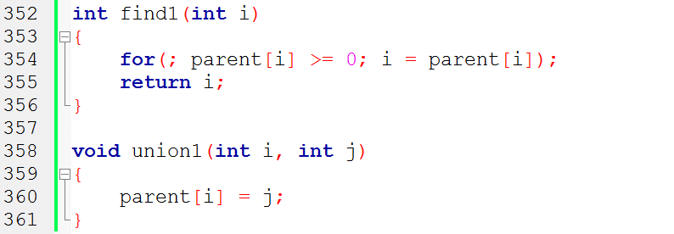
Array Set Representation
4
1
9
S1={0, 6, 7, 8}, S2={1, 4, 9}, S3={2, 3, 5}
0
i
[0]
[1]
[2]
[3]
[4]
[5]
[6]
[7]
[8]
[9]
6
7
8
parent
-
4
4
-
3
2
-
3
2
0
0
0
4
2
3
5

Slide 78
Degenerate Tree
union(0,1), find(0)
union(1,2), find(0)
.
.
.
union(n-2,n-1),find(0)
n-1
union operation
O(n) n-1
find operation
O(n²)
n-2
•
•
•
0
degenerate tree

Slide 79
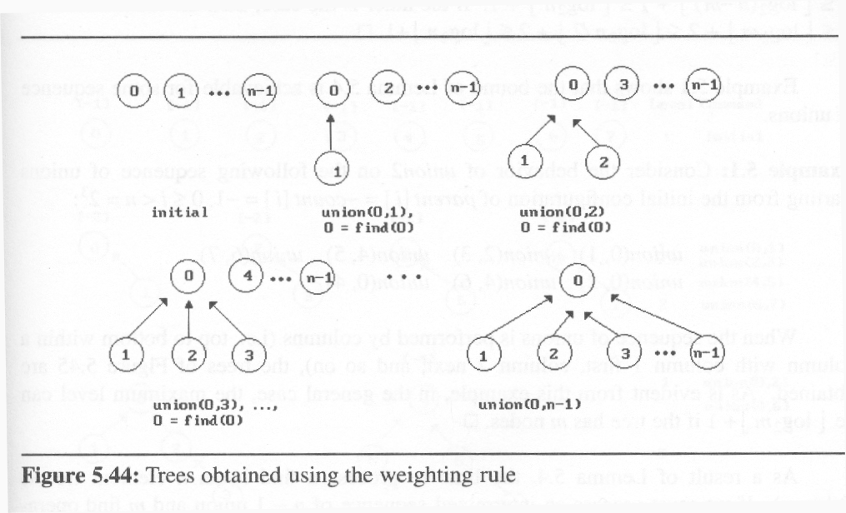
Set Representation
weighting rule for union(i,j):
If (no. of nodes in i) < (no. of nodes in j) then i (少) → j (多)
2
1
3
1

Slide 80
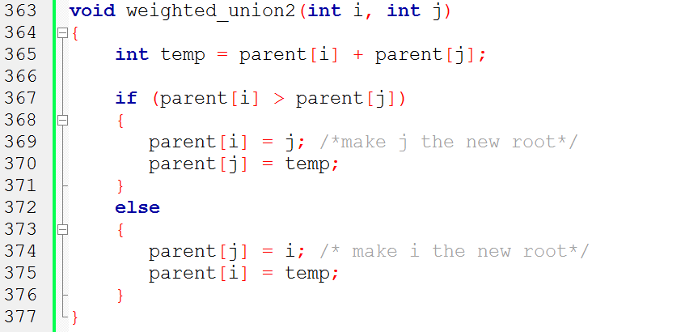
Modified Union Operation

Slide 81
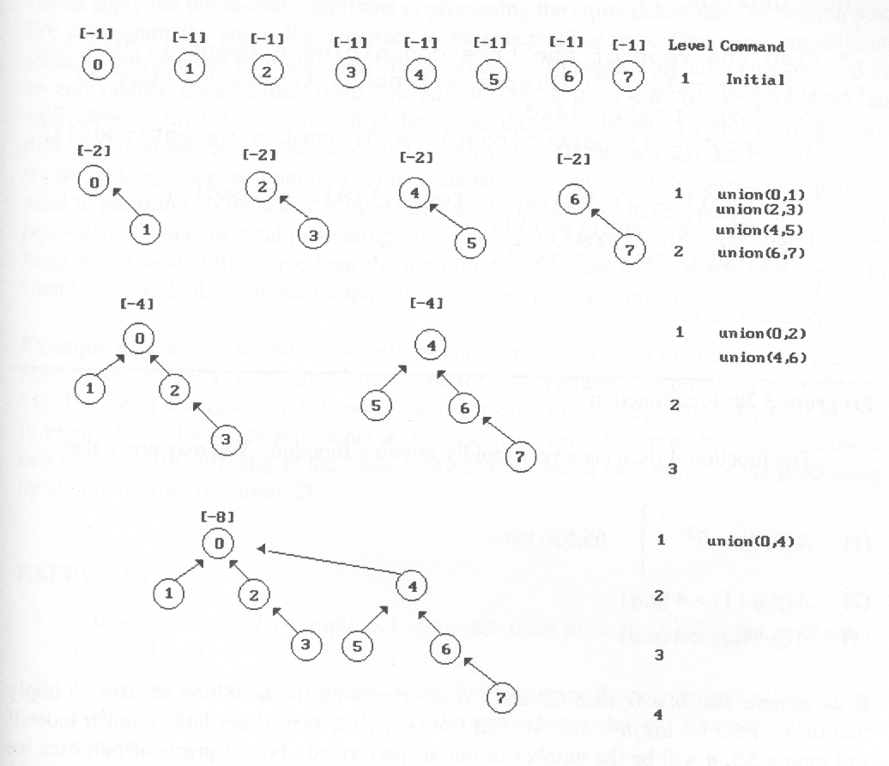
Set Representation
⎣ log₂8⎦+1

Slide 82
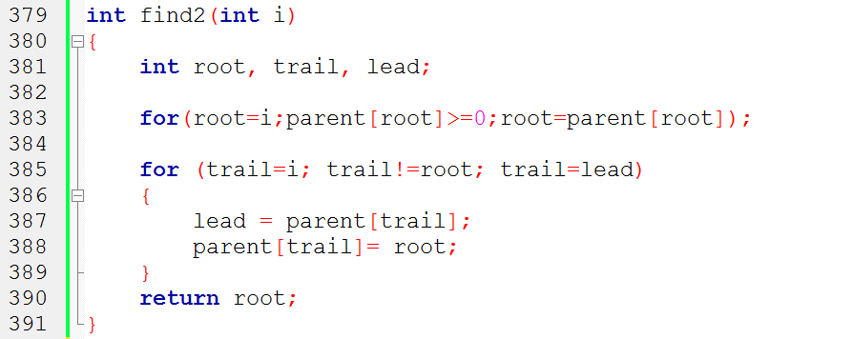
Modified Find(i) Operation
parent[root]==-8
root==0
0
root==4
1
2
4
If j is a node on the path from
i to its root then make j a child
of the root
root==6
3
5
6
lead==6
root==7
i==7
trail==7
7

Slide 83
Modified Find(i) Operation
root==0
0
1
2
4
lead==4
trail==6
If j is a node on the path from
i to its root then make j a child
of the root
3
5
6
7

Slide 84
Modified Find(i) Operation
lead==0
root==0
0
trail==4
1
2
4
If j is a node on the path from
i to its root then make j a child
of the root
3
6
5
7

Slide 85
Set Representation
0
0
4
1
2
4
6
7
1
2
3
5
6
3
5
7
find(7) find(7) find(7) find(7) find(7) find(7) find(7) find(7)
go up 3 1 1 1 1 1 1 1
reset 2
12 moves (vs. 24 moves)

Slide 86
Equivalance class Applications
Find equivalence class i ≡ j
Find S_{i} and S_{j} such that i ∈ S_{i} and j ∈ S_{j}
(two finds)
S_{i} = S_{j} do nothing
S_{i} ≠ S_{j} union(S_{i} , S_{j})
example 0 ≡ 4, 3 ≡ 1, 6 ≡ 10, 8 ≡ 9, 7 ≡ 4, 6 ≡ 8, 3 ≡ 5, 2 ≡ 11, 11 ≡ 0 {0, 2, 4, 7, 11}, {1, 3, 5}, {6, 8, 9, 10}

Slide 87
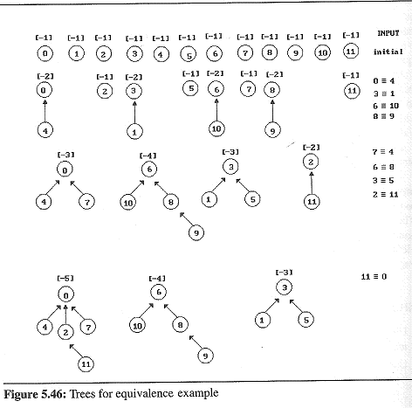
Set Representation

Slide 88
Doubly Linked List
Move in forward and backward direction.
Singly linked list (in one direction only)
How to get the preceding node during deletion or insertion?
Node in doubly linked list
Using 2 pointers
left link field (llink)
right link field (rlink)
...
NULL
no
ptr
yes

Slide 89
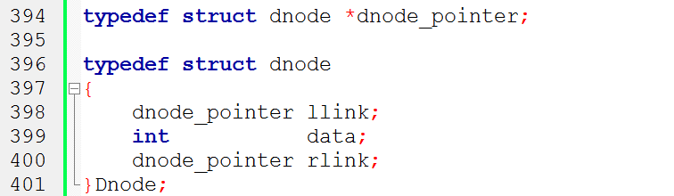
Doubly Linked Lists
ptr
ptr
= ptr->rlink->llink
= ptr->llink->rlink
head node
llink item rlink
ptr.llink
ptr
ptr.rlink
ptr.llink.rlink
ptr.rlink.llink

Slide 90
Head node
Head node
•
•
• •
newnode

Slide 91
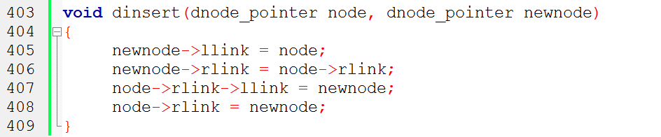
Node Insertion of Doubly Linked List


●
❍
Head node
node
llink item rlink
④
③
②
①
new node

Slide 92
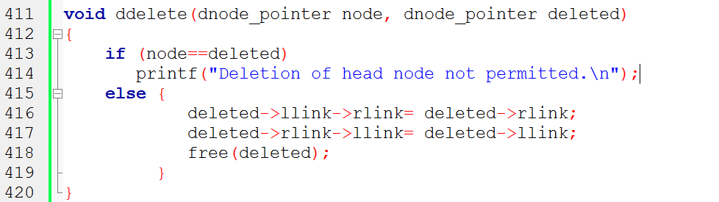
Node Deletion of Doubly Linked List


●
Head node
②
llink item rlink
①
deleted

Slide 93
Singly Linked List (bidirectional move)

Slide 94
