Slide 1
CHAPTER 1
BASIC CONCEPT

Slide 2
How to create programs
Requirements
Analysis: bottom-up vs. top-down
Design: data objects and operations
Refinement and Coding
Verification
Program Proving
Testing
Debugging

Slide 3
Data Type
Data Type
Objects Operations
Abstract Data Type
An abstract data type(ADT) is a data type that is organized in such a way
The specification of the objects and the operations on the objects
The representation of the objects and the implementation of the operations

Slide 4
Specification vs. Implementation
Operation specification
function name
the types of arguments
the type of the results
Implementation independent

Slide 5

Describe Ferris Wheel?
Specification:
multiple passenger cars
attached to the rim
Operations:
rotate upright

Slide 6
Describe Natural Number?
Specification:
An ordered subrange of the integers starting at zero and ending at the maximum integer
Operations:
rotate upright

Slide 7
*Structure 1.1:Abstract data type Natural_Number (p.17) structure Natural_Number is objects: an ordered subrange of the integers starting at zero and ending at the maximum integer (INT_MAX) on the computer functions: for all x, y ∈ Nat_No; TRUE, FALSE∈Boolean Add, Sub, Succ, and Eq are the usual integer operations. Nat_No Zero ( ) ::= 0 Boolean Is_Zero(x) ::= if (x) return FALSE else return TRUE Nat_No Add(x, y) ::= if ((x+y) <= INT_MAX) return x+y else return INT_MAX Boolean Eq(x,y) ::= if (x== y) return TRUE else return FALSE Nat_No Succ(x) ::= if (x == INT_MAX) return x else return x+1 Nat_No Sub(x,y) ::= if (x<y) return 0 else return x-y
::= is defined as

Slide 8
*Structure 1.1:Abstract data type Natural_Number (p.17) axioms: (describe relations) Is_Zero(Zero()) ::= TRUE Is_Zero(Succ (x)) ::= FALSE Add(Zero(), y) ::= y Add(Succ(x),y) ::= Successor(Add(x,y)) Eq(x,Zero()) ::= Iz_Zero(x) Eq(Zero(),Succ(y)) ::= FALSE Eq(Succ(x),Succ(y)) ::=Equal(x,y) Sub(x,Zero()) ::=x Sub(Zero,Succ(y)) ::=Zero() Sub(Succ(x),Succ(y)) ::=Sub(x,y) end Natural_Number

Slide 9

Truly Understand
You can clearly explain it by your own words!

Slide 10
What is Algorithm?
An algorithm is
any well-defined computation procedure
takes some value, or set of values, as Input
produces some value, or set of values, as Output
A tool for solving well-specific computational problem

Slide 11
Algorithm
Definition An algorithm is a finite set of instructions that accomplishes a particular task
Criteria
input
output
definiteness: clear and unambiguous
finiteness: terminate after a finite number of steps
effectiveness: instruction is basic enough to be carried out

Slide 12
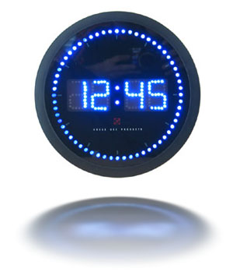
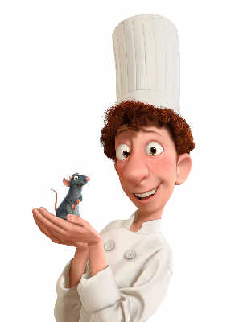

Algorithm Definition with 5 Conditions
Input≧0
Output＞0
Definiteness, Unambiguity
Each operation is clearly defined
Finiteness, Termination
Finally, the algorithm must halt (停)
不會產生無窮迴路
Effectiveness
Each operation is
basic and achievable (step by step)
Y:= X / 0

Slide 13
Algorithm v.s. Procedure
The most difference is
“Whether it can halt?”

Slide 14
Data Structure
DS is a way to store and organize data in order to facilitate access and modifications
No single DS works well for all purpose
It’s important to know the strengths and limitation

Slide 15
Algorithm v.s. Data Structure
一體兩面
Program=
AL + DS

Slide 16
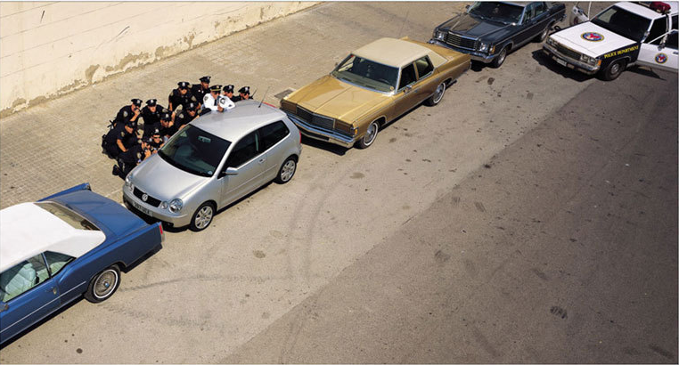
Volkswagen

Slide 17
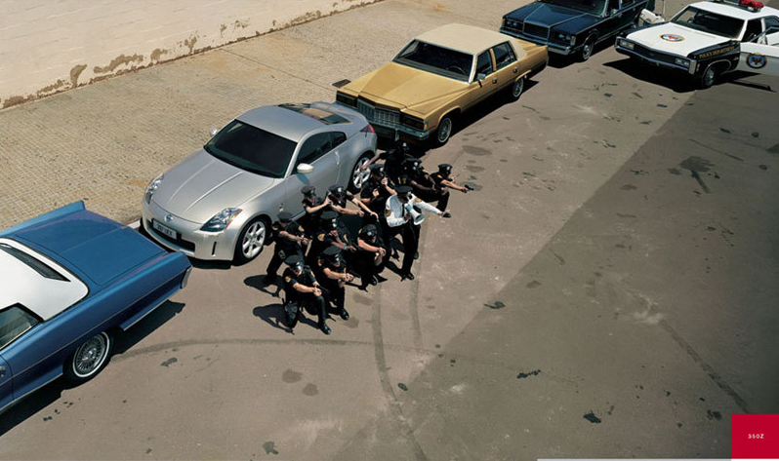
Nissan

Slide 18
Problem & Algorithm
Instance of a problem
consists of the inputs needed to compute a solution to the problem
Correctness of a algorithm
If for every input instance, it halts with the correct output
A correct algorithm solves the given computational problem

Slide 19
What kind of problem can be solved by algorithm?
The Human Genome Project
The Internet Applications
Electronic Commerce with Public-key cryptography and digital signatures
Manufacturing and other commercial settings

Slide 20
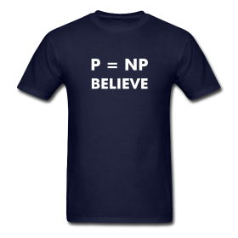
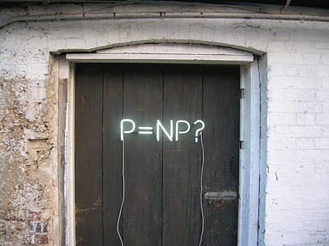

計算問題的世紀大難題 P=NP?
US$ 16.99 / 一件
US$ 20.95 / 一件

Slide 21
Analyzing Algorithm

Slide 22
Pseudocode
Typically, the algorithm is written in a pseudocode
Similar in many respects to C, PASCAL, or Java…
The point is whether the expressive method is most clear and concise to specify a given algorithm

Slide 23
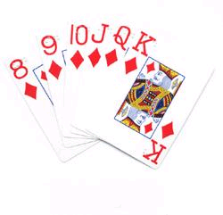
Insertion sort
Example: Sorting problem
Input: A sequence of n numbers
Output: A permutation of the input sequence such that
★The number that we wish to sort are known as the keys.

Slide 24
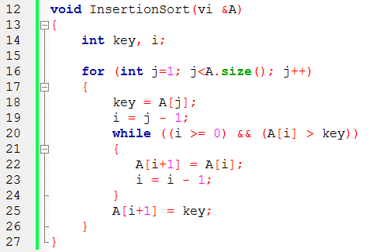
An Example: Insertion Sort
i
j
1
2
3
4
5
6
5
2
4
6
1
3

Slide 25
key
i
j
1
2
3
4
5
6
5
2
4
6
1
3

Slide 26
key
i
j
1
2
3
4
5
6
2
5
4
6
1
3

Slide 27
key
i
j
1
2
3
4
5
6
2
4
5
6
1
3

Slide 28
key
i
j
1
2
3
4
5
6
2
4
5
6
1
3

Slide 29
key
i
j
1
2
3
4
5
6
1
2
4
5
6
3

Slide 30
1
2
3
4
5
6
1
2
3
4
5
6

Slide 31
Observation
Sorted in place :
The numbers are rearranged within the array A, with at most a constant number of them sorted outside the array at any time.
Loop invariant :
At the start of each iteration of the “while loop”, the subarray A[1]…[j-1] consists of the elements originally in A[1]…[j-1] but in sorted order.

Slide 32
Analyzing algorithms
Come to mean predicting the resources that the algorithm requires
Resources:
memory, time , bandwidth, logic gate
Assumption: one processor, RAM model

Slide 33
Performance(1/2)
How does algorithm behave when the problem size gets very large n?
Running time (Time Complexity)
Memory/storage requirements (Space Complexity)
Only additional storage requirement is considered.

Slide 34
Performance(2/2)
Remember that we use the RAM model:
All memory equally expensive to access
(記憶體一樣貴)
No concurrent operations
(無平行運算)
All reasonable instructions take unit time
(相同執行時間)
Constant word size
(固定單位)
Unless we are explicitly manipulating bits

Slide 35
Running Time
On a particular input, number of primitive steps that are executed
Except for time of executing a function call most statements roughly require the same amount of time
It is convenient to define the notion of step so that it is machine-independent
★Best case, Worst case and Average case

Slide 36
Insertion Sort
What is the precondition
for this loop?

Slide 37
Insertion Sort
How many times will this loop execute?

Slide 38
Insertion Sort
c₁ n
c₂ (n-1)
c₄ (n-1)
c₅ Σ_{2..n} t_{j}
c₆ Σ_{2..n} (t_{j}-1)
c₇ Σ_{2..n} (t_{j}-1)
c₈ (n-1)
***t_{j} is number of times the while loop executed for the value j

Slide 39
Best-case
★不要進入 while 迴圈
for j = 2,3,…,n

Slide 40

Best-case
Linear function on n
(n)

Slide 41
Worst-case
★每次都進入 while 迴圈
for j = 2,3,…,n

Slide 42
Worst-case
quadratic function on n
(n²)

Slide 43
Worst-case v.s. Average-case Analysis
Usually, we concentrate on finding only on the Worst-case running time
Reason:
It is an upper bound on the running time
The worst case occurs fair often
The average case is often as bad as the worst case.
For example, the insertion sort. Again, quadratic function.

Slide 44
Average Case?
Apply Invert Table

Slide 45
5
2
4
6
1
3
Invert table
0
1
1
0
4
3
1
2
3
4
5
6
1
2
3
4
5
6
5
2
4
6
1
3
2
4
5
6
1
3
1
2
3
4
5
6
1
2
3
4
5
6
2
5
4
6
1
3
2
4
5
6
1
3
1
2
3
4
5
6
1
2
4
5
6
3

Slide 46
Average-case
5
2
4
6
1
3
Invert table
0
1
1
0
4
3

Slide 47
Order of Growth
In some particular cases, we shall be interested in Average-case, or expect running time of an algorithm
However, Rate of growth, or Order of growth, of the running time that really interests us

Slide 48
Analysis
Simplifications
Ignore actual and abstract statement costs
Order of growth is the interesting measure:
Highest-order term is what counts
Remember, we are doing asymptotic analysis
As the input size grows larger it is the high order term that dominates

Slide 49
Worst-case
for i = 2,3,…,n
quadratic function on n

Slide 50
Growth of Function
The coefficients don’t affect as much as the rate of growth
A problem P
Algorithm 1 solves P in n days
Algorithm 2 solves P in 2^{n} seconds
Which one is faster?
“Algorithm 1 runs faster for n > 20”
→2²⁰=1048576 secs
→n x 12 x 60 x 60 =864000 secs

Slide 51
小時候胖不是胖
So…

Slide 52
Asymptotic Notation

Slide 53
Asymptotic Tightly Upper Bound

Slide 54
How to read and view the notation?
⇒ big-Oh of n² , order n²
⇒ “Set“ of Function

Slide 55
How to read and view the notation?
“=“ : abuse
“ “ belong to
⇒f(n) big-Oh of (n²)
⇒f(n) doesn’t grow faster than n²
⇒

Slide 56
Asymptotic Tightly Lower Bound

Slide 57
Asymptotic Tightly Bound

Slide 58
Theorem
For any two functions f(n) and g(n), if and only if and

Slide 59
Asymptotic Upper Bound

Slide 60
Asymptotic Lower Bound

Slide 61
Examples

Slide 62
Example:

Slide 63
Example:
In general,

Slide 64
Order of Growth

Slide 65
Order of Growth

Slide 66
Order of Growth

Slide 67
Order of Growth

Slide 68
Quick Sort
Prof. Shin-Hung Chang

Slide 69
Quicksort
Sorts in place
Sorts O(n log n) in the average case
Sorts O(n²) in the worst case
So why would people use it instead of merge sort?

Slide 70
Quicksort
Quicksort(A, p, r)
{
if (p < r)
{
j = Partition(A, p, r);
Quicksort(A, p, j);
Quicksort(A, j+1, r);
}
}

Slide 71
Partition
Clearly, all the action takes place in the partition() function
Rearranges the subarray in place
End result:
Two subarrays
All values in first subarray ≤ all values in second
Returns the index of the “pivot” element separating the two subarrays
How do you suppose we implement this function?

Slide 72
Partition In Words
Partition(A, p, r):
Select an element to act as the “pivot” (which?)
Grow two regions, A[p..j] and A[j+1..r]
All elements in A[p..j] ≦ pivot
All elements in A[j+1..r] ≧ pivot
Increment i until A[i] ≧ pivot
Decrement j until A[j] ≦ pivot
Swap A[i] and A[j]
Repeat until i >= j
Return j

Slide 73
Partition(A, 1, 10)
pivot
Partition(A, p, r)
{x = A[p];
i = p - 1;
j = r + 1;
while (TRUE)
{ repeat
j--;
until A[j] <= x;
repeat
i++;
until A[i] > x;
if (i < j)
Swap(A, i, j);
else
return j;}
}
p=
r=
1 2 3 4 5 6 7 8 9 10
x=6
A =
6
14
10
8
7
9
3
2
4
1
i
j
x=6
A =
1
14
10
8
7
9
3
2
4
6
i
j
x=6
A =
1
4
2
8
7
9
3
10
14
6
i
j
A =
1
4
2
8
7
9
3
10
14
6
i
j
A =
1
4
2
3
7
9
8
10
14
6
j
i

Slide 74
Partition Code
Partition(A, p, r)
{ x = A[p];
i = p - 1;
j = r + 1;
while (TRUE)
repeat
j--;
until A[j] <= x;
repeat
i++;
until A[i] > x;
if (i < j)
Swap(A, i, j);
else
return j;
}
Θ(n)
What is the running time of partition()?

Slide 75
Analyzing Quicksort
In the worst case:
T(1) = Θ(1)
T(n) = T(n - 1) + Θ(n)
Time Complexity
T(n) = Θ(n²)

Slide 76
Analyzing Quicksort
In the best case:
T(n) = 2T(n/2) + Θ(n)
Time Complexity
T(n) = Θ(n lg n)

Slide 77
Improving Quicksort
The real liability of quicksort is that it runs in O(n²) on already-sorted input
Discuss two solutions:
Randomize input array
Random pivot element
How will these solve the problem?
By insuring that no particular input can be chosen to make quicksort run in O(n²) time

Slide 78
Binary Search
Prof. Shin-Hung Chang

Slide 79
Binary Search
Given a value and a sorted array a[], find index i such that a[i] = value, or report that no such index exists.
Invariant : a[lo] ≤ value ≤ a[hi]
Ex. Binary search for 33.
6
13
14
25
33
43
51
53
64
72
84
93
95
96
97
0
1
2
3
4
5
6
7
8
9
10
11
12
13
14
lo
hi

Slide 80
Binary Search
6
13
14
25
33
43
51
53
64
72
84
93
95
96
97
0
1
2
3
4
5
6
7
8
9
10
11
12
13
14
lo
mid
hi
6
13
14
25
33
43
51
53
64
72
84
93
95
96
97
0
1
2
3
4
5
6
7
8
9
10
11
12
13
14
lo
hi
6
13
14
25
33
43
51
53
64
72
84
93
95
96
97
0
1
2
3
4
5
6
7
8
9
10
11
12
13
14
lo
mid
hi

Slide 81
Time Complexity
(1)Sorting: O(nlogn)
(2) Search: O(log n)

