Slide 1
CHAPTER 3
STACKS AND QUEUES

Slide 2
Stack
A stack is an ordered list in which insertions and deletions are made at the same end called the top.
Therefore, stack performs the Last-In-First-Out (LIFO) or (FILO) feature.
B
A
C
B
A
D
C
B
A
E
D
C
B
A
top
D
C
B
A
top
top
top
top
top

Slide 3
An application of stack:
stack frame of function call
(activation record)
fp
a1
fp: a pointer to current stack frame
(Main)
fp
main
stack frame of invoking function
(OS)
(OS)
system stack before a1 is invoked
system stack after a1 is invoked
(a) (b)

Slide 4
Nested Procedure Calls
By the time Sub3 is called, the stack contains all three return addresses:
ESP
(ret to Sub2)
(ret to Sub1)
(ret to main)

Slide 5
structure Stack is objects: a finite ordered list with zero or more elements. functions: for all stack ∈ Stack, item ∈ element, max_stack_size ∈ positive integer Stack CreateS(max_stack_size) ::= create an empty stack whose maximum size is max_stack_size Boolean IsFull(stack, max_stack_size) ::= if (number of elements in stack == max_stack_size) return TRUE else return FALSE Stack Add(stack, item) ::= if (IsFull(stack)) stack_full else insert item into top of stack and return
ADT for Stack

Slide 6
Boolean IsEmpty(stack) ::= if(stack == CreateS(max_stack_size)) return TRUE else return FALSE Element Delete(stack) ::= if(IsEmpty(stack)) return else remove and return the item on the top of the stack.

Slide 7
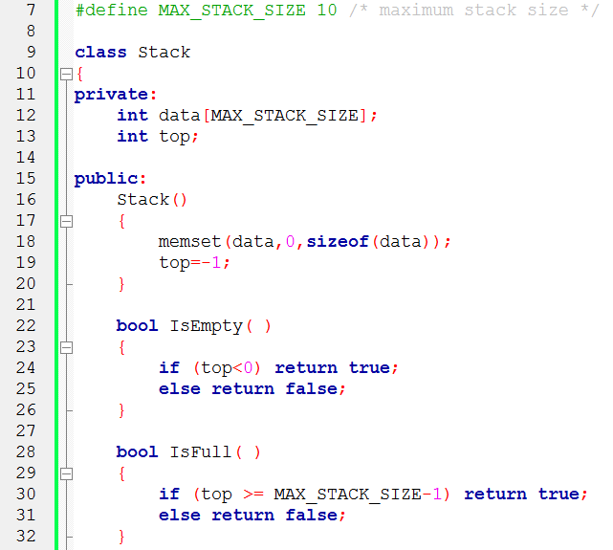
Implementation: using array (1/2)

Slide 8
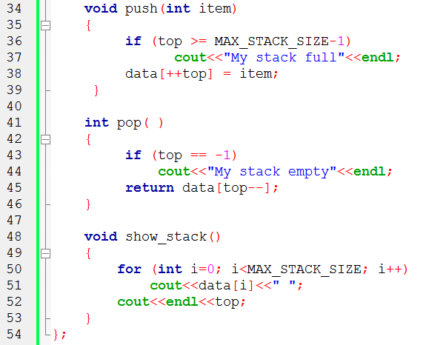
Implementation: using array (2/2)

Slide 9
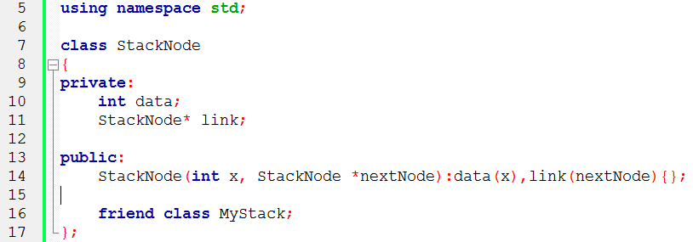
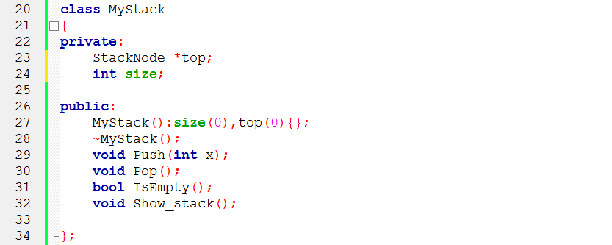
Implementation: using linked list (1/2)

Slide 10
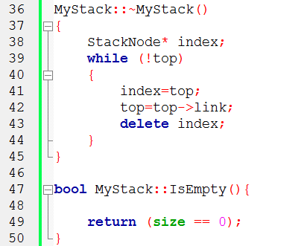
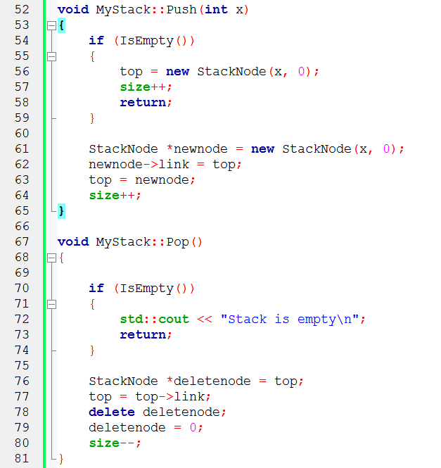
Implementation: using linked list (2/2)

Slide 11
Queue
A queue is an ordered list in which all
insertion take place one end, called the rear
deletions take place at the opposite end, called the front
A queue performs First-In-First-Out (FIFO) feature
A
B
A
C
B
A
D
C
B
A
rear
front
D
C
B
rear
front
rear
front
rear
front
rear
front

Slide 12
Application: Job scheduling

Slide 13
structure Queue is objects: a finite ordered list with zero or more elements. functions: for all queue∈Queue, item∈element, max_queue_size∈positive integer Queue CreateQ(max_queue_size) ::= create an empty queue whose maximum size is max_queue_size Boolean IsFullQ(queue, max_queue_size) ::= if(number of elements in queue == max_queue_size) return TRUE else return FALSE Queue AddQ(queue, item) ::= if (IsFullQ(queue)) queue_full else insert item at rear of queue and return queue
ADT of Queue

Slide 14
Boolean IsEmptyQ(queue) ::= if (queue ==CreateQ(max_queue_size)) return TRUE else return FALSE Element DeleteQ(queue) ::= if (IsEmptyQ(queue)) return else remove and return the item at front of queue.

Slide 15
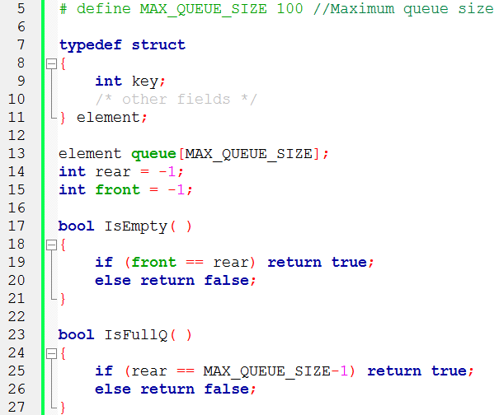
Implementation 1: using array (1/2)

Slide 16
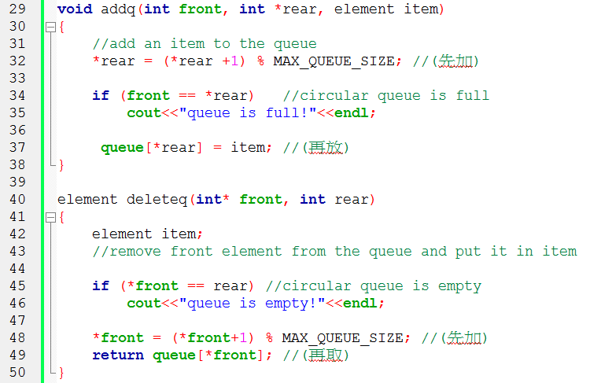
Implementation 1: using array (2/2)

Slide 17
Problem
There may be available space when IsFullQ is true.
Movement is required.
rear
front
front
rear
1 | 2 | 3 | 4 | 5 | 6
rear
front

Slide 18
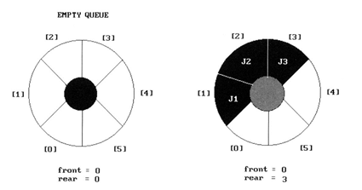
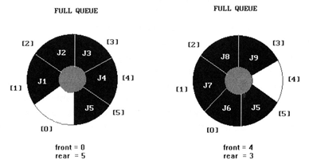
regard the array queue[MAX_QUEUE_SIZE] as circular
Implementation 2: regard an array as a circular queue
front: one position counterclockwise from the first element
rear: current end
Problem: one space is left when queue is full.

Slide 19

Add && delete
to a circular queue

Slide 20

A Mazing Problem
Representation of the maze
The most obvious choice is a two dimensional array
“0” the open paths and “1” the barriers
Note that not every position has eight neighbors.
To avoid checking for these border conditions we can surround the maze by a border of ones.
Thus an m×p maze will require
an (m+2) × (p+2) array
The entrance is at position [1][1] and the exit at [m][p]
entrance
1 1 1 1 1 1 1 1 1 1 1 1 1 1 1 1 1
1 0 1 0 0 0 1 1 0 0 0 1 1 1 1 1 1
1 1 0 0 0 1 1 0 1 1 1 0 0 1 1 1 1
1 0 1 1 0 0 0 0 1 1 1 1 0 0 1 1 1
1 1 1 0 1 1 1 1 0 1 1 0 1 1 0 0 1
1 1 1 0 1 0 0 1 0 1 1 1 1 1 1 1 1
1 0 0 1 1 0 1 1 1 0 1 0 0 1 0 1 1
1 0 1 1 1 1 0 0 1 1 1 1 1 1 1 1 1
1 0 0 1 1 0 1 1 0 1 1 1 1 1 0 1 1
1 1 1 0 0 0 1 1 0 1 1 0 0 0 0 0 1
1 0 0 1 1 1 1 1 0 0 0 1 1 1 1 0 1
1 0 1 0 0 1 1 1 1 1 0 1 1 1 1 0 1
1 1 1 1 1 1 1 1 1 1 1 1 1 1 1 1 1
exit

Slide 21
A possible representation
If X marks the spot of the current location, maze[row][col], then following shows the possible moves from this position

Slide 22
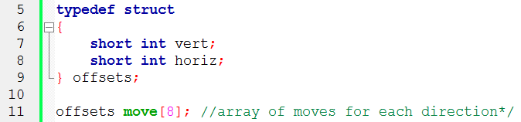
A possible implementation
next_row = row + move[dir].vert; next_col = col + move[dir].horiz;

Slide 23
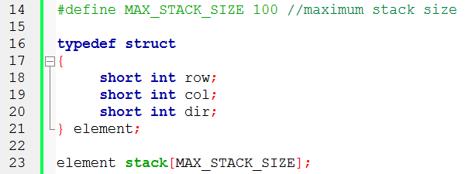
Use stack to keep pass history

Slide 24
Initialize a stack to the maze’s entrance coordinates and direction to north; while (stack is not empty) { /* move to position at top of stack */ <row, col, dir> = pop from stack; while (there are more moves from current position) { <next_row, next_col > = coordinates of next move; dir = direction of move; if ( (next_row == EXIT_ROW) && (next_col == EXIT_COL)) success;

Slide 25
if (maze[next_row][next_col] == 0 && mark[next_row][next_col] == 0) /* 不是牆壁而且沒走過 */ { mark[next_row][next_col] = 1; /* 標記走過 */ /* save current position and direction */ push <row, col, dir> to the stack; row = next_row; col = next_col; dir = north; } } } printf(“No path found\n”);

Slide 26
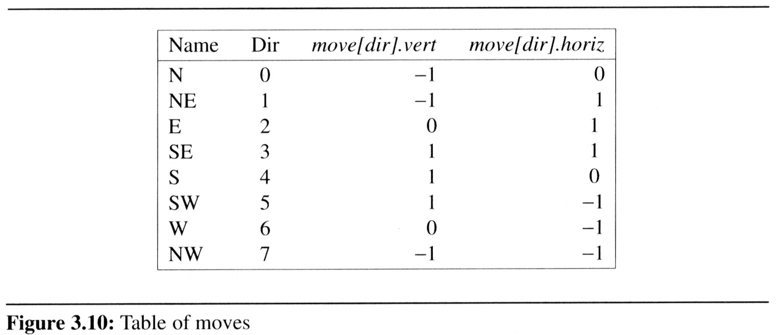
R: row C: col D: dir
R 1 C 1 D 1
R4 C14 D 2
R3 C12 D 5
R3 C13 D 3
R3 C13 D 6
Pop out
R2 C12 D 3
R2 C11 D 2
maze[1][1]: entrance
R1 C10 D 3
R 1 C 9 D 2
1 1 1 1 1 1 1 1 1 1 1 1 1 1 1 1 1
1 0 1 0 0 0 1 1 0 0 0 1 1 1 1 1 1
1 1 0 0 0 1 1 0 1 1 1 0 0 1 1 1 1
1 0 1 1 0 0 0 0 1 1 1 1 0 0 1 1 1
1 1 1 0 1 1 1 1 0 1 1 0 1 1 0 0 1
1 1 1 0 1 0 0 1 0 1 1 1 1 1 1 1 1
1 0 0 1 1 0 1 1 1 0 1 0 0 1 0 1 1
1 0 1 1 1 1 0 0 1 1 1 1 1 1 1 1 1
1 0 0 1 1 0 1 1 0 1 1 1 1 1 0 1 1
1 1 1 0 0 0 1 1 0 1 1 0 0 0 0 0 1
1 0 0 1 1 1 1 1 0 0 0 1 1 1 1 0 1
1 0 1 0 0 1 1 1 1 1 0 1 1 1 1 0 1
1 1 1 1 1 1 1 1 1 1 1 1 1 1 1 1 1
❒
❒
❒
❒
❒
❒
❒
R 1 C 8 D 2
❒
❒
❒
❒
❒
R 2 C 7 D 1
❒
❒
❒
❒
❒
❒
R 3 C 6 D 1
R 3 C 5 D 2
R 2 C 4 D 3
R 1 C 5 D 5
R 1 C 4 D 2
R 1 C 3 D 2
R 2 C 2 D 1
R 1 C 1 D 1
maze[15][11]: exit
R 1 C 1 D 3

Slide 27

The size of a stack?
000001
111110
100001
011111
100001
111110
100001
011111
100000
m x p
$mp→\left\lceil \frac{m}{2}\right\rceil ×p or mp→\left\lceil \frac{p}{2}\right\rceil ×m$

Slide 28
void path (void) { /*output a path through the maze if such a path exists*/ int i, row, col, next_row, next_col, dir, found = FALSE; element position; mark[1][1] = 1; top =0; stack[0].row = 1; stack[0].col = 1; stack[0].dir = 1; while (top > -1 && !found) { position = pop(&top); row = position.row; col = position.col; dir = position.dir; while (dir < 8 && !found) { /*move in direction dir */ next_row = row + move[dir].vert; next_col = col + move[dir].horiz;
(1,1)
(m,p)
(m+2)*(p+2)
0
7 N 1
6 W E 2
5 S 3
4

Slide 29
if (next_row==EXIT_ROW && next_col==EXIT_COL) found = TRUE; else if ( !maze[next_row][next_col] && !mark[next_row][next_col]) { mark[next_row][next_col] = 1; position.row = row; position.col = col; position.dir = ++dir; push(&top, position); row = next_row; col = next_col; dir = 0; } else ++dir; } }

Slide 30
if (found) { printf(“The path is :\n”); printf(“row col\n”); for (i = 0; i <= top; i++) printf(“ %2d%5d”, stack[i].row, stack[i].col); printf(“%2d%5d\n”, row, col); printf(“%2d%5d\n”, EXIT_ROW, EXIT_COL); } else printf(“The maze does not have a path\n”); }

Slide 31
Evaluation of Expressions
X = a / b - c + d * e - a * c
a = 4, b = c = 2, d = e = 3
Interpretation 1:
((4/2)-2)+(3*3)-(4*2)=0 + 8+9=1
Interpretation 2:
(4/(2-2+3))*(3-4)*2=(4/3)*(-1)*2=-2.66666…
How to generate the machine instructions corresponding to a given expression?
precedence rule + associative rule

Slide 32
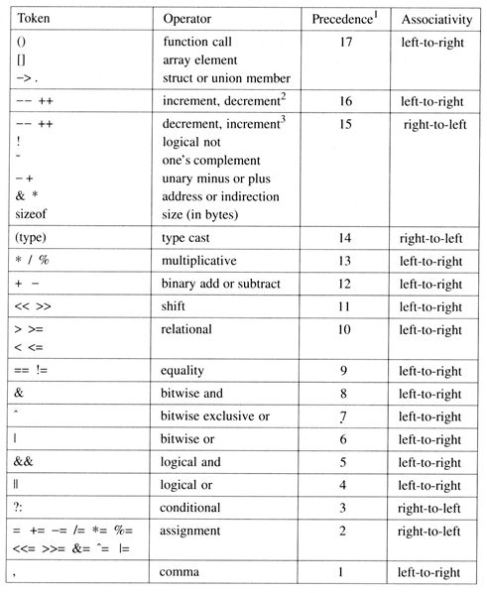
Precedence v.s. Associativity

Slide 33
Infix / Postfix
Evaluating postfix expressions
The standard way of writing expressions is known as infix notation
binary operator in-between its two operands
Infix notation is not the one used by compilers to evaluate expressions
Instead compilers typically use a parenthesis-free notation referred to as postfix notation
Postfix: no parentheses, no precedence

Slide 34
user
compiler

Slide 35
Evaluation of Expressions
string: 6 2/3-4 2*+
add the string with the operator
we make a single left-to-right scan of it
6 2 / 3 - 4 2 * +
2
2
the answer is
not an operator, put into the stack
not an operator, put into the stack
is an operator, pop two elements of the stack
not an operator, put into the stack
is an operator, pop two elements of the stack
not an operator, put into the stack
not an operator, put into the stack
is an operator, pop two elements of the stack
is an operator, pop two elements of the stack
end of string, pop the stack and get answer
1
2
3
4
4*2
6 / 2 - 3 + 4 * 2
6
6/2
6/2-3
0
6/2-3+4*2
top
STACK
now, top must +1
now, top must -2
now, top must -1

Slide 36
#define MAX_STACK_SIZE 100 /* maximum stack size */ #define MAX_EXPR_SIZE 100 /* max size of expression */ typedef enum{1paran, rparen, plus, minus, times, divide, mod, eos, operand} precedence; int stack[MAX_STACK_SIZE]; /* global stack */ char expr[MAX_EXPR_SIZE]; /* input string */
Goal: Infix -> Postfix
Assumptions:
operators: +, -, *, /, %
operands: single digit integer

Slide 37
int eval(void) { /* evaluate a postfix expression, expr, maintained as a global variable, ‘\0’ is the the end of the expression. The stack and top of the stack are global variables. get_token is used to return the token type and the character symbol. Operands are assumed to be single character digits */ precedence token; char symbol; int op1, op2; int n = 0; /* counter for the expression string */ int top = -1; token = get_token(&symbol, &n);

Slide 38
while (token != eos) { if (token == operand) push(&top, symbol-’0’); /* stack insert */ else { /* remove two operands, perform operation, and return result to the stack*/ op2 = pop(&top); /* stack delete */ op1 = pop(&top); switch(token) { case plus : push(&top, op1+op2); break; case minus : push(&top, op1-op2); break; case times : push(&top, op1*op2); break; case divide : push(&top, op1/op2); break; case mod : push(&top, op1%op2); } } token = get_token (&symbol, &n); } return pop(&top); /* return result */ }

Slide 39
precedence get_token(char *symbol, int *n) { /* get the next token, symbol is the character representation, which is returned, the token is represented by its enumerated value, which is returned in the function name */ *symbol =expr[(*n)++]; switch (*symbol) { case ‘(‘ : return lparen; case ’)’ : return rparen; case ‘+’ : return plus; case ‘-’ : return minus; case ‘/’ : return divide; case ‘*’ : return times; case ‘%’ : return mod; case ‘\0‘ : return eos; default : return operand; } }

Slide 40
Infix to Postfix Conversion (Intuitive Algorithm, for human being)
(1)Fully parenthesize expression
a / b - c + d * e - a * c -->((((a / b) - c) + (d * e)) - a * c))
(2)All operators replace their corresponding right
parentheses.
((((a / b) - c) + (d * e)) - a * c))
(3)Delete all parentheses.
ab/c-de*+ac*-
*
*
/
-
+
-

Slide 41
Infix to Postfix Conversion (Stack, for Computer)
a * ( b + c ) / d
operand, print out
operator
operator
operand, print out
operator
operand, print out
operator
operator
operand, print out
eos
push into the stack
+
pop the stack and printout
2
the isp of “( “ is 0 and the icp of “* “ is 13
the isp of “/ “ is 13 and the icp of “* “ is 13
the isp of “+“ is 12 and the icp of “( “ is 20
operator “)”, pop and print out until “(”
(
1
*
output
0
/
a
b
c
+
*
d
/
top
stack
now, top must +1
now, top must - 1

Slide 42
Rules
(1)Operators are taken out of the stack as long as their
in-stack precedence(isp) ≧ incoming precedence(icp)
裡面的等級 ≧ 進入的等級 (會輸出)
(2)”(“ has low-isp, and high-icp
( ) + - * / % eos
isp 0 19 12 12 13 13 13 0
icp 20 19 12 12 13 13 13 0

Slide 43
precedence stack[MAX_STACK_SIZE]; /* isp and icp arrays -- index is value of precedence lparen, rparen, plus, minus, times, divide, mod, eos */ static int isp [ ] = {0, 19, 12, 12, 13, 13, 13, 0}; static int icp [ ] = {20, 19, 12, 12, 13, 13, 13, 0};

Slide 44
void postfix(void) { /* output the postfix of the expression. The expression string, the stack, and top are global */ char symbol; precedence token; int n = 0; int top = 0; /* place eos on stack */ stack[0] = eos;

Slide 45
for (get token; token != eos; get token) { if (token == operand) printf (“%c”, symbol); else if (token == rparen ) { /*unstack tokens until left parenthesis */ while (stack[top] != lparen) print_token(pop(&top)); pop(&top); /*discard the left parenthesis */ } else{ /* remove and print symbols whose isp is greater than or equal to the current token’s icp */ while(isp[stack[top]] >= icp[token] ) print_token(delete(&top)); push(&top, token); } } while ((token = pop(&top)) != eos) print_token(token); print(“\n”); }

Slide 46
(1) evaluation
(2) transformation

Slide 47
Multiple stacks and queues
Two stacks
More than two stacks (n)
memory is divided into n equal segments
boundary[stack_no]
0 ≤ stack_no < MAX_STACKS
top[stack_no]
0 ≤ stack_no < MAX_STACKS
b1
t1
b2
t2
b1
t1
t2
b2
t1
b1
b2
t2

Slide 48
Initially, boundary[i]=top[i].
0 1 [ m/n ] 2[ m/n ] m-1
boundary[ 0] boundary[1] boundary[ 2] boundary[n]
top[ 0] top[ 1] top[ 2]

Slide 49
#define MEMORY_SIZE 100 /* size of memory */ #define MAX_STACK_SIZE 100 /* max number of stacks plus 1 */ /* global memory declaration */ element memory[MEMORY_SIZE]; int top[MAX_STACKS]; int boundary[MAX_STACKS]; int n; /* number of stacks entered by the user */ top[0] = boundary[0] = -1; for (i = 1; i < n; i++) top[i] =boundary[i] =(MEMORY_SIZE/n)*i; boundary[n] = MEMORY_SIZE-1;

Slide 50
void push(int i, element item) { /* add an item to the ith stack */ if (top[i] == boundary [i+1]) stack_full(i); may have unused storage memory[++top[i]] = item; } element pop(int i) { /* remove top element from the ith stack */ if (top[i] == boundary[i]) return stack_empty(i); return memory[top[i]--]; }

Slide 51
(往右)
Find j, stack_no < j < n
such that top[j] < boundary[j+1]
or, 0 ≤ j < stack_no
(往左)
b[0] t[0] b[1] t[1] b[s] t[s] t[i+1] t[j] b[j+1] b[n]
b[i+1] b[j]
b=boundary, t=top
meet
往左或右找一個空間

