Slide 1
Container (STL)
Prof. Shin-Hung Chang

Slide 2
Standard Template Library
The standard template library (STL) contains
Containers
Algorithms
Iterators
Container is a way that stored data is organized in memory, for example an array of elements.
Algorithms in the STL are procedures that are applied to containers to process their data, for example search for an element in an array, or sort an array.
Iterators are a generalization of the concept of pointers, they point to elements in a container, for example you can increment an iterator to point to the next element in an array

Slide 3
Containers, Iterators, Algorithms
Algorithms use iterators to interact with objects
stored in containers
Container
Container
Iterator
Algorithm
Objects
Iterator
Algorithm
Iterator
Iterator
Algorithm

Slide 4
Containers
A container is a way to store data, either built-in data types like int and float, or class objects
The STL provides several basic kinds of containers
<vector> : one-dimensional array
<list> : double linked list
<deque> : double-ended queue
<queue> : queue
<stack> : stack
<set> : set
<map> : associative array

Slide 5
Sequence Containers (1)
A sequence container stores a set of elements in sequence, in other words each element (except for the first and last one) is preceded by one specific element and followed by another.
<vector>, <list> and <deque> are sequential containers
In an ordinary C++ array the size is fixed and can not change during run-time, it is also tedious to insert or delete elements.
Advantage: quick random access

Slide 6
Sequence Containers (2)
<vector> is an expandable array that can shrink or grow in size
Disadvantage: inserting or deleting elements in the middle
<list> is a double linked list (each element has points to its successor and predecessor), it is quick to insert or delete elements
Disadvantage: has slow random access
<deque> is a double-ended queue, that means one can insert and delete elements from both ends, it is a kind of combination between a stack (last in first out) and a queue (first in first out) constitutes a compromise between a <vector> and a <list>

Slide 7
Associative Containers (1)
An associative container is non-sequential but uses a key to access elements.
The keys, typically a number or a string, are used by the container to arrange the stored elements in a specific order
For example in a dictionary the entries are ordered alphabetically

Slide 8
Associative Containers (2)
A <set> stores a number of items which contain keys.
Keys are the attributes used to order the items, for example a set might store objects which are ordered alphabetically.
A <map> stores pairs of objects: a key object and an associated value object.
A <map> is somehow similar to an array except instead of accessing its elements with index numbers, you access them with indices of an arbitrary type.
<set> and <map> only allow one key of each value, whereas <multiset> and <multimap> allow multiple identical key values

Slide 9
Vector Container
int array[5] = {12, 7, 9, 21, 13 };
vector<int> v(array,array+5);
12
7
9
21
13
v.pop_back();
13
v.push_back(15);
…
12
7
9
21
12
7
9
21
15
0 1 2 3 4
12
7
9
21
15
v.begin();
v[3]
v.end();

Slide 10
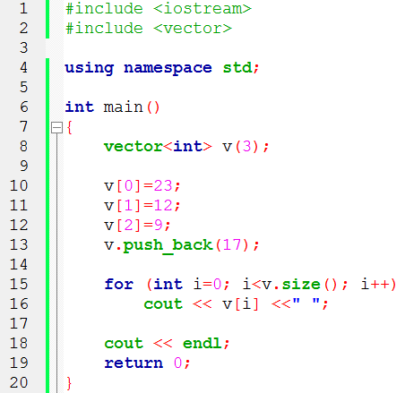
Vector Container Example
Output: 23 12 9 17

Slide 11
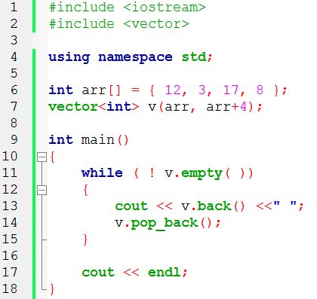
Vector Container Example
Output: 8 17 3 12

Slide 12
Iterators
Iterators are pointer-like entities that are used to access individual elements in a container.
Often they are used to move sequentially from element to element, a process called iterating through a container.
vector<int>
array_
17
vector<int>::iterator
4
23
The iterator corresponding to
the class vector<int> is of
the type vector<int>::iterator
12
size_
4

Slide 13
Iterators
The member functions begin( ) and end( ) return an
iterator to the first and past the last element of a container
vector<int>
v.begin()
array_
17
4
23
12
v.end()
size_
4

Slide 14
Iterators
One can have multiple iterators pointing to different or identical elements in the container
vector<int>
i1
array_
17
4
i2
23
12
i3
size_
4

Slide 15
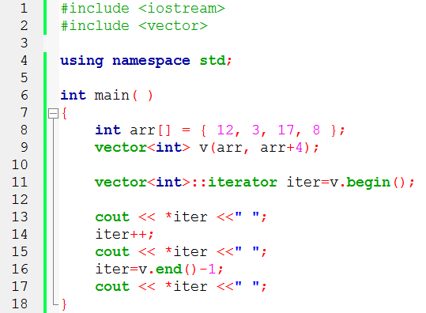
Iterators
Output: 12 3 8

Slide 16
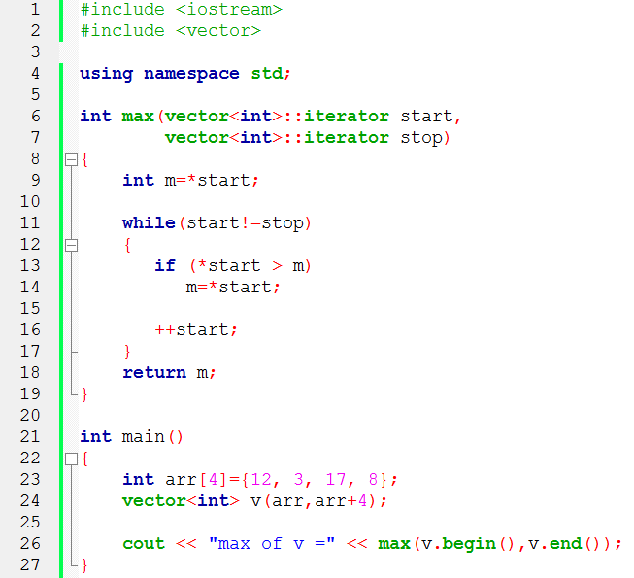
Iterators

Slide 17
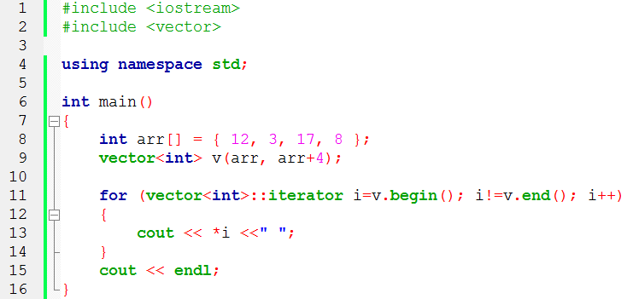
Iterators
Output: 12 3 17 8

Slide 18
Iterator Categories
Not every iterator can be used with every container
For example: list class provides no random access iterator
Every algorithm requires an iterator with a certain level of capability
For example: to use the [ ] operator you need a random access iterator
Iterators are divided into five categories in which a higher (more specific) category always subsumes a lower (more general) category, e.g. An algorithm that accepts a forward iterator will also work with a bidirectional iterator and a random access iterator
input
forward
bidirectional
random
access
output

Slide 19
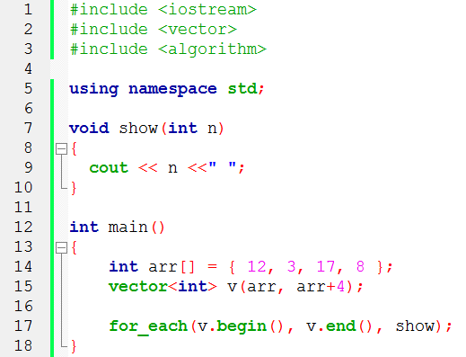
for_each( ) Algorithm
Output: 12 3 17 8

Slide 20
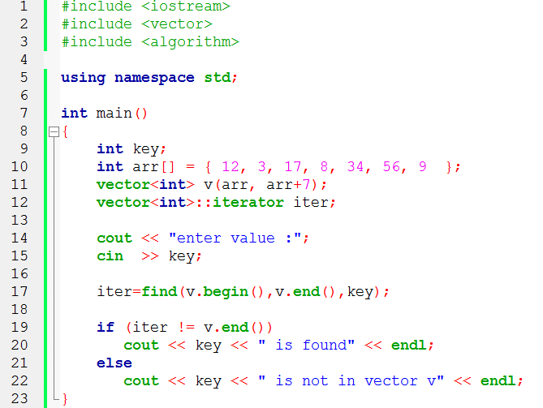
find( ) Algorithm

Slide 21
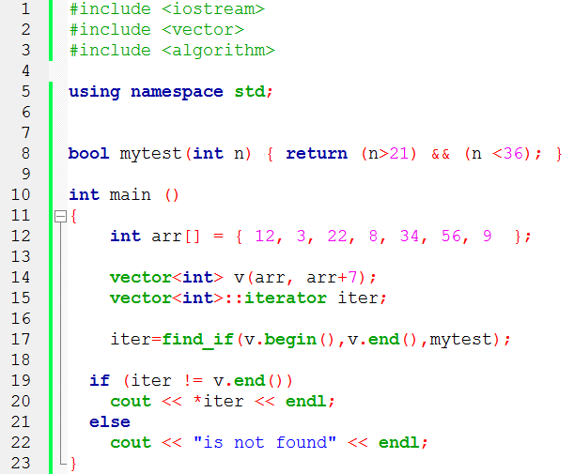
find_if( ) Algorithm
Output: 22

Slide 22
count_if( ) Algorithm
#include <vector>
#include <algorithm>
#include <iostream>
bool mytest(int n) { return (n>14) && (n <36); }
Int main ( )
{ int arr[] = { 12, 3, 17, 8, 34, 56, 9 };
vector<int> v(arr, arr+7);
int n=count_if(v.begin(),v.end(),mytest);
cout << ”found ” << n << endl;
}
Output: 2

Slide 23
List Container
list container is a double linked list, in which each element contains a pointer to its successor and predecessor.
It is possible to add and remove elements from both ends of the list
“do not” allow random access
efficiently insert new elements and sort and merge lists

Slide 24
List Container
int array[5] = {12, 7, 9, 21, 13 };
list<int> li(array,array+5);
12
7
9
21
13
li.pop_back();
13
li.push_back(15);
…
12
7
9
21
12
7
9
21
15
12
li.pop_front();
…
li.push_front(8);
7
9
21
8
12
7
9
21
15
li.insert()
19
7
12
17
21
23

Slide 25
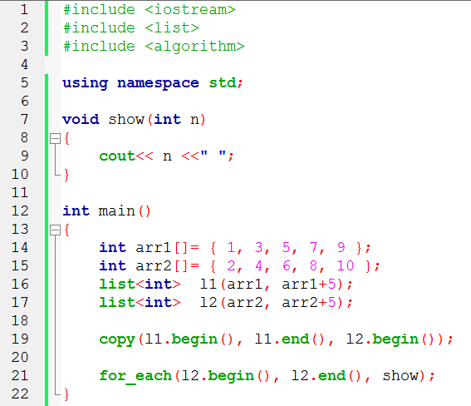
Insert Iterators
Output: 1 3 5 7 9

Slide 26
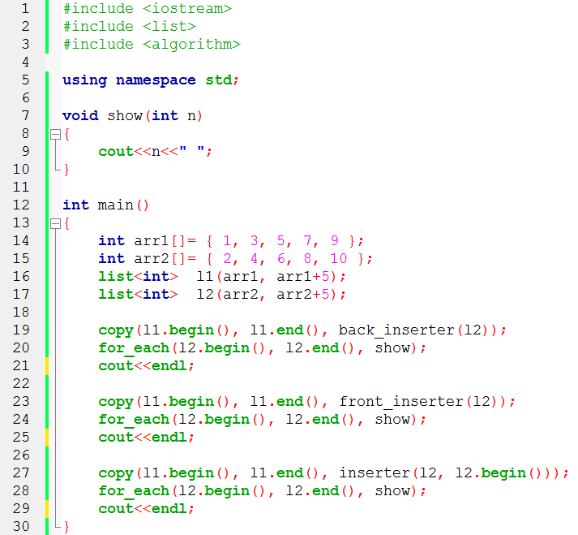
Insert Iterators
//l2 = { 2, 4, 6, 8, 10, 1, 3, 5, 7, 9 }
//I2 = { 9, 7, 5, 3, 1, 2, 4, 6, 8, 10 }
//l2 = { 1, 3, 5, 7, 9, 2, 4, 6, 8, 10 }

Slide 27
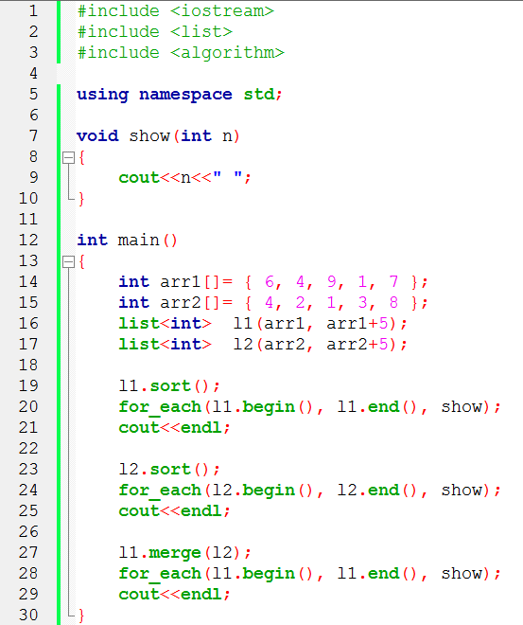
Sort & Merge
// l1 = { 1, 4, 6, 7, 9}
// l2 = { 1, 2, 3, 4, 8}
// l1 = { 1, 1, 2, 3, 4, 4, 6, 7, 8, 9}, l2= { }

Slide 28
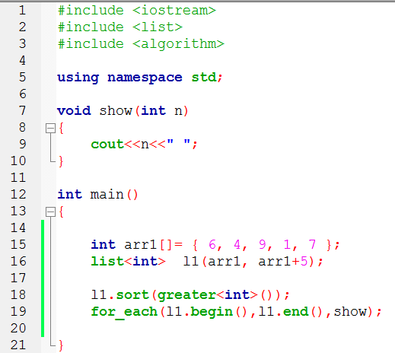
Functions Objects
//l1 = { 9, 7, 6, 4, 1 }

Slide 29
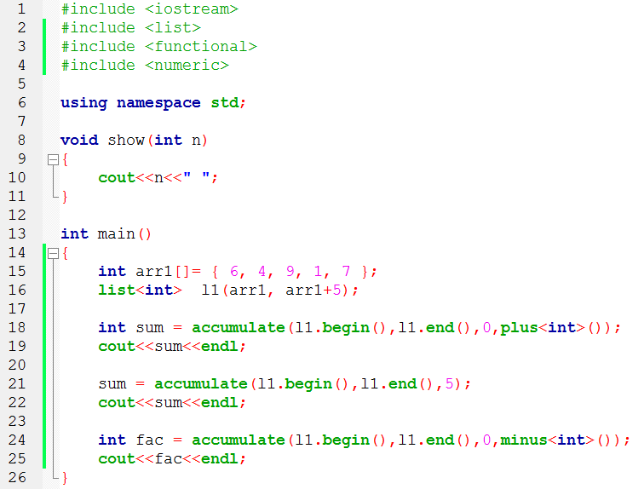
Function Objects
27
32
-27
Initialized value

Slide 30
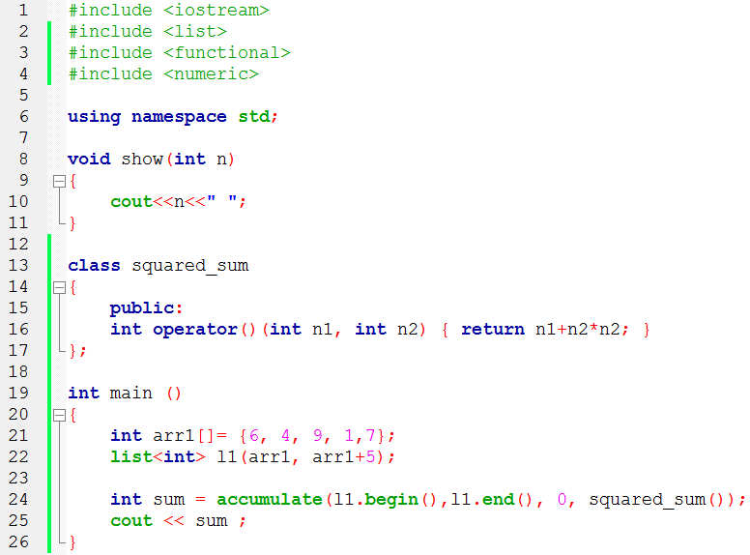
User Defined Function Objects
183
operator overloading

Slide 31
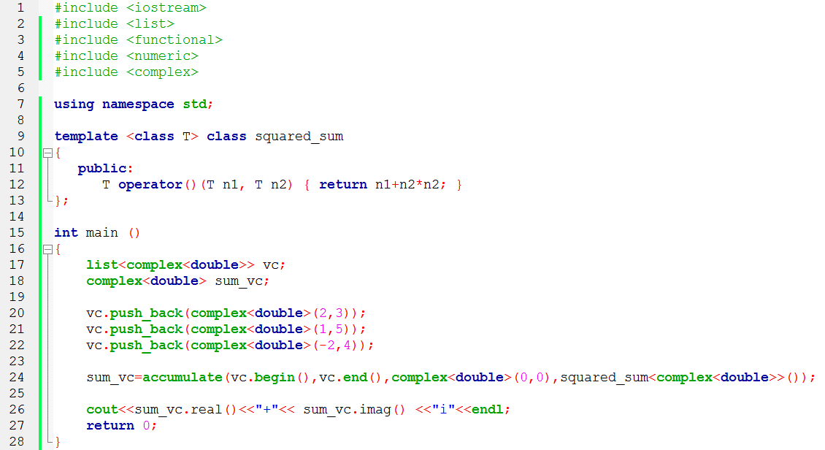
User Defined Function Objects
Output: -41+6i

Slide 32
Associative Containers
Associative container the items are not arranged in sequence, but usually as a tree structure or a hash table.
The main advantage of associative containers is the speed of searching (binary search like in a dictionary)
Searching is done using a key which is usually a single value like a number or string
The value is an attribute of the objects in the container
The STL contains two basic associative containers
sets and multisets
maps and multimaps

Slide 33
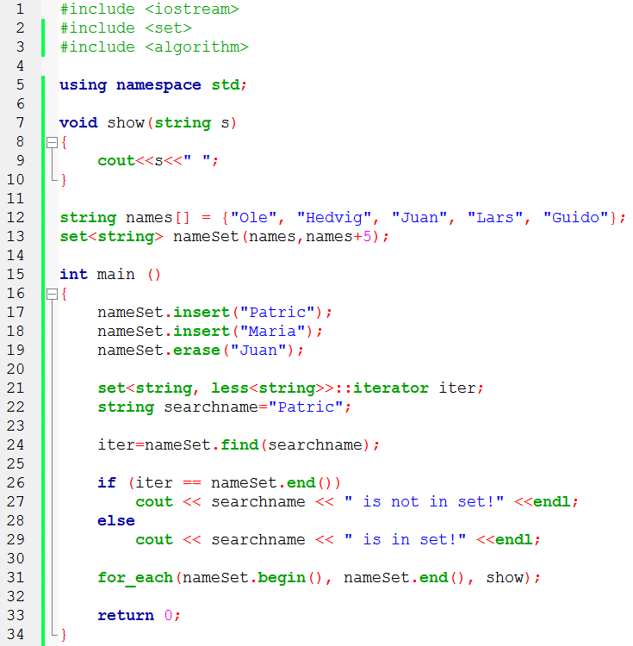
Sets and Multisets
(差別在資料能否重覆)

Slide 34
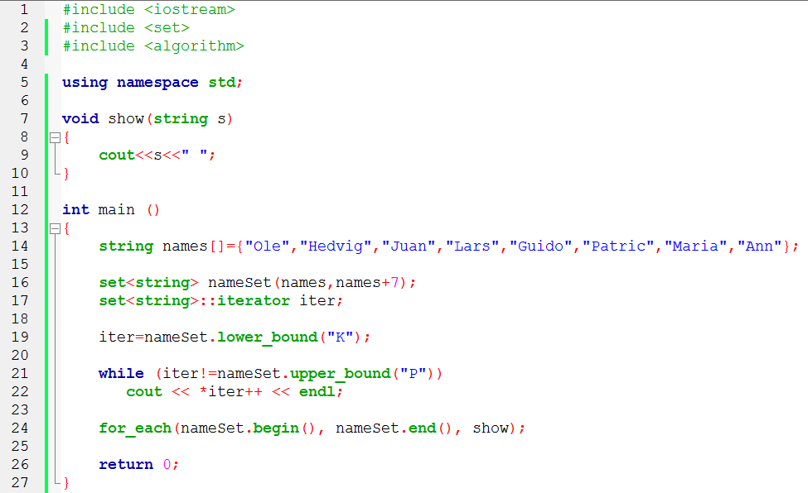
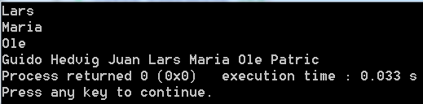
//指到第一個 (>K )的
//指到第一個(<P)的

Slide 35
Maps and Multimaps
Map stores pairs <key, value> of a key object and associated value object.
The key object contains a key that will be searched for and the value object contains additional data
The key could be a string, for example the name of a person and the value could be a number, for example the telephone number of a person

Slide 36
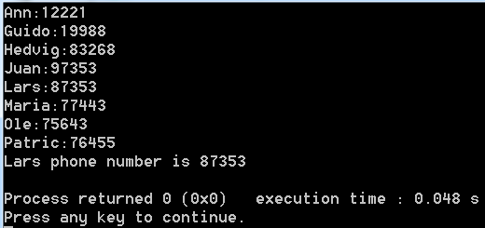
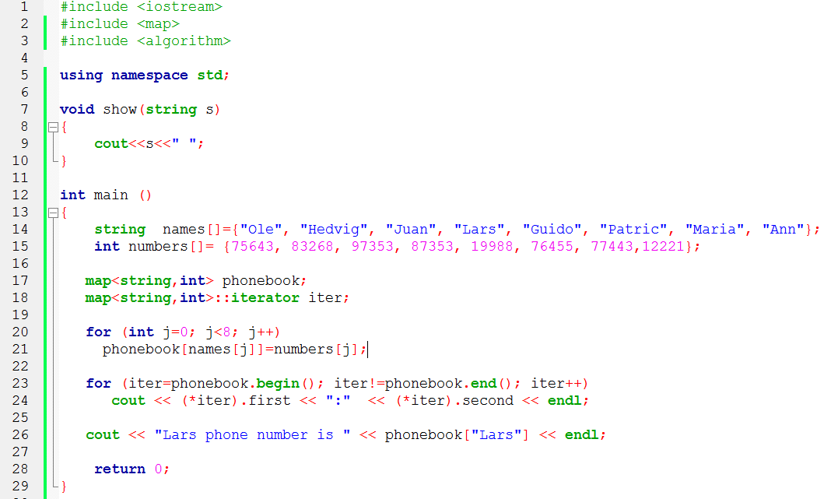
Maps and Multimaps

