Slide 1
CHAPTER 3
Trees

Slide 2
Tree
A tree structure means that the data are organized so that items of information are related by branches
Examples:
Root
leaf

Slide 3
Definition of Tree
Definition (recursively): A tree is a finite set of one or more nodes such that
There is a specially designated node called root.
The remaining nodes are partitioned into n>=0 disjoint set T₁,…,T_{n}, where each of these sets is a tree.
T₁,…,T_{n} are called the subtrees of the root.
Every node in the tree is the root of some subtree

Slide 4
Terminology (1/3)
node: the item of information plus the branches to each node.
degree: the number of subtrees of a node
degree of a tree: the maximum of the degree of the nodes in the tree.
terminal nodes (or leaf): nodes that have degree zero
nonterminal nodes: nodes that don’t belong to terminal nodes.
children: the roots of the subtrees of a node X are the children of X
parent: X is the parent of its children.

Slide 5
Terminology (2/3)
siblings: children of the same parent are said to be siblings.
Ancestors of a node: all the nodes along the path from the root to that node.
level of a node: defined by letting the root be at level one. If a node is at level l, then it children are at level l+1.
Height (or depth): the maximum level of any node in the tree

Slide 6
Terminology (3/3)
Property: (# edges) = (#nodes) - 1
Example
A is the root node
B is the parent of D and E
C is the sibling of B
D and E are the children of B
D, E, F, G, I are external nodes, or leaves
A, B, C, H are internal nodes
The level of E is 3
The height (depth) of the tree is 4
The degree of node B is 2
The degree of the tree is 3
The ancestors of node I is A, C, H
The descendants of node C is F, G, H, I
Level
A
1
B
C
2
H
3
D
E
F
G
I
4

Slide 7
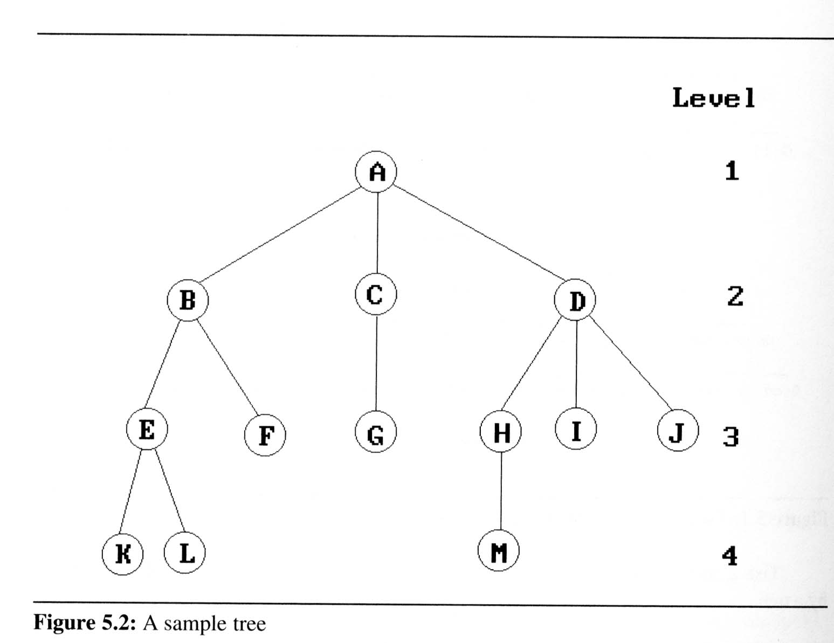
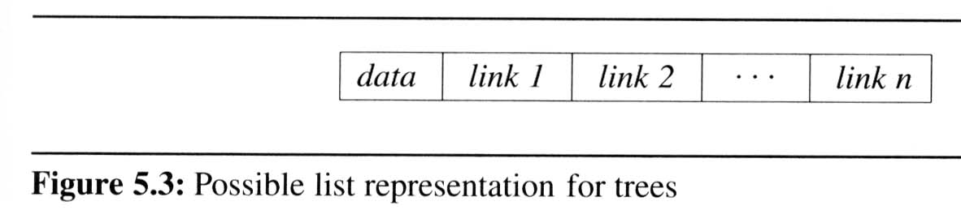
Representation of Trees
Linked List Representation
Figure 5.2 as a list in which each of the subtrees is also a list
( A ( B ( E ( K, L ), F ), C ( G ), D ( H ( M ), I, J ) ) )
The root comes first, followed by a list of sub-trees

Slide 8
Binary Trees
Binary trees are characterized by the fact that any node can have at most two branches
Definition (recursive):
A binary tree is a finite set of nodes that is either empty or consists of a root and two disjoint binary trees called the left subtree and the right subtree
Thus the left subtree and the right subtree are distinguished
Any tree can be transformed into binary tree
by left child-right sibling representation
A
A
B
B

Slide 9
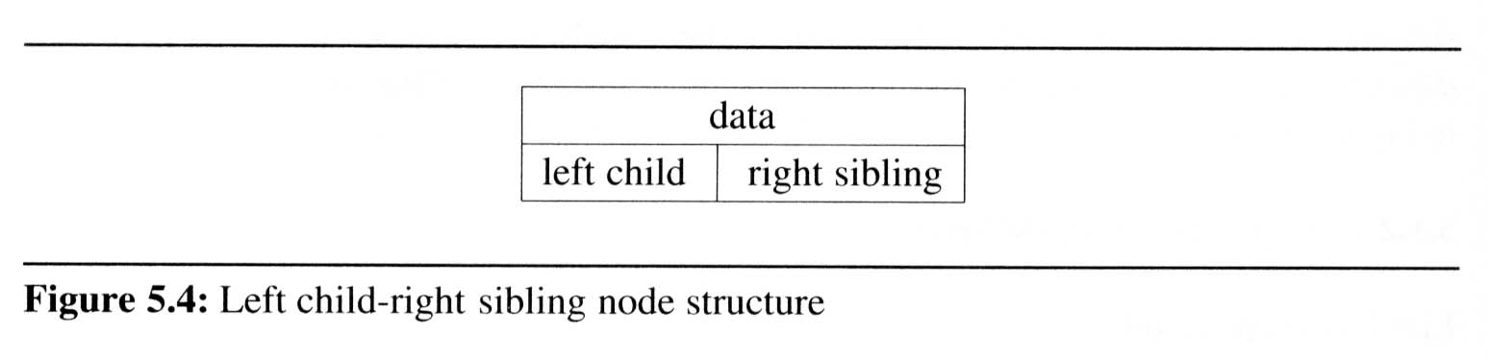
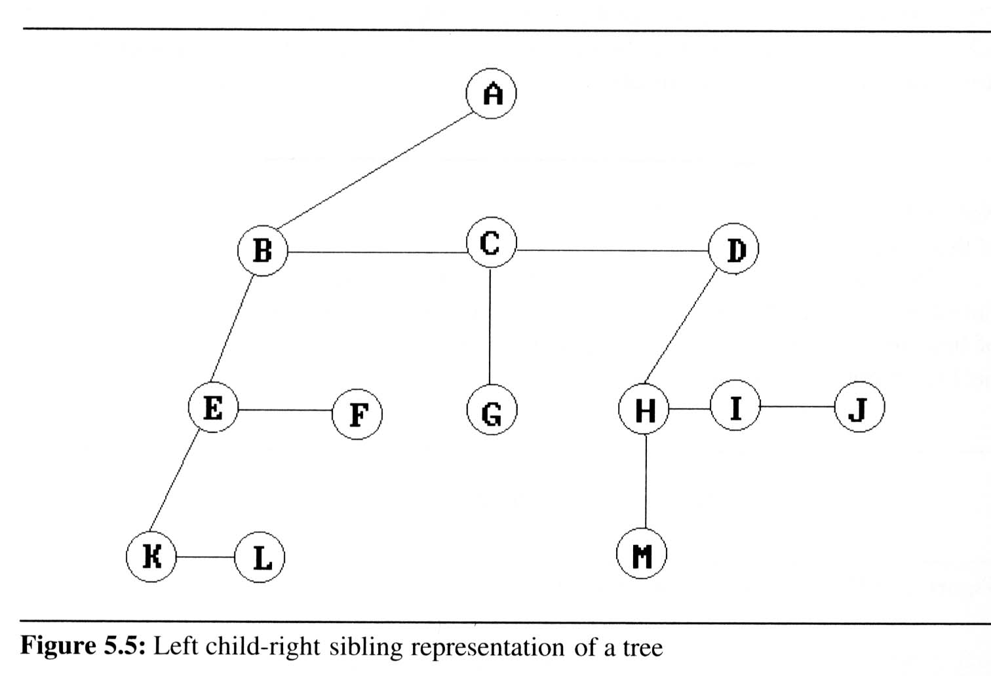
Representation of Trees (1/2)
Left Child- Right Sibling Representation

Slide 10
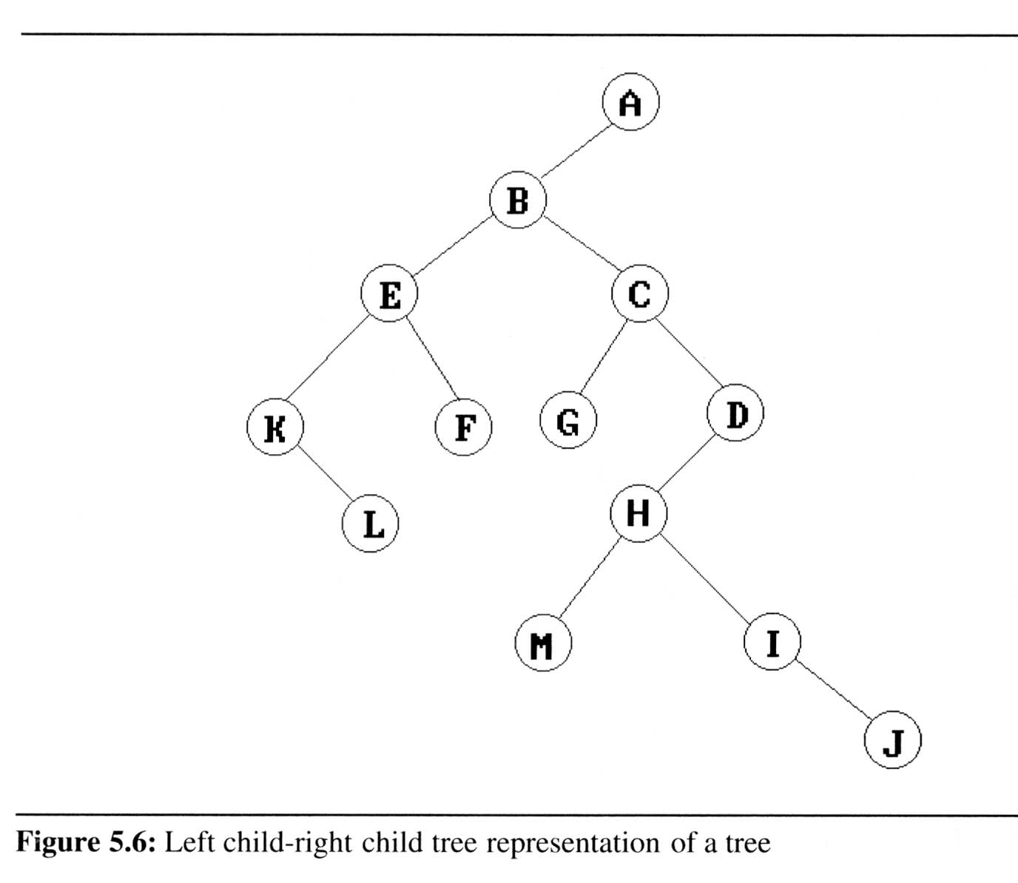
Representation of Trees (2/2)
Representation as a Two-Degree Tree
children
siblings

Slide 11
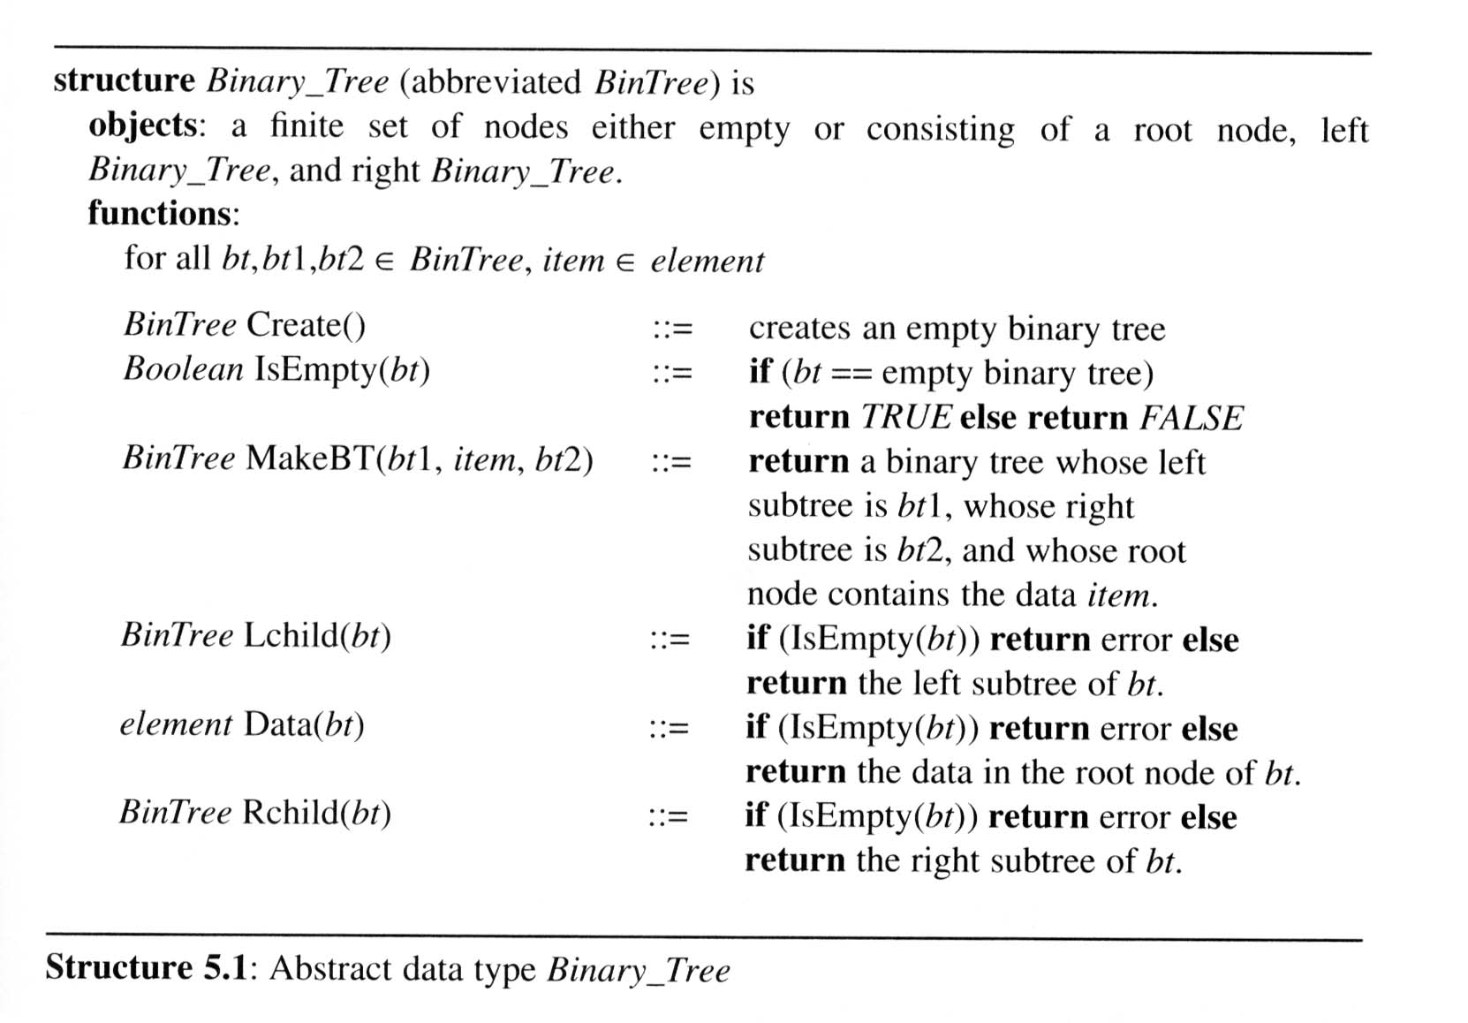
ADT of Binary Tree

Slide 12
Two special binary trees:
(a) skewed tree, (b) complete binary tree
The all leaf nodes of these trees are on two adjacent levels
Skewed Binary Tree
Complete Binary Tree
A
A
1
A
B
B
2
B
C
C
3
D
E
F
G
D
4
H
I
E
5

Slide 13
Properties of binary trees
Maximum number of nodes:
The maximum number of nodes on level i of a binary tree is 2^{i-1}, i ≥1.
The maximum number of nodes in a binary tree of depth k is 2^{k}-1, k≥1.
Relation between number of leaf nodes and degree-2 nodes:
For any nonempty binary tree, T, if n₀ is the number of leaf nodes and n₂ is the number of nodes of degree 2, then n₀ = n₂ + 1.

Slide 14
Properties of binary trees
Definition:
A full binary tree of depth k is a binary tree of death k having 2^{k}-1 nodes, k ≥ 0.
A binary tree with n nodes and depth k is complete iff its nodes correspond to the nodes numbered from 1 to n in the full binary tree of depth k.
The height of a complete binary tree with n nodes is ⎡log₂(n+1)⎤
1
1
2
2
3
3
4
5
6
7
4
5
6
7
8
9
10
11
12
13
14
15
8
9
Complete binary tree
Full binary tree of depth 4

Slide 15
Binary tree representations
(using array)
If a complete binary tree with n nodes is represented sequentially, then for any node with index i, 1 ≤ i ≤ n, we have
parent(i) is at ⎣i /2⎦ if i ≠ 1. If i = 1, i is at the root and has no parent.
LeftChild(i) is at 2*i if 2i ≤ n. If 2*i>n, then i has no left child
RightChild(i) is at 2*i+1 if 2i+1 ≤ n.
If 2*i+1>n, then i has no left child
1
[1]
[2]
[3]
[4]
[5]
[6]
[7]
⎣i /2⎦
1 2 3 4 5 6 7
i
2
3
Level 1
4
5
6
7
Level 2
Level 3
2*i
2*i+1
i

Slide 16
Binary tree representations
(using array)
Waste spaces: in the worst case, a skewed tree of depth k requires 2^{k}-1 spaces. Of these, only k spaces will be occupied
Insertion or deletion of nodes from the middle of a tree requires the movement of potentially many nodes to reflect the change in the level of these nodes

Slide 17
[1]
[2]
[3]
[4]
[5]
[6]
[7]
[8]
[9]
.
[16]
A
B
--
C
--
--
--
D
--
.
E
[1]
[2]
[3]
[4]
[5]
[6]
[7]
[8]
[9]
A
B
C
D
E
F
G
H
I
A
A
B
B
C
C
D
E
F
G
D
E
H
I

Slide 18
Binary tree representations
(using link)
typedef struct node* tree_pointer;
typedef struct node
{
int data;
tree_pointer left_child, right_child;
};
left_child
data
right_child
data
left_child
right_child

Slide 19
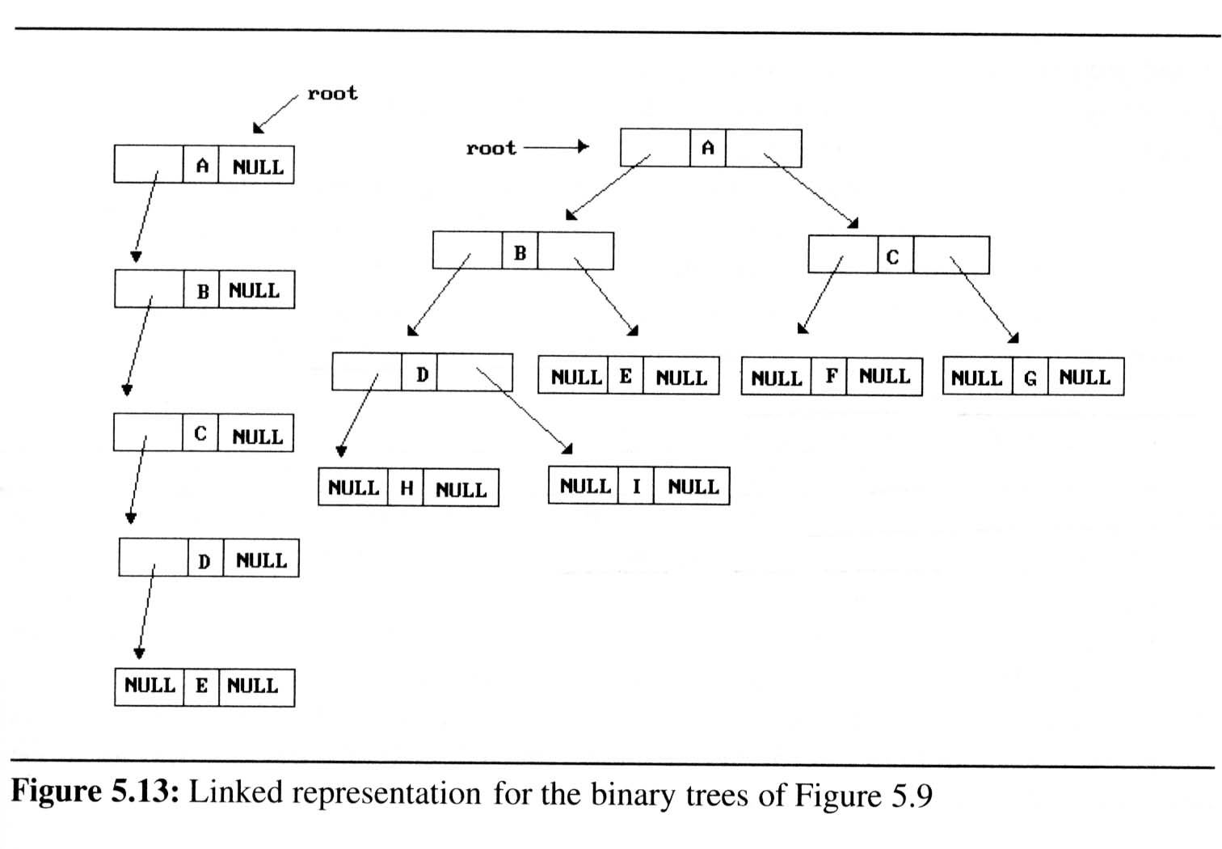
Binary tree representations
(using link)

Slide 20
Binary Tree Traversals
How to traverse a tree or visit each node in the tree exactly once?
There are six possible combinations of traversal
LVR, LRV, VLR, VRL, RVL, RLV
Adopt convention that we traverse left before right, only 3 traversals remain
LVR (inorder), LRV (postorder), VLR (preorder)
left_child
data
right_child
V
:
visiting
node
L: moving left
R: moving right

Slide 21
Binary Tree Traversals
Arithmetic Expression using binary tree
inorder traversal (infix)
A / B * C * D + E
preorder traversal (prefix)
+ * * / A B C D E
postorder traversal (postfix)
A B / C * D * E +
level order traversal
+ * E * D / C A B
+
*
E
*
D
/
C
A
B

Slide 22
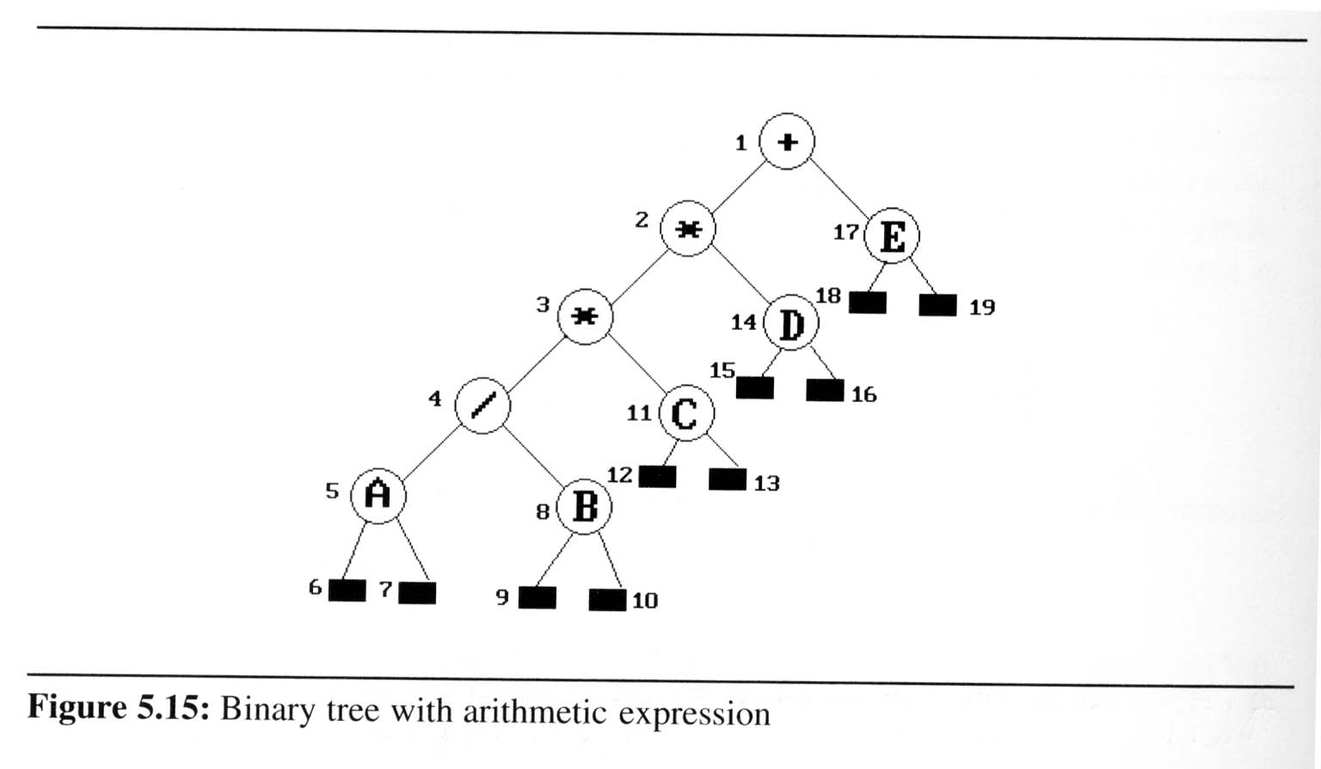
Binary Tree Traversals
Inorder traversal (LVR) (recursive version)
output:
A
/
B
*
C
*
D
+
E
void inorder(tree_pointer ptr)
/* inorder tree traversal */
{
if (ptr) {
inorder(ptr->left_child);
printf(“%d”, ptr->data);
indorder(ptr->right_child);
}
}
ptr
L
V
R

Slide 23
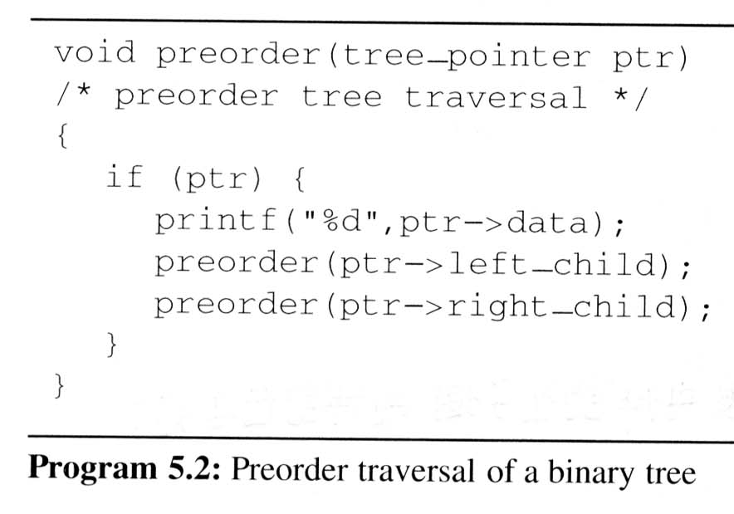
Binary Tree Traversals
Preorder traversal (VLR) (recursive version)
output:
+
*
*
/
A
B
C
D
E
V
L
R

Slide 24
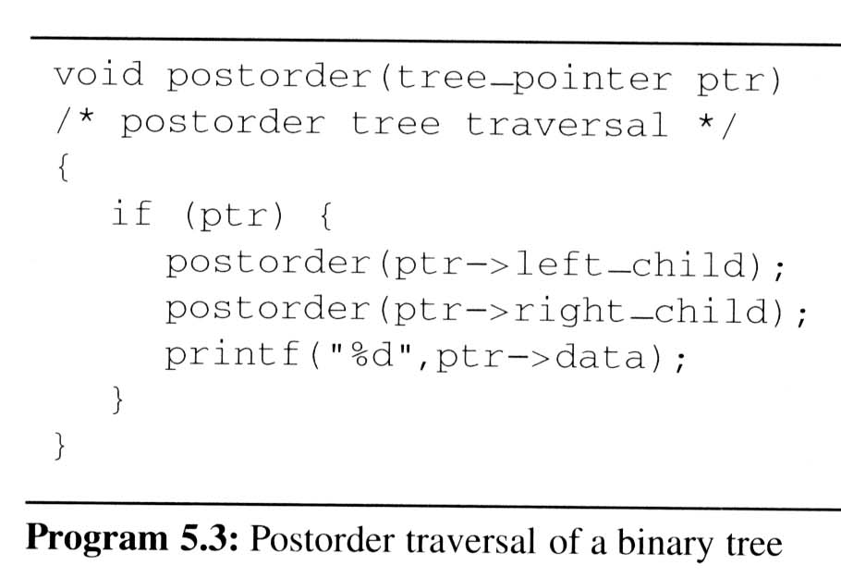
Binary Tree Traversals (5/9)
Postorder traversal (LRV) (recursive version)
output:
A
B
/
C
*
D
*
E
+
L
R
V

Slide 25
Binary Tree Traversals
Iterative inorder traversal
Use a stack to simulate recursion
void iter_inorder(tree_pointer node)
{
int top= -1; /* initialize stack */
tree_pointer stack[MAX_STACK_SIZE];
for(;;) {
for (; node; node=node->left_child)
add(&top, node);/* add to stack */
node= delete(&top);/* delete from stack */
if (!node) break; /* empty stack */
printf(“%D”, node->data);
node = node->right_child;
}
}
5
4
8
11
3
14
2
17
1
A
/
B
*
C
*
D
+
E
L
V
R
output:
A
/
B
*
C
*
D
+
E
node

Slide 26
Binary Tree Traversals
Analysis of inorder2 (Non-recursive Inorder traversal)
Let n be the number of nodes in the tree
Time complexity: O(n)
Every node of the tree is placed on and removed from the stack exactly once
Space complexity: O(n)
equal to the depth of the tree which (skewed tree is the worst case)

Slide 27
Binary Tree Traversals
Level-order traversal
method:
Visit the root first, then the root’s left child, followed by the root’s right child.
Continue in this manner, visiting the nodes at each new level from the leftmost node to the rightmost nodes
This traversal requires a queue to implement

Slide 28
Binary Tree Traversals
Level-order traversal (using queue)
void level_order(tree_pointer ptr)
/* level order tree traversal */
{
int front = rear = 0;
tree_pointer queue[MAX_QUEUE_SIZE];
if (!ptr) return; /* empty queue */
addq(front, &rear, ptr);
for (;;) {
ptr = deleteq(&front, rear);
if (ptr) {
printf(“%d”, ptr->data);
if (ptr->left_child)
addq(front, &rear,ptr>left_child);
if (ptr->right_child)
addq(front, &rear, ptr>right_child);
}
else break;
}
}
output:
+
*
E
*
D
/
C
A
B
1
2
17
3
14
4
11
5
8
+
*
E
*
D
/
C
A
B
FIFO
ptr

Slide 29
Copying Binary Trees
Modify the postorder traversal algorithm only slightly to copy the binary tree
tree_poointer copy(tree_pointer original)
{
tree_pointer temp;
if (original) {
temp=(tree_pointer) malloc(sizeof(node));
if (IS_FULL(temp)) {
fprintf(stderr, “the memory is full\n”);
exit(1);
}
temp->left_child=copy(original->left_child);
temp->right_child=copy(original->right_child);
temp->data=original->data;
return temp;
}
return NULL;
}

Slide 30
Testing Equality
Binary trees are equivalent if they have the same topology and the information in corresponding nodes is identical
V
L
R
int equal(tree_pointer first, tree_pointer second)
{
return ((!first && !second) || ( first && second &&
(first->data == second->data) &&
equal(first->left_child, second->left_child) &&
equal(first->right_child, second->right_child)))
}

Slide 31
Propositional Calculus Expression
Variables: x₁, x₂, …, x_{n} can hold only of two possible values, true or false
Operators: ∧(and), ∨(or), ¬(not)
Propositional Calculus Expression
A variable is an expression
If x and y are expressions, then ¬x, x∧y, x∨y are expressions
Parentheses can be used to alter the normal order of evaluation (¬ > ∧ > ∨)
Example: x₁ ∨ (x₂ ∧ ¬x₃)

Slide 32
Satisfiability Problem
Satisfiability problem:
Is there an assignment to make an expression true?
Example x₁ ∨ (x₂ ∧ ¬x₃) :
x₁ and x₃ are FALSE
x₂ is TRUE
false ∨ (true ∧ ¬false) = false ∨ true = true
For n value of an expression, there are 2^{n} possible combinations of true and false

Slide 33
Satisfiability Problem
(x₁ ∧ ¬x₂) ∨ (¬ x₁ ∧ x₃) ∨ ¬x₃
postorder traversal
∨
data
∨
¬
value
∧
∧
X₃
X₁
¬
¬
X₃
X₂
X₁

Slide 34
Satisfiability Problem
node structure
For the purpose of our evaluation algorithm, we assume each node has four fields:
Definition the node structure in C as:
left_child data value right_child
typedef emun {not, and, or, true, false } logical; typedef struct node* tree_pointer; typedef struct node { tree_pointer list_child; logical data; short int value; tree_pointer right_child; } ;

Slide 35
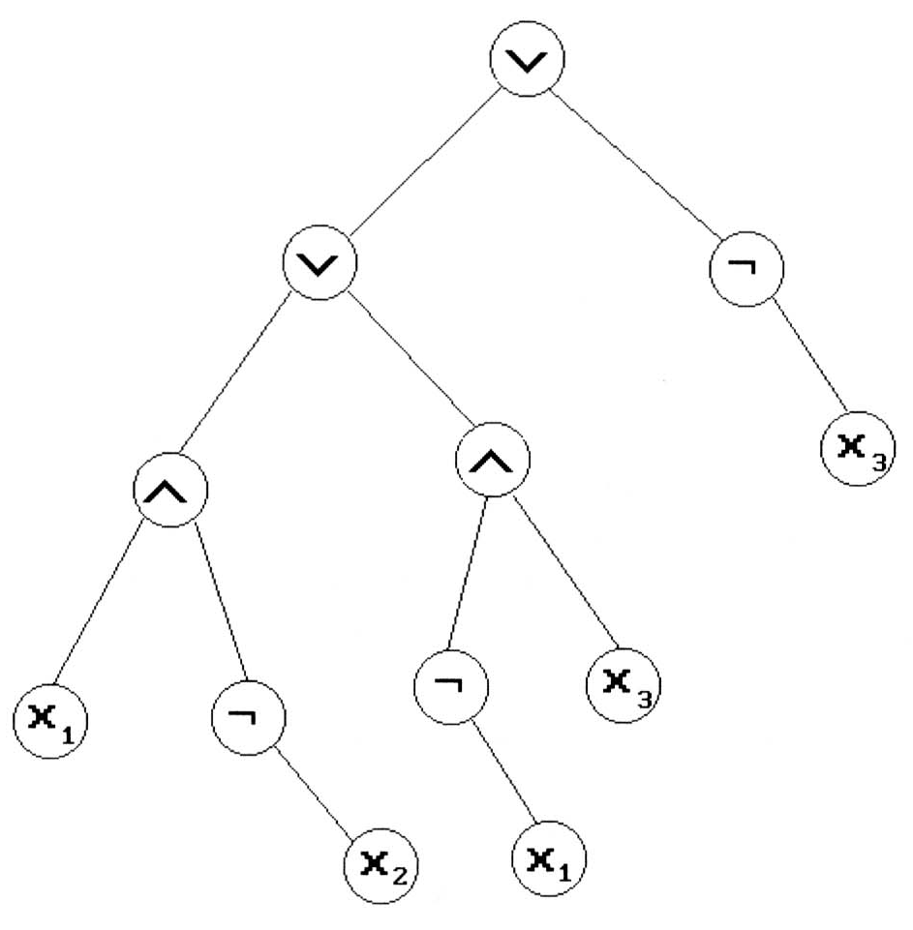
Satisfiability function
To evaluate the tree is easily obtained by modifying the original recursive postorder traversal
void post_order_eval(tree_pointer node) { /* modified post order traversal to evaluate a
propositional calculus tree */ if (node) { post_order_eval(node->left_child); post_order_eval(node->right_child); switch(node->data) { case not: node->value = !node->right_child->value; break; case and: node->value = node->right_child->value && node->left_child->value; break; case or: node->value = node->right_child->value | | node->left_child->value; break; case true: node->value = TRUE; break; case false: node->value = FALSE; } } }
L
R
V
node
TRUE
TRUE
FALSE
FALSE
T
TRUE
TRUE
T
F
TRUE
FALSE
FALSE
TRUE
F
T
FALSE
TRUE

Slide 36
Threaded Binary Trees
Threads
Do you find any drawback of the above tree?
Too many null pointers in current representation of binary trees
n: number of nodes
number of non-null links: n-1
total links: 2n
null links: 2n-(n-1) = n+1
Solution: replace these null pointers with some useful “threads”

Slide 37
Threaded Binary Trees
Rules for constructing the threads
If ptr->left_child is null, replace it with a pointer to the node that would be visited before ptr in an inorder traversal
If ptr->right_child is null, replace it with a pointer to the node that would be visited after ptr in an inorder traversal

Slide 38
Threaded Binary Trees
A Threaded Binary Tree
t: true ⇒ thread
f: false ⇒ child
root
A
dangling
f
B
f
C
D
t
E
t
F
G
dangling
inorder traversal:
H
I
H D I B E A F C G

Slide 39
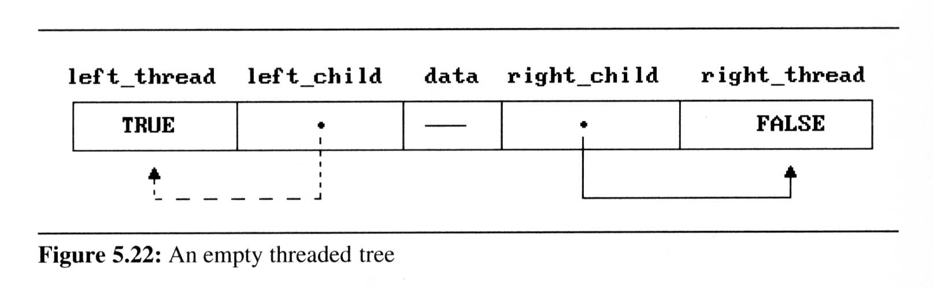
Threaded Binary Trees
Two additional fields of the node structure, left-thread and right-thread
If ptr->left-thread=TRUE, then ptr->left-child contains a thread;
Otherwise it contains a pointer to the left child.
Similarly for the right-thread
typedef struct threaded_tree* threaded_pointer;
typedef struct threaded_tree {
short int left_thread;
threaded_pointer left_child;
char data;
threaded_pointer right_child;
short int right_thread; };

Slide 40
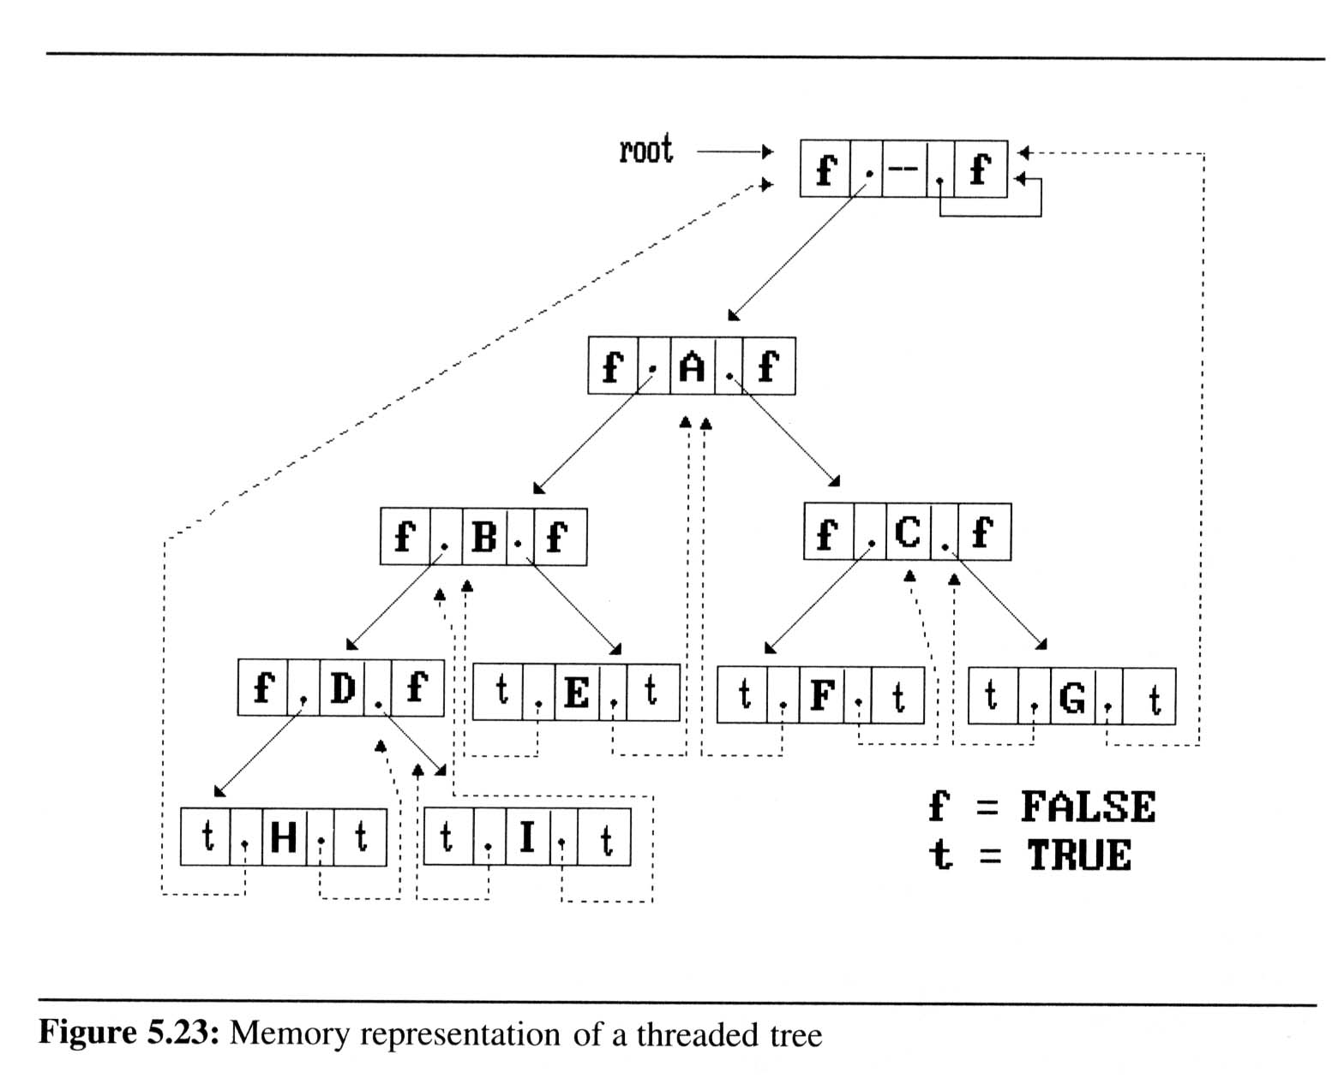
Threaded Binary Trees
If we don’t want the left pointer of H and the right pointer of G to be dangling pointers, we may create root node and assign them pointing to the root node

Slide 41
Threaded Binary Trees
Inorder traversal of a threaded binary tree
By using of threads we can perform an inorder traversal without making use of a stack
Now, we can follow the thread of any node, ptr, to the “next” node of inorder traversal
If ptr->right_thread = TRUE, the inorder successor of ptr is ptr->right_child by definition of the threads
Otherwise we obtain the inorder successor of ptr by following a path of left-child links from the right-child of ptr until we reach a node with left_thread = TRUE

Slide 42
Threaded Binary Trees
Finding the inorder successor of a node
threaded_pointer insucc (threaded_pointer tree){
threaded_pointer temp;
temp = tree->right_child;
if (!tree->right_thread)
while (!temp->left_thread)
temp = temp->left_child;
return temp;
}
tree
temp
Inorder

Slide 43
Threaded Binary Trees
Inorder traversal of a threaded binary tree
void tinorder(threaded_pointer tree){
/* traverse the threaded binary tree inorder */
threaded_pointer temp = tree;
for (;;) {
temp = insucc(temp);
if (temp==tree)
break;
printf(“%3c”,temp->data);
}
}
output:
H
D
I
B
E
A
F
C
G
tree
Time Complexity: O(n)

Slide 44
Threaded Binary Trees
Inserting A Node Into A Threaded Binary Tree
Insert child as the right child of node parent
change parent->right_thread to FALSE
set child->left_thread and child->right_thread to TRUE
set child->left_child to point to parent
set child->right_child to parent->right_child
change parent->right_child to point to child

Slide 45
Threaded Binary Trees
Right insertion in a threaded binary tree
void insert_right(thread_pointer parent, threaded_pointer child){
/* insert child as the right child of parent in a threaded binary tree */
threaded_pointer temp;
child->right_child = parent->right_child;
child->right_thread = parent->right_thread;
child->left_child = parent;
child->left_thread = TRUE;
parent->right_child = child;
parent->right_thread = FALSE;
If(!child->right_thread){
temp = insucc(child);
temp->left_child = child;
}
}
root
A
parent
B
C
X
child
parent
temp
A
B
child
X
C
First Case
D
Second Case
E
F
successor

Slide 46
Heaps
Definition
A max(min) tree is a tree in which the key value in each node is no smaller (no larger) than the key values in its children.
A max (min) heap is a complete binary tree that is also a max (min) tree
Basic Operations:
Creation of an empty heap
Insertion of a new element into a heap
Deletion of the largest element from the heap

Slide 47
Heaps
The examples of max heaps and min heaps
Property: The root of max heap (min heap) contains the largest (smallest) element
[1]
14
[1]
9
[1]
30
[2]
12
[3]
7
[2]
6
[3]
3
[2]
25
[4]
[5]
[6]
[4]
10
8
6
5
Max heap
[1]
2
[1]
10
[1]
11
[2]
7
[3]
4
[2]
20
[3]
83
[2]
21
[4]
[5]
[6]
[4]
10
8
6
50
Min heap

Slide 48
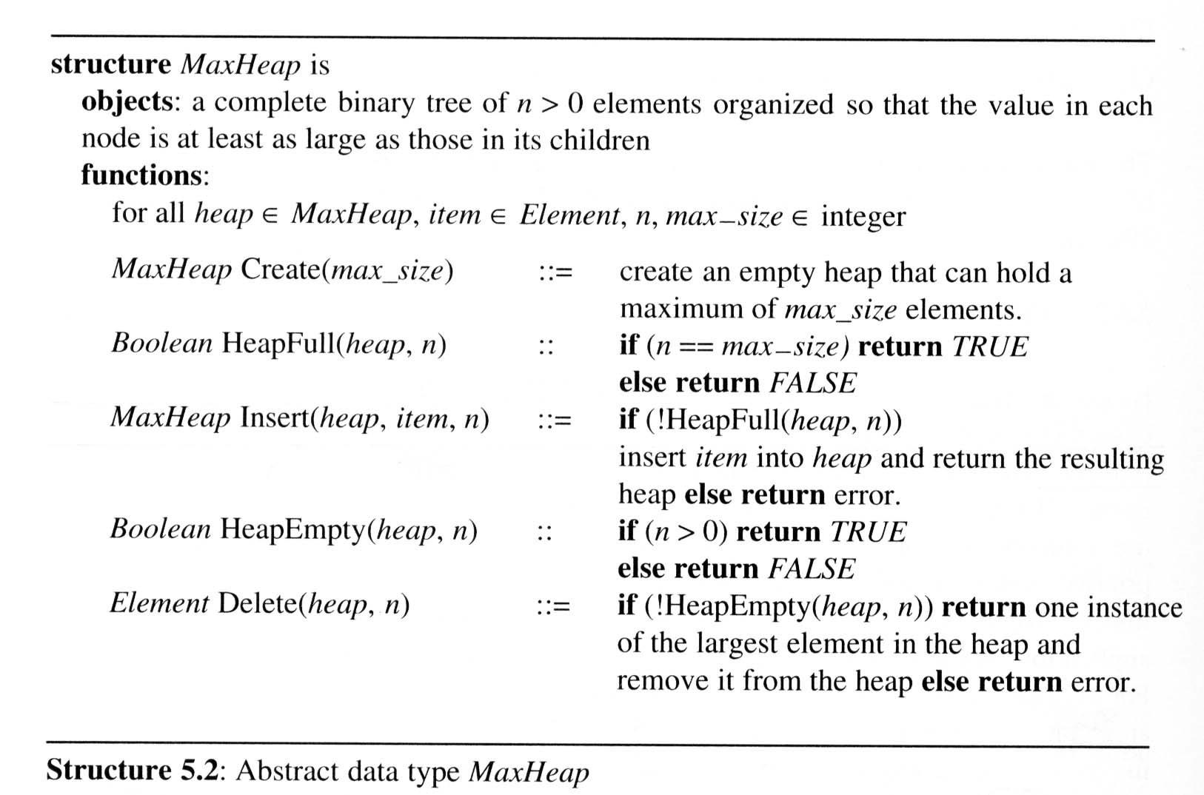
ADT of Heaps

Slide 49
Heaps
Insertion Into A Max Heap
The complexity of the insertion function is O(log₂ n)
insert
21
void insert_max_heap(element item, int *n)
{
int i;
if (HEAP_FULL(*n)) {
fprintf(stderr, “the heap is full.\n”);
exit(1);
}
i = ++(*n);
while ((i!=1)&&(item.key>heap[i/2].key)) {
heap[i] = heap[i/2];
i /= 2;
}
heap[i]= item;
}
5
*n=
6
5
i=
6
3
7
3
1
[1]
20
21
[2]
[3]
parent sink
15
20
item upheap
2
5
[4]
[5]
[6]
[7]
14
10
2
5

Slide 50
Heaps
Deletion
from a max heap
Analysis of delete_max_heap
The complexity of the insertion function is O(log₂ n)
element delete_max_heap(int *n)
{
int parent, child;
element item, temp;
if (HEAP_EMPTY(*n)) {
fprintf(stderr, “The heap is empty\n”);
exit(1);
}
item = heap[1];
temp = heap[(*n)--];
parent = 1;
child = 2;
while (child <= *n){
if ((child < *n)&&
(heap[child].key<heap[child+1].key))
child++;
if (temp.key >= heap[child].key) break;
heap[parent] = heap[child];
parent =child;
child *= 2;
}
heap[parent] = temp;
return item;
}
parent =
1
2
4
*n=
5
4
child =
2
4
8
[1]
15
20
[2]
[3]
15
14
2
item.key =
20
[4]
[5]
temp.key =
10
14
10
10

Slide 51
Heaps
Queue previous: FIFO
Priority queues
Heaps are frequently used to implement priority queues
Delete the element with highest (lowest) priority
Insert the element with arbitrary priority
Heaps is the only way to implement priority queue

Slide 52
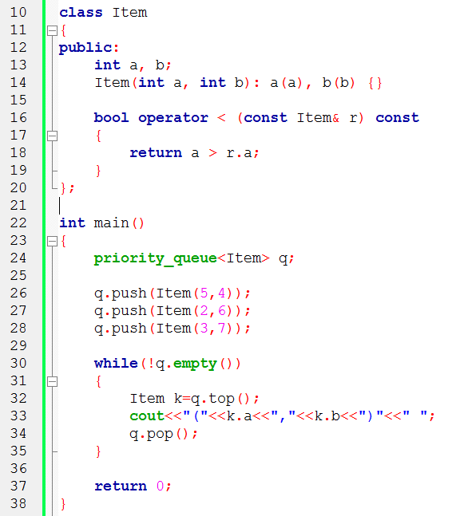
STL: Priority Queue

Slide 53
Treap

Slide 54
Definition
A treap is a binary search tree in which each node has both a key and a priority.
Nodes are ordered
in-order fashion by their keys and
heap-ordered by their priorities

Slide 55
Keys
a b c d e f g
BST
Priorities
3 7 4 1 5 2 6
min heap

Slide 56
Keys
a b c d e f g
BST
Priorities
3 7 4 1 5 2 6
min heap
a3
b
7

Slide 57
Keys
a b c d e f g
BST
Priorities
3 7 4 1 5 2 6
min heap
a3
a3
b
7
c
4
c
4
b
7

Slide 58
Keys
a b c d e f g
BST
Priorities
3 7 4 1 5 2 6
min heap
a3
a3
d
1
d
1
a3
c
4
c
4
c
4
b
7
d
1
b
7
b
7

Slide 59
Keys
a b c d e f g
BST
Priorities
3 7 4 1 5 2 6
min heap
d
1
a3
e
5
c
4
b
7

Slide 60
Keys
a b c d e f g
BST
Priorities
3 7 4 1 5 2 6
min heap
d
1
d
1
e
5
f
2
a3
a3
c
4
f
2
c
4
e
5
b
7
b
7

Slide 61
Keys
a b c d e f g
BST
Priorities
3 7 4 1 5 2 6
min heap
d
1
f
2
a3
c
4
e
5
g
6
b
7

Slide 62
Existence
Why must a treap with any priorities exist?
We can always create one by sorting by priority and then inserting as a binary search tree

Slide 63
Insertion
How do we insert into an existing treap?
Insert as a BST
perform a series of tree rotations to enforce the heap ordering

Slide 64
Rotation
x
Right Rotation
r
A
r
C
x
Left Rotation
B
C
B
A

Slide 65
Deletion
Rotate it down to a leaf
then delete it

Slide 66
Delete
d
1
d
1
a3
f
2
a3
d
1
c
4
e
5
g
6
c
4
f
2
b
7
b
7
e
5
g
6

Slide 67
Delete
d
1
a3
a3
c
4
d
1
b
7
d
1
c
4
f
2
f
2
b
7
e
5
g
6
e
5
g
6

Slide 68
Delete
d
1
a3
a3
c
4
c
4
b
7
f
2
b
7
d
1
f
2
d
1
g
6
e
5
e
5
g
6

Slide 69
Delete
d
1
a3
a3
c
4
c
4
b
7
f
2
b
7
f
2
d
1
g
6
e
5
g
6
e
5
d
1

Slide 70
Delete
d
1
a3
a3
c
4
c
4
b
7
f
2
b
7
f
2
e
5
g
6
e
5
g
6
d
1

Slide 71
Range Sum Query (RSQ)

Slide 72
Range Sum Query (RSQ)
Given an integer array, find the sum of the elements between indices i and j (i ≤ j), inclusive.
0 | 1 | 2 | 3 | 4 | 5 | 6 | 7
12 | -4 | 7 | -8 | 2 | 3 | -6 | 9
For example:
Sum(2,5)=7+(-8)+2+3=4
Sum(3,7)=(-8)+2+3+(-6)+9=0

Slide 73
Brute-Force Algorithm
Given an array with n integers, and n queries?
Time Complexity:
O(n) for each query.
Therefore, O(n²) for n queries.

Slide 74
Prefix Sum
0 | 1 | 2 | 3 | 4 | 5 | 6 | 7
12 | -4 | 7 | -8 | 2 | 3 | -6 | 9
add
prefix sum
0 | 1 | 2 | 3 | 4 | 5 | 6 | 7
12 | 8 | 15 | 7 | 9 | 12 | 6 | 15
For example:
Sum(2,5)=Sum(5)-Sum(2-1)=12-8=4
Sum(3,7)=Sum(7)-Sum(3-1)=15-15=0

Slide 75
Prefix Sum
Given an array with n integers, and n queries?
Time Complexity:
Prefix Sum: O(n)
O(1) for each query.
Therefore, O(n) for n queries.
Overall: O(n)+O(n)=O(n)

Slide 76
Problem
要興建一條公路，分成 N 個路段興建，依序編號 1 到 N
第 i 個路段興建的時間需要 Ti
發包給三家公司興建，每一家公司必須負責一些連續的路段
也就是把這條公路切成三段：
A 公司甲花費 T₁+...+T_{A}的時間興建前 A 個路段
B公司乙花費 T_{A+1}+...+T_{B} 的時間興建第 A+1...、B 路段
C公司丙花費 T_{B+1}+...+T_{N} 的時間興建剩餘的路段
請問這條公路所需的最低工期為？

Slide 77
Sample
Case 1: (1,2,3,1,2)
Ans: 3
Case 2:(1,2,3,1,2,2,2,1,5)
Ans: 7
Case 3:(1,2,3,1,2,2,2,1,5,3,4,6,8)
Ans: 14
Case 4:(1,2,3,1,2,2,2,1,5,3,4,6,8,1,2,3,4,5,7)
Ans: ???

Slide 78
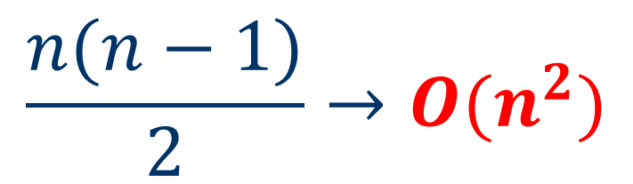
Solution 1
i
j
0 | 1 | 2 | 3 | 4 | 5 | 6 | 7 | 8 | 9 | 10 | 11 | 12 | 13 | 14 | 15 | 16 | 17 | 18
1 | 2 | 3 | 1 | 2 | 2 | 2 | 1 | 5 | 3 | 4 | 6 | 8 | 1 | 2 | 3 | 4 | 5 | 7
Find any two indexes: i and j
How many selections?
C(n, 2)=
Calculating sum for each selection.
O(n³)
$$\frac{n(n−1)}{2}→O(n^{2})$$

Slide 79

Solution 2
i
j
0 | 1 | 2 | 3 | 4 | 5 | 6 | 7 | 8 | 9 | 10 | 11 | 12 | 13 | 14 | 15 | 16 | 17 | 18
1 | 2 | 3 | 1 | 2 | 2 | 2 | 1 | 5 | 3 | 4 | 6 | 8 | 1 | 2 | 3 | 4 | 5 | 7
1 | 3 | 6 | 7 | 9 | 11 | 13 | 14 | 19 | 22 | 26 | 32 | 40 | 41 | 43 | 46 | 50 | 55 | 62
prefix sum
Calculating prefix sum: O(n)
Find any two indexes: i and j
How many selections?
C(n, 2)=
Calculating sum for each selection: O(1)
Overall: O(n²)
$$\frac{n(n−1)}{2}→O(n^{2})$$

Slide 80
Solution 3
11
Where is j???
i
0 | 1 | 2 | 3 | 4 | 5 | 6 | 7 | 8 | 9 | 10 | 11 | 12 | 13 | 14 | 15 | 16 | 17 | 18
1 | 2 | 3 | 1 | 2 | 2 | 2 | 1 | 5 | 3 | 4 | 6 | 8 | 1 | 2 | 3 | 4 | 5 | 7
1 | 3 | 6 | 7 | 9 | 11 | 13 | 14 | 19 | 22 | 26 | 32 | 40 | 41 | 43 | 46 | 50 | 55 | 62
prefix sum
Calculating prefix sum: O(n)
Given a i and find a j.
How many selections of i?
O(n)
Find j : O(n)
Overall: O(n²)

Slide 81
Solution 4
Where is j???
小?
小?
11
29
j
22
i
0 | 1 | 2 | 3 | 4 | 5 | 6 | 7 | 8 | 9 | 10 | 11 | 12 | 13 | 14 | 15 | 16 | 17 | 18
1 | 2 | 3 | 1 | 2 | 2 | 2 | 1 | 5 | 3 | 4 | 6 | 8 | 1 | 2 | 3 | 4 | 5 | 7
1 | 3 | 6 | 7 | 9 | 11 | 13 | 14 | 19 | 22 | 26 | 32 | 40 | 41 | 43 | 46 | 50 | 55 | 62
29
prefix sum
Calculating prefix sum: O(n)
Given a i and find a j.
How many selections of i?
O(n)
Find j : Binary Search: O(long)
Overall: O(nlogn)
(6+18)/2=12

Slide 82
Drawback of Prefix Sum
Given an array with n integers, and n queries?
Additionally, n modifications are needed.
0 | 1 | 2 | 3 | 4 | 5 | 6 | 7
12 | -4 | 7 | -8 | 2 | 3 | -6 | 9
For example:
Sum(2,5)
=Sum(5)-Sum(2-1)
=6-2=4
6
new prefix sum
0 | 1 | 2 | 3 | 4 | 5 | 6 | 7
6 | 2 | 9 | 1 | 3 | 6 | 0 | 9

Slide 83
Prefix Sum with modifications
Given an array with n integers, and n queries and n modifications?
Time Complexity:
Prefix Sum: O(n)
O(1) for each query.
Therefore, O(n) for n queries.
O(n) for each modification.
Therefore, O(n²) for n modifications.
Overall: O(n)+O(n)+O(n²)=O(n²)

Slide 84
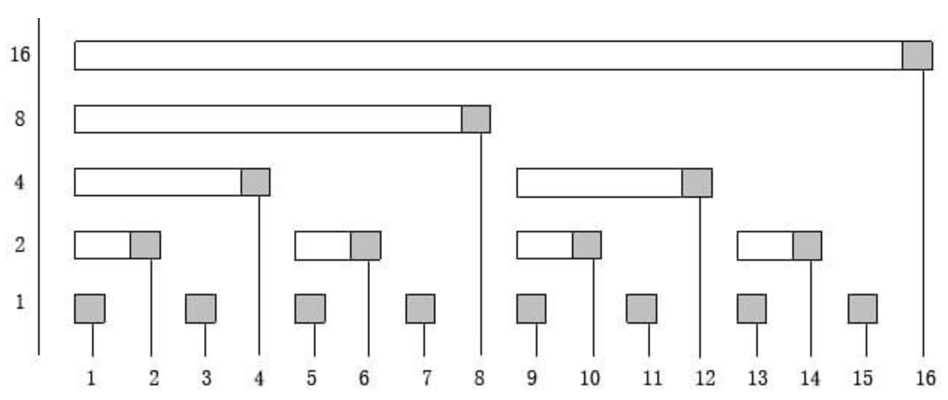
Fenwick Tree (Bit Index Tree, BIT)

Slide 85
Lowbit(k)
Lowbit(k) = k & -k
(2’s complement)
Example:
0100₂ ₍₄₎& 1100₂ ₍₋₄₎= 0100₂
0101₂ ₍₅₎& 1011₂ ₍₋₅₎= 0001₂

Slide 86
Fenwick Tree (Bit Index Tree, BIT)
Lowbit
Index i

Slide 87
Fenwick Tree (Bit Index Tree, BIT)
Lowbit
9-Lowbit(9)=8
Index i
2+Lowbit(2)=4
7-Lowbit(7)=6
14-Lowbit(14)=12
Parent of index i(right) i-Lowbit(i)
Parent of index i(left ) i+Lowbit(i)

Slide 88
BIT, add( ), sum( ), rsum( )
void add (int x, int d)
{ while (x<=n)
{ c[x]+=d; x+=lowbit(x);}
}
int sum(int x)
{ int ret=0;
while (x>0)
{ ret+=c[x]; x-=lowbit(x);}
return ret;
}
int rsum(int x, int y)
{ return( sum(y)-sum(x-1) );
}

Slide 89
BIT, add(1, d)
k+=lowbit(k)
Index i
k=0001
k=0100
k=1000
k=10000
k=0010

Slide 90
BIT, add(2, d)
k+=lowbit(k)
Index i
k=0010
k=0100
k=1000
k=10000

Slide 91
BIT, add(3, d)
k+=lowbit(k)
Index i
k=0011
k=1000
k=10000
k=0100

Slide 92
BIT, add(4, d)
k+=lowbit(k)
Index i
k=0100
k=1000
k=10000

Slide 93
BIT, add(5, d)
k+=lowbit(k)
Index i
k=0101
k=1000
k=10000
k=0110

Slide 94
BIT, add(6, d)
k+=lowbit(k)
Index i
k=0110
k=1000
k=10000

Slide 95
BIT, add(7, d)
k+=lowbit(k)
Index i
k=0111
k=10000
k=1000

Slide 96
BIT, sum (7)
k-=lowbit(k)
0100
0110
Index i
0111

Slide 97
BIT, sum (12)
k-=lowbit(k)
1000
Index i
1100

Slide 98
BIT, rsum (7,12)
rsum(7,12) = sum(12)-sum(6)
Index i
rsum(7,12) = sum(12)-sum(6)

Slide 99
Bit Index Tree (BIT)
Given an array with n integers, and n queries and n modifications?
Time Complexity:
Build Bit Index Tree: O(nlogn)
O(logn) for each query.
Therefore, O(nlogn) for n queries.
O(logn) for each modification.
Therefore, O(nlogn) for n modifications.
Overall: O(nlogn)

