Slide 1
CHAPTER 3
Trees II

Slide 2
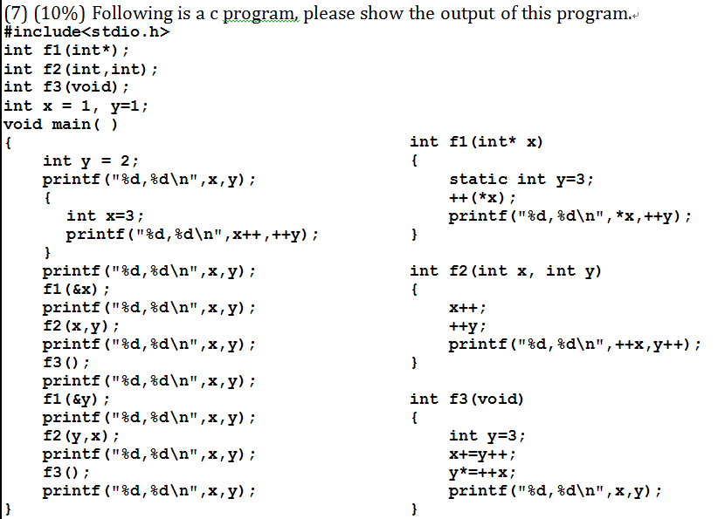

Slide 3
Binary Search Trees
Why do binary search trees need?
  Heap is not suited for applications in which arbitrary elements are to be deleted from the element list
    a min (max) element is deleted O(log₂n)
    deletion of an arbitrary element O(n)
    search for an arbitrary element O(n)
Definition of binary search tree:
  Every element has a unique key
  The keys in a nonempty left subtree (right subtree) are smaller (larger) than the key in the root of subtree
  The left and right subtrees are also binary search trees (Recursively)

Slide 4
Examples of Binary Search Trees
20
30
60
12
25
5
40
70
10
15
30
2
65
80
medium
smaller
larger

Slide 5
Binary Search Trees
Search(25)
Search(76)
Search:
44
17
88
32
65
97
28
54
82
29
76
80

Slide 6
Binary Search Trees- Searching
tree_pointer search(tree_pointer root,int key)/*Recursive*/
{
if (!root) return NULL; /*empty tree*/
if (key == root->data) return root; /*found*/
if (key < root->data)
return search(root->left_child, key);
return search(root->right_child,key);
}
tree_pointer search2(tree_pointer tree, int key)/*non-recursive*/
{
while (tree){
if (key == tree->data) return tree;/*founded*/
if (key < tree->data)
tree = tree->left_child;
else tree = tree->right_child;
}
return NULL;
}
O(h)

Slide 7
Binary Search Trees-Insertion
30
30
30
5
40
5
40
5
40
2
2
80
2
35
80
Insert 80
Insert 35

Slide 8
Binary Search Trees-Insertion
void insert_node(tree_pointer node, int num)
{
tree_pointer ptr;
temp = modified_search(node, num);
if (temp || !(node))
{
ptr = (tree_pointer) malloc(sizeof(node));
if (IS_FULL(ptr)) {
fprintf(stderr, “The memory is full\n”);
exit(1);}
ptr->data = num;
ptr->left_child = ptr->right_child = NULL;
if (node) /*non-empty tree*/
if (num<temp->data) temp->left_child=ptr;
else temp->right_child = ptr;
else node = ptr;
}
}

Slide 9
Binary Search Tree-Deletion
Three cases:
  case 1:leaf(no clild) → delete
  case 2:one child → delete and change the pointer to this child
  case 3:two child → either the smallest element in the right subtree or the largest element in the left subtree

Slide 10
Binary Search Tree-Deletion (1)
1
2
T1
Delete 2

Slide 11
Binary Search Tree-Deletion (2)
1
1
2
2
T1
T1
T2
T2
Delete 2

Slide 12
Binary Search Tree-Deletion (3)
1
1
2
T1
T1
Value
T2
T3
T2
T3

Slide 13
Binary Search Tree-Deletion (3)
40
40
40
20
60
20
55
20
55
10
30
50
70
10
30
50
70
10
30
50
70
45
55
45
60
45
52
52
52
deleting 60

Slide 14
Height of binary search tree
The height of a binary search tree with n elements can become as large as n. (Why?)
It can be shown that when insertions and deletions are made at random, the height of the binary search tree is O(log₂n) on the average.
Search trees with a worst-case height of O(log₂n) are called balance search trees

Slide 15
Binary Search Trees- Complexity
Time Complexity
  Searching, Insertion, Deletion
    O(h), where h is the height of the tree
  Worst case - skewed binary tree
    O(n), where n is the # of internal nodes
Prevent worst case
  balancing scheme
  AVL, 2-3 tree, and Red-black tree

Slide 16
Forests
Definition:
  A forest is a set of n ≥ 0 disjoint trees
Transforming a forest into a binary tree
  If T₁,…,T_{n} is a forest of trees, then the binary tree corresponding to this forest, denoted by B(T₁,…,T_{n} ):
  is empty, if n = 0
  has root equal to root(T₁); has left subtree equal to B(T₁₁,T₁₂,…,T_{1m}); and has right subtree equal to B(T₂,T₃,…,T_{n})
    where T₁₁,T₁₂,…,T_{1m} are the subtrees of root (T₁)

Slide 17
Forests
Rotate the tree clockwise by 45 degrees
B(T1)
B(T2)
B(T3)
B(T1)
Leftmost child
A
B(T11)
B(T2)
A
E
G
B
E
B(T12)
B(T21)
B(T3)
B
C
D
F
H
I
C
F
G
B(T13)
B(T31)
Right sibling
D
H
B(T32)
I

Slide 18
Forest Traversal
  Forest preorder traversal
    If F is empty, then return.
    Visit the root of the first tree of F.
    Traverse the subtrees of the first tree in tree preorder.
    Traverse the remaining tree of F in preorder.
  Forest inorder traversal
    If F is empty, then return
    Traverse the subtrees of the first tree in tree inorder
    Visit the root of the first tree of F
    Traverse the remaining tree of F in inorder
  Forest postorder traversal
    If F is empty, then return
    Traverse the subtrees of the first tree in tree postorder
    Traverse the remaining tree of F in postorder
    Visit the root of the first tree of F

Slide 19
Forest Traversal – Preorder
VLR
V
A
E
D
L
B
C
D
H
J
R
F
I
R
V
R
V
E
D
B
C
D
A
L
L
F
H
I
J

Slide 20
Forest Traversal – Preorder
VLR
R
V
R
V
E
D
B
C
D
A
L
L
F
H
I
J
V
R
V
B
C
E
D
D
A
L
R
L
F
H
I
J
B
C D
E
F

Slide 21
Forest Traversal – Preorder
VLR
V
R
B
C
E
D
D
A
R
L
V
F
H
I
J
B
C D
E
F
L
D H
I J
Preorder: ABCDEFDHIJ

Slide 22
Forest Traversal – Preorder
VLR
A
B
E
A
E
D
C
D
F
B
C
D
F
H
I
J
D
H
I
J
Preorder: ABCDEFDHIJ

Slide 23
Forest Traversal – Postorder
LRV
V
A
E
D
L
B
C
D
H
J
R
F
I

Slide 24
Forest Traversal – Inorder
LVR
inorder: EFBGCHIJDA
V
A
E
D
L
B
C
D
H
J
R
F
I

Slide 25
Rebuild a Binary Tree
Inorder
Yes
Yes
Preorder
Postorder
?

Slide 26
Rebuild a Binary Tree(In+Pre)
preorder: A (B C)(D E F G H I)
inorder: (B C)A(E D G H F I)
A
B, C
E, D, G, H, F, I
A
B
D
preorder: A(B C)(D E F G H I)
inorder: (B C)A(E D G H F I)
C
E
F, G, H, I

Slide 27
Rebuild a Binary Tree(In+Pre)
preorder: A(B C)(D E (F G H I))
inorder: (B C)A(E D (G H F I))
A
A
D
B
D
B
C
E
F
C
E
F, G, H, I
F, G
I

Slide 28
Rebuild a Binary Tree(In+Pre)
preorder: A(B C)(D E (F (G H) I))
inorder: (B C)A(E D ((G H) F I))
A
B
D
C
E
F
G
I
H

Slide 29
Rebuild a Binary Tree(Pos+Pre)
preorder : A (B C) (D E F G H I)
postorder: (C B) (E H G I F D) A
A
B, C
E, D, G, H, F, I
A
A
?
B
E, D, G, H, F, I
B
E, D, G, H, F, I
C
C

Slide 30
Rebuild a Binary Tree(Pos+Pre)
preorder : A (B C) (D (E)(F (G H) I)))
postorder: (C B) ((E)((H G)I F))D) A
A
A
? 2
B,C
D
C
E
F
B
? 2
I
H, G

Slide 31
Binary Search Tree - Best Time
All BST operations are O(height)
minimum height of a binary tree with n nodes
  What is the best case tree?
  What is the worst case tree?
Best case running time of BST operations is O(log n)

Slide 32
Binary Search Tree - Worst Time
Worst case running time is O(n)
  What happens when you Insert elements in ascending order?
    Insert: 2, 4, 6, 8, 10, 12 into an empty BST
Problem: Lack of “balance”

Slide 33
Balanced and Unbalanced BST
1
4
“unbalanced”
2
2
5
3
“balanced”
1
3
4
4
“balanced”?
5
2
6
6
1
3
5
7
7

Slide 34
Balancing Binary Search Trees
Many algorithms exist for keeping binary search trees balanced
  (AVL) trees (Adelson-Velskii and Landis)
  Splay trees and other self-adjusting trees
  B-trees and other multiway search trees
  Red-Black Tree

Slide 35
Perfect Balance
Want a complete tree after every operation
  tree is full except possibly in the lower right
This is expensive
  For example, insert 2 in the tree on the left and then rebuild as a complete tree
6
5
Insert 2 &
complete tree
4
9
2
8
1
5
8
1
4
6
9

Slide 36
Balance Factor
AVL Tree
+1
11
-1
-1
3
13
0
0
0
1
7
15
0
0
5
9

Slide 37
Balance Factor
AVL Tree
Tree
+2
+1
11
11
-2
-1
-1
-1
3
13
3
13
0
-1
0
0
0
0
1
7
15
1
7
15
0
1
0
0
5
9
5
9
0
8

Slide 38









Single Rotation - LL
+2
0
z
y
+1
L
y
$$δ$$
0
0
L
x
z
0
x
$$γ$$
$$α$$
$$β$$
$$γ$$
$$δ$$
$$α$$
$$β$$
$$α, β,γ,δ :has same height$$

Slide 39





Single Rotation - RR
-2
x
R
-1
0
$$α$$
y
y
R
0
0
0
$$β$$
z
x
z
$$γ$$
$$δ$$
$$α$$
$$β$$
$$γ$$
$$δ$$
$$α, β,γ,δ :has same height$$

Slide 40












Double Rotation - LR
+2
+2
z
-1
L
z
+1
0
y
$$δ$$
R
0
x
$$δ$$
x
$$α$$
0
0
x
0
y
$$γ$$
y
z
$$β$$
$$γ$$
$$α$$
$$β$$
$$α$$
$$β$$
$$γ$$
$$δ$$
$$α, β,γ,δ :has same height$$

Slide 41








Double Rotation - RL
-2
-2
z
z
R
$$α$$
-1
0
$$α$$
+1
y
x
x
0
L
0
0
0
x
$$δ$$
$$β$$
y
y
z
$$β$$
$$γ$$
$$γ$$
$$δ$$
$$α$$
$$β$$
$$γ$$
$$δ$$
$$α, β,γ,δ :has same height$$

Slide 42
Example
Build an AVL tree with the following values:
  15, 20, 24, 10, 13, 7, 30, 36, 25

Slide 43
  15, 20, 24, 10, 13, 7, 30, 36, 25
20
15
15
24
20
10
24
13
20
20
13
24
15
24
10
15
13
10

Slide 44
  15, 20, 24, 10, 13, 7, 30, 36, 25
20
13
13
24
10
20
10
15
7
15
24
7
30
13
36
10
20
7
15
30
24
36

Slide 45
  15, 20, 24, 10, 13, 7, 30, 36, 25
13
13
10
20
10
20
7
15
30
7
15
24
24
36
30
25
13
25
36
10
24
7
20
30
15
25
36

Slide 46
  Remove 24 and 20 from the AVL tree.
13
13
10
24
10
20
7
20
30
7
15
30
15
25
36
25
36
13
13
10
30
10
15
7
15
36
7
30
25
25
36

Slide 47
Convex Hull
Prof. Shin-Hung Chang

Slide 48
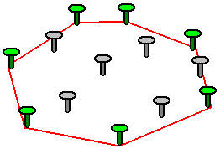
Convex Hull
Your points are nails sticking into a board.
If you stretched a rubber band completely around your points, so that all the points were inside the perimeter of the rubberband.
The nails that the rubber band touches are the points of a polygon that is called the Convex Hull.

Slide 49
Convex Hull
Brute-Force
Brute force approach requires whether other points appears in the same sides of each line of two points.
O(n³)

Slide 50
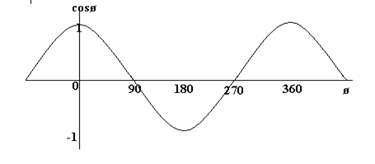



Inner Product
$$\overset{⃑}{V_{1}}∙\overset{⃑}{V_{2}}=|\overset{⃑}{V_{1}}||\overset{⃑}{V_{2}}|\cos{θ}$$
$\cos{θ}=\frac{\overset{⃑}{V_{1}}∙\overset{⃑}{V_{2}}}{|\overset{⃑}{V_{1}}||\overset{⃑}{V_{2}}|}$
$$\overset{⃑}{V_{1}}=(x_{1},y_{1})$$
$$\overset{⃑}{V_{2}}=(x_{2},y_{2})$$
$$\cos{θ}=\frac{x_{1}x_{2}+y_{1}y_{2}}{\sqrt[2]{x_{1}^{2}+y_{1}^{2}} \sqrt[2]{x_{2}^{2}+y_{2}^{2}}}$$

Slide 51
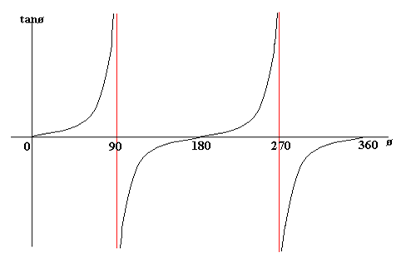

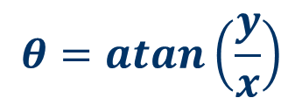

atan( )
(x,y)
$$tanθ=\frac{y}{x}$$
But, x=0?
y
$$θ=atan\left(\frac{y}{x}\right)$$
$$θ$$
(0,0)
x

Slide 52
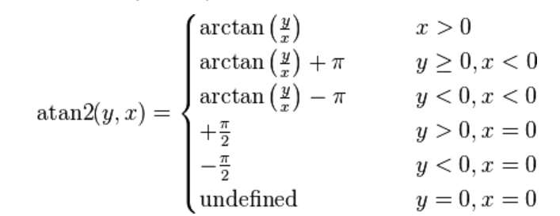
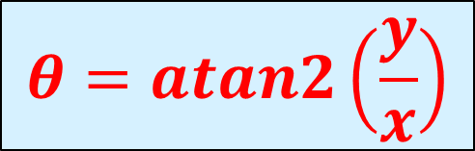



atan2( )
(x<0,y>0)
$$θ2$$
(x>0,y>0)
(x,y)
$$θ3$$
y
$θ$1
x
$$θ=atan2\left(\frac{y}{x}\right)$$

Slide 53
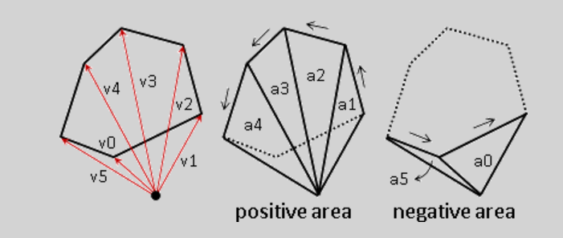
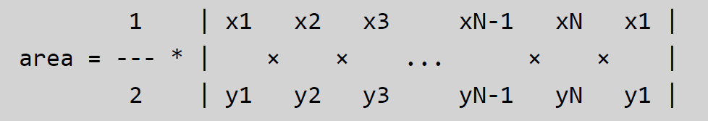
Area of polygon
(0,0)
_
+

Slide 54
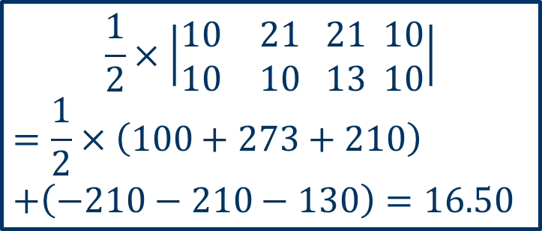
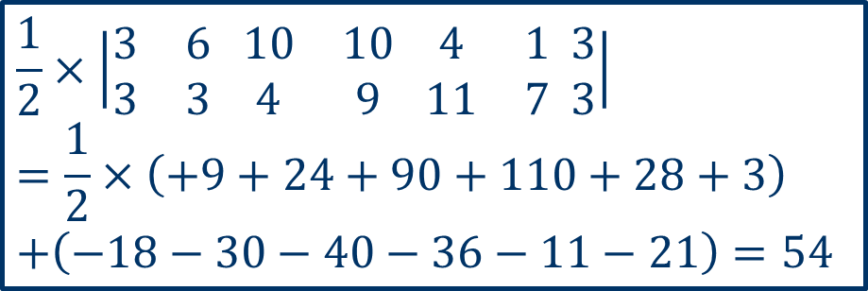

Area of Polygon
(4,11)
(1,7)
(21,13)
(10,9)
(10,10)
(10,4)
(3,3)
(6,3)
(21,10)
$$\frac{1}{2}×\left|\begin{matrix}3 & 6 \\ 3 & 3\end{matrix} \begin{matrix}10 & 10 \\ 4 & 9\end{matrix} \begin{matrix}4 & 1 \\ 11 & 7\end{matrix} \begin{matrix}3 \\ 3\end{matrix}\right|$$
$$=\frac{1}{2}×\left(+9+24+90+110+28+3\right)$$
$$+\left(−18−30−40−36−11−21\right)=54$$
$$\frac{1}{2}×\left|\begin{matrix}10 & 21 \\ 10 & 10\end{matrix} \begin{matrix}21 \\ 13\end{matrix} \begin{matrix}10 \\ 10\end{matrix}\right|$$
$$=\frac{1}{2}×\left(100+273+210\right)$$
$$+\left(−210−210−130\right)=16.50$$
$$54+16.50=70.50$$

Slide 55
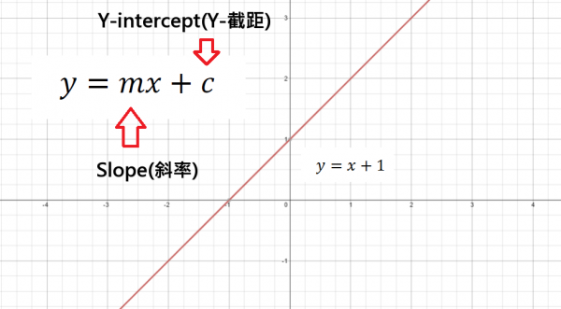
Slope-Intercept Formula
y-x-1=0
(2,0)→0-2-1<0
(3,1)→1-3-1<0
(-2,0)→0+2-1>0
(-4,3)→3+4+1>0

Slide 56
Inside a Polygon ?

Slide 57




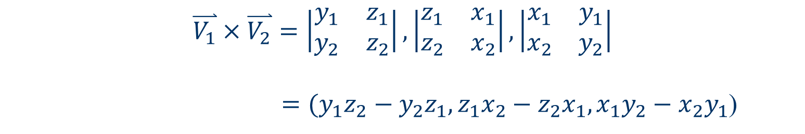

Cross Product
$$\overset{⃑}{V_{1}}=(x_{1},y_{1},z_{1})$$
$$\overset{⃑}{V_{2}}=(x_{2},y_{2},z_{2})$$
$$\overset{⃑}{V_{1}}×\overset{⃑}{V_{2}}=\left|\begin{matrix}y_{1} & z_{1} \\ y_{2} & z_{2}\end{matrix}\right|,\left|\begin{matrix}z_{1} & x_{1} \\ z_{2} & x_{2}\end{matrix}\right|,\left|\begin{matrix}x_{1} & y_{1} \\ x_{2} & y_{2}\end{matrix}\right|$$
$=(y_{1}z_{2}−y_{2}z_{1},z_{1}x_{2}−z_{2}x_{1},x_{1}y_{2}−x_{2}y_{1}$)
$$\overset{⃑}{V_{1}}=(x_{1},y_{1},0)$$
$$\overset{⃑}{V_{2}}=(x_{2},y_{2},0)$$
$$\overset{⃑}{V_{1}}×\overset{⃑}{V_{2}}=\left|\begin{matrix}y_{1} & 0 \\ y_{2} & 0\end{matrix}\right|,\left|\begin{matrix}0 & x_{1} \\ 0 & x_{2}\end{matrix}\right|,\left|\begin{matrix}x_{1} & y_{1} \\ x_{2} & y_{2}\end{matrix}\right|$$
$=(0,0,x_{1}y_{2}−x_{2}y_{1}$)

Slide 58
Graham Scan Algorithm
Find the point P[0] with the lowest y-coordinate and lowest x-coordinate.
Sort the points according to the value of cross product.
Use a stack to find the convex hull according to the scan algorithm.

Slide 59
Example
(3,4.5)
(6,2.1)
(1,1)
(3.1,1.3)
(0,0)

Slide 60
Example
(3,4.5)
3
(6,2.1)
(1,1)
(3.1,1.3)
1
4
2
(0,0)
5
(2,-3.2)

Slide 61
Example
3
1
4
2
5
(2,-3.2)
1
stack

Slide 62
Example
3
+
1
4
2
5
(2,-3.2)
2
1
stack

Slide 63
Example
3
-
1
4
2
5
(2,-3.2)
2
1
stack

Slide 64
Example
3
+
1
4
2
5
(2,-3.2)
4
3
1
stack

Slide 65
Example
3
+
1
4
2
5
(2,-3.2)
4
3
1
stack

Slide 66
Example
3
+
1
4
2
5
(2,-3.2)
5
3
1
stack

Slide 67
Tricky – Collinear
4
5
3
1
6
2
7

Slide 68
Complexity of
Graham Scan Algorithm
Find the point P[0] with the lowest y-coordinate and lowest x-coordinate.
  O(n)
Sort the points according to the value of cross product.
  O(nlogn)
Use a stack to find the convex hull according to the scan algorithm.
  O(n)

Slide 69
Selection Trees
Problem:
  suppose we have k order sequences, called runs, that are to be merged into a single ordered sequence
Solution:
  straightforward : k-1 comparison
  selection tree : ⎡log₂k⎤+1
There are two kinds of selection trees:
winner trees and loser trees

Slide 70
Selection Trees
Definition: (Winner tree)
  A selection tree is the binary tree where each node represents the smaller of its two children
  root node is the smallest node in the tree
  a winner is the record with smaller key
Rules:
  tournament : between sibling nodes
  put X in the parent node ⇒ X tree
  where X = winner or loser

Slide 71
Winner Tree
Each node represents
the smaller of its two
children.
Sequential allocation
(complete binary tree)
1
6
2
3
6
8
4
5
6
7
9
6
8
17
8
9
10
11
12
13
14
15
10
9
20
6
8
9
90
17
ordered sequence
15
20
20
15
15
11
100
18
16
38
30
25
50
16
110
20
run 1
run 2
run 3
run 4
run 5
run 6
run 7
run 8

Slide 72
6
1
6
2
3
6
8
4
5
6
7
9
6
8
17
8
9
10
11
12
13
14
15
10
9
20
6
8
9
90
17
ordered sequence
15
20
20
15
15
11
100
18
16
38
30
25
50
16
110
20
run 1
run 2
run 3
run 4
run 5
run 6
run 7
run 8

Slide 73
6
1
6
8
2
3
6
9
8
4
5
6
7
9
6
15
8
17
8
9
10
11
12
13
14
15
10
9
20
6
15
8
9
90
17
ordered sequence
15
20
20
15
15
11
100
18
16
38
30
25
50
16
110
20
run 1
run 2
run 3
run 4
run 5
run 6
run 7
run 8

Slide 74
6 | 8
1
8
9
2
3
9
8
9
4
5
6
7
9
15
8
9
17
8
9
10
11
12
13
14
15
10
9
20
15
8
15
9
90
17
ordered sequence
15
20
20
15
15
11
100
18
16
38
30
25
50
16
110
20
run 1
run 2
run 3
run 4
run 5
run 6
run 7
run 8

Slide 75
Selection Trees
Analysis of merging runs using winner trees
(vs. sibling nodes)
  # of levels: ⎡log₂K ⎤ +1 ⇒ restructure time: O(log₂K)
  merge time: O(nlog₂K)
  setup time: O(K)
  merge time: O(nlog₂K)
Slight modification: loser tree
  (consider the parent) node only

Slide 76
Loser Tree
6
overall
winner
6
6
8
8
9
15
17
9
6
8
17
10
20
9
90
10
9
20
6
8
9
90
17
15
15
Run 1 2 3 4 5 6 7 8

Slide 77
Loser Tree
6
overall
winner
8
6
8
9
9
15
17
10
20
9
90
10
9
20
15
8
9
90
17
15
15
Run 1 2 3 4 5 6 7 8

Slide 78
Loser Tree
6 | 8
overall
winner
9
8
9
9
15
17
9
10
15
9
90
20
10
9
20
15
15
8
9
90
17
15
Run 1 2 3 4 5 6 7 8

Slide 79
Loser Tree
6 | 8 | 9
overall
winner
9
15
9
20
17
15
20
10
20
15
90
10
9
20
15
15
9
90
17
20
Run 1 2 3 4 5 6 7 8

