Slide 1
CHAPTER 6
GRAPH

Slide 2
Definition
A graph G consists of two sets
a finite, nonempty set of vertices V(G)
a finite, possible empty set of edges E(G)
G(V,E) represents a graph
An undirected graph is one in which the pair of vertices in an edge is unordered, (v0, v1) = (v1,v0)
A directed graph is one in which each edge is a directed pair of vertices, <v0, v1> != <v1, v0>
v0
v1
v0
v1

Slide 3
Examples for Graph
complete undirected graph: n(n-1)/2 edges
complete directed graph: n(n-1) edges
0
0
0
0
1
2
1
1
2
1
2
3
3
4
5
6
2
G1
3
G2
G3
complete graph
incomplete graph
V(G1)={0,1,2,3} E(G1)={(0,1),(0,2),(0,3),(1,2),(1,3),(2,3)}
V(G2)={0,1,2,3,4,5,6} E(G2)={(0,1),(0,2),(1,3),(1,4),(2,5),(2,6)}
V(G3)={0,1,2} E(G3)={<0,1>,<1,0>,<1,2>}

Slide 4
Restrictions on graphs
A graph may not have an edge from a vertex, i, back to itself. Such edges are known as self loops
A graph may not have multiple occurrences of the same edge. If we remove this restriction, we obtain a data referred to as a multigraph
0
0
2
1
3
1
2
multigraph:
multiple occurrences
of the same edge
self edge
(a)
(b)

Slide 5
Adjacent and Incident
If (v0, v1) is an edge in an undirected graph,
v0 and v1 are adjacent
The edge (v0, v1) is incident on vertices v0 and v1
If <v0, v1> is an edge in a directed graph
v0 is adjacent to v1, and v1 is adjacent from v0
The edge <v0, v1> is incident on v0 and v1
V₀
V₁
V₀
V₁

Slide 6
Subgraph and Path
A subgraph of G is a graph G’
such that V(G’) ⊆ V(G) and E(G’) ⊆ E(G).
0
0
0
1
2
0
1
2
1
2
3
1
2
3
3
G1
(i) (ii) (iii) (iv)
0
0
0
0
0
1
1
1
1
2
2
2
G3
(i) (ii) (iii) (iv)

Slide 7
Path
A path from vertex v_{p} to vertex v_{q} in a graph G,
a sequence of vertices, v_{p}, v_{i1}, v_{i2}, ..., v_{in}, v_{q}
such that (v_{p}, v_{i1}), (v_{i1}, v_{i2}), ..., (v_{in}, v_{q}) are edges in an undirected graph.
A path such as (0, 2), (2, 1), (1, 3) is also written as 0, 2, 1, 3
The length of a path is the number of edges on it
0
0
0
1
2
1
2
1
2
3
3
3

Slide 8
Simple path and cycle
simple path (simple directed path):
A path in which all vertices, except possibly the first and the last, are distinct.
A cycle is a simple path in which the first and the last vertices are the same.
0
0
1
2
1
2
3
3

Slide 9
Connected graph
In an undirected graph G
Two vertices, v₀ and v₁, are connected if there is a path in G from v₀ to v₁
An undirected graph is connected if, for every pair of distinct vertices v_{i}, v_{j}, there is a path from v_{i} to v_{j}
connected
unconnected
0
0
1
2
1
2
3
3

Slide 10
Connected component
A connected component of an undirected graph is a maximal connected subgraph.
A tree is a graph that is connected and acyclic (has no cycle).
0
0
0
1
2
1
2
1
3
3
3
4
5
6
tree (acyclic graph)

Slide 11
Strongly Connected Component
A directed graph is strongly connected if there is a directed path from v_{i} to v_{j} and also from v_{j} to v_{i}
A strongly connected component is a maximal subgraph that is strongly connected
strongly connected component
(maximal strongly connected subgraph)
0
0
1
2
1
2
not strongly connected

Slide 12
Degree
Degree
The degree of a vertex
is the number of edges incident to that vertex.
For directed graph
in-degree (v) : the number of edges that have v as the head
out-degree (v) : the number of edges that have v as the tail
If di is the degree of a vertex i in a graph G with n vertices and e edges, the number of edges is

Slide 13
Degree
A directed graph as a digraph
Generally, term graph, we assume that it is an undirected graph
undirected graph
directed graph
degree
in-degree & out-degree
2
0
in:1, out: 1
3
0
0
3
3
1
2
1
in: 1, out: 2
3
1
2
3
1
1
1
1
3
3
4
5
6
2
in: 1, out: 0
3

Slide 14
ADT for Graph
structure Graph is
objects: a nonempty set of vertices and a set of undirected edges, where each edge is a pair of vertices
functions: for all graph ∈ Graph, v, v₁ and v₂ ∈ Vertices
Graph Create()::=return an empty graph
Graph InsertVertex(graph, v)::= return a graph with v inserted. v has no incident edge.
Graph InsertEdge(graph, v1,v2)::= return a graph with new edge between v1 and v2
Graph DeleteVertex(graph, v)::= return a graph in which v and all edges incident to it are removed
Graph DeleteEdge(graph, v1, v2)::=return a graph in which the edge (v1, v2) is removed
Boolean IsEmpty(graph)::= if (graph==empty graph) return TRUE
else return FALSE
List Adjacent(graph,v)::= return a list of all vertices that are adjacent to v

Slide 15
Adjacency Matrix
Let G = (V,E) be a graph with n vertices.
The adjacency matrix of G is a two-dimensional n x n array
If the edge (vi, vj) is in E(G), adj_mat[i][j]=1, o.w. =0
The adjacency matrix for an undirected graph is symmetric; the adjacency matrix for a digraph need not be symmetric
0
4
0
2
1
5
0
6
3
1
1
2
7
3
2

Slide 16
Merits of Adjacency Matrix
For an undirected graph, the degree of any vertex, i, is its row sum:
For a directed graph, the row sum is the out-degree, while the column sum is the in-degree.
The complexity of checking edge number or examining if G is connect
G is undirected: O(n²/2)
G is directed: O(n²)

Slide 17
Adjacency lists
There is one list for each vertex in G. The nodes in list i represent the vertices that are adjacent from vertex i
For an undirected graph with n vertices and e edges, this representation requires n head nodes and 2e list nodes
C declarations for adjacency lists
#define MAX_VERTICES 50
typedef struct node* node_pointer;
typedef struct node {
int vertex;
struct node* link;
};
node_pointer graph[MAX_VERTICES];
int n=0; /* vertices currently in use */

Slide 18
0
0
4
1
2
2
1
5
3
0
1
2
3
1
2
3
3
6
0
2
3
7
0
1
3
0
1
2
3
4
5
6
7
1
2
0
1
2
0
3
0
0
3
0
1
2
1
1
2
0
2
1
5
4
6
5
7
2
6

Slide 19
Interesting Operations
degree of a vertex in an undirected graph
# of nodes in adjacency list
# of edges in a graph
determined in O(n+e)
out-degree of a vertex in a directed graph
# of nodes in its adjacency list
in-degree of a vertex in a directed graph
traverse the whole data structure

Slide 20
Compact Representation
Sequentially pack the nodes from the adjacency lists
node[1] ~ node[n+2e+1] may be used.
node[0] ~ node[n-1] gives the starting point of the list for vertex I
node[n]: n+2e+1
node[n+1] … node[n+2e]: head node of edge
The vertices adjacent from vertex i are stored in node[node[i]], … , node[node[i+1]-1], 0≦i<n
The number of edge in G may be determined in O(n+e) time
4
0
5
6
2
1
3
7

Slide 21
Determine In-degree of Vertices
0
0
1
2
•
•
•
1 NULL
0 NULL
1
1 NULL
2
Inverse adjacency list of G₃

Slide 22
Alternate Node Structure
tail head column link for head row link for tail
0
1
2
0
0 1 NULL NULL
0
1
1 0 NULL
1 2 NULL NULL
1
2 NULL
2

Slide 23
Vertices in Any Order
Order is of no significance
Head nodes vertex links
0
•
3 •
1 •
2 NULL
0
1
•
2 •
0 •
3 NULL
1
2
2
•
3 •
0 •
1 NULL
3
3
•
2 •
1 •
0 NULL

Slide 24
Weighted edges
The edges of a graph have weights assigned to them.
These weights may represent as
the distance from one vertex to another
cost of going from one vertex to an adjacent vertex.
adjacency matrix: adj_mat[i][j] would keep the weights.
adjacency lists: add a weight field to the node structure.
A graph with weighted edges is called a network

Slide 25
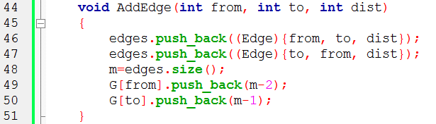

2
1
2
1 2 2
1 3 3
2 4 4
3 4 5
3
4
3
4
5
edges
0 | 1
(1,2,2) | (2,1,2)
G
1
2
3
4
0
1

Slide 26
2
1
2
1 2 2
1 3 3
2 4 4
3 4 5
3
4
3
4
5
edges
0 | 1 | 2 | 3
(1,2,2) | (2,1,2) | (1,3,3) | (3,1,3)
G
1
2
3
4
0 | 2
1
3

Slide 27
2
1
2
1 2 2
1 3 3
2 4 4
3 4 5
3
4
3
4
5
edges
0 | 1 | 2 | 3 | 4 | 5
(1,2,2) | (2,1,2) | (1,3,3) | (3,1,3) | (2,4,4) | (4,2,4)
G
1
2
3
4
0 | 2
1 | 4
3
5

Slide 28
2
1
2
1 2 2
1 3 3
2 4 4
3 4 5
3
4
3
4
5
edges
0 | 1 | 2 | 3 | 4 | 5 | 6 | 7
(1,2,2) | (2,1,2) | (1,3,3) | (3,1,3) | (2,4,4) | (4,2,4) | (3,4,5) | (4,3,5)
G
1
2
3
4
0 | 2
1 | 4
3 | 6
5 | 7

Slide 29
Graph Traversal
Given G=(V,E) and vertex v, find all w∈V, such that w connects v
Depth First Search (DFS) : preorder traversal
Breadth First Search (BFS): level order traversal
Spanning Trees
Biconnected Components

Slide 30
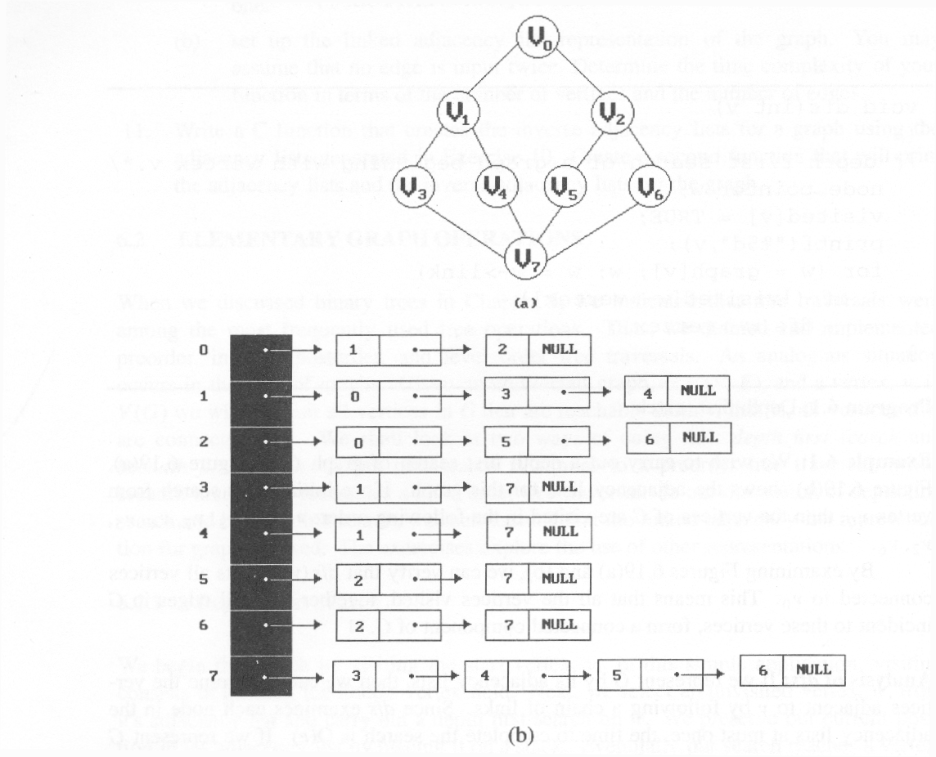
Graph Traversal
Using Adjacency List representation of Graph
depth first search (DFS): v₀, v₁, v₃, v₇, v₄, v₅, v₂, v₆
breadth first search (BFS): v₀, v₁, v₂, v₃, v₄, v₅, v₆, v₇

Slide 31
Depth First Search
It needs stack to implement depth-first search
starting with node v the global array visited is initialized to 0
Recursive DFS

Slide 32
Depth First Search
w
Data structure
adjacency list: O(e)
adjacency matrix: O(n²)
void dfs(int v)
{
node_pointer w;
visited[v]= TRUE;
printf(“%5d”, v);
for (w=graph[v]; w; w=w->link)
if (!visited[w->vertex])
dfs(w->vertex);
}
#define FALSE 0
#define TRUE 1
short int visited[MAX_VERTICES];
visited:
[0]
[1]
[2]
[3]
[4]
[5]
[6]
[7]
output:
0
1
3
7
4
5
2
6

Slide 33
Breadth First Search
It needs a queue to implement breadth-first search
starting with node v the global array visited is initialized to 0

Slide 34
Breadth First Search
visited:
[0]
[1]
[2]
[3]
[4]
[5]
[6]
[7]
out
0
1
2
3
4
5
6
7
in
output:
0
1
2
3
4
5
6
7
void bfs(int v)
{ node_pointer w;
queue_pointer front, rear;
front = rear = NULL;
printf(“%5d”, v);
visited[v] = TRUE;
addq(&front, &rear, v);
while (front) {
v= deleteq(&front);
for (w=graph[v]; w; w=w->link)
if (!visited[w->vertex]) {
printf(“%5d”, w->vertex);
addq(&front, &rear, w->vertex);
visited[w->vertex] = TRUE;
}
}
}
adjacency list: O(v+e)
adjacency matrix: O(n²)
w

Slide 35
Spanning trees
Definition: A tree T is said to be a spanning tree of a connected graph G
If T is a subgraph of G and T contains all vertices of G.
E(G): T (tree edges) + N (nontree edges)
T: set of edges used during search
N: set of remaining edges
0
0
0
0
1
2
1
2
1
2
1
2
3
3
3
3

Slide 36
DFS- and BFS-Spanning trees
When graph G is connected, a depth first or breadth first search starting at any vertex will visit all vertices in G
We may use DFS or BFS to create a spanning tree
Depth first spanning tree when DFS is used
Breadth first spanning tree when BFS is used
0
0
DFS Spanning
0
BFS Spanning
1
2
1
2
1
2
3
4
5
6
3
4
5
6
3
4
5
6
7
7
nontree edge cycle
7

Slide 37
Properties of Spanning Trees
If a nontree edge (v, w) is introduced into any spanning tree T, then a cycle is formed.
A spanning tree is a minimal subgraph, G’, of G such that V(G’) = V(G) and G’ is connected.
We define a minimal subgraph as one with the fewest number of edge
A spanning tree has n-1 edges

Slide 38
Minimum Cost Spanning Trees (MST)
Introduction
The cost of a spanning tree of a weighted, undirected graph is the sum of the costs (weights) of the edges in the spanning tree.
A minimum-cost spanning tree is a spanning tree of lowest cost sum.
Three different algorithms can be used to obtain a minimum cost spanning tree.
Kruskal’s algorithm
Prim’s algorithm
Sollin’s algorithm
All the three use a design strategy called the greedy method

Slide 39
Greedy Strategy
Build an optimal solution in stages
At each stage, the strategy select the best decision possible at this time.
Use the lowest-cost criterion for constructing minimum-cost spanning trees
Make sure that the decision will result in a feasible solution
A feasible solution works within the constraints specified by the problem

Slide 40
Minimum Cost Spanning Trees
The MST solution must satisfy the following constrains
Must use only edges within the graph
MST contains exactly n - 1 edges
Not use edges that produce a cycle

Slide 41
Kruskal’s Algorithm
Build a minimum cost spanning tree T by adding edges to T one at a time
Select the edges into T in non-decreasing order of the cost
An edge is added to T if it does not form a cycle
Since G is connected and has n > 0 vertices, exactly n-1 edges will be selected

Slide 42
Kruskal’s Algorithm
Time complexity: O(e log e)
Theorem 6.1: Let G be an undirected connected graph. Kruskal’s algorithm generates a minimum cost spanning tree

Slide 43
Kruskal’s Algorithm
Given a G(V,E)
T= {};
while (T contains less than n-1 edges && E is not empty)
{ choose a lowest cost edge (v,w) from E;
delete (v,w) from E;
if ((v,w) does not create a cycle in T)
add (v,w) to T
else discard (v,w);
}
if (T contains fewer than n-1 edges)
printf(“No spanning tree\n”);
0
28
10
1
14
16
5
6
2
24
25
✗
18
12
4
✗
choose
22
3

Slide 44
What is “Cut”
A Cut(S,V-S) of an undirected graph G(V,E) is a partition of G
A edge (u,v) crosses the Cut(S,V-S)
If one of its endpoint is in S and the other is in V-S
An edge is a light edge crossing a cut if its weight is minimum

Slide 46
Prim’s Algorithm
Prim’s Algorithm( G(V,E) )
{ Q ← root node
While Q≠V
{ find minimum cost edge (u,v)
where u in Q and v in (V-Q)
add v to Q
}
}

Slide 47

Prim’s Algorithm
Given G(V,E)
T={};
TV={0};
while (T contains fewer than n-1 edges)
{ let (u,v) be a lowest cost edge s.t. $u∈TV and v∈TV$
if (there is no such edge ) break;
add v to TV;
add (u,v) to T;
}
if (T contains fewer than n-1 edges)
printf(“No spanning tree\n”);
0
28
10
1
14
16
5
6
2
24
25
18
12
4
22
3

