Slide 1
CHAPTER 6
GRAPH 2

Slide 2
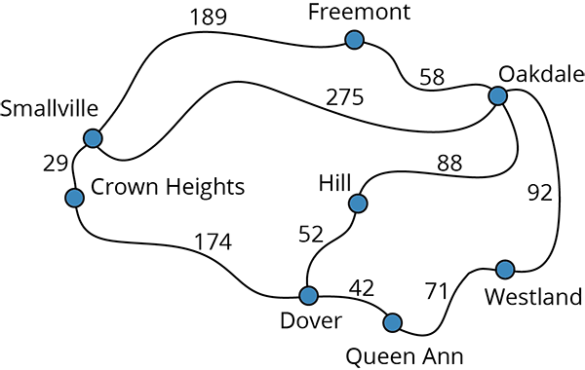
Shortest Path
Is there a path from city Crown Height to all other cities?
root

Slide 3
Shortest Path
Single source/All shortest path (SSAS) ★nonnegative edge cost
Problem: given a directed graph G = (V, E), a length function length(i, j), length(i, j) ≥ 0, for the edges of G, and a source vertex v.
Need to solve: determine a shortest path from v to each of the remaining vertices of G.
Let S denote the set of vertices
dist[w]: the length of shortest path starting from v, going through only the vertices that are in S, ending at w.
v
45
50 10
V₀
V₁
V₄
20 10 15 20 35 30
15 3
V₂
V₃
V₅
path length
1) v0 v2 10
2) v0 v2 v3 25
3) v0 v2 v3 v1 45
4) v0 v4 45

Slide 4
Single Source Shortest Path
Prof. Shin-Hung Chang

Slide 5
Single-Source Shortest Path
Problem: given a weighted directed graph G, find the minimum-weight path from a given source vertex s to another vertex v
“Shortest-path” = minimum weight
Weight of path is sum of edges
E.g., A road map: what is the shortest path from FJU to Taipei Railway Station?

Slide 6
Single-Source Shortest Path
Input:
Directed graph G = (V, E)
Weight function w : E → R (real number)
Weight of path p = <v₀, v₁, . . . , v_{k}>

Slide 7
Definition of Shortest Path
Shortest Path Weight u to v is defined as:

Slide 8
Output of single-source shortest-path algorithm
Finally, for each vertex v ∈ V:
d[v] =δ(s, v)
Reduces as algorithms progress.
Always maintain d[v] ≥ δ(s, v)
Call d[v] a shortest-path estimate
π[v]: predecessor of v on a shortest path from s

Slide 9
Relaxation
A key technique in shortest path algorithms is relaxation
Idea: for all v, maintain upper bound d[v]
Relax(u,v,w) {
if (d[v] > d[u]+w) then
{d[v]=d[u]+w;
π[v]=u;}
}
u
v
u
v
5
2
9
5
2
6
Relax
Relax
u
v
u
2
2
v
5
7
5
6

Slide 10
Shortest Path Properties
In graphs with negative weight cycles, some shortest paths will not exist (Why?):
< 0

Slide 11
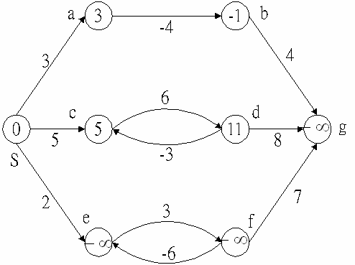
Negative-Weight edge
d[a]=3, why?
d[c]=5, why?
d[e]=-∞, why?
Negative Weighted Cycle

Slide 12
Dijkstra’s Algorithm
Graph G must contains no negative edge weights
Similar to Prim’s algorithm for MST
Use a priority queue keyed on d[v]

Slide 13
Dijkstra’s Algorithm
A | B | C | D
B
B
0
10
5
∞
10
2
A
4
3
D
D
9
5
6
5
C
1
C
8
6

Slide 14
Dijkstra’s Algorithm
Dijkstra(G)
for each v ∈ V
d[v] = ∞;
d[s] = 0; S = ∅; Q = V;
while (Q ≠ ∅)
u = ExtractMin(Q);
S = S U {u};
for each v ∈ u->Adj[]
if (d[v] > d[u]+w(u,v))
d[v] = d[u]+w(u,v);
B∞
10
2
A0
4
3
D∞
5
C∞
1
S = ∅
Q = A, B, C, D

Slide 15
Dijkstra’s Algorithm
Dijkstra(G)
for each v ∈ V
d[v] = ∞;
d[s] = 0; S = ∅; Q = V;
while (Q ≠ ∅)
u = ExtractMin(Q);
S = S U {u};
for each v ∈ u->Adj[]
if (d[v] > d[u]+w(u,v))
d[v] = d[u]+w(u,v);
B∞
u
10
2
A0
4
3
D∞
5
C∞
1
S = A
Q = B, C, D

Slide 16
Dijkstra’s Algorithm
Dijkstra(G)
for each v ∈ V
d[v] = ∞;
d[s] = 0; S = ∅; Q = V;
while (Q ≠ ∅)
u = ExtractMin(Q);
S = S U {u};
for each v ∈ u->Adj[]
if (d[v] > d[u]+w(u,v))
d[v]=d[u]+w(u,v);
v
B10
u
10
2
A0
4
3
D∞
5
C5
1
v
S = A
Q = B, C, D

Slide 17
Dijkstra’s Algorithm
Dijkstra(G)
for each v ∈ V
d[v] = ∞;
d[s] = 0; S = ∅; Q = V;
while (Q ≠ ∅)
u = ExtractMin(Q);
S = S U {u};
for each v ∈ u->Adj[]
if (d[v] > d[u]+w(u,v))
d[v]=d[u]+w(u,v);
v
B10
10
2
A0
4
3
D∞
v
5
C5
1
u
S = A,C
Q = B,D

Slide 18
Dijkstra’s Algorithm
Dijkstra(G)
for each v ∈ V
d[v] = ∞;
d[s] = 0; S = ∅; Q = V;
while (Q ≠ ∅)
u = ExtractMin(Q);
S = S U {u};
for each v ∈ u->Adj[]
if (d[v] > d[u]+w(u,v))
d[v]=d[u]+w(u,v);
v
B9
10
2
A0
4
3
D6
v
5
C5
1
u
S = A,C
Q = B,D

Slide 19
Dijkstra’s Algorithm
Dijkstra(G)
for each v ∈ V
d[v] = ∞;
d[s] = 0; S = ∅; Q = V;
while (Q ≠ ∅)
u = ExtractMin(Q);
S = S U {u};
for each v ∈ u->Adj[]
if (d[v] > d[u]+w(u,v))
d[v]=d[u]+w(u,v);
v
B9
10
2
A0
4
3
D6
u
5
C5
1
S = A,C,D
Q = B

Slide 20
Dijkstra’s Algorithm
Dijkstra(G)
for each v ∈ V
d[v] = ∞;
d[s] = 0; S = ∅; Q = V;
while (Q ≠ ∅)
u = ExtractMin(Q);
S = S U {u};
for each v ∈ u->Adj[]
if (d[v] > d[u]+w(u,v))
d[v]=d[u]+w(u,v);
v
B8
10
2
A0
4
3
D6
u
5
C5
1
S = A,C,D
Q = B

Slide 21
Dijkstra’s Algorithm
Dijkstra(G)
for each v ∈ V
d[v] = ∞;
d[s] = 0; S = ∅; Q = V;
while (Q ≠ ∅)
u = ExtractMin(Q);
S = S U {u};
for each v ∈ u->Adj[]
if (d[v] > d[u]+w(u,v))
d[v]=d[u]+w(u,v);
u
B8
10
2
A0
4
3
D6
5
C5
1
v
S = A,C,D,B
Q = ∅

Slide 22
Dijkstra’s Algorithm
Dijkstra(G)
for each v ∈ V
d[v] = ∞;
d[s] = 0; S = ∅; Q = V;
while (Q ≠ ∅)
u = ExtractMin(Q);
S = S U {u};
for each v ∈ u->Adj[]
if (d[v] > d[u]+w(u,v))
d[v]=d[u]+w(u,v);
u
B8
10
2
A0
4
3
D6
5
C5
1
v
S = A,C,D,B
Q = ∅

Slide 23
Dijkstra’s Algorithm
Dijkstra(G)
for each v ∈ V
d[v] = ∞;
d[s] = 0; S = ∅; Q = V;
while (Q ≠ ∅)
u = ExtractMin(Q);
S = S U {u};
for each v ∈ u->Adj[]
if (d[v] > d[u]+w(u,v))
d[v]=d[u]+w(u,v);
How many times is ExtractMin() called?
How many times is Relax called?
A:O(V lg V + E)

Slide 24
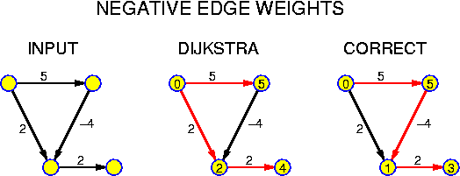
Why not negative edges?
The problem is that one can not be sure that the currently closest node to source has reached its final distance

Slide 25
Dijkastra’s Algorithm
Find the shortest path from a given source node to every other node.
Given:
cost e(v_{i}, v_{j}) of all edges; v₀ is the source node
e(v_{i}, v_{j}) = ∞, if v_{i} and v_{j} are not adjacent
S ← {v₀};
dist[v₀] ← 0;for each v in V - {v₀} do dist[v] ← e(v₀, v);
while S≠V do
choose a vertex w in V-S such that dist[w] is a minimum;
add w to S;
for each v in V-S do
dist[v] ← min(dist[v], dist[w]+e(w, v));

Slide 26
Dijkastra’s Algorithm
#define MAX_VERTICES 6
int cost[ ][MAX_VERTICES]=
{ { 0, 50, 10, 1000, 45, 1000},
{1000, 0, 15, 1000, 10, 1000},
{ 20, 1000, 0, 15, 1000, 1000},
{1000, 20, 1000, 0, 35, 1000},
{1000, 1000, 30, 1000, 0, 1000},
{1000, 1000, 1000, 3, 1000, 0}};
int distance[MAX_VERTICES];
short int found{MAX_VERTICES];
int n = MAX_VERTICES;
45
V₀
50 10
V₁
V₄
20 10 15 20 35 30
V₂
15 3
V₃
V₅

Slide 27


Dijkastra’s Algorithm(v=0)
found:
[0]
[1]
[2]
[3]
[4]
[5]
void shortestpath(int v, int cost[][MAX_ERXTICES],
int distance[], int n, short int found[])
{
int i, u, w;
for (i=0; i<n; i++) {
found[i] = FALSE;
distance[i] = cost[v][i];
}
found[v] = TRUE;
distance[v] = 0;
for (i=0; i<n-2; i++)
{ u = choose(distance, n, found);
found[u] = TRUE;
for (w=0; w<n; w++)
if (!found[w])
if (distance[w]>distance[u]+cost[u][w])
distance[w] = distance[u]+cost[u][w];
}
}
cost:
45
v
V₀
50 10
V₁
V₄
20 10 15 20 35 30
V₂
15 3
V₃
V₅
v0 v1 v2 v3 v4 v5
0
50
45
10
$$∞$$
distance:
25
45
$$∞$$
i:
1
2
3
0
u:
2
3
1
4
w:
0
1
2
3
4
5

Slide 28
All-Pair Shortest Paths Algorithm
Given a weighted, directed graph G=(V, E), we want to compute the shortest paths from u to v for all vertex pairs

Slide 29
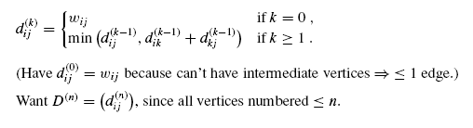
Floyd-Warshall Algorithm
Let d ^{(k)}_{i j} = shortest-path weight of any path i j with all intermediate vertices in {1, 2, . . . , k}

Slide 30
1
6
3
4
11
2
2
3
(1,2)
(1,3)
D⁽⁰⁾ | 1 | 2 | 3
1 | 0 | 4 | 11
2 | 6 | 0 | 2
3 | 3 | ∞ | 0
D⁽¹⁾ | 1 | 2 | 3
1 | 0 | 4 | 11
2 | 6 | 0 | 2
3 | 3 | 7 | 0
(2,1)
(2,3)
(3,1)
(3,2)

Slide 31
1
6
3
4
11
2
2
3
(1,2)
D⁽¹⁾ | 1 | 2 | 3
1 | 0 | 4 | 11
2 | 6 | 0 | 2
3 | 3 | 7 | 0
D⁽²⁾ | 1 | 2 | 3
1 | 0 | 4 | 6
2 | 6 | 0 | 2
3 | 3 | 7 | 0
(1,3)
(2,1)
(2,3)
(3,1)
(3,2)

Slide 32
1
6
3
4
11
2
2
3
(1,2)
D⁽²⁾ | 1 | 2 | 3
1 | 0 | 4 | 6
2 | 6 | 0 | 2
3 | 3 | 7 | 0
D⁽³⁾ | 1 | 2 | 3
1 | 0 | 4 | 6
2 | 5 | 0 | 2
3 | 3 | 7 | 0
(1,3)
(2,1)
(2,3)
(3,1)
(3,2)

Slide 33
Example
1 2 3 4 5
1
2
3
4
5

Slide 34
Example
d⁽¹⁾₄₂ =min {d⁽⁰⁾_{42,}d⁽⁰⁾₄₁ + d⁽⁰⁾₁₂}
d⁽⁰⁾₁₂
1 2 3 4 5
1 2 3 4 5
1
2
3
4
5
1
2
3
4
5
d⁽⁰⁾₄₁
d⁽⁰⁾₄₂

Slide 35
Example
1 2 3 4 5
1 2 3 4 5
1
2
3
4
5
1
2
3
4
5

Slide 36
1 2 3 4 5
1 2 3 4 5
1
2
3
4
5
1
2
3
4
5

Slide 37
1 2 3 4 5
1 2 3 4 5
1
2
3
4
5
1
2
3
4
5

Slide 38
1 2 3 4 5
1
2
3
4
5
5

Slide 40
Activity on Edge (AOE) Critical Path Problem
V7
A10=5
V2
V2
A7=9
A4=1
A1=6
V9
V5
V1
A2=4
A11=4
V3
A5=1
A8=7
V8
A3=5
A9=4
A6=2
V4
V6

Slide 41
Activity on Edge (AOE) Critical Path Problem
ee=
6/
16/
V7
A10=5
V2
V2
A7=9
21/
A4=1
A1=6
7/
V9
ee=
0/
4/
V5
14/
V1
A2=4
A11=4
V3
A5=1
A8=7
V8
A3=5
5/
7/
A9=4
A6=2
V4
V6

Slide 42
Activity on Edge (AOE) Critical Path Problem
6/
16/16
=le
V7
A10=5
V2
V2
A7=9
21/21
=le
A4=1
A1=6
7/
V9
0/
4/
V5
14/
V1
A2=4
A11=4
V3
A5=1
A8=7
V8
A3=5
5/
7/
A9=4
A6=2
V4
V6

Slide 43
Activity on Edge (AOE) Critical Path Problem
6/6
16/16
V7
A10=5
V2
V2
A7=9
21/21
A4=1
A1=6
7/7
V9
0/0
4/6
V5
14/17
V1
A2=4
A11=4
V3
A5=1
A8=7
V8
A3=5
5/11
7/13
A9=4
A6=2
V4
V6

Slide 44
Activity on Edge (AOE) Critical Path Problem
6/6
16/16
V7
A10=5
V2
V2
A7=9
21/21
A4=1
A1=6
7/7
V9
0/0
4/6
V5
14/17
V1
A2=4
A11=4
V3
A5=1
A8=7
V8
A3=5
5/11
7/13
A9=4
A6=2
V4
V6

Slide 45
Activity on Edge (AOE) Critical Path Problem
6/6
16/16
V7
A10=5
V2
V2
A7=9
21/21
A4=1
A1=6
7/7
V9
0/0
4/6
V5
14/17
A2=4
V1
V3
A5=1
V8
A11=4
A8=7
A3=5
5/11
7/13
A9=4
A6=2
V4
V6

Slide 46
Articulation Points
Assumption: G is an undirected, connected graph
Definition: A vertex v of G is an articulation point
iff the deletion of v,
together with the deletion of all edges incident to v
leaves behind a graph that has at least two connected components.

Slide 47
Connected components
If G is an undirected graph, then one can determine whether or not it is connected:
simply making a call to either dfs or bfs
then determining if there is any unvisited vertex
void connected(void)
{
for (i=0; i<n; i++)
{
if (!visited[i])
{
dfs(i);
printf(“\n”);
}
}
}
adjacency list: O(n+e)
adjacency matrix: O(n²)

Slide 48
Examples of Articulation Points
Examples of Articulation Points (node 1, 3, 5, 7)
8 9
0
8 9
0
0
8 9
7
7
1
1
7
1
2
2
2
3
5
3
5
3
5
4
6
4
6
4
6
Connected graph
two connected components
one connected graph

Slide 49
Biconnected Graph
Assumption: G is an undirected, connected graph
Definition: A biconnected graph is a connected graph that
has no articulation points
Definition: A biconnected component of a connected graph G is
a maximal biconnected subgraph H of G.

Slide 50
Example of Biconnected Component
A maximal connected subgraph H
no subgraph that is both biconnected and properly contains H
0
8
9
0
8 9
1
7
7
7
1
7
2
1
3
5
2
3
3
5
5
4
6
4
6

Slide 51
Find the BCs
By using depth first spanning tree of a connected undirected graph
The depth first number (dfn) outside the vertices in the figures gives the DFS visit sequence
If u is an ancestor of v then dfn(u) < dfn(v)
0
3
4 0
9 8 9 8
4
5
1 5
7 7
nontree
edge
(back edge)
3
1
0 5
3 5
2
6
7
6
2
4
2 2
1
3
7
8 9
4 6
1 6
0
9
8

Slide 52
Find the BCs
dfn( ) and low( )
low(u): the lowest dfn that we can reach
from u using a path of descendants followed by at most one back edge
low(u) = min{
dfn(u), min{ low(w) | w is a child of u }, min{ dfn(w) | (u, w) is a back edge } }
dfn
low
0
3
0
1 5
4
0
5
5
2
4
2
6
7
6
5
0
1
7
5
3
0
9
9
8
8
0
4
8 9

Slide 53
Find AP
Any vertex u is an articulation point iff
u is the root and has two or more children
u is not the root and has at least one child w such that we cannot reach an ancestor of u using a path that consists of only
w
descendants of w
a single back edge
thus, low(w) ≥ dfn(u)
dfn
low
0
3
0
4
0
5
5
1 5
≦
2
4
2
6
7
6
5
0
1
7
5
3
0
≦
≦
9
9
8
8
0
4
8 9

Slide 54
Determining dfn and low
Easily modify dfs( ) to compute dfn and low for each vertex of a connected undirected graph
#define MIN2 (x, y) ((x) < (y) ? (x) : (y)) short int dfn[MAX_VERTICES]; short int low[MAX_VERTICES]; int num;
void init(void) { int i; for (i = 0; i < n; i++) { visited[i] = FALSE; dfn[i] = low[i] = -1; } num = 0; }

Slide 55
Determining dfn and low
we invoke the function with call dfnlow(x, -1), where x is the starting vertex (root) for the depth first search
void dfnlow(int u, int v) { node_pointer ptr; int w; dfn[u] = low[u] = num++; for (ptr = graph[u]; ptr; ptr = ptr ->link) { w = ptr ->vertex; if (dfn[w] < 0) { /*w is an unvisited vertex */ dfnlow(w, u); low[u] = MIN2(low[u], low[w]); } else if (w != v) low[u] =MIN2(low[u], dfn[w] ); } }
u:
3
4
2
1
0
1
v is the parent of u (if any)
-1
3
4
2
1
v:
2
w:
4
1
2
0
2
1
0
3
num:
2
3
4
0
1
w is a child of u
5
ptr
dfn(u)
0
8 9
1
7
(u, w) is a back edge
2
0
1
2
3
4
5
6
7
8
9
3
5
dfn:
-1
4
-1
3
-1
2
-1
0
-1
1
-1
-1
-1
-1
-1
low:
-1
4
-1
3
0
-1
2
-1
-1
-1
-1
-1
-1
0
-1
1
4
6

Slide 56
Graph Operations (19/20)
Partition the edges of the connected graph into their biconnected components
In dfnlow, we know that low[w] has been computed following the return from the function call dfnlow(w, u)
If low[w] ≥ dfn[u], then we have identified a new biconnected component
We can output all edges in a biconnected component if we use a stack to save the edges when we first encounter them
The function bicon (Program 6.6) contains the code modified from dfnlow, and the same initialization is used

Slide 57
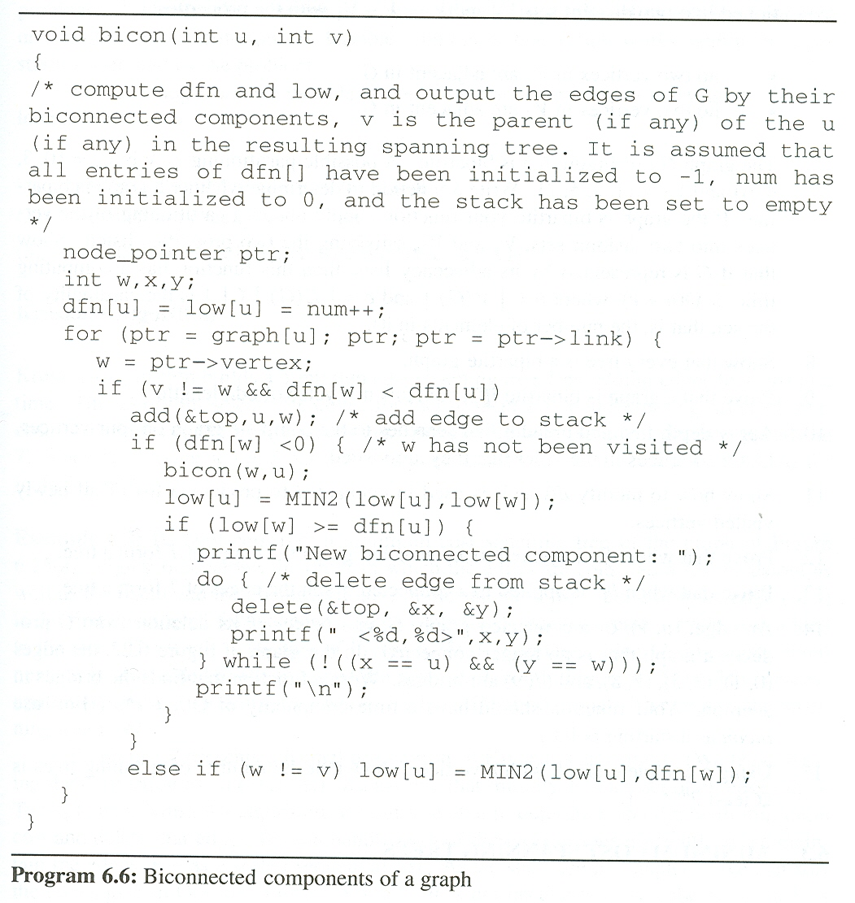
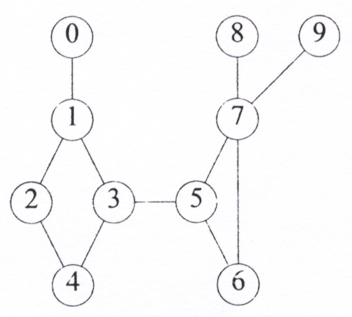
0
1
2
3
4
5
6
7
8
9
Find Biconnected components
dfn:
-1
-1
-1
-1
-1
-1
-1
-1
-1
-1
4
3
2
0
1
5
6
7
9
8
output:
<1, 0>
<1, 3>
<2, 1>
<4, 2>
<3, 4>
low:
-1
-1
-1
-1
-1
-1
-1
-1
4
3
7
0
2
0
-1
0
-1
0
5
6
1
5
5
9
8
<7, 9>
u:
3
<7, 8>
4
2
1
0
1
2
4
5
6
7
9
7
8
7
6
5
3
3
10
13
79
78
75
21
67
42
56
34
35
<7, 5>
<6, 7>
-1
-1
-1
3
4
2
1
2
4
3
3
5
6
7
6
7
6
5
v:
3
<5, 6>
w:
4
2
1
0
2
3
1
4
2
3
5
6
7
9
7
9
8
7
8
6
5
7
5
6
7
3
1
0
4
5
<3, 5>
back edge or not yet visited
num:
0
1
2
3
4
5
6
7
8
9
10
ptr
w is a child of u
(u, w) is a back edge

