Slide 1



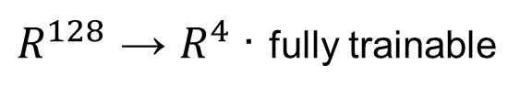
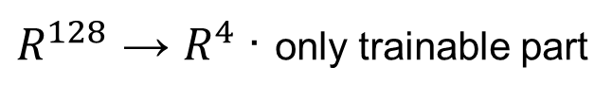
TRANSFER – linear probing
SCRATCH – baseline
PTB-XL (Source)
Chapman-Shaoxing (target)
100 Hz · 5 classes: NORM, MI, STTC, CD, HYP
100 Hz · 4 classes: AFIB, GSVT, SB, SR
train 3 encoders → 128-d
train 3 encoders → 128-d
freeze weights
Frozen encoder
backprop end-to-end
extract Chapman-Shaoxing embeddings
no_grad() · eval()
Encoder keeps training
What each encoder captures
gradients flow through every layer
random init
ResNet
LSTM
Transformer
Learns rhythm from scratch
No prior ECG knowledge.
Local morphology:
P, QRS, T shapes
Temporal sequence
RR intervals, rhythm
Global attention: CLS token collapses to source morphology
train head + encoder
train linear head only
Linear head
Encoder + head
$R^{128}$ → $R^{4}$· only trainable part
$R^{128}$ → $R^{4}$· fully trainable
Chapman-Shaoxing test set
compute F1 macro (per architecture)
Results
Table II & Fig. 2

