Slide 1
Методы эвристического планирования (2/…)
Алгоритм Дейкстры. Алгоритм эвристического поиска.

Slide 2

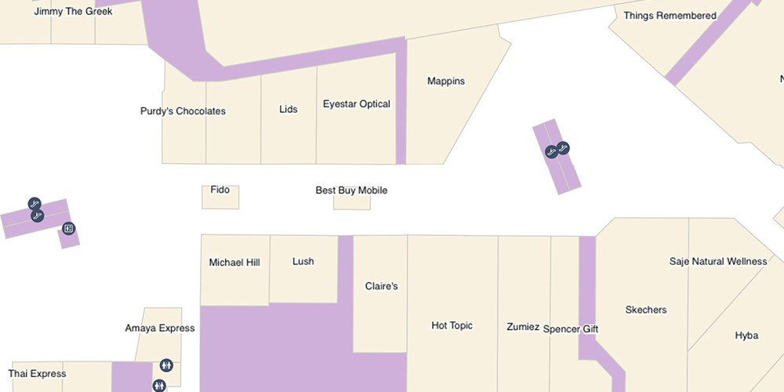
Планирование траектории
2
Текущее состояние
Последовательность действий (план)
Желаемое состояние
Робот в позиции (3, 7)
Робот в позиции (12, 2)

Slide 3
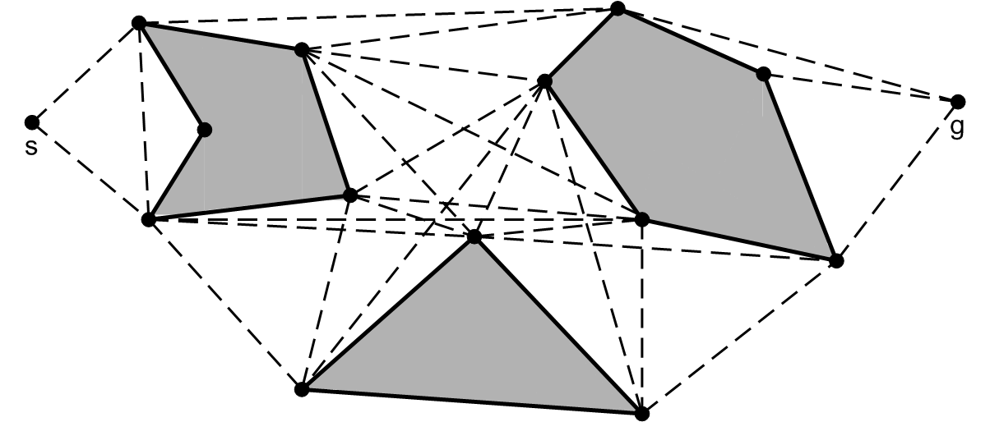
Планирование траектории как задача поиска пути на графе
3
Вершины ~ состояние робота (координаты положения на плоскости)
Ребра ~ действия (например – перемещения вдоль прямолинейных сегментов)
Веса ребер ~ количественно-выраженные свойства действий (например – длина перемещения, «опасность» перемещения и пр.)
План ~ путь (на графе)
Задача
Построить граф
Найти путь на графе

Slide 4
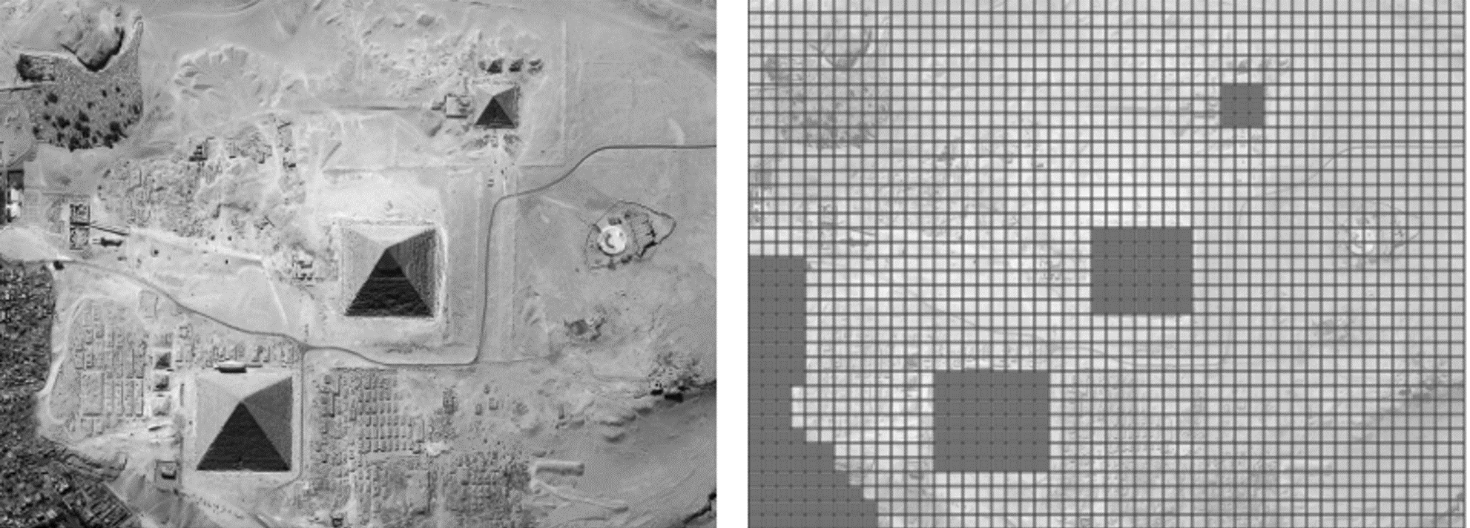
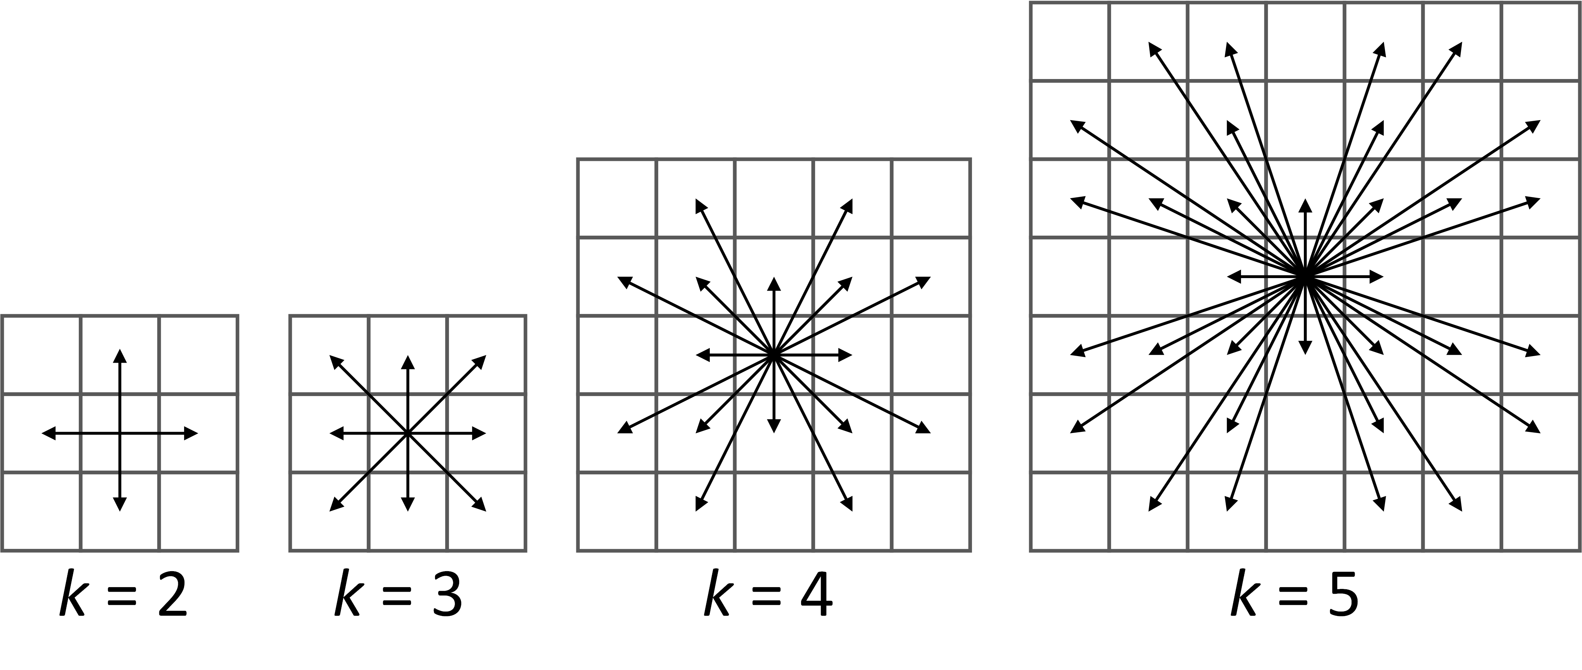
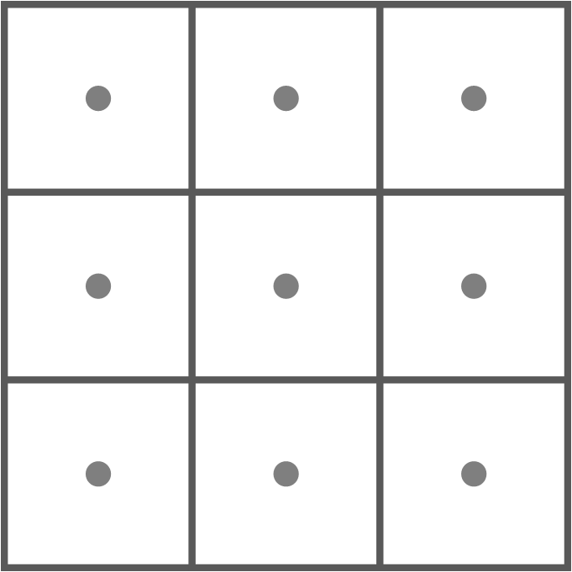
Grid – regular tessellation of the workspace
4
Cost
c_{hv}=1 c_{d} =√2
c_{hv}=1 c_{d} =1.4
c_{hv}=10 c_{d} =14
Vertices – centers of grid cells Each vertex is associated with (x, y) coordinate Each vertex is either blocked (1) or free (0)
Edges – 2^{k} segments connecting neighboring grid elements
Cost – Euclidean distance between the vertices
Vertices
Edges
r

Slide 5
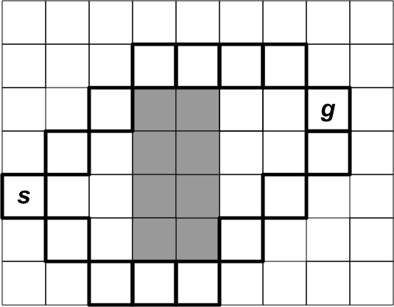
Path planning task
5
Path – sequence of adjacent traversable cells
Path cost
Least cost path
SP={π} – set of paths from a_{ij} to a_{lk}
π*∈SP – shortest path ⇔ c(π*)≤c(π) ∀π∈SP
Path planning task PTask=⟨Graph, start, goal⟩
Solution π (path from s to g)
Optimal solution π* (least cost path)
r

Slide 6
G*-value
6
g*(a) = c (π*(s, a))
Cost of a shortest path from the start vertex to the vertex a
30
28
86
r

Slide 7
G*-value
7
g*(a) = c (π*(s, a))
Cost of a shortest path from start vertex to the vertex a
?
20
10
24
10
28
10
14
14
10
10
14
24
10
10
10
10
14
10
14
10
10
10
10
20
What if all g*-values are known?
How to find a path from start to a selected vertex?
r

Slide 8
G*-value
8
g*(a) = c (π*(s, a))
Procedure GetPathFromG*Values()
a = goal (1)
path = a (2)
while (a≠start) (3)
a = argmin_{a’∈adj(a)}(g*(a’)+c(a’,a)) (4)
path = a + path (5)
20
10
24
10
28
10
14
14
10
10
14
24
10
10
10
10
14
10
14
10
10
10
10
20
What if all g*-values are known?
Path can be reconstructed by a simple back-propagating algorithm
r

Slide 9
G*-value
9
g*(a) = c (π*(s, a))
Not g*(a’), but g*(a’) + c(a’, a) !!!
Why?
Procedure GetPathFromG*Values()
a = g (1)
path = a (2)
while (a≠s) (3)
a = argmin_{a’∈adj(a)}(g*(a’)+c(a’,a)) (4)
path = a + path (5)
20
10
24
10
28
10
14
14
10
10
14
24
10
10
10
10
14
10
14
10
10
10
10
20
What if all g*-values are known?
Path can be reconstructed by a simple back-propagating algorithm
r

Slide 10
G*-value
10
g*(a) = c (π*(s, a))
Not g*(a’), but g*(a’) + c(a’, a) !!!
Why?
Procedure GetPathFromG*Values()
a = g (1)
path = a (2)
while (a≠s) (3)
a = argmin_{a’∈adj(a)}(g*(a’)+c(a’,a)) (4)
path = a + path (5)
20
10
24
10
28
10
14
20
10
10
14
24
10
10
10
10
14
10
14
10
10
10
10
20
What if all g*-values are known?
Path can be reconstructed by a simple back-propagating algorithm
r

Slide 11
G*-value
11
g*(a) = c (π*(s, a))
Not g*(a’), but g*(a’) + c(a’, a) !!!
Why?
Procedure GetPathFromG*Values()
a = g (1)
path = a (2)
while (a≠s) (3)
a = argmin_{a’∈adj(a)}(g*(a’)+c(a’,a)) (4)
path = a + path (5)
20
10
24
10
28
10
14
20
10
10
14
24
10
10
10
10
14
10
14
10
10
10
10
20
What if all g*-values are known?
Path can be reconstructed by a simple back-propagating algorithm
r

Slide 12
G*-value
12
g*(a) = c (π*(s, a))
Not g*(a’), but g*(a’) + c(a’, a) !!!
Why?
Procedure GetPathFromG*Values()
a = g (1)
path = a (2)
while (a≠s) (3)
a = argmin_{a’∈adj(a)}(g*(a’)+c(a’,a)) (4)
path = a + path (5)
20
10
24
10
28
10
14
20
10
10
14
24
10
10
10
10
14
10
14
10
10
10
10
20
What if all g*-values are known?
Path can be reconstructed by a simple back-propagating algorithm
Reconstructed path is not the least cost one
r

Slide 13
G*-value
13
g*(a) = c (π*(s, a))
Not g*(a’), but g*(a’) + c(a’, a) !!!
Why?
Procedure GetPathFromG*Values()
a = g (1)
path = a (2)
while (a≠s) (3)
a = argmin_{a’∈adj(a)}(g*(a’)+c(a’,a)) (4)
path = a + path (5)
20
10
24
10
28
10
14
20
10
10
14
24
10
10
10
10
14
10
14
10
10
10
10
20
What if all g*-values are known?
Path can be reconstructed by a simple back-propagating algorithm
That’s the least cost path
r

Slide 14
G*-value
14
g*(a) = c (π*(s, a))
Finding a path = estimating g*-values
20
10
24
10
28
10
14
20
10
10
14
24
10
10
10
10
14
10
14
10
10
10
10
20
What if all g*-values are known?
Path can be reconstructed by a simple back-propagating algorithm
r

Slide 15
Estimating G*-values: expansion
15
g*(a) is known for some a. What next?
?
?
10
24
10
?
10
14
14
10
10
?
?
10
10
?
10
14
10
14
10
10
?
10
?
How can we use g*(a) to compute other g*-values?
r

Slide 16
Estimating G*-values: expansion
16
g*(a) is known for some a. What next?
?
?
10
24
10
?
10
14
14
10
10
?
?
10
10
?
10
14
10
14
10
10
?
10
?
1. We can not use g*(a) to compute all other g*-values.
2. We can use g*(a) compute g*-values of the neighboring nodes.
2.1 Will these be true g*-values? => NOT necessarily. These are called g-values.
r

Slide 17
Estimating G*-values: expansion
17
g*(a) is known for some a. What next?
?
34
10
24
10
34
10
14
14
10
10
34
38
38
10
10
10
14
10
14
10
10
10
1. We can not use g*(a) to compute all other g*-values.
2. We can use g*(a) compute g*-values of the neighboring nodes.
2.1 Will these be true g*-values? => NOT necessarily. These are called g-values.
r

Slide 18
Estimating G*-values: expansion
18
g*(a) is known for some a. What next?
?
34
10
24
10
34
10
14
14
10
10
34
38
38
10
10
10
14
10
14
10
10
10
1. We can not use g*(a) to compute all other g*-values.
2. We can use g*(a) compute g*-values of the neighboring nodes.
2.1 Are the computed values true g*-values? => NOT necessarily. These are called g-values.
r

Slide 19
Estimating G*-values: expansion
19
Expansion – using g-value of the node to compute g-values of the Successors
ExpandNode(а) (1)
Forall а'∈GetSuccesors(а) do (2)
if g(а') > g(а) + c(а, а') (3)
g(а') = g(а) + c(а, а') (4)
34
10
24
10
34
10
14
14
10
10
34
38
38
10
10
10
14
10
14
10
10
10
1. We can not use g*(a) to compute all other g*-values.
2. We can use g*(a) compute g*-values of the neighboring nodes.
2.1 Are the computed values true g*-values? => NOT necessarily. These are called g-values.
r

Slide 20
Estimating G*-values: expansion
20
Expansion – using g-value of the node to compute g-values of the Successors
ExpandNode(а) (1)
Forall а'∈GetSuccesors(а) do (2)
if g(а') > g(а) + c(а, а') (3)
g(а') = g(а) + c(а, а') (4)
34
10
24
10
34
10
14
14
10
10
34
38
38
10
10
10
14
10
14
10
Successors = adjacent nodes
10
10
GetSuccessors(а) (1)
Succ = {} (2)
Forall а'∈Graph.GetAdjacentNodes(а) do (3)
Succ.Add(а') (4)
Return Succ (5)
r

Slide 21
Pathfinding = expansions
21
IDEA
Expand nodes systematically (= in some order)
Until g-values of all nodes converge to g*-values
Reconstruct a path using g*-values
r

Slide 22
Pathfinding = expansions
22
IDEA
Expand nodes systematically (= in some order)
Until g-values of all nodes converge to g*-values
Reconstruct a path using g*-values
OPEN questions
In which order?
Will g-values converge (can a guarantee be provided)?
Is it necessary to get all g*-values?
r

Slide 23
Pathfinding = expansions
23
IDEA
Expand nodes systematically (= in some order)
Until g-values of all nodes converge to g*-values
Reconstruct a path using g*-values
OPEN questions
In which order?
Will g-values converge (can a guarantee be provided)?
Is it necessary to get all g*-values?
Will this ordering lead to a desired result?
r

Slide 24
Pathfinding = expansions
24
IDEA
Expand nodes systematically (= in some order)
Until g-values of all nodes converge to g*-values
Reconstruct a path using g*-values
OPEN questions
In which order?
Will g-values converge (can a guarantee be provided)?
Is it necessary to get all g*-values?
Dikstra’s answer
In the order of ascending g-values
r

Slide 25
Systematic expansions
25
OPEN “list” = set of nodes that are candidates for an expansion
CLOSED “list” = nodes that have already been expanded
Add start-node to OPEN
Extract a node from OPEN
Expand it + update OPEN
Move to CLOSED
Repeat
Dikstra’s answer
In the order of ascending g-values
r

Slide 26
Systematic expansions
26
OPEN “list” = set of nodes that are candidates for an expansion
CLOSED “list” = nodes that have already been expanded
??? (Initial step)
Extract a node from OPEN
Expand it + update OPEN (how?)
Move to CLOSED
Repeat until ??? (termination condition)
Dikstra’s answer
In the order of ascending g-values
r

Slide 27
Systematic expansions
27
OPEN “list” = set of nodes that are candidates for an expansion
CLOSED “list” = nodes that have already been expanded
Add start-node to OPEN
Extract a node from OPEN
Expand it + update OPEN
Move to CLOSED
Repeat until ??? (termination condition)
Dikstra’s answer
In the order of ascending g-values
How to update?
r

Slide 28
Systematic expansions
28
OPEN “list” = set of nodes that are candidates for an expansion
CLOSED “list” = nodes that have already been expanded
Add start-node to OPEN
Extract a node from OPEN
Expand it + update OPEN
Move to CLOSED
Repeat until ??? (termination condition)
Dikstra’s answer
In the order of ascending g-values
How to update?
Add/update nodes with the decreased g-values
r

Slide 29
Systematic expansions
29
OPEN “list” = set of nodes that are candidates for an expansion
CLOSED “list” = nodes that have already been expanded
Add start-node to OPEN
Extract a node from OPEN
Expand it + update OPEN
Move to CLOSED
Repeat until OPEN is empty
Dikstra’s answer
In the order of ascending g-values
May be we can terminate earlier?
Will talk about this soon
r

Slide 30
Running example
30
1
2
3
Step 0
OPEN “list” = set of nodes that are candidates for an expansion
CLOSED “list” = nodes that have already been expanded
A
goal
B
C
0
Add start-node to OPEN
Extract a node from OPEN
Expand it + update OPEN
Move to CLOSED
Repeat until OPEN is empty
g(start) = 0
Open = {start)
Closed = {}
Under expansion:
r

Slide 31
Running example
31
1
2
3
Step 1
OPEN “list” = set of nodes that are candidates for an expansion
CLOSED “list” = nodes that have already been expanded
A
goal
B
10
C
0
Add start-node to OPEN
Extract a node from OPEN
Expand it + update OPEN
Move to CLOSED
Repeat until OPEN is empty
Open = {}
Closed = {}
Under expansion:
start
r

Slide 32
Running example
32
1
2
3
Step 1
OPEN “list” = set of nodes that are candidates for an expansion
CLOSED “list” = nodes that have already been expanded
A
goal
B
10
C
0
Add start-node to OPEN
Extract a node from OPEN
Expand it + update OPEN
Move to CLOSED
Repeat until OPEN is empty
Open = {B1}
Closed = {}
Under expansion:
start
r

Slide 33
Running example
33
1
2
3
Step 1
OPEN “list” = set of nodes that are candidates for an expansion
CLOSED “list” = nodes that have already been expanded
A
goal
B
10
14
C
0
Add start-node to OPEN
Extract a node from OPEN
Expand it + update OPEN
Move to CLOSED
Repeat until OPEN is empty
Open = {B1}
Closed = {}
Under expansion:
start
r

Slide 34
Running example
34
1
2
3
Step 1
OPEN “list” = set of nodes that are candidates for an expansion
CLOSED “list” = nodes that have already been expanded
A
goal
B
10
14
C
0
Add start-node to OPEN
Extract a node from OPEN
Expand it + update OPEN
Move to CLOSED
Repeat until OPEN is empty
Open = {B1, B2}
Closed = {}
Under expansion:
start
r

Slide 35
Running example
35
1
2
3
Step 1
OPEN “list” = set of nodes that are candidates for an expansion
CLOSED “list” = nodes that have already been expanded
A
goal
B
10
14
10
C
0
Add start-node to OPEN
Extract a node from OPEN
Expand it + update OPEN
Move to CLOSED
Repeat until OPEN is empty
Open = {B1, B2}
Closed = {}
Under expansion:
start
r

Slide 36
Running example
36
1
2
3
Step 1
OPEN “list” = set of nodes that are candidates for an expansion
CLOSED “list” = nodes that have already been expanded
A
goal
B
10
14
C
0
10
Add start-node to OPEN
Extract a node from OPEN
Expand it + update OPEN
Move to CLOSED
Repeat until OPEN is empty
Open = {B1, B2, C2}
Closed = {}
Under expansion:
start
r

Slide 37
Running example
37
1
2
3
Step 1
OPEN “list” = set of nodes that are candidates for an expansion
CLOSED “list” = nodes that have already been expanded
A
goal
B
10
14
C
0
10
Add start-node to OPEN
Extract a node from OPEN
Expand it + update OPEN
Move to CLOSED
Repeat until OPEN is empty
Open = {B1, B2, C2}
Closed = {start}
Under expansion:
r

Slide 38
Running example
38
1
2
3
Step 2
OPEN “list” = set of nodes that are candidates for an expansion
CLOSED “list” = nodes that have already been expanded
A
goal
B
10
14
C
0
10
Add start-node to OPEN
Extract a node from OPEN
Expand it + update OPEN
Move to CLOSED
Repeat until OPEN is empty
Open = {B1, B2, C2}
Closed = {start}
Under expansion: ???
r

Slide 39
Running example
39
1
2
3
Step 2
OPEN “list” = set of nodes that are candidates for an expansion
CLOSED “list” = nodes that have already been expanded
A
goal
B
10
14
C
0
10
Add start-node to OPEN
Extract a node from OPEN
Expand it + update OPEN
Move to CLOSED
Repeat until OPEN is empty
Open = {B2, C2}
Closed = {start}
Under expansion:
B1
r

Slide 40
Running example
40
1
2
3
Step 2
OPEN “list” = set of nodes that are candidates for an expansion
CLOSED “list” = nodes that have already been expanded
A
20
goal
B
10
14
C
0
10
Add start-node to OPEN
Extract a node from OPEN
Expand it + update OPEN
Move to CLOSED
Repeat until OPEN is empty
Open = {B2, C2}
Closed = {start}
Under expansion:
B1
r

Slide 41
Running example
41
1
2
3
Step 2
OPEN “list” = set of nodes that are candidates for an expansion
CLOSED “list” = nodes that have already been expanded
20
A
goal
B
10
14
C
0
10
Add start-node to OPEN
Extract a node from OPEN
Expand it + update OPEN
Move to CLOSED
Repeat until OPEN is empty
Open = {B2, C2, A1}
Closed = {start}
Under expansion:
B1
r

Slide 42
Running example
42
1
2
3
Step 2
OPEN “list” = set of nodes that are candidates for an expansion
CLOSED “list” = nodes that have already been expanded
20
A
24
goal
B
10
14
C
0
10
Add start-node to OPEN
Extract a node from OPEN
Expand it + update OPEN
Move to CLOSED
Repeat until OPEN is empty
Open = {B2, C2, A1}
Closed = {start}
Under expansion:
B1
r

Slide 43
Running example
43
1
2
3
Step 2
OPEN “list” = set of nodes that are candidates for an expansion
CLOSED “list” = nodes that have already been expanded
20
24
A
goal
B
10
14
C
0
10
Add start-node to OPEN
Extract a node from OPEN
Expand it + update OPEN
Move to CLOSED
Repeat until OPEN is empty
Open = {B2, C2, A1, A2}
Closed = {start}
Under expansion:
B1
r

Slide 44
Running example
44
1
2
3
Step 2
OPEN “list” = set of nodes that are candidates for an expansion
CLOSED “list” = nodes that have already been expanded
20
24
A
goal
20
B
10
14
C
0
10
Add start-node to OPEN
Extract a node from OPEN
Expand it + update OPEN
Move to CLOSED
Repeat until OPEN is empty
Open = {B2, C2, A1, A2}
Closed = {start}
Under expansion:
B1
r

Slide 45
Running example
45
1
2
3
Step 2
OPEN “list” = set of nodes that are candidates for an expansion
CLOSED “list” = nodes that have already been expanded
20
24
A
goal
B
10
14
C
0
10
Add start-node to OPEN
Extract a node from OPEN
Expand it + update OPEN
Move to CLOSED
Repeat until OPEN is empty
Open = {B2, C2, A1, A2}
Closed = {start}
Under expansion:
B1
r

Slide 46
Running example
46
1
2
3
Step 2
OPEN “list” = set of nodes that are candidates for an expansion
CLOSED “list” = nodes that have already been expanded
20
24
A
goal
B
10
14
24
C
0
10
Add start-node to OPEN
Extract a node from OPEN
Expand it + update OPEN
Move to CLOSED
Repeat until OPEN is empty
Open = {B2, C2, A1, A2}
Closed = {start}
Under expansion:
B1
r

Slide 47
Running example
47
1
2
3
Step 2
OPEN “list” = set of nodes that are candidates for an expansion
CLOSED “list” = nodes that have already been expanded
20
24
A
goal
B
10
14
C
0
10
Add start-node to OPEN
Extract a node from OPEN
Expand it + update OPEN
Move to CLOSED
Repeat until OPEN is empty
Open = {B2, C2, A1, A2}
Closed = {start}
Under expansion:
B1
r

Slide 48
Running example
48
1
2
3
Step 2
OPEN “list” = set of nodes that are candidates for an expansion
CLOSED “list” = nodes that have already been expanded
20
24
A
goal
B
10
14
20
C
0
10
Add start-node to OPEN
Extract a node from OPEN
Expand it + update OPEN
Move to CLOSED
Repeat until OPEN is empty
Open = {B2, C2, A1, A2}
Closed = {start}
Under expansion:
B1
r

Slide 49
Running example
49
1
2
3
Step 2
OPEN “list” = set of nodes that are candidates for an expansion
CLOSED “list” = nodes that have already been expanded
20
24
A
goal
B
10
14
C
0
10
Add start-node to OPEN
Extract a node from OPEN
Expand it + update OPEN
Move to CLOSED
Repeat until OPEN is empty
Open = {B2, C2, A1, A2}
Closed = {start}
Under expansion:
B1
r

Slide 50
Running example
50
1
2
3
Step 2
OPEN “list” = set of nodes that are candidates for an expansion
CLOSED “list” = nodes that have already been expanded
20
24
A
goal
B
10
14
C
0
10
Add start-node to OPEN
Extract a node from OPEN
Expand it + update OPEN
Move to CLOSED
Repeat until OPEN is empty
Open = {B2, C2, A1, A2}
Closed = {start, B1}
Under expansion:
r

Slide 51
Running example
51
1
2
3
Step 3
OPEN “list” = set of nodes that are candidates for an expansion
CLOSED “list” = nodes that have already been expanded
20
24
A
goal
B
10
14
C
0
10
Add start-node to OPEN
Extract a node from OPEN
Expand it + update OPEN
Move to CLOSED
Repeat until OPEN is empty
Open = {B2, A1, A2}
Closed = {start, B1}
Under expansion: ???
r

Slide 52
Running example
52
1
2
3
Step 3
OPEN “list” = set of nodes that are candidates for an expansion
CLOSED “list” = nodes that have already been expanded
20
24
A
goal
B
10
14
C
0
10
Add start-node to OPEN
Extract a node from OPEN
Expand it + update OPEN
Move to CLOSED
Repeat until OPEN is empty
Open = {B2, A1, A2}
Closed = {start, B1}
Under expansion: C2
r

Slide 53
Running example
53
1
2
3
Step 3
OPEN “list” = set of nodes that are candidates for an expansion
CLOSED “list” = nodes that have already been expanded
20
24
A
goal
B
10
14
C
0
10
Add start-node to OPEN
Extract a node from OPEN
Expand it + update OPEN
Move to CLOSED
Repeat until OPEN is empty
Open = {B2, A1, A2}
Closed = {start, B1}
Under expansion: C2
r

Slide 54
Running example
54
1
2
3
Step 3
OPEN “list” = set of nodes that are candidates for an expansion
CLOSED “list” = nodes that have already been expanded
20
24
A
goal
B
10
14
24
C
0
10
20
Add start-node to OPEN
Extract a node from OPEN
Expand it + update OPEN
Move to CLOSED
Repeat until OPEN is empty
Open = {B2, A1, A2, B3, C2}
Closed = {start, B1, C2}
Under expansion:
r

Slide 55
Running example
55
1
2
3
Step 4
OPEN “list” = set of nodes that are candidates for an expansion
CLOSED “list” = nodes that have already been expanded
20
24
A
goal
B
10
14
24
C
0
10
20
Add start-node to OPEN
Extract a node from OPEN
Expand it + update OPEN
Move to CLOSED
Repeat until OPEN is empty
Open = {B2, A1, A2, B3, C2}
Closed = {start, B1, C2}
Under expansion: ???
r

Slide 56
Running example
56
1
2
3
Step 4
OPEN “list” = set of nodes that are candidates for an expansion
CLOSED “list” = nodes that have already been expanded
20
24
A
goal
B
10
14
24
C
0
10
20
Add start-node to OPEN
Extract a node from OPEN
Expand it + update OPEN
Move to CLOSED
Repeat until OPEN is empty
Open = {B2, A1, A2, B3, C2}
Closed = {start, B1, C2}
Under expansion: B2
r

Slide 57
Running example
57
1
2
3
Step 4
OPEN “list” = set of nodes that are candidates for an expansion
CLOSED “list” = nodes that have already been expanded
20
24
28
A
goal
B
10
14
24
C
0
10
20
Add start-node to OPEN
Extract a node from OPEN
Expand it + update OPEN
Move to CLOSED
Repeat until OPEN is empty
Open = {B2, A1, A2, B3, C2}
Closed = {start, B1, C2, B2}
Under expansion:
r

Slide 58
Running example
58
1
2
3
Step 9
OPEN “list” = set of nodes that are candidates for an expansion
CLOSED “list” = nodes that have already been expanded
20
24
28
A
goal
B
10
14
24
C
0
10
20
Add start-node to OPEN
Extract a node from OPEN
Expand it + update OPEN
Move to CLOSED
Repeat until OPEN is empty
Open = {}
Closed = {start, B1, C2, B2, A1, C3, A2, B3, goal}
Under expansion:
r

Slide 59
Running example : Observations questions
59
1
2
3
Step 9
A
20
24
28
???
goal
B
10
14
24
C
0
10
20
Open = {}
Closed = {start, B1, C2, B2, A1, C3, A2, B3, goal}
Under expansion:
r

Slide 60
Running example : Observations questions
60
1
2
3
Step 9
A
20
24
28
g-values of the CLOSED nodes never decreased
Does this always hold?
goal
B
10
14
24
C
0
10
20
Open = {}
Closed = {start, B1, C2, B2, A1, C3, A2, B3, goal}
Under expansion:
r

Slide 61
Running example : Observations questions
61
1
2
3
Step 9
A
20
24
28
g-values of the CLOSED nodes never decreased
Does this always hold?
g-values of the OPEN nodes never decreased
Does this always hold?
goal
B
10
14
24
C
0
10
20
Open = {}
Closed = {start, B1, C2, B2, A1, C3, A2, B3, goal}
Under expansion:
r

Slide 62
Running example : Observations questions
62
1
2
3
Step 9
A
20
24
28
g-values of the CLOSED nodes never decreased
Does this always hold?
g-values of the OPEN nodes never decreased
Does this always hold?
# all nodes in the graph were expanded
Can we stop expansions earlier?
goal
B
10
14
24
C
0
10
20
Open = {}
Closed = {start, B1, C2, B2, A1, C3, A2, B3, goal}
Under expansion:
r

Slide 63
Running example : Observations questions
63
1
2
3
Step 9
A
20
24
28
g-values of the CLOSED nodes never decreased
Does this always hold?
g-values of the OPEN nodes never decreased
Does this always hold?
# all nodes in the graph were expanded
Can we stop expansions earlier?
goal
(Dijkstra) YES
B
10
14
24
C
0
10
20
Open = {}
Closed = {start, B1, C2, B2, A1, C3, A2, B3, goal}
Under expansion:
r

Slide 64
Running example : Observations questions
64
1
2
3
Step 9
A
20
24
28
g-values of the CLOSED nodes never decreased
Does this always hold?
g-values of the OPEN nodes never decreased
Does this always hold?
# all nodes in the graph were expanded
Can we stop expansions earlier?
goal
(Dijkstra) YES
B
10
14
24
C
0
10
20
Open = {}
Closed = {start, B1, C2, B2, A1, C3, A2, B3, goal}
Under expansion:
No nodes are RE-OPENED
r

Slide 65
Running example : Observations questions
65
1
2
3
Step 9
A
20
24
28
g-values of the CLOSED nodes never decreased
Does this always hold?
g-values of the OPEN nodes never decreased
Does this always hold?
# all nodes in the graph were expanded
Can we stop expansions earlier?
goal
(Dijkstra) YES
B
10
14
24
C
0
10
20
Open = {}
Closed = {start, B1, C2, B2, A1, C3, A2, B3, goal}
Under expansion:
No nodes are RE-OPENED
We can avoid some computations:
If the successor is in CLOSED => move on
r

Slide 66
Running example : Observations questions
66
1
2
3
Step 9
A
20
24
28
g-values of the CLOSED nodes never decreased
Does this always hold?
g-values of the OPEN nodes never decreased
Does this always hold?
# all nodes in the graph were expanded
Can we stop expansions earlier?
goal
(Dijkstra) YES
B
10
14
24
C
0
10
20
(Dijkstra) NO
Open = {}
Closed = {start, B1, C2, B2, A1, C3, A2, B3, goal}
Under expansion:
No nodes are RE-OPENED
We can avoid some computations:
If the successor is in CLOSED => move on
r

Slide 67
Running example : Observations questions
67
1
2
3
Step 9
A
20
24
28
g-values of the CLOSED nodes never decreased
Does this always hold?
g-values of the OPEN nodes never decreased
Does this always hold?
# all nodes in the graph were expanded
Can we stop expansions earlier?
goal
(Dijkstra) YES
B
10
14
24
C
0
10
20
(Dijkstra) NO
Open = {}
Closed = {start, B1, C2, B2, A1, C3, A2, B3, goal}
Under expansion:
No nodes are RE-OPENED
We can avoid some computations:
If the successor is in CLOSED => move on
It depends on the edge cost
r

Slide 68
Running example : Observations questions
68
1
2
3
Step 9
A
20
24
28
g-values of the CLOSED nodes never decreased
Does this always hold?
g-values of the OPEN nodes never decreased
Does this always hold?
# all nodes in the graph were expanded
Can we stop expansions earlier?
goal
(Dijkstra) YES
B
10
14
24
C
0
10
20
(Dijkstra) NO
Open = {}
Closed = {start, B1, C2, B2, A1, C3, A2, B3, goal}
Under expansion:
(Dijkstra) It depends
No nodes are RE-OPENED
We can avoid some computations:
If the successor is in CLOSED => move on
It depends on the edge cost
r

Slide 69
Running example : Observations questions
69
1
2
3
Step 9
A
20
24
28
g-values of the CLOSED nodes never decreased
Does this always hold?
g-values of the OPEN nodes never decreased
Does this always hold?
# all nodes in the graph were expanded
Can we stop expansions earlier?
goal
(Dijkstra) YES
B
10
14
24
C
0
10
20
(Dijkstra) NO
Open = {}
Closed = {start, B1, C2, B2, A1, C3, A2, B3, goal}
Under expansion:
(Dijkstra) It depends
No nodes are RE-OPENED
We can avoid some computations:
If the successor is in CLOSED => move on
It depends on the edge cost
If we need a shortest path between start and any node => NO
r

Slide 70
Running example : Observations questions
70
1
2
3
Step 9
A
20
24
28
g-values of the CLOSED nodes never decreased
Does this always hold?
g-values of the OPEN nodes never decreased
Does this always hold?
# all nodes in the graph were expanded
Can we stop expansions earlier?
goal
(Dijkstra) YES
B
10
14
24
C
0
10
20
(Dijkstra) NO
Open = {}
Closed = {start, B1, C2, B2, A1, C3, A2, B3, goal}
Under expansion:
(Dijkstra) It depends
No nodes are RE-OPENED
We can avoid some computations:
If the successor is in CLOSED => move on
It depends on the edge cost
If we need a shortest path between start and any node => NO
If we a need a shortest path between start and a fixed node => YES
r

Slide 71
Running example : Observations questions
71
1
2
3
Step 9
A
20
24
28
g-values of the CLOSED nodes never decreased
Does this always hold?
g-values of the OPEN nodes never decreased
Does this always hold?
# all nodes in the graph were expanded
Can we stop expansions earlier?
goal
(Dijkstra) YES
B
10
14
24
C
0
10
20
(Dijkstra) NO
Open = {}
Closed = {start, B1, C2, B2, A1, C3, A2, B3, goal}
Under expansion:
(Dijkstra) It depends
No nodes are RE-OPENED
We can avoid some computations:
If the successor is in CLOSED => move on
It depends on the edge cost
If we need a shortest path between start and any node => NO
If we a need a shortest path between start and a fixed node => YES (when to stop?)
r

Slide 72
Running example : Observations questions
72
1
2
3
Step 9
A
20
24
28
g-values of the CLOSED nodes never decreased
Does this always hold?
g-values of the OPEN nodes never decreased
Does this always hold?
# all nodes in the graph were expanded
Can we stop expansions earlier?
goal
(Dijkstra) YES
B
10
14
24
C
0
10
20
(Dijkstra) NO
Open = {}
Closed = {start, B1, C2, B2, A1, C3, A2, B3, goal}
Under expansion:
(Dijkstra) It depends
No nodes are RE-OPENED
We can avoid some computations:
If the successor is in CLOSED => move on
It depends on the edge cost
If we a need a shortest path between start and a fixed node => YES (when to stop?)
1. When goal is added to OPEN
2. When goal is expanded
r

Slide 73
Running example : Observations questions
73
1
2
3
Step 9
A
20
24
28
g-values of the CLOSED nodes never decreased
Does this always hold?
g-values of the OPEN nodes never decreased
Does this always hold?
# all nodes in the graph were expanded
Can we stop expansions earlier?
goal
(Dijkstra) YES
B
10
14
24
C
0
10
20
(Dijkstra) NO
Open = {}
Closed = {start, B1, C2, B2, A1, C3, A2, B3, goal}
Under expansion:
(Dijkstra) It depends
No nodes are RE-OPENED
We can avoid some computations:
If the successor is in CLOSED => move on
It depends on the edge cost
If we a need a shortest path between start and a fixed node => YES (when to stop?)
1. When goal is added to OPEN
2. When goal is expanded
r

Slide 74
Running example : Observations questions
74
1
2
3
Step 9
A
20
24
28
g-values of the CLOSED nodes never decreased
Does this always hold?
g-values of the OPEN nodes never decreased
Does this always hold?
# all nodes in the graph were expanded
Can we stop expansions earlier?
goal
(Dijkstra) YES
B
10
14
24
C
0
10
20
(Dijkstra) NO
Open = {}
Closed = {start, B1, C2, B2, A1, C3, A2, B3, goal}
Under expansion:
(Dijkstra) It depends
No nodes are RE-OPENED
We can avoid some computations:
If the successor is in CLOSED => move on
It depends on the edge cost
If we a need a shortest path between start and a fixed node => YES (when to stop?)
When goal is extracted from OPEN and is about to be expanded
r

Slide 75
Running example : Observations questions
75
1
2
3
Step 3
A
20
24
g-values of the OPEN nodes never decreased
Does this always hold?
(Dijkstra) NO
B
10
14
It depends on the edge cost
C
0
10
Open = {B2, A1, A2}
Closed = {start, B1}
Under expansion:
C2
r

Slide 76
Running example : Observations questions
76
1
2
3
Step 3
A
20
24
g-values of the OPEN nodes never decreased
Does this always hold?
(Dijkstra) NO
B
10
14
?
20
It depends on the edge cost
10
?
10
C
0
Open = {B2, A1, A2}
Closed = {start, B1}
Under expansion:
C2
r

Slide 77
Running example : Observations questions
77
1
2
3
Step 3
A
20
24
g-values of the OPEN nodes never decreased
Does this always hold?
(Dijkstra) NO
B
10
14
30
It depends on the edge cost
C
0
10
20
Open = {B2, A1, A2}
Closed = {start, B1, C2}
Under expansion:
g(B3)=30

Slide 78
Running example : Observations questions
78
1
2
3
Step 4
A
20
24
g-values of the OPEN nodes never decreased
Does this always hold?
(Dijkstra) NO
B
10
14
30
It depends on the edge cost
C
0
10
20
Open = {A1, A2}
Closed = {start, B1, C2}
Under expansion:
B2
g(B3)=30

Slide 79
Running example : Observations questions
79
1
2
3
Step 4
A
20
24
g-values of the OPEN nodes never decreased
Does this always hold?
14
(Dijkstra) NO
B
10
14
30
10
It depends on the edge cost
C
0
10
20
Open = {A1, A2, B3, C3}
Closed = {start, B1, C2}
Under expansion:
B2
g(B3)=30

Slide 80
Running example : Observations questions
80
1
2
3
Step 4
A
20
24
28
g-values of the OPEN nodes never decreased
Does this always hold?
(Dijkstra) NO
B
10
14
24
It depends on the edge cost
C
0
10
20
Open = {A1, A2}
Closed = {start, B1, C2}
Under expansion:
B2
g(B3)=24
g-value decreases

Slide 81
Running example : Observations questions
81
1
2
3
Step 4
A
20
24
28
g-values of the OPEN nodes never decreased
Does this always hold?
(Dijkstra) NO
B
10
14
24
It depends on the edge cost
C
0
10
20
Open = {A1, A2}
Closed = {start, B1, C2}
Under expansion:
B2
Not correct to terminate search when goal is added to OPEN
g(B3)=24
g-value decreases

Slide 82
Implementation questions?
82
What are OPEN and CLOSED? What to they contain?
Where g-values are stored?
r

Slide 83
Implementation questions?
83
What are OPEN and CLOSED? What to they contain?
Where g-values are stored?
Naïve answer:
g-value is the numeric field of the graph node
inCLOSED is the boolean field of the graph node
OPEN is a container that contains ‘copies’ of the graph nodes
r

Slide 84
Implementation questions?
84
What are OPEN and CLOSED? What to they contain?
Where g-values are stored?
More correct answer
Separate data structure – SearchNode
Each SearchNode corresponds to a considered graph node
SearchNode encapsulates all the data need for a search
OPEN and CLOSED “lists” are containers that contain SearchNodes
r

Slide 85
Implementation questions?
85
What are OPEN and CLOSED? What to they contain?
Where g-values are stored?
More correct answer
Separate data structure – SearchNode
Each SearchNode corresponds to a considered graph node
SearchNode encapsulates all the data need for a search
OPEN and CLOSED “lists” are containers that contain SearchNodes
SearchNode:
x
y
g-value
parent
r

Slide 86
Implementation questions?
86
What are OPEN and CLOSED? What to they contain?
Where g-values are stored?
More correct answer
Separate data structure – SearchNode
Each SearchNode corresponds to a considered graph node
SearchNode encapsulates all the data need for a search
OPEN and CLOSED “lists” are containers that contain SearchNodes
SearchNode:
x
y
g-value
parent
r
They are populated on-the-fly during the search

Slide 87
Path finding as tree search
87
1
2
3
Step 3
A
20
24
Expanded nodes
CLOSED
C1
goal
MoveUp
MoveRight
B
10
14
MoveUR
B1
B2
C2
C
0
10
MoveUp
MoveUR
Search frontier
OPEN
Open = {B2, A1, A2}
Closed = {start, B1}
Under expansion:
C2
A1
A2
Search tree = a collection of the search nodes

Slide 88
Path finding as tree search with Duplicate detection
88
C1
5
5
7
B1
B2
g=7
C2
g=5
5
7
Node under expansion
A1
g=12
A2
g=10

Slide 89
Path finding as tree search with Duplicate detection
89
C1
5
5
7
B1
B2
g=7
C2
g=5
5
7
4
Path of a better cost: 7+4 < 5 + 7
A1
g=12
A2
g=10

Slide 90
Path finding as tree search with Duplicate detection
90
C1
5
5
7
B1
B2
g=7
C2
g=5
5
7
4
Path of a better cost: 7+4 < 5 + 7
A1
g=11
A2
g=10

Slide 91
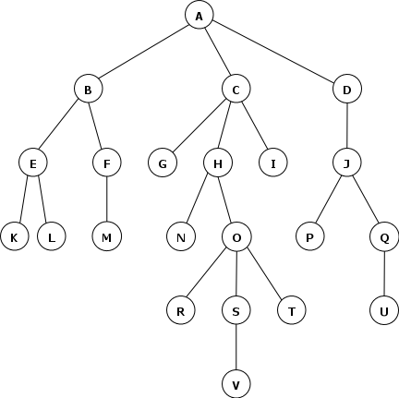
Path finding as tree search with Duplicate detection
91
5
5
5
3
2
3
5
10
3
1
CLOSED part of the search tree
Cost level: 5
Cost level: 7
Cost level: 8
Cost level: 10
etc.

Slide 92
QUiz
92
DIJKSTRA pseudo-code
r

Slide 93
DIJKSTRA pseudo-code
93
DijkstraSearch()
(01) Generate node s_{start} with g(s_{start}) := 0 and bp(s_{start}) := ∅
(02) OPEN := {s_{start}}
(03) CLOSED := ∅
(04) While (OPEN ≠ ∅)
(05) s := argmin_{s∈OPEN} g(s)
(06) OPEN := OPEN \ {s}
(07) CLOSED := CLOSED ∪ {s}
(08) if s corresponds to goal location
(09) return GetPathFromBackPointers(CLOSED)
//All the needed nodes are in CLOSED so far
(10) foreach s' ∈ adj(s) //here s is graph vertex, not node
(11) if node corresponding s' to have not been generated
(12) generate s' with g(s') := g(s) + c(s, s') and bp(s') := s
(13) insert s' into OPEN
(14) else //s' is either in OPEN or in CLOSED
(15) if g(s') > g(s) + c(s, s')
(16) g(s')=g(s) + c(s, s')
(17) update s' in OPEN
(18) return path not found
r

Slide 94
DIJKSTRA pseudo-code
94
DijkstraSearch()
(01) Generate node s_{start} with g(s_{start}) := 0 and bp(s_{start}) := ∅
(02) OPEN := {s_{start}}
(03) CLOSED := ∅
(04) While (OPEN ≠ ∅)
(05) s := argmin_{s∈OPEN} g(s)
(06) OPEN := OPEN \ {s}
(07) CLOSED := CLOSED ∪ {s}
(08) if s corresponds to goal location
(09) return GetPathFromBackPointers(CLOSED)
//All the needed nodes are in CLOSED so far
(10) foreach s' ∈ adj(s) //here s is graph vertex, not node
(11) if node corresponding s' to have not been generated
(12) generate s' with g(s') := g(s) + c(s, s') and bp(s') := s
(13) insert s' into OPEN
(14) else //s' is either in OPEN or in CLOSED
(15) if g(s') > g(s) + c(s, s')
(16) g(s')=g(s) + c(s, s')
(17) update s' in OPEN
(18) return path not found
We can modify this, taking into account that CLOSED contains nodes with their g-values equal to g*-values (i.e. g-values can not be lowered down)
r

Slide 95
DIJKSTRA pseudo-code
95
DijkstraSearch()
(01) Generate node s_{start} with g(s_{start}) := 0 and bp(s_{start}) := ∅
(02) OPEN := {s_{start}}
(03) CLOSED := ∅
(04) While (OPEN ≠ ∅)
(05) s := argmin_{s∈OPEN} g(s)
(06) OPEN := OPEN \ {s}
(07) CLOSED := CLOSED ∪ {s}
(08) if s corresponds to goal location
(09) return GetPathFromBackPointers(CLOSED)
//All the needed nodes are in CLOSED so far
(10) foreach s' ∈ adj(s) //here s is graph vertex, not node
(11) if node corresponding s' to have not been generated
(12) generate s' with g(s') := g(s) + c(s, s') and bp(s') := s
(13) insert s' into OPEN
(14) else //s' is either in OPEN or in CLOSED
(15) if s’ ∉ CLOSED and g(s') > g(s) + c(s, s')
(16) g(s')=g(s) + c(s, s')
(17) update s' in OPEN
(18) return path not found
We can modify this, taking into account that CLOSED contains nodes with their g-values equal to g*-values (i.e. g-values can not be lowered down)
r
If s’ is in CLOSED – continue

Slide 96
Dijkstra properties
96
Sound
the returned solution is a valid path
Complete
it returns a solution iff one exists
it returns “failure” iff no solution exists
Optimal
The cost of the solution is minimal
r

Slide 97
What’s wrong with dijkstra
97
???
r

Slide 98
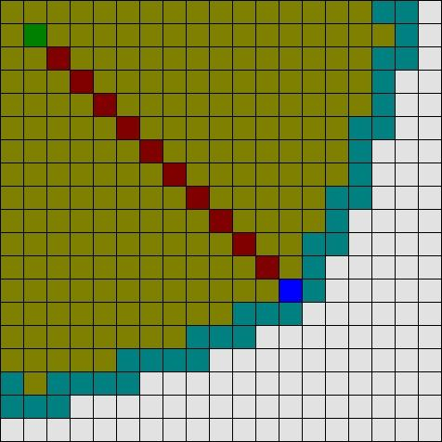
What’s wrong with dijkstra
98
Number of expansions (=steps, =time, =memory) can be large
Can we lower down the number of expanded nodes?
And still provide guarantees of completeness/optimality?
r

Slide 99
Focusing the search with heuristics
99
f(s) = g(s) + h(s)
g(s) – cost from start to s h(s) – estimate of the cost from s to goal
This cost is computed by the search algorithm
It is updated as search goes on
This is an educated guess
It is NOT (typically) updated as search goes on
s
start
goal
r

Slide 100
Focusing the search with heuristics
100
f(s) = g(s) + h(s)
g(s) – cost from start to s h(s) – estimate of the cost from s to goal
This cost is computed by the search algorithm
It is updated as search goes on
This is an educated guess
It is NOT (typically) updated as search goes on
s
start
goal
f(s) is the approximate cost of reaching goal from start via s
HEURISTIC SEARCH:
On each iteration choose a node that minimizes f(s) not g(s)
r

Slide 101
HS pseudocode pseudo-code
101
HeuristicSearch()
(01) Generate node s_{start} with g(s_{start}) := 0 and bp(s_{start}) := ∅
(02) OPEN := {s_{start}}
(03) CLOSED := ∅
(04) While (OPEN ≠ ∅)
(05) s := argmin_{s∈OPEN} (g(s) + h(s))
(06) OPEN := OPEN \ {s}
(07) CLOSED := CLOSED ∪ {s}
(08) if s corresponds to goal location
(09) return GetPathFromBackPointers(CLOSED)
//All the needed nodes are in CLOSED so far
(10) foreach s' ∈ adj(s) //here s is graph vertex, not node
(11) if node corresponding s' to have not been generated
(12) generate s' with g(s') := g(s) + c(s, s') and bp(s') := s
(13) insert s' into OPEN
(14) else //s' is either in OPEN or in CLOSED
(15) if s’ ∉ CLOSED and g(s') > g(s) + c(s, s')
(16) g(s')=g(s) + c(s, s')
(17) update s' in OPEN
(18) return path not found
r

Slide 102
HS pseudocode pseudo-code
102
HeuristicSearch()
(01) Generate node s_{start} with g(s_{start}) := 0 and bp(s_{start}) := ∅
(02) OPEN := {s_{start}}
(03) CLOSED := ∅
(04) While (OPEN ≠ ∅)
(05) s := argmin_{s∈OPEN} (g(s) + h(s))
(06) OPEN := OPEN \ {s}
(07) CLOSED := CLOSED ∪ {s}
(08) if s corresponds to goal location
(09) return GetPathFromBackPointers(CLOSED)
//All the needed nodes are in CLOSED so far
(10) foreach s' ∈ adj(s) //here s is graph vertex, not node
(11) if node corresponding s' to have not been generated
(12) generate s' with g(s') := g(s) + c(s, s') and bp(s') := s
(13) insert s' into OPEN
(14) else //s' is either in OPEN or in CLOSED
(15) if s’ ∉ CLOSED and g(s') > g(s) + c(s, s')
(16) g(s')=g(s) + c(s, s')
(17) update s' in OPEN
(18) return path not found
Really? Is that the only difference?
Does it make any change?
r

Slide 103
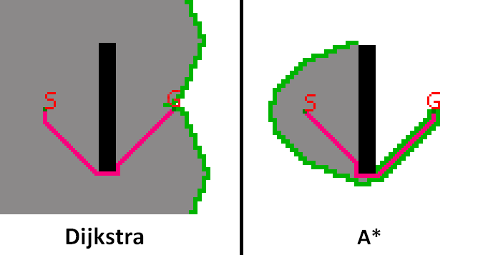
HS pseudocode pseudo-code
103
HeuristicSearch()
(01) Generate node s_{start} with g(s_{start}) := 0 and bp(s_{start}) := ∅
(02) OPEN := {s_{start}}
(03) CLOSED := ∅
(04) While (OPEN ≠ ∅)
(05) s := argmin_{s∈OPEN} (g(s) + h(s))
(06) OPEN := OPEN \ {s}
(07) CLOSED := CLOSED ∪ {s}
(08) if s corresponds to goal location
(09) return GetPathFromBackPointers(CLOSED)
//All the needed nodes are in CLOSED so far
(10) foreach s' ∈ adj(s) //here s is graph vertex, not node
(11) if node corresponding s' to have not been generated
(12) generate s' with g(s') := g(s) + c(s, s') and bp(s') := s
(13) insert s' into OPEN
(14) else //s' is either in OPEN or in CLOSED
(15) if s’ ∉ CLOSED and g(s') > g(s) + c(s, s')
(16) g(s')=g(s) + c(s, s')
(17) update s' in OPEN
(18) return path not found
Really? Is that the only difference?
Does it make any change?
Yes it does
No heuristic is used
“Good” heuristic is used
=>
Less steps (faster)
Same result
r

Slide 104
HS pseudocode pseudo-code
104
HeuristicSearch()
(01) Generate node s_{start} with g(s_{start}) := 0 and bp(s_{start}) := ∅
(02) OPEN := {s_{start}}
(03) CLOSED := ∅
(04) While (OPEN ≠ ∅)
(05) s := argmin_{s∈OPEN} (g(s) + h(s))
(06) OPEN := OPEN \ {s}
(07) CLOSED := CLOSED ∪ {s}
(08) if s corresponds to goal location
(09) return GetPathFromBackPointers(CLOSED)
//All the needed nodes are in CLOSED so far
(10) foreach s' ∈ adj(s) //here s is graph vertex, not node
(11) if node corresponding s' to have not been generated
(12) generate s' with g(s') := g(s) + c(s, s') and bp(s') := s
(13) insert s' into OPEN
(14) else //s' is either in OPEN or in CLOSED
(15) if s’ ∉ CLOSED and g(s') > g(s) + c(s, s')
(16) g(s')=g(s) + c(s, s')
(17) update s' in OPEN
(18) return path not found
Really? Is that the only difference?
Does it make any change?
Yes it does
No heuristic is used
“Good” heuristic is used
=>
Less steps (faster)
Same result
“Good” ???
r

Slide 105
To be continued
105

