Slide 1
Методы эвристического планирования (3/…)
Алгоритм A*
Основные свойства эвристических функций

Slide 2

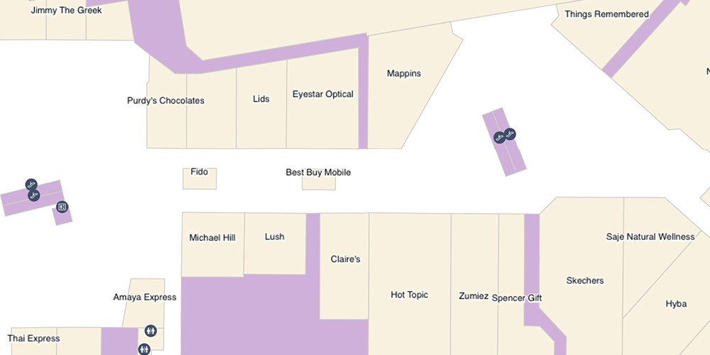
Планирование траектории
2
Текущее состояние
Последовательность действий (план)
Желаемое состояние
Робот в позиции (3, 7)
Робот в позиции (12, 2)

Slide 3
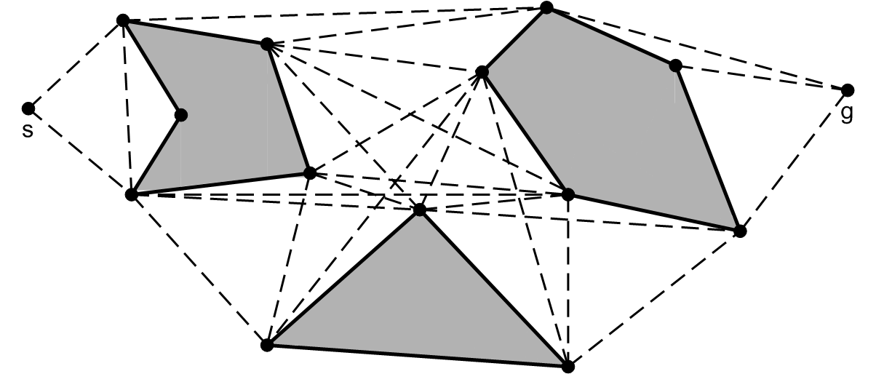
Планирование траектории как задача поиска пути на графе
3
Вершины ~ состояние робота (координаты положения на плоскости)
Ребра ~ действия (например – перемещения вдоль прямолинейных сегментов)
Веса ребер ~ количественно-выраженные свойства действий (например – длина перемещения, «опасность» перемещения и пр.)
План ~ путь (на графе)
Задача
Построить граф
Найти путь на графе

Slide 4
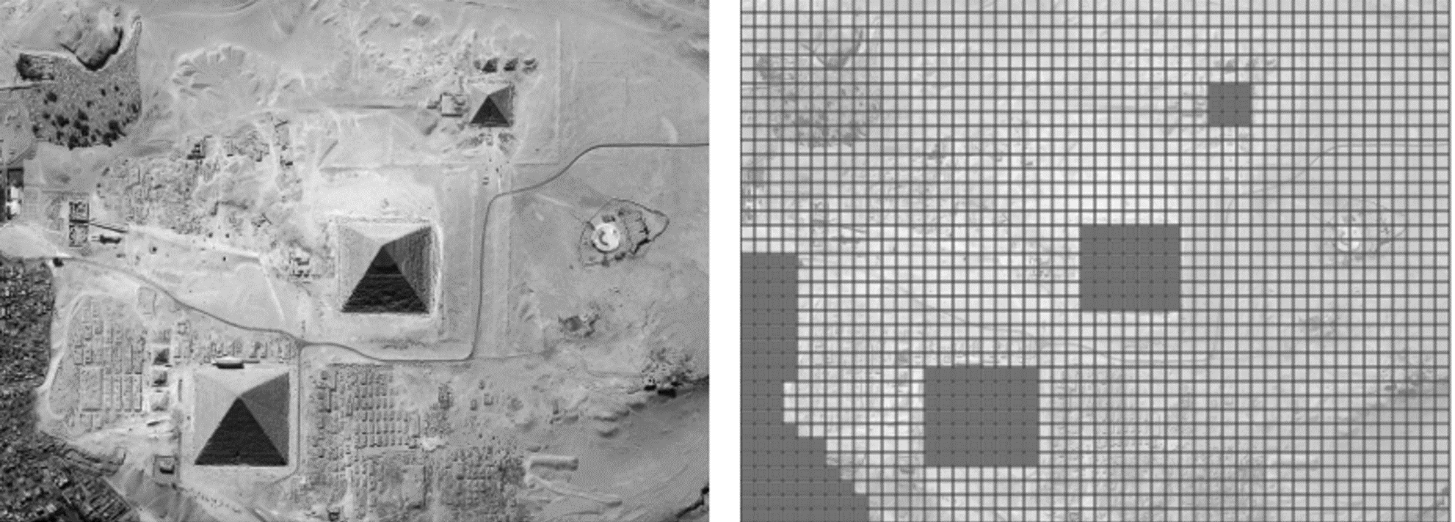
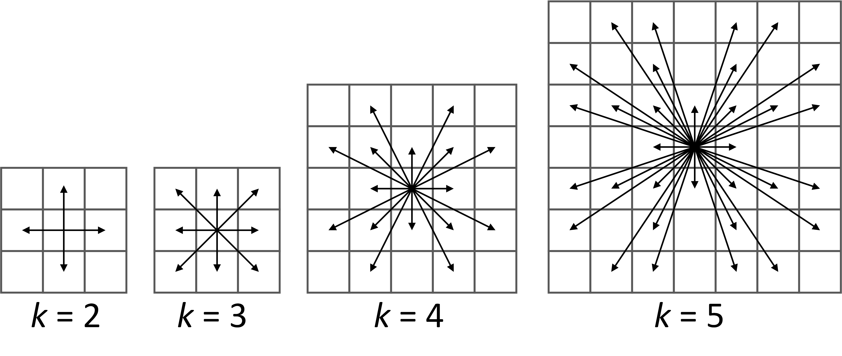
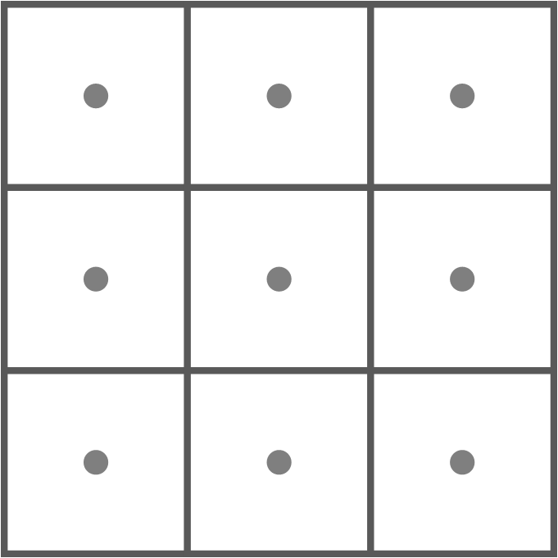
Grid – regular tessellation of the workspace
4
Cost
c_{hv}=1 c_{d} =√2
c_{hv}=1 c_{d} =1.4
c_{hv}=10 c_{d} =14
Vertices – centers of grid cells Each vertex is associated with (x, y) coordinate Each vertex is either blocked (1) or free (0)
Edges – 2^{k} segments connecting neighboring grid elements
Cost – Euclidean distance between the vertices
Vertices
Edges
r

Slide 5
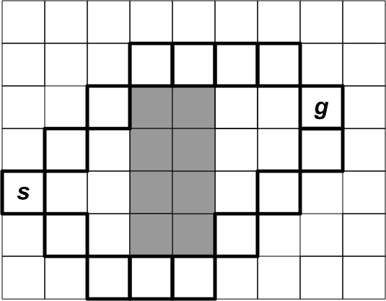
Path planning task
5
Path – sequence of adjacent traversable cells
Path cost
Least cost path
SP={π} – set of paths from a_{ij} to a_{lk}
π*∈SP – shortest path ⇔ c(π*)≤c(π) ∀π∈SP
Path planning task PTask=⟨Graph, start, goal⟩
Solution π (path from s to g)
Optimal solution π* (least cost path)
r

Slide 6
G*-value
6
g*(a) = c (π*(s, a))
Cost of a shortest path from the start vertex to the vertex a
30
28
86
r

Slide 7
Estimating G*-values: expansion
7
Expansion – using g-value of the node to compute g-values of the Successors
ExpandNode(а) (1)
Forall а'∈GetSuccesors(а) do (2)
if g(а') > g(а) + c(а, а') (3)
g(а') = g(а) + c(а, а') (4)
34
10
24
10
34
10
14
14
10
10
34
38
38
10
10
10
14
10
14
10
10
10
1. We can not use g*(a) to compute all other g*-values.
2. We can use g*(a) compute g*-values of the neighboring nodes.
2.1 Are the computed values true g*-values? => NOT necessarily. These are called g-values.
r

Slide 8
Systematic expansions
8
OPEN “list” = set of nodes that are candidates for an expansion
CLOSED “list” = nodes that have already been expanded
Add start-node to OPEN
Extract a node from OPEN
Expand it + update OPEN
Move to CLOSED
Repeat until goal node is expanded
Dikstra’s
In the order of ascending g-values
Add/update nodes with the decreased g-values
r

Slide 9
Search tree
9
1
2
3
Step 3
A
20
24
Expanded nodes
CLOSED
C1
goal
MoveUp
MoveRight
B
10
14
MoveUR
B1
B2
C2
C
0
10
MoveUp
MoveUR
Search frontier
OPEN
Open = {B2, A1, A2}
Closed = {start, B1}
Under expansion:
C2
A1
A2
Search tree = a collection of the generated (explored) search nodes

Slide 10
Path finding as tree search with Duplicate detection
10
C1
5
5
7
B1
B2
g=7
C2
g=5
5
7
Node under expansion
A1
g=12
A2
g=10

Slide 11
Path finding as tree search with Duplicate detection
11
C1
5
5
7
B1
B2
g=7
C2
g=5
5
7
4
Path of a better cost: 7+4 < 5 + 7
A1
g=12
A2
g=10

Slide 12
Path finding as tree search with Duplicate detection
12
C1
5
5
7
B1
B2
g=7
C2
g=5
5
7
4
Path of a better cost: 7+4 < 5 + 7
A1
g=11
A2
g=10

Slide 13
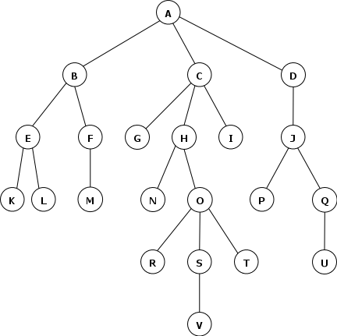
Path finding as tree search with Duplicate detection
13
0
CLOSED part of the search tree
g-values = g*-values = true shortest paths (will never decrease any more)
3
4
5
3
5
4
2
4
3
5
10
3
5
8
10
15
7
OPEN part of the search tree
g-values may decrease (new paths of better costs might be found)
7
2
3
7
8
Not yet generated nodes = not explored part of the search space

Slide 14
DIJKSTRA pseudo-code
14
DijkstraSearch()
(01) Generate node s_{start} with g(s_{start}) := 0 and bp(s_{start}) := ∅
(02) OPEN := {s_{start}}
(03) CLOSED := ∅
(04) While (OPEN ≠ ∅)
(05) s := argmin_{s∈OPEN} g(s)
(06) OPEN := OPEN \ {s}
(07) CLOSED := CLOSED ∪ {s}
(08) if s corresponds to goal location
(09) return GetPathFromBackPointers(CLOSED)
//All the needed nodes are in CLOSED so far
(10) foreach s' ∈ adj(s) //here s is graph vertex, not node
(11) if node corresponding s' to have not been generated
(12) generate s' with g(s') := g(s) + c(s, s') and bp(s') := s
(13) insert s' into OPEN
(14) else //s' is either in OPEN or in CLOSED
(15) if s’ ∉ CLOSED and g(s') > g(s) + c(s, s')
(16) g(s')=g(s) + c(s, s')
(17) update s' in OPEN
(18) return path not found
We can modify this, taking into account that CLOSED contains nodes with their g-values equal to g*-values (i.e. g-values can not be lowered down)
r
If s’ is in CLOSED – continue

Slide 15
Dijkstra properties
15
Sound
the returned solution is a valid path
Complete
it returns a solution iff one exists
it returns “failure” iff no solution exists
Optimal
The cost of the solution is minimal
r

Slide 16
What’s wrong with dijkstra
16
???
r

Slide 17
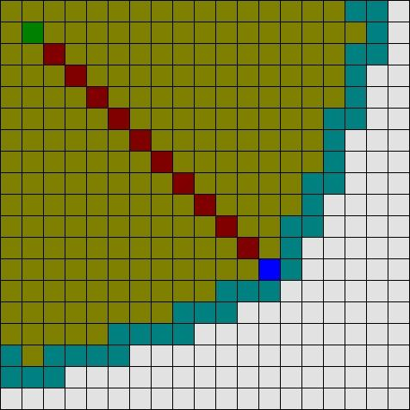
What’s wrong with dijkstra
17
Number of expansions (=steps, =time, =memory) can be large
Can we lower down the number of expanded nodes?
And still provide guarantees of completeness/optimality?
r

Slide 18
Focusing the search with heuristics
18
f(s) = g(s) + h(s)
g(s) – cost from start to s h(s) – estimate of the cost from s to goal
This cost is computed by the search algorithm
It is updated as search goes on
This is an educated guess
It is NOT (typically) updated as search goes on
s
start
goal
r

Slide 19
Focusing the search with heuristics
19
f(s) = g(s) + h(s)
g(s) – cost from start to s h(s) – estimate of the cost from s to goal
This cost is computed by the search algorithm
It is updated as search goes on
This is an educated guess
It is NOT (typically) updated as search goes on
s
start
goal
f(s) is the approximate cost of reaching goal from start via s
HEURISTIC SEARCH:
On each iteration choose a node that minimizes f(s) not g(s)
r

Slide 20
HS pseudocode pseudo-code
20
HeuristicSearch()
(01) Generate node s_{start} with g(s_{start}) := 0 and bp(s_{start}) := ∅
(02) OPEN := {s_{start}}
(03) CLOSED := ∅
(04) While (OPEN ≠ ∅)
(05) s := argmin_{s∈OPEN} (g(s) + h(s))
(06) OPEN := OPEN \ {s}
(07) CLOSED := CLOSED ∪ {s}
(08) if s corresponds to goal location
(09) return GetPathFromBackPointers(CLOSED)
//All the needed nodes are in CLOSED so far
(10) foreach s' ∈ adj(s) //here s is graph vertex, not node
(11) if node corresponding s' to have not been generated
(12) generate s' with g(s') := g(s) + c(s, s') and bp(s') := s
(13) insert s' into OPEN
(14) else //s' is either in OPEN or in CLOSED
(15) if s’ ∉ CLOSED and g(s') > g(s) + c(s, s')
(16) g(s')=g(s) + c(s, s')
(17) update s' in OPEN
(18) return path not found
r

Slide 21
HS pseudocode pseudo-code
21
HeuristicSearch()
(01) Generate node s_{start} with g(s_{start}) := 0 and bp(s_{start}) := ∅
(02) OPEN := {s_{start}}
(03) CLOSED := ∅
(04) While (OPEN ≠ ∅)
(05) s := argmin_{s∈OPEN} (g(s) + h(s))
(06) OPEN := OPEN \ {s}
(07) CLOSED := CLOSED ∪ {s}
(08) if s corresponds to goal location
(09) return GetPathFromBackPointers(CLOSED)
//All the needed nodes are in CLOSED so far
(10) foreach s' ∈ adj(s) //here s is graph vertex, not node
(11) if node corresponding s' to have not been generated
(12) generate s' with g(s') := g(s) + c(s, s') and bp(s') := s
(13) insert s' into OPEN
(14) else //s' is either in OPEN or in CLOSED
(15) if s’ ∉ CLOSED and g(s') > g(s) + c(s, s')
(16) g(s')=g(s) + c(s, s')
(17) update s' in OPEN
(18) return path not found
Really? Is that the only difference?
Does it make any change?
r

Slide 22
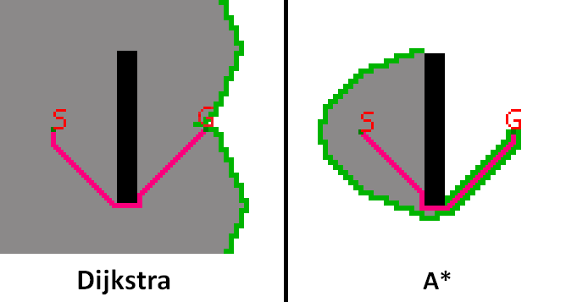
HS pseudocode pseudo-code
22
HeuristicSearch()
(01) Generate node s_{start} with g(s_{start}) := 0 and bp(s_{start}) := ∅
(02) OPEN := {s_{start}}
(03) CLOSED := ∅
(04) While (OPEN ≠ ∅)
(05) s := argmin_{s∈OPEN} (g(s) + h(s))
(06) OPEN := OPEN \ {s}
(07) CLOSED := CLOSED ∪ {s}
(08) if s corresponds to goal location
(09) return GetPathFromBackPointers(CLOSED)
//All the needed nodes are in CLOSED so far
(10) foreach s' ∈ adj(s) //here s is graph vertex, not node
(11) if node corresponding s' to have not been generated
(12) generate s' with g(s') := g(s) + c(s, s') and bp(s') := s
(13) insert s' into OPEN
(14) else //s' is either in OPEN or in CLOSED
(15) if s’ ∉ CLOSED and g(s') > g(s) + c(s, s')
(16) g(s')=g(s) + c(s, s')
(17) update s' in OPEN
(18) return path not found
Really? Is that the only difference?
Does it make any change?
Yes it does
No heuristic is used
“Good” heuristic is used
=>
Less steps (faster)
Same result
r

Slide 23
HS pseudocode pseudo-code
23
HeuristicSearch()
(01) Generate node s_{start} with g(s_{start}) := 0 and bp(s_{start}) := ∅
(02) OPEN := {s_{start}}
(03) CLOSED := ∅
(04) While (OPEN ≠ ∅)
(05) s := argmin_{s∈OPEN} (g(s) + h(s))
(06) OPEN := OPEN \ {s}
(07) CLOSED := CLOSED ∪ {s}
(08) if s corresponds to goal location
(09) return GetPathFromBackPointers(CLOSED)
//All the needed nodes are in CLOSED so far
(10) foreach s' ∈ adj(s) //here s is graph vertex, not node
(11) if node corresponding s' to have not been generated
(12) generate s' with g(s') := g(s) + c(s, s') and bp(s') := s
(13) insert s' into OPEN
(14) else //s' is either in OPEN or in CLOSED
(15) if s’ ∉ CLOSED and g(s') > g(s) + c(s, s')
(16) g(s')=g(s) + c(s, s')
(17) update s' in OPEN
(18) return path not found
Really? Is that the only difference?
Does it make any change?
Yes it does
No heuristic is used
“Good” heuristic is used
=>
Less steps (faster)
Same result
“Good” ???
r

Slide 24
Magic oracle heuristic
24
0
3
4
CLOSED
5
3
5
4
2
4
3
5
10
3
h(s) = h*(s)
{true cost of the shortest path from s to goal}
5
7
8
10
15
7
h(J)=15
F(J)=7+15 =22
2
3
4
7
7
8
OPEN
4
8
h(H)=11
F(H)=10+11= 21
3
Same node
Not yet generated nodes
goal

Slide 25
Magic oracle heuristic
25
0
h(s) = h*(s)
{true cost of the shortest path from s to goal}
3
4
CLOSED
5
3
5
4
2
4
3
5
10
3
h(J)=15
F(J)=7+15
5
7
8
10
15
7
h(J)=15
F(J)=7+15 =22
2
3
4
7
7
8
The search
i) guarantees finding the shortest path ii) expands only the nodes that lie on the shortest path
OPEN
4
8
h(H)=11
F(H)=10+11
h(H)=11
F(H)=10+11= 21
3
Same node
Not yet generated nodes
goal

Slide 26
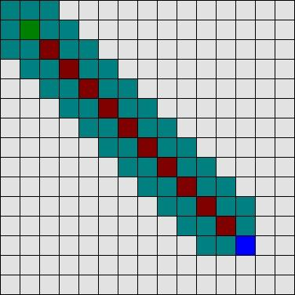
Magic oracle heuristic
26
h(s) = h*(s)
{true cost of the shortest path from s to goal}
The search
i) guarantees finding the shortest path ii) expands only the nodes that lie on the shortest path
Dijkstra

Slide 27
Admissible heuristic
27
h(s) = h*(s) {true cost of the shortest path from s to goal}
The search i) guarantees finding the shortest path ii) expands only the nodes that lie on the shortest path
h(s) ? h*(s) admissible heuristic
The search guarantees finding the shortest path
≠ < > ≤ ≥

Slide 28
Admissible heuristic
28
h(s) = h*(s) {true cost of the shortest path from s to goal}
The search i) guarantees finding the shortest path ii) expands only the nodes that lie on the shortest path
h(s) ≤ h*(s) admissible heuristic
The search guarantees finding the shortest path
Admissible heuristic = never overestimates the cost-to-go

Slide 29
Admissible heuristic vs state re-expansions
29
h(s) = 0 {Dijkstra}
The search i) guarantees finding the shortest path ii) never re-expands a state (=states in CLOSED have g(s)=g*(s)
h(s) ≤ h*(s) admissible heuristic
The search i) guarantees finding the shortest path ii) never re-expands a state (=states in CLOSED have g(s)=g*(s)
?
?

Slide 30
Admissible heuristic vs state re-expansions
30
h=25
start
7
B
A
h=19
15
7
h=10
C
25
15
goal
h=0
D

Slide 31
Admissible heuristic vs state re-expansions
31
h=25
start
7
B
h(A) = 25 ≤ 29 = c(π*)
h(B) = 19 ≤ 25 = c(π*)
h(C) = 10 ≤ 15 = c(π*)
h(D) = 0 ≤ 0 = c(π*)
Heuristic is admissible
A
h=19
15
7
h=10
C
25
15
goal
h=0
D

Slide 32
Admissible heuristic vs state re-expansions
32
h=25
Step 1:
CLOSED = {A}
OPEN = {B, C}
f(B) = g(B) + h(B) = 7 + 19 = 26
f(C) = g(C) + h(C) = 15 + 10 = 25
=>
C will be expanded next
start
0
7
B
A
h=19
7
15
7
h=10
15
C
25
15
goal
h=0
D

Slide 33
Admissible heuristic vs state re-expansions
33
h=25
Step 2:
CLOSED = {A, C}
OPEN = {B, D}
f(B) = g(B) + h(B) = 7 + 19 = 26
f(D) = g(D) + h(D) = 30 + 0 = 30
=>
B will be expanded next
start
0
7
B
A
h=19
7
15
7
h=10
15
C
25
15
goal
30
h=0
D

Slide 34
Admissible heuristic vs state re-expansions
34
h=25
Step 2:
CLOSED = {A, C, B}
OPEN = {D}
g(D) = 29 (was 30)
better path to a state in OPEN found
g(C) = 14 (was 15)
better path to a state in CLOSED found
start
0
7
B
A
h=19
7
15
7
h=10
14
C
25
15
goal
29
h=0
D

Slide 35
Admissible heuristic vs state re-expansions
35
Admissible heuristic != each state in CLOSED have g(s) = g*(s)
One needs to account for this during the search
A better path to a state s residing in CLOSED is found
g(s) is updated (lowered down)
bp(s) is updated
s is removed from CLOSED and is added to OPEN
at some later iteration of the search s might be expanded again
Re-expansion

Slide 36
HS pseudocode pseudo-code
36
HeuristicSearch()
(01) Generate node s_{start} with g(s_{start}) := 0 and bp(s_{start}) := ∅
(02) OPEN := {s_{start}}
(03) CLOSED := ∅
(04) While (OPEN ≠ ∅)
(05) s := argmin_{s∈OPEN} (g(s) + h(s))
(06) OPEN := OPEN \ {s}
(07) CLOSED := CLOSED ∪ {s}
(08) if s corresponds to goal location
(09) return GetPathFromBackPointers(CLOSED)
//All the needed nodes are in CLOSED so far
(10) foreach s' ∈ adj(s) //here s is graph vertex, not node
(11) if node corresponding s' to have not been generated
(12) generate s' with g(s') := g(s) + c(s, s') and bp(s') := s
(13) insert s' into OPEN
(14) else //s' is either in OPEN or in CLOSED
(15) if s’ ∉ CLOSED and g(s') > g(s) + c(s, s')
(16) g(s')=g(s) + c(s, s')
(17) update s' in OPEN
(18) return path not found
Can not use this anymore
It complicates the whole thing
r

Slide 37
Admissible heuristic vs state re-expansions
37
Admissible heuristic != each state in CLOSED have g(s) = g*(s)
One needs to account for this during the search
A better path to a state s residing in CLOSED is found
g(s) is updated (lowered down)
bp(s) is updated
s is removed from CLOSED and is added to OPEN
at some later iteration of the search s might be expanded again
Can re-expansions be avoided?
Re-expansion

Slide 38
Monotone (consistent) heuristic
38
h(succ(s)) ≤ h(s) + cost(s, succ(s)) monotone heuristics
The search i) guarantees finding the shortest path ii) never re-expands any node

Slide 39
Monotone (consistent) heuristic
39
h(s) ≤ h(succ(s)) + cost(s, succ(s)) monotone heuristics
The search i) guarantees finding the shortest path ii) never re-expands any node

Slide 40
Monotone (consistent) heuristic
40
h(s) ≤ h(succ(s)) + cost(s, succ(s)) monotone heuristics
The search i) guarantees finding the shortest path ii) never re-expands any node
Sort of triangle inequality:
h(s) - h(succ(s)) ≤ cost(s, succ(s))

Slide 41
Monotone (consistent) heuristic
41
h(s) ≤ h(succ(s)) + cost(s, succ(s)) monotone heuristics
The search i) guarantees finding the shortest path ii) never re-expands any node
h=25
start
7
B
A
h=19
15
7
h(A) = 25 ≤ 27 = c(π*)
h(B) = 19 ≤ 22 = c(π*)
h(C) = 10 ≤ 15 = c(π*)
h(D) = 0 ≤ 0 = c(π*)
Heuristic is admissible
h=10
h(B) = 19 ≤ 10 + 7 = h(C) + cost(B, C) false
Heuristic is not consistent
C
25
15
goal
h=0
D

Slide 42
Admissible heuristics, consistent heuristics
42
False: If h is admissible => h is consistent
True: if h is consistent => h is admissible

Slide 43
‘good’ heuristics
43
h(s) = h*(s) {true cost of the shortest path from s to goal}
The search i) guarantees finding the shortest path ii) expands only the nodes that lie on the shortest path
h(s) ≤ h*(s) admissible heuristic
The search guarantees finding the shortest path
h(succ(s)) ≤ h(s) + cost(s, succ(s)) monotone heuristics
The search i) guarantees finding the shortest path ii) never re-expands any node

Slide 44
What makes heuristic good
44
h(s) = h*(s) {true cost of the shortest path from s to goal}
The search i) guarantees finding the shortest path ii) expands only the nodes that lie on the shortest path
h(s) ≤ h*(s) admissible heuristic
The search guarantees finding the shortest path
h(succ(s)) ≤ h(s) + cost(s, succ(s)) monotone heuristics
The search i) guarantees finding the shortest path ii) never re-expands any node
A*

Slide 45
What makes heuristic good
45
h(s) = h*(s) {true cost of the shortest path from s to goal}
The search i) guarantees finding the shortest path ii) expands only the nodes that lie on the shortest path
h(s) ≤ h*(s) admissible heuristic
The search guarantees finding the shortest path
h(succ(s)) ≤ h(s) + cost(s, succ(s)) monotone heuristics
The search i) guarantees finding the shortest path ii) never re-expands any node
A*
A*
This is also , obviously

Slide 46
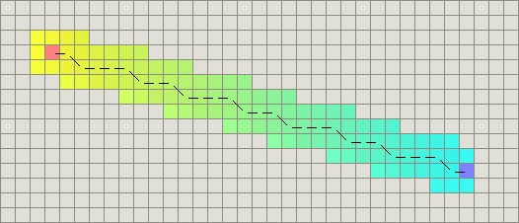
Heuristics for grid graphs
46
Euclidean distance
c_{hv} * sqrt(dx * dx + dy * dy)
Manhattan distance
c_{hv} * (dx + dy)
Chebyshev distance
max(dx, dy)
Octile (diagonal) distance
c_{hv} * |dx – dy| + c_{d}* min(dx, dy)
Manhattan distance is an inadmissible heuristic when diagonal moves are allowed
For cardinal only moves it’s admissible

Slide 47
A* variants
f = w1*g + w2*h
By varying w1 and w2 we can get different behavior. This page has videos for the following variants:
w1 = 1; w2 = 0: Dijkstra's Algorithm. This is traditional graph search without a heuristic
w1 = 0; w2 = 1: Pure Heuristic Search. This is also known as greedy best-first search. It focuses search efforts on states with low heuristic values.
w1 = 1; w2 = 1: A*. This is the regular A* algorithm.
w1 = 1; w2 = 10: Weighted A*. Weighted A* gives up optimality to try to find a solution more quickly.

Slide 48
Let’s go coding
48

