Slide 1
TDD with MVC
Test Driven Design (TDD) when Working with Razor Template Engine and ASP.NET MVC

Slide 2
Paul Herrera
pherrera@tribune.com
@pherrera0727
Principal Software Engineer @ Tribune

Slide 3
TDD
Test Driven Development
Write Tests First
Guarantees Testability
Leads to Better Design
Proven Increases in Production
Will Cause us to Write Double the Code

Slide 4
A Paradox
How do we write double the code and have increases in production?

Slide 5
TDD – Makes you More Productive
Reduces the dependency on a debugger.
Forces small incremental changes.
Regressions bugs are found quickly.
Refactoring increases code readability

Slide 6
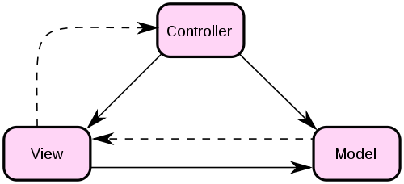
MVC

Slide 7
MVC – Project Layout
Let’s create the project.

Slide 8
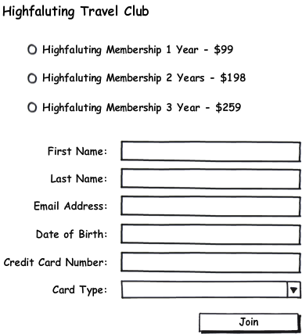
Travel Club Signup

Slide 9
Test Driven Process
Quickly add a test.
Run all tests and see the new one fail.
Make a little change.
Run all tests and see them all succeed.
Refactor to remove duplication.
-- Test Driven Development by Example
Kent Beck

Slide 10
Code
Let’s do some code.

Slide 11
Integration Tests
Testing Database Calls
Must use Developer Sandbox
Database must be in a “Well Known State”
Slow Running Tests
Using NDBUnit

Slide 12
Code
Let’s do some code.

Slide 13
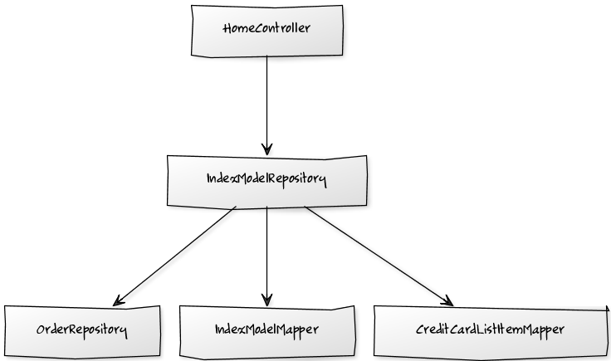
What We Did

Slide 14
Refactoring
We never broke the code.
The code has reduced duplication.
Better Separation of Concerns.
Much more readable.

Slide 15
Inversion of Control
Currently we have tight coupling: all the place we have the new keyword.
Let the caller pass us our dependencies.
Allows us to include Dependency Injection

