Slide 1
TDD with MVC
Test Driven Design (TDD) when Working with Razor Template Engine and ASP.NET MVC

Slide 2
Paul Herrera
pherrera@tribune.com
@pherrera0727
Principal Software Engineer @ Tribune

Slide 3
TDD
Test Driven Development
Write Tests First
Guarantees Testability
Leads to Better Design
Will Cause us to Write Double the Code
Proven Increases in Production

Slide 4
A Paradox
How do we write double the code and have increases in production?

Slide 5
TDD – Makes you More Productive
Reduces the dependency on a debugger.
Forces small incremental changes.
Regressions bugs are found quickly.
Refactoring increases code readability

Slide 6
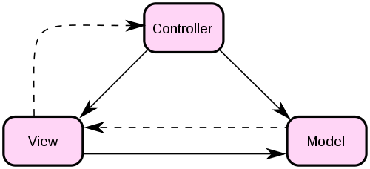
MVC

Slide 7
MVC – Project Layout
Let’s review the Project Layout

