Slide 1
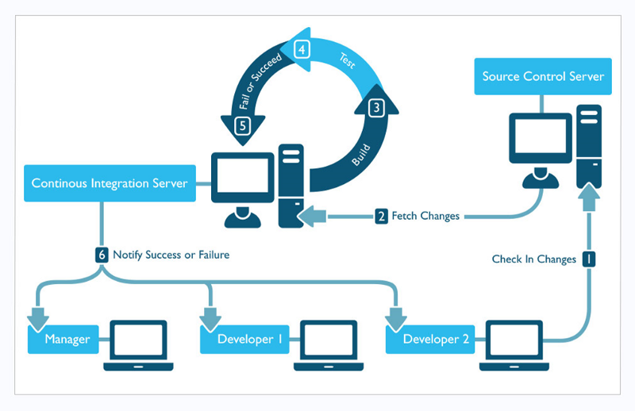

Slide 2
Restore DB
Add / Remove AG
Rename DB
Operation X
Database Infrastructure

Slide 3

Restore DB A
Restore DB B
Run SQL Upgrade Scripts
Reset Web Server
Operation X
Restore DB
Add / Remove AG
Rename DB
Operation X
Database Infrastructure

