Slide 1
* Blue
- Portfolios
- Vehicles
- Benchmarks
* Red
-Equity Char
* Green
- Returns
* Purple
- Clients

Slide 2
Public Site
Investor Reporting
ReturnsWeb
* Blue
- Portfolios
- Vehicles
- Benchmarks
* Red
-Equity Char
* Green
- Returns
* Purple
- Clients
Communication

Slide 3
Public Site
Investor Reporting
ReturnsWeb
B
R
G
B
R
C
B
G
C
* Blue
- Portfolios
- Vehicles
- Benchmarks
* Red
-Equity Char
* Green
- Returns
* Purple
- Clients
Shared Tools
Communication

Slide 4
Business Outcome
Data Source

Slide 5
Application
Business Outcome
Excel Sheet
Excel Sheet
Web Service
Excel Sheet
SQL Query
Application
SQL Query
Web Service
Data Sources

Slide 6
User Interface Layer
Business Logic Layer
Data Access Layer
Data Source
Data Source
Data Source

Slide 7
User Interface Layer
Business Logic Layer
Data Access Layer
Data Source
Data Source
Data Source

Slide 8
Fund Center

Slide 9
Fund Center
* Blue
- Funds
- Indexes
* Red
- Equity Char
* Green
- Returns
* Purple
- NAVs
- Assets

Slide 10
Fund Center
B
R
G
P
* Blue
- Funds
- Indexes
* Red
- Equity Char
* Green
- Returns
* Purple
- NAVs
- Assets

Slide 11
Fund Center
B
R
G
P
* Blue
- Funds
- Indexes
* Red
- Equity Char
* Green
- Returns
* Purple
- NAVs
- Assets
Communication

Slide 12
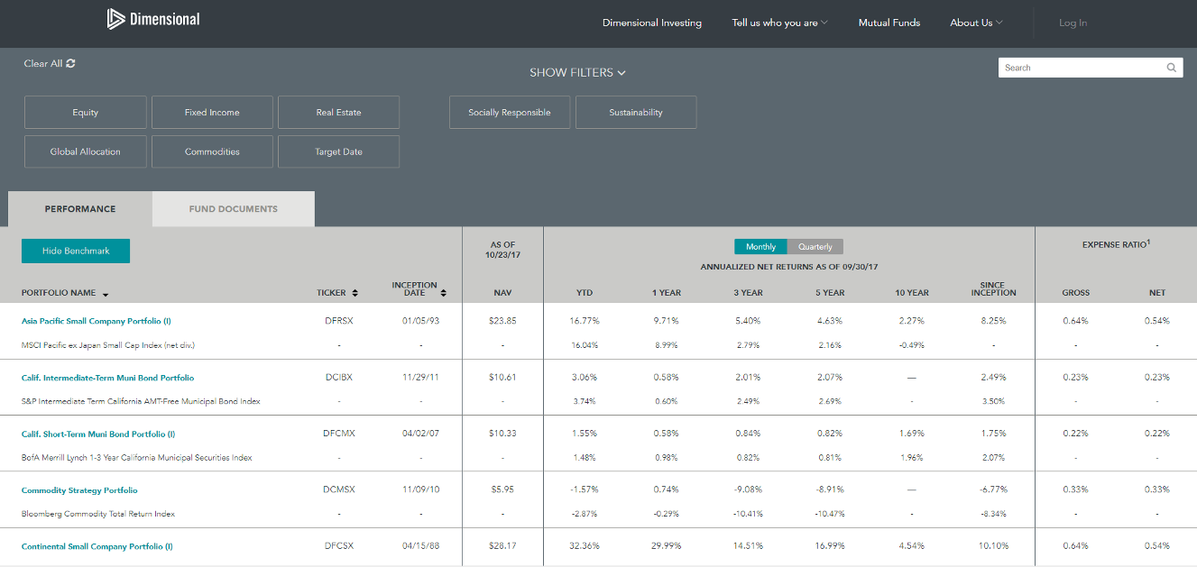
Blue
Blue
P
Green
Red

