Slide 1
LED Hourglass
Julian tupas
CSCE 462-501
SPRING 2021

Slide 2
objective
Emulate the visual behavior of a traditional hourglass:
As time passes, sand at the top of an hourglass is siphoned to the bottom
https://media.giphy.com/media/xFmuT64Jto3mRO4w3G/giphy.gif

Slide 3
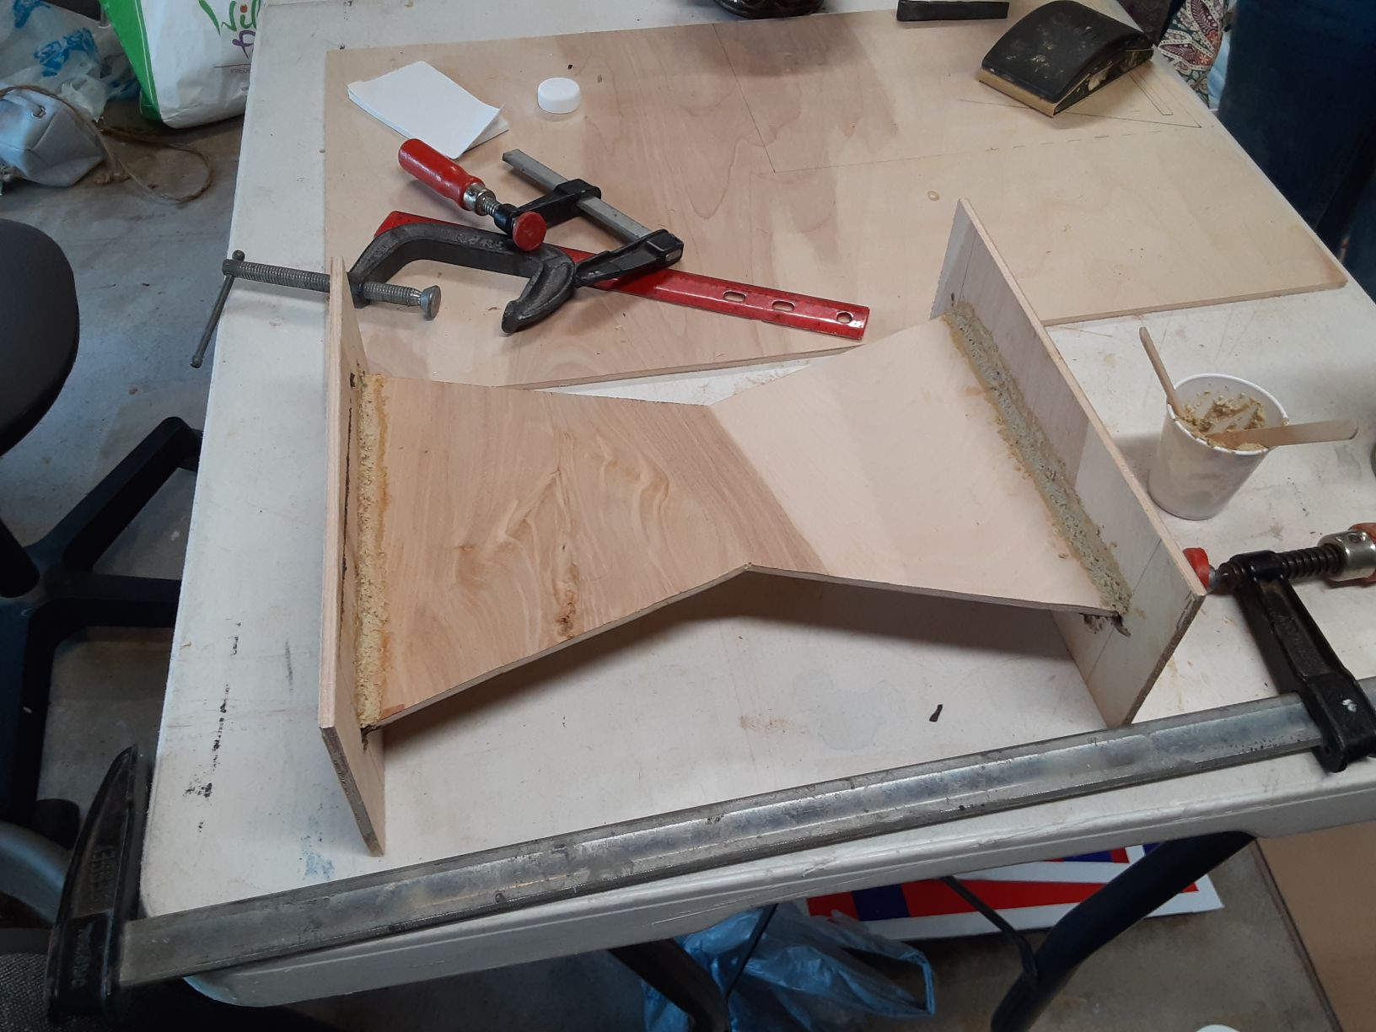
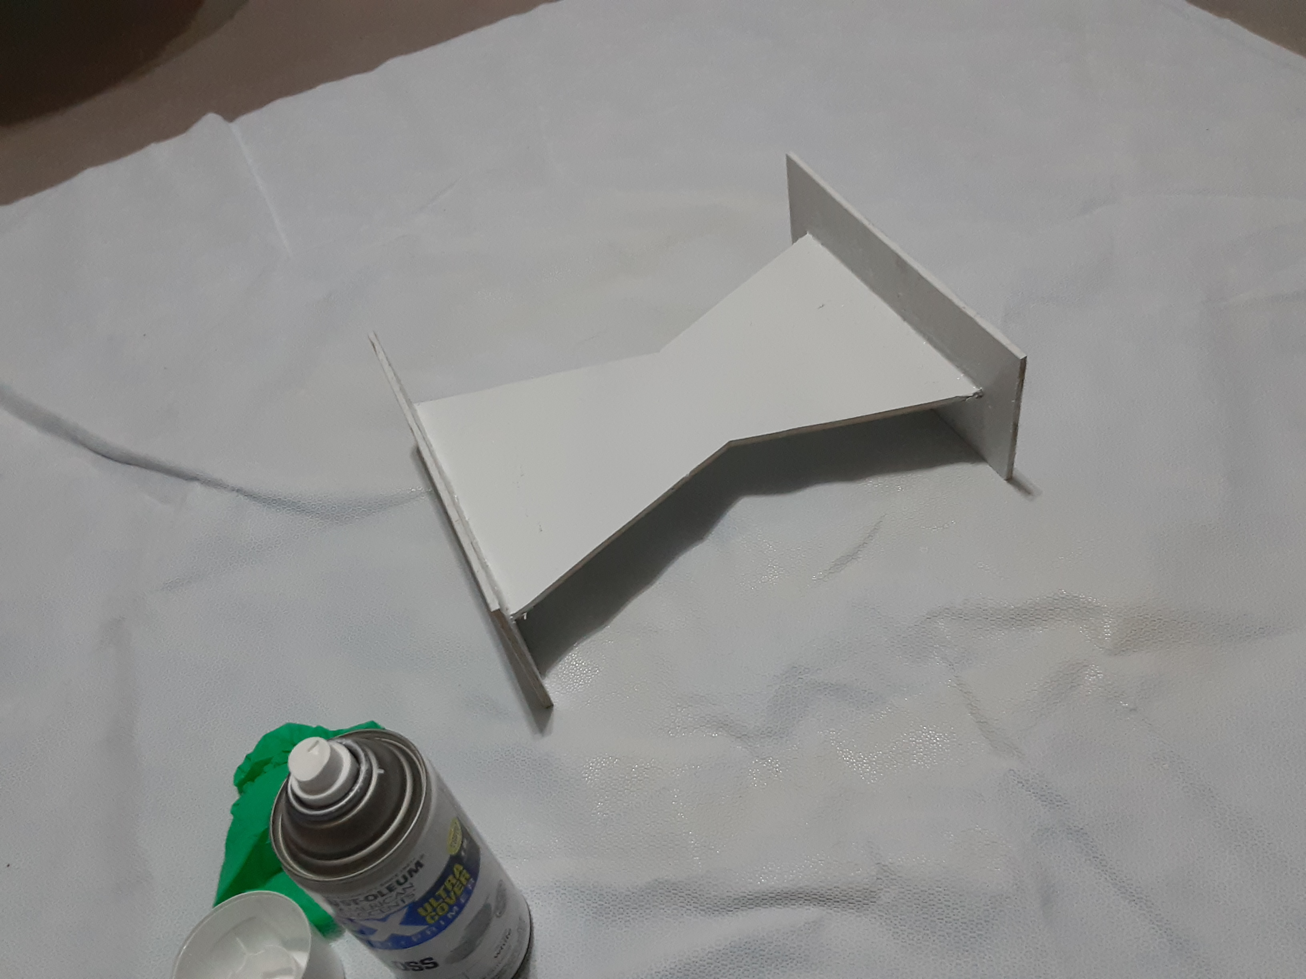
materials
Frame:
plywood
adhesives: wood glue, hot glue, epoxy
spray paint
3D printing plastic

Slide 4
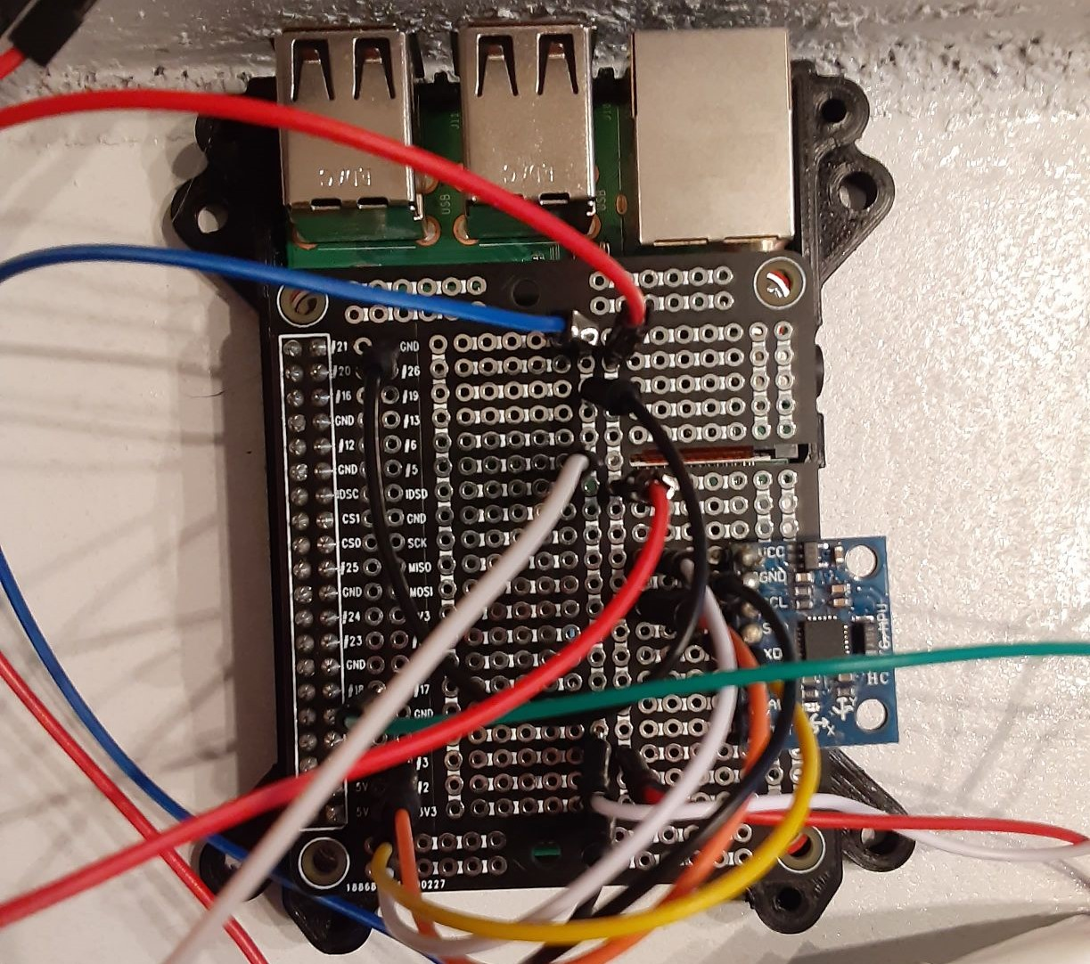
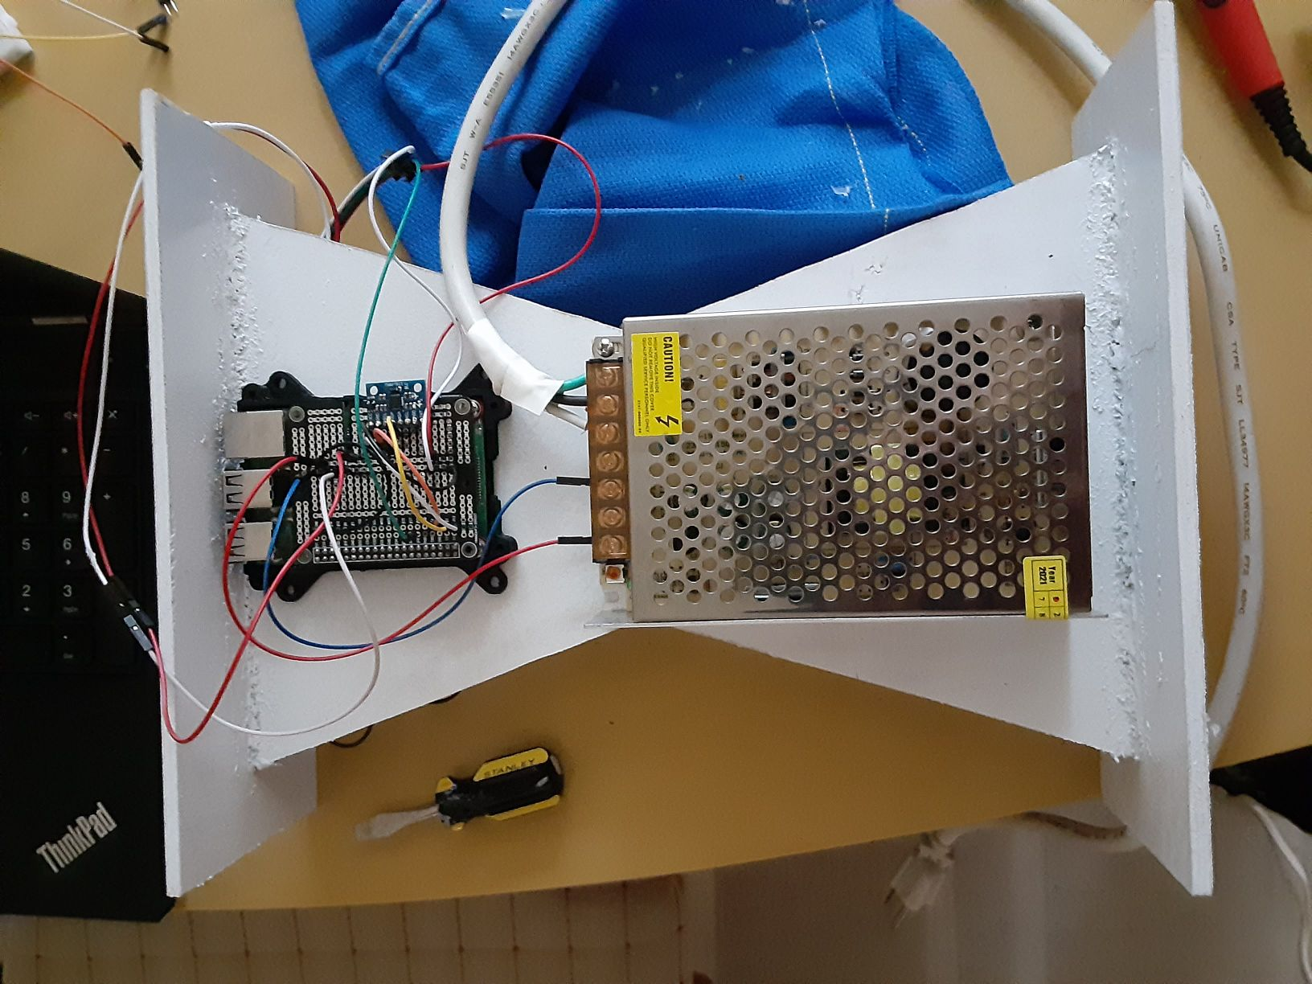
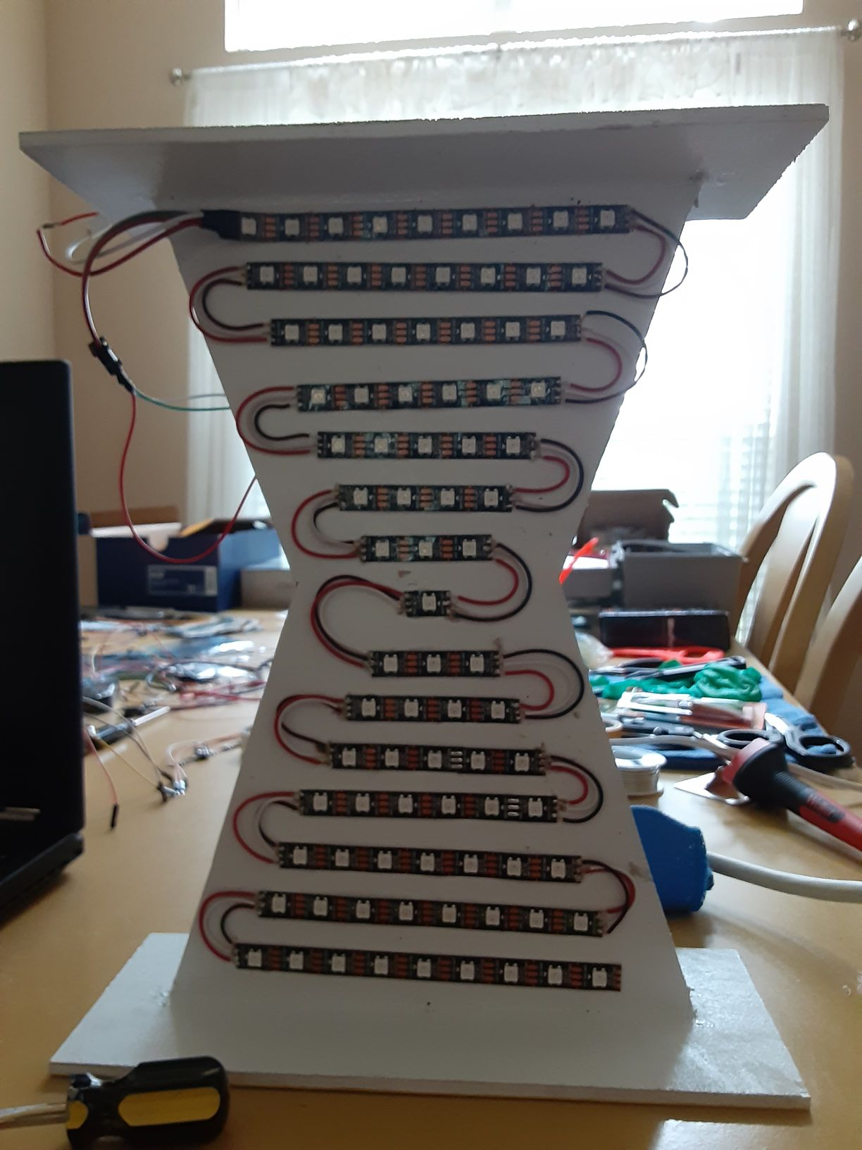
materials
Electronics:
Raspberry Pi 3B+ microprocessor
HiLetGo MPU6050 accelerometer/gyroscope
WSB1812 LED strip
5V switching power supply
RPi prototyping circuit board
jumper wires
solder

Slide 5
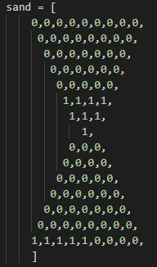
Software
Python script keeps a set of frames for each falling grain of sand
Pi receives signal from the accelerometer indicating vertical and horizontal orientation
Based on orientation, play an animation on the LED array of falling particles made of the drawn frames

Slide 6
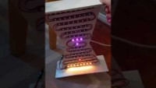
demonstration
https://youtu.be/-QcQOUe_HNM

