Slide 1


Audit BoFS
Steve Grubb
Red Hat

Slide 2

RHEL4 Audit

Slide 3
RHEL4 Audit
CAPP/EAL4+ with IBM
Certified by NIAP
HP and Unisys under eval

Slide 4
Changes Needed
Amtu, at, coreutils, dbus, gdm, glibc, kdm, openssh, pam, passwd, shadow, util-linux, vixie-cron, vsftpd, xdm.
All entry point programs must set loginuid
Apps that modify trusted databases updated to send audit event records

Slide 5
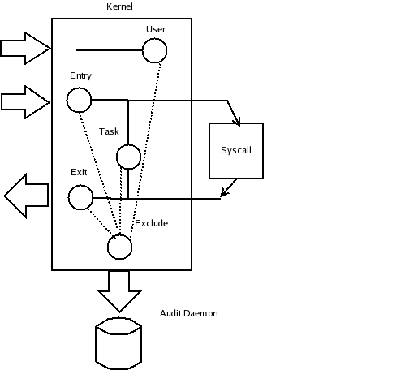
Audit Filters

Slide 6
Known Uses
Resource utilization review
  Cron & aureport
Boot performance analysis
  filemond bootchart.org
SE Linux policy guidance
  Ausearch & audit2allow

Slide 7
Current Work

Slide 8
RHEL4
RHEL4 U2 – CAPP
RHEL4 U3 – NISPOM
RHEL4 U4 – SOX
Fedora Core 5 – LSPP

Slide 9
NISPOM
Audit-1.0.12
Login/Logout – gdm, sshd, login
Black listing tty & accts - pam_tally
Report tools - aureport

Slide 10
Sarbanes-Oxley
Audit-1.0.15
Execve enhancements
Collect all parameters in aux record
Add tty to record

Slide 11
LSPP
Add context to all record
Add ability to audit by SE Linux user, role, type
Add terminal to syscall records for RBAC
Search by SE Linux user, role, type
Audit records hardcoded in kernel for policy load, boolean change, SE Linux enable/disable

Slide 12
LSPP
Cups audit events
Device allocator audit evens

Slide 13
Other
Performance update

Slide 14
Future Work

Slide 15
Library to Parse Events
Create framework to allow apps to pull audit events from the logs
Ausearch & aureport will use
Encapsulate log format knowledge so apps don't need to know

Slide 16
Kernel
Ability to track child processes
Needed for autrace

Slide 17
Audit Event Dispatcher
To meet DCID 6/3 Audit 9 need to respond in realtime to suspicious events
Auditd forks and exec's dispatcher
Comm is done via socketpair
Dispatcher reads stdin for events
Example in contrib/skeleton.c

Slide 18
Audit Event Dispatcher
/sbin/audispd
Will be plugin based
Relay events
  Ssl, syslog, dbus, snmp
Input events, other systems, iptables

Slide 19
Audit Event Dispatcher
Analyze events - anomalies
  Failed logins within certain time
  Logins at strange times
  Max concurrent sessions reached
  Logins from certain accounts
  Logins from certain locations
  Certain number of DAC failures

Slide 20
Audit Event Dispatcher
Analyze events
  Certain number of MAC failures
  Failure of amtu
  Failure of LSPP/RBAC self test
  Failure of crypto test
  Attempt to access certain directory
  Attempt to execute certain programs

Slide 21
Audit Event Dispatcher
Analyze events
  Adding account
  Deleting account
  Changes to account

Slide 22
Audit Event Dispatcher
React to anomaly events
  Ignore
  Log it
  Alert admin – console message, dbus, email, snmp
  Kill process
  Kill session
  Terminate access – logout, forge FIN packet, iptables

Slide 23
Audit Event Dispatcher
React to anomaly events
  Lock account for time
  Lock account for remote access
  Lock account
  Lock terminal
  Set SE Linux boolean
  Execute script

Slide 24
Audit Event Dispatcher
React to anomaly events
  Change to Single user mode
  Halt system

Slide 25
Audit Explorer
Gui to review logs
Likely to look like spreadsheet with cells
Right click on cell to list searches
Based on aureport as bottom layer

Slide 26
Questions ?
User space tools: http://people.redhat.com/sgrubb/audit
Mail list: http://www.redhat.com/mailman/listinfo/linux-audit

