Slide 1

Controller Area Network
CAN CC / CAN FD / CAN XL

Slide 2
CAN data packets on the bus - simplified for nerds
Media access by CSMA/CR (resolution) sometimes CSMA/CA (avoidance)
Structure of a CAN CC (aka Classical CAN, CAN 2.0B) frame:
Simplified: [CAN Identifier] [Data length] [Data 0..8]
Content addressing (by CAN Identifier & CAN Bus)
No MAC number / Node addresses / ARP / Routing – just plain OSI Layer 2
CAN CC-only controller breaking upgrade to CAN FD (ISO 11898-1:2015)
S
O
F
CAN-ID
(11/29 Bit)
R
T
R
I
D
E
r
e
s
DLC
(4 Bit)
DATA
(0-8 Byte)
Checksum
(15 Bit)
D
E
L
A
C
K
D
E
L
EOF
(7 Bit)
Arbitration
Control
Data
Check
Acknowledge

Slide 3
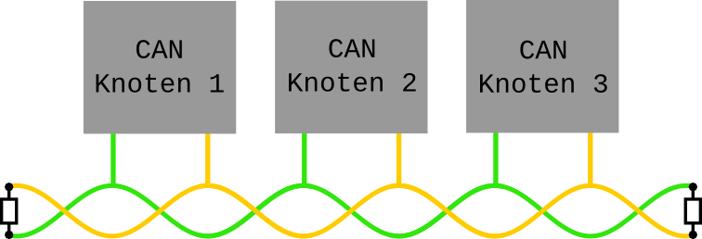
Safe but not secure
Serial communication protocol, ISO Standard 11898
Two wires: Unshielded twisted pair, terminated
Transfer rate up to 1MBit/s (CAN CC) and up to ~4MBit/s (CAN FD)
Invented by Robert Bosch GmbH, 1983
Only defines the Media Access Layer
CAN
ECU
CAN
ECU
CAN
ECU

Slide 4
Multi-master bus topology
Unlike point-to-point Ethernet all nodes use the same wire
CAN
ECU
CAN
ECU
CAN
ECU
The wires are named CAN_Low and CAN_High

Slide 5
Differential potentials for electro magnetic interference (EMI)
A glitch occurs on both lines at the same time ➔ difference remains stable
CAN
ECU
CAN
ECU
CAN
ECU
Unshielded twisted pair

Slide 6
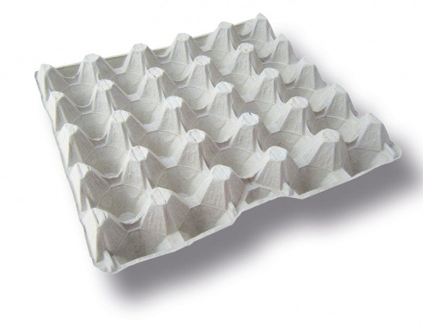
Bus termination to prevent reflection/echos
Terminate data transmission to prevent reflection/echos a the end of the wire
CAN
ECU
CAN
ECU
CAN
ECU
120 Ohms each ➔ 60 Ohms total

Slide 7
Data acknowledge by receive node
Only acknowledged CAN frames are valid CAN frames.
CAN
ECU
CAN
ECU
CAN
ECU
Protocol violations lead to a destroyed CAN frame (error flag)

Slide 8
Switching from CAN CC to CAN FD by using the reserved bit
0 0 0
S
O
F
CAN-ID
(11 Bit)
R
T
R
I
D
E
r
0
DLC
(4 Bit)
DATA
(0-8 Byte)
Checksum
(15 Bit)
D
E
L
A
C
K
D
E
L
EOF
(7 Bit)
Arbitration
Control
Data
Check
Acknowledge
Breaking reserved bits: new funtionality & incompatibility
0 0 1 0
S
O
F
CAN-ID
(11 Bit)
r
1
I
D
E
F
D
F
r
0
B
R
S
E
S
I
DLC
(4 Bit)
DATA
(0-64 Byte)
Checksum
(17/21 Bit)
StuffCNT (4 Bit)
D
E
L
A
C
K
D
E
L
EOF
(7 Bit)
Arbitration
Control
Data
Check
Acknowledge
Arbitration Bitrate
FD Data Bitrate (BRS = 1)
Arbitration Bitrate

Slide 9
CAN FD – new bits and definitions in detail
0 0 1 0
S
O
F
CAN-ID
(11 Bit)
r
1
I
D
E
F
D
F
r
0
B
R
S
E
S
I
DLC
(4 Bit)
DATA
(0-64 Byte)
Checksum
(17/21 Bit)
StuffCNT (4 Bit)
D
E
L
A
C
K
D
E
L
EOF
(7 Bit)
Arbitration
Control
Data
Check
Acknowledge
no RTR function
DLC
0
1
..
7
8
9
A
B
C
D
E
F
DATA LEN
0
1
..
7
8
12
16
20
24
32
48
64
Error State Indicator
Flexible Data Frame
Bit Rate Switch
non-linear(!!) mapping : DLC ➔ payload length

Slide 10
Compatible data structure layout for CAN CC and CAN FD
  CAN CC data structure (the len element was formerly named can_dlc)
  CAN FD data structure
struct can_frame {
canid_t can_id; /* 32 bit CAN_ID + EFF/RTR/ERR flags */
__u8 len; /* frame payload length in byte (0 .. 8) */
__u8 __pad; /* padding */
__u8 __res0; /* reserved / padding */
__u8 len8_dlc; /* optional DLC for 8 byte payload length */
__u8 data[8] __attribute__((aligned(8)));
};
struct canfd_frame {
canid_t can_id; /* 32 bit CAN_ID + EFF/RTR/ERR flags */
__u8 len; /* frame payload length in byte (0 .. 64) */
__u8 flags; /* additional flags for CAN FD */
__u8 __res0; /* reserved / padding */
__u8 __res1; /* reserved / padding */
__u8 data[64] __attribute__((aligned(8)));
};

Slide 11
CAN FD data structure – dual use with CAN CC layout
Writing CAN CC data into a CAN FD data structure creates valid content.
struct can_frame
CAN ID
LEN
PAD
RES
8dlc
0
1
2
3
4
5
6
7
struct canfd_frame
CAN ID
LEN
FD
RES
RES
0
1
2
3
4
5
6
7
--------------
60
61
62
63
#define CANFD_BRS 0x01 /* bit rate switch (second bitrate for payload data) */
#define CANFD_ESI 0x02 /* error state indicator of the transmitting node */
#define CANFD_FDF 0x04 /* mark CAN FD for dual use of struct canfd_frame */
Writing direction into data structure

Slide 12
How to activate CAN FD on a CAN_RAW socket
Reading and writing CAN data structures with CAN CC
Switch the socket into CAN FD mode with setsockopt() syscall
struct can_frame cframe;
int s = socket(PF_CAN, SOCK_DGRAM, CAN_RAW);
(..)
nbytes = read(s, &cframe, sizeof(struct can_frame));
struct canfd_frame cframe;
int s = socket(PF_CAN, SOCK_DGRAM, CAN_RAW);
setsockopt(s, SOL_CAN_RAW, CAN_RAW_FD_FRAMES, ...);
(..)
nbytes = read(s, &cframe, sizeof(struct canfd_frame));

Slide 13
Switching from CAN CC to CAN FD by using the reserved bit (recap)
0 0 0
S
O
F
CAN-ID
(11 Bit)
R
T
R
I
D
E
r
0
DLC
(4 Bit)
DATA
(0-8 Byte)
Checksum
(15 Bit)
D
E
L
A
C
K
D
E
L
EOF
(7 Bit)
Arbitration
Control
Data
Check
Acknowledge
Breaking reserved bits: new funtionality & incompatibility
0 0 1 0
S
O
F
CAN-ID
(11 Bit)
r
1
I
D
E
F
D
F
r
0
B
R
S
E
S
I
DLC
(4 Bit)
DATA
(0-64 Byte)
Checksum
(17/21 Bit)
StuffCNT (4 Bit)
D
E
L
A
C
K
D
E
L
EOF
(7 Bit)
Arbitration
Control
Data
Check
Acknowledge
Arbitration Bitrate
FD Data Bitrate (BRS = 1)
Arbitration Bitrate

Slide 14
Switching from CAN FD to CAN XL by using the reserved bit
0 0 1 0
S
O
F
CAN-ID
(11 Bit)
r
1
I
D
E
F
D
F
r
0
B
R
S
E
S
I
DLC
(4 Bit)
DATA
(0-64 Byte)
Checksum
(17/21 Bit)
StuffCNT (4 Bit)
D
E
L
A
C
K
D
E
L
EOF
(7 Bit)
Arbitration
Control
Data
Check
Acknowledge
Breaking reserved bits: new funtionality & incompatibility
0 0 1 1 0
S
O
F
PRIO
(11 Bit)
r
1
I
D
E
F
D
F
X
L
F
r
0
A
D
S
SDT
(8 Bit)
S
E
C
DLC
(11 Bit)
VCID
(8 Bit)
AF
(32 Bit)
DATA
(1-2048 Byte)
Check
sums
D
A
S
D
E
L
A
C
K
D
E
L
EOF
(7 Bit)
Arbitration
Control
Data
Check
Acknowledge
Arbitration Bitrate (CAN PHY)
XL Data Bitrate (DATA PHY)
Arbitration Bitrate

Slide 15
New/changed CAN XL frame content (simplified checksums)
0 0 1 1 0
S
O
F
PRIO
(11 Bit)
r
1
I
D
E
F
D
F
X
L
F
r
0
A
D
S
SDT
(8 Bit)
S
E
C
DLC
(11 Bit)
VCID
(8 Bit)
AF
(32 Bit)
DATA
(1-2048 Byte)
Check
sums
D
A
S
D
E
L
A
C
K
D
E
L
EOF
(7 Bit)
Arbitration
Control
Data
Check
Acknowledge
PRIO – 11 bit priority for arbitration (former 11 bit CAN Identifier)
ADS/DAS – switch sequence between arbitration and data phase
SDT – 8 bit Service Data Unit Type
SEC – 1 bit simple extended content (e.g. for security/segmentation)
DLC – 11 bit data length code (0 .. 2047) => 1 .. 2048 data bytes
VCID – 8 bit virtual CAN network identifier (analogue to VLAN identifier)
AF – 32 bit acceptance field (function depending on SDT)
DATA – 1 .. 2048 data bytes (depenting on DLC value)

Slide 16
Data structure layout for CAN FD in comparison to CAN XL
  CAN FD data structure
  CAN XL data structure (big endian representation of canfd_frame.can_id space)
struct canfd_frame {
canid_t can_id; /* 32 bit CAN_ID + EFF/RTR/ERR flags */
__u8 len; /* frame payload length in byte (0 .. 64) */
__u8 flags; /* additional flags for CAN FD */
__u8 __res0; /* reserved / padding */
__u8 __res1; /* reserved / padding */
__u8 data[64] __attribute__((aligned(8)));
};
struct canxl_frame {
__u8 __res0; /* reserved / padding must be set to zero */
__u8 vcid; /* virtual CAN network identifier */
__u16 prio; /* 11 bit priority for arbitration */
__u8 flags; /* additional flags for CAN XL */
__u8 sdt; /* SDU (service data unit) type */
__u16 len; /* frame payload length in byte (1 .. 2048) */
__u32 af; /* acceptance field */
__u8 data[2048];
};

Slide 17
Details of the data structure layout for CAN XL
struct canxl_frame {
__u8 __res0; /* reserved / padding must be set to zero */
__u8 vcid; /* virtual CAN network identifier */
__u16 prio; /* 11 bit priority for arbitration */
__u8 flags; /* additional flags for CAN XL */
__u8 sdt; /* SDU (service data unit) type */
__u16 len; /* frame payload length in byte (1 .. 2048) */
__u32 af; /* acceptance field */
__u8 data[2048];
};
vcid – contains values 0x00 .. 0xFF (0x00 = untagged / no VCID)
prio – shares the position and functionality with the 11 bit CAN ID in CAN CC/FD
flags – shares the position with the length (len) information in CAN CC/FD frames
To intentionally break with valid CAN CC/FD length values (0 .. 64) CANXL_XLF must be set in CAN XL frames:
#define CANXL_XLF 0x80 /* mandatory CAN XL frame flag (must always be set!) */
#define CANXL_SEC 0x01 /* Simple Extended Content (security/segmentation) */

Slide 18
CAN XL frame content: Service Data Unit Types (SDT)
Service Data Unit Types (0x00 .. 0xFF) – according to CAN CiA 611-1 (working draft)
0x00 : reserved
0x01 : Content based addressing
0x03 : CC CAN / CAN FD
0x04 : IEEE 802.3 (MAC frame)
0x05 : IEEE 802.3 (MAC frame) extended
0x06 : CAN CC
0x07 : CAN FD
0x08 : CiA 611-2 (Multi-PDU)
0x09 : AUTOSAR Multi-PDU
0x0A : CiA 613-2 (CANsec key agreement protocol)
0x0B .. 0xDF : reseved for future use
0xE0 .. 0xFE : manufacturer specific
0xFF : reserved

Slide 19
CAN XL summary
CAN XL is like „Ethernet with CSMA/CR arbitration“
High reliability (CRC/bitstuffing) with 10 Mbit/s data rate
CAN XL controller support CAN XL / CAN FD / CAN CC
CAN XL transceivers with switchable physical layer (arbitration/data)
Virtual CAN interface identifiers (analogue ethernet VLANs)
SDU (service data unit) types for multiple content use-cases

