Slide 1

Games, Games, Games!!!

Slide 2

Under construction

Slide 3
Me, Myself & I
Worked on various FOSS Games
  WorldForge (4 Years)
  Thousand Parsec (Founded, 6 Years)
Ran Gaming Miniconf at
Linux.conf.au 2007 and 2008
Given talks at Linux.conf.au, Freeplay

Slide 4
Not the first
Computer Games Development
16 March 2004
  Cam Dunn, Ratbag
Computer Games Ported to Linux
20 August 1996
  Matthew Tippett

Slide 5

Why? Oh god Why?
“FOSS games can not compete”
Commercial game companies are using FOSS technologies
Closed nature of gaming console
Gaming preventing people removing Windows
FOSS Games are just cool

Slide 6
The Talk
Why FOSS Games are important
Why we are already winning
Games that exist
Making your games exist
My game

Slide 7
Final Frontier
Many people believe FOSS games can not compete
  Sound familiar?
  “Open Source can not compete with the quality of commercial software”

Slide 8
Little Survey

Slide 9

Boring, I'm not a gamer!
Xbox, Playstation, Wii
World Domination
Performance

Slide 10
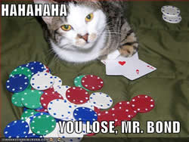
We are already winning!

Slide 11
Open Source Growing At an Exponential Rate

Slide 12
First games where FOSS
Spacewar!
Dungeon
MUD

Slide 13

Commercial Games

Slide 14
AAA titles using FOSS
Civilisation IV
Eve Online
Battlefield 2
Command & Conquer: Red Alert 3
Freedom Force
ID Software

Slide 15
Ni!
Python
    Commercial Games using Python
    BigWorld,
    Troika Games – TOEE & Vampire: Bloodlines,
    Totally Games – Star Trek Bridge Commander,
    Irrational Games – Freedom Force,
    Firefly – Civilisation 4,
    CCP Games – Eve Online,
    Digital Illusions – Battlefield 2,
    Many, many, more

Slide 16


Size does matter!
Found in Nintendo DS and Gameboy Games
Lua
  Complete language in under 200k
  MIT License
SQLite
  Complete SQL database in under 150k
  Zero-configuration
  Public Domain

Slide 17

Stability Matters
Linux runs the backend of many games

Slide 18
FOSS Games
Polished Games
Innovative Games
Making your own Games
Thousand Parsec

Slide 19
Polished Games

Slide 20

www.wesnoth.org
Click Me

Slide 21
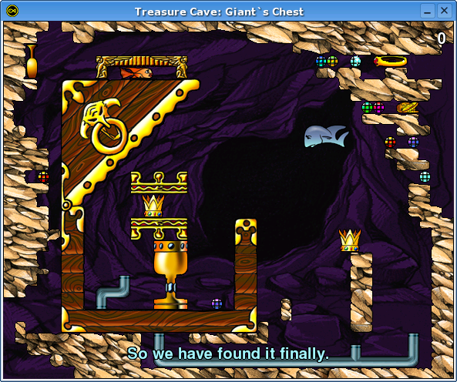
Fish Fillets NG
  http://fillets.sourceforge.net/

Slide 22
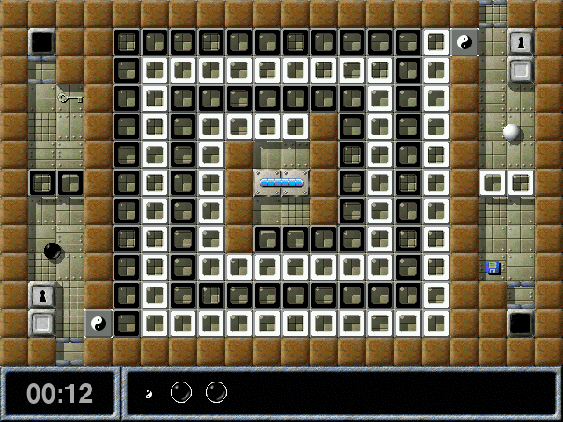
Enigma http://www.nongnu.org/enigma/

Slide 23
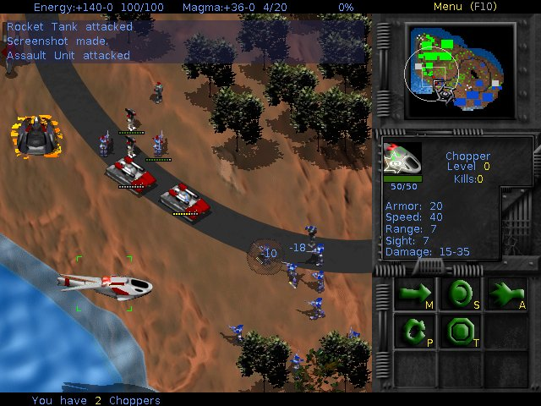
Bos Wars http://www.boswars.org/

Slide 24
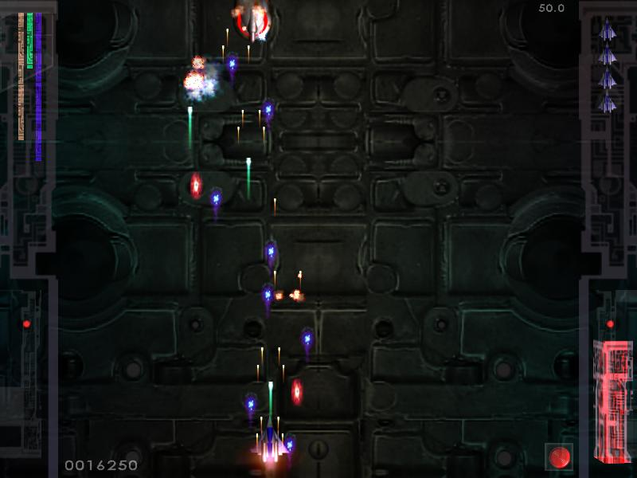
Chromium http://www.reptilelabour.com/software/chromium/

Slide 25
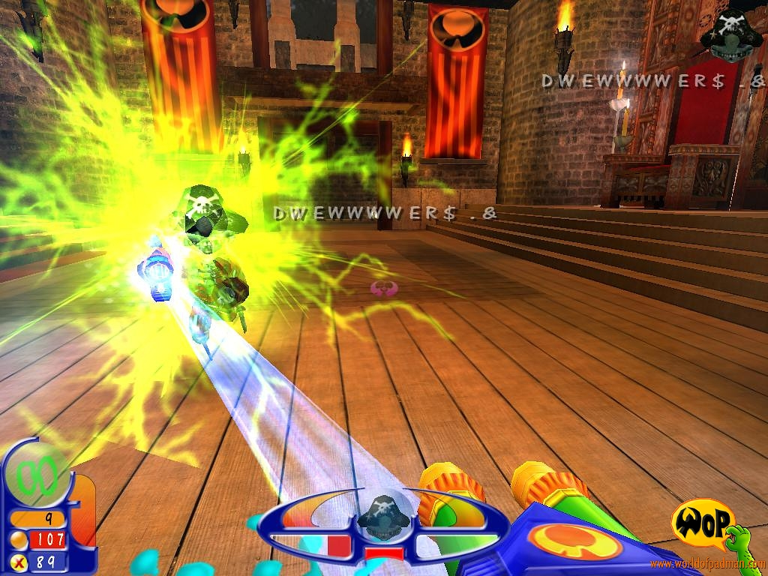
World of Padman http://www.worldofpadman.com/

Slide 26
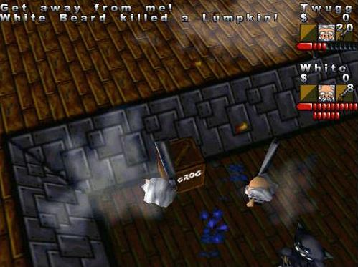
Egoboo http://egoboo.sourceforge.net/

Slide 27
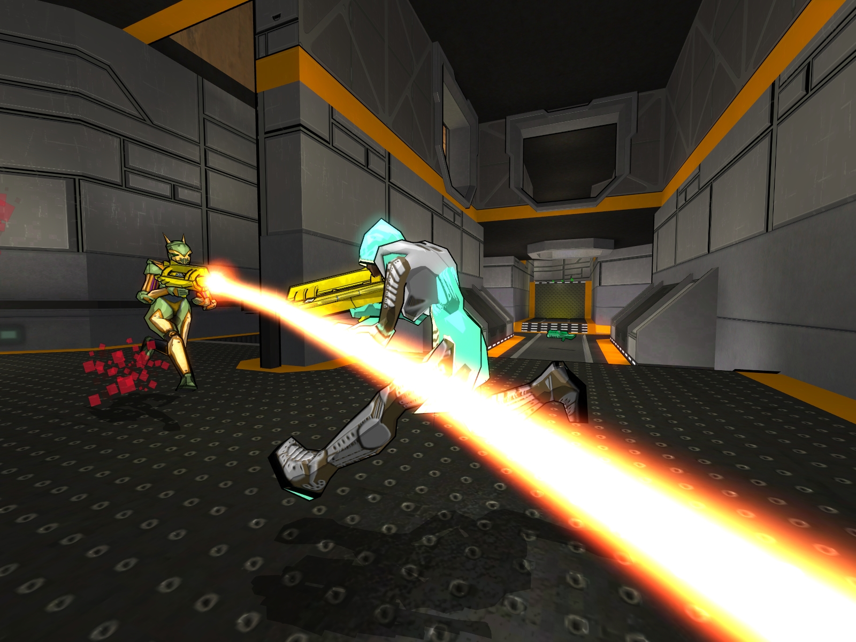
Warsow http://www.warsow.net/

Slide 28
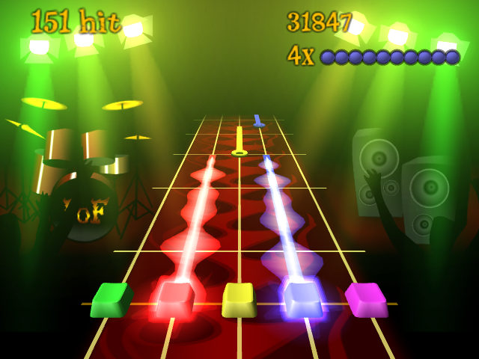
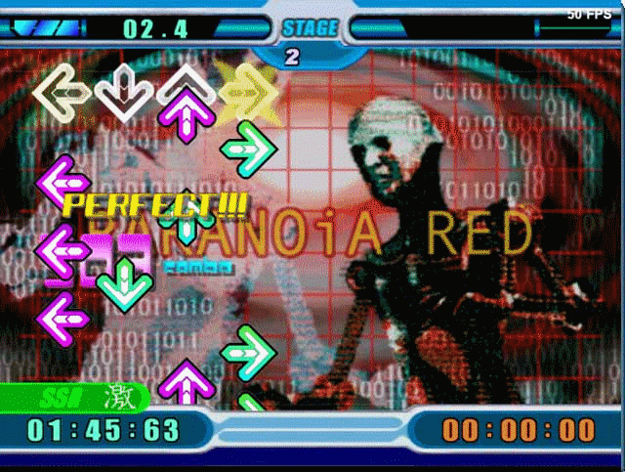
Party Games
Frets on Fire
  http://fretsonfire.sourceforge.net/
Stepmania
  http://www.stepmania.com/

Slide 29
Innovative Games

Slide 30
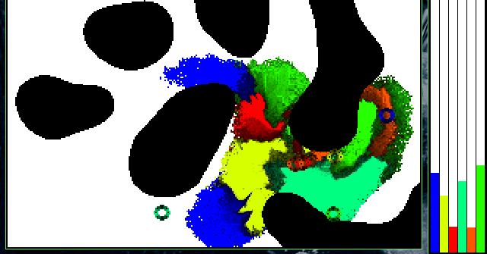
Liquid War http://www.ufoot.org/liquidwar/

Slide 31
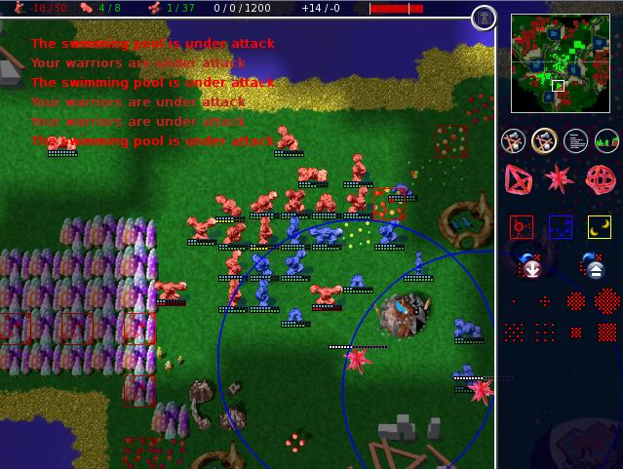
Globulation 2
http://globulation2.org/

Slide 32
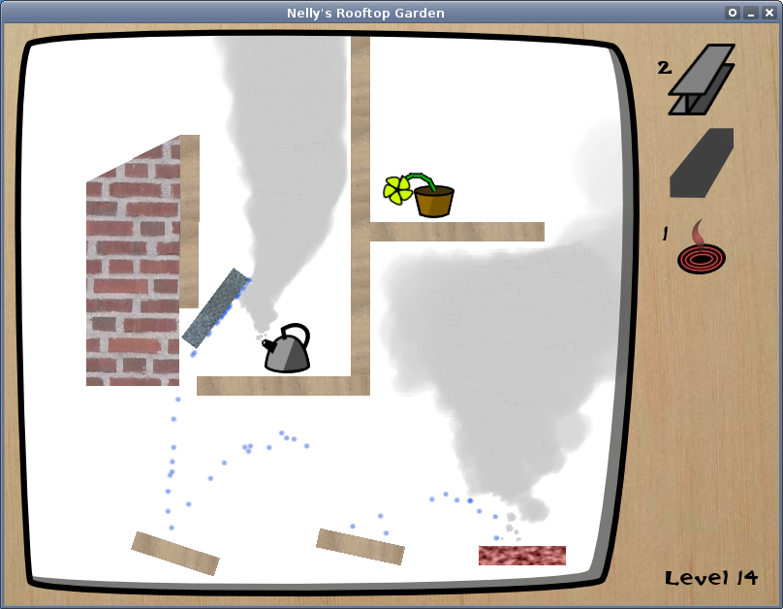
Nelly's Garden
http://www.partiallydisassembled.net/nelly/

Slide 33
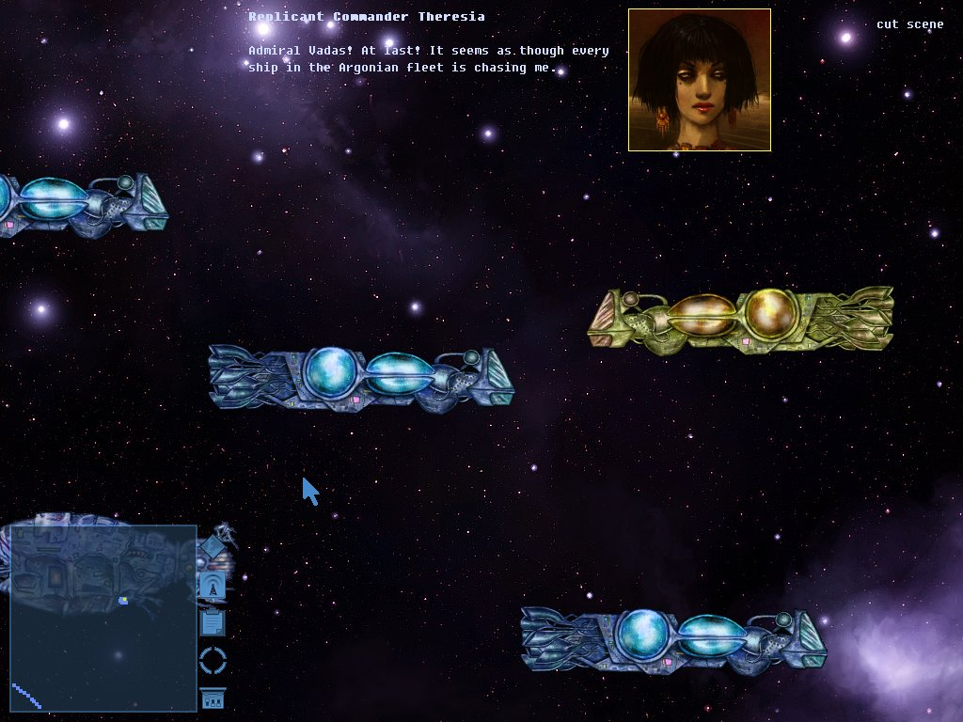
Really Rather Good Battles In Space
http://rrgbis.sourceforge.net/

Slide 34
More, more, more!
Freshmeat – Games (2918 projects)
  http://freshmeat.net/browse/80/
Linux Game Tome
  http://www.happypenguin.org/
Wikipedia
  http://en.wikipedia.org/wiki/Category:Open_source_video_games
Freegamer Blog
  http://freegamer.blogspot.com/

Slide 35
Making your own Games

Slide 36

pygame, pyglet,
pyopengl, pyopenal
pyode,
panda3d, soya3, pyogre

Slide 37



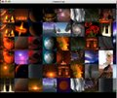

Click Me
pyglet.org

Slide 38



Slide 39




Ohhh Perrty
Ogre 3d
Crystal Space
Irrlicht 3D
Nebula Device
Click!
Click!
Click!

Slide 40

We need YOU!

Slide 41
I don't have time!
Pyweek – 7 days
  www.pyweek.org
Ludum Dare – 48 hours
  http://www.imitationpickles.org/ludum/
PyDay – 24 hours
  http://groups.google.com/group/pyday

Slide 43

Thousand Parsec
http://www.thousandparsec.net/

Slide 44
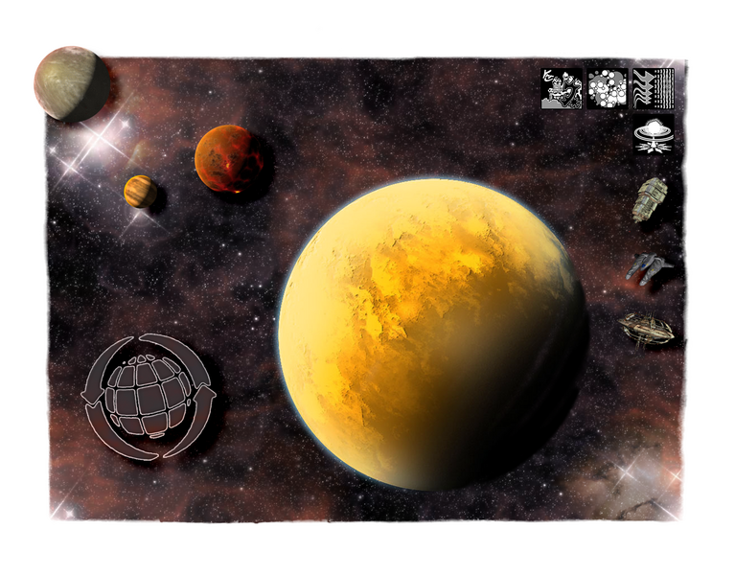
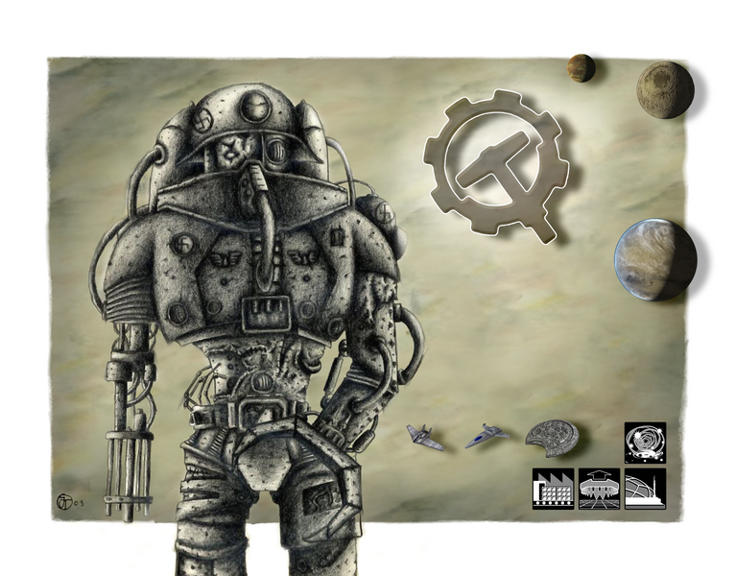
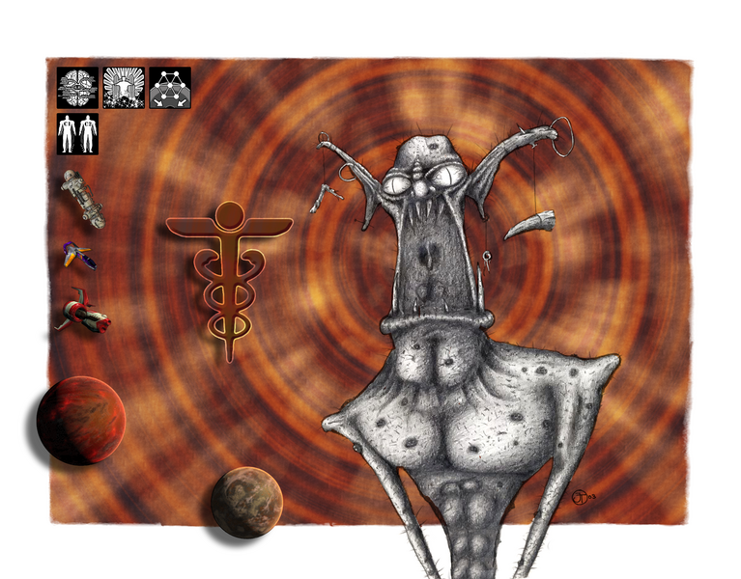
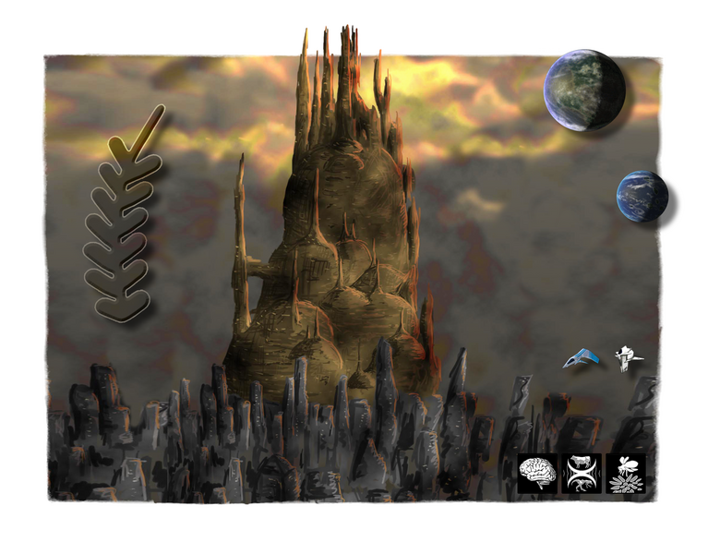
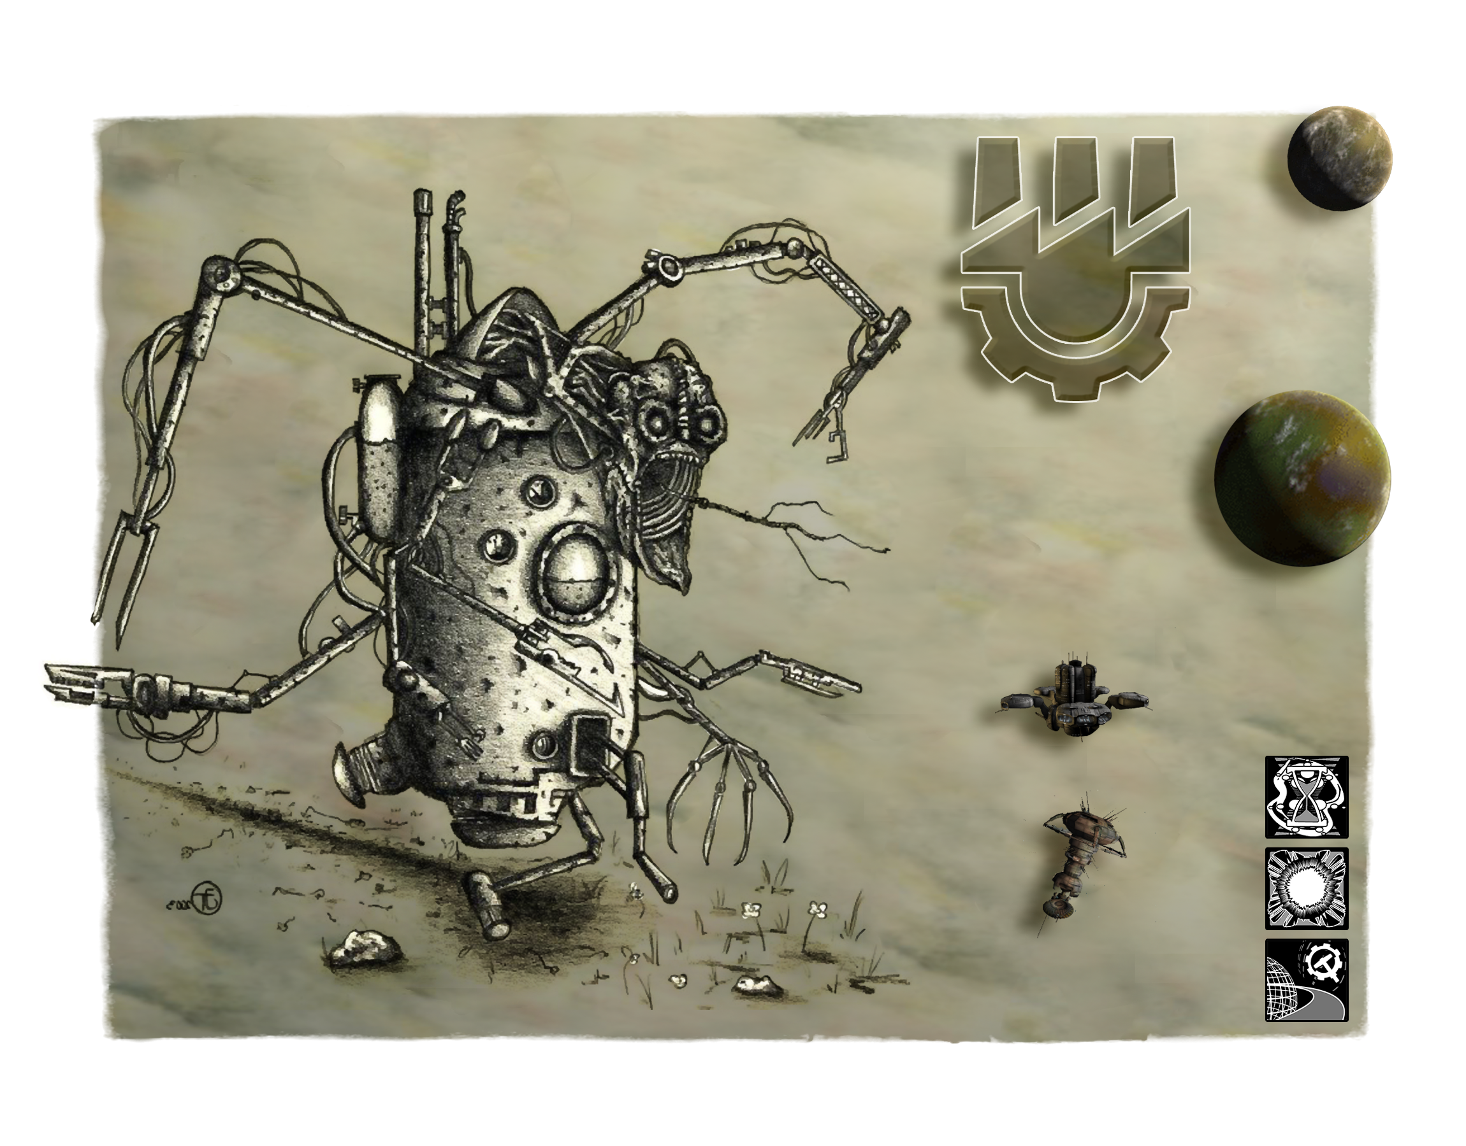
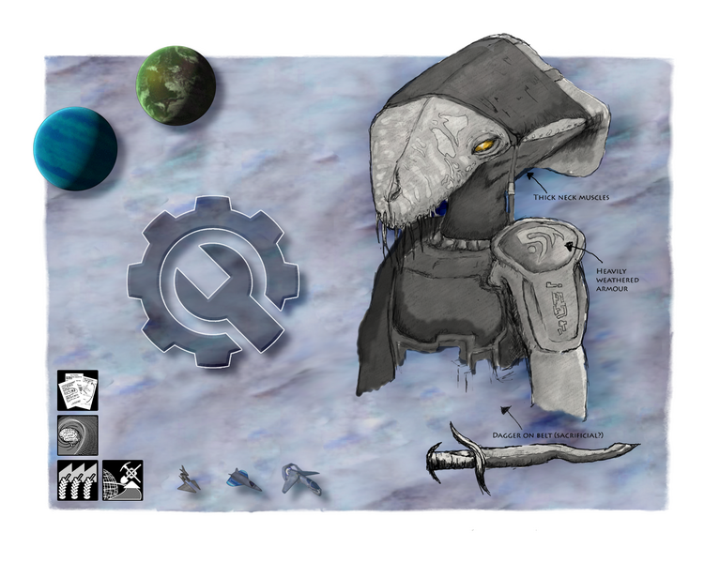
Thousand Parsec
http://www.thousandparsec.net/
Framework
Playable Games

Slide 45
Thousand Parsec
http://www.thousandparsec.net/
Any client <-> Any Server
Star Wars, Star Trek, Your own ideas!
Web of 4x games

Slide 46
Thousand Parsec
http://www.thousandparsec.net/
Buy stuff!
- $25 T-shirt (I'm wearing one)
- $20 Calendar
- $2 Magnet

