Slide 1
TCP/IP-TDM
Transmission Control Protocol
Internet Protocol
Time Division Multiplexing
The clock is ticking!
Now is the time to act!

Slide 2
Remastering an Ubuntu Live CD for use at school
Remastering Ubuntu
How I customised an Ubuntu Live CD to support technology classes I ran at school for a year 5 and a year 3/4 class.
Ongoing project...

Slide 3
In the beginning...
School got some Lego RCX
Needed a geek to play with it...
Committed Communist
Hippy
FOSS Evangelist
  Had to be Free (libre)
Parent
  Had to be Free (gratis)

Slide 4
A Plan to deviate from ...
MediaWiki
PC
  Live CD
  Bootable USB
  LTSP
  Windows
Lego
  NQC

Slide 5
First Year
Year 5 class
8 sessions + Mystery Circuit
    BlinkenLights
    GNUCAP
    Regenerative Breaking / Railgun
    Guido van Robot
    Melting_Silver / Automotive
    Dodgem
    Dodgem part 2
    Electronics Recap

Slide 6
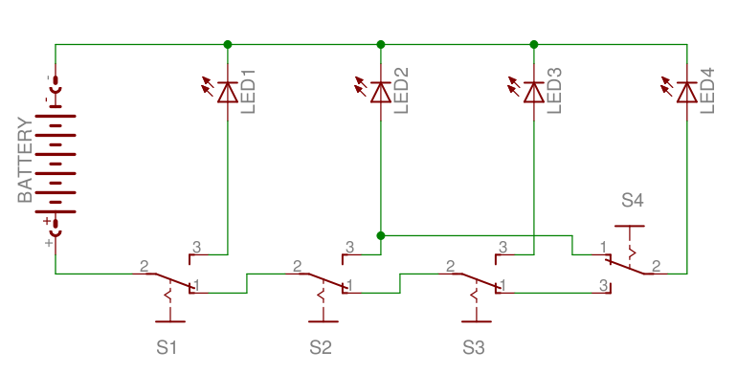
Mystery Circuit

Slide 7
Lessons Learned
+
  Kids loved it (learnt something?)
  Teacher loved the free time
-
  Lego may be too creative ...
  Live (as in 'grenade') DVD
  End of year is busy!

Slide 8
Second (current) Year
Year 3/4 class
7 sessions (so far)
    Melting_Silver
    Rocketry
    LiveDVD / CanalLocks
    Guido van Robot (2011)
    Railgun / Regenerative_Breaking
    Blinkenlights 2011
    budd:e

Slide 9
Lessons Learned
+
  neutered DVD
  DVD coverart
  Permission slips
-
  (3 « 4) « 5
  Assemble, then glue!

Slide 10
Remastering HOWTO
And here's a WIKI page I prepared earlier:
http://adelie/wiki/Ubuntu_Customization_Kit

Slide 11
Things to Do
MediaWiki
  Hosting
  Export: .pdf / .html / .*
  Live-DVD
New/more/other Stuff?
  Year 3/4 Term 2
  Year 6
Different Audiences
  Younger Kids?
  Older Kids?
  Much older Kids?

Slide 12
Thanks!
Liz
Karen
Sophia
beta-testers
Thomas Sprinkmeier
thomas.sprinkmeier@gmail.com

