Slide 1
Extend segment routing for another source routing protocol named RPL for Linux
Alexander Aring, Stefan Schmidt, Michael Richardson

Slide 2

What’s RPL?
IETF Routing Protocol – ROLL WG
Simplification of the routing protocol
  Tree like topology in a mesh
    Root node
    Nodes have one parents
    Nodes can have n-childs
  Out of scope
    Self-healing
    Floating root nodes
    Security, a lot of more...

Slide 3
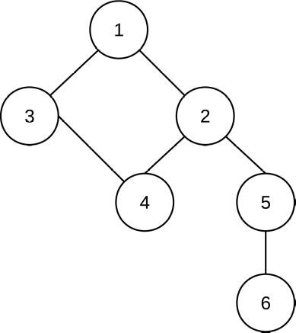
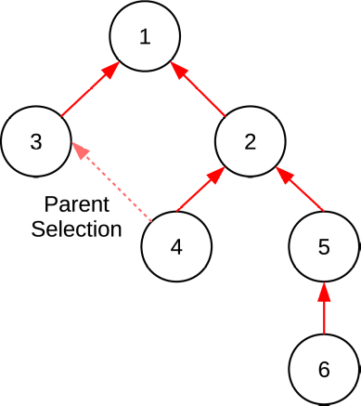
Upward Routes storing and non-storing mode

Slide 4
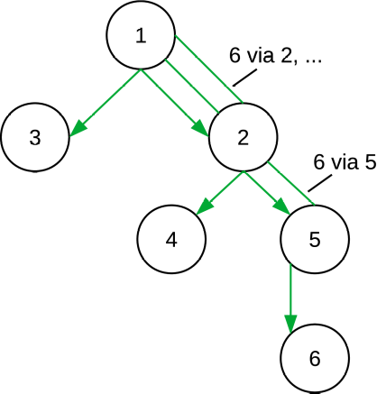
Downward Routes storing mode

Slide 5
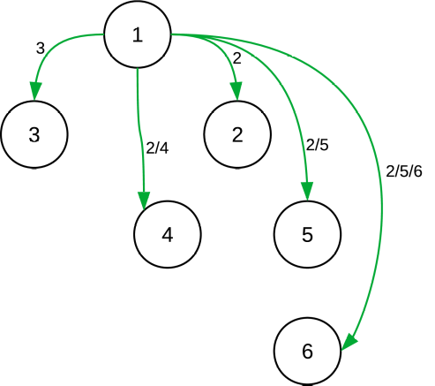
Downward Routes non-storing

Slide 6
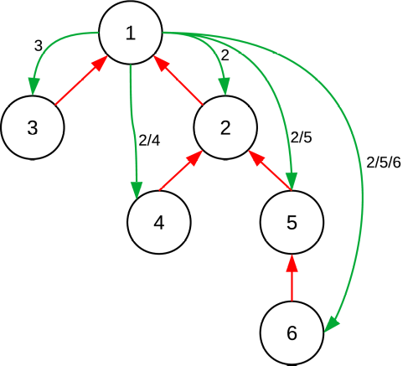
Downward and Upward Routes non-storing

Slide 7
RPL - Segment Routing
Root Node inserts SR extension header
Forwarding
  Address swapping
  Loop detection
Compression
  Addresses inside the segment array
  According to destination address

Slide 8
Implementation
Lightweight Tunnel (net/ipv6/rpl_iptunnel.c)
  Like IPv6 Segment Routing (the other SR)
    Per route prefix and adding source routing header
    Cannot setup IP encapsulation yet
  Config: IPV6_RPL_LWTUNNEL
Forwarding (net/ipv6/exthdrs.c)
  Always build into IPv6
  Can be enabled via sysfs
Compression Helpers (net/ipv6/rpl.c)

Slide 9
rpld
Experimental user space daemon
Exchange ICMPv6 messages
Tree implementation to represent topology
Non-storing mode operation
  Creating upward routes
  Nodes report parent and own address to root node
  Root node setup RPL source routing entries

Slide 10
DEMO

Slide 11
Future Work

