Slide 1


安全操作系统
中国科学技术大学计算机系
陈香兰（0512－87161312）
xlanchen@ustc.edu.cn
助教：裴建国
Autumn 2008

Slide 2
第八章 国外知名安全操作系统介绍
SE-Linux介绍
EROS介绍

Slide 3
Introduction to SE-Linux

Slide 4
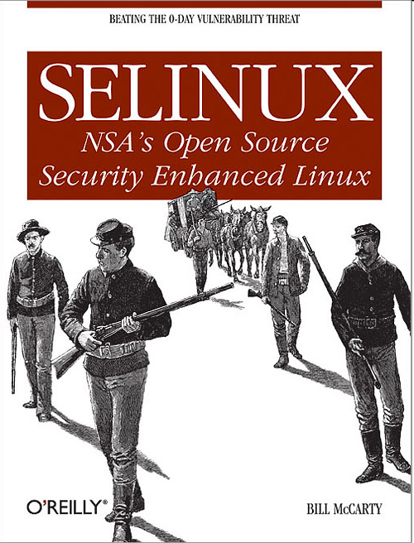
Reference Book
SELinux
NSA's Open Source Security Enhanced Linux
By Bill McCarty
October 2004
Pages: 254

Slide 5
声明
本部分内容参考了网上搜索到的多个ppt
  David Quigley关于SELinux的ppt《 Security Enhanced Linux》
  Kenduest Lee（小州）的《SELinux入门初探》

Slide 6
主要内容
Definition
History
Concepts
Architecture
SELinux Policy Language
Userspace
实现
使用

Slide 7
主要内容
Definition
History
Concepts
Architecture
SELinux Policy Language
Userspace
实现
使用

Slide 8
Wikipedia says:
Security-Enhanced Linux (SELinux) is a Linux feature that provides a variety of security policies, including U.S. Department of Defense style mandatory access controls, through the use of Linux Security Modules (LSM) in the Linux kernel. It is not a Linux distribution, but rather a set of modifications that can be applied to Unix-like operating systems, such as Linux and BSD. …
Primarily developed by the US National Security Agency …

Slide 9
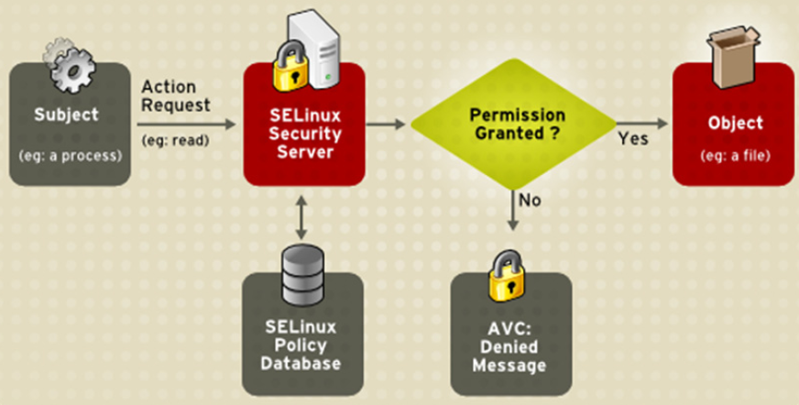
运行示意图

Slide 10
主要内容
Definition
History
Concepts
Architecture
SELinux Policy Language
Userspace
实现
使用

Slide 11
SELinux Timeline
1985: LOCK (early Type Enforcement)
1990:
DTMach / DTOS
1995:
Utah Fluke / Flask
1999: 2.2 Linux Kernel (patch)
2000:
2001: 2.4 Linux Kernel (patch)
2002: LSM
2003: 2.6 Linux Kernel (mainline)
2006: Full network labeling
Present
Notes:
FLUX/Fluke was name of OS Flask was built on
DTOS and DTMach developed by Secure Computing Corp and NSA

Slide 12
主要内容
Definition
History
Concepts
Architecture
SELinux Policy Language
Userspace
实现
使用

Slide 13
Concepts
Basic security models
  TE
  RBAC
  MLS
Basic elements
  Subjects
    process that are requesting access to an object
  Objects
    items in a system that are acted upon (files, IPC, sockets, etc….)
  Actions

Slide 14
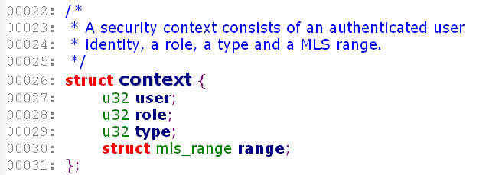
SELinux中对上述几种安全模型的实现
All Objects and Subjects contain a security context
  Security Context(s) are composed of four parts
观察linux-2.6.26\security\selinux\ss\context.h中关于安全上下文的定义

Slide 15
Security context，安全上下文
Three security attribute
User identity：与主体或客体相关联的用户id
  对一个主体，即进程而言，代表了该进程运行所处的账户上下文
  对一个客体，表明该客体的拥有者
  注意：与Linux自主访问控制中的UID，是不同的两套概念
Role
Type

Slide 16
Role：a set of permission a user can be granted
  在任意时刻，用户只能处于一个角色
  newrole命令：使用户从一个角色切换到另一个角色
    类似linux中的su命令
  4种标准角色:
    staff_r Used for users permitted to enter the sysadm_r role
    sysadm_r Used for the system administrator
    system_r Used for system processes and objects
    user_r Used for ordinary users
  dummy role for object that have no other need of a role
    object_r
Notes:
后缀”-r“

Slide 17
Type
TE给每个主体和系统中的客体定义了一个类型
当一个类型与进程关联时，其type也称为domain
Type用来将主体和客体划分为不同的组
  例如sysadm_t
安全上下文的格式
user:role:type
系统中每个文件/目录/网络端口等都被指定一个安全上下文，安全策略则给出各安全上下文之间的作用规则
Notes:
后缀”-t“

Slide 18

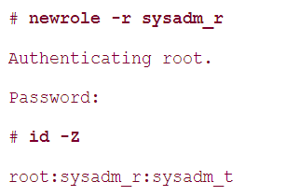
在selinux中查看用户的安全上下文

Slide 19
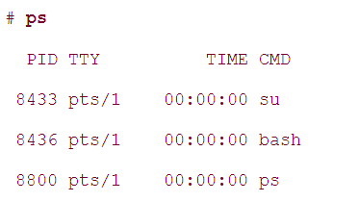
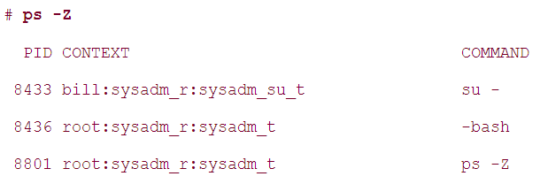
在selinux中查看进程的安全上下文

Slide 20
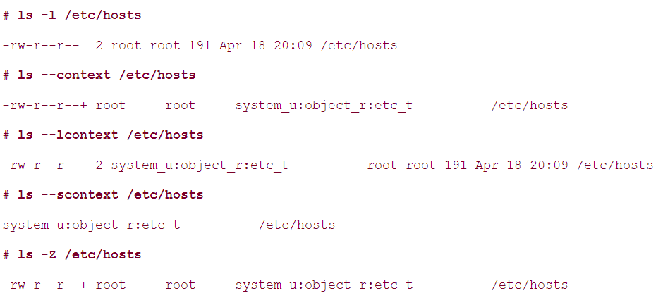
在selinux中查看文件的安全上下文

Slide 21
All Security Context components are checked against the policy to see if access is allowed.
Type is the base component while role and user are used to further restrict type enforcement
user
role
Domain type
object type
用户、角色、域类型与客体类型的关系图
Notes:
每个用户属于某个角色；角色有与用户组相关的域类型；域类型指定了对客体类型的访问控制权限

Slide 22
安全标识符SID
与安全上文对应
系统启动时，这个数据结构将被装载
  initial SIDs
理解：安全上下文，被保存在某种数据结构中，例如表格，使用SID可以在这个数据结构中找到对应的安全上下文

Slide 23
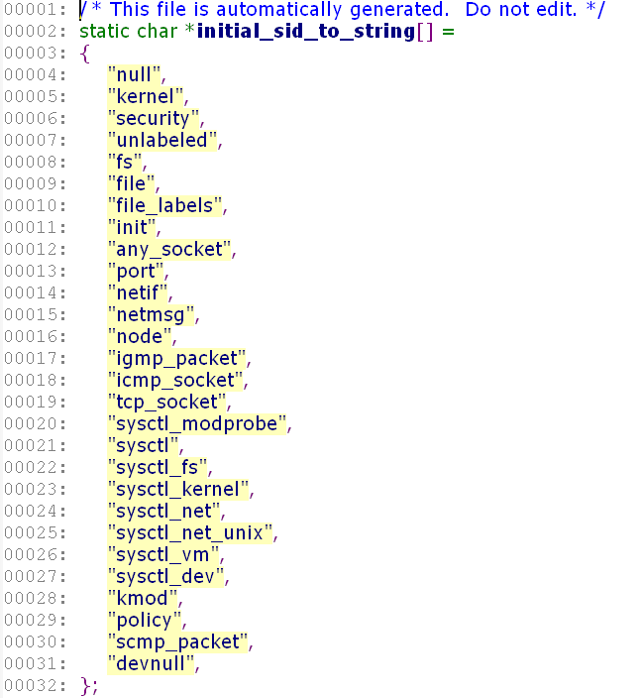

Slide 24
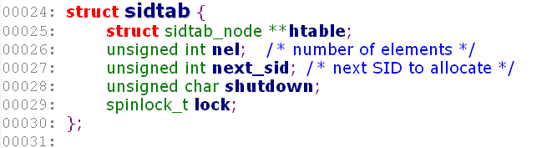
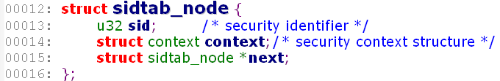
对象的生命期
根据生命期的不同，linux中的对象分成2种
  transient objects and persistent objects
transient objects
  通常是一些内核数据结构，例如：进程
  SELinux使用memory-resident table进行SID和安全上下文的映射关系

Slide 25
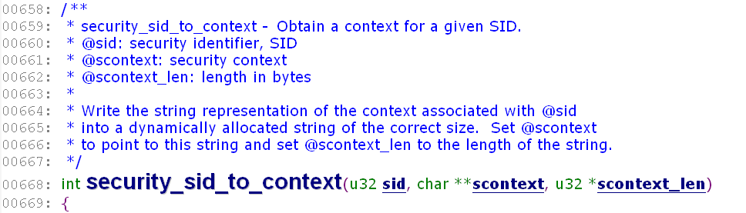

Slide 26
persistent objects
  例如文件、目录
  SELinux利用文件系统来存放永久安全描述符PSID
    例如，利用ext2/ext3的扩展属性
  在最初安装SELinux时，要为文件创建PSID
    labeling进程利用setfile进行
    Setfile根据一个称为file context的数据库进行
    File context为一些特殊文件定义了初始安全上下文；为其他文件定义了缺省的安全上下文

Slide 27
Access Decisions
The SELinux security server makes two basic kinds of decisions:
  Access decisions
  Transition decisions, also called labeling decisions

Slide 28
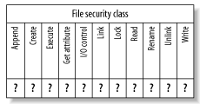
Access decisions
Access vector
  A bitmap associated with each object class
A simplified access vector for the file class

Slide 29
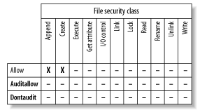
Make the access decision by considering
  主体的安全上下文
  客体的安全上下文
  客体的安全类型
  Action
返回：访问向量
3个向量中，允许主体
Append/create客体
A simplified access vector resulting from an access decision
Notes:
Allow
The allow access vector identifies operations that the subject is permitted to perform on the object. No log entry is made of the operation.
Auditallow
The auditallow access vector causes a log entry to be made when the indicated operation is performed. Despite its name, it doesn't allow any operation; only the Allow vector does so.
Dontaudit
The dontaudit access vector identifies operations that the subject is not permitted to perform on the object, but that don't cause the denial to be logged.
Three rules govern access to objects:
A requested action is denied unless the security server returns allow. Therefore, requests that have no matching policy rule are denied.
If an action is denied, a log entry is made unless the security server returns dontaudit.
If the security server returns auditallow, a log entry is made.

Slide 30
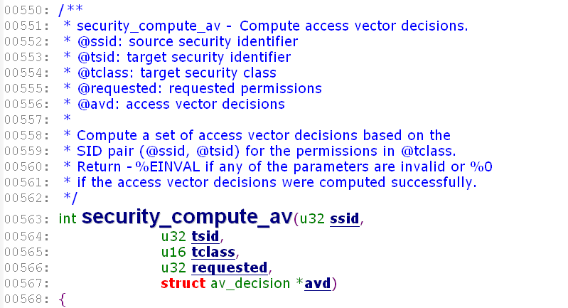

Slide 31
Transition decisions
For newly created objects
  Process (subject) creation
  File (object) creation

Slide 32
主要内容
Definition
History
Concepts
Architecture
SELinux Policy Language
Userspace
实现
使用

Slide 33
SELinux Architecture
SELinux consists of the following major components:
  Kernel-level code
  The SELinux shared library
    libselinux1.so
  A security policy
    From a binary policy file：/etc/security/selinux
  Tools
  Labeled SELinux filesystems (optional)

Slide 34
关于内核部分，采用了LSM
Kernel framework for security modules
Provides a set of hooks to implement further security checks
Usually placed after existing DAC checks and before resource access
Implications? SELinux check is not called if the DAC fails
Makes auditing difficult at times.

Slide 35
SELinux LSM Module
Policy Management
Interface
User Space
Kernel Space
Selinux Filesystem
Access
Vector
Cache
Security Server
(Policy Rules and
Access Decision Logic)
Various Kernel
Object Managers
Cache Miss
LSM Hooks
Yes or No?
SELinux LSM Module
Figure taken from SELinux by Example

Slide 36
关于用户态库：
User-Space
Object Manager
Userspace Object Managers
Allow
access?
Access
Vector
Cache
Yes or No?
libselinux
Policy Management
Interface
User Space
Kernel Space
Selinux Filesystem
Access
Vector
Cache
Security Server
(Policy Rules and
Access Decision Logic)
Cache Miss
Yes or No?
Figure taken from SELinux by Example
Notes:
User-space AVC is in libselinux
User-space consults kernel via Selinuxfs
User-space object managers must declare types for their objects
Ex Database server would define (database,table,schema,entry etc..)

Slide 37
Policy Server
User-Space
Object Manager
Load
User
Policy
Policy
Management
Interface
User-Space
Security Server
Policy
Management
Server
Access
Vector
Cache
Cache Miss?
Yes or No?
libselinux
Policy Server
User Space
Kernel Space
Selinux Filesystem
Access
Vector
Cache
Security Server
(Policy Rules and
Access Decision Logic)
Cache Miss
Yes or No?
Figure taken from SELinux by Example
Notes:
PMS allows you to restrict administration of certain parts of the policy. Now a secadmin doesn’t need to install database policy. A database admin can
Avoid context switches by moving the user space policy decisions to user space

Slide 38
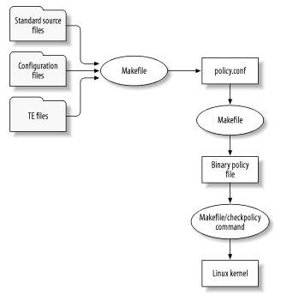
关于策略和策略文件

Slide 39
Policy Language
Policy Source
Modules
Checkpolicy
policy.conf
Classes and Permissions
Type Enforcement
Statements
(Types, TE Rules,
Roles, Users)
Binary Policy
File
Make, Scripts,
M4, and so on
load_policy
Kernel Space
Selinux Filesystem
Constraints
Resource labeling
Specifications
Access
Vector
Cache
Security Server
(Policy Rules and
Access Decision Logic)
Cache Miss
Yes or No?
SELinux LSM Module
Figure taken from SELinux by Example

Slide 40
关于SELinux的一些源文件
the SELinux source files are of four major types
  Standard source files that are seldom modified by the SELinux administrator
  Source files that are typically modified by the SELinux administrator during initial configuration of SELinux
  Type-Enforcement (TE) source files
  File Context (FC) source files

Slide 41
SELinux Tools
SELinux includes three main categories of tools:
  Special commands used to administer and use SELinux
  Modified versions of standard Linux commands and programs
  Supplementary SELinux tools, used for purposes such as policy analysis and development

Slide 42
SELinux commands
例如
chcon
checkpolicy
getenforce/setenforce
newrole
run_init
setfiles
avc_enforcing
avc_toggle

Slide 43
Modified Linux commands and programs
例如
  cp, mv, install, and other basic commands
  id
  ls
  ps
  cron
  login
  logrotate
  pam
  ssh
  various programs that modify /etc/passwd or /etc/shadow

Slide 44
Supplementary SELinux tools
例如
  Apol
  SeAudit
  SeCmds
  SePCuT
  SeUser

Slide 45
主要内容
Definition
History
Concepts
Architecture
SELinux Policy Language
Userspace
实现
使用

Slide 46
Object Classes
Represents resources of a certain kind
Policy must include declarations for all object classes
Classes
  File related (blk_file,chr_file,dir,fd …)
  Network related (socket, packet_socket, rawip_socket, …)
  IPC related (ipc, msg, msgq, sem, shm)
  Misc Classes (capability, process, security, system)

Slide 47
Permissions
Specific to a particular Object Class
Includes traditional Linux permissions
Extends existing permissions to be finer grained
Includes SELinux specific permissions for labeling

Slide 48
Type Enforcement
Several major keywords
  type
  attribute
  typeattribute
  typealias
  allow
  dontaudit
  auditallow
  Neverallow

Slide 49
类型的定义
type <typename> [aliases] [attributes];
例
    # httpd_config_t 是一个系统管理文件的类型
    type httpd_config_t, file_type, sysadmfile;
    # httpd_port_t是保留的端口，端口号小于1024
    type http_port_t, port_type, reserved_port_type;

Slide 50
TE访问向量规则（TE Access Vector Rules）
<av_kind> <source_type(s)> <target_type(s)>:<class(es)> <permission(s)>
av_kind
  allow 表示允许主体对客体执行允许的操作。
  neverallow 表示不允许主体对客体执行指定的操作。
  auditallow 表示允许操作并记录访问决策信息。
  dontaudit 表示不记录违反规则的决策信息，
  且违反规则不影响运行。

Slide 51
例
#允许域user_t对bin_t类型客体进行类别为file的read等操作
allow user_t bin_t:file{read getattr lock execute ioctl execute_no_trans};
#允许域user_t对它自己类型的客体进行process类别的所有操作
allow user_t self: process*;
#允许域userdomain对shell_exec_t类型客体进行file类别的read等操作
allow userdomain shell_exec_t: file{ read getattr lock execute ioctl};
# 不允许域passwd_t对非bin_t等类型的客体进行file类别的execute_no_trans操作
neverallow passwd_t ~{ bin_t sbin_t ld_so_t} : file execute_no_trans;
#不允许域domain对非domain类型的客体进行process类别的类型转移操作
neverallow domain ~domain: process transition;

Slide 52
TE转移规则
类型转移的语法如下：
type_transition <source_type(s)> <target_type(s)> : \
<class(es)> <new_type>
域转移语法如下：
type_transition <current_domain> <type_of_program> : \
process <new_domain>
创建一个新客体时
创建一个新进程时

Slide 53
例：域转移
type_transition httpd_t httpd_sys_script_exec_t:process \
httpd_sys_script_t;
type_transition initrc_t squid_exec_t:process squid_t;
当后台进程httpd以域httpd_t运行类型为httpd_sys_script_exec_t的文件，如：CGI脚本文件，新的进程（如：CGI脚本进程）将赋为httpd_sys_script_t域。
当域为initrc_t的init进程执行squid_exec_t类型的文件时，新进程将赋为squid_t域。

Slide 54
例：类型转移
type_transition named_t var_run_t:sock_file named_var_run_t;
当在域named_t的一个进程在类型为var_run_t的目录创建一个socket文件时，该socket文件被赋予named_var_run_t类型。

Slide 55
RBAC
Adds 2 components to security context
  user
  role
Adds 3 policy language keywords
  allow (different than AVC allow)
  role_transition (similar to type_transition)
  Dominance

Slide 56
角色定义
role <rolename> types <domain(s)>;
例：
  #允许管理者角色访问域ldconfig_t
  role sysadm_r types ldconfig_t;

Slide 57
角色的继承
# master_r继承sysadm_r和user_r角色的权限
dominance {role master_r {role sysadm_r; role user_r;} }

Slide 58
角色的转移
#当一个管理者执行一个$1_exec_t类型的进程时，进程从sysadm_r转移到system_r
role_transition sysadm_r $1_exec_t system_r;
角色允许的语法如下：
allow <current_role(s)> <new_role(s)>;
#允许角色user_r转移到新角色
allow user_r sysadm_r;

Slide 59
用户定义
user <user_identifier> <roles>{role_list};
例：
user root { user_r sysadm_r } ;
特殊用户：system_u、user_u
login, sshd, 和 crond命令运行登录时设置安全上下文，默认的安全上下文由下面文件决定：policy/contexts/users/username (per-user defaults)
policy/contexts/default_contexts (system defaults)
Notes:
system_u 系统进程和资源的用户，linux用户不能创建它，也不能删除它。
user_u linux普通用户，在策略中没定义，没定义的普通用户是不能登录机器的。

Slide 60
Multilevel Security
策略对级别和类型进行声明
对客体和许可进行限制
  constrain <class_set> <perm_set> <expression>;
表达式主要有：
  u1 op u2 #u1和u2分别表示操作前后的用户身份
  r1 role_op r2 #r1和r2分别表示操作前后的角色
  t1 op t2 #t1和t2分别表示操作前后的类型
  u1 op user_set #user_set表示用户身份集
  u2 op user_set
  r1 op role_set
  r2 op role_set
  t1 op type_set
  t2 op type_set
表达式中的关键字有
  not, and, or, =, !=等，role_op还包括角色继承操作符

Slide 61
例
constrain process transition( r1 == r2 or t1 == privrole);
constrain dir_file_class_set { create relabelto relabelfrom }
( u1 == u2 or t1 == privowner );
constrain socket_class_set { create relabelto relabelfrom }
( u1 == u2 or t1 == privowner );
限制进程域转移的能力，类型转移前后进程的角色一致，或者，进程有类型为privrole。
限制标识客体的能力，即标识客体时，标识前后客体的用户身份一致或者标识前进程的域为privowner

Slide 62
给SID定义上下文
sid sid_identifier security_context
一些策略库预定义的SID在policy/initial_sid_contexts中
例：
  sid kernel system_u: system_r: kernel_t
  sid security system_u: object_r: security_t
  sid unlabeled system_u: object_r: unlabeled_t

Slide 63
文件系统的标识行为
当文件系统被SELinux内核mount上时，安全服务器决定给基于filesystem类型的文件系统里的节点合适的标识行为。
对于有唯一且永久的节点号的传统文件系统
  fs_use_psid ext2;
  fs_use_psid ext3;
  fs_use_psid reiserfs;
永久sid

Slide 64
对于代表管道和socket对象的伪文件系统
  fs_use_task pipefs system_u:object_r:fs_t;
  fs_use_task sockfs system:object_r:fs_t;
对于代表伪终端和共享内存对象的伪文件系统
  fs_use_trans devpts system_u:object_r;devpts_t;
  fs_use_trans tmpfs system_u:object_r:temfs_t;
指定创建进程的上下文给代表对象的节点
从创建进程的上下文和与文件系统类型相关的上下文中派生出上下文。
派生出的上下文由配置中的类型转移来决定

Slide 65
网络对象上下文
例1：定义端口的上下文
portcon tcp 80 system_u:object_r:http_port_t
portcon tcp 8080 system_u:object_r:http_port_t
例2：定义网络接口的上下文：
netifcon eth0 system_u:object_r:netif_eth0_t
system_u:object_r:netmsg_eth0_t
例3：定义节点的上下文
nodecon 10.33.10.66 255.255.255.255 system_u:object_r:node_zeus_t;
nodecon 10.33.10.0 255.255.255.0 system_u:object_r:node_any_t

Slide 66
Reference Policy
Maintained by NSA and FC Mailing Lists
Compiles into three versions
  Strict, Targeted, MLS
  Targeted
  除指定的后台外，每个主体和客体都运行在unconfined_t，除了标准的linux DAC限制外，在unconfined_t域系统上的客体没有任何限制
  在Fedora Core Linux中配置的是targeted策略
  Strict，严格策略
  每个主体和客体有一个指定的域，复杂

Slide 67
主要内容
Definition
History
Concepts
Architecture
SELinux Policy Language
Userspace
实现
使用

Slide 68
组件
checkpolicy
libselinux
libsemanage
libsepol
Policycoreutils

Slide 69
libselinux
Used by SELinux aware applications
Houses user space AVC
Contains functions to
  calculate AVCs
  get/set/create contexts
  query policy engine
User-Space
Object Manager
Access
Vector
Cache
libselinux

Slide 70
libsemanage
Used to query and configure state of a running system
Provides functions to query/modify
  login names
  users
  network ports/interfaces
  file contexts
  level translations
  roles
  etc.

Slide 71
SELinuxfs
Interface between userspace and kernel
Used by libselinux and libsemanage to communicate requests with the kernel
Provides a quick and easy interface for humans
Usually not used directly from programs

Slide 72
Policycoreutils
SELinux Management and policy analysis tools
  audit2allow
  audit2why
  load_policy
  newrole
  restorecon
  semanage
  semodule
  sestatus
  setbool
  etc...

Slide 73
主要内容
Definition
History
Concepts
Architecture
SELinux Policy Language
Userspace
实现
使用

Slide 74
实现
观察selinux在Linux2.6.26中的位置
  了解目录信息
  大概了解selinux的源代码规模
使用sourcelinecounter，了解selinux的代码量

Slide 75
结合LSM架构，理解SELinux
SELinux security data structures for kernel objects
  观察linux-2.6.26\security\selinux\include\objsec.h
SELinux提供的各种钩子函数
  观察linux-2.6.26\security\selinux\hooks.c中selinux_ops

Slide 76
SELinux的初始化
  selinux_init是在根文件系统挂载后，被调用的，因此可以直接从根文件系统中获得配置数据
  观察linux-2.6.26\security\selinux\hooks.c中selinux_init

Slide 77
selinuxfs pseudo filesystem
for exporting the security policy API
观察selinux文件系统

Slide 78
主要内容
Definition
History
Concepts
Architecture
SELinux Policy Language
Userspace
实现
使用

Slide 79
Distributions
Fedora Core 3 and later
Debian GNU/Linux
Gentoo Linux
SuSe
SE-BSD
SE-MACH

Slide 80

Demo Systems
http://selinux.dev.gentoo.org
  Gentoo
http://www.coker.com.au/selinux/play.html
  a Fedora Core system administered by Russell Coker
http://selinux.simplyaquatics.com
  Debian

Slide 81
Using and Administering SELinux
System Modes and SELinux Tuning
Controlling SELinux
Routine SELinux System Use and Administration
Monitoring SELinux
Troubleshooting SELinux

Slide 82
System Modes and SELinux Tuning
系统运行模式
  Disabled
  Permissive模式
    编译选项：NSA SELinux Development support
  Enforcement模式
违反策略之后，…
Notes:
允许模式
强制模式
允许模式：总是允许，对于违反策略的行为要审计
强制模式：违反策略则不允许

Slide 83
Controlling SELinux
Switching the SELinux mode
  启动时切换：修改启动参数
  运行时切换
  角色：sysadm_r
  修改/selinux/enforce为1或者0
  利用各种命令或工具
Loading a security policy
  参考相关手册
Labeling files
  参考相关手册

Slide 84
Routine SELinux System Use and Administration
Entering a role
  newrole
Viewing security contexts
  id；ls；ps （--context ; --lcontext ; --scontext ; -Z）
Adding users and groups
  useradd
Starting and controlling daemons
Tuning SELinux

Slide 85
Monitoring SELinux
SELinux Log Message Format
  avc: result { operation } for pid=pid exe=exe path=opath dev=devno:ptno ino=node scontext=source tcontext=target tclass=class
Result: granted或者denied
Exe：可执行文件
Opath：对象路径
Devno和Ptno：对象所在块设备号和分区号
Node：对象索引节点号
Source：进程的安全上下文
Target：对象的安全上下文
Class：对象的类型

Slide 86
举例：
内核审计log消息的指针，()中依次是时间戳组成的当前时间的未格式化长整数，毫秒的短整数和序列数，帮助从多个消息进行审核跟踪。
时间戳 主机名
Jan 14 19:10:04 hostname kernel: audit(1105758604.519:420): \
avc: denied { getattr } for pid=5962 exe=/usr/sbin/httpd \
path=/home/auser/public_html dev=hdb2 ino=921135 \
scontext=root:system_r:httpd_t \
tcontext=user_u:object_r:user_home_t tclass=dir
Notes:
红色：主体相关
蓝色：客体相关

Slide 87
avc: denied { write } for pid=10400 exe=/usr/bin/nmap lport=255 scontext=root:staff_r:nmap_t tcontext=root:staff_r:nmap_t tclass=rawip_socket
avc: denied { read } for pid=12999 exe=/usr/bin/slocate name=slocate.db dev=03:02 ino=391745 scontext=bill:staff_r:staff_t tcontext=system_u:object_r:var_lib_t tclass=file

Slide 88
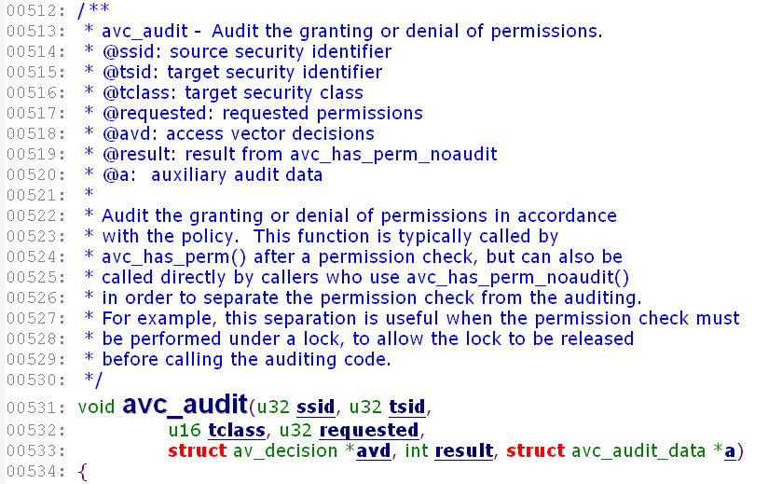

Slide 89
More Information
SELinux Homepage: www.nsa.gov/selinux
SELinux Mailing list: http://www.nsa.gov/selinux/info/list.cfm?MenuID=41.1.1.9
Redhat SELinux Mailing List: http://www.redhat.com/mailman/listinfo/fedora-selinux-list
Fedora SELinux Wiki: http://fedoraproject.org/wiki/SELinux

Slide 90
Thanks！
The end.

Slide 91

SELinux
Security Enhanced Linux
NSA，
National Security Agency，
美国国家安全局
SCC，
Secure Computing Corp.
Type enforcement，类型实施
DTMach→DTOS
DTOS安全结构→Flask
Flask+Linux➔SELinux

Slide 92
Type Enforcement, TE
类型加强
DTE

Slide 93
TE Access Control
allow user_t bin_t : file {read execute write getattr setattr}
Source type(s):
  The domain type of the process accessing the object
Target type(s):
  The type of the object being accessed by the process
Object class(es):
  The class of object to permit access to
Permission(s):
  The kind of access permitted for the indicated object class

Slide 94
Domain Transitions
Analogous to SetUID programs
Joe running as user_t (untrusted user) needs to change his password. How does Joe change his password?
What does this solve? Restricts trusted domain passwd_t and allows user_t to transition to it.
Implicit domain transitions provided via type_transition.
allow user_t passwd_exec_t : file {getattr execute}
allow passwd_t passwd_exec_t : file entrypoint
allow user_t passwd_t : process transition
返回

Slide 95
Users & Roles
First and second component of a security context
  user:role
SELinux usernames and DAC usernames are not synonymous
Semanage is used to maintain mappings of DAC to SELinux usernames.
Roles are collections of types geared towards a purpose
Roles can be used to further restrict actions on the system
SELinux usernames are granted roles in the system
返回

Slide 96
MLS
MLS portion of Security Context is composed of 4 parts
  Low/High
  Sensitivity/Category
Includes syntax to define dominance of security levels
Subjects with range of levels considered trusted subjects
Implements a variation of Bell-La Padula

Slide 97
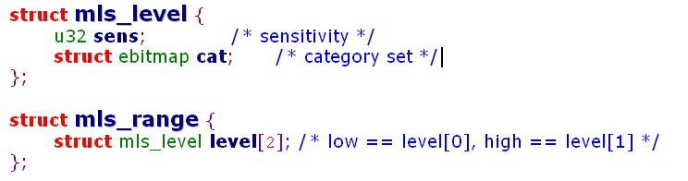
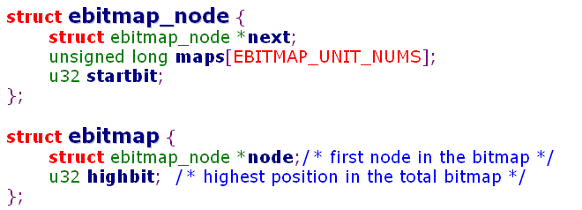
返回

Slide 98
Security object classes
系统中定义了30中不同的客体类别
  File classes
  Interprocess communication classes, IPC
  Network classes
  Object class
  System classes
每个类别有不同的许可
  例如，file有19个许可
  ioctl read write create getattr setattr lock relabelfrom relabelto append unlink link rename execute swapon quotaon mounton execute_no_trans entrypoint
返回

Slide 99
File classes
blk_file Block device file
chr_file Character device file
dir Directory
fd File descriptor
fifo_file FIFO file
file File
Filesystem Formatted filesystem residing on disk
partition
lnk_file Hard or symbolic link
sock_file Network socket file
返回

Slide 100
IPC classes
ipc (Obsolete)
msg IPC message within queue
msgq IPC queue
sem IPC semaphore
shm IPC shared memory
返回

Slide 101
Network classes
key_socket IPSec socket
netif Network interface
netlink_socket Socket used to communicate with kernel via the
netlink syscall
node TCP/IP network host, as represented by IP addr
packet_socket Obsolete object type used by Linux 2.0 programs
invoking the socket syscall
rawip_socket Raw IP socket
socket Generic socket
tcp_socket TCP socket
udp_socket UDP socket
unix_dgram_socket Unix-domain datagram socket
unix_stream_socket Unix-domain stream socket
返回

Slide 102
Object class
passwd Linux password file
返回

Slide 103
System classes
capability SELinux capability
process Process
security Security-related objects, such as
the SELinux policy
system Kernel and system objects
进程，既是主体也是客体
返回

Slide 104
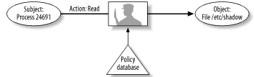
Action
vary with the type of object
For example, on file objects
  Append; Create; Execute; Get attribute; I/O control; Link; Lock; Read; Rename; Unlink; Write
返回
A typical SELinux decision

