Slide 1
Lending Club Case Study
Risk analytics in banking and financial services
How to make a decision for loan approval based on the applicant’s profile.
Find out the driving factors (or driver variables) behind loan default,

Slide 2
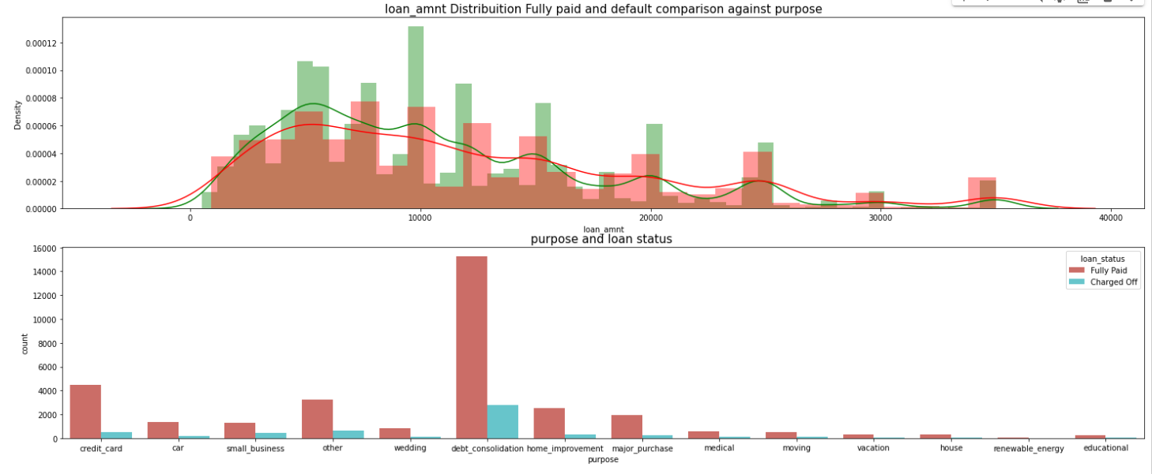
loan_amnt Distribuition Fully paid and default comparison against purpose

Slide 3
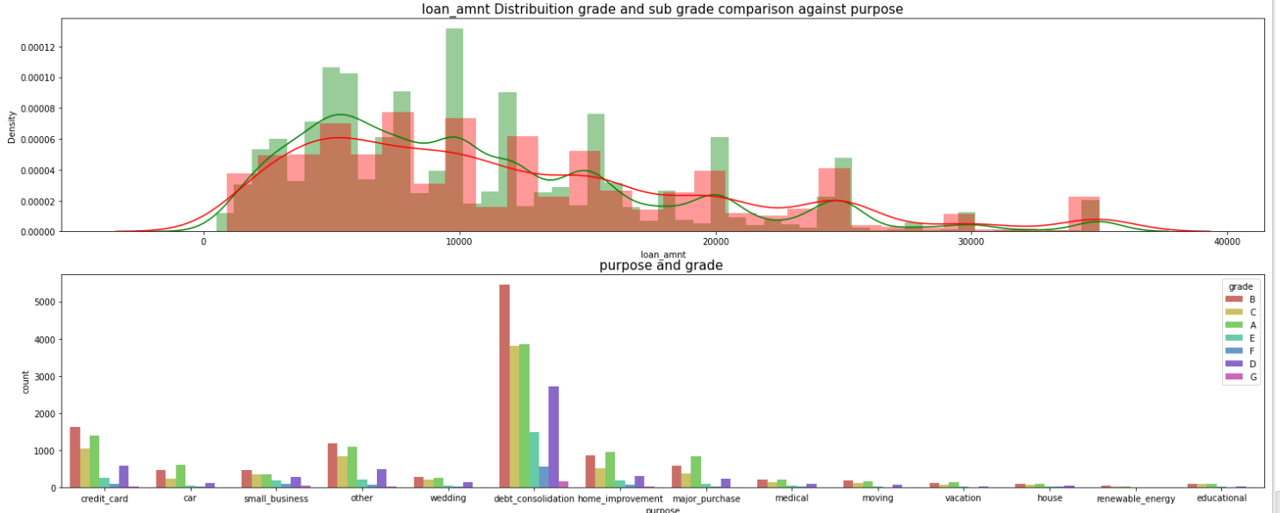
loan_amnt Distribuition grade comparison against purpose

Slide 4
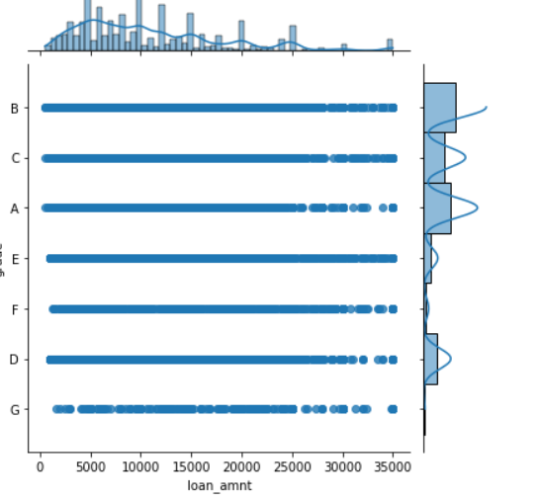
Grade A &B has high loan

Slide 5
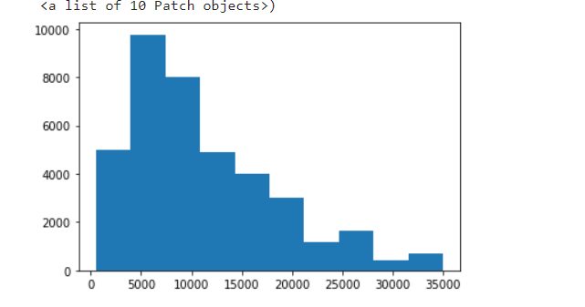
Highest loan is between 5k to 10k

