Slide 1
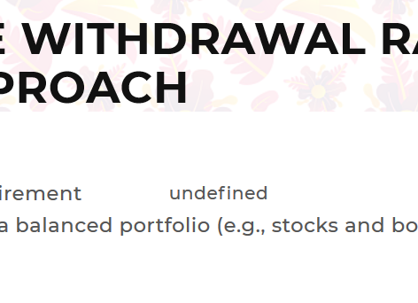
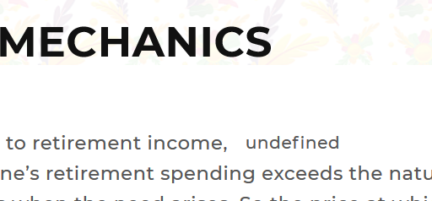
ANIMATED GIFS broken again!

Slide 2

TRADITIONAL
Delete THE + APPROACH
SET IT AND LEAVE IT
Delete STRATEGY

Slide 3
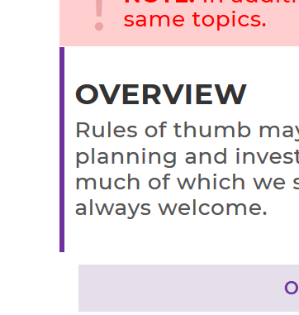
OVERVIEW sections
Please put padding back above / below OVERVIEW sections on all pages

Slide 4
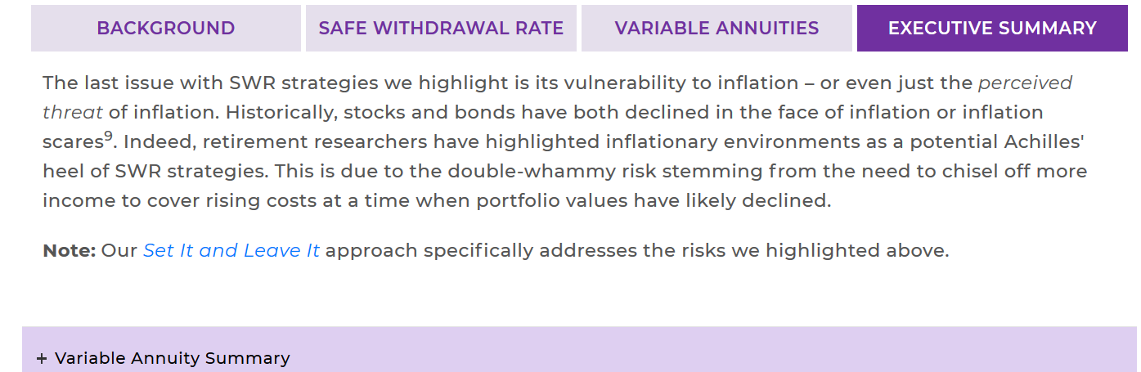
TRADITIONAL
Delete footnote 9

Slide 5
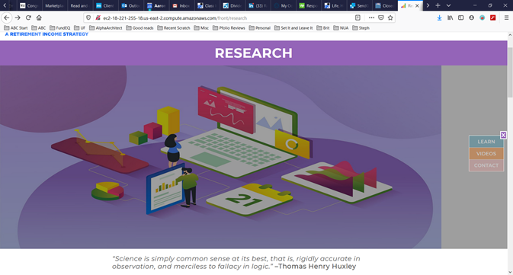
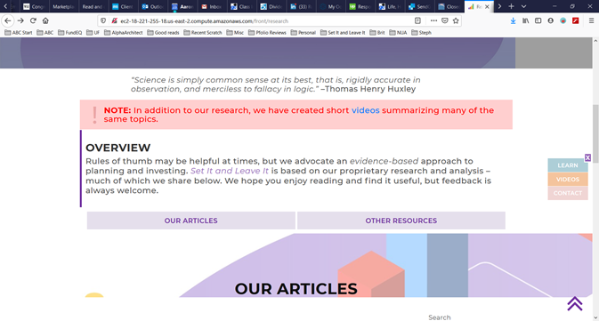
RESEARCH
[1] use the research hero image I sent (no gray shading)
[2] change the background image back (it got replaced with the hero image)

Slide 6
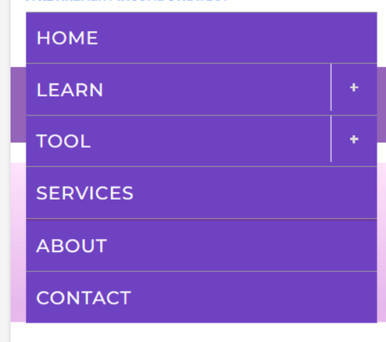
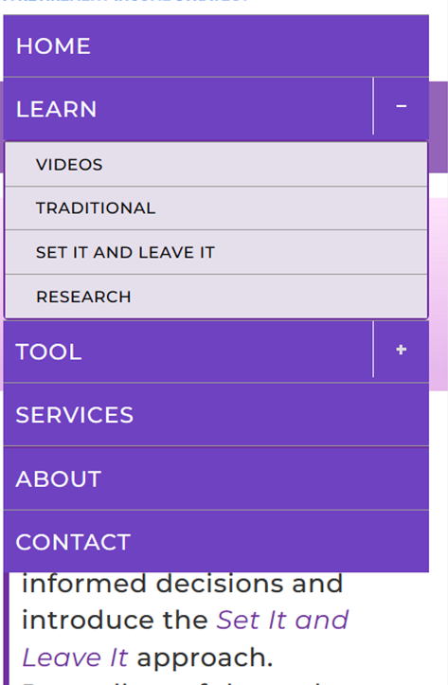
RESPONSIVE MENU
Clicking on LEARN and TOOL should expand/collapse (same functionality as the +/-)

Slide 7
PDF [3] It works on my PC in MOBILE/developer mode too (like in your videos), but not on my phone ==> QUESTION: Would it be easier to email it to the user? [4] The PDF it generates (on my computer) is not good. See attached. Reply :- Ok i will check and update you soon.
Please let me know

Slide 8
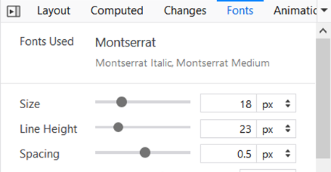
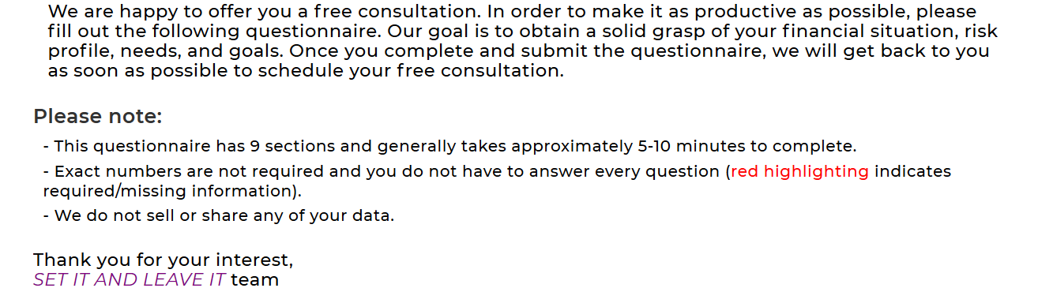
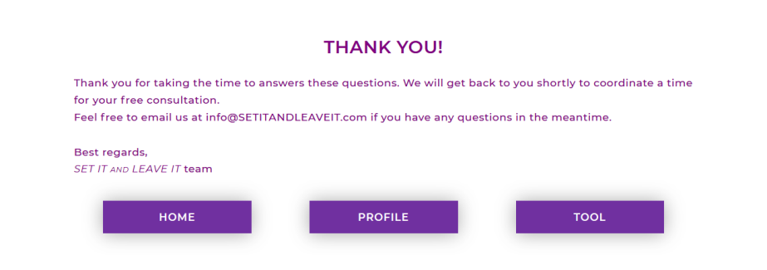
QUESTIONNAIRE OVERVIEW
Make all of this text 18px with 0.5 line spacing ➔
LEFT align all text
Please make square bullets 
Please make paragraph text on THANK YOU! page 18px also

Slide 9
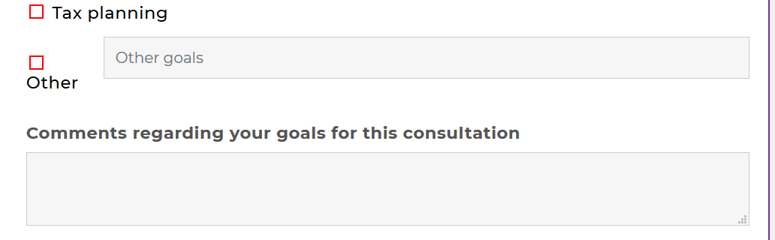
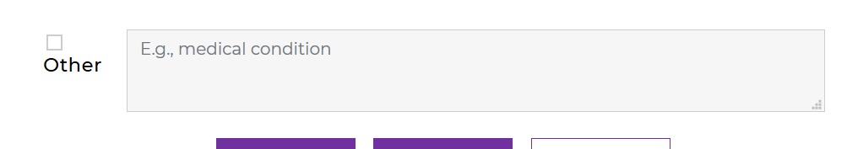
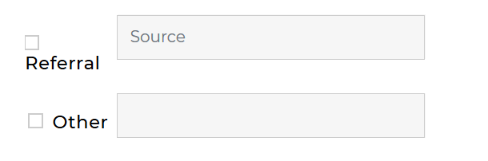
QUESTIONNAIRE GOALS
Please fix formatting for Other by moving text input box below Other
Same fix for Other on INSURANCE DETAILS page
Different fix for Other on OTHER QUESTIONS page
- Keep on SAME line / make more space for Referral + Other

Slide 10
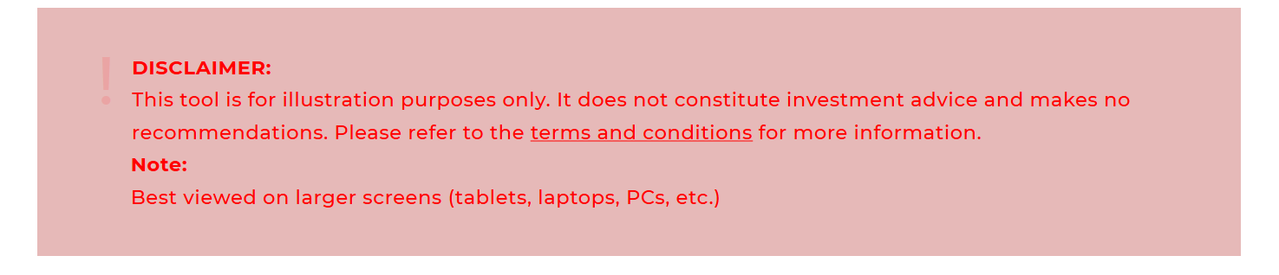
TOOL
Text for DISCLAIMER should start on SAME line ➔ DISCLAIMER: This tool is for …
Text for NOTE should start on SAME line ➔ NOTE: Best viewed on ….
Upper-case / capitalize both DISCLAIMER + NOTE
Capitalize NOTE

