Slide 1

SET IT AND LEAVE IT
This header should not be an active link and not blue (make it like it was before)

Slide 2
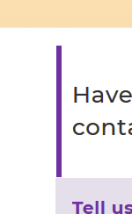
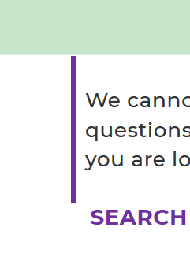

OVERVIEW sections
Please put padding back above / below OVERVIEW sections on ALL pages
FAQ SERVICES CONTACT

Slide 3
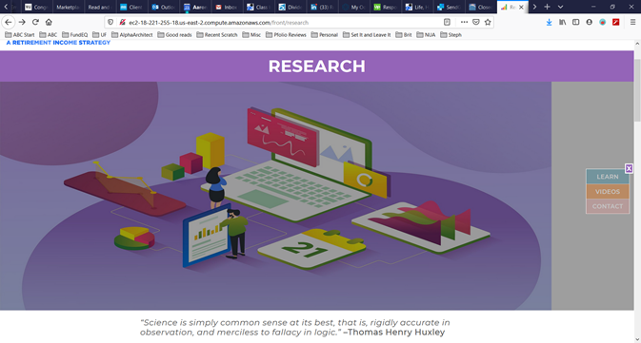
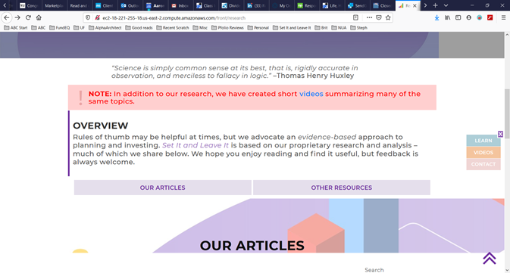
RESEARCH
[1] use the research hero image I sent (no gray shading)
[2] change the background image back (it got replaced with the hero image)

Slide 4
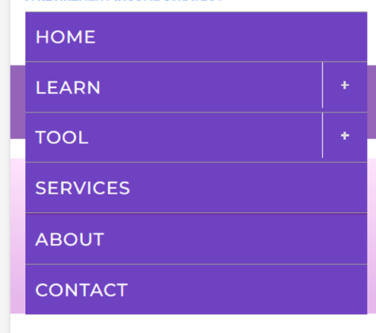
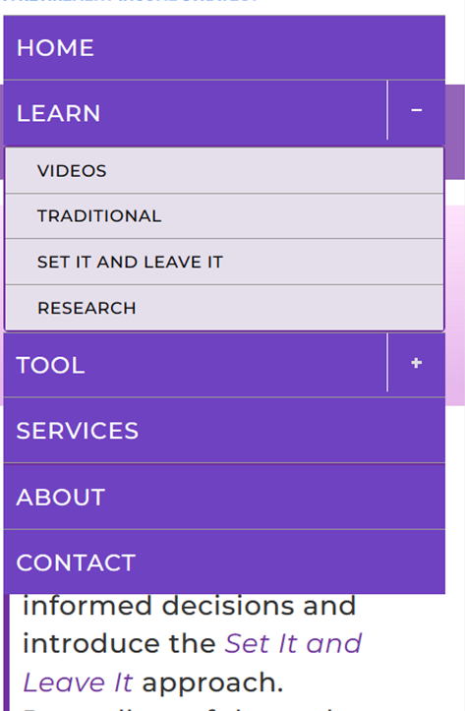
RESPONSIVE MENU
Clicking on LEARN and TOOL should expand/collapse (same functionality as the +/-)
[AGAIN!] Now the responsive navigation menu DOES NOT CLOSE when going to another page.

Slide 5
PDF [3] It works on my PC in MOBILE/developer mode too (like in your videos), but not on my phone ==> QUESTION: Would it be easier to email it to the user? [4] The PDF it generates (on my computer) is not good. See attached. Reply :- Ok i will check and update you soon.
Please let me know
Is this working now?

Slide 6
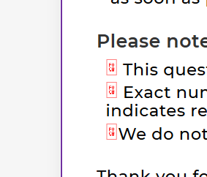
QUESTIONNAIRE OVERVIEW
Bullets got broken

Slide 7
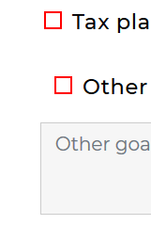
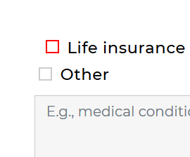
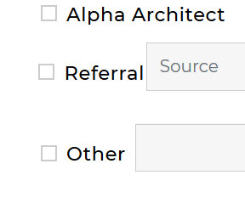
QUESTIONNAIRE
[GOALS] Please get this aligned
[INSURANCE DETAILS] Please get this aligned
[OTHER QUESTIONS] Please insert little space between Referral and input box AND please LEFT align both inputs boxes

Slide 8
TOOL
Typo: DISCLIMER ➔ DISCLAIMER
Word wrap / indentation should be same as before
Text should be SAME SIZE = 21px
!
DISCLAIMER: This tool is for illustration purposes only. It does not constitute investment advice and makes no recommendations. Please refer to the terms and conditions for more information.
NOTE: Best viewed on larger screens (tablets, laptops, PCs, etc.)

