Slide 1
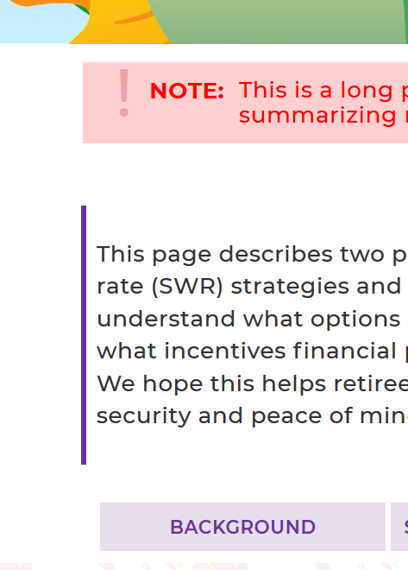
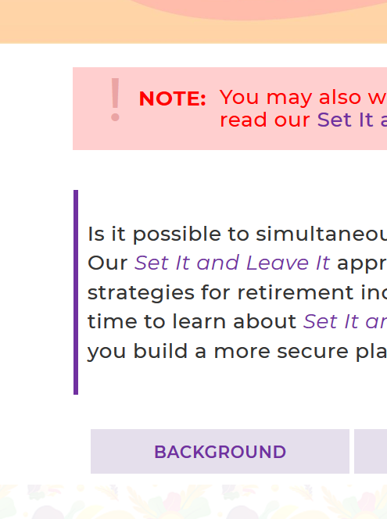

TRADITIONAL + SET IT AND LEAVE IT
I would really like the padding around ALL red boxes and ALL overview sections the SAME and EVEN
SET IT AND LEAVE IT
All the same
This is good
TRADITIONAL
Space between red box and overview section is too big. Please all three same as SET IT AND LEAVE IT
The rest of the pages (RESEARCH, TOOL, FAQ, SERVICES, CONTACT) are good BUT please make QUOTE on research page bigger text = 28px
Done

Slide 2
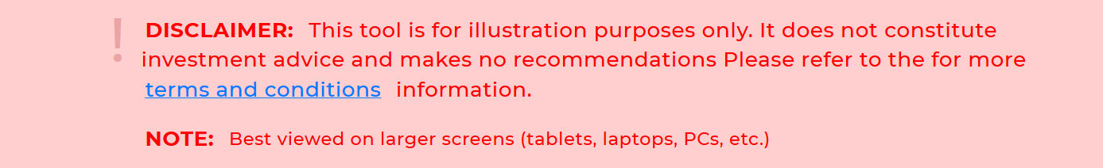
TOOL
Please make text same size = 21px
Done

Slide 3

AFTER LOGIN
Please CENTER both buttons
Still off a little
Use <center> or similar code?
Done

Slide 4
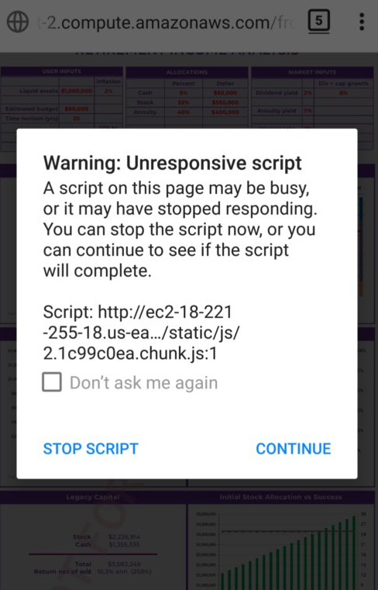
PDF [3] It works on my PC in MOBILE/developer mode too (like in your videos), but not on my phone ==> QUESTION: Would it be easier to email it to the user? [4] The PDF it generates (on my computer) is not good. See attached. Reply :- Ok i will check and update you soon.
THIS IS STILL NOT WORKING ON MY MOBILE
For a script in the web page, you can open the Firefox Browser Console, which may show what is causing the error. To open the error console, press the Alt key to view the file menu, then select Tools, Web Developer, and Browser Console, or press Ctrl+Shift+J. In the Browser Console, look for references to a specific script or add-on that generated the error message. If you find a reference to an add-on that generated the error, you can disable the add-on to see if that resolves the error.

