Slide 1
Kubernetes
Kubernetes is also known as 'k8s'. This word comes from the Greek language, which means a pilot or helmsman.
Kubernetes is an extensible, portable, and open-source platform designed by Google in 2014.
It is mainly used to automate the deployment, scaling, managing micro-services and containerized applications across a distributed cluster of nodes.
Kubernetes gives you the platform to run your application on containers as cluster of physical or virtual machines.
A Kubernetes cluster is a set of machines for running containerized applications. You can visualize a Kubernetes cluster as two parts: the control plane and the compute machines, or nodes.
The Kubernetes API (application programming interface) is the front end of the Kubernetes control plane and is how users interact with their Kubernetes cluster. The API server determines if a request is valid and then processes it. The Kubernetes API is the interface used to manage, create, and configure Kubernetes clusters. It's how the users, external components, and parts of your cluster all communicate with each other.

Slide 2
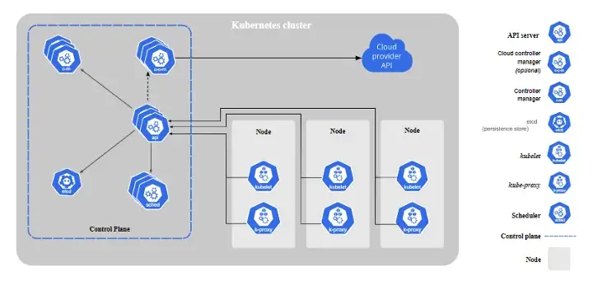
Components of Kubernetes master
As previously mentioned, the master and worker nodes within a Kubernetes cluster contain various components. The components of the master node collectively form the Control Plane, and the components of the worker node collectively form the Data Plane. The control plane serves as the command center in the cluster, while the data plane serves as the soldier executing commands. Let’s explore these components in detail.

Slide 3
Components of Kubernetes master
Control plane
The control plane components are responsible for granting external access to a Kubernetes cluster, storing the state of Kubernetes objects, scheduling objects to worker nodes, and detecting and responding to events within the cluster.
The control plane comprises these 5 components: kube-apiserver, etcd, kube-scheduler, kube-controller-manager, and cloud-controller-manager. Here’s a detailed explanation of how each of these components operates:
Kube-apiserver: The Kubernetes API server receives the REST commands which are sent by the user. After receiving, it validates the REST requests, process, and then executes them. After the execution of REST commands, the resulting state of a cluster is saved in 'etcd' as a distributed key-value store.
Etcd: it is an open-source, distributed key-value storage which is used to store the cluster data which is written in a GO programming language.
Kube-scheduler: it is a process that is responsible for assigning pods to the available worker nodes on the based of resources utilizations.
Kube-controller-manager: The primary role of this service is to maintain the state of a cluster, such as the number of replicas. If any variation in desired state is observed, the kube-controller-manager runs required procedures to make sure that the desired state is met.
Cloud-controller-manager: The cloud-controller-manager runs cloud-specific controller processes in a cluster. It links the Kubernetes cluster to a cloud provider’s API and isolates the components that interact with that cloud platform from components that only interact with your cluster.
The cloud-controller-manager is absent for on-premises and local environments. For high-performance, the cloud-controller-manager can be horizontally scaled.

Slide 4
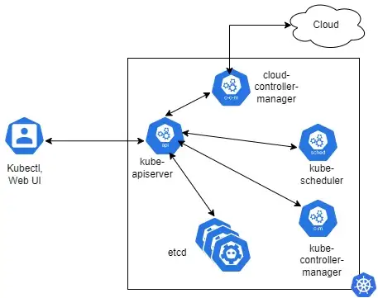
User access to Kubernetes cluster

Slide 5
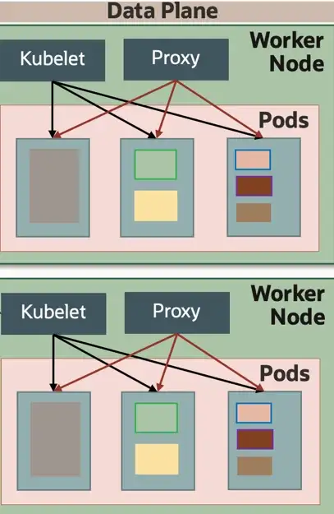
Data plane
The data plane is made up of worker nodes. Each worker node contains three components: kubelet, kube-proxy, and container runtime.

Slide 6
Components of Kubernetes worker
Kubelet: This component is an agent service that executes on each worker node in a cluster. It takes new or modified pod specifications from kube-apiserver. It ensures that the pods and their containers are running smoothly. Every kubelet in each worker node communicates with the master node. It also starts, stops, and maintains the containers which are organized into pods directly by the master node.
Containers runtime: The container-runtime is responsible for running containers in a pod. Kubernetes implements the concept of Container Runtime Interface (CRI), which requires that container runtime environments are compliant with the Open Container Initiative (OCI). Kubernetes supports the following CRIs: cri-o, rktlet, frakti, cri-containerd, singularity-cri.
Kube-proxy: runs on each worker nodes. The main aim of this component is request forwarding. Each node interacts with the Kubernetes services through Kube-proxy. Kube-proxy also performs host-level subnetting to ensure services are accessible to other components.

Slide 7
Key objects of kubernetes
Pod : It is the smallest and simplest basic unit of the Kubernetes application. This object indicates the processes which are running in the cluster. In other works, A pod is one or more containers that logically run together on nodes.
Node: A node is nothing but a single host, which is used to run the virtual or physical machines. A node in the Kubernetes cluster is also known as a minion.
Service: A service in a Kubernetes is a logical set of pods, which works together. With the help of services, users can easily manage load balancing configurations.
Replication controller:
Replicaset: are used to consistently replicate a Pod. They provide a guarantee that a set number of replicas will be running at any time. If a node goes offline or a Pod becomes unhealthy, Kubernetes will automatically schedule a new Pod instance to maintain the specified replica count.
Namespace: Kubernetes supports various virtual clusters, which are known as namespaces(resources name). It is a way of dividing the cluster resources between two or more users.

Slide 8
Features of Kubernetes
Pod: A pod is a collection of containers and its storage inside a node of a Kubernetes cluster. It is possible to create a pod with multiple containers inside it. For example, keeping a database container and data container in the same pod. Two types of pods 1) single container pod 2) Multi container pod.
Horizontal scaling: Kubernetes can scale up and scale down the application as per the requirements with a simple command, using a UI, or automatically based on CPU usage.
Service discovery : Kubernetes can expose a container using the DNS name or using their own IP address. It can also automatically manage DNS records by specifying and transferring services to their required hosts.
Load balancing: Kubernetes load balances and distribute network traffic to containers to maintain stable deployment
Automated rollouts and rollbacks: Kubernetes rolls out changes to the application or its configuration while monitoring application health to ensure it doesn’t kill all your instances at the same time. If something goes wrong, with Kubernetes you can rollback the change.
Persistent Storage: Kubernetes provides an essential feature called 'persistent storage' for storing the data, which cannot be lost after the pod is killed or rescheduled. Kubernetes supports various storage systems for storing the data, such as Google Compute Engine's Persistent Disks (GCE PD) or Amazon Elastic Block Storage (EBS). It also provides the distributed file systems: NFS or GFS.
Self Healing: Kubernetes allows to replaces and reschedules containers when nodes die. It also kills containers that don’t respond to user-defined health check and doesn’t advertise them to clients until they are ready to serve.
Automated scheduling: Kubernetes provides advanced scheduler to launch container on cluster nodes based on their resource requirements and other constraints, while not sacrificing availability.

