Slide 1
Web Design: Responsive Layouts
Sarah Murto
09/29/2015
4662W - Graduate Workshop
Notes:
Hello, I am Sarah Murto, and I am going to be talking about responsive layouts today.

Slide 2
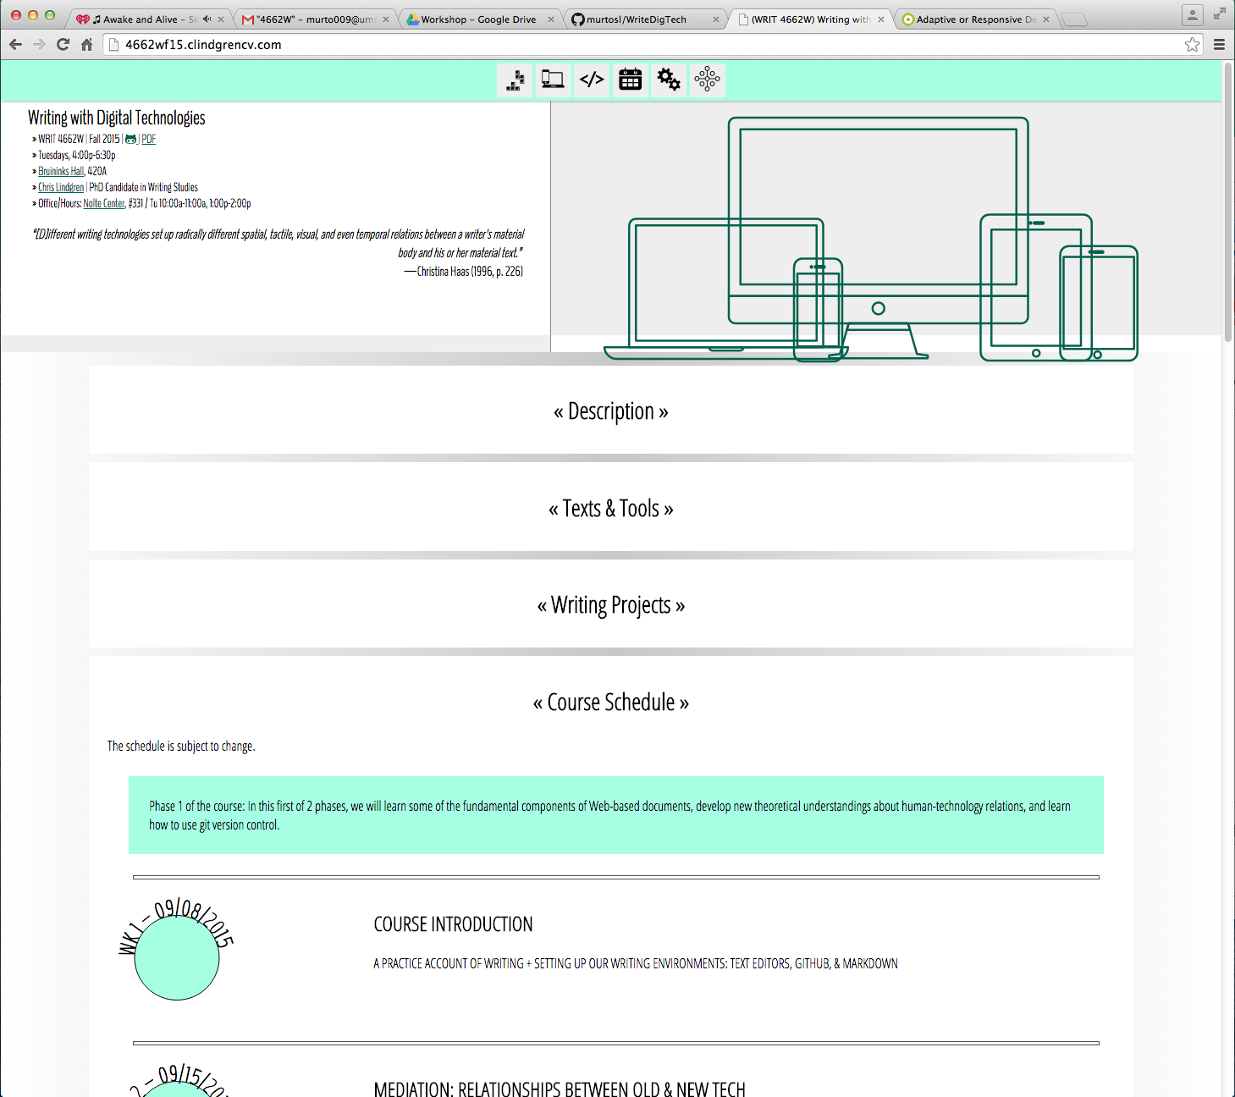
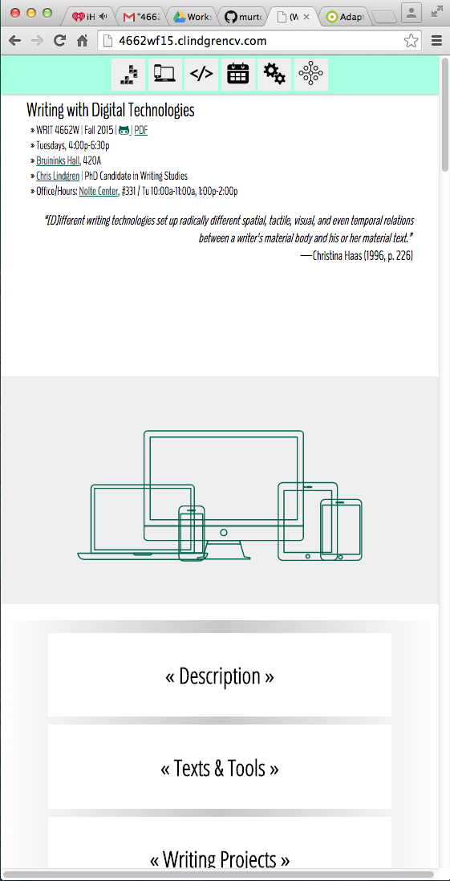
Responsive Layout
One Layout
Works at Many Sizes
Our Class Website: Desktop VS Mobile
Notes:
A responsive layout is a layout that adjusts to fit the size of the screen it is being viewed on. If a screen is narrow, the layout will be narrow; if the screen is wide, they layout will be wide. Our class website works like this, as you can see in these screen shots. The website fits whether the screen is narrow or wide.

Slide 3
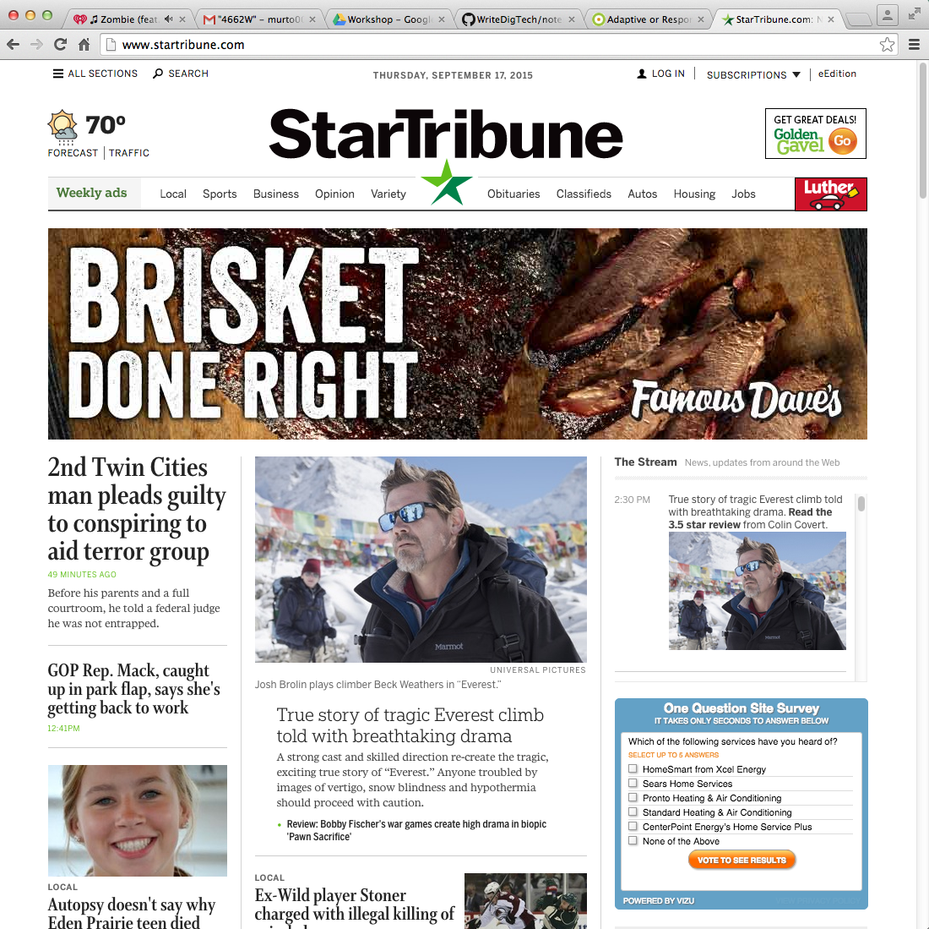
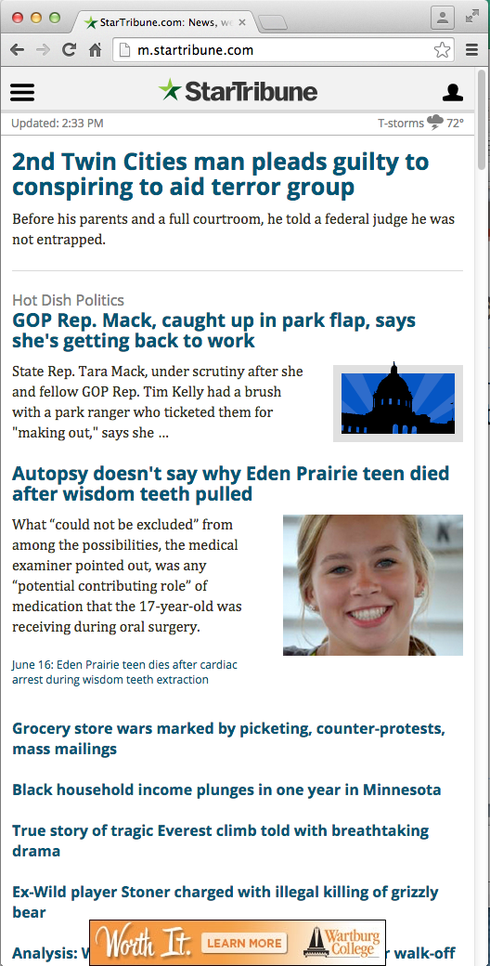
Adaptive Layout
Multiple layouts
Detects which version to show
StarTribune.com : Desktop VS Mobile
Notes:
An adaptive layout is a bit different. An adaptive layout will look at the device the website is being viewed on, and load a different layout based on that information. For instance, the website for the Star Tribune looks completely different on a desktop computer than on a mobile device. It loads a completely different layout when it detects your on a mobile phone. Not all adaptive layouts need to be this drastic, this is just a clear example.

Slide 4
How we got here…
There used to just be computer monitors
Which were usually 800 x 600px
Phones started browsing the web in 2000
Very small percentage of users: 0.6% in 2008
Smartphones started appearing in 2007
They had a legitimate browser
Some companies made apps instead of websites
Tablets appeared in 2010
Adding more screen sizes
Notes:
These types of layouts were invented more recently. When the internet was started, it could only be viewed on computer monitors and most of those monitors were similar in size; 800x600. Phones had the ability to browse the web in the early 2000s, but it wasn’t popular at all. Even in 2008, the total percentage of people browsing the web on their phone was 0.6%. However, smartphones, which started appearing in 2007, made browsing the web easier, and it started to take off. Companies initially made apps to make up for their websites not working on smartphones, and some still have them – like Facebook. But apps are harder to support because they’re device specific. When tablets started appearing in 2010, companies started moving away from having apps, since it became too much to support from a development standpoint.

Slide 5
Where and when is this useful?
There are many screen sizes to support now.
“Websites are often described as ‘platform agnostic’; that is, they will work on any operating system.” (Glassman & Shen, 79)
Desktop Computers, Tablets, Smartphones
TVs, Watches, Video Game Consoles…
A website should work however it is accessed.
Notes:
We have a lot of screen sizes to support now, and a lot more devices. The web is meant to be usable no matter how it is accessed, and shouldn’t care what device you’re running on. Right now, that means whether your on a computer, phone or tablet, but in the future that will commonly also include your TV, SmartWatches, Video game consoles, refrigerators. It’s going to become impossible to be device-specific.

Slide 6
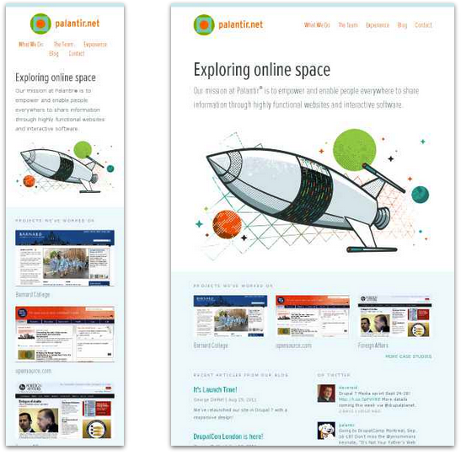
Palantir
Smartphone (320px)
Tablet (768px)
Notes:
So how do these adjustments for various devices look now? This is an older layout for the website “Pal-lan-teer.” As you can see, the smartphone layout is very vertical, and when it’s viewed on a tablet, the top navigation and the bottom section fill the horizontal width better.

Slide 7
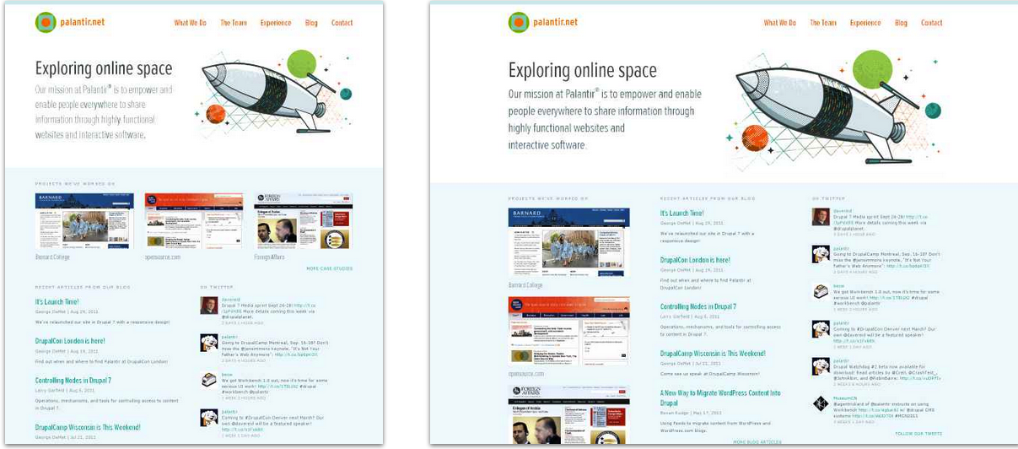
Palantir
Netbook (1024 px)
Desktop (1600 px)
Notes:
When it’s viewed on a netbook, the text at the top adjusts itself under the header, and when it’s a full desktop site, the bottom section becomes three columns instead of stacked vertically. This kind of flexibility lets the website look good and function at the many screen sizes.

Slide 8
Which method is best?
Inherently neither.
Could use responsive, adaptive, or a blend
Adaptive is specific
Newer screen sizes may not work
Able to drastically change layout
Responsive is faster and flexible
Loads faster – no detection needed
May not work on older browsers
Notes:
These adjustments are usually done in a blend of adaptive and responsive techniques. Adaptive techniques let the layout change drastically, but also need to be set per screen size. When a new device comes out, the website might not work anymore, because it doesn’t have a proper layout for that device’s size. Responsive will load faster than adaptive because every device will use the same code, but that doesn’t mean the code will work. Older browsers may not be able to handle responsive techniques.

Slide 9
How do we do this?
Flexible Sizing
Elements on the page resize to fit
Flexible Grids
Elements on the page shift positions to fit
Media Queries
Elements on the page load different based on device
Notes:
There are three main methods of getting this done: flexible sizing, flexible grids and media queries. I’ll go through each of these individually.

Slide 10
Flexible Sizing
Elements on the page resize to fit
Shrinking or Narrowing to fit screen
CSS
Relative: width: 100%;
Static: width: 800px;
Max Width:
max-width: 500px;
Notes:
(Brownlee) Flexible sizing means elements on the page will resize to fit the screen. This is usually done by setting the size of elements to be a percentage of the screen rather than a hard-set number. If the element should never be larger or smaller than a certain size, that size can also be written into the CSS, using properties like Max Width or Min Height. This will prevent an element from getting too tiny or too large.

Slide 11
Flexible Sizing
Images can also resize
A normal image can be resized
Set the width and height as a percent
A vector image can be used
Vector images (SVG) resize un-pixelated.
CSS
Vectors:
<svg viewBox="0 0 50 50" style="height:80%; width:70%;">….</svg>
Images:
<img style="height:80%; width:70%;”… />
Notes:
(Brownlee) Images can also be flexibly sized, but not all images look good at all sizes. To get around this, you can use a vector image, also known as an SVG file. The computer is automatically better at adjusting the size of vector images so that they don’t appear pixelated when resized. Nothing is stopping a normal image from being resized, it just might not look the best. SVGs have their own HTML tag so that they can be loaded and resized. This resizing also required the viewBox attribute, which let’s the page know the image can change size. It can then use the normal CSS height and width settings.

Slide 12
Flexible Grids
Elements on the page shift positions to fit
Calculations are preformed and the page adjusts as needed
Pre-made frameworks or libraries are easiest
Bootstrap, Foundation, or others
Notes:
(Glassman & Shen, 84) Flexible grids let items on the page move around when it is resized, by performing calculations to see where to move the element. This is useful if you need your layout to slide around to look right on a smaller screen. You may have played with this in the assignment from this weekend. It is usually a good idea to use a library like bootstrap, Foundation or pure.css to do this as they have been tested on many devices by many people.

Slide 13
Media Queries
Elements on the page load different based on device
<link rel="stylesheet" type="text/css"
media="screen and (max-device-width: lOOOpx)" href="/css/small.css" />
Loads a specific CSS file with a certain size
@media screen and (max-width: lOOOpx) { display:none; }
Loads specified CSS only at certain size.
Notes:
(Glassman & Shen, 84) Lastly, media queries can be used to load things based on your specific device. The media queries can look at screen size, or device type and tell the browser what to do from there. For instance, you can load a completely different CSS file for mobile phones than you do for desktop screens. You can also have your specific code in the same CSS file as everything else, and the browser will display that CSS for mobile and the alternative CSS for other sizes. That should only be done if you don’t have too many differences between layouts though.

Slide 14
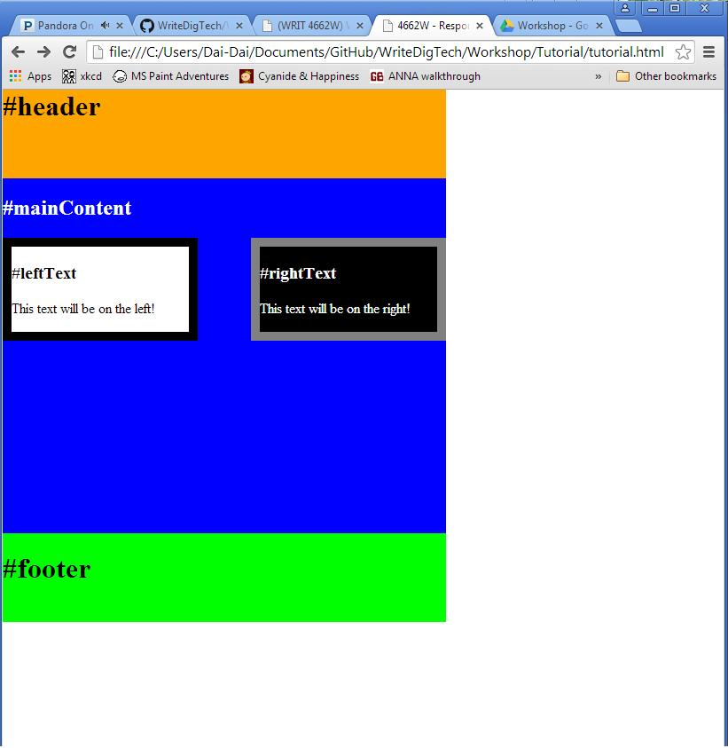
Try it yourself!
Make this page responsive:
Should take up 100% of the screen
Should resize when the browser size is adjusted.
Notes:
So to practice what we’ve just learned, we’re going to take a static webpage and make it responsive. You’re going to adjust this beautifully colored webpage CSS so it takes up 100% of the screen, and it should resize when the browser is adjusted.

Slide 15
Try it yourself!
Adjust the CSS to make the page responsive.
Change pixels to percentages
Add min-heights and min-widths
Resize your browser to see the results
<style type="text/css">
#header{
background-color: orange;
width: 500px;
height: 100px;
}
</style>
<style type="text/css">
#header{
background-color: orange;
width: 100%;
height: 20%;
min-height: 50px;
}
</style>
Notes:
If you’re not sure where to start, you’re basically going to change all the hardcoded pixel sizes into percentages. You can also throw in some min and max height or width limitations to make sure the website works at many different sizes if boxes are getting too big or too small.

Slide 16
Try it yourself!
How do I do this?
Once you have tutorial.html on your computer, and saved, click and drag this file to your browser.
The file will appear just like any other website.
Adjust the CSS in the file and save.
Change the sizes from pixels to percentages
Refresh the page in your browser to see your changes.
Notes:
Hopefully you’ve practiced this this weekened, but I’m going to give you a link to the code. You’re going to save it to your computer, and open it in your development environment. You can then drag that file to your browser and it will show up like any webpage. You can then play with the CSS to try and get this to work by changing the code and refreshing the page. I do have these files on a flash drive if you’re having problems with your internet connection.

Slide 17
Try it yourself!
https://github.com/murtosl/WriteDigTech/tree/master/Workshop/Tutorial
Download Tutorial.html
If you’re stuck, there are also solutions!
Make the page take up 100% of the screen
Make the page resize when the browser size is adjusted.
<style type="text/css">
#header{
background-color: orange;
width: 500px;
height: 100px;
}
</style>
<style type="text/css">
#header{
background-color: orange;
width: 100%;
height: 20%;
min-height: 50px;
}
</style>
Notes:
So that is the URL so my repo, there are solutions in there as well if you’re stuck. Please feel free to ask me any questions! Good luck.

Slide 18
Works Cited
Brownlee, John. "9 GIFs That Explain Responsive Design Brilliantly." Co.Design. Fast Company & Inc, 12 Nov. 2014. Web. 20 Sept. 2015. <http://www.fastcodesign.com/3038367/9-gifs-that-explain-responsive-design-brilliantly>.
Glassman, Nancy R., and Phil Shen. "One Site Fits All: Responsive Web Design." Journal of Electronic Resources in Medical Libraries 11.2 (2014): 78-90. Web. 8 Sept. 2015. <http://dx.doi.org/10.1080/15424065.2014.908347>.
Harris, Matthew. "Responsive or Adaptive Design – Which Is Best for Mobile Viewing of Your Website?" Medium Well Web Design Online Marketing and Ecommerce. Medium Well, 7 Mar. 2014. Web. 15 Sept. 2015. <http://www.mediumwell.com/responsive-adaptive-mobile/>.
Lindgren, Chris. (WRIT 4662W) Writing with Digital Technologies. University of Minnesota-Twin Cities, 2015. Web. 17 Sept. 2015. <http://4662wf15.clindgrencv.com/>.
Snell, Jeremny. "FLEXIBLE EVERYTHING Getting Responsive With Web Design." Computers In Libraries 33.3 (2013): 12-16. CINAHL Plus with Full Text. Web. 8 Sept. 2015.
StarTribune.com. Star Tribune Media Company LLC. Web. 17 Sept. 2015. <http://www.startribune.com/>.
Uggedal, Eivind. Media Queries. Web. 15 Sept. 2015. <http://mediaqueri.es/>.

