Slide 1
Web Design: Responsive Layouts
Sarah Murto
09/29/2015
4662W - Graduate Workshop

Slide 2
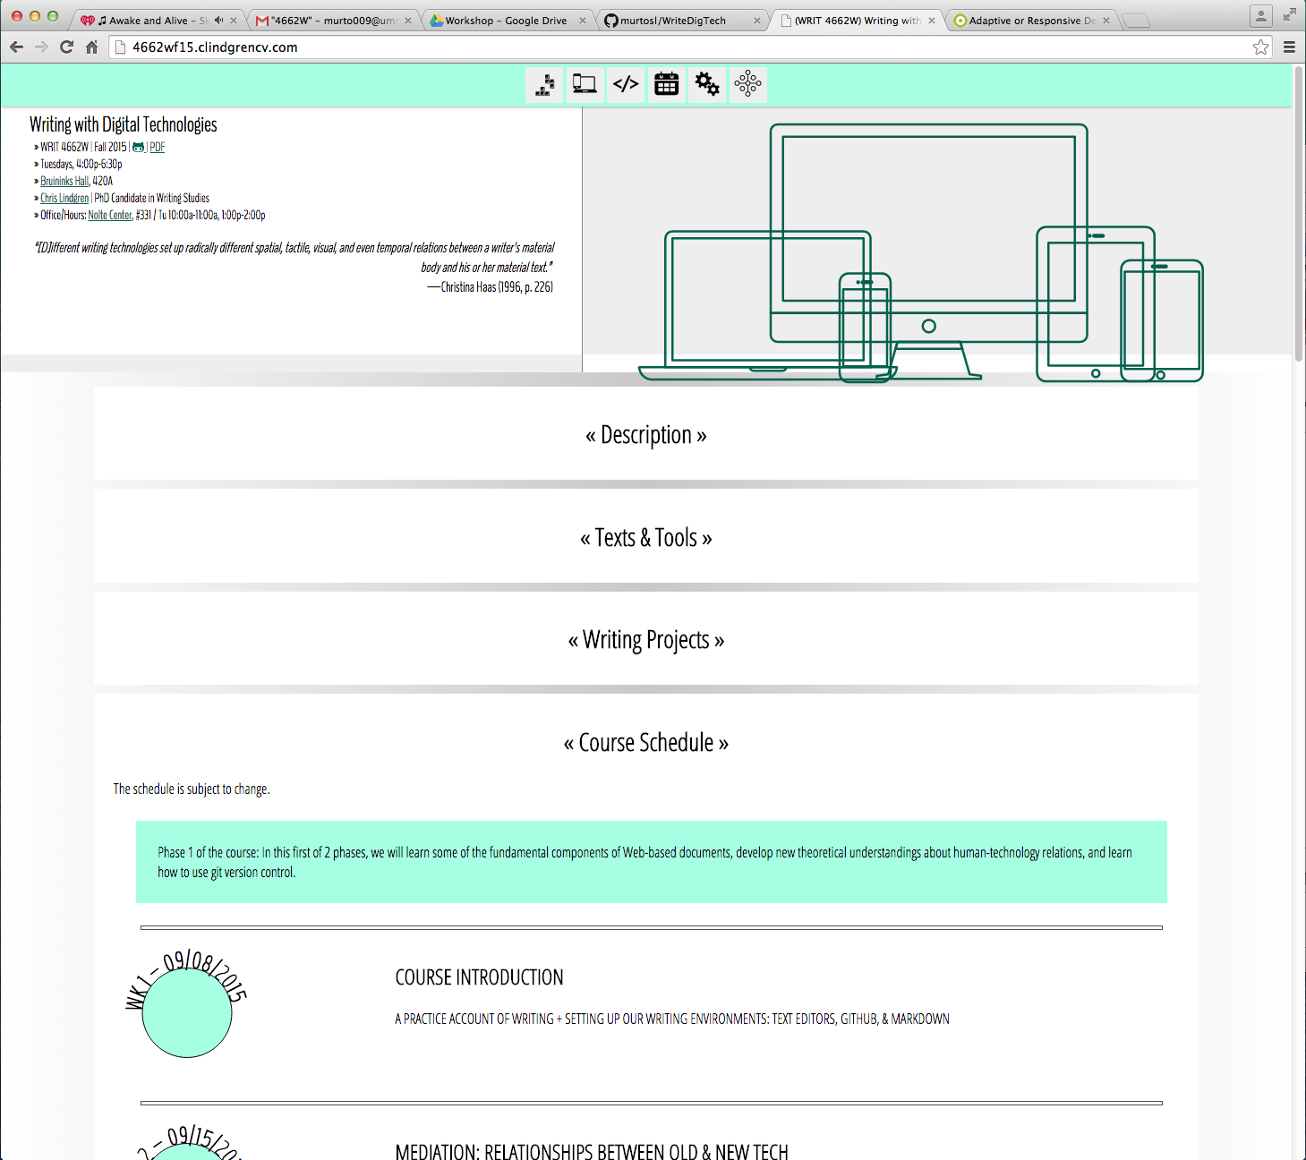
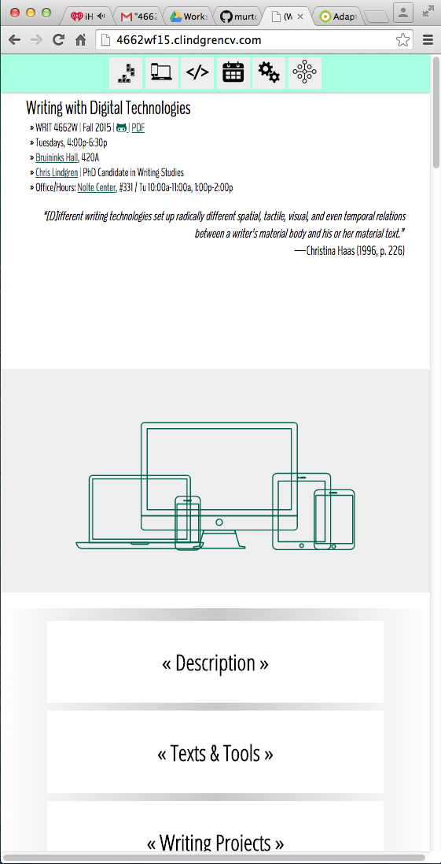
Responsive Layout
One Layout
Works at Many Sizes
Our Class Website: Desktop VS Mobile
Notes:
(Harris)

Slide 3


Adaptive Layout
Multiple layouts
Detects which version to show
StarTribune.com : Desktop VS Mobile
Notes:
(Harris) Technically, a mobile redirect.

Slide 4
How we got here…
There used to just be computer monitors
Which were usually 800 x 600px
Phones started browsing the web in 2000
Very small percentage of users: 0.6% in 2008
Smartphones started appearing in 2007
They had a legitimate browser
Some companies made apps instead of websites
Tablets appeared in 2010
Adding more screen sizes
Notes:
0.6% of phones were used to access the web in December 2008 – Snell
Phones are portrait, 320 x 480
Tablets are now 786 x 1024, but desktops are bigger. – Glassman
“While apps are powerful (and cool) tools, they can be a challenge to maintain and keep up to date. There are a number of things that must be taken into consideration before delving into app development. Which device(s) will the library support? Does the library have the resources and staff to develop and maintain apps for multiple devices?
As an alternative to apps, many libraries have developed separate web- sites for mobile users. Websites are often described as ‘‘platform agnostic’’; that is, they will work on any operating system.9 Several years ago, when smartphones were not as smart as they are now, a ‘‘watered down’’ version of the library’s website was sufficient to inform patrons about hours, location, and contact information.10 Now, library patrons expect to be able to use their mobile devices to perform the same functions as their desktop computers, and mobile-optimized websites have evolved accordingly.1,7” (Glassman 79)

Slide 5
Where and when is this useful?
There are many screen sizes to support now.
“Websites are often described as ‘platform agnostic’; that is, they will work on any operating system.” (Glassman & Shen, 79)
Desktop Computers, Tablets, Smartphones
TVs, Watches, Video Game Consoles…
A website should work however it is accessed.
Notes:
We have a lot of screen sizes to support now, there will be even more in the future.

Slide 6
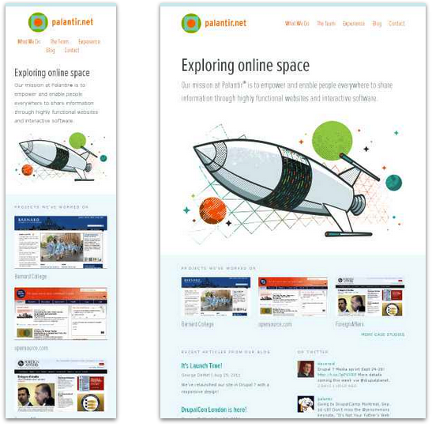
Palantir
Smartphone (320px)
Tablet (768px)
Notes:
More columns in downpage section, navigation moves to the side

Slide 7
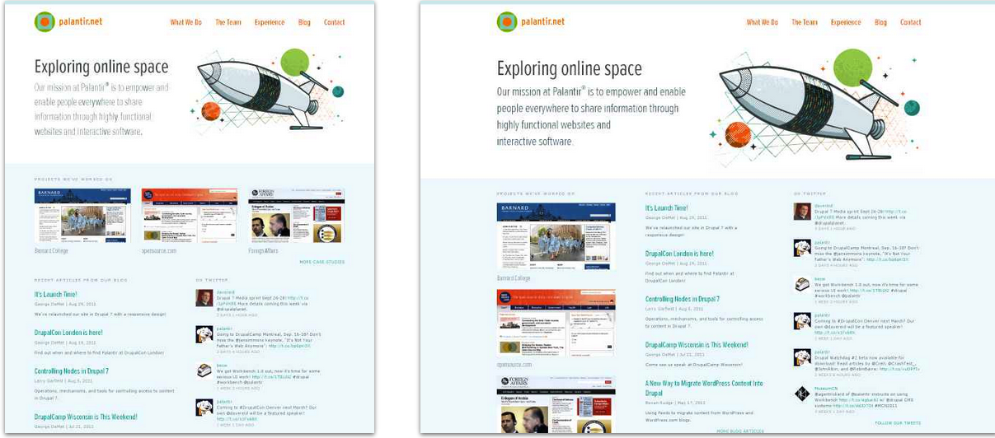
Palantir
Netbook (1024 px)
Desktop (1600 px)
Notes:
Image slides to side of text, Page Screen Shots move to be in a column, instead of horizontal.

Slide 8
Which method is best?
Inherently neither.
Could use responsive, adaptive, or a blend
Adaptive is specific
Newer screen sizes may not work
Able to drastically change layout
Responsive is faster and flexible
Loads faster – no detection needed
May not work on older browsers
Notes:
(Harris)

Slide 9
How do we do this?
Flexible Sizing
Elements on the page resize to fit
Flexible Grids
Elements on the page shift positions to fit
Media Queries
Elements on the page load different based on device
Notes:
(Glassman & Shen, 84)

Slide 10
Flexible Sizing
Elements on the page resize to fit
Shrinking or Narrowing to fit screen
CSS
Relative: width: 100%;
Static: width: 800px;
Max Width:
max-width: 500px;
Notes:
(Brownlee)

Slide 11
Flexible Sizing
Images can also resize
A normal image can be resized
Set the width and height as a percent
A vector image can be used
Vector images (SVG) resize un-pixelated.
CSS
Vectors:
<svg viewBox="0 0 50 50" style="height:80%; width:70%;">….</svg>
Images:
<img style="height:80%; width:70%;”… />
Notes:
(Brownlee)

Slide 12
Flexible Grids
Elements on the page shift positions to fit
Calculations are preformed and the page adjusts as needed
Pre-made frameworks or libraries are easiest
Bootstrap, Foundation, or others
Notes:
(Glassman & Shen, 84)

Slide 13
Media Queries
Elements on the page load different based on device
<link rel="stylesheet" type="text/css"
media="screen and (max-device-width: lOOOpx)" href="/css/small.css" />
Loads a specific CSS file with a certain size
@media screen and (max-width: lOOOpx) { display:none; }
Loads specified CSS only at certain size.
Notes:
(Glassman & Shen, 84)

Slide 14
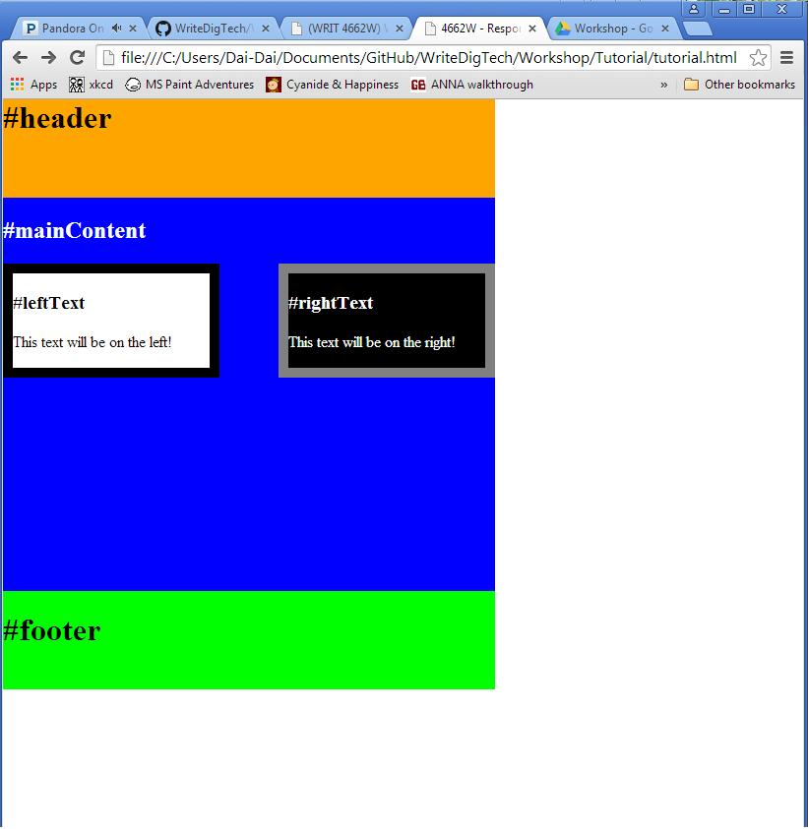
Try it yourself!
Make this page responsive:
Should take up 100% of the screen
Should resize when the browser size is adjusted.

Slide 15
Try it yourself!
Adjust the CSS to make the page responsive.
Change pixels to percentages
Add min-heights and min-widths
Resize your browser to see the results
<style type="text/css">
#header{
background-color: orange;
width: 500px;
height: 100px;
}
</style>
<style type="text/css">
#header{
background-color: orange;
width: 100%;
height: 20%;
min-height: 50px;
}
</style>

Slide 16
Try it yourself!
How do I do this?
Once you have tutorial.html on your computer, and saved, click and drag this file to your browser.
The file will appear just like any other website.
Adjust the CSS in the file and save.
Change the sizes from pixels to percentages
Refresh the page in your browser to see your changes.

Slide 17
Try it yourself!
https://github.com/murtosl/WriteDigTech/tree/master/Workshop/Tutorial
Download Tutorial.html
If you’re stuck, there are also solutions!
Make the page take up 100% of the screen
Make the page resize when the browser size is adjusted.
<style type="text/css">
#header{
background-color: orange;
width: 500px;
height: 100px;
}
</style>
<style type="text/css">
#header{
background-color: orange;
width: 100%;
height: 20%;
min-height: 50px;
}
</style>

Slide 18
Works Cited
Brownlee, John. "9 GIFs That Explain Responsive Design Brilliantly." Co.Design. Fast Company & Inc, 12 Nov. 2014. Web. 20 Sept. 2015. <http://www.fastcodesign.com/3038367/9-gifs-that-explain-responsive-design-brilliantly>.
Glassman, Nancy R., and Phil Shen. "One Site Fits All: Responsive Web Design." Journal of Electronic Resources in Medical Libraries 11.2 (2014): 78-90. Web. 8 Sept. 2015. <http://dx.doi.org/10.1080/15424065.2014.908347>.
Harris, Matthew. "Responsive or Adaptive Design – Which Is Best for Mobile Viewing of Your Website?" Medium Well Web Design Online Marketing and Ecommerce. Medium Well, 7 Mar. 2014. Web. 15 Sept. 2015. <http://www.mediumwell.com/responsive-adaptive-mobile/>.
Lindgren, Chris. (WRIT 4662W) Writing with Digital Technologies. University of Minnesota-Twin Cities, 2015. Web. 17 Sept. 2015. <http://4662wf15.clindgrencv.com/>.
Snell, Jeremny. "FLEXIBLE EVERYTHING Getting Responsive With Web Design." Computers In Libraries 33.3 (2013): 12-16. CINAHL Plus with Full Text. Web. 8 Sept. 2015.
StarTribune.com. Star Tribune Media Company LLC. Web. 17 Sept. 2015. <http://www.startribune.com/>.
Uggedal, Eivind. Media Queries. Web. 15 Sept. 2015. <http://mediaqueri.es/>.

